Slide 1
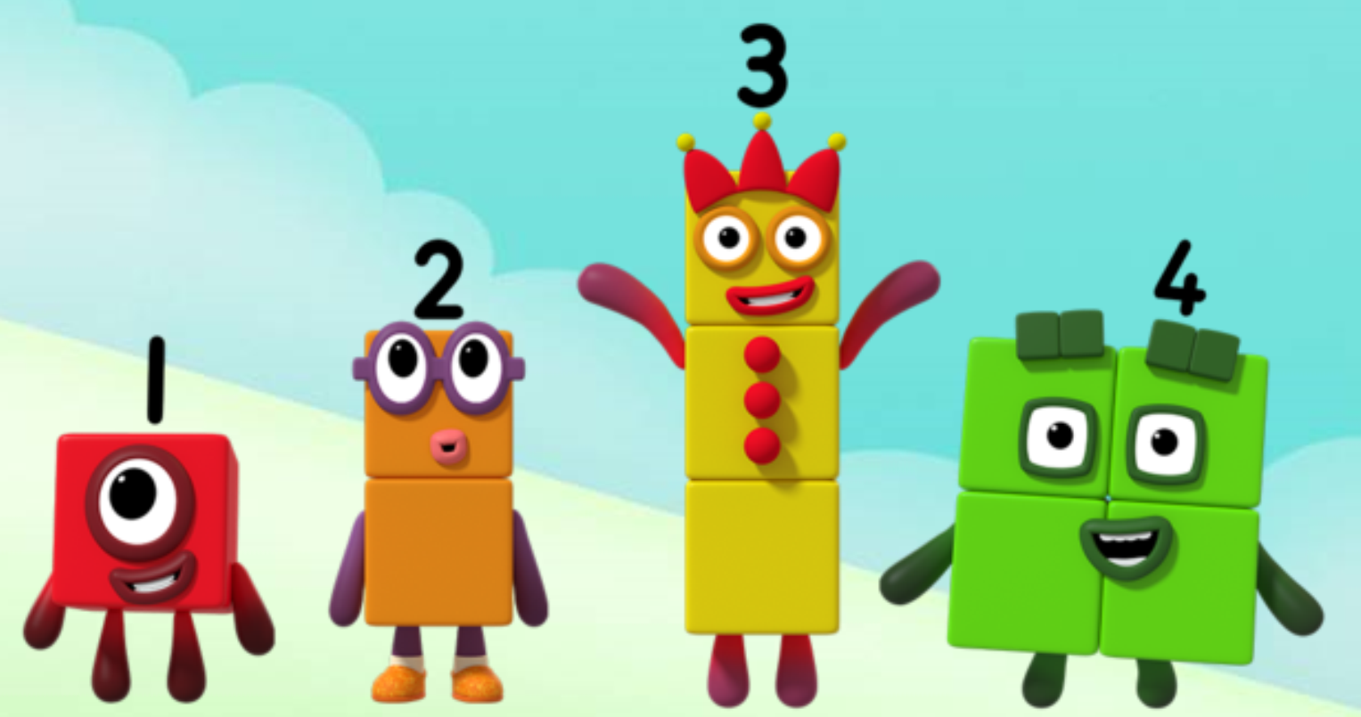
Series 1 Episode 10
How to count

Slide 2
Maths in the Episode
To watch this episode go to BBC iPlayer – Numberblocks. Look for Series 1: How to Count
Learning to count
In this episode the Numberblocks get muddled with their counting.
They need to remember the rules of counting:
count everything once (and only once!)
say the counting numbers in the right order
remember that the last number they say when they are counting tells us ‘how many’ things there are.

Slide 3
Talk and discuss together
Watch the episode together.
Ask your child what they noticed and be interested in anything they have to say.
Use the following pictures and activities to explore and talk about the maths involved.

Slide 4
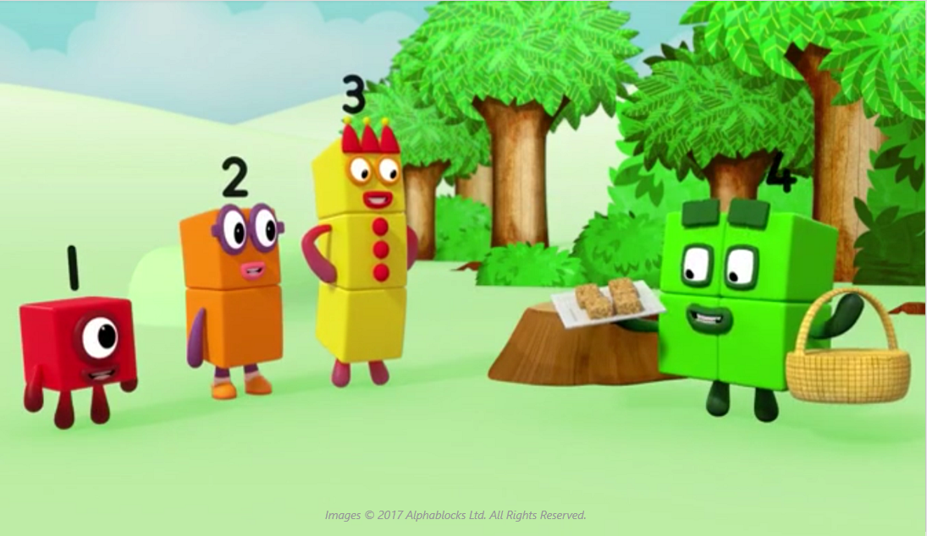
Can you remember what went wrong with the counting?

Slide 7
Move, touch or point at objects to help you count everything once.

Slide 8
Say the numbers in the right order!

Slide 9
The last number you say is how many things there are!

Slide 10
Around the home
Practise saying and singing the counting numbers often. For example, can you put on your shoes before we count to five?
Count lots of different sorts of objects, small things and big things, e.g. biscuits, shoes, people.
Arrange objects in different ways to count them, e.g. in a line or in a ring.
Move or touch objects to help you remember which ones have already been counted.
Count things that you cannot see or touch, e.g. count claps, taps under the table, coins dropping into a pot.
Count movements. For example, how many hops, skips or jumps can you do?

Slide 11
General tips that can make a difference in maths
Provide lots of opportunities to say how many things you can see (up to 5) without counting.
Whenever you talk about a small set of objects, say the number. For example, please pick up those 3 teddies or look at those 2 dogs.
Count up (starting from one) when walking upstairs and count back when walking downstairs.
Count lots of different objects, big and small, and ask ‘How many are there?’ Your child should be able to tell you without going back and re-counting. If they can’t, then tell them: ‘There are 6 altogether’.
Play with fingers, firstly practise counting fingers.
Ask your child to put their fingers down and then say or hold up a number such as 3. Can they do it without counting? Can they do it using different fingers? Can they do it using fingers from two hands?
Play board games with your child which involve moving along numbered tracks, such as ‘Snakes and Ladders’. Check that your child counts along the track correctly, moving one square for each number counted.
Regular use of these simple ideas, whenever the opportunity arises, will improve your child’s maths.

Slide 12
General tips that can make a difference in maths
Notice when there are two amounts and one is more than the other, or they are the same. For example, I have 2 eyes and 2 ears, or I have more chips than peas.
Talk about and describe shapes you can see outside or around your home. For example, count corners, talk about straight/curved edges, flat/curved surfaces. If you have building blocks then talk about and describe the things that are built.
In the bath or at the sink, play with containers, pouring water, counting how many small pots are needed to fill the big container.
Encourage your child to draw a picture of their number work and explain their mark-making to you, for example, how many leaves they find on a walk. This doesn’t necessarily mean writing the numerals (1, 2, 3, 4… etc.).
Sing counting songs and rhymes. You can find some on the internet, but children love it if you join in with them!
Make a deliberate maths mistake from time to time and ask your child to explain why you are wrong. For example, say that 4 is bigger than 5.
Regular use of these simple ideas, whenever the opportunity arises, will improve your child’s maths.

