Slide 1
Understanding probability as a measure of likelihood
KS3 Mastery PD Materials: Exemplified Key Ideas
Materials for use in the classroom or to support professional development discussions
(from 5.3 Probability)
Summer 2021

Slide 2
About this resource
These slides are designed to complement the 5.3 Probability Core Concept document and its associated Theme Overview document 5 Statistics and probability, both found in the Secondary Mastery Professional Development pages.
These slides re-present the key examples from the Core Concept document so that the examples can be used either directly in the classroom or with a group of teachers. There are prompt questions alongside the examples, and further clarification in the notes.
These slides do not fully replicate the Core Concept document, so should be used alongside it. Reference to specific page numbers, and to other useful NCETM resources, can be found in the notes for each slide.
This slide deck is not designed to be a complete PD session, rather it is a selection of resources that you can adapt and use as needed when planning a session with a group of teachers.

Slide 3


About this resource
The slides are structured as follows:
  The big picture:
    Where does this fit in?
    What do students need to understand?
    Why is this key idea important?
  Prior learning
  Misconceptions
  Exemplified key ideas
  Reflection questions
  Appendices:
    Key vocabulary
    Representations and structure
    Previous and Future learning
    Useful links
The exemplified key idea slides have the following symbols to indicate how they have been designed to be used:
Into the classroom
The examples are presented on these slides so that they could be used in PD, but also directly in the classroom. The notes feature suggested questions and things teachers might consider when using with students.
PD discussion prompts
These slides look at the examples in more detail, with question prompts to promote discussion among maths teachers. The notes feature reference to further information and guidance within the Core Concepts document.

Slide 4
Where does this fit in?
The NCETM has identified a set of six ‘mathematical themes’ within Key Stage 3 mathematics that bring together a group of ‘core concepts’.
The fifth of these themes is Statistics and probability, which covers the following interconnected core concepts:
    5.1 Statistical representations and measures
    5.2 Statistical analysis
    5.3 Probability
Notes:
Linked on this slide is the Theme Overview document of Statistics and probability. This document includes why it is important, the key underpinning knowledge and links to prior and future learning. There is also guidance about how the five big ideas of Teaching for Mastery relate specifically to this theme.

Slide 5
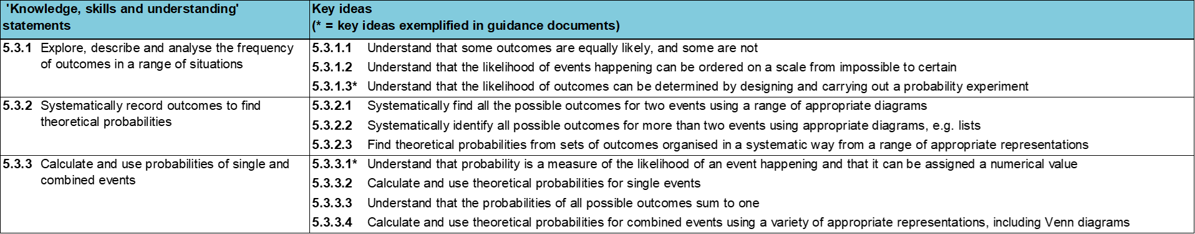
Where does this fit in?
Within this core concept, 5.3 Probability, there are three statements of knowledge, skills and understanding.
These, in turn, are broken down into ten key ideas. The highlighted key idea is exemplified in this slide deck.
Notes:
For key ideas marked with an asterisk, we exemplified the common difficulties and misconceptions that students might have and included elements of what teaching for mastery may look like. We have provided examples of possible student tasks and teaching approaches.
Within these slides are ‘classroom-ready’ versions of the examples for the key idea that has been highlighted. There are also slides that may be useful for discussion in a professional development session.

Slide 6
What do students need to understand?
5.3.3.1 Understand that probability is a measure of the likelihood of an event happening and that it can be assigned a numerical value
Distinguish between events that have different likelihoods and start to explain numerically why one event is more likely than another.
Understand that the probability of an event with only two equally likely outcomes is a half, and that each possible outcome will occur approximately half of the time.
Use the theoretical probability of a particular outcome to predict an expected number of occurrences of that outcome in an experiment.
Identify the numerical values of outcomes in different single events and use these values to order the outcomes according to their likelihood.
  What prior knowledge might your students already have?
  What language might they use to describe this key idea?
  What questions might you want to ask to assess their prior learning?

Slide 7
Why is this key idea important? (1)
Students will encounter probability in many aspects of their daily lives, from sporting events to weather reports. However, probability is an area of mathematics that students can find perplexing. Students may feel that their lived experiences do not reflect calculated mathematical likelihoods. For example, rolling a six on a dice in order to win a board game often ‘feels’ far less likely than any of the other outcomes.
The introduction of probability at Key Stage 3 will offer students a way to quantify, explore and explain likelihood and coincidence, and to reason about uncertainty.
Students should have the opportunity to engage in experiments and develop a feel for likely, unlikely, even, certain and impossible chances, before starting to quantify probabilities and the likelihood of different outcomes.
Furthermore, students need to appreciate that predictions of likelihood do not predict individual events. Rather, experimental data will tend towards this theoretical value (for example, knowing that flipping a head or a tail on a coin has an even chance of occurring does not mean these outcomes will occur an equal number of times).
Notes:
A more detailed overview of the core concept of probability can be found on page 2 of the 5.3 Core Concept document.
The background to each key idea is also explored in more detail on the following pages:
5.3.1 Explore, describe and analyse the frequency of outcomes in a range of situations – page 5
5.3.2 Systematically record outcomes to find theoretical probabilities – pages 5-6
5.3.3 Calculate and use probabilities of single and combined events – pages 6-7

Slide 8
Why is this key idea important? (2)
Before they quantify probabilities, students need to appreciate that, where an event has different possible outcomes, some of these outcomes may be more or less likely than others for different possible reasons.
One factor that underpins uncertainty is that of randomness: students should understand that although an individual event might be random, reasoning about uncertain events can be fruitful when they are repeated many times. Given enough time, trends in apparently random behaviour can become predictable by analysing the frequency of outcomes.
Specific and precise language is key to working with probability. For example, students should understand the distinctions between an event (for example, flipping a coin) and an outcome (for example, a coin landing on heads) or between probability and possibility (for example, it is possible that it will snow in summer, but not probable).
Students will learn that the total chance of all the outcomes of an event will sum to one and should understand how this can be illustrated on a number line, and subsequently link this knowledge to the relationship:
[the chance of an outcome not happening] = 100% − [the chance of it happening]
Notes:
A more detailed overview of the core concept of probability can be found on page 2 of the 5.3 Core Concept document.
The background to each key idea is also explored in more detail on the following pages:
5.3.1 Explore, describe and analyse the frequency of outcomes in a range of situations – page 5
5.3.2 Systematically record outcomes to find theoretical probabilities – pages 5-6
5.3.3 Calculate and use probabilities of single and combined events – pages 6-7

Slide 9
Prior learning
Key Stage 3 Learning Outcome
3.1.3 Understand that fractions are an example of a multiplicative relationship and apply this understanding to a range of contexts
3.1.4 Understand that ratios are an example of a multiplicative relationship and apply this understanding to a range of contexts
Please note: Numerical codes refer to statements of knowledge, skills and understanding in the NCETM breakdown of Key Stage 3 mathematics.
  What representations might your students already be familiar with?
  What language might they use?
  How does this fit in with your curriculum progression?
Notes:
You may find it useful to speak to your partner schools to see how fractions, ratios and multiplicative relationships have been covered and the language used.
You can find further details regarding prior learning in the following segments of the NCETM primary mastery professional development materials (linked on last slide):
• Year 3: 3.2 Unit fractions: identifying, representing and comparing
• Year 3: 3.3 Non-unit fractions: identifying, representing and comparing
• Year 6: 2.27 Scale factors, ratio and proportional reasoning
Within the Statistics and probability Theme Overview document, you can also find a broader description of students’ potential previous learning (page 3), alongside further information about key underpinning knowledge (page 2).

Slide 10
Checking prior learning
The following slides contain questions for checking prior learning.
  What representations might students use to support their understanding of these questions?
  What variation might you put in place for these questions to fully assess students’ understanding of the concept?
  How might changing the language of each question change the difficulty?
  Why are these such crucial pre-requisites for this key idea?

Slide 11
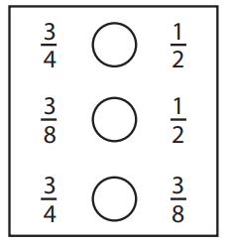
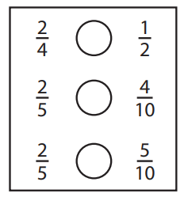
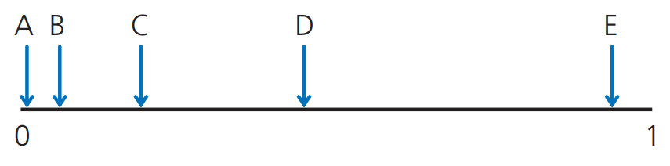
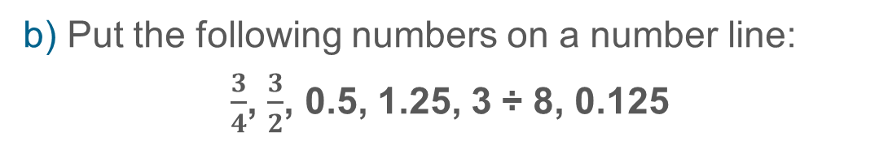
Checking prior learning (1)
a) Make each number sentence correct using =, > or <.
b) Put the following numbers on a number line:
$\frac{3}{4}$, $\frac{3}{2}$, 0.5, 1.25, 3 ÷ 8, 0.125
c) Some events are marked on a probability scale.
What might each event be? Explain your thinking.
Notes:
References to the questions (links on final slide):
a) NCETM primary assessment materials, Year 5 page 17
b) NCETM primary assessment materials, Year 6 page 20
c) NCETM secondary assessment materials, page 49

Slide 12
Checking prior learning (2)
d) Which of these statements is correct? Explain your thinking for each statement.
  When flipping a coin there are two possible outcomes (heads or tails) and only one of them can happen. Each of them has a probability of one half.
  In a football match there are three possible outcomes (win, lose or draw) and only one of them can happen. Each of them has a probability of one third.
  When sitting at a table there are four possible seats (one is red, one yellow, one red and one green). You can only sit in one seat. The probability you sit in the green seat is one quarter.
  A 100m race has five runners (Adam, Max, Grace, Emily and Tilly). Each of them has a probability of one fifth of winning.
  When rolling a die there are six numbers. The probability of rolling each of the numbers is one sixth.
Notes:
References to the questions (links on final slide):
d) NCETM secondary assessment materials, page 48

Slide 13
Common difficulties and misconceptions
What aspects of this key idea might students find challenging?
What misconceptions might students have?
When teaching this topic, you may find students encounter difficulties with…
Identifying likelihood
Working with proportion
Understanding that, as more trials take place, outcomes tend towards theoretical probability
More information, and some suggestions for overcoming these challenges, can be found on the following slides.

Slide 14
Common difficulties and misconceptions (1)
Identifying likelihood
Students tend to have an innate understanding of ‘more likely’ and ‘less likely’ from their own experiences and can justify these using numerical values given a basic understanding of fractions.
However, difficulties can occur when students focus on the absolute number of possible successful outcomes, irrespective of the total number of all possible outcomes. For example, ‘It’s more likely because there are more ways to win.’ To overcome this, students should have experience of a variety of situations where the total number of successful outcomes might be the same, but they represent a different proportion of all the possible outcomes. For example, the probability of choosing a black ace from a pack of cards changes when:
  the whole pack is used
  the red aces are removed
  all the diamonds are removed, etc.
Initially, students may use phrases such as ‘Three ways of winning out of five ways in total.’ It will be important to introduce the language of ‘The probability of winning is…’. Probability has a number of unfamiliar terms that can easily get confused by students. You should make every effort to use precise language and appropriate terms when referring to, for instance, outcomes, events, occurrences, probability and possibility, which can easily sound similar, but can mean very
different things.
Notes:
This can be found on page 14 of the 5.3 Core Concept document

Slide 15
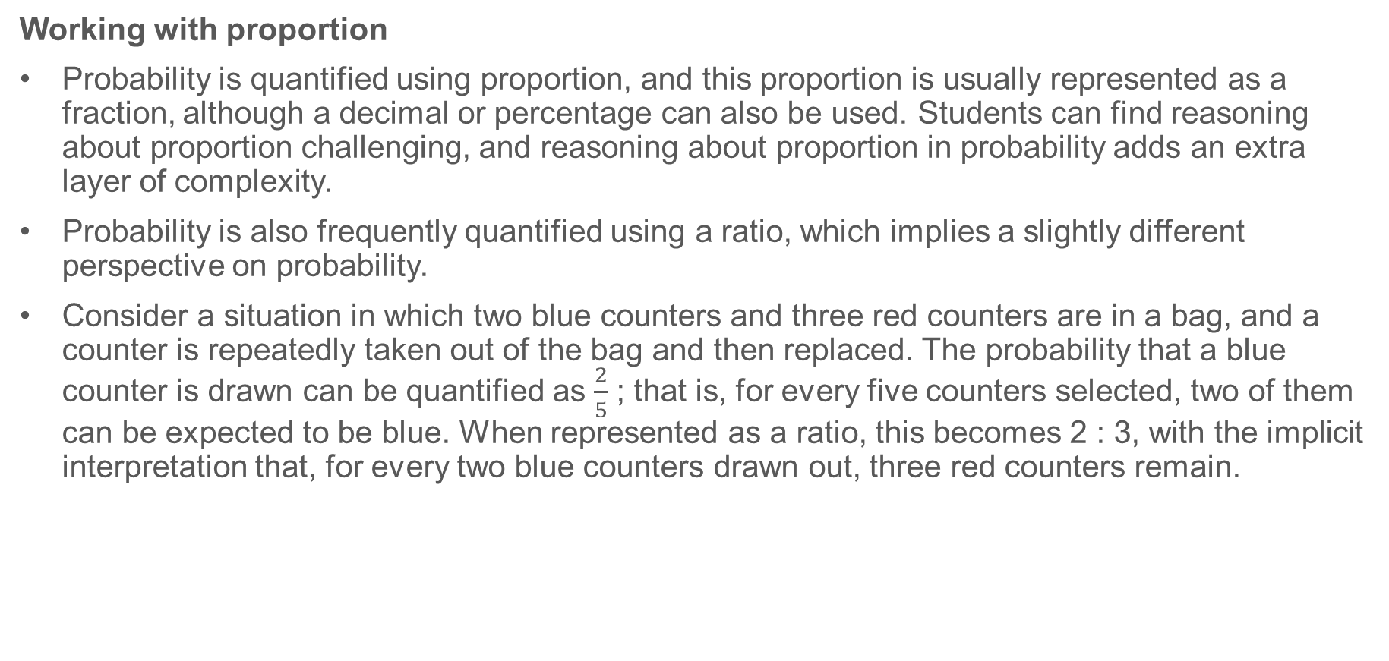
Common difficulties and misconceptions (2)
Working with proportion
Probability is quantified using proportion, and this proportion is usually represented as a fraction, although a decimal or percentage can also be used. Students can find reasoning about proportion challenging, and reasoning about proportion in probability adds an extra layer of complexity.
Probability is also frequently quantified using a ratio, which implies a slightly different perspective on probability.
Consider a situation in which two blue counters and three red counters are in a bag, and a counter is repeatedly taken out of the bag and then replaced. The probability that a blue counter is drawn can be quantified as $\frac{2}{5}$ ; that is, for every five counters selected, two of them can be expected to be blue. When represented as a ratio, this becomes 2 : 3, with the implicit interpretation that, for every two blue counters drawn out, three red counters remain.
Notes:
This can be found on page 14 of the 5.3 Core Concept document

Slide 16
Common difficulties and misconceptions (3)
Understanding that, as more trials take place, outcomes tend towards theoretical probability
It is important for students to develop an understanding of the number of trials needed to be able to make reliable predictions, but it is often larger and more time consuming than is pragmatic for students to do individually within a lesson.
Collecting different groups’ results and putting them together to achieve a larger class set is one way of addressing this. Another way is students doing a few trials each so that they understand the process, before switching to IT-based probability simulation programs.
Notes:
This can be found on page 14 of the 5.3 Core Concept document

Slide 17
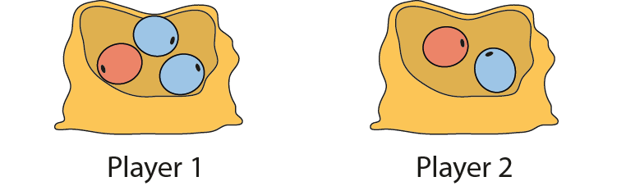
Distinguish between events that have different likelihoods and start to explain numerically why one event is more likely than another
Example 1
Play this game with a partner.
Each player has a bag from which they take turns to randomly select a bead and then replace it.
Each time a player selects a red bead they score a point.
The first player to score 5 points wins the game.
Explain if the game you have played is fair and, if not, why not.
Notes:
Suggested questioning:
If the number of red beads is the same in each example, does that mean the probability of selecting red is the same? Why or why not?
What does ‘fair’ mean?
How many different ways can you write the probability of selecting red for each player?
Things for you to think about:
The game in Example 1 has been designed so that, while the number of red beads is the same in each bag, the proportion of red beads to blue beads is different. This will be a key point to draw out during discussion after students have played the game. It is advised that you think in advance about what language you expect students to use, and how you will model this.

Slide 18
Distinguish between events that have different likelihoods and start to explain numerically why one event is more likely than another
Example 1
Play this game with a partner.
Each player has a bag from which they take turns to randomly select a bead and then replace it.
Each time a player selects a red bead they score a point.
The first player to score 5 points wins the game.
  What language will you expect students to use in their explanations?
  What misconceptions about proportion might you encounter?
Explain if the game you have played is fair and, if not, why not.
Notes:
Due to space constraints, the image on this PD discussion slide is very small. PD Leads might like to use or print the ‘in the classroom’ version of this slide for teachers to access during discussions.
More detail about the sequencing of this example can be found on page 15 of the 5.3 Core Concept document.

Slide 19
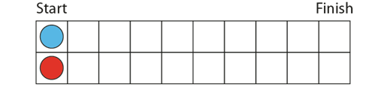
Distinguish between events that have different likelihoods and start to explain numerically why one event is more likely than another
Example 2
Play this game with a partner.
Each player has a counter to move along the track.
Players take turns to roll a 6-sided dice.
Player 1 can move their counter one space along the track if a number greater than 4 is rolled.
Player 2 can move their counter one space if a number less than 4 is rolled.
If 4 is rolled, the player rolls the dice again.
The first player to reach the end of the track is the winner.
Explain if the game you have played is fair and, if not, why not.
Notes:
Suggested questioning:
What numbers will mean each player can move? Is there an equal number of opportunities for each player?
Is this game fair?
If the game is biased towards one player, does this mean that player will definitely win? How would your answer change if the track was longer/shorter?
Things for you to think about:
The rules of the game in Example 2 have been chosen to draw attention to the number of possible outcomes (out of a total of six equally likely ones) that allow player 1 or player 2 to move along the track. Discussion following the playing of the game should attempt to draw out this point.

Slide 20
Distinguish between events that have different likelihoods and start to explain numerically why one event is more likely than another
Example 2
Play this game with a partner.
Each player has a counter to move along the track.
  What are the benefits and challenges of giving students time to actually play a game to illustrate probability?
  What questions would you plan to ask to ensure you elicit the best quality discussion from this game?
Players take turns to roll a 6-sided dice.
Player 1 can move their counter one space along the track if a number greater than 4 is rolled.
Player 2 can move their counter one space if a number less than 4 is rolled.
If 4 is rolled, the player rolls the dice again.
The first player to reach the end of the track is the winner.
Explain if the game you have played is fair and, if not, why not.
Notes:
Due to space constraints, the image on this PD discussion slide is very small. PD Leads might like to use or print the ‘in the classroom’ version of this slide for teachers to access during discussions.
More detail about the sequencing of this example can be found on page 15 of the 5.3 Core Concept document.

Slide 21
Understand that the probability of an event with only two equally likely outcomes is a half, and that each possible outcome will occur approximately half of the time
Example 3
Flip a coin and record your results on a tally chart.
Every 5 flips, calculate the percentage number of heads that have been flipped and record this on a graph.
Continue for 50 flips, recording each percentage every 5 flips and marking this on the graph to show the progression of the percentage results as a line.
Notes:
Suggested questioning:
How will you calculate the percentage after 5 flips? How about after 10 flips?
What happens to your percentage over time?
Things for you to think about:
This is a classic mathematics experiment and can be repeated for scenarios where the probabilities are 1/3 and 2/3 or 1/4 and 3/4. You might wish to think about how students will collate results, and whether they will need support in getting started with this. Collating results from across the class is a time-efficient way to generate a large sample of data. Different resulting graphs can be compared, and a simple spreadsheet designed to model the results so that multiple examples can be quickly created to illustrate the general nature of tending to (in this example) 50%.

Slide 22
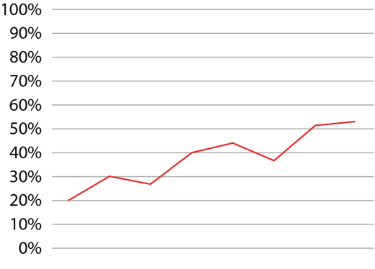
Understand that the probability of an event with only two equally likely outcomes is a half, and that each possible outcome will occur approximately half of the time
Example 3
Steve carries out the experiment and draws this graph of his results.
Flip a coin and record your results on a tally chart.
Every 5 flips, calculate the percentage number of heads that have been flipped and record this on a graph.
Continue for 50 flips, recording each percentage every 5 flips and marking this on the graph to show the progression of the percentage results as a line.
What do you notice about this graph?
Notes:
Suggested questioning:
What happens to your percentage over time?
What would happen as we continue this graph along the x axis?
Things for you to think about:
This is a classic mathematics experiment and can be repeated for scenarios where the probabilities are 1/3 and 2/3 or 1/4 and 3/4. You might wish to think about how students will collate results, and whether they will need support in getting started with this. Collating results from across the class is a time-efficient way to generate a large sample of data. Different resulting graphs can be compared, and a simple spreadsheet designed to model the results so that multiple examples can be quickly created to illustrate the general nature of tending to (in this example) 50%.

Slide 23
Understand that the probability of an event with only two equally likely outcomes is a half, and that each possible outcome will occur approximately half of the time
Example 3
  How would you organise this activity in your classroom?
  What support might students need with the recording of results and drawing of graphs?
  What are the benefits or limitations of offering students a graph compared to them creating their own.
  How would you structure the sharing and discussing of results to ensure students understand?
Flip a coin and record your results on a tally chart.
Every 5 flips, calculate the percentage number of heads that have been flipped and record this on a graph.
Continue for 50 flips, recording each percentage every 5 flips and marking this on the graph to show the progression of the percentage results as a line.
Number of heads this set of 5 | 1 | 2 | 1 | …
Total number of heads obtained | 1 | 3 | 4 | …
Number of flips so far | 5 | 10 | 15 | …
Percentage number of heads | 20% | 30% | 27% | …
Notes:
Due to space constraints, the image on this PD discussion slide is very small. PD Leads might like to use or print the ‘in the classroom’ version of this slide for teachers to access during discussions.
More detail about this example can be found on page 16 of the 5.3 Core Concept document. The table illustrated here is an example of a structure that might support students to organise their work.

Slide 24
Use the theoretical probability of a particular outcome to predict an expected number of occurrences of that outcome in an experiment
Example 4
Am I lucky today?
For each scenario, roll a dice 30 times and record the resulting number of points.
a) You score a point every time you roll an even number.
b) You score a point every time you roll a 6.
c) You score a point every time you roll a number less than 6.
d) You score a point every time you roll a number greater than 2.
e) You score a point every time you roll a square number.
f) You score a point every time you roll a number less than 10.
In each case, decide whether you were luckier or not than expected. Explain your reasoning by comparing your results with the expected number of occurrences.
Notes:
Suggested questioning:
What is the total number of possible outcomes?
What is the total number of successful outcomes?
What is the probability of __?
‘The total number of possible outcomes is …’
‘The total number of successful outcomes is …’
‘The probability of … is …’
Things for you to think about:
In Example 4, it is important for students to get a sense of how likely they think the outcomes will be while playing the game, and it may help to ask students to predict what they think the outcome will be after 30 rolls of the dice.
The phrase ‘Am I lucky today?’ draws attention to the difference between expected results and actual results. Class discussion of this could again raise the idea that the results of such experiments settle down and tend to the expected value if the dice is rolled enough times.

Slide 25
Use the theoretical probability of a particular outcome to predict an expected number of occurrences of that outcome in an experiment
Example 4
Am I lucky today?
For each scenario, roll a dice 30 times and record the resulting number of points.
  What questions will you ask to support students to understand the expected outcome in each case?
  What language will you encourage students to use to formalise their ideas? How will you model this?
a) You score a point every time you roll an even number.
b) You score a point every time you roll a 6.
c) You score a point every time you roll a number less than 6.
d) You score a point every time you roll a number greater than 2.
e) You score a point every time you roll a square number.
f) You score a point every time you roll a number less than 10.
In each case, decide whether you were luckier or not than expected. Explain your reasoning by comparing your results with the expected number of occurrences.
Notes:
Due to space constraints, the image on this PD discussion slide is very small. PD Leads might like to use or print the ‘in the classroom’ version of this slide for teachers to access during discussions.
More detail about this example can be found on page 17 of the 5.3 Core Concept document.

Slide 26
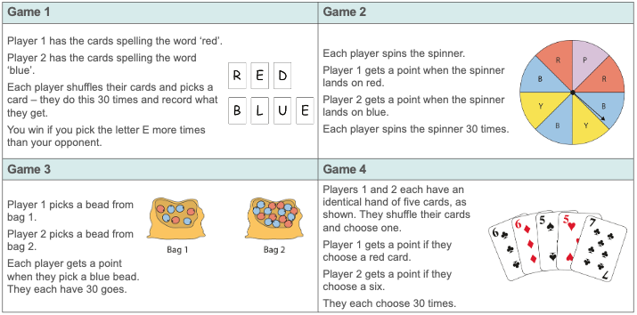
Identify the numerical values of outcomes in different single events and use these values to order the outcomes according to their likelihood
Example 5
Which is more likely?
Play these games in pairs. Each time, decide which player is more likely to win.
Notes:
A printable version of this example can be found on the following slide. The next four slides give a larger version of each game, for use when discussing with your classes.
Suggested questioning:
How many total outcomes are there? How many successful outcomes? What is the probability of a successful outcome?
Does each player have an equal chance of winning? Why or why not?
How could you change the rules to be fair?
Things for you to think about:
The games in Example 5 offer students the opportunity to focus on the number of possible outcomes and the number of successful outcomes.
In Game 1, the number of successful outcomes is the same, while the total number of outcomes is different.
Game 2 involves only one scenario, and so the number of total outcomes is the same, but the number of successful outcomes is different for each player.
Game 3 requires more in terms of comparing the resulting fractions, and so conversion to either a decimal or percentage could be a useful strategy.
Game 4 introduces examples of outcomes that are not mutually exclusive, although at this stage this is not important, because the comparison can still be made and the probabilities are equal. A similar example to this final game can easily be devised where the two probabilities are greater than a half. In this case, the question could be posed how it is possible to have a greater number of possible outcomes than there are total outcomes, highlighting the non-mutually exclusive nature of the question.

Slide 27
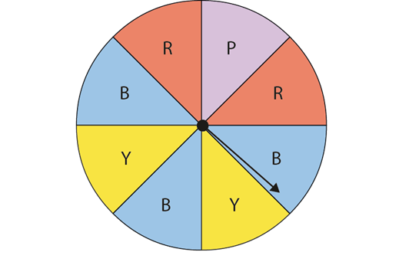
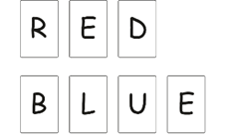
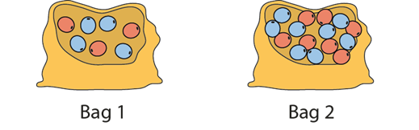
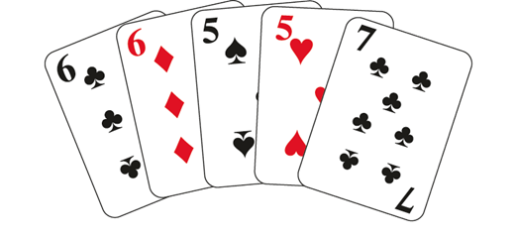
Example 5 – printable version
Game 1 |  |  | Game 2
Player 1 has the cards spelling the word ‘red’. Player 2 has the cards spelling the word ‘blue’. Each player shuffles their cards and picks a card – they do this 30 times and record what they get. You win if you pick the letter E more times than your opponent. |  |  | Each player spins the spinner. Player 1 gets a point when the spinner lands on red. Player 2 gets a point when the spinner lands on blue. Each player spins the spinner 30 times.
Game 3 |  |  | Game 4
Player 1 picks a bead from bag 1. Player 2 picks a bead from bag 2. Each player gets a point when they pick a blue bead. They each have 30 goes. |  |  | Players 1 and 2 each have an identical hand of five cards, as shown. They shuffle their cards and choose one. Player 1 gets a point if they choose a red card. Player 2 gets a point if they choose a six. They each choose 30 times.
Notes:
The games in Example 5 offer students the opportunity to focus on the number of possible outcomes and the number of successful outcomes.
In Game 1, the number of successful outcomes is the same, while the total number of outcomes is different.
Game 2 involves only one scenario, and so the number of total outcomes is the same, but the number of successful outcomes is different for each player.
Game 3 requires more in terms of comparing the resulting fractions, and so conversion to either a decimal or percentage could be a useful strategy.
Game 4 introduces examples of outcomes that are not mutually exclusive, although at this stage this is not important, because the comparison can still be made and the probabilities are equal. A similar example to this final game can easily be devised where the two probabilities are greater than a half. In this case, the question could be posed how it is possible to have a greater number of possible outcomes than there are total outcomes, highlighting the non-mutually exclusive nature of the question.

Slide 28
Identify the numerical values of outcomes in different single events and use these values to order the outcomes according to their likelihood
Example 5a
Which is more likely?
Play these games in pairs. Each time, decide which player is more likely to win.
Game 1
Player 1 has the cards spelling the word ‘red’.
Player 2 has the cards spelling the word ‘blue’.
Each player shuffles their cards and picks a card – they do this 30 times and record what they get.
You win if you pick the letter E more times than your opponent.
Notes:
Suggested questioning:
How many total outcomes are there? How many successful outcomes? What is the probability of a successful outcome?
Does each player have an equal chance of winning? Why or why not?
Both words have one E – does this mean that is equally likely to select an E for each player?
Which is bigger, 1/3 or ¼?
How could you change the rules to be fair?
Things for you to think about:
The games in Example 5 offer students the opportunity to focus on the number of possible outcomes and the number of successful outcomes. In Game 1, the number of successful outcomes is the same, while the total number of outcomes is different.

Slide 29
Identify the numerical values of outcomes in different single events and use these values to order the outcomes according to their likelihood
Example 5b
Which is more likely?
Play these games in pairs. Each time, decide which player is more likely to win.
Game 2
Each player spins the spinner.
Player 1 gets a point when the spinner lands on red.
Player 2 gets a point when the spinner lands on blue.
Each player spins the spinner 30 times.
Notes:
Suggested questioning:
How many total outcomes are there? How many successful outcomes? What is the probability of a successful outcome?
Does each player have an equal chance of winning? Why or why not?
All of the sectors are the same size, does that mean that each payer has an equal chance of winning?
Which is bigger, 2/8 or 3/8?
How could you change the rules to be fair?
Things for you to think about:
The games in Example 5 offer students the opportunity to focus on the number of possible outcomes and the number of successful outcomes. Game 2 involves only one scenario, and so the number of total outcomes is the same, but the number of successful outcomes is different for each player.

Slide 30
Identify the numerical values of outcomes in different single events and use these values to order the outcomes according to their likelihood
Example 5c
Which is more likely?
Play these games in pairs. Each time, decide which player is more likely to win.
Game 3
Player 1 picks a bead from bag 1.
Player 2 picks a bead from bag 2.
Each player gets a point when they pick a blue bead. They each have 30 goes.
Notes:
Suggested questioning:
How many total outcomes are there? How many successful outcomes? What is the probability of a successful outcome?
Does each player have an equal chance of winning? Why or why not?
Which is bigger, 4/7 or 8/15? How might you rewrite these fractions to make it easier to compare them? Could you represent them both on a number line?
How could you change the rules to be fair? Do the bags need to have the same total number of beads?
Can you remove one bead to make the game fair?
Things for you to think about:
The games in Example 5 offer students the opportunity to focus on the number of possible outcomes and the number of successful outcomes. Game 3 requires more in terms of comparing the resulting fractions, and so conversion to either a decimal or percentage could be a useful strategy.

Slide 31
Identify the numerical values of outcomes in different single events and use these values to order the outcomes according to their likelihood
Example 5d
Which is more likely?
Play these games in pairs. Each time, decide which player is more likely to win.
Game 4
Players 1 and 2 each have an identical hand of five cards, as shown. They shuffle their cards and choose one.
Player 1 gets a point if they choose a red card.
Player 2 gets a point if they choose a six.
They each choose 30 times.
Notes:
Suggested questioning:
How many total outcomes are there? How many successful outcomes? What is the probability of a successful outcome?
Does each player have an equal chance of winning? Why or why not?
How would the fairness of this game change if you included different cards?
Things for you to think about:
The games in Example 5 offer students the opportunity to focus on the number of possible outcomes and the number of successful outcomes. Game 4 introduces examples of outcomes that are not mutually exclusive, although at this stage this is not important, because the comparison can still be made and the probabilities are equal. A similar example to this final game can easily be devised where the two probabilities are greater than a half. In this case, the question could be posed how it is possible to have a greater number of possible outcomes than there are total outcomes, highlighting the non-mutually exclusive nature of the question.

Slide 32
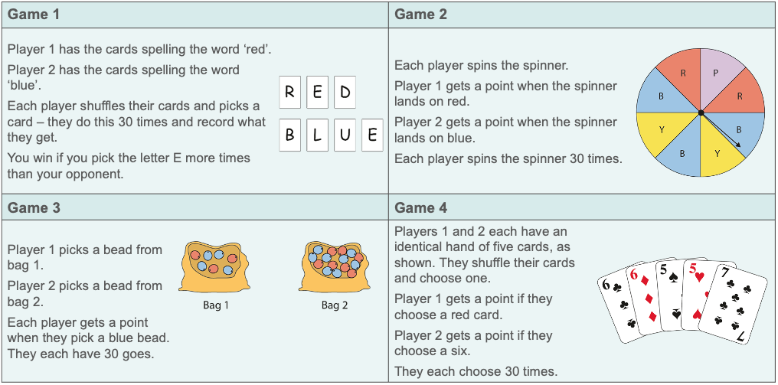
Identify the numerical values of outcomes in different single events and use these values to order the outcomes according to their likelihood
Example 5
  What misconceptions is each game designed to expose?
  What questions might you ask to encourage students to think more deeply about each of these situations?
Which is more likely?
Play these games in pairs. Each time, decide which player is more likely to win.
Notes:
Due to space constraints, the image on this PD discussion slide is very small. PD Leads might like to use or print the ‘in the classroom’ version of this slide for teachers to access during discussions.
More detail about the sequencing of this example can be found on pages 17-18 of the 5.3 Core Concept document.

Slide 33
Reflection questions
What other mathematical concepts will be supported by students’ stronger understanding of this key idea?
What mathematical language will you continue to use to support pupils to make connections with other areas?
Which representations might you continue to use to further develop students’ understanding?

Slide 35
Appendices
You may choose to use the following slides when planning or delivering a PD session. They cover:
  Key vocabulary
  Representations and structure
  Previous learning
  Future learning
  Library of links

Slide 36
Key vocabulary (1)
Term | Definition
combined event | A combined (or compound) event is an event that includes several outcomes. Example: In selecting people at random for a survey, a combined event could be ‘girl with brown eyes’.
conditional probability | The conditional probability of an event B is the probability that the event will occur, given the knowledge that an event A has already occurred. This probability is written P(B|A) (‘the probability of B given A’). In the case where events A and B are independent, P(B|A) = P(B). If events A and B are dependent, then the probability that both events occur is P(A and B) = P(A) × P(B|A).
dependent and independent events | Two events are said to be dependent when the outcome of one has an influence on the outcome of the other. Example: Picking two balls from a bag of balls when the first one is not replaced; the probability of choosing the second ball will be influenced by which ball is chosen first. When there is no such influence, the events are said to be independent. Example: Picking two balls from a bag of balls when the first ball is replaced before picking the second.

Slide 37
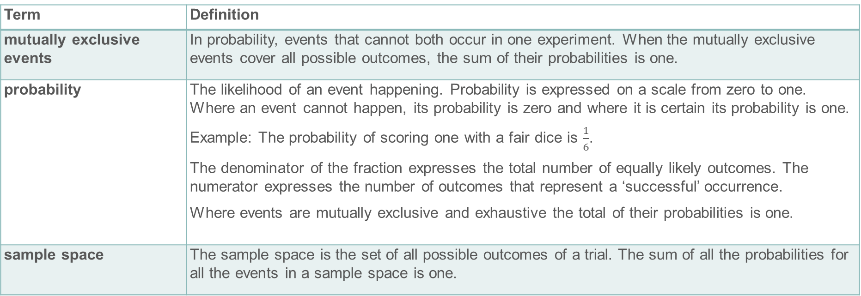
Key vocabulary (2)
Term | Definition
mutually exclusive events | In probability, events that cannot both occur in one experiment. When the mutually exclusive events cover all possible outcomes, the sum of their probabilities is one.
probability | The likelihood of an event happening. Probability is expressed on a scale from zero to one. Where an event cannot happen, its probability is zero and where it is certain its probability is one. Example: The probability of scoring one with a fair dice is $\frac{1}{6}$. The denominator of the fraction expresses the total number of equally likely outcomes. The numerator expresses the number of outcomes that represent a ‘successful’ occurrence. Where events are mutually exclusive and exhaustive the total of their probabilities is one.
sample space | The sample space is the set of all possible outcomes of a trial. The sum of all the probabilities for all the events in a sample space is one.

Slide 38

Representations and structure
There are a number of different representations that you may wish to use to support students’ understanding of this key idea. These might include:
Probability scale
Probability space
  A probability space is a useful representation to identify all outcomes where events are being combined.
Tree diagrams
  Although not a requirement of the national curriculum Key Stage 3 programme of study, students may find a tree diagram helpful in identifying and classifying outcomes of more than one event.
  A probability scale supports students in quantifying between everyday terms such as ‘likely’, ‘impossible’ and ‘certain’.
Notes:
More information about representations can be found on pages 5-7 of the Theme Overview document 5 Statistics and probability.

Slide 39
Previous learning
From Upper Key Stage 2, students will bring experience of:
interpreting and presenting discrete and continuous data using appropriate graphical methods, including bar charts, pictograms and time graphs
solving comparison, sum and difference problems using information presented in bar charts, pictograms, tables and other graphs
interpreting and constructing pie charts and line graphs, and using these to solve problems
encountering and drawing graphs relating two variables, arising from their own enquiry and in other subjects (non-statutory guidance)
calculating and interpreting the mean as an average
knowing when it is appropriate to find the mean of a data set (non-statutory guidance).
Notes:
Theme 5 Statistics and probability

Slide 40
Future learning (1)
In KS4, students will build on the core concepts in this mathematical theme to:
infer properties of populations or distributions from a sample, whilst knowing the limitations of sampling
interpret and construct tables and line graphs for time series data
{construct and interpret diagrams for grouped discrete data and continuous data, i.e. histograms with equal and unequal class intervals and cumulative frequency graphs, and know their appropriate use}
Please note: Braces { } indicate additional mathematical content to be taught to more highly attaining students.
Notes:
Theme 5 Statistics and probability

Slide 41
Future learning (2)
In KS4, students will build on the core concepts in this mathematical theme to:
interpret, analyse and compare the distributions of data sets from univariate empirical distributions through:
  appropriate graphical representation involving discrete, continuous and grouped data, {including box plots}
  appropriate measures of central tendency (including modal class) and spread {including quartiles and inter-quartile range}
apply statistics to describe a population
use and interpret scatter graphs of bivariate data; recognise correlation and know that it does not indicate causation; draw estimated lines of best fit; make predictions; interpolate and extrapolate apparent trends whilst knowing the dangers of so doing
Please note: Braces { } indicate additional mathematical content to be taught to more highly attaining students.
Notes:
Theme 5 Statistics and probability

Slide 42
Library of links
The following resources from the NCETM website have been referred to within this slide deck:
  NCETM Secondary Mastery Professional Development
    Statistics and probability theme overview document
    5.3 Probability core concept guidance document
    3.1 Understanding multiplicative relationships Core Concept Document
  Using mathematical representations at KS3 | NCETM
  Insights from experienced teachers | NCETM
  NCETM primary mastery professional development materials
  NCETM primary assessment materials
  NCETM secondary assessment materials

