Slide 1
2.23 Multiplication strategies for larger numbers and long multiplication
Representations | Year 6
Multiplication and Division

Slide 2
How to use this presentation
You can find the teacher guide 2.23 Multiplication strategies for larger numbers and long multiplication by following the link below.

Slide 3
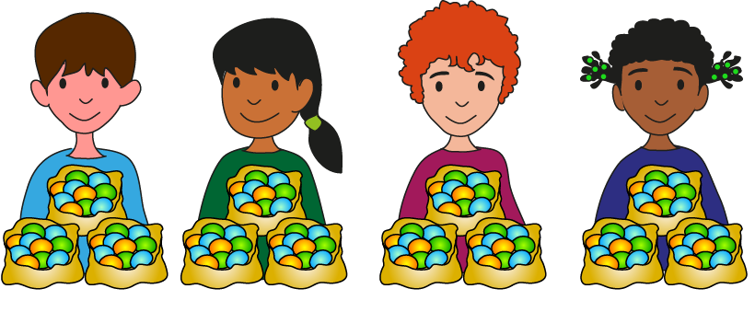
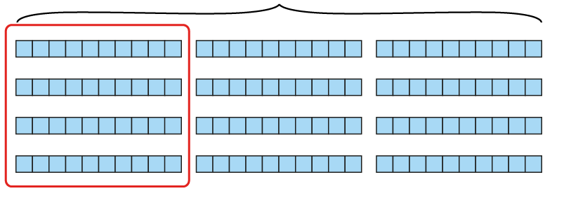
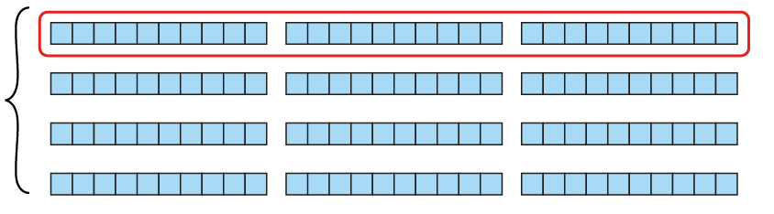
2.23 Strategies and long multiplication Step 1:1
3 × 10
3
4
4 × 10
4 × 3 tens = 12 tens
3 × 4 tens = 12 tens
= 12 × 10
= 12 × 10
= 120
= 120
Notes:
There are ten sweets in one bag.
If four children have three bags of
sweets each, how many sweets do they have altogether?

Slide 4
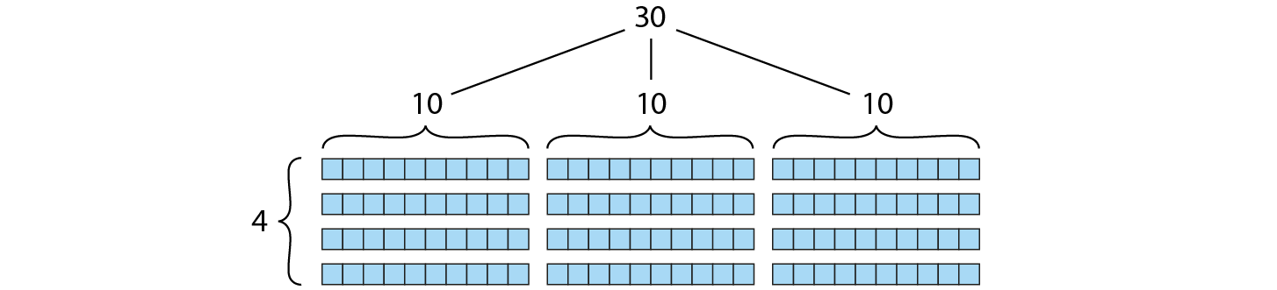
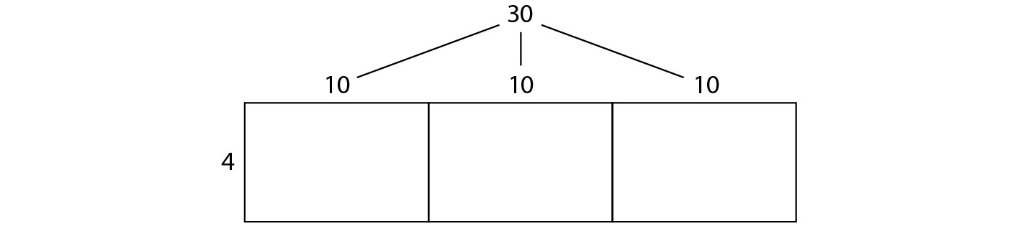

2.23 Strategies and long multiplication Step 1:2

Slide 5
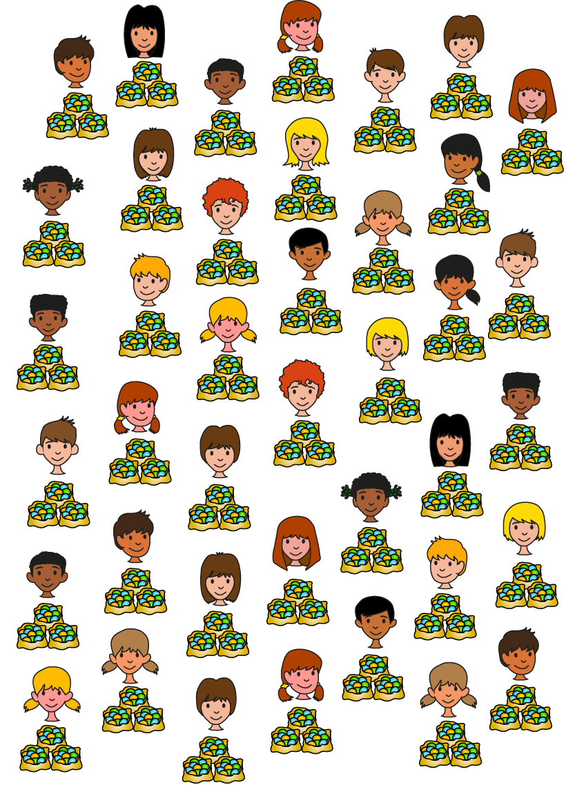
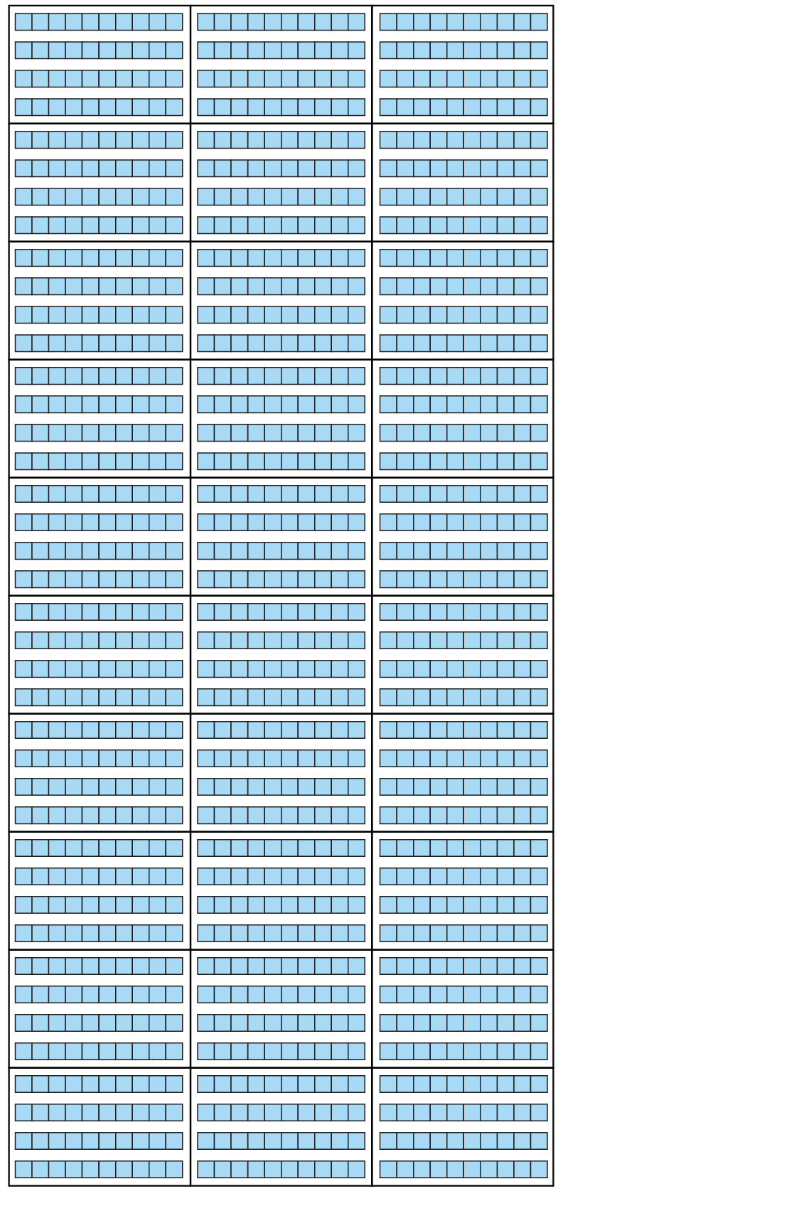
2.23 Strategies and long multiplication Step 1:3
3 × 10
10
10
10
4
4
4
30 × 40 = 3 × 10 × 4 × 10
4
= 3 × 4 × 10 × 10
4
= 3 × 4 × 100
4
4
= 1,200
4
4
4
Notes:
There are ten sweets in one bag.
If forty children have three bags of
sweets each, how many sweets do they have altogether?

Slide 6
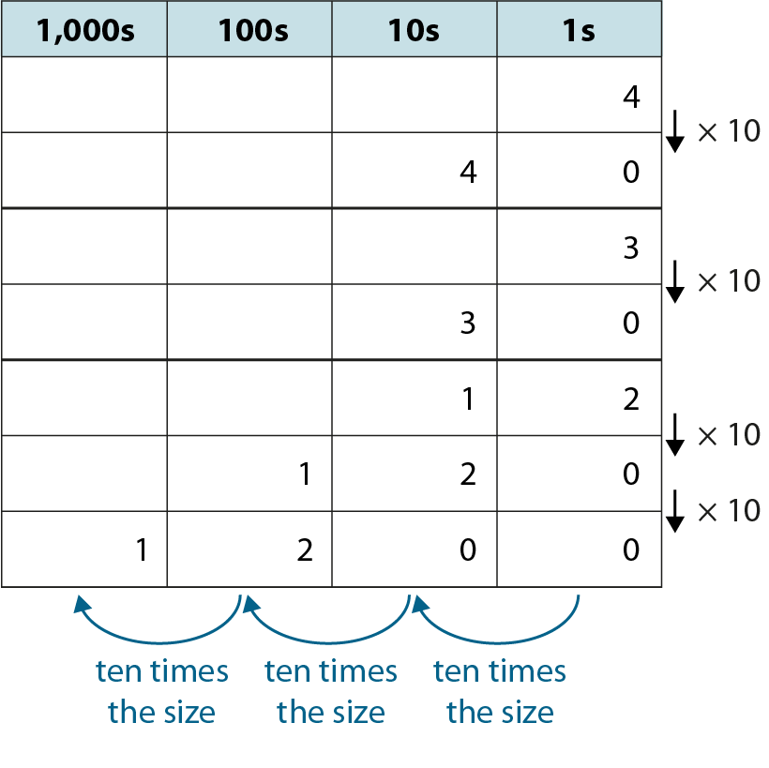
2.23 Strategies and long multiplication Step 1:3

Slide 7
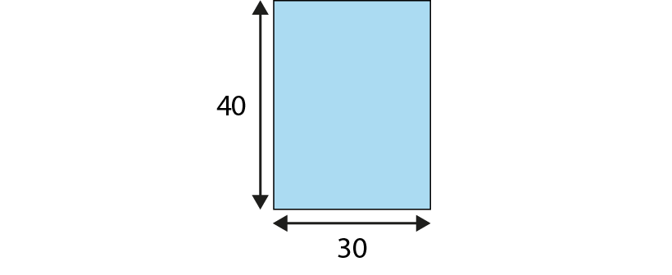
2.23 Strategies and long multiplication Step 1:3
30 × 40 = 120
40 × 30 = 120

Slide 8
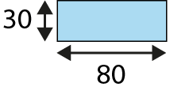
2.23 Strategies and long multiplication Step 1:5
80 boxes of 30 eggs
30 × 80 = 3 × 8 × 10 × 10
= 3 × 8 × 100
= 2,400
30 × 80 = 2,400
80 × 30 = 2,400
Notes:
Eggs come in boxes of thirty. A supermarket orders eighty boxes of eggs in one week.
How many eggs does the farmer need to supply?

Slide 9
2.23 Strategies and long multiplication Step 1:5
800 boxes of 30 eggs
10 times 80 × 30
30 × 800 = 10 × 30 × 80
= 10 × 2,400
= 24,000
30 × 800 = 24,000
800 × 30 = 24,000
Notes:
A lorry can carry 800 boxes of eggs. How many eggs does the farmer
need to fill the lorry?

Slide 10
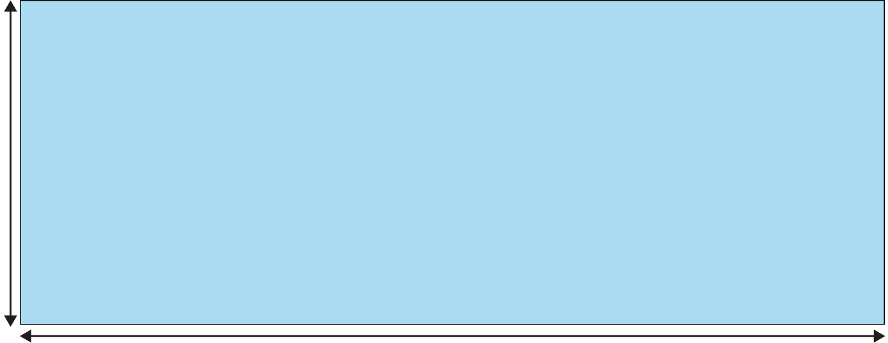
2.23 Strategies and long multiplication Step 1:5
300 loads of 800 boxes of eggs
10 times 800 × 30
300
800
300 × 800 = 10 × 30 × 800
= 10 × 24,000
= 240,000
300 × 800 = 240,000
800 × 300 = 240,000
Notes:
In one month, a lorry delivers 300 loads of 800 boxes.
How many boxes is that?

Slide 11
2.23 Strategies and long multiplication Step 1:6
3
30
30
30
300
3,000
×
×
×
×
×
×
8
8
80
800
800
800
=
=
=
=
=
=
24
240
2,400
24,000
240,000
2,400,000
Notes:
What’s the same? What’s different?

Slide 12
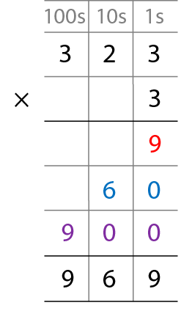
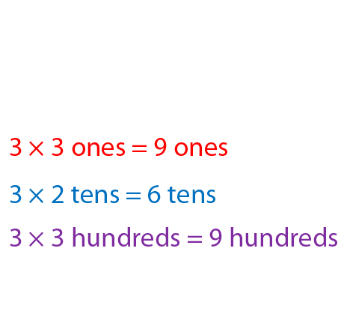
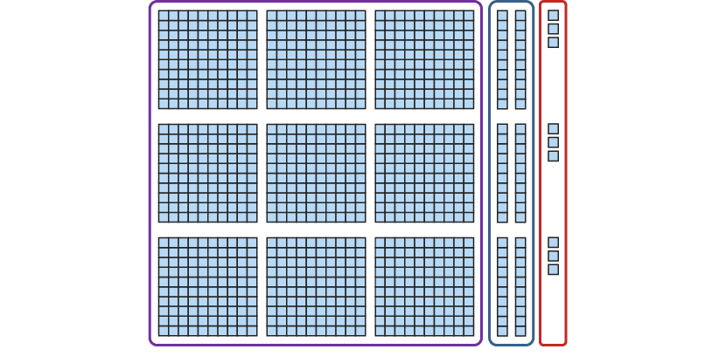
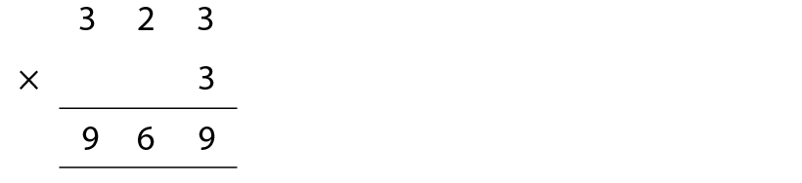
2.23 Strategies and long multiplication Step 2:1
323 books on a bookcase.
How many on a bookcase that holds 3 times as many?
Notes:
Ahmed has three hundred and twenty-three books on his bookcase.
His friend has a bookcase that holds three times as many.
How many books does it hold?

Slide 13
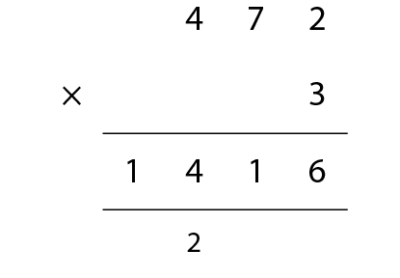
2.23 Strategies and long multiplication Step 2:2
472 × 3 = 1,416
Notes:
A lorry driver takes deliveries from Swindon to York once a week.
The journey there and back is 472 miles.
How far does she travel in three weeks?

Slide 14
2.23 Strategies and long multiplication Step 2:2
472 × 3 = 1,416
472 × 30 = 14,160
Notes:
The driver does this journey for thirty weeks each year.
How far will she have travelled in one year?

Slide 15
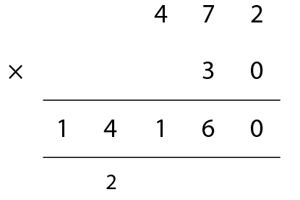
2.23 Strategies and long multiplication Step 2:3
472 × 30
Ezra’s method
Ling’s method
1,416 × 10 = 14,160
Notes:
What’s the same? What’s different?

Slide 16
2.23 Strategies and long multiplication Step 2:5
472 × 300
472 × 3 = 1,416
1,416 × 100 = 141,600
Notes:
A lorry driver takes deliveries from Swindon to York once a week.
The journey there and back is 472 miles.
How far does she travel in three hundred weeks?

Slide 17
2.23 Strategies and long multiplication Step 2:7
472 × 3,000
472 × 3 = 1,416
1,416 × 1,000 = 1,416,000
Notes:
How far does she travel in three thousand weeks?

Slide 18
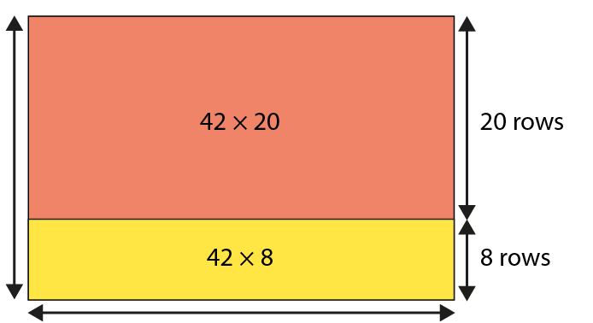
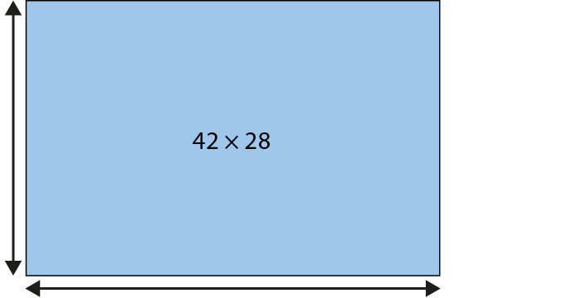
2.23 Strategies and long multiplication Step 3:1
28 rows
42 in each row
Notes:
Seats in one section of a stadium are in rows of forty-two.
If there are twenty-eight rows, how many seats are there in this section?

Slide 19
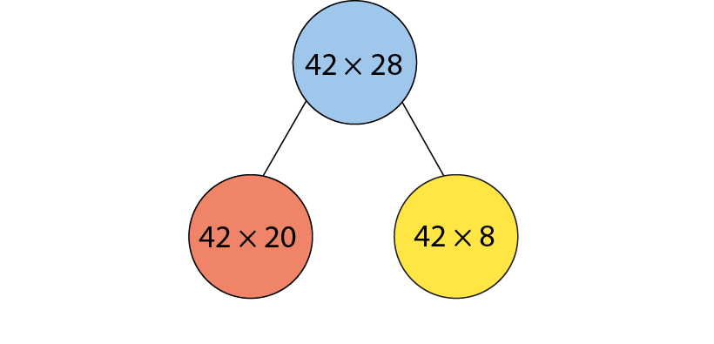
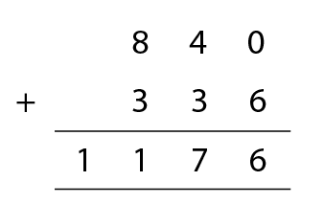
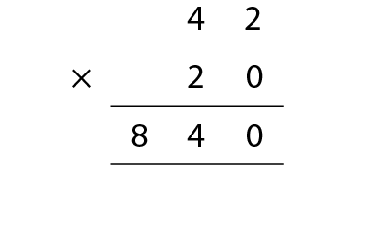
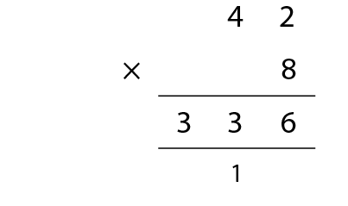
2.23 Strategies and long multiplication Step 3:1
Notes:
Seats in one section of a stadium are in rows of forty-two.
If there are twenty-eight rows, how many seats are there in this section?

Slide 20
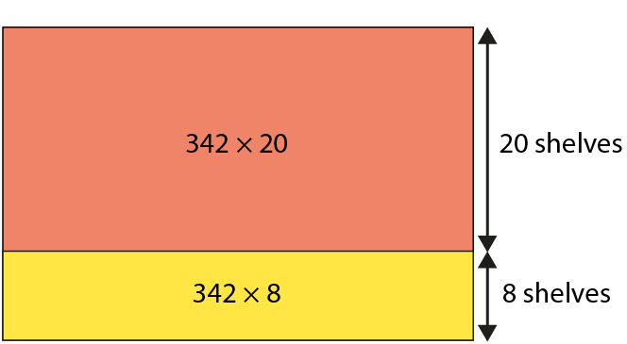
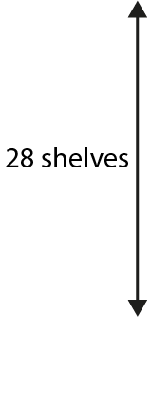
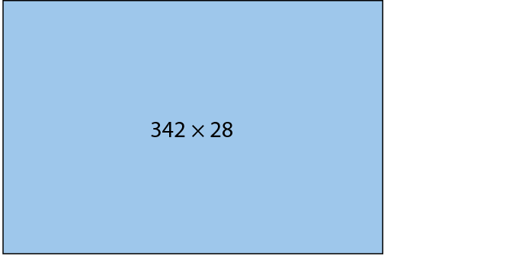

2.23 Strategies and long multiplication Step 3:2
Notes:
A factory can store three hundred and forty-two bottles of juice on one shelf.
If it has twenty-eight full shelves in the storeroom, how many
bottles of juice does it have to sell?

Slide 21
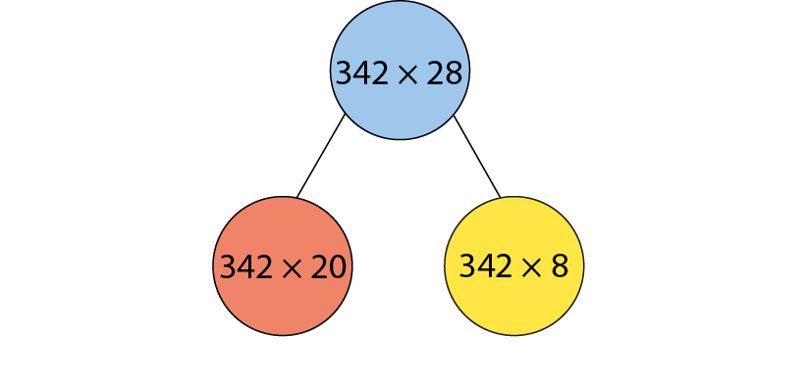
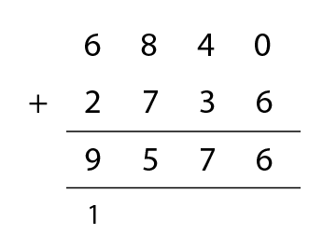
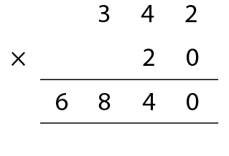
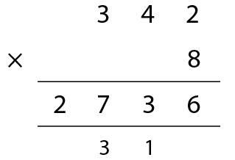
2.23 Strategies and long multiplication Step 3:2
Notes:
A factory can store three hundred and forty-two bottles of juice on one shelf.
If it has twenty-eight full shelves in the storeroom, how many
bottles of juice does it have to sell?

Slide 22
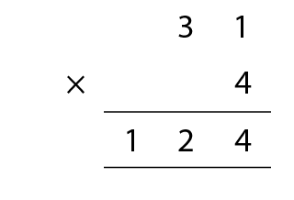
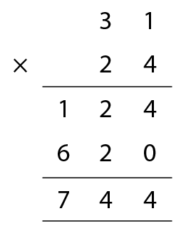
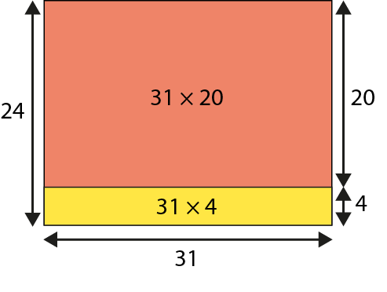
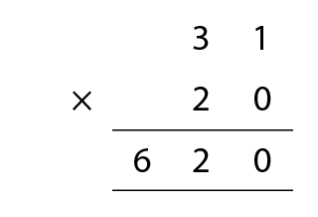
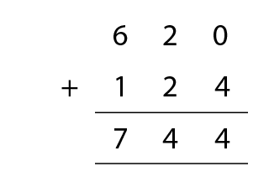
2.23 Strategies and long multiplication Step 4:1
31 × 24
Notes:
Martha wants to calculate how many hours there are in January.

Slide 23
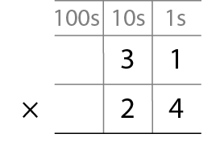
2.23 Strategies and long multiplication Step 4:2
Step 1 – write the factors

Slide 24
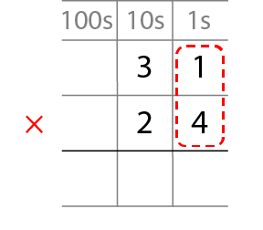
2.23 Strategies and long multiplication Step 4:2
Step 2 – multiply the 1s digit by the 1s digit

Slide 25
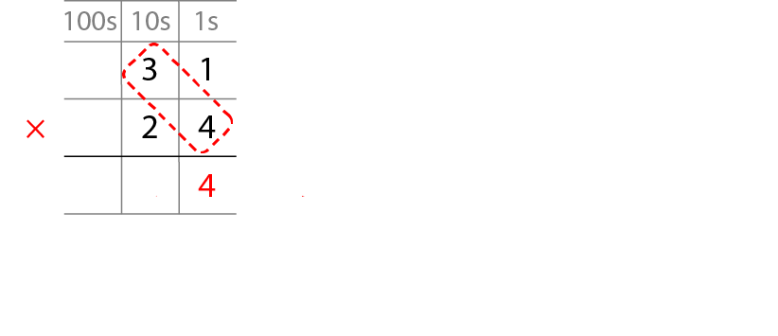

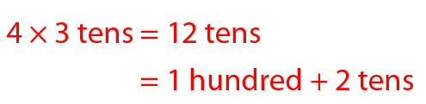
2.23 Strategies and long multiplication Step 4:2
Step 3 – multiply the 10s digit by the 1s digit and regroup
1
2

Slide 26
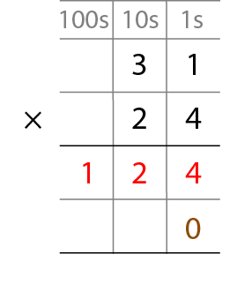
2.23 Strategies and long multiplication Step 4:2
Step 4 – place a 0 to show that it’s 10 times the size
1
2

Slide 27
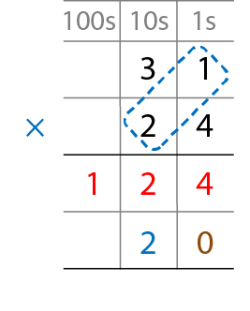
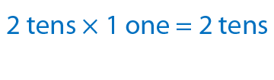
2.23 Strategies and long multiplication Step 4:2
Step 5 – multiply the 1s digit by the 10s digit

Slide 28
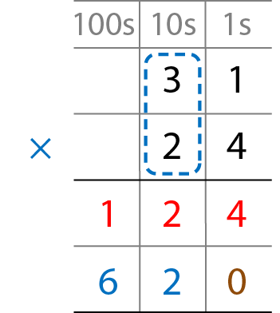
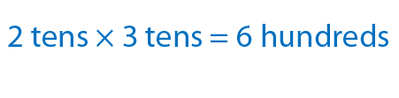
2.23 Strategies and long multiplication Step 4:2
Step 6 – multiply the 10s digit by the 10s digit

Slide 29
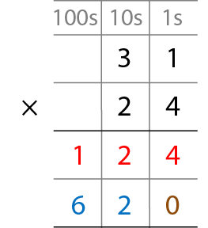
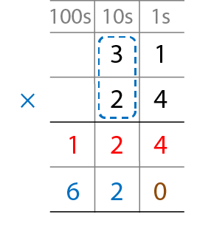



2.23 Strategies and long multiplication Step 4:2
Step 7 – add the partial products

Slide 30
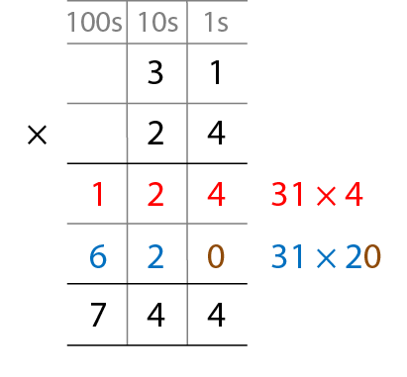
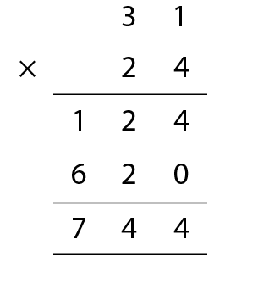
2.23 Strategies and long multiplication Step 4:3
Notes:
What’s the same? What’s different?

Slide 31
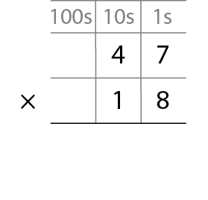
2.23 Strategies and long multiplication Step 4:5
Step 1 – write the factors

Slide 32
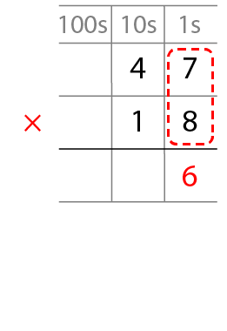

2.23 Strategies and long multiplication Step 4:5
Step 2 – multiply the 1s digit by the 1s digit and regroup
5

Slide 33




2.23 Strategies and long multiplication Step 4:5
Step 3 – multiply the 10s digit by the 1s digit,
adding the regrouped 10s and regroup again
5

Slide 34

2.23 Strategies and long multiplication Step 4:5
Step 4 – place a 0 to show that it’s 10 times the size

Slide 35



2.23 Strategies and long multiplication Step 4:5
Step 5 – multiply the 1s digit by the 10s digit

Slide 36


2.23 Strategies and long multiplication Step 4:5
Step 6 – multiply the 10s digit by the 10s digit

Slide 37


2.23 Strategies and long multiplication Step 4:5
Step 7 – add the partial products

Slide 38

2.23 Strategies and long multiplication Step 4:7
27 × 23

Slide 39

2.23 Strategies and long multiplication Step 4:8
Notes:
Lesa has done this calculation but has the incorrect answer.
Explain her mistake.

Slide 40




2.23 Strategies and long multiplication Step 4:9

Slide 41





2.23 Strategies and long multiplication Step 4:12

Slide 42



2.23 Strategies and long multiplication Step 5:2
23 × 14 = 23 × 2 × 7
23 × 14 = 23 × 7 × 2
= 46 × 7
= 161 × 2
= 322
= 322
Notes:
If there are fourteen classes of twenty-three children in a school, how
many children are there in the school?

Slide 43

2.23 Strategies and long multiplication Step 5:4
Oliver’s method
Notes:
Water bottles come in boxes of fifteen bottles.
A school has bought three hundred and twenty-four boxes. How many bottles does
the school have?

Slide 44
2.23 Strategies and long multiplication Step 5:4
Tanima’s method
 | 3 | 2 | 4 |  |  |  |  |  | 9 | 7 | 2
× |  |  | 3 |  |  |  | × |  |  |  | 5
 | 9 | 7 | 2 |  |  |  |  | 4 | 8 | 6 | 0
 |  | 1 |  |  |  |  |  |  | 3 | 1
Notes:
Water bottles come in boxes of fifteen bottles.
A school has bought three hundred and twenty-four boxes. How many bottles does
the school have?

