Slide 1
Series 3 Episode 16
FlatLand

Slide 2
Practitioner Notes

Slide 3
Episode Description
Four and Squary go on a visit to Flatland where all the flat shapes live and meet lots of new friends made from straight lines - Square, Triangle, and Rectangle. Rectangle introduces Four to some other 2D shapes who also have four corners and four sides. Four then comes across Pentagon, Hexagon, and Heptagon. Each has one more side than the one before it. Squary wants to go home but they don’t know how to get back. Just in time, Octagon comes to the rescue to make an octagonal basket for a hot air balloon. Circle arrives to take Four and Squary back to meet the other Numberblocks for a picnic where they tell them all about their adventure in Flatland.

Slide 4
Maths in the Episode
Naming 2D shapes
Each shape is identified by counting the number of sides and saying the names. They are: triangle, square, rectangle, rhombus, trapezium, kite, arrowhead, parallelogram, pentagon, hexagon, heptagon and octagon.
Properties of shapes
2D shapes have the same number of corners as they do sides. The number of sides or corners determines the name of the shape, but the sides do not all have to be the same length, and the orientation of the shape does not change its properties.

Slide 5
Using Mathematical Language
Use these stem sentences to rehearse the mathematical ideas in the programme:
“This 2D shape is a <triangle>.”
It is flat.
It has <3> corners.
It has <3> straight sides.”
“A circle has 1 curved line.”
“A <square> has <one> more corner(s) than a <triangle>.”
“A <square> has <one> fewer side(s) than a <pentagon>.”

Slide 6
Talk and Discuss Together

Slide 7
Talk and Discuss Together
Watch the episode of Numberblocks. First ask the children what they noticed and allow them to talk to you and each other.
What do you think Four would tell the other Numberblocks about after his adventure to Flatland?
The following slides are designed to stimulate children and adults to talk about the episode and draw out some key aspects of the mathematics.

Slide 8
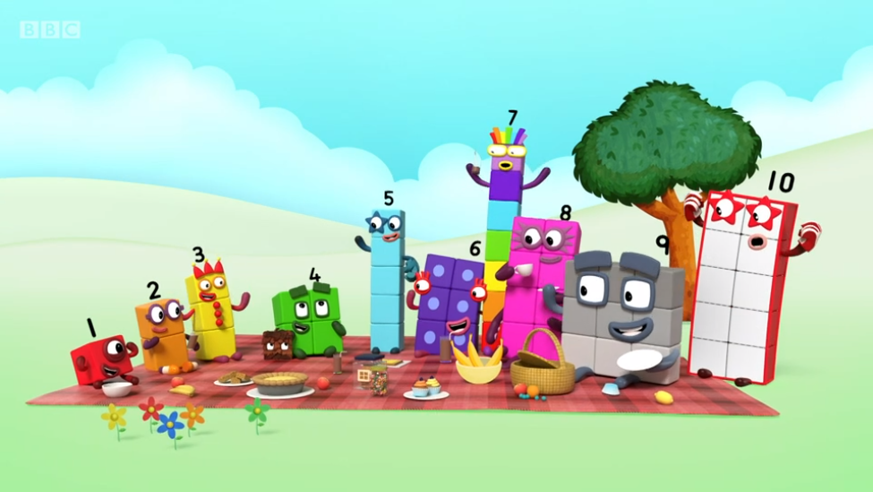
Images © 2017 Alphablocks Ltd. All Rights Reserved.
Images © 2017 Alphablocks Ltd. All Rights Reserved.
Notes:
Ask the children “What do you think Four would tell the other Numberblocks about after his adventure to Flatland?”

Slide 9
Enabling Environments in Reception

Slide 10
Enabling Environments
Playing and Exploring
Leave chalk outside for floor art. Draw around feet, hands, other objects. Provide jigsaws and pattern blocks to explore fitting shapes together
Active Learning
Notice whether the children name familiar 2D shapes in their play. Use familiar 2D shape properties when asking children to identify shapes. For example, “I think we need a round piece.” “A straight piece will fit in there (for example, train track).” “I think we need to find a rectangle to fit in here.”
Creating and Thinking Critically
Use 3D objects to print 2D shapes with paint. Display the children’s work on a tabletop for the children to match the object to the print.
Use outlines of objects in shelving to match the right equipment to the place where it must be packed away.

Slide 11
Learning Together in Y1
Notes:
In this set of slides, we use Triangle to illustrate what is possible to experience when learning about 2D shapes. The aim is to understand what makes a triangle a triangle: 3 points, connected by 3 straight lines. When the 3 straight lines are connected at the points they form corners. These corners are also known as vertices. This language is introduced in Y2. The set of slides abstracts a triangle form the Flatland character Triangle.

Slide 12

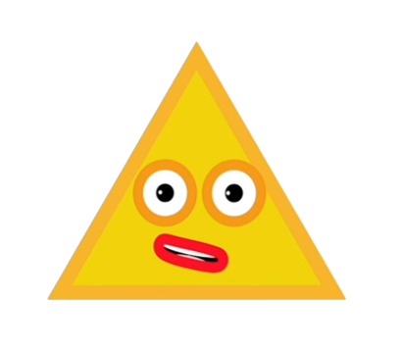
Who are you?
I have 3 corners.
I have 3 straight sides.
I am Triangle.
Images © 2017 Alphablocks Ltd. All Rights Reserved.
Notes:
Use this slide to introduce ‘Triangle’.
The animations identify the corners and straight sides.
The shape is identified as a triangle because it has three corners and three straight sides.

Slide 13

Images © 2017 Alphablocks Ltd. All Rights Reserved.
Notes:
The animations reveal the link between the familiar Flatland character and the abstract 2D shape of a triangle.
Discuss after each click: What’s the same? What is different?
Use to practise and reinforce the language of corners and straight sides.

Slide 14
What can you see?
I see 3 corners.
I see 3 straight sides.
I see a triangle
Images © 2017 Alphablocks Ltd. All Rights Reserved.
Notes:
Use this slide to abstract the properties of triangles (rather than the properties of Flatland character Triangle).
Discuss:
If we join the three points/dots with straight lines, what do you think we will see?
What are the straight lines called when they make a shape?
What is the name of this shape?
What makes it a triangle?

Slide 15
What can you see?
I see 3 corners.
I see 3 straight sides.
I see a triangle
Images © 2017 Alphablocks Ltd. All Rights Reserved.
Notes:
Use this slide to practise identifying a triangle by its properties. This example uses a different type of triangle (not equilateral like Triangle is). This triangle is also orientated so that no side is parallel with any side of the screen. If you come out of ‘slideshow’ mode, you can change the side lengths and angles to make different-looking triangles.
If we join the three points/dots with straight lines, what do you think we will see?
What are the straight lines called when they make a shape?
What is the name of this shape?
What makes it a triangle? How is it different to the previous triangle?

Slide 16
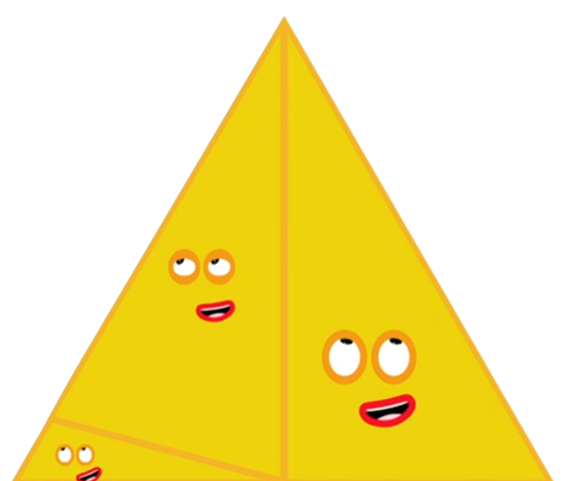
A triangle has:
3 corners
3 straight sides.
How many triangles can you see?
Images © 2017 Alphablocks Ltd. All Rights Reserved.
Notes:
If you come out of ‘slide show’ mode, it is possible to drag the black spots to re-position around a different triangle.
Animations reveal one of the smaller triangles within the big triangle.
Where else can you see a smaller triangle within the big triangle?
There are 5 triangles to find. (See next slide)

Slide 17
Images © 2017 Alphablocks Ltd. All Rights Reserved.
Notes:
Use this slide to print off to give to the children to hunt for the triangles.

Slide 18
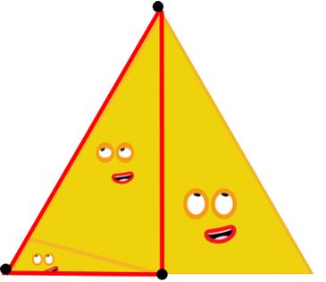
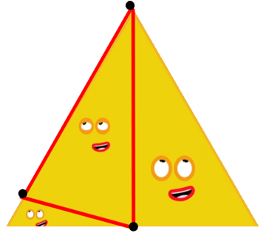
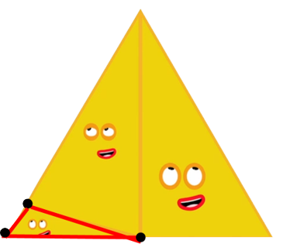
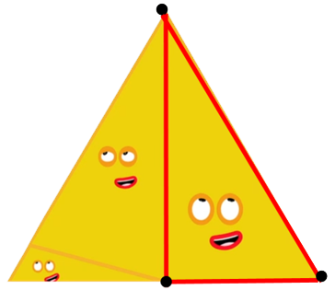
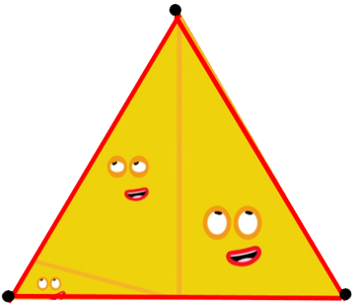
A triangle has:
3 corners
3 straight sides.
How many triangles can you see?
Images © 2017 Alphablocks Ltd. All Rights Reserved.
Notes:
All the possible answers.

Slide 19
Further activities for Y1
Go on a triangle walk and take photos of examples of triangles. Print photos and draw on corners and sides.
In the playgroup, ask the children to get into groups of 3 and draw chalk lines, or string between each person to make different triangles.
Use square dot or isometric dot paper to join dots to make different triangles.
Match Numberblocks to their Flatland shape.

Slide 20
Learning Together in Y2
Notes:
This set of slides illustrates the distinctive features of shapes, in particular what makes a shape regular or irregular. It uses quadrilaterals as its focus, but similar experiences could be used with the other polygons introduced in the episode.
A square is a regular quadrilateral. All its sides are the same length. All its corners/vertices are the same shape (all internal angles are the same size).
You can rotate a regular shape on top of itself the same number of times as the number of sides.
For example, a square can be rotated to make 4 copies of itself.
A pentagon can be rotated 5 times to make copies of itself.

Slide 21
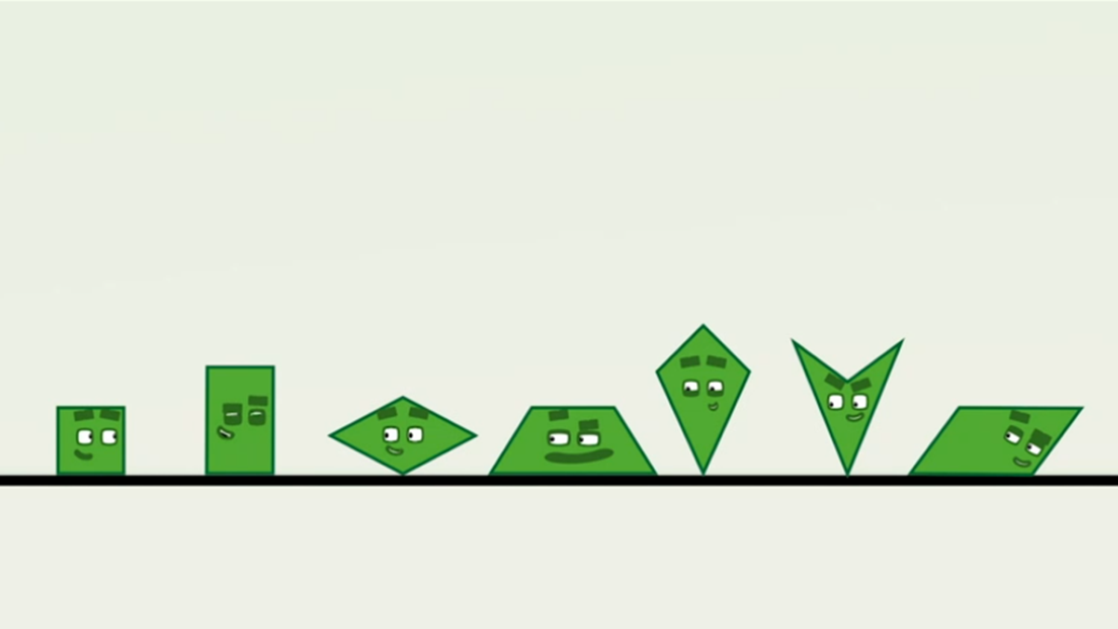
a
b
c
d
e
f
g
Images © 2017 Alphablocks Ltd. All Rights Reserved.
Notes:
Use this slide to discuss what is the same about each of the shapes and what is different. Each shape is labelled with a letter to assist in describing the shapes, as it is not a requirement of Y2 to name the different types of quadrilaterals.
Lead the discussion to recognise that 4 sides and 4 vertices is insufficient to describe a square or a rectangle.

Slide 22

How many different sized squares can you draw on the dotty paper?
a
b
c
Images © 2017 Alphablocks Ltd. All Rights Reserved.
Notes:
Discuss:
Which shape is not a square? Why? (All the sides must be the same length. All the vertices must be the same shape. Each corner is a square corner.)
Use Geoboards or an online Geoboard/Geoboard app to experiment with making different sized apps.
Provide some dotty paper (see next slide) to experiment with making squares.

Slide 24
What do you notice?
There are 4 copies of this square.
a
b
c
d
Images © 2017 Alphablocks Ltd. All Rights Reserved.
Notes:
What do you notice about the squares?
The slide animates to create copies of the square by rotating.
b is a copy of a but has been rotated once.
c is a copy of b but has been rotated once.
d is a copy of c but has been rotated once.
a is a copy of d but has been rotated once.

Slide 25

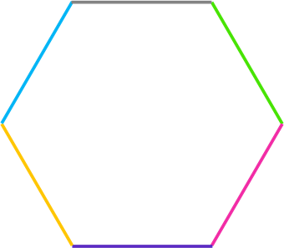
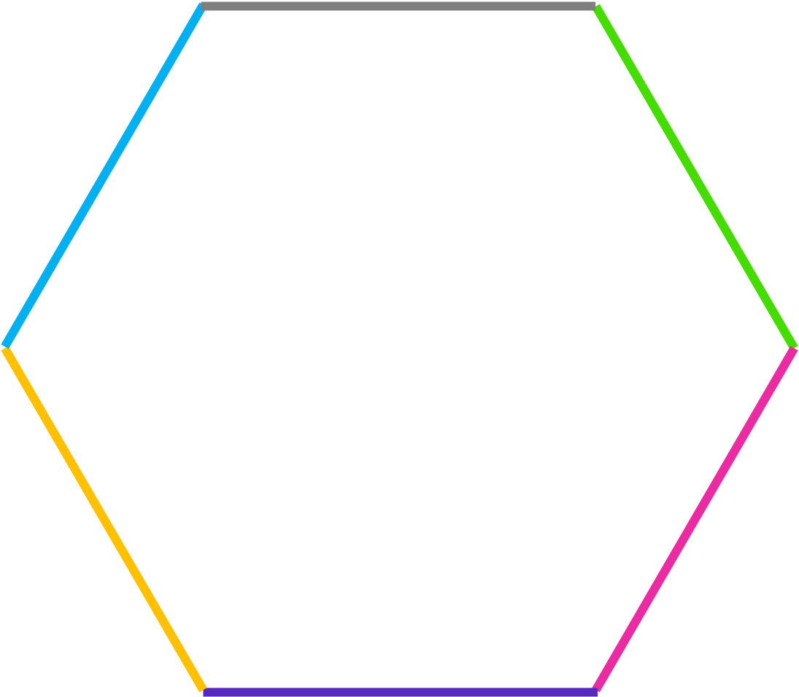
How many copies can you make with this hexagon?
There are 6 copies of this hexagon.
Images © 2017 Alphablocks Ltd. All Rights Reserved.
Notes:
Give out paper version of the hexagon (see next slide). Ask the children to explore how many copies there are.
The slide animates to reveal 6 copies.

Slide 27
How many copies can you make with this hexagon?
There are 2 copies of this hexagon.
Images © 2017 Alphablocks Ltd. All Rights Reserved.
Notes:
Give out paper copies of this hexagon. (See next slide).
The slide animates to reveal 2 copies.

Slide 28
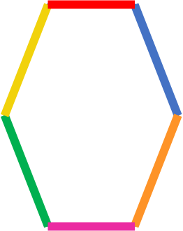

Slide 29
What is different about these hexagons?
This hexagon is regular.
This hexagon is not regular.
Images © 2017 Alphablocks Ltd. All Rights Reserved.
Notes:
There are only two copies because some of the corners are different shapes. This shape is not regular.

Slide 30
What do you notice about the number of copies?
This hexagon is regular.
It has 6 copies.
This hexagon is not regular.
It has 2 copies.
This square is regular.
It has 4 copies.
Images © 2017 Alphablocks Ltd. All Rights Reserved.
Notes:
Read the statements and discuss and share ideas.
Discuss:
What do you notice about the regular shapes?
What do you notice about the number of copies a regular shape can make? (When the shape is regular, the number of copies is the same as the number of sides.)

Slide 31
Further activities for Y2
Explore the number of copies of other regular and non-regular polygons to test “when the shape is regular, the number of copies is the same as the number of sides”.
Sort polygons into regular and not regular (irregular). This could be done on a Carroll diagram along with comparing side lengths.
Draw copies of regular and irregular polygons on squared and dotty paper.
Name irregular polygons by noticing how many vertices and how many sides.

