Slide 1
1.16 Subtraction: two-digit and two-digit numbers
Representations | Year 2
Number, Addition and Subtraction

Slide 2
How to use this presentation
You can find the teacher guide 1.16 Subtraction: two-digit and two-digit numbers by following the link below.

Slide 3
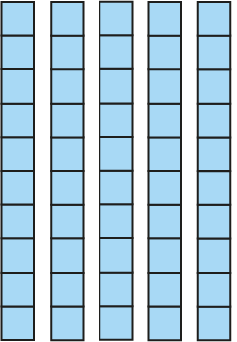



1.16 Subtraction: two-digit and two-digit numbers – step 1:1
56
− 2
= 54

Slide 4
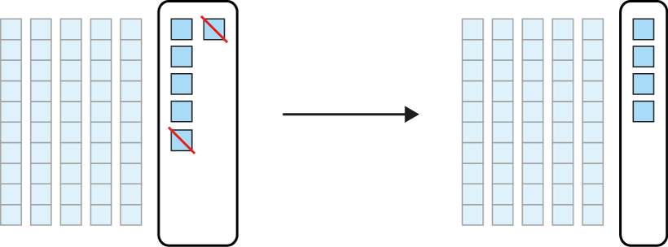
1.16 Subtraction: two-digit and two-digit numbers – step 1:1
56
− 2
= 54

Slide 5
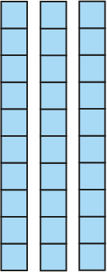

1.16 Subtraction: two-digit and two-digit numbers – step 1:1
56
− 20
= 36

Slide 6
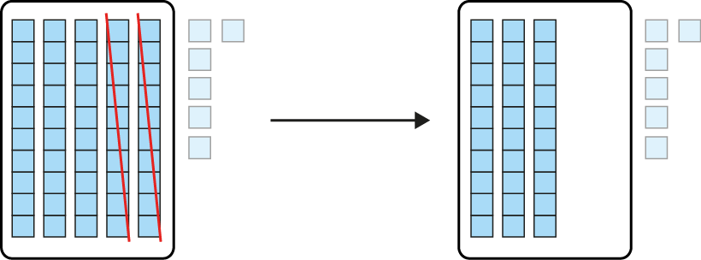
1.16 Subtraction: two-digit and two-digit numbers – step 1:1
56
− 20
= 36

Slide 7




1.16 Subtraction: two-digit and two-digit numbers – step 1:2
45
− 20
− 3
= 22
Notes:
At first I had forty-five biscuits. Then I sold twenty biscuits, and then I dropped three biscuits. How many are left?

Slide 8
1.16 Subtraction: two-digit and two-digit numbers – step 1:2
45
− 3
− 20
= 22
Notes:
At first I had forty-five biscuits. Then I dropped three biscuits, and then I sold twenty biscuits. How many are left?

Slide 9
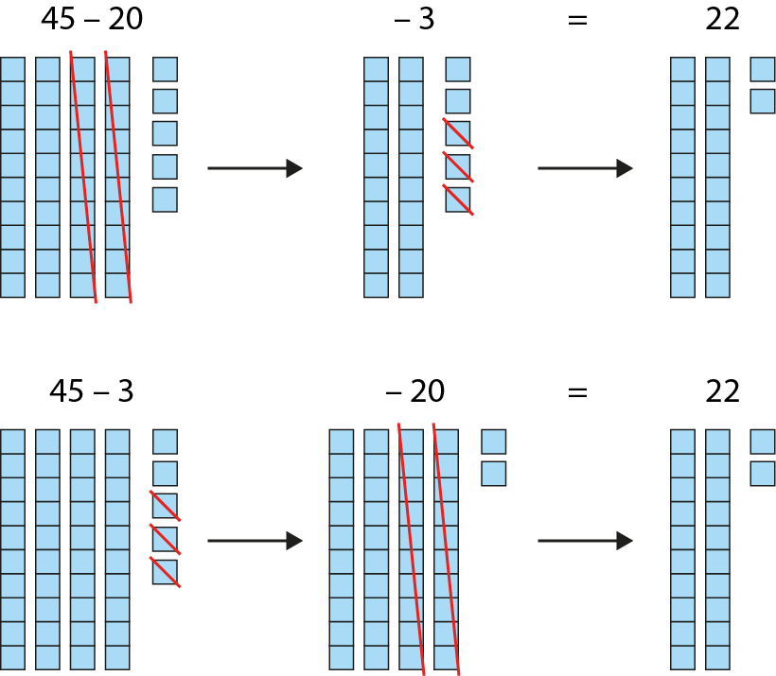
1.16 Subtraction: two-digit and two-digit numbers – step 1:2

Slide 10








1.16 Subtraction: two-digit and two-digit numbers – step 1:2
45
− 20
− 3
= 22
45
− 3
− 20
= 22

Slide 11
1.16 Subtraction: two-digit and two-digit numbers – step 2:1
45 − 20 − 3
45 − 23
Notes:
At first I had forty-five biscuits. Then I sold twenty biscuits, and then I dropped three biscuits. How many are left?
vs.
There were forty-five children in the playground. Then twenty-three of them went into the dinner hall. How many children are still in the playground?

Slide 12
1.16 Subtraction: two-digit and two-digit numbers – step 2:2
45
− 23

Slide 13
1.16 Subtraction: two-digit and two-digit numbers – step 2:2
45
− 23

Slide 14
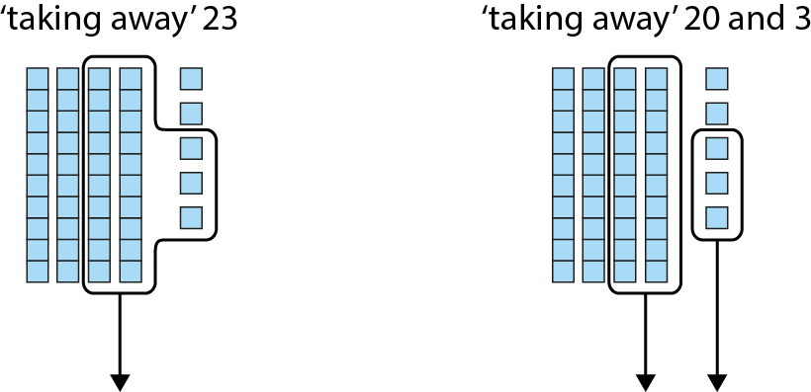
1.16 Subtraction: two-digit and two-digit numbers – step 2:2

Slide 15
1.16 Subtraction: two-digit and two-digit numbers – step 2:2

Slide 16













1.16 Subtraction: two-digit and two-digit numbers – step 2:3

Slide 17












1.16 Subtraction: two-digit and two-digit numbers – step 2:4

Slide 18

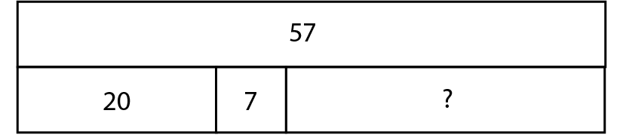


1.16 Subtraction: two-digit and two-digit numbers – step 2:4

Slide 19
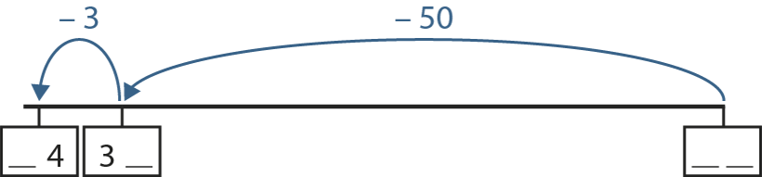
1.16 Subtraction: two-digit and two-digit numbers – step 2:5

Slide 20
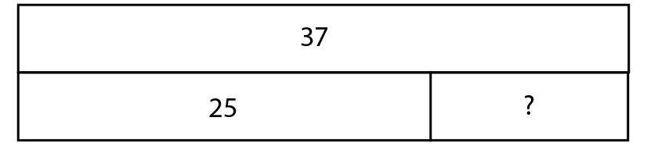

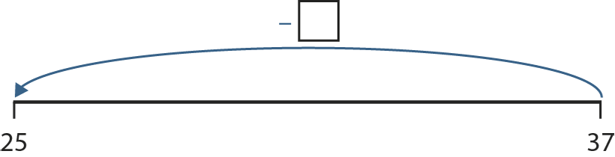

1.16 Subtraction: two-digit and two-digit numbers – step 2:5

Slide 21











1.16 Subtraction: two-digit and two-digit numbers – step 2:6

Slide 22









1.16 Subtraction: two-digit and two-digit numbers – step 2:6
59
1
59

Slide 23

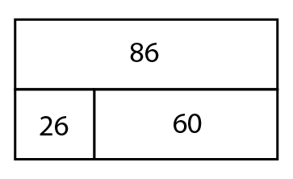
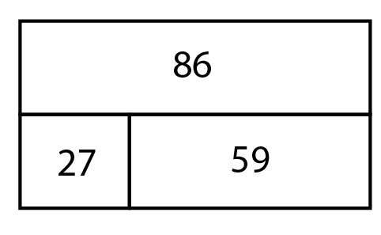
1.16 Subtraction: two-digit and two-digit numbers – step 2:6
59
1
59

Slide 24













1.16 Subtraction: two-digit and two-digit numbers – step 2:7

Slide 25













1.16 Subtraction: two-digit and two-digit numbers – step 2:7

Slide 26
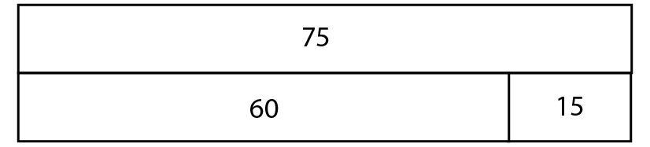
1.16 Subtraction: two-digit and two-digit numbers – step 2:8

Slide 27
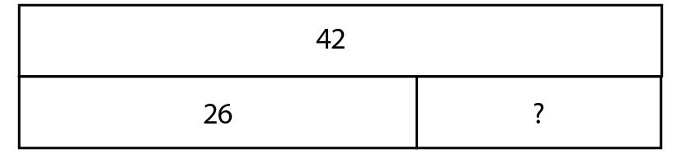



1.16 Subtraction: two-digit and two-digit numbers – step 2:8

Slide 28
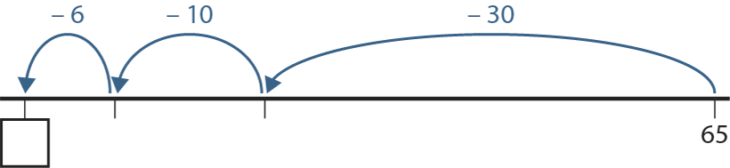

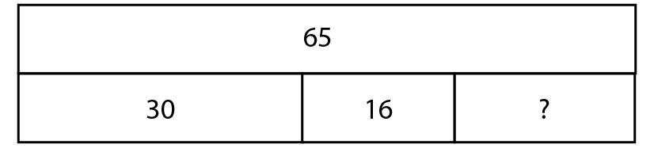

1.16 Subtraction: two-digit and two-digit numbers – step 2:8
25
35
Notes:
Paul had sixty-five stickers. He gave thirty stickers to Andrew and sixteen stickers to Alicia. How many stickers does Paul have left?’

Slide 29
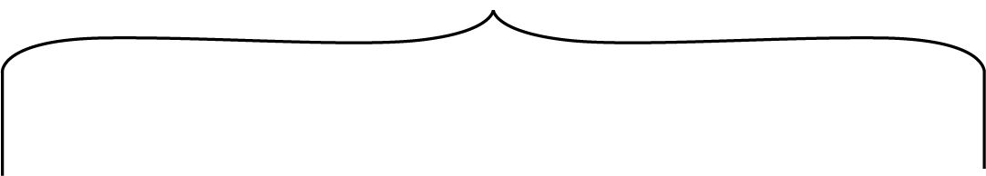


1.16 Subtraction: two-digit and two-digit numbers – step 2:9
35 − 34
= 1

Slide 30








1.16 Subtraction: two-digit and two-digit numbers – step 2:9

