Slide 1
2.29 Decimal place-value knowledge, multiplication and division
Representations | Year 6
Multiplication and Division

Slide 2
How to use this presentation
You can find the teacher guide 2.29 Decimal place-value knowledge, multiplication and division by following the link below.

Slide 3
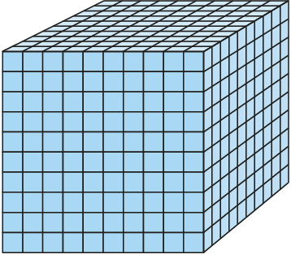
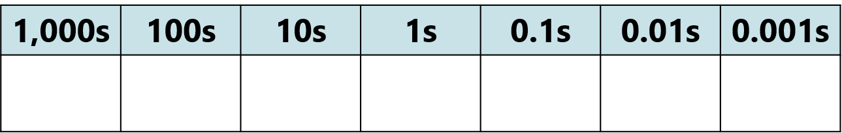

2.29 Extending decimal place-value to ×/÷ Step 1:1
Notes:
One is the whole.

Slide 4
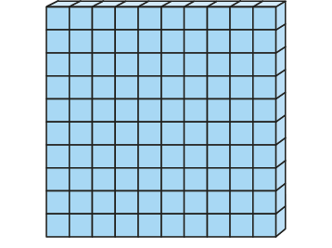
2.29 Extending decimal place-value to ×/÷ Step 1:1
1 ÷ 10 = 0.1 1 × 0.1 = 0.1
Notes:
When a whole is divided into ten equal parts, each part is
one tenth of the whole.
There are ten tenths in one whole.

Slide 5
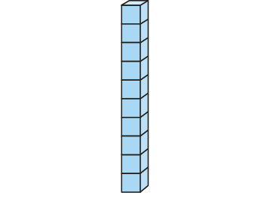
2.29 Extending decimal place-value to ×/÷ Step 1:1
1 ÷ 100 = 0.01 1 × 0.01 = 0.01
Notes:
When a whole is divided into one hundred equal parts, each part is
one hundredth of the whole.
There are one hundred hundredths in one whole.

Slide 6
2.29 Extending decimal place-value to ×/÷ Step 1:1
0.1 ÷ 10 = 0.01 0.1 × 0.1 = 0.01
Notes:
When one tenth of the whole is divided into ten equal parts, each part is
one hundredth of the whole.
There are ten hundredths in one tenth.

Slide 7

2.29 Extending decimal place-value to ×/÷ Step 1:1
1 ÷ 1,000 = 0.001 1 × 0.001 = 0.001
Notes:
When a whole is divided into one thousand equal parts, each part is
one thousandth of the whole.
There are one thousand thousandths in one whole.

Slide 8
2.29 Extending decimal place-value to ×/÷ Step 1:1
0.01 ÷ 10 = 0.001 0.01 × 0.1 = 0.001
Notes:
When one hundredth of the whole is divided into ten equal parts, each part is
one thousandth of the whole.
There are ten thousandths in one hundredth.

Slide 9
2.29 Extending decimal place-value to ×/÷ Step 1:1
0.1 ÷ 100 = 0.001 0.1 × 0.01 = 0.001
Notes:
When one tenth of the whole is divided into one hundred equal parts, each part is
one thousandth of the whole.
There are one hundred thousandths in one tenth.

Slide 10
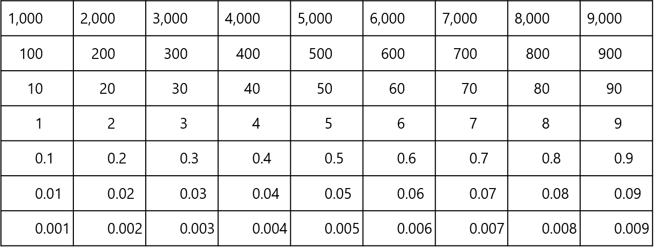
2.29 Extending decimal place-value to ×/÷ Step 1:1

Slide 11
2.29 Extending decimal place-value to ×/÷ Step 1:2
Multiplying by 1,000
Notes:
We had six ones. We now have six thousandths.

Slide 12
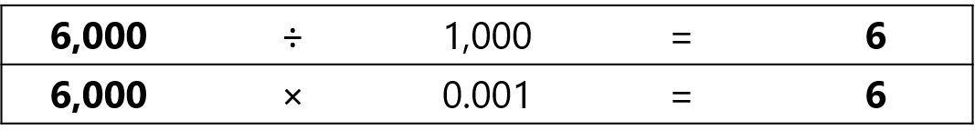
2.29 Extending decimal place-value to ×/÷ Step 1:2
Multiplying by 1,000
Dividing by 1,000 / Multiplying by 0.001
Notes:
We had six thousandths. We now have six ones.

Slide 13
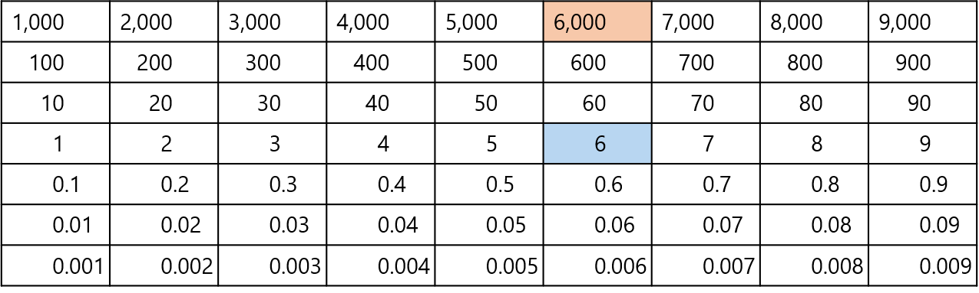
2.29 Extending decimal place-value to ×/÷ Step 1:2
Multiplying by 1,000
Dividing by 1,000 / multiplying by 0.001
Multiplying and dividing by 1,000

Slide 14
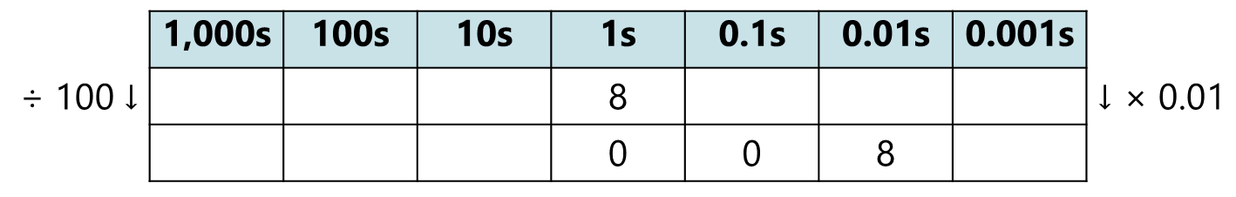
2.29 Extending decimal place-value to ×/÷ Step 1:3
Example 1 – division of a single-digit number by 100 / multiplication by 0.01
Notes:
We are dividing by 100 / multiplying by 0.01, so we need to
move the digits two places to the right.

Slide 15
2.29 Extending decimal place-value to ×/÷ Step 1:3
Example 1 – division of a single-digit number by 100 / multiplication by 0.01
Notes:
We had eight ones. We now have eight hundredths.

Slide 16
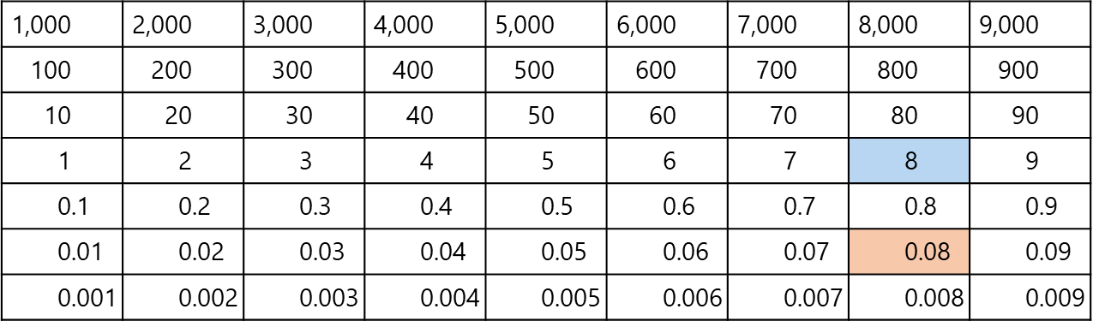
2.29 Extending decimal place-value to ×/÷ Step 1:3
Example 1 – division of a single-digit number by 100 / multiplication by 0.01

Slide 17
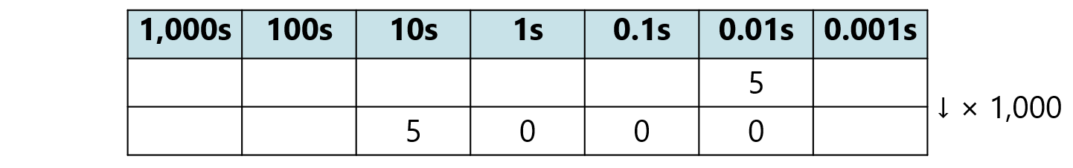
2.29 Extending decimal place-value to ×/÷ Step 1:3
Example 2 – multiplication of a whole number of hundredths by 1,000
Notes:
We are multiplying by one thousand, so we need to
move the digits three places to the left.

Slide 18
2.29 Extending decimal place-value to ×/÷ Step 1:3
Example 2 – multiplication of a whole number of hundredths by 1,000
Notes:
We had five hundredths. We now have five tens.

Slide 19
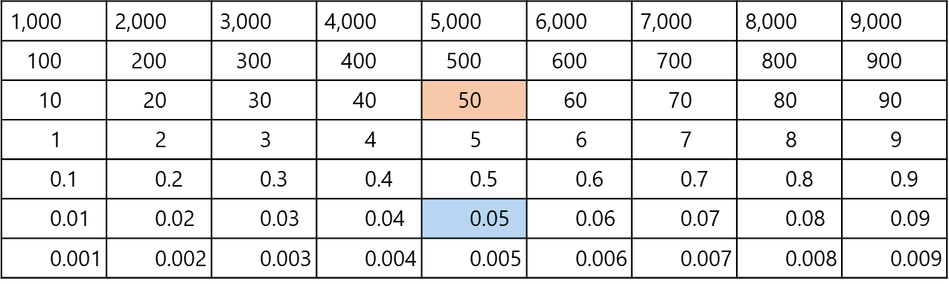
2.29 Extending decimal place-value to ×/÷ Step 1:3
Example 2 – multiplication of a whole number of hundredths by 1,000

Slide 20
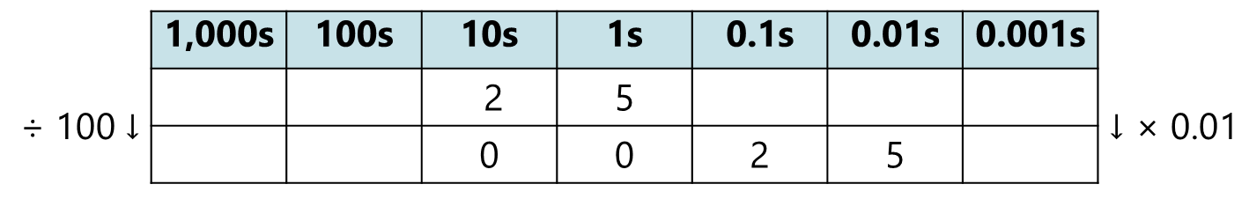
2.29 Extending decimal place-value to ×/÷ Step 1:5
Example 1 – two-digit number divided by 100 / multiplied by 0.01
Notes:
We are dividing by 100 / multiplying by 0.01, so we need to move
the digits two places to the right.

Slide 21
2.29 Extending decimal place-value to ×/÷ Step 1:5
Example 1 – two-digit number divided by 100 / multiplied by 0.01
Notes:
We had twenty-five ones. We now have twenty-five hundredths.

Slide 22
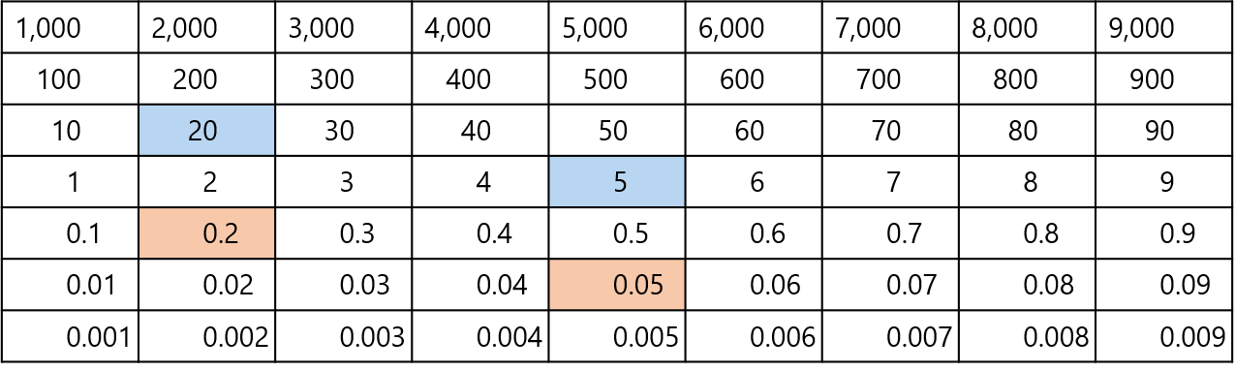
2.29 Extending decimal place-value to ×/÷ Step 1:5
Example 1 – two-digit number divided by 100 / multiplied by 0.01

Slide 23
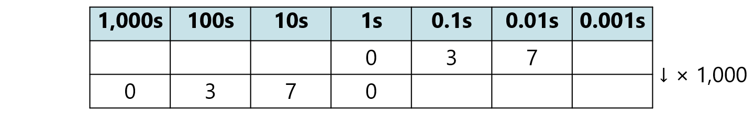
2.29 Extending decimal place-value to ×/÷ Step 1:5
Example 2 – multiplying a decimal fraction by 1,000
Notes:
We are multiplying by one thousand, so we need to
move the digits three places to the left.

Slide 24
2.29 Extending decimal place-value to ×/÷ Step 1:5
Example 2 – multiplying a decimal fraction by 1,000
Notes:
We had thirty-seven hundredths. We now have thirty-seven tens.

Slide 25
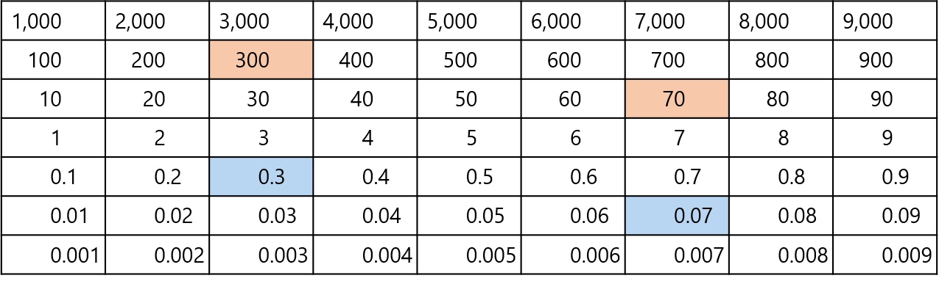
2.29 Extending decimal place-value to ×/÷ Step 1:5
Example 2 – multiplying a decimal fraction by 1,000

Slide 26
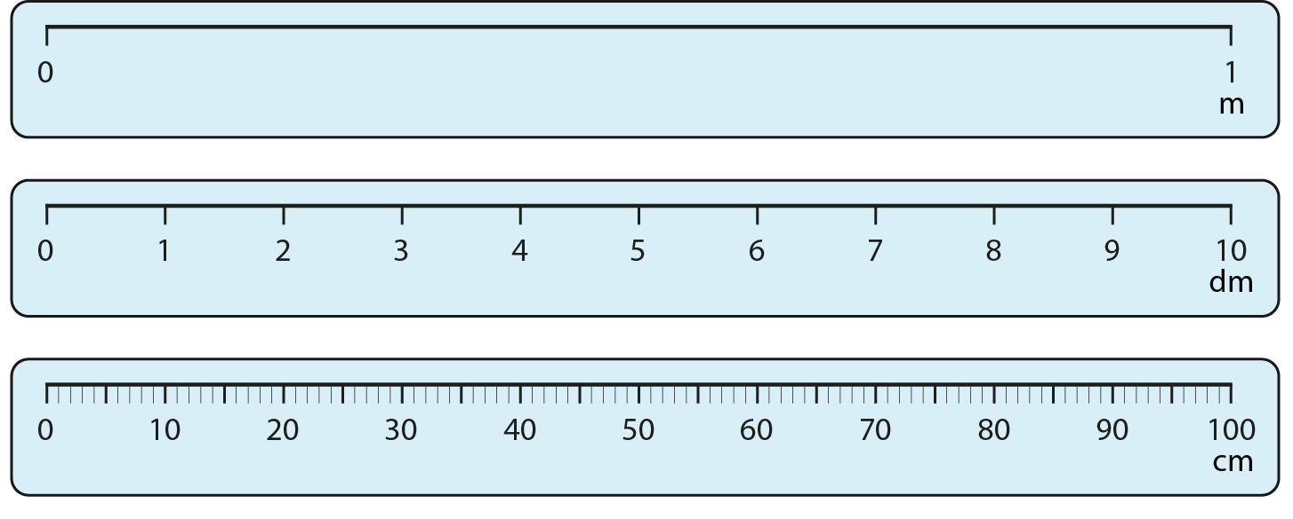
2.29 Extending decimal place-value to ×/÷ Step 2:1
Not to scale.
Notes:
What’s the same?
What’s different?

Slide 27
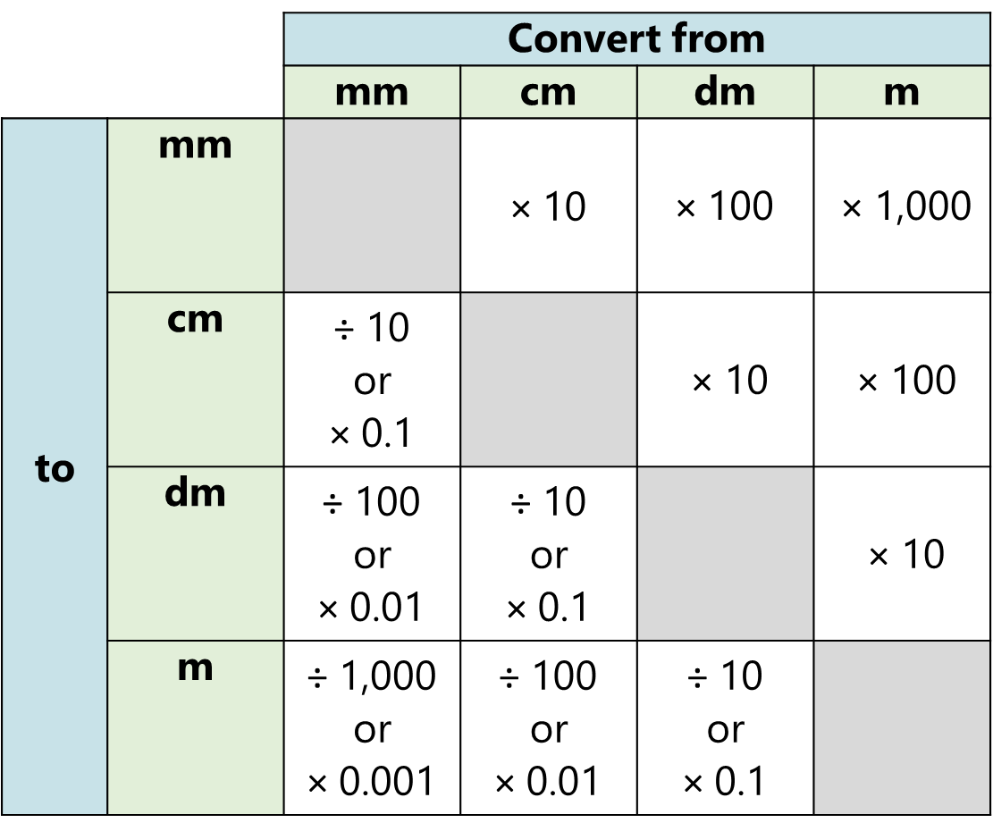
2.29 Extending decimal place-value to ×/÷ Step 2:1

Slide 28

2.29 Extending decimal place-value to ×/÷ Step 2:4

Slide 29
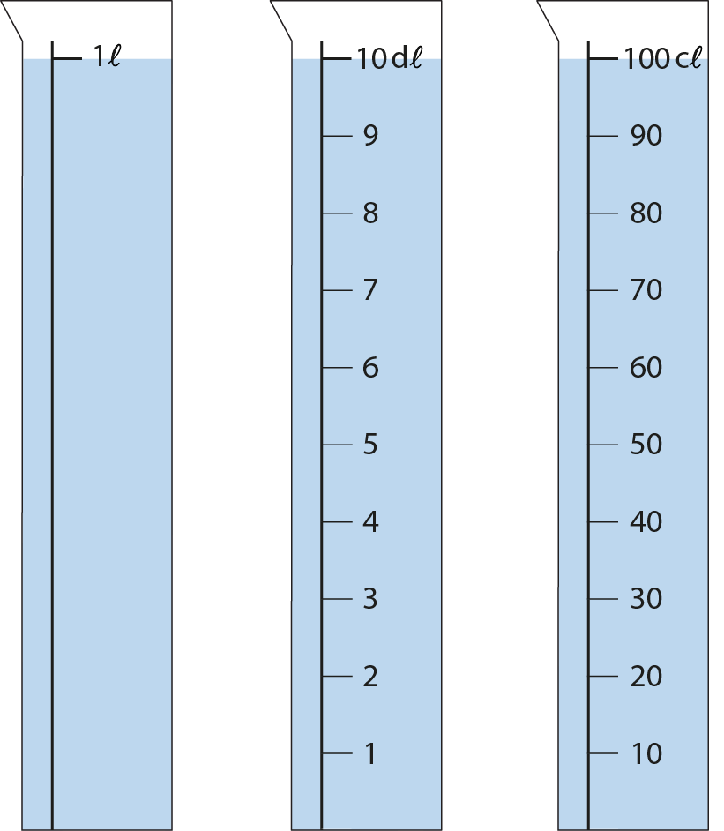
2.29 Extending decimal place-value to ×/÷ Step 2:4
Notes:
What’s the same?
What’s different?

