Slide 1
Year 4, Unit 7
Coordinates

Slide 2
Year 4, Unit 7
These materials heavily reflect the prioritisation approach of the ready-to-progress criteria in the DfE Primary Mathematics Guidance 2020 and on the PPTs that exemplify them on the NCETM website. They also include other relevant National Curriculum content. Related sections of the NCETM Primary Mastery Professional Development Materials provide small-step teaching guidance.
Ready-to-progress criteria addressed by this unit
Teaching of this unit supports the following criteria from the ‘DfE Mathematics Guidance: key stages 1 & 2’ (the 335-page document available as a download)
4G-1 Page 192
Prior learning
If the following ready-to-progress criteria, contained in the same DfE guidance document as above, were secured in Year 3, children will be ready to start on this unit.
3G-1 Page 134
3G-2 Page 137

Slide 3
Contents
The links below take you to the starting slide of each learning outcome.
1 | Pupils give directions from one position to another on a grid
2 | Pupils move objects including polygons on a grid according to directions, and mark the new position
3 | Pupils describe translations of polygons drawn on a square grid
4 | Pupils draw polygons specified by translations
5 | Pupils mark points specified as a translation from the origin
6 | Pupils mark the position of points specified by coordinates in the first quadrant of a coordinate grid, and write coordinates for already marked points
7 | Pupils draw polygons specified by coordinates in the first quadrant
8 | Pupils translate polygons in the first quadrant
Click the arrow button to return to this Contents slide.

Slide 4
Year 4, Unit 7, Learning Outcome 1
Learning Outcome 1
Pupils give directions from one position to another on a grid
The following slide supports the teaching of this learning outcome.

Slide 5


Year 4, Unit 7, Learning Outcome 1
Give the teddy directions to get to the strawberry
  Right ____ squares
  Down ____ squares

Slide 6
Year 4, Unit 7, Learning Outcome 2
Learning Outcome 2
Pupils move objects including polygons on a grid according to directions, and mark the new position
The following slide supports the teaching of this learning outcome.

Slide 7

4G-1 Draw polygons specified by coordinates or by translation
Look at polygon A. How would we need to move this for it to cover polygon B?
Count with me as we move the polygon across. In which direction do we need to move it first? How many squares to the right have we moved? Now which direction do we need to move the polygon? How many squares down have we moved?
The polygon has been translated 4 squares to the right and 3 squares down.

Slide 8
Year 4, Unit 7, Learning Outcome 3
Learning Outcome 3
Pupils describe translations of polygons drawn on a square grid
The following slides have been collated to support the teaching of this learning outcome.

Slide 9
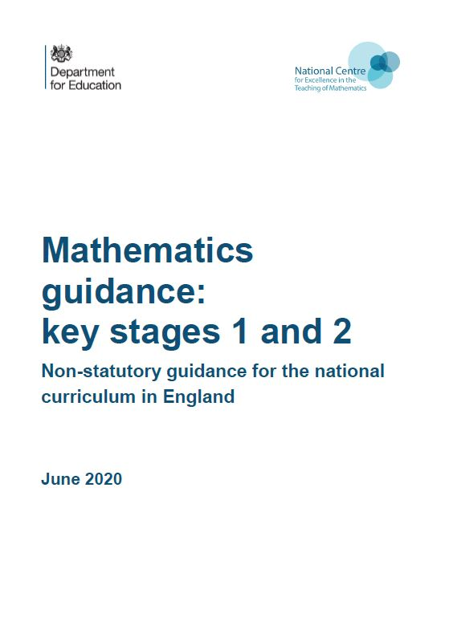
Year 4, Unit 7, Learning Outcome 3
Additional teacher guidance for this outcome should be read first and can be found in the DfE Mathematics guidance. Page references relate to the 335-page document available as a download at the bottom of this web page.
Ready to progress criteria | Pages
4G-1 | 192

Slide 10








Year 4, Unit 7, Learning Outcome 3
Describe the translation of shape A to shape B
B
A

Slide 11
4G-1 Draw polygons specified by coordinates or by translation
Children should practise using squared grids and assorted polygons and:
  translate polygons according to given instructions:
  describe the movement left/right and up/down of a polygon which has already been translated.
Model to children how this can be done by translating each point of the polygon individually and joining these points, or alternatively translating and marking one point first then marking the other points of the polygon relative to the translated point.
Provide opportunities for children to practise each of these methods.

Slide 12
Year 4, Unit 7, Learning Outcome 4
Learning Outcome 4
Pupils draw polygons specified by translation
The following slides have been collated to support the teaching of this learning outcome.

Slide 13
Year 4, Unit 7, Learning Outcome 4
Additional teacher guidance for this outcome should be read first and can be found in the DfE Mathematics guidance. Page references relate to the 335-page document available as a download at the bottom of this web page.
Ready to progress criteria | Pages
4G-1 | 193

Slide 14




Year 4, Unit 7, Learning Outcome 4
Here is a square.
Translate the square right 2 squares and up 4 squares.

Slide 15
Year 4, Unit 7, Learning Outcome 5
Learning Outcome 5
Pupils mark points specified as a translation from the origin
The following slides have been collated to support the teaching of this learning outcome.

Slide 16
Year 4, Unit 7, Learning Outcome 5
Additional teacher guidance for this outcome should be read first and can be found in the DfE Mathematics guidance. Page references relate to the 335-page document available as a download at the bottom of this web page.
Ready to progress criteria | Pages
4G-1 | 193

Slide 17

4G-1 Draw polygons specified by coordinates or by translation
What can you see? What do we call this? What do we call the horizontal axis? The vertical axis?
Start at the origin and mark a point along 5, and up 4.
If I counted 4 along and up 5 would this be the same point?
Repeat for other points in the first quadrant using axes with no number labels.
First count along the x-axis, then count along the y-axis.

Slide 18
Year 4, Unit 7, Learning Outcome 6
Learning Outcome 6
Pupils mark the position of points specified by coordinates in the first quadrant of a coordinate grid, and write coordinates for already marked points
The following slides have been collated to support the teaching of this learning outcome.

Slide 19
Year 4, Unit 7, Learning Outcome 6
Additional teacher guidance for this outcome should be read first and can be found in the DfE Mathematics guidance. Page references relate to the 335-page document available as a download at the bottom of this web page.
Ready to progress criteria | Pages
4G-1 | 194

Slide 20
4G-1 Draw polygons specified by coordinates or by translation
Once children are familiar with unlabelled axes, move to axes with number labels, drawing attention to the origin of each and how this is labelled with O, not a zero.
Children should practise on these labelled quadrants by:
  writing the coordinate notation for a given point;
  marking the position of points specified by coordinates.
Activities for the above may include ‘battleships’, coordinate bingo, treasure maps and oversized grids marked out on the floor on which children can manipulate real objects.
Is the point (5,4) the same as the point (4,5)? Why not?

Slide 21
Year 4, Unit 7, Learning Outcome 7
Learning Outcome 7
Pupils draw polygons specified by coordinates in the first quadrant
The following slides have been collated to support the teaching of this learning outcome.

Slide 22
Year 4, Unit 7, Learning Outcome 7
Additional teacher guidance for this outcome should be read first and can be found in the DfE Mathematics guidance. Page references relate to the 335-page document available as a download at the bottom of this web page.
Ready to progress criteria | Pages
4G-1 | 194

Slide 23
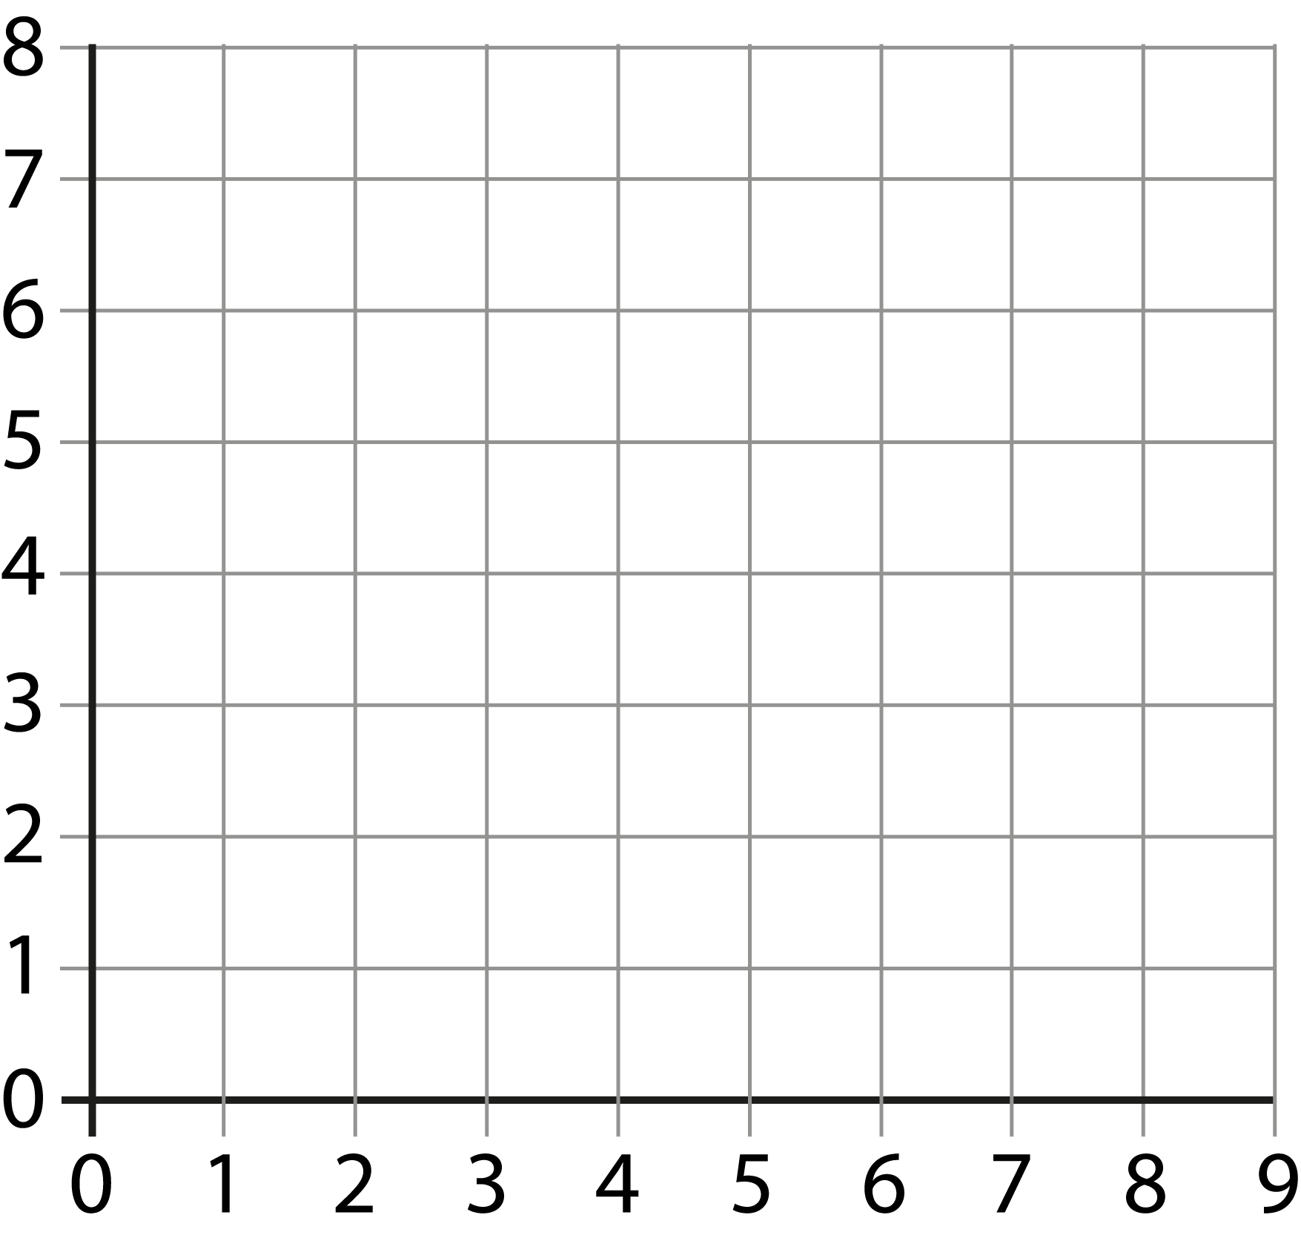


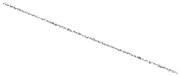
4G-1 Draw polygons specified by coordinates or by translation
(3,5) (5,6) (8,3)
Can you mark these three points on your axes? Now join the points with a ruler. What shape have you made?
What if the first point was changed to (5,3)?
If (1,1), (3,1) and (3,3) are the points of three vertices of a square, at which point would the fourth vertex be?
Repeat, providing lots of practice for children to mark and join specified coordinates.

Slide 24
Year 4, Unit 7, Learning Outcome 8
Learning Outcome 8
Pupils translate polygons in the first quadrant
The following slides have been collated to support the teaching of this learning outcome.

Slide 25
Year 4, Unit 7, Learning Outcome 8
Additional teacher guidance for this outcome should be read first and can be found in the DfE Mathematics guidance. Page references relate to the 335-page document available as a download at the bottom of this web page.
Ready to progress criteria | Pages
4G-1 | 194

Slide 26






4G-1 Draw polygons specified by coordinates or by translation
What do we call this shape? Can you describe how point A has moved to point B.
Now can you translate the three remaining points in the same way? When you join the translated points, what do you notice about the two shapes?
Is the new polygon any different to the original polygon?
What if point B was one square up, can you see straight away where the other vertices would need to be?
A
B

Slide 27
4G-1 Draw polygons specified by coordinates or by translation
Once children are familiar with translating polygons and describing the translation of polygons ask them to:
  mark a series of points and join them to make a polygon. Name the polygon they have drawn;
  translate the polygon and give the coordinates of the vertices of this new polygon.

Slide 28
Year 4, Unit 7

