Slide 1
Numberblocks
Support Materials
Series 2, Episode 5
Ten

Slide 2
Practitioner Notes

Slide 3
Episode Description
Numberblock Nine tells One he wishes he could get bigger - he always gets one smaller when he sneezes. One hops on top of Nine and they make Ten. One asks Ten why she has a ‘1’ and a ‘0’ on top and Ten starts singing, explaining that the ‘1’ means one Ten and she is a ten-block. She has ten blocks, just as One has one block, Two has two blocks, and so on. She sings about each character, and all the Numberblocks from One to Ten dance in turn and split apart to show how many blocks they have.

Slide 4
Maths in the Episode
Saying the counting numbers up to 10
Throughout this episode Ten counts from 1 to 10.
Equivalence of ten ones and one ten
This episode introduces a big idea that is fundamental to understanding our base 10 number system. Ten is both ten ones and also one ten. This incorporates the concept of unitising. Ten is both ten ones and one unit of ten. Young children need lots of experience of exchanging ten ones for one ten and recognising their equivalence (they have the same value). Notice that the gridlines marking Ten sometimes disappear, to mark the fact that she is one ten and plays a special role in other numbers that follow, e.g. 11 is one ten and one more.

Slide 5
Using Mathematical Language
Use these stem sentences to rehearse this principle:
“I can see 1, 2, 3, 4, 5, 6, 7, 8, 9, 10 (while pointing), ten balloons.”
As children begin to experience number equivalence of ten ones and one ten, they can use stem sentences of the form:
“Ten ones is the same as one ten”
or:
“One ten is the same as ten ones.”

Slide 6
Talk and Discuss Together

Slide 7
Talk and Discuss Together
Watch the episode of Numberblocks. First ask the children what they noticed and allow them to talk to you and each other. The following slides are designed to stimulate children and adults to talk about the episode and draw out some key aspects of the mathematics.

Slide 8
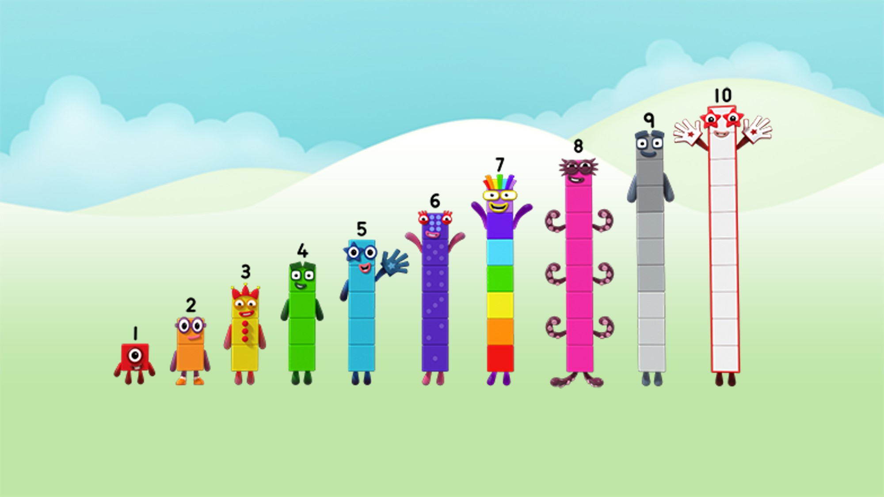
Images © 2017 Alphablocks Ltd. All Rights Reserved.
Notes:
Discuss the programme. What did you see? What did you like?
What is special about Ten?
Use this picture to practise saying the counting numbers in order from 1 to 10.
When you get to 5, high five with a friend. When you get to 10, clap your hands.
Practise saying the numbers in different voices and volumes.
Play musical tens
Hand out numbers or images of Numberblocks from 1-10. Move around the space. When the music stops get into a line 1-10. Check each group of 10 by shouting out: 1, 2 …

Slide 9
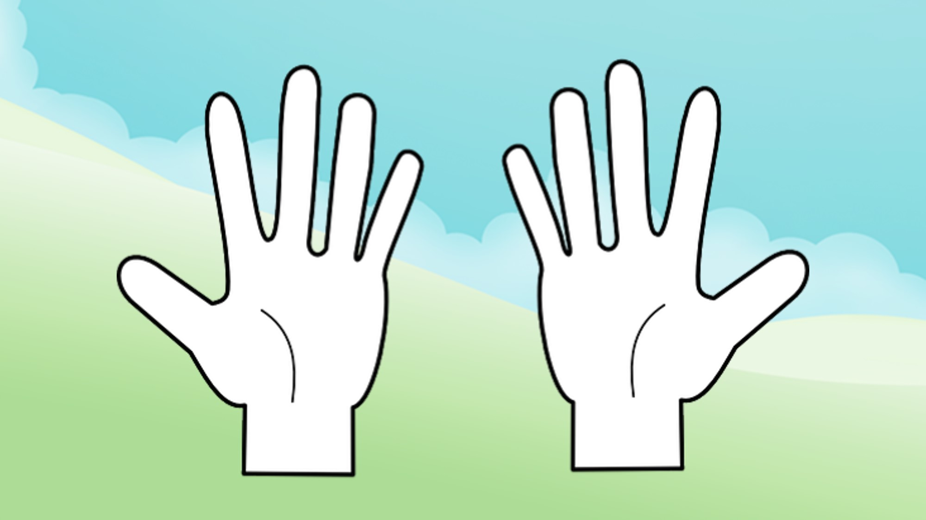
Images © 2017 Alphablocks Ltd. All Rights Reserved.
Notes:
Ask the children to look at their hands and count their fingers. How do you do this?
(Start with fingers down, then move fingers up; start with fingers up and move fingers down).
Which is easier?
What else do you have ten of (e.g. toes)?
Ask children to ‘throw’ you 10 without counting (opening both hands quickly)
Combine with a partner. Roll a dice marked 5, 6, 7, 8, 9, 10.
Make the numbers 5-10 using fingers from each hand. Each child can only use one hand.
Encourage children not to count the 5, as they already know there are five there. They can ‘count on’ the ones, or show the correct number of fingers if children can do this without counting (subitising).

Slide 10
Notes:
This slide considers the structure of 10 in a tens frame.
The slide is animated:
Click 1 shows five dots.
Click 2 shows ten dots.
Discuss what 5 looks like – only the top row is filled.
Discuss what 10 looks like – when the whole of the frame is filled: two groups of 5 make 10.
Now play the rest of the animation. When children see 10 they call ‘10 again’ and clap with two hands.
When children see only five cells filled they call ‘high five’ and hold up one hand.
For other amounts they call ‘no 10’.
Play the slide several times, gradually increasing the speed.

Slide 11
Enabling Environments

Slide 12
Enabling Environments
Playing and Exploring
Provide opportunities to bundle/group collections into 10s, e.g. straws, counters, coins etc. Describe the bundles/groups as one ten. Leave out some tens frame structures for children to fill with their groups of ten objects.
Active Learning
Notice how confidently children use the principles of counting for quantities up to ten during their play, and recheck when they are not sure.
Creating and Thinking Critically
Provide opportunities to draw around hands (including fingers) and feet (including toes). Children can paint or finger print to represent the colours of each number block for each respective finger.

Slide 13
Learning Together in Y1

Slide 14
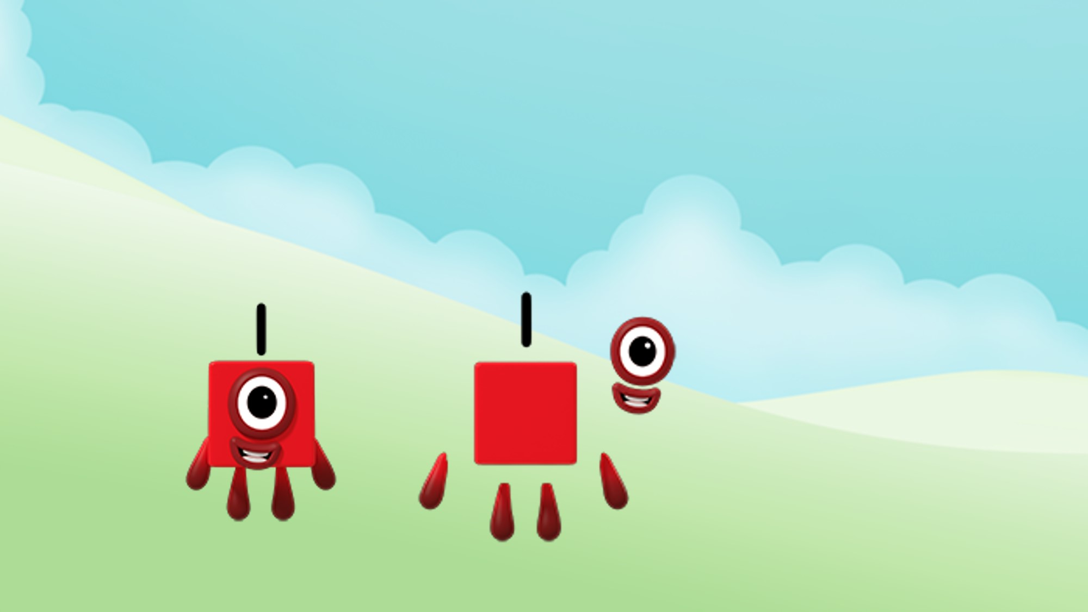
One is made from 1 one.
Images © 2017 Alphablocks Ltd. All Rights Reserved.
Notes:
Use slides 14-23 to discuss what the children notice. Discuss how each number is separated into ones and how many ones for each number, from 1 to 10.
Each slide has an animation:
Click 1 reveals the speech bubble. Read together for each slide. The children may pick up on the rhythmic pattern and notice what stays the same and what changes.

Slide 15
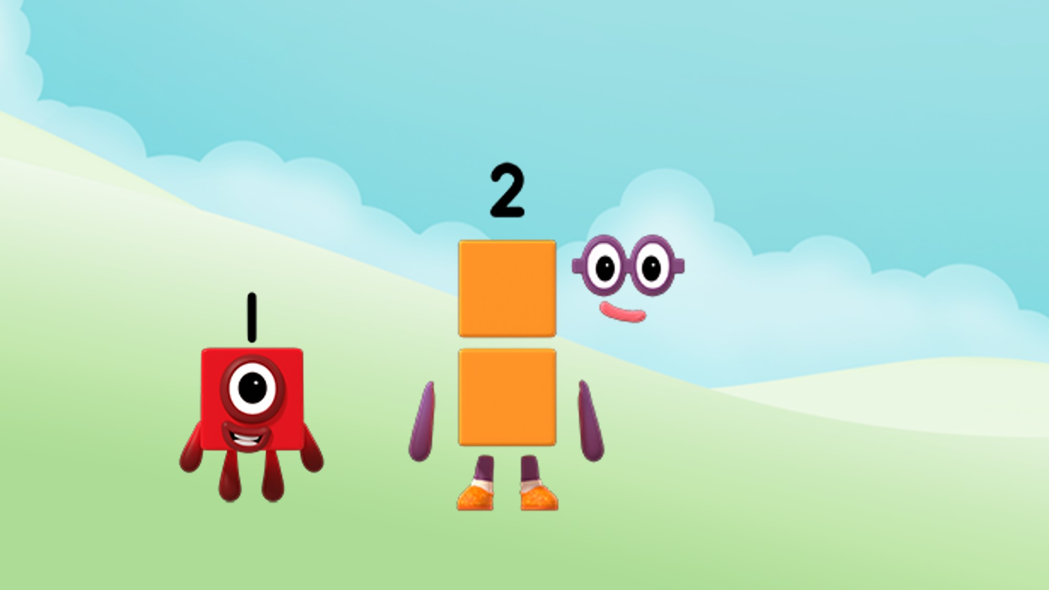
Two is made from 2 ones.
Images © 2017 Alphablocks Ltd. All Rights Reserved.
Notes:
Use slides 14-23 to discuss what the children notice. Discuss how each number is separated into ones and how many ones for each number, from 1 to 10.
Each slide has an animation:
Click 1 reveals the speech bubble. Read together for each slide. The children may pick up on the rhythmic pattern and notice what stays the same and what changes.

Slide 16
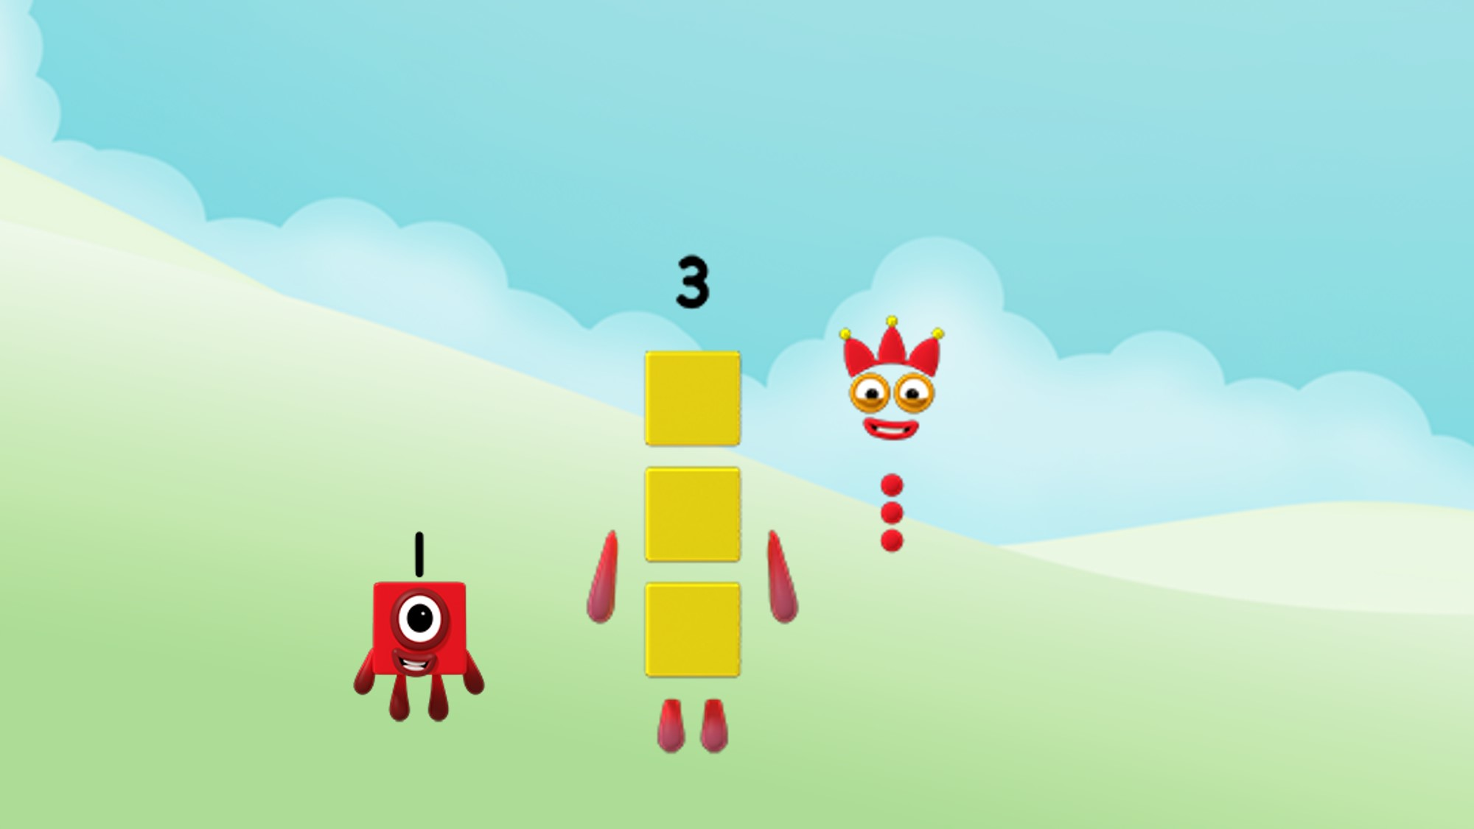
Three is made from 3 ones.
Images © 2017 Alphablocks Ltd. All Rights Reserved.
Notes:
Use slides 14-23 to discuss what the children notice. Discuss how each number is separated into ones and how many ones for each number, from 1 to 10.
Each slide has an animation:
Click 1: reveals the speech bubble. Read together for each slide. The children may pick up on the rhythmic pattern and notice what stays the same and what changes.

Slide 17
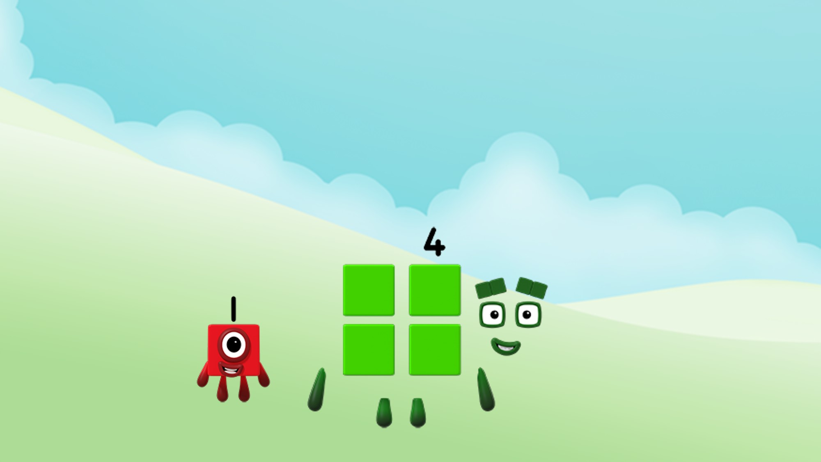
Four is made from 4 ones.
Images © 2017 Alphablocks Ltd. All Rights Reserved.
Notes:
Use slides 14-23 to discuss what the children notice. Discuss how each number is separated into ones and how many ones for each number, from 1 to 10.
Each slide has an animation:
Click 1 reveals the speech bubble. Read together for each slide. The children may pick up on the rhythmic pattern and notice what stays the same and what changes.

Slide 18
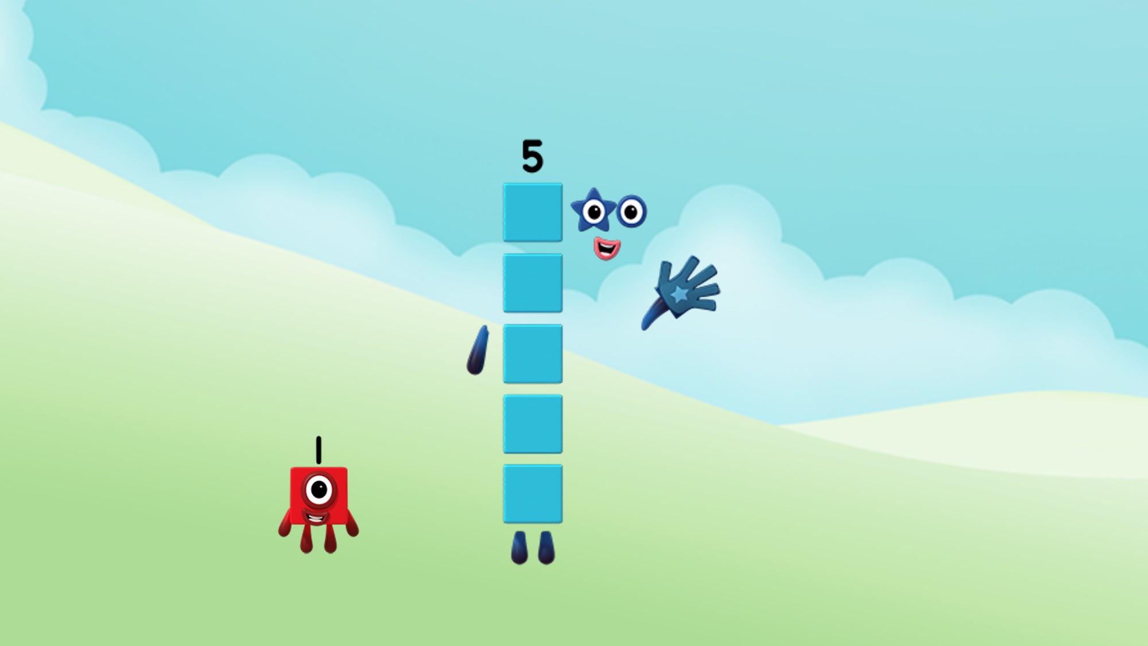
Five is made from 5 ones.
Images © 2017 Alphablocks Ltd. All Rights Reserved.
Notes:
Use slides 14-23 to discuss what the children notice. Discuss how each number is separated into ones and how many ones for each number, from 1 to 10.
Each slide has an animation:
Click 1 reveals the speech bubble. Read together for each slide. The children may pick up on the rhythmic pattern and notice what stays the same and what changes.

Slide 19
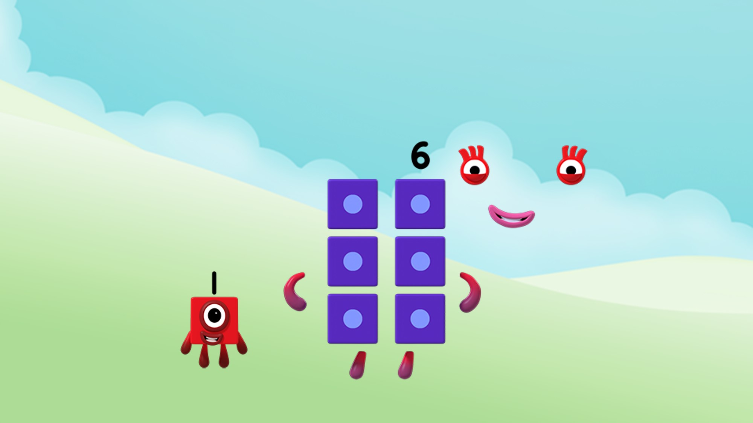
Six is made from 6 ones.
Images © 2017 Alphablocks Ltd. All Rights Reserved.
Notes:
Use slides 14-23 to discuss what the children notice. Discuss how each number is separated into ones and how many ones for each number, from 1 to 10.
Each slide has an animation:
Click 1 reveals the speech bubble. Read together for each slide. The children may pick up on the rhythmic pattern and notice what stays the same and what changes.

Slide 20
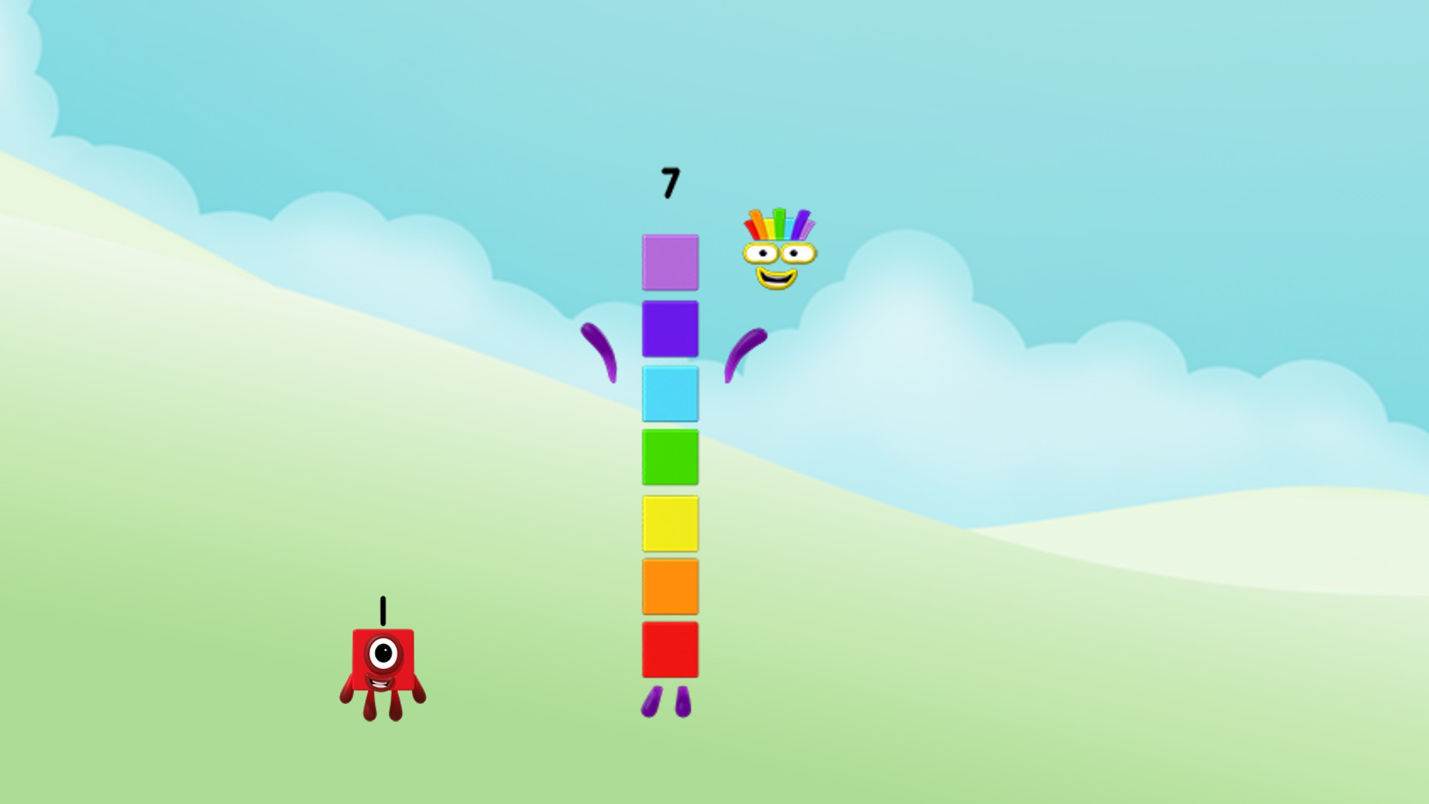
Seven is made from 7 ones.
Images © 2017 Alphablocks Ltd. All Rights Reserved.
Notes:
Use slides 14-23 to discuss what the children notice. Discuss how each number is separated into ones and how many ones for each number, from 1 to 10.
Each slide has an animation:
Click 1 reveals the speech bubble. Read together for each slide. The children may pick up on the rhythmic pattern and notice what stays the same and what changes.

Slide 21
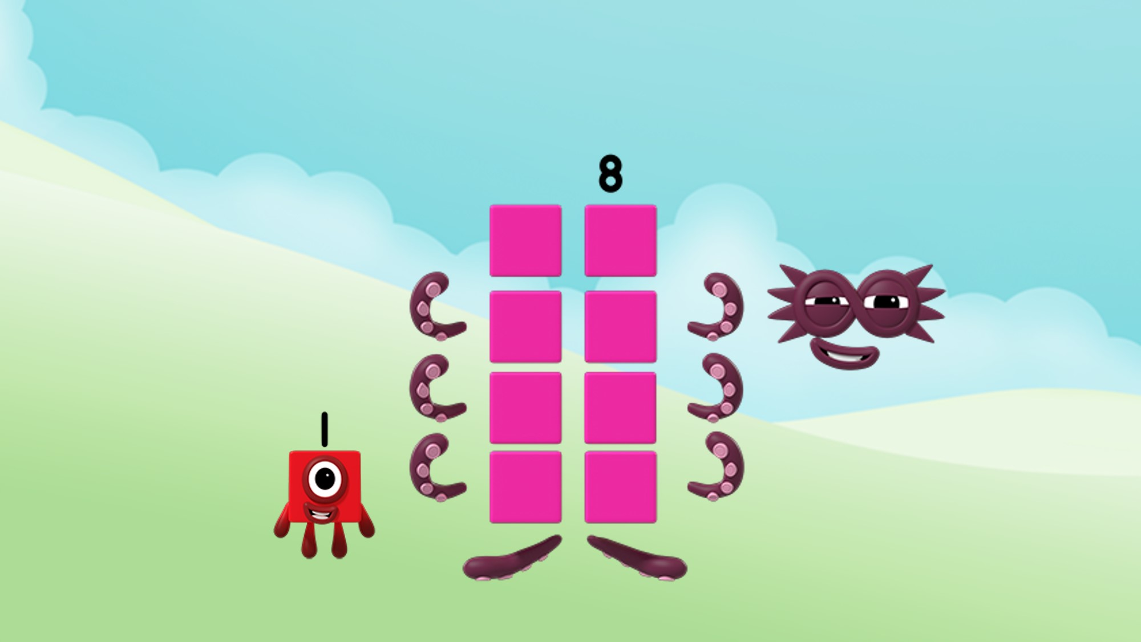
Eight is made from 8 ones.
Images © 2017 Alphablocks Ltd. All Rights Reserved.
Notes:
Use slides 14-23 to discuss what the children notice. Discuss how each number is separated into ones and how many ones for each number, from 1 to 10.
Each slide has an animation:
Click 1 reveals the speech bubble. Read together for each slide. The children may pick up on the rhythmic pattern and notice what stays the same and what changes.

Slide 22
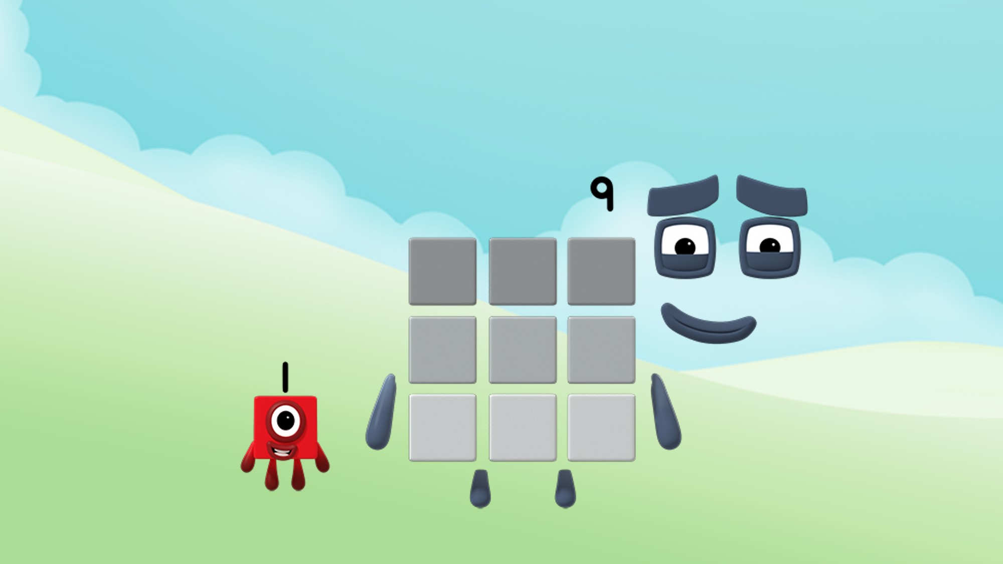
Nine is made from 9 ones.
Images © 2017 Alphablocks Ltd. All Rights Reserved.
Notes:
Use slides 14-23 to discuss what the children notice. Discuss how each number is separated into ones and how many ones for each number, from 1 to 10.
Each slide has an animation:
Click 1 reveals the speech bubble. Read together for each slide. The children may pick up on the rhythmic pattern and notice what stays the same and what changes.

Slide 23
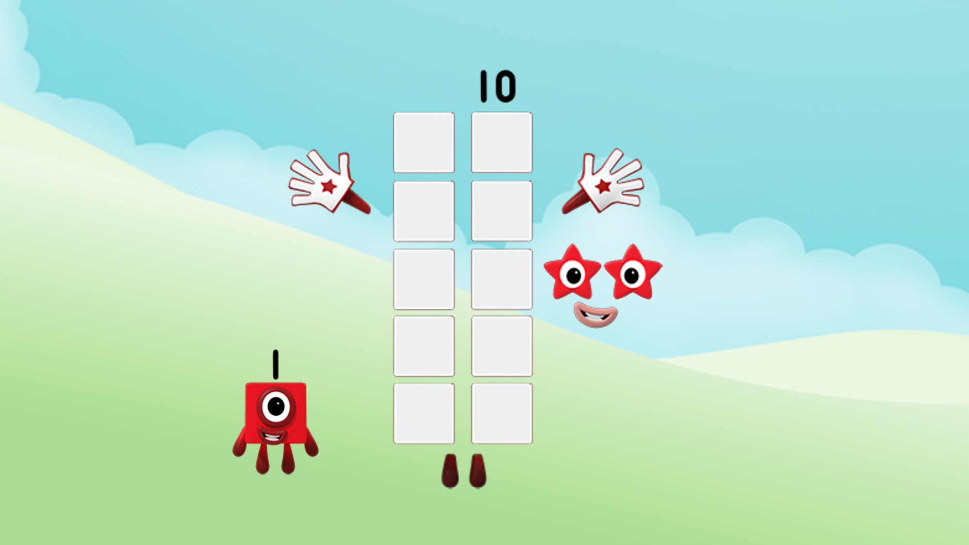
Ten is made from 10 ones.
Images © 2017 Alphablocks Ltd. All Rights Reserved.
Notes:
Use slides 14-23 to discuss what the children notice. Discuss how each number is separated into ones and how many ones for each number, from 1 to 10.
Each slide has an animation:
Click 1 reveals the speech bubble. Read together for each slide. The children may pick up on the rhythmic pattern and notice what stays the same and what changes.

Slide 24
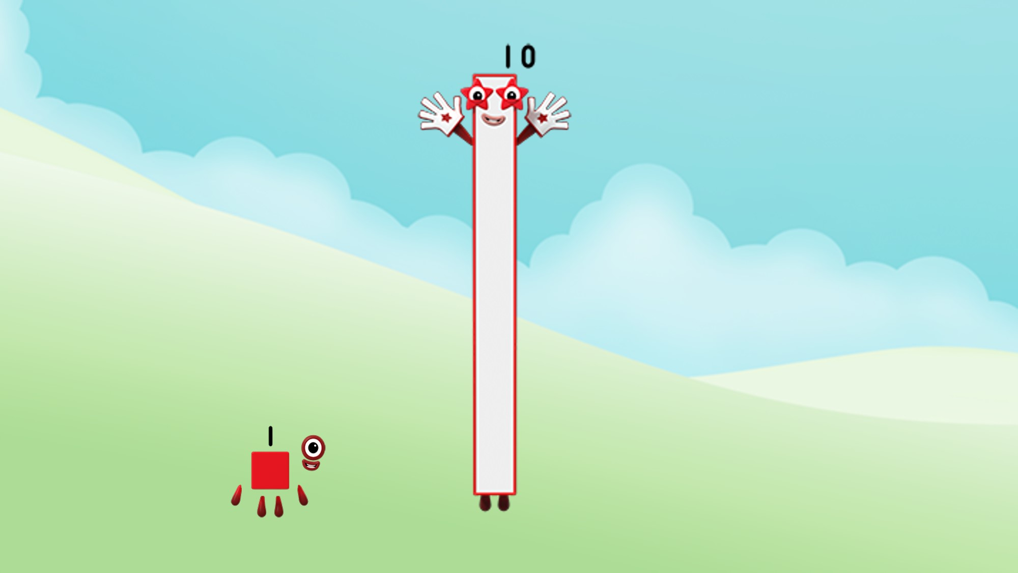
Ten is made from 1 Ten.
One is made from 1 One.
Images © 2017 Alphablocks Ltd. All Rights Reserved.
Notes:
Use this slide to focus on the importance of the position of 1 in both numbers.
What’s the same? They both have a 1 digit in their number. They both have a red outline. Same number of arms and legs (not important for the number sense but children will comment).
What’s different? Ten has a zero as well. The zero keeps the one in the right place (next to 0) to indicate/mean one ten. This image of Ten also does not have the demarcated blocks so that the children can observe a single long block.
This slide is animated:
Click 1: One’s speech bubble appears. Read aloud together.
Click 2: Ten’s speech bubble appears. Read aloud together. What’s the same, what’s different about these sentences?

Slide 25
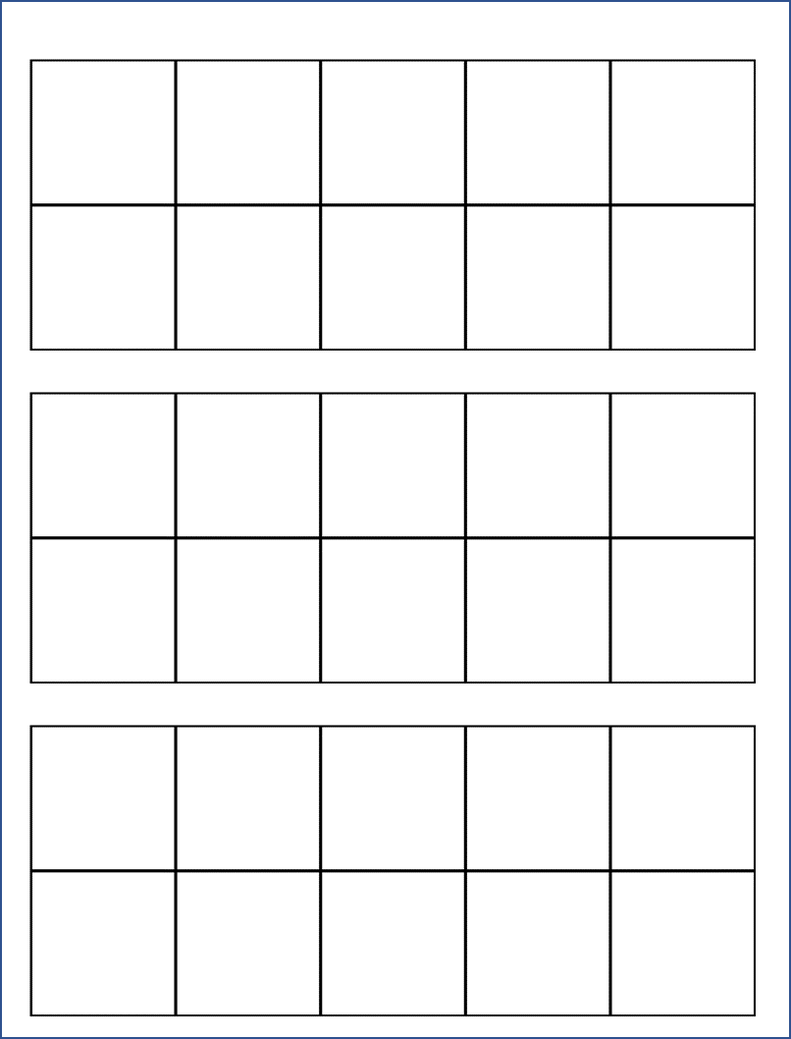
Player 1
Player 2
Notes:
The game is animated to illustrate the rules.
Click to start the animation before explaining the rules.
Watch the animation and try and work out what the rules are. Ask the children to discuss in pairs what to do to play the game.
Encourage the children to explain:
“You exchange the ten ones for one yellow. The yellow represents 10.”

Slide 26
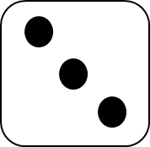
Game: Ten Ones for One Ten
2 players
You need:
1 dice (1-6)
1 baseboard each
Red counters.
Yellow counters.
Notes:
Play this game to practise exchanging ten ones for one ten.
Rules:
Player 1 rolls the dice and lays the number of counters on their tens frame in red.
Player 2 rolls the dice and lays the number of counters on a tens frame.
Keep playing until a tens frame is filled. Remove red counters and place a yellow counter next to the empty tens frame.
Winner is the first person to have three yellow counters.

Slide 27
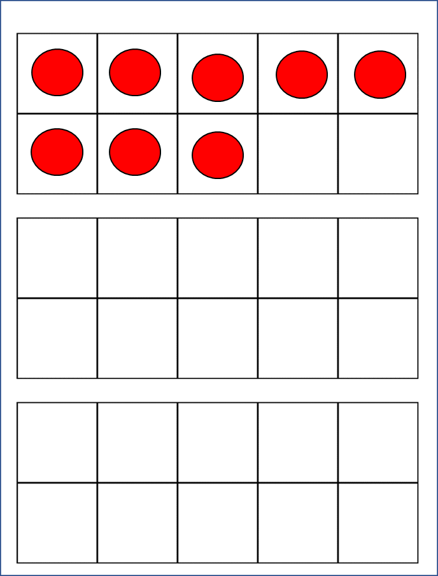
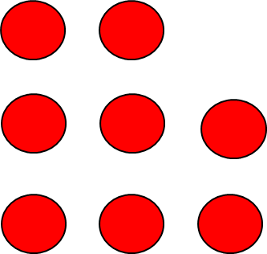
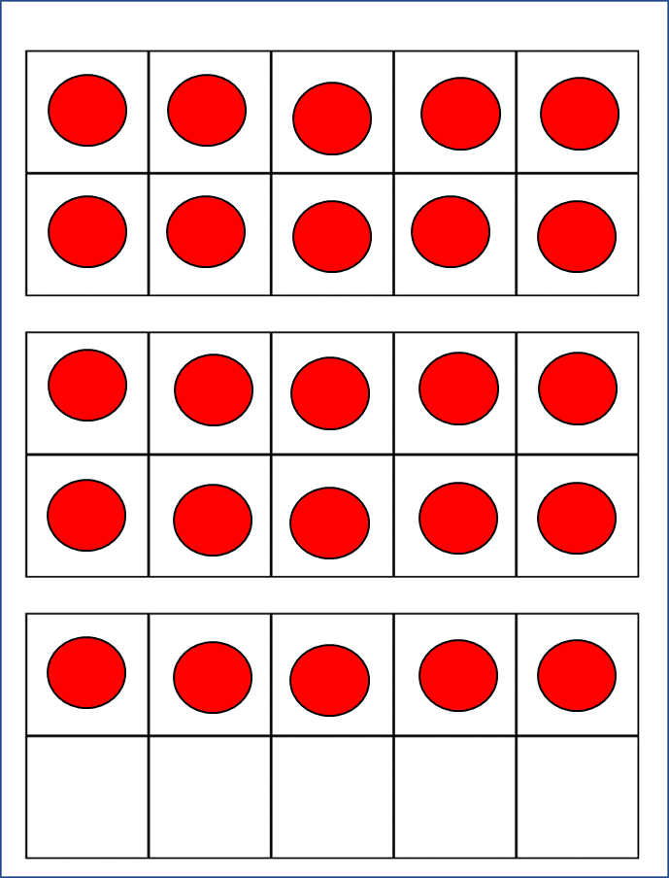
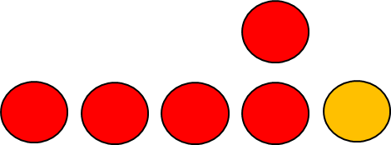
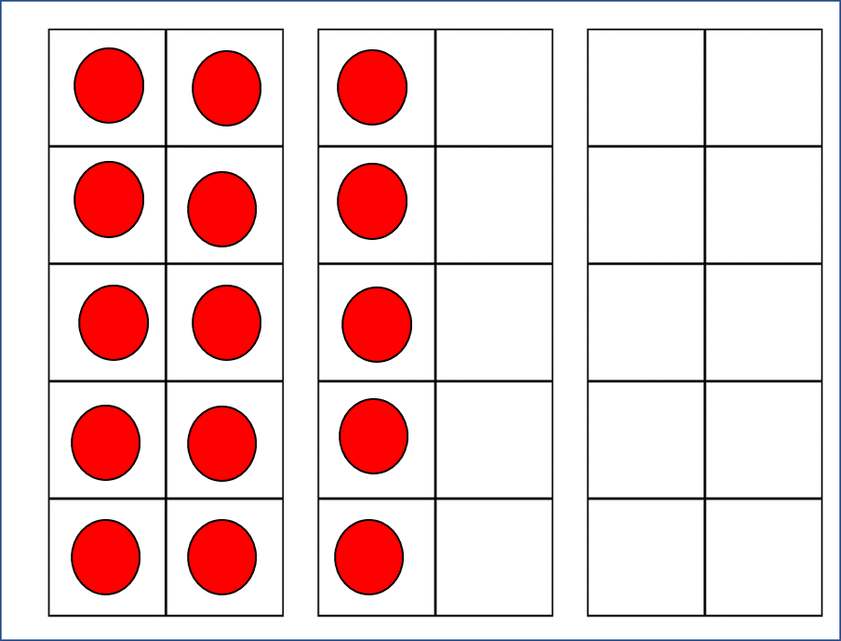
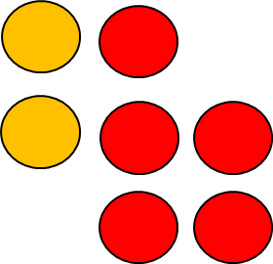
(a)
Player 2
Click a, b and c in turn to reveal answer
(b)
Player 3
Player 4
(c)
Notes:
Use this slide to challenge thinking following on from playing the game.
What do you notice? Spend time drawing out features of the tens frame. There is no need to talk about the quantities of red counters other than describing 10s (completed tens frames) and subitising the counters less than 10.
This slide is animated:
Can you match the tens frames to the players? Ask the children to decide which tens frame (a, b or c) matches which player.

