Slide 1
1.15 Addition: two-digit and two-digit numbers
Representations | Year 2
Number, Addition and Subtraction

Slide 2
How to use this presentation
You can find the teacher guide 1.15 Addition: two-digit and
two-digit numbers by following the link below.

Slide 3
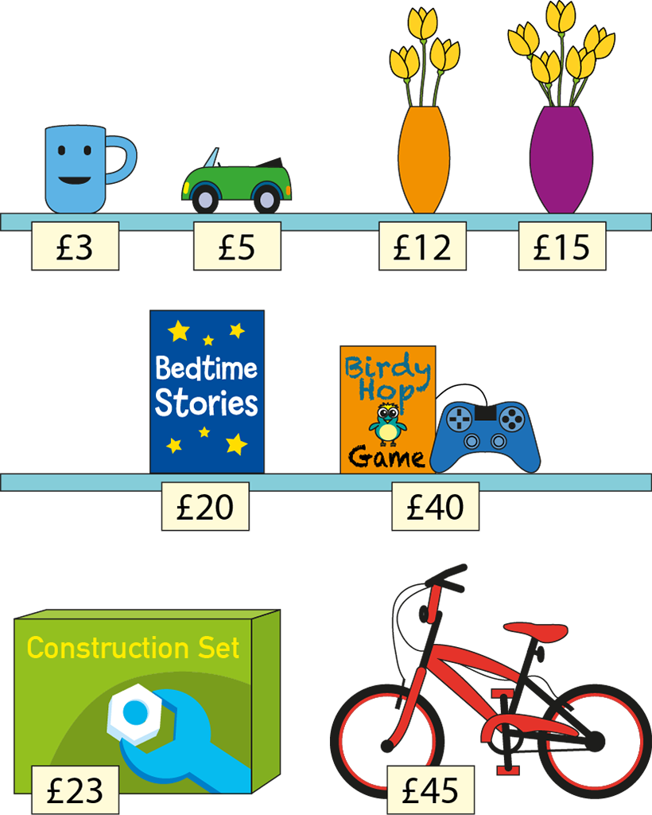
1.15 Addition: two-digit + two-digit – step 1:1

Slide 4


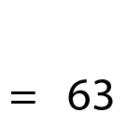

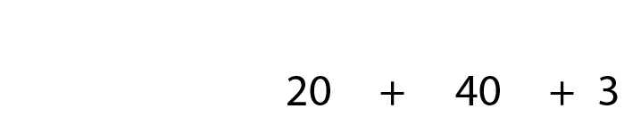

1.15 Addition: two-digit + two-digit – step 1:1
= £63

Slide 5
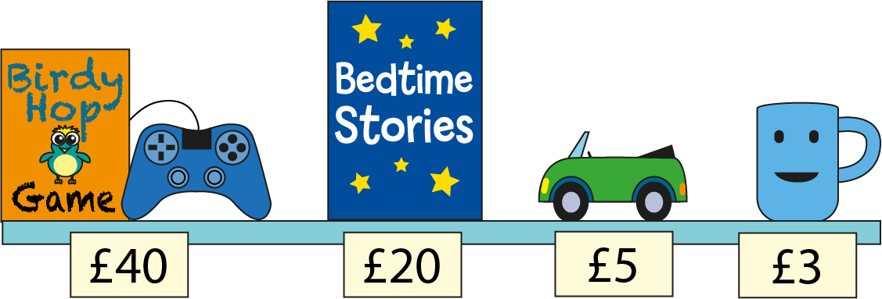


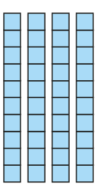











1.15 Addition: two-digit + two-digit – step 1:2
= £68

Slide 6









1.15 Addition: two-digit + two-digit – step 1:2
= £68

Slide 7











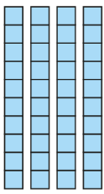






1.15 Addition: two-digit + two-digit – step 1:2
= £68

Slide 8








1.15 Addition: two-digit + two-digit – step 1:2
= £68

Slide 9
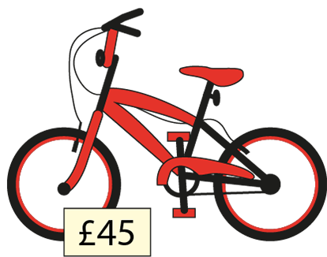
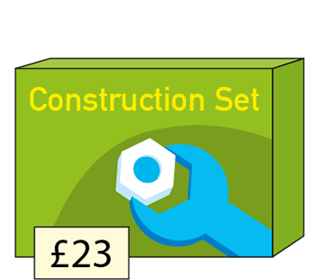
1.15 Addition: two-digit + two-digit – step 2:1
40 + 5 + 20 + 3
45 + 23

Slide 10






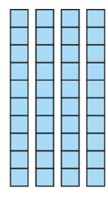










1.15 Addition: two-digit + two-digit – step 2:1
= £68

Slide 11



1.15 Addition: two-digit + two-digit – step 2:1
= £68

Slide 12






1.15 Addition: two-digit + two-digit – step 2:2

Slide 13
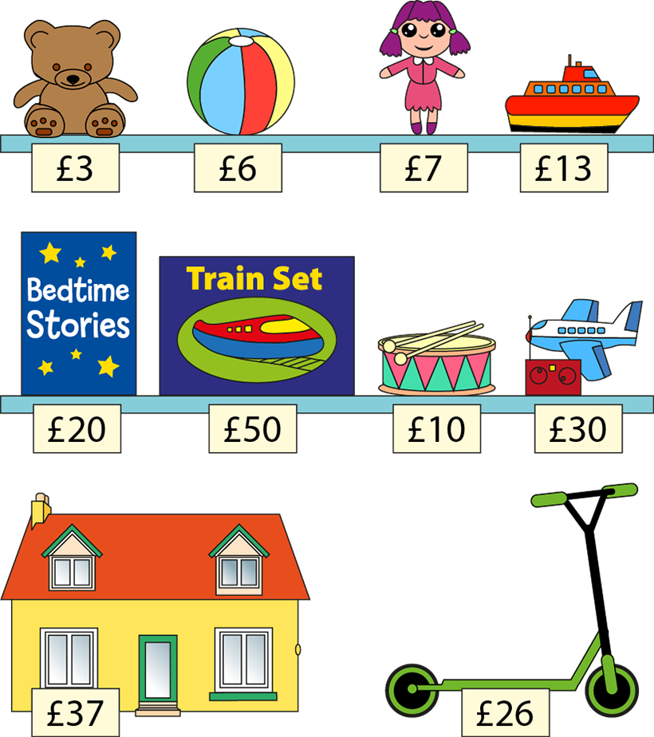
1.15 Addition: two-digit + two-digit – step 2:4

Slide 14
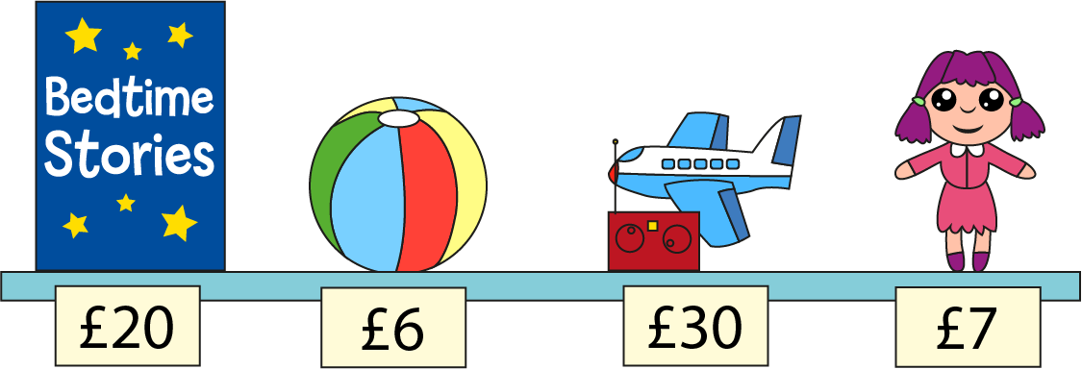








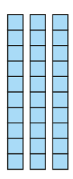


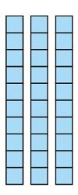








1.15 Addition: two-digit + two-digit – step 2:4
= £63

Slide 15
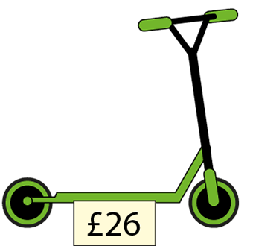
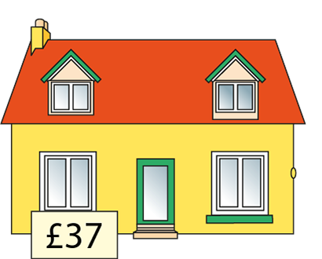
1.15 Addition: two-digit + two-digit – step 2:5
20 + 6 + 30 + 7
26 + 37

Slide 16










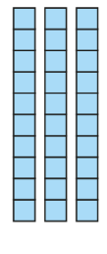




1.15 Addition: two-digit + two-digit – step 2:5
= £63

Slide 17



1.15 Addition: two-digit + two-digit – step 2:5
= £63

Slide 18

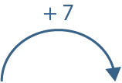



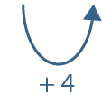

1.15 Addition: two-digit + two-digit – step 2:6
26 + 37 =
26 + 30 + 7
= 63

Slide 19








1.15 Addition: two-digit + two-digit – step 2:7

Slide 20
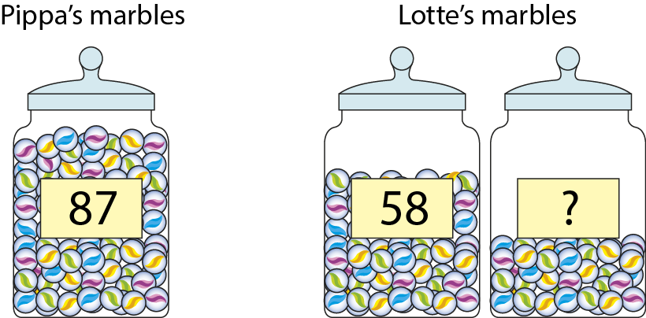
1.15 Addition: two-digit + two-digit – step 2:8
Notes:
Pippa has eighty-seven marbles. Lotte has fewer marbles than Pippa. In one jar Lotte has fifty-eight marbles. What is the maximum number of marbles Lotte could have in the second jar?

