Slide 1
Series 3 Episode 5
Zero

Slide 2
Practitioner Notes

Slide 3
Episode Description
When there's nothing there to count and none is the amount, nobody does it better than Zero. Learn all about the number zero with Numberblock Zero.

Slide 4
Maths in the Episode
The value of zero
‘Zero’ is a way of representing ‘nothing’. In this episode nothing is introduced in multiple ways: what is left when 1 is taken from 1, when a container is empty, when you can’t see something that should be in view and when there is none of something left. Although Zero has no blocks, he does have a numberling: 0.

Slide 5
Using Mathematical Language
Use these stem sentences to rehearse the mathematical ideas in the programme:
“There are no < > left.”
“There are none left.”
“There is nothing there.”
Notes:
< > indicates what can be changed in the stem sentence.

Slide 6
Talk and Discuss Together

Slide 7
Talk and Discuss Together
Watch the episode of Numberblocks. Use the following pictures as a stimulus. First ask the children what they noticed in the programme and allow them to talk to you and each other.
Zero is a Numberblock without a block. In the pictures (in slides 8 and 9) what can you have none of? (Use your imagination).
The following slides are designed to stimulate children and adults to talk about the episode and draw out some key aspects of the mathematics.

Slide 8
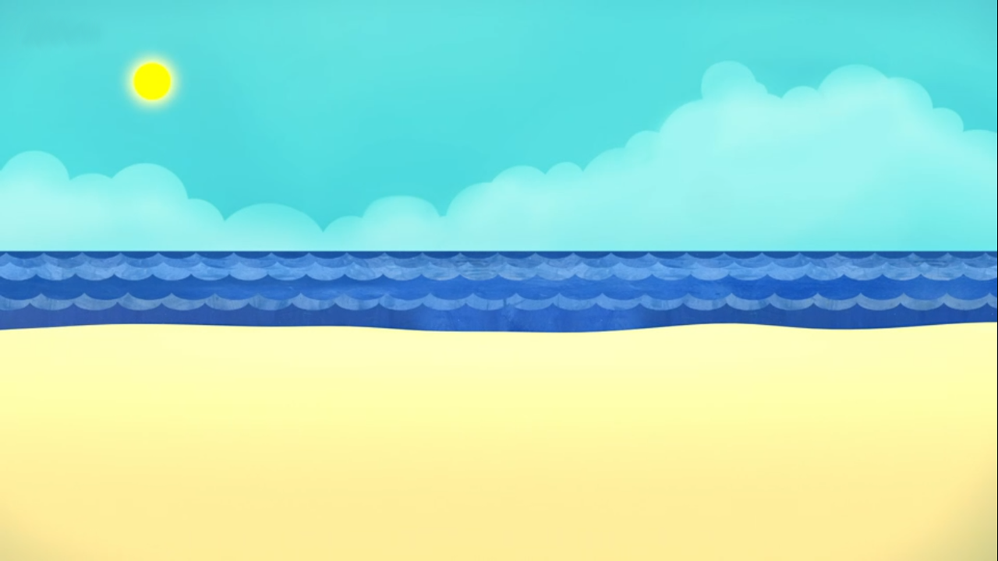
Images © 2017 Alphablocks Ltd. All Rights Reserved.
Notes:
Use this picture as the stimulus for Talk and Discussion (slide 7).

Slide 9
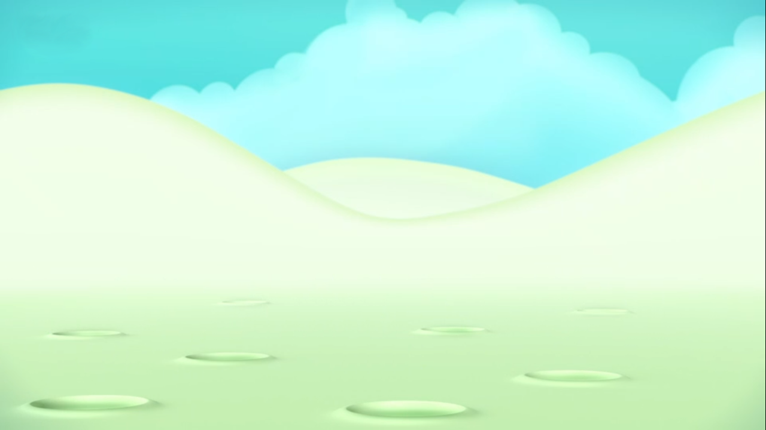
Images © 2017 Alphablocks Ltd. All Rights Reserved.
Notes:
Use this picture as the stimulus for Talk and Discussion (slide 7).

Slide 10
Enabling Environments in Reception

Slide 11
Enabling Environments
Playing and Exploring
Play hide and seek. When everyone is hiding there is no-one there. When you look behind something but no-one is there.
Active Learning
In the sand or water area encourage the children to describe whether their containers are full, part-full or empty. This container has sand in it. This container is empty. There is nothing in it.
Creating and Thinking Critically
Pass round a plate with 10 objects (biscuits/pieces of fruit), each child takes one and the group count backwards. When the plate is empty, shout ‘Zero!’

Slide 12
Learning Together in Y1

Slide 13
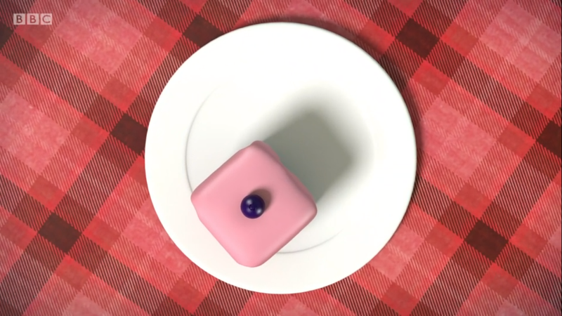
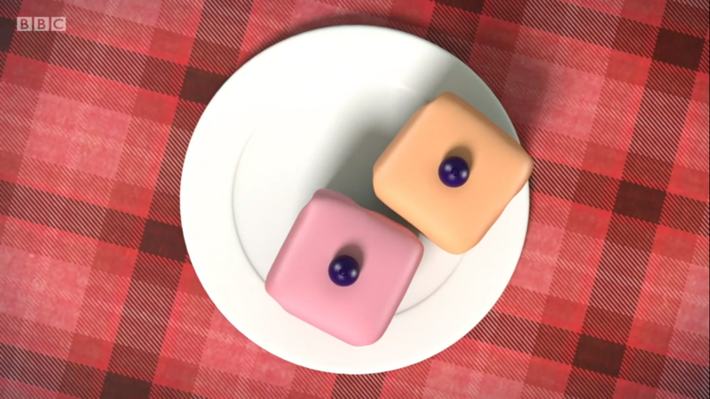
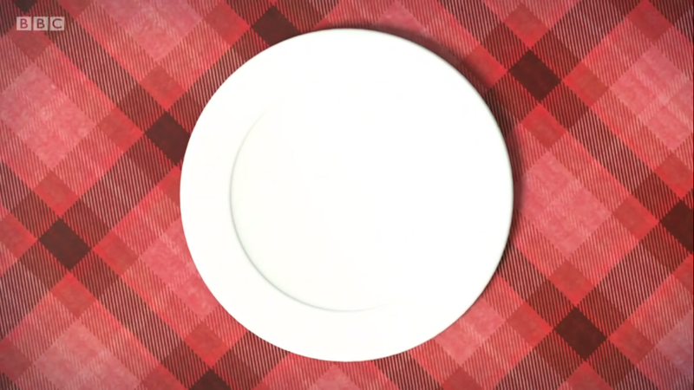
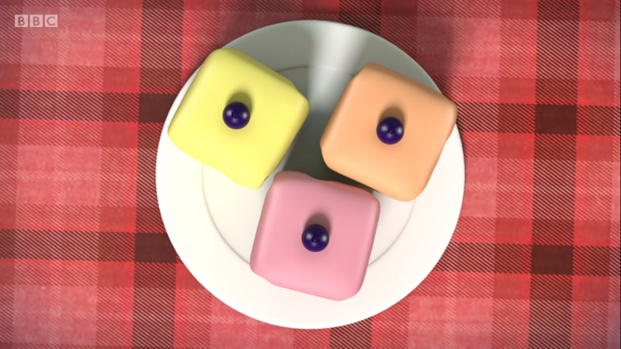
Images © 2017 Alphablocks Ltd. All Rights Reserved.
Notes:
Use these pictures to discuss what is the same and what is different about them.
Using the picture cards from the next slide (14), ask the children to work in pairs or small groups to put the plates in order in a line.

Slide 14
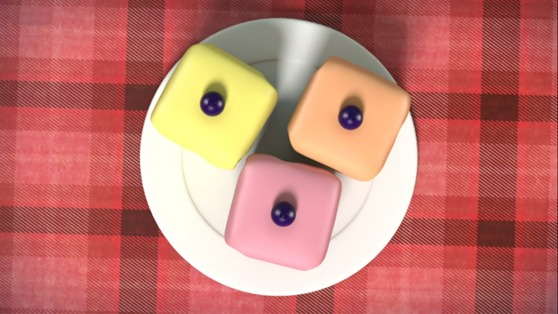
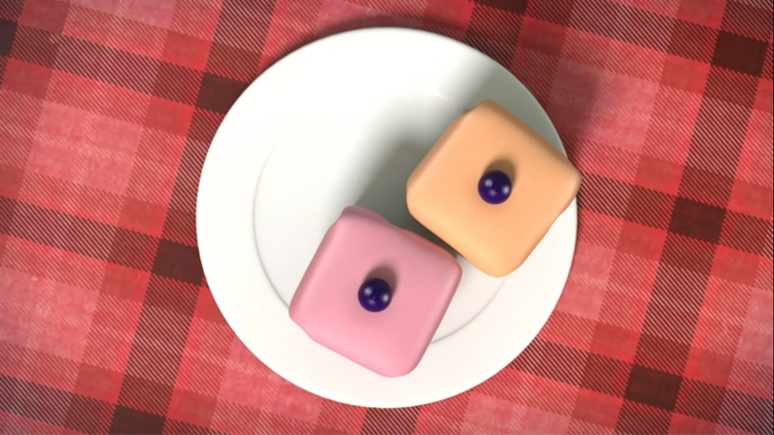
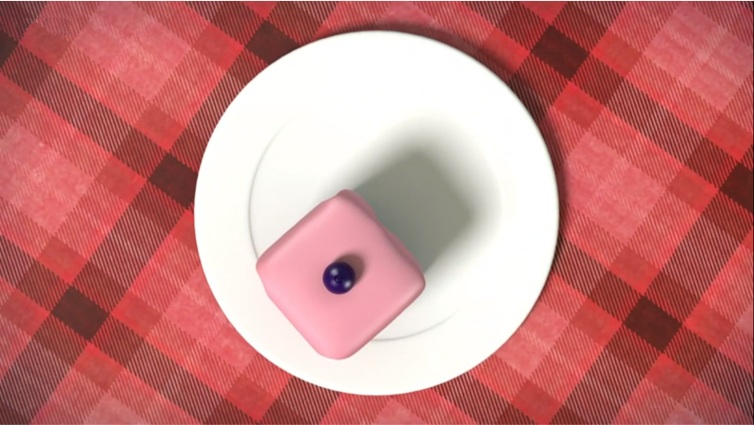
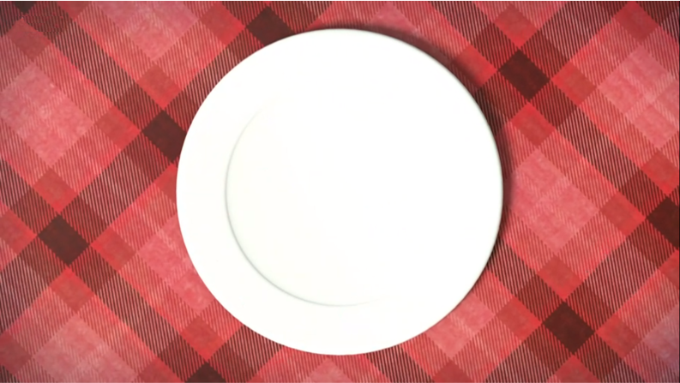
Images © 2017 Alphablocks Ltd. All Rights Reserved.
Notes:
Hidden slide.
Print off, cut along dotted line and give to a group of children to order. See slide 13 notes.

Slide 15
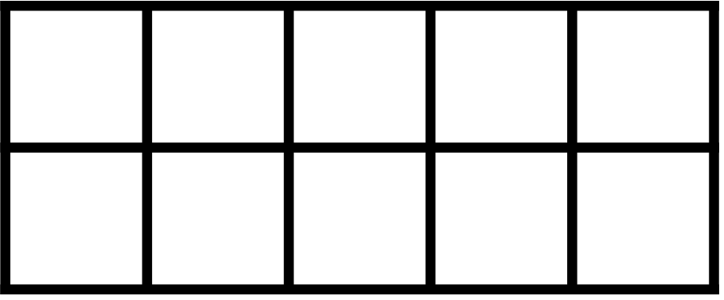
Images © 2017 Alphablocks Ltd. All Rights Reserved.
Notes:
Use this slide to see what zero looks like on the familiar representation of a tens frame.
Use the pictures ordered by the children and the class ten frame.
How can we make our tens frame match our pictures? What do we need to put on the tens frame to represent zero? Nothing!

Slide 16




Images © 2017 Alphablocks Ltd. All Rights Reserved.
Notes:
Use this slide to allow for discussion about where zero is placed on the number line.
What do you notice about the line? It has divisions along it.
How many divisions does it have? Four.
What numbers can you see at the top of the picture? Do you think they are in the right order? Where do the numbers need to go so that the number line matches the number of counters on the tens frames?

Slide 17
Further activities for Y1
Pass a bowl of counters/ pieces of fruit/ cubes around. Each person takes one out. There are 6 cubes in the bowl: who will be the last person to get one? Who will get none?
Play a race-to-0 game. Put 10 counters on a tens frame. Roll a dice. Remove that number of counters. Take turns until the first person gets to zero. (If you have 2 counters left you must roll a 2 to win).
Draw a large number line on the playground with chalk. Ask children to help you decide where to write zero. Use a toy to make the correct number of jumps along the line after rolling a dice. Whose toy will land on zero? See if children can work in partners to roll a dice and tell their friend to make that number of jumps along the line. Who arrives exactly on zero first? Look for children who can start to predict that if they are on three, they need to roll a 3 on the dice to make three jumps to land on zero.

