Slide 1
Proving the interior angle sum of a triangle
KS3 Mastery PD Materials: Exemplified Key Ideas
Materials for use in the classroom or to support professional development discussions
(from 6.1 Geometrical properties)
Summer 2021

Slide 2
About this resource
These slides are designed to complement the 6.1 Geometrical properties Core Concept document and its associated Theme Overview document 6 Geometry, both found in the Secondary Mastery Professional Development pages.
These slides re-present the key examples from the Core Concept document so that the examples can be used either directly in the classroom or with a group of teachers. There are prompt questions alongside the examples, and further clarification in the notes.
These slides do not fully replicate the Core Concept document, so should be used alongside it. Reference to specific page numbers, and to other useful NCETM resources, can be found in the notes for each slide.
This slide deck is not designed to be a complete PD session, rather it is a selection of resources that you can adapt and use as needed when planning a session with a group of teachers.

Slide 3


About this resource
The slides are structured as follows:
  The big picture:
    Where does this fit in?
    What do students need to understand?
    Why is this key idea important?
  Prior learning
  Misconceptions
  Exemplified key ideas
  Reflection questions
  Appendices:
    Key vocabulary
    Representations and structure
    Future learning
    Useful links
The exemplified key idea slides have the following symbols to indicate how they have been designed to be used:
Into the classroom
The examples are presented on these slides so that they could be used in PD, but also directly in the classroom. The notes feature suggested questions and things teachers might consider when using with students.
PD discussion prompts
These slides look at the examples in more detail, with question prompts to promote discussion among maths teachers. The notes feature reference to further information and guidance within the Core Concepts document.

Slide 4
Where does this fit in?
The NCETM has identified a set of six ‘mathematical themes’ within Key Stage 3 mathematics that bring together a group of ‘core concepts’.
The sixth of these themes is Geometry, which covers the following interconnected core concepts:
6.1 Geometrical properties
6.2 Perimeter, area and volume
6.3 Transforming shapes
6.4 Constructions
Notes:
Linked on this slide is the Theme Overview document of Geometry. This document includes why it is important, the key underpinning knowledge and links to prior and future learning. There is also guidance about how the five big ideas of Teaching for Mastery relate specifically to this theme.

Slide 5
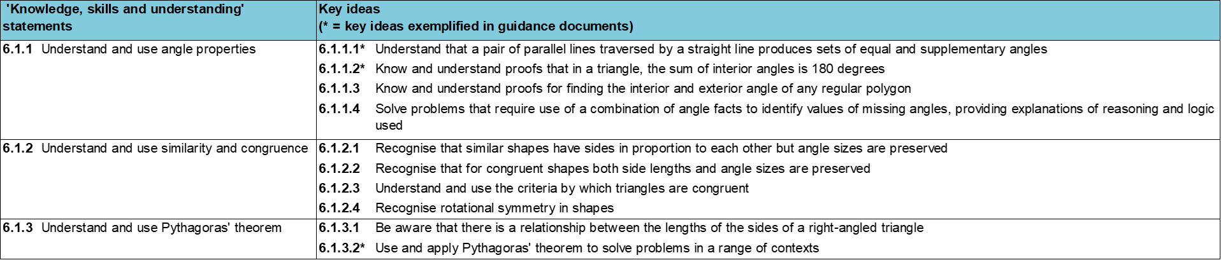
Where does this fit in?
Within this core concept, 6.1 Geometrical properties, there are three statements of knowledge, skills and understanding.
These, in turn, are broken down into ten key ideas. The highlighted key idea is exemplified in this slide deck.
Notes:
For key ideas marked with an asterisk, we exemplified the common difficulties and misconceptions that students might have and included elements of what teaching for mastery may look like. We have provided examples of possible student tasks and teaching approaches.
Within these slides are ‘classroom-ready’ versions of the examples for the key idea that has been highlighted. There are also slides that may be useful for discussion in a professional development session

Slide 6
What do students need to understand?
6.1.1.2 Know and understand proofs that in a triangle, the sum of interior angles is 180 degrees
Appreciate the difference between a demonstration and a proof.
Understand that the angle sum of a triangle result is built from existing knowledge of angle facts.
Appreciate different proofs of the same result.
  What prior knowledge might your students already have?
  What language might they use to describe this key idea?
  What questions might you want to ask to assess their prior learning?

Slide 7
Why is this key idea important?
A 2001 report* about the teaching and learning of geometry from 11–19 set out a number of objectives for a well-taught geometry curriculum, notably:
  to develop spatial awareness, geometrical intuition and the ability to visualise
  to encourage the development and use of conjecture, deductive reasoning and proof.
The geometry of intersecting lines and the connections and deductions that can be made from diagrams, provide rich opportunities in which students can be encouraged to build logical, deductive arguments. Students develop a narrative, connecting and combining known facts in order to generate further mathematical truths.
*The Royal Society / Joint Mathematical Council working group, 2001: xii, 7
Notes:
A more detailed overview of the core concept of Geometrical properties can be found on pages 8-11 of the 6.1 Core Concept document.
The background to each key idea is also explored in more detail on the following pages:
6.1.1 Understand and use angle properties – page 8
6.1.2 Understand and use similarity and congruence – page 9
6.1.3 Understand and use Pythagoras’ theorem – pages 9-11

Slide 8
Prior learning
Upper Key Stage 2 Learning Outcome
Recognise angles where they meet at a point, are on a straight line, or are vertically opposite, and find missing angles
Compare and classify geometric shapes based on their properties and sizes and find unknown angles in any triangles, quadrilaterals, and regular polygons
Solve problems involving similar shapes where the scale factor is known or can be found
  What prior knowledge might your students already have?
  What language might they use to describe this key idea?
  What questions might you want to ask to assess their prior learning?
Notes:
You may find it useful to speak to your partner schools to see how the above has been covered and the language used.
You can find further details regarding prior learning in the following segments of the NCETM primary mastery professional development materials (linked on final slide):
Year 6: 2.27 Scale factors, ratio and proportional reasoning
Within the Geometry Theme Overview document, you can also find a broader description of students’ potential previous learning (page 3), alongside further information about key underpinning knowledge (page 2).

Slide 9
Prior learning
Key Stage 3 Learning Outcome
1.4.1 Understand and use the conventions and vocabulary of algebra including forming and interpreting algebraic expressions and equations
  What representations might your students already be familiar with?
  What language might they use?
  How does this fit in with your curriculum progression?

Slide 10
Checking prior learning
The following slides contain questions for checking prior learning.
  What representations might students use to support their understanding of these questions?
  What variation might you put in place for these questions to fully assess students’ understanding of the concept?
  How might changing the language of each question change the difficulty?
  Why are these such crucial pre-requisites for this key idea?

Slide 11
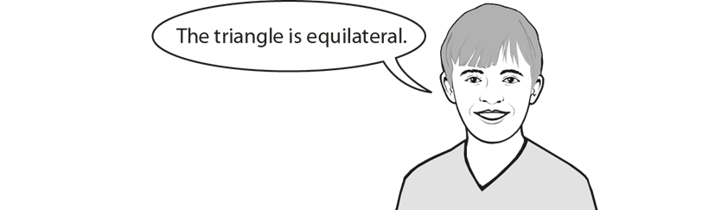
Checking prior learning
a)
Two of the angles in a triangle are 70° and 40°
Jack says,
Explain why Jack is not correct.
Notes:
References to the questions (links on final slide):
a) 2018 Key Stage 2 Mathematics Paper 3: reasoning, Question 14

Slide 12
Common difficulties and misconceptions
What aspects of this key idea might students find challenging?
What misconceptions might students have?
When teaching this topic, you may find students encounter difficulties with…
Students often confuse a demonstration for a proof
More information, and some suggestions for overcoming these challenges, can be found on the following slides

Slide 13
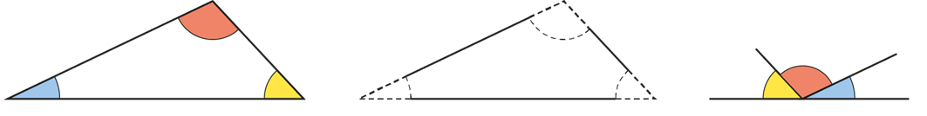
Common difficulties and misconceptions
Students often confuse a demonstration for a proof. In KS2, students learnt that the sum of the interior angles of a triangle is 180° and will have used this fact to calculate missing angles. They may have seen a demonstration of this fact involving cutting out a paper triangle, tearing off the three corners and showing that the angles can be placed together on a straight line:
It is important that students appreciate that, while this indicates that such a relationship might be true (and indeed is a very useful way of appealing to students’ intuition), it is a demonstration and not a proof.
Notes:
More detail can be found on page 18 of the 6.1 Core Concept document.
In KS3, students will develop their understanding of what is meant by mathematical proof. This is likely to include understanding proof as a form of convincing argument based on logical deduction and an expression of generalisation, as opposed to checking against a few specific cases. Students are also developing an understanding about the conventions of communicating proof, including the use of language such as ‘if … then’, ‘therefore’ and ‘because’, and correct and unambiguous use of mathematical symbolism.

Slide 14
Appreciate the difference between a demonstration and a proof
Example 1
Emma and Samira each show that the angles in a triangle add up to 180°.
Emma constructs a triangle using a pair of compasses and a ruler, measures each of the interior angles and adds them up. They have a sum of 180°. She repeats this for two different triangles and finds the same result.
Samira cuts out a paper triangle, tears off all three corners and places them along the edge of a ruler to show that they fit together and lie on a straight line.
Give reasons why Emma and Samira have not produced a convincing argument.
Notes:
Suggested questioning:
Questions which might promote deeper thinking from students include:
‘How do we know that the sum of the angles is not 179° or 181°?’
‘Do you think it is a coincidence that the angle sum of a triangle is exactly half a turn? Why do you think that might be?’
Things for you to think about:
Students often confuse a demonstration for a proof. In KS2, students learnt that the sum of the interior angles of a triangle is 180° and will have used this fact to calculate missing angles. They may have seen a demonstration of this fact involving cutting out a paper triangle, tearing off the three corners and showing that the angles can be placed together on a straight line. It is important that students appreciate that, while this indicates that such a relationship might be true it is a demonstration and not a proof.
Consider asking students to repeat Emma and Samira’s approaches.

Slide 15
Appreciate the difference between a demonstration and a proof
Example 1
  What language would you like students to use in their explanations?
  Would you encourage students to do these tasks for themselves? Why?
Emma and Samira each show that the angles in a triangle add up to 180°.
Emma constructs a triangle using a pair of compasses and a ruler, measures each of the interior angles and adds them up. They have a sum of 180°. She repeats this for two different triangles and finds the same result.
Samira cuts out a paper triangle, tears off all three corners and places them along the edge of a ruler to show that they fit together and lie on a straight line.
Give reasons why Emma and Samira have not produced a convincing argument.
Notes:
Due to space constraints, the image on this PD discussion slide is very small. PD Leads might like to use or print the ‘in the classroom’ version of this slide for teachers to access during discussions.
This example can be found on page 18 of the 6.1 Core Concept document.
Through doing the activity themselves, students will come to appreciate the role of measurement and estimation in both methods.

Slide 16
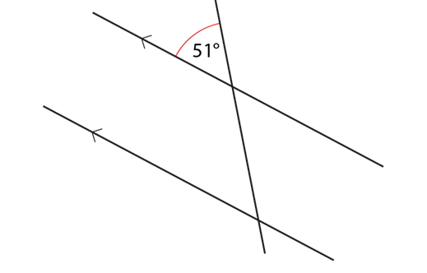
Understand that the angle sum of a triangle result is built from existing knowledge of angle facts
Example 2
Look at this diagram:
Fill in all the missing angles.
Give a clear explanation for each answer.
Notes:
Suggested questioning:
Which angle can you deduce immediately? Why?
Things for you to think about:
Students can be guided to use mental imagery to slide the parallel lines closer to each other.
The diagram of a pair of parallel lines with a transversal is a very powerful image. It contains within it all the structures and relationships that are needed to deduce the angle sum of a triangle.

Slide 17
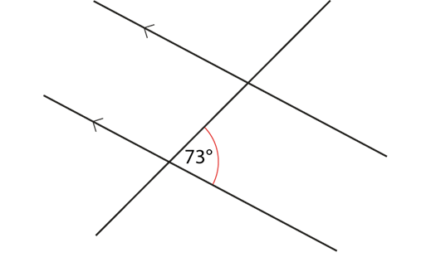
Understand that the angle sum of a triangle result is built from existing knowledge of angle facts
Example 3
Look at this diagram:
Fill in all the missing angles.
Give a clear explanation for each answer.
Notes:
Suggested questioning:
Which angle can you deduce immediately? What angle fact have you used?
Things for you to think about:
Compare the diagrams in Example 2 and Example 3, what is the same and what is different about them?
It is important for students to be given time to discuss all the relationships they see in this diagram at each of the stages outlined in the Examples 2, 3 and 4, so that they thoroughly internalise these structures.

Slide 18
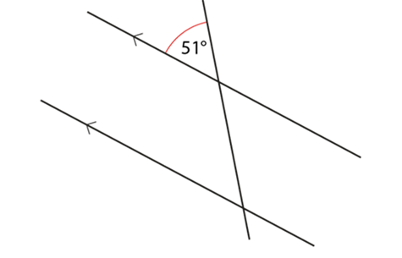
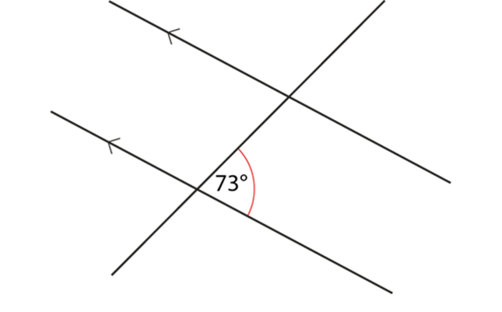
Understand that the angle sum of a triangle result is built from existing knowledge of angle facts
Examples 2 and 3
Look at these diagrams:
Fill in all the missing angles.
Give a clear explanation for each answer.
  What language would you like students to use in their explanations?
  How can you use dynamic geometry software to support students visualise the structures with parallel lines and transversals?
Notes:
This example can be found on page 19 of the 6.1 Core Concept document.

Slide 19
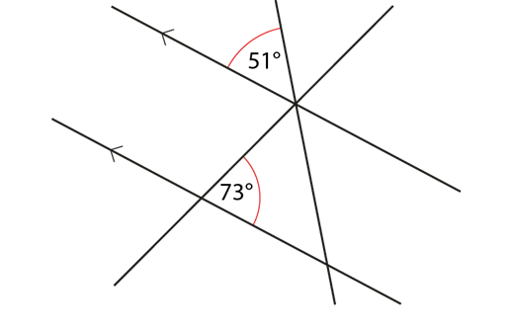
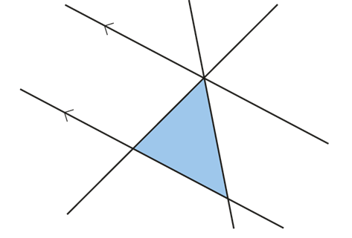
Understand that the angle sum of a triangle result is built from existing knowledge of angle facts
Example 4
This diagram is a combination of the diagrams from Examples 2 and 3:
Use your previous answers and fill in as many missing angles as you can.
What do you notice about the three angles in the shaded triangle?
Where else can you see these three angles next to each other?
Notes:
Suggested questioning:
Which angle facts are you using at each stage?
Things for you to think about:
Why might it be important for students to tackle Examples 2 and 3 before seeing the diagrams combined in Example 4?
By combining the two diagrams in Examples 2 and 3, a triangle is created. Part c) draws attention to the relevance of 180° as half a full turn or the sum of the angles on a straight line.

Slide 20
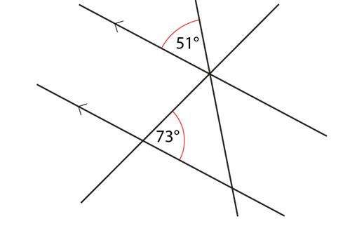

Understand that the angle sum of a triangle result is built from existing knowledge of angle facts
Example 4
This diagram is a combination of the diagrams from Examples 2 and 3:
Use your previous answers and fill in as many missing angles as you can.
What do you notice about the three angles in the shaded triangle?
Where else can you see these three angles next to each other?
  Why is this layering and building up of facts in this way useful?
  Where does the sum of angles in a triangle appear in your scheme of learning?
  What properties are needed in most proofs for the sum of angles in a triangle?
Notes:
Due to space constraints, the image on this PD discussion slide is very small. PD Leads might like to use or print the ‘in the classroom’ version of this slide for teachers to access during discussions.
This example can be found on page 20 of the 6.1 Core Concept document.

Slide 21
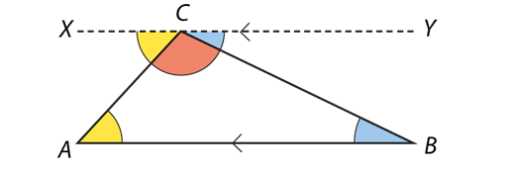
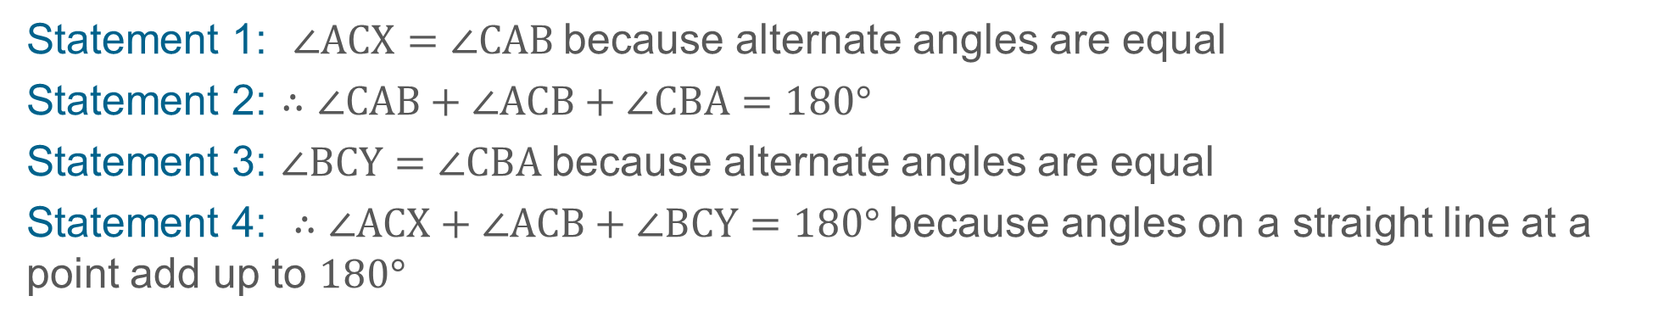
Appreciate different proofs of the same result
Example 5
Rearrange the statements to prove that the sum of the interior angles of triangle ABC is 180°.
Statement 1: $∠ACX=∠CAB$because alternate angles are equal
Statement 2: $∴∠CAB+∠ACB+∠CBA=180°$
Statement 3: $∠BCY=∠CBA$because alternate angles are equal
Statement 4: $∴∠ACX+∠ACB+∠BCY=180°$because angles on a straight line at a point add up to $180°$
Notes:
Suggested questioning:
Read the formal notation part of the statement $∠ACX=∠CAB$. Why is this true?
Things for you to think about:
This scaffolding provides a useful scaffolding device to prepare students for constructing their own reasoned arguments and proofs (both verbally and in written form) in the future.

Slide 22

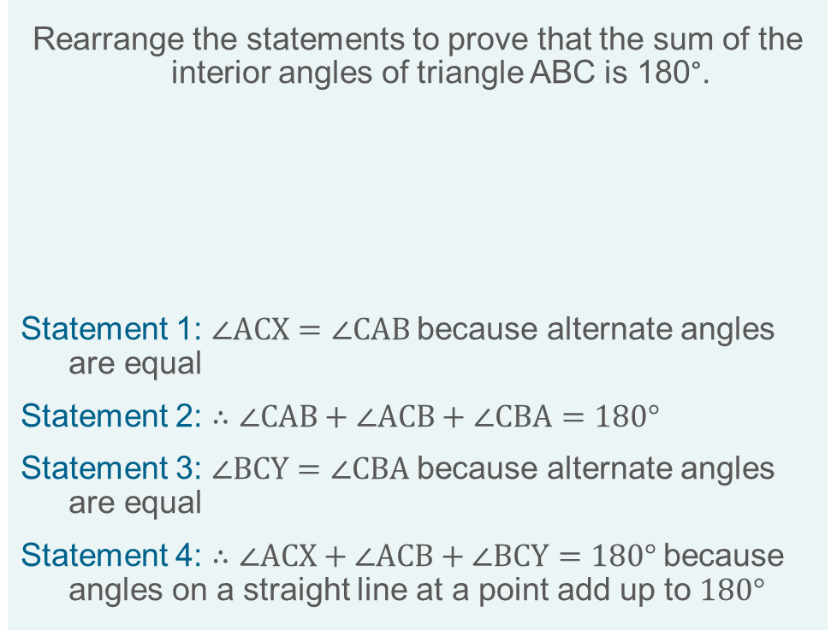
Appreciate different proofs of the same result
Example 5
Rearrange the statements to prove that the sum of the interior angles of triangle ABC is 180°.
Statement 1: $∠ACX=∠CAB$because alternate angles are equal
Statement 2: $∴∠CAB+∠ACB+∠CBA=180°$
Statement 3: $∠BCY=∠CBA$because alternate angles are equal
Statement 4: $∴∠ACX+∠ACB+∠BCY=180°$because angles on a straight line at a point add up to $180°$
  What is the advantage of asking students to sequence statements in this way?
  How would you adapt the diagram to give an acute angle at the top of the triangle?
  How can you support students to see the generalisation for any triangle?
Notes:
Due to space constraints, the image on this PD discussion slide is very small. PD Leads might like to use or print the ‘in the classroom’ version of this slide for teachers to access during discussions.
More detail about the sequencing of this example can be found on page 21 of the 6.1 Core Concept document.

Slide 23
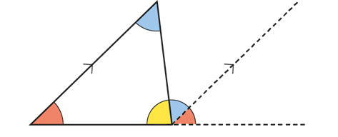
Appreciate different proofs of the same result
Example 6
Look at this diagram and think what it might be showing.
Share your ideas with your partner and agree what the diagram is telling you.
Work with your partner to construct a clear written argument which explains (using the diagram) why the angle sum of a triangle is 180°.
Notes:
Suggested questioning:
Why do you think the diagram has angles shown in colours?
Things for you to think about:
Consider having a large version of the diagram from Example 6 displayed so that everyone can see it clearly. Give students time to look at the diagram and, on their own, make sense of it before sharing their ideas with their partner.
It will be useful to share as a whole class (using a visualiser or asking students to show their work on the board) how students have expressed themselves. It will be important to share examples of correct use of mathematical language (for example, appropriate use of ‘alternate’ and ‘corresponding’ angles) as well as clear and efficient use of mathematical symbolism. When students can clearly articulate what they want to say using precise mathematical language and symbolism, they have a tool for thinking clearly and logically.

Slide 24

Appreciate different proofs of the same result
Example 6
Look at this diagram and think what it might be showing.
Share your ideas with your partner and agree what the diagram is telling you.
Work with your partner to construct a clear written argument which explains (using the diagram) why the angle sum of a triangle is 180°.
  What other opportunities might you offer students to construct clear written and spoken arguments and proofs?
  What are the fundamental geometric proofs for Key Stage 3 (and GCSE) and in what order should they be approached?
Notes:
Due to space constraints, the image on this PD discussion slide is very small. PD Leads might like to use or print the ‘in the classroom’ version of this slide for teachers to access during discussions.
This example can be found on page 21 of the 6.1 Core Concept document.

Slide 25
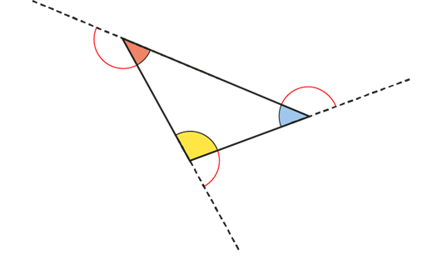
Appreciate different proofs of the same result
Example 7
Given that the exterior angles of a polygon add up to 360°, prove that the interior angles of this triangle add up to 180°.
Notes:
Suggested questioning:
What do we mean by exterior angle?
Things for you to think about:
It may be helpful to begin by drawing a triangle on the floor of the classroom (maybe on a large piece of sugar paper). Get students to walk around the perimeter, taking note of the direction they are facing when they start, the turns they make at each vertex, and the direction they are facing when they return to their starting point.

Slide 26

Appreciate different proofs of the same result
Example 7
Given that the exterior angles of a polygon add up to 360°, prove that the interior angles of this triangle add up to 180°.
  How can you use technology to demonstrate scaling down proportionately to show the triangle reducing to a point and the external angles showing a full turn?
Notes:
More detail about this example can be found on page 22 of the 6.1 Core Concept document.

Slide 27
Reflection questions
What other mathematical concepts will be supported by students’ stronger understanding of this key idea?
What mathematical language will you continue to use to support pupils to make connections with other areas?
Which representations might you continue to use to further develop students’ understanding?

Slide 29
Appendices
You may choose to use the following slides when planning or delivering a PD session. They cover:
  Key vocabulary
  Representations and structure
  Future learning
  Library of links

Slide 30
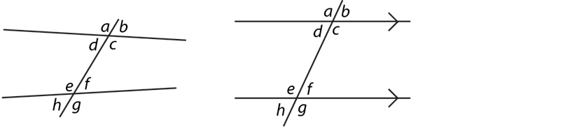
Key vocabulary
Term | Definition
alternate angles | Where two straight lines are cut by a third, as in the diagrams, the angles d and f (also c and e) are alternate. Where the two straight lines are parallel, alternate angles are equal.
corresponding angles | Where two straight lines are cut by a third, as in the diagrams, the angles a and e are corresponding. Similarly, b and f, c and g, and d and h are corresponding. Where parallel lines are cut by a straight line, corresponding angles are equal.
interior angle | At a vertex of a polygon, the angle that lies within the polygon.
supplementary angle | Two neighbouring angles whose sum is 180°. When two lines intersect each other, the resulting adjacent angles are supplementary.
transversal | A line that cuts across two or more (usually parallel) lines.

Slide 31
Representations and structure
There are a number of different representations that you may wish to use to support students’ understanding of this key idea. These might include:
Dynamic geometry software
  The guided use of dynamic geometry software can provide an environment in which students are able to make and test conjectures. By dragging and changing features, they are able to identify variant and invariant properties, leading to a deeper understanding of generalisations.
Mental imagery
  All concrete and pictorial representations have their limitations in the way they are able to represent the abstract world of mathematics. The ultimate purpose of all representations is to support students’ mental construct of an idea or concept. Students do not use the representation to do the mathematics; rather, the representation supports the student in making a mental representation of the idea.
Notes:
More information about the representations and structure involved in this key idea can be found:
On page 6 of the Theme Overview document
Links to all of these can be found on the final slide.

Slide 32
Previous learning
From Upper Key Stage 2, students will bring experience of:
  drawing 2D shapes using given dimensions and angles
  recognising, describing and building simple 3D shapes, including making nets
  comparing and classifying geometric shapes based on their properties and sizes, and finding unknown angles in any triangles, quadrilaterals and regular polygons
  illustrating and naming parts of circles, including radius, diameter and circumference, and knowing that the diameter is twice the radius
  recognising angles where they meet at a point, are on a straight line or are vertically opposite, and finding missing angles
  drawing and translating simple shapes on the coordinate plane and reflecting them in the axes.

Slide 33
Future learning (1)
In KS4, students will build on the core concepts in this mathematical theme to:
  interpret and use fractional {and negative} scale factors for enlargements
  {describe the changes and invariance achieved by combinations of rotations, reflections and translations}
  identify and apply circle definitions and properties, including: centre, radius, chord, diameter, circumference, tangent, arc, sector and segment
  {apply and prove the standard circle theorems concerning angles, radii, tangents and chords, and use them to prove related results}
  construct and interpret plans and elevations of 3D shapes
  interpret and use bearings
  calculate arc lengths, angles and areas of sectors of circles
  calculate surface areas and volumes of spheres, pyramids, cones and composite solids
  apply the concepts of congruence and similarity, including the relationships between lengths, {areas and volumes} in similar figures

Slide 34
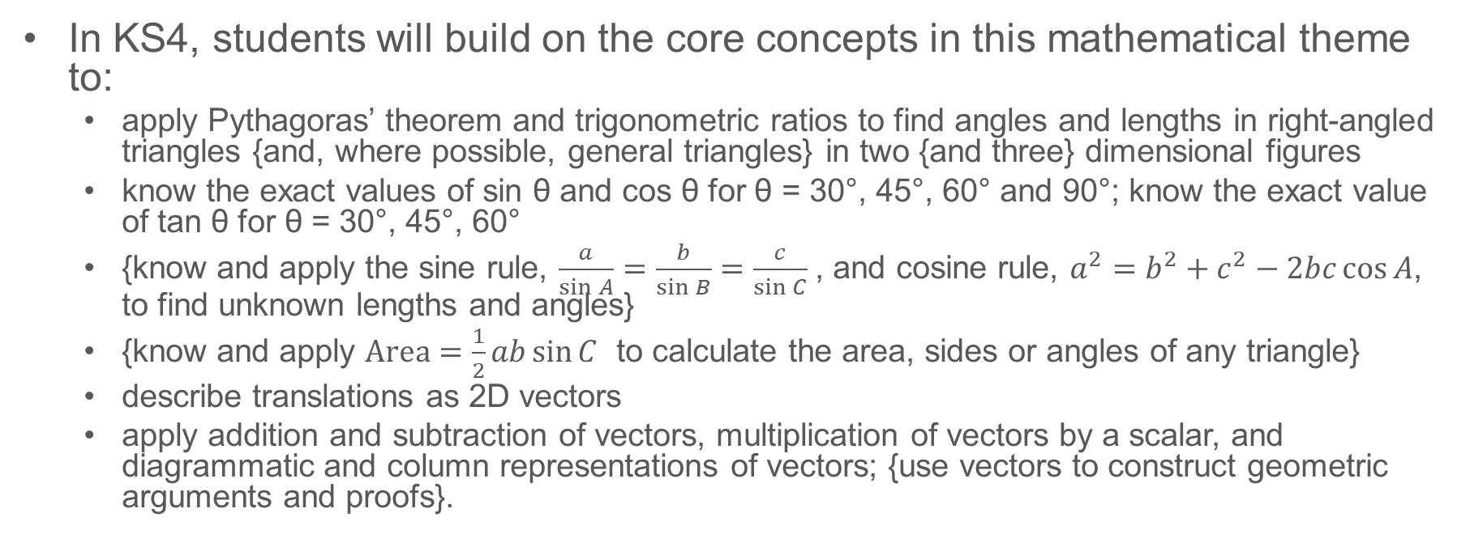
Future learning (2)
In KS4, students will build on the core concepts in this mathematical theme to:
  apply Pythagoras’ theorem and trigonometric ratios to find angles and lengths in right-angled triangles {and, where possible, general triangles} in two {and three} dimensional figures
  know the exact values of sin θ and cos θ for θ = 30°, 45°, 60° and 90°; know the exact value of tan θ for θ = 30°, 45°, 60°
  {know and apply the sine rule, $\frac{a}{\sin{A}}=\frac{b}{\sin{B}}=\frac{c}{\sin{C}}$ , and cosine rule, $a^{2}=b^{2}+c^{2}−2bc\cos{A}$, to find unknown lengths and angles}
  {know and apply $Area=\frac{1}{2}ab\sin{C}$ to calculate the area, sides or angles of any triangle}
  describe translations as 2D vectors
  apply addition and subtraction of vectors, multiplication of vectors by a scalar, and diagrammatic and column representations of vectors; {use vectors to construct geometric arguments and proofs}.
Notes:
Please note: Braces { } indicate additional mathematical content to be taught to more highly attaining students.

Slide 35
Library of links
The following resources from the NCETM website have been referred to within this slide deck:
  NCETM Secondary Mastery Professional Development
    6 Geometry Theme Overview Document
    6.1 Geometrical properties Core Concept Document
  NCETM primary mastery professional development materials
There are also references to:
  Standards & Testing Agency’s past mathematics papers

