Slide 1
The Primary Mathematics Teaching for Mastery Specialist Teacher Programme
Teacher Research Group
Wednesday 27th April 2016
Angela Linford

Slide 2
Overview of the session:
8:45 am Gap task feedback
9:30 am Observe Y3 lesson – Fractions
10:15am Coffee
10:30am Discussion of lesson and action plans/tasks for work before next time
11:00 am Planning a mastery lesson
11:45am Close

Slide 3
Gap tasks/action plan points
Which aspects of mastery from your action plan did you focus on?
What have you tried/done differently since our last TRG?
How has the work gone?
What impact did it have on the children’s learning/understanding?
What might you do differently next time?
Have you shared any aspects with other members of staff?

Slide 4
Gap tasks/action plan points
Split into groups of 3 but not with someone from your own school.
We have a TRIAD.
One person talks about their experiences and resultant thinking
One person asks questions for clarification and probes their thinking
One person acts as timekeeper and records the key reflections during the dialogue. These notes are then given to the person who was speaking as a reflection of their work.
After 10 minutes swap roles
Then again

Slide 5
Mastery of Mathematics is more…..
Deep and sustainable learning
The ability to build on something that has already been sufficiently mastered
The ability to reason about a concept and make connections
Conceptual and procedural fluency

Slide 6
Teaching for Mastery: The 5 Big Ideas
Representation
& Structure
Access
Mathematical Thinking
Chains of Reasoning
Fluency
Number Facts
Variation
Procedural
Conceptual
Table Facts
Pattern
Making Connections
Making Connections
Making Connections
Making Connections
Coherence
Small steps are easier to take

Slide 7
CPA
Concrete
Pictorial
Abstract

Slide 8
Context of Lesson and prior learning
Day 5 in second block on Fractions (first block before Easter break)
Children are familiar with the part, part, whole model
They can name fraction of shapes and discrete objects
They understand a tenth as a decimal
The have explored that fractions have to be equal but not congruent shapes
Today’s small step - the whole can be different things. You need to be clear about what the whole is. Then you can say what fraction of the whole you can see.

Slide 9
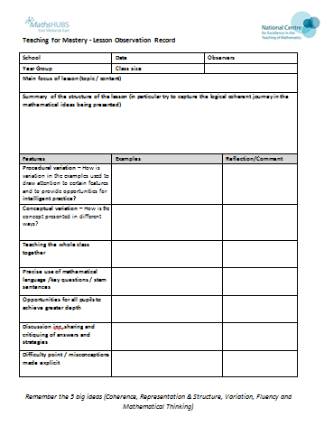
Paired activity
Work with your partner teacher to complete the lesson observation form, using your own notes to help.

Slide 10
Post lesson discussion
What struck you about the lesson?
Let’s discuss some features of the lesson.
What one thing will you take from today’s lesson?

Slide 11
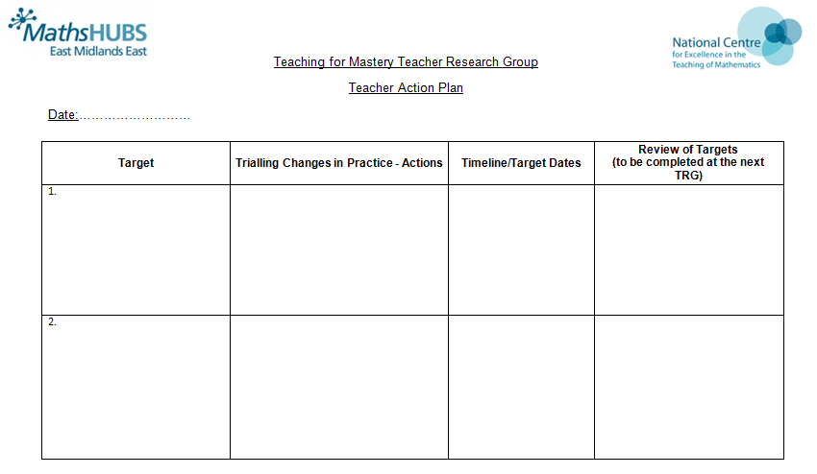
Action Planning

Slide 12
Planning a mastery lesson
Year 3 obj: calculate mathematical statements for division, including for two-digit numbers divided by one-digit numbers, using formal written methods
Small step – dividing a 2 digit number into equal groups, no exchange

Slide 13
Teaching for Mastery: The 5 Big Ideas
Representation
& Structure
Access
Mathematical Thinking
Chains of Reasoning
Fluency
Number Facts
Variation
Procedural
Conceptual
Table Facts
Pattern
Making Connections
Making Connections
Making Connections
Making Connections
Coherence
Small steps are easier to take

Slide 14
Key Features of the lesson
Repetition – providing a conceptual framework
Common misconceptions identified
Conceptual variation – moving from one representation of the concept to another
Procedural variation – how it can be tackled and represented
Simple but deep
Small focus

Slide 15
Teaching strategies to support mastery
Discussion – the answer is only the beginning
Ping-Pong style – providing sufficient scaffold for all pupils to access
Repetition and chorusing
Precision in the use of mathematical language
Carefully chosen examples and representations to draw out the essence of the concept (conceptual variation)
Intelligent practice (often outside of the lesson)

Slide 16
Next TRG
Wednesday 8th June
We will discuss how our action plan work has gone in a similar way to today.
We will discuss and analyse how the planned lesson went/reflection
Would anyone like to offer to teach a short lesson at their school for us to observe? Or is there a better focus for that TRG?

Slide 17
TRG 4
TRG 4 will now be held at Minster School, Southwell and will involve all 4 TRG groups. We will be planning a unit of work together and evaluating our work
I will let you know the date ASAP.

Slide 18
Summing up
Thank you
Action plan points
Try out the lesson either in your own class or in a colleague’s class
Perhaps keep a log/reflection/journal of the things you try out and how they have gone

