Slide 1
Year 1, Unit 4
Recognise, compose, decompose and manipulate 2D and 3D shapes

Slide 2
Year 1, Unit 4
These materials heavily reflect the prioritisation approach of the ready-to-progress criteria in the DfE Primary Mathematics Guidance 2020 and on the PPTs that exemplify them on the NCETM website. They also include other relevant National Curriculum content.
Ready-to-progress criteria addressed by this unit
Teaching of this unit supports the following criteria from the ‘DfE Mathematics Guidance: key stages 1 & 2’ (the 335-page document available as a download)
1G-1 Page 42
1G-2 Page 44
The work of the Early Childhood Maths Group on spatial reasoning provides further guidance relevant to this unit. This includes a spatial reasoning trajectory to download, which describes developmental progression from birth to 7 years old. It suggests ways to sensitively support children in each phase of spatial reasoning development and how the environment might support spatial reasoning development.

Slide 3
Contents
The links below take you to the starting slide of each learning outcome.
1 | Pupils compose pattern block images
2 | Pupils copy, extend and develop repeating and radiating pattern block patterns
3 | Pupils compose tangram images
4 | Pupils investigate tetromino and pentomino arrangements
5 | Pupils investigate ways that four cubes can be composed into different 3D models
6 | Pupils explore, discuss and compare 3D shapes
7 | Pupils identify 2D shapes within 3D shapes
Click the arrow button to return to this Contents slide.

Slide 4
Contents
The links below take you to the starting slide of each learning outcome.
8 | Pupils explore, discuss and compare 2D shapes
9 | Pupils explore, discuss and identify circles and shapes that are not circles from shape cut-outs
10 | Pupils explore, discuss and identify triangles and shapes that are not triangles from shape cut-outs
11 | Pupils explore, discuss and identify rectangles (including squares) from shape cut-outs
Click the arrow button to return to this Contents slide.

Slide 5
Year 1, Unit 4, Learning Outcome 1
Learning Outcome 1
Pupils compose pattern block images
The following slides have been collated to support the teaching of this learning outcome.

Slide 6

Year 1, Unit 4
Spatial reasoning starter
Look at the picture. Let’s describe everything we can see.
This is an aerial view of an object – a picture taken from above. I wonder what the object could be? Imagine flying like a bird and looking down. What kind of things might look like this from above?
What other things might you see from above if you flew like a bird? Imagine and describe what they would look like from the air.

Slide 7
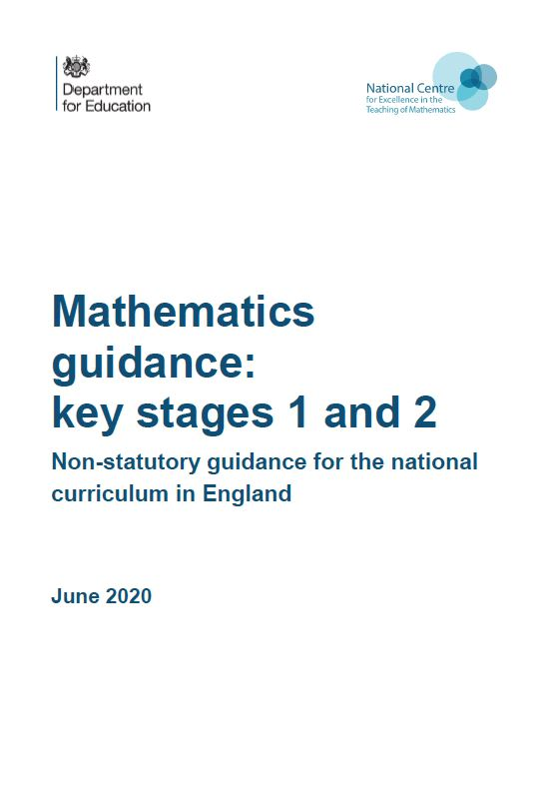
Year 1, Unit 4, Learning Outcome 1
Additional teacher guidance for this outcome should be read first and can be found in the DfE Mathematics guidance. Page references relate to the 335-page document available as a download at the bottom of this web page.
Ready to progress criteria | Pages
1G-2 | 44-46

Slide 8
Year 1, Unit 4, Learning Outcome 1
You could use some of the following tasks to support this learning outcome:
Find all the different ways to make the yellow hexagon, trapezium and blue rhombus from other pattern block pieces.
Use pattern blocks to fill bigger shapes (e.g. slide 10), focusing on rotating pieces, and paying careful attention to aligning the edges of pieces. Draw in the edges of the pattern blocks to show how they make up the bigger shapes.
Find different ways to fill empty templates, such as a larger geometric shapes, or pictures. Use known substitutions to generate alternatives, e.g. changing a hexagon for two trapezia.

Slide 9
Year 1, Unit 4, Learning Outcome 1
Through all of these tasks, make careful pedagogical choices about how to model pattern block work. For example, online software will allow easy modelling of different ways to compose a regular hexagon. However, if the focus is on teaching children how to rotate and place pattern block pieces with sides fully meeting, then you will need to use practical resources, for example, a visualiser and small pattern blocks, or large magnetic display pattern blocks.

Slide 10
Year 1, Unit 4, Learning Outcome 1

Slide 11
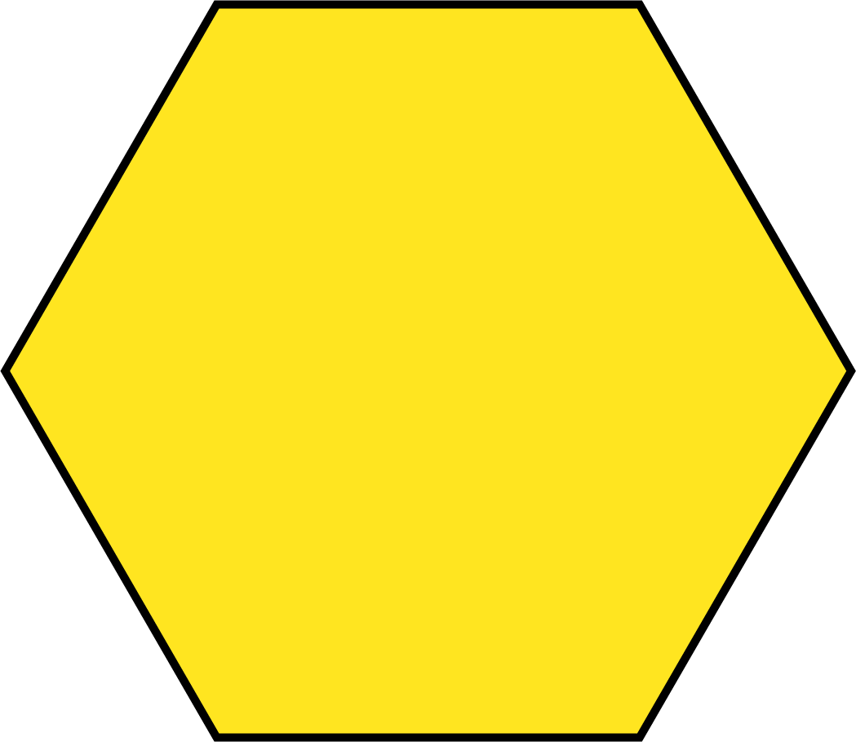


Year 1, Unit 4, Learning Outcome 1

Slide 12
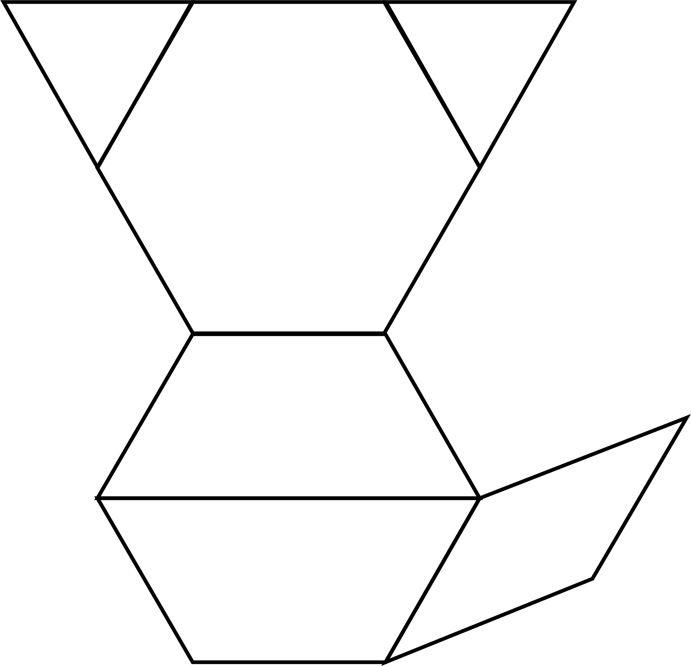
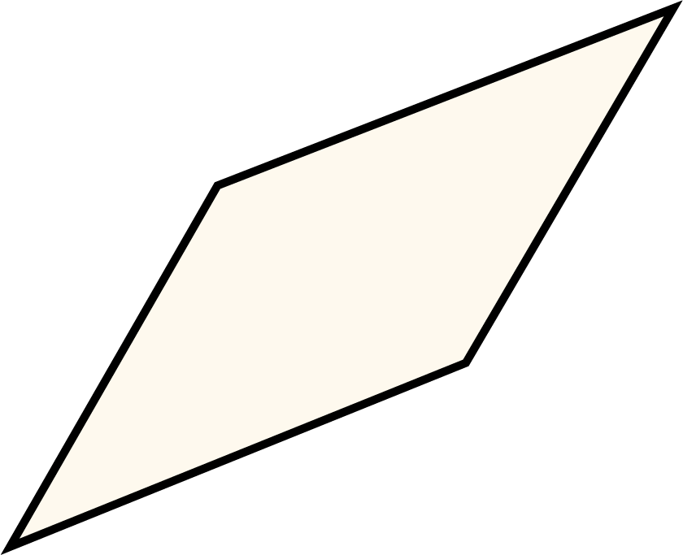

1G-2 Compose 2D and 3D shapes from smaller shapes
Can you find your own pattern blocks the same as these? Can you name any of the shapes you need?
Can you make the picture shown here? Lay the blocks over a copy of the image.
Which of these shapes will need to be rotated to fit on this picture?
Can you say where each piece should be placed?
What do you notice about the two red shapes and the yellow shape?

Slide 13
1G-2 Compose 2D and 3D shapes from smaller shapes
Can you make the same picture using these shapes? What did you need to do to make the same picture?
What other pictures can you make with these pattern blocks?
What other pictures can you make using some different pattern blocks?
Can you copy a pattern your friend has made?

Slide 14
Year 1, Unit 4, Learning Outcome 2
Learning Outcome 2
Pupils copy, extend and develop repeating and radiating pattern block patterns
The following slides have been collated to support the teaching of this learning outcome.

Slide 15
Year 1, Unit 4
Spatial reasoning starter
I’ve made a design using some curved and straight lines. Look carefully. Let’s describe it. Let’s use lots of detail, so that someone who couldn’t see it can imagine it exactly.
Now have a go at copying it on your whiteboard. Look really carefully. Think about how big you will make each part of the design.
When you are finished, compare your picture to the one on the board, and change any bits you want to improve.

Slide 16
Year 1, Unit 4, Learning Outcome 2
Additional teacher guidance for this outcome should be read first and can be found in the DfE Mathematics guidance. Page references relate to the 335-page document available as a download at the bottom of this web page.
Ready to progress criteria | Pages
1G-2 | 44-46

Slide 17
Year 1, Unit 4, Learning Outcome 2
You could use some of the following tasks to support this learning outcome:
Lay pattern blocks over outlines of patterns.
Discuss and describe the characteristics of a pattern, and extend repeating patterns (in both directions) and radiating patterns, by adding more pattern block pieces.
Use pattern block pieces to replicate a pattern.
Alter a pattern by using know substitutions, e.g. substituting all of the blue rhombuses for two triangles.
Create radiating patterns.

Slide 18
Year 1, Unit 4, Learning Outcome 2

Slide 19
Year 1, Unit 4, Learning Outcome 2

Slide 20
Year 1, Unit 4, Learning Outcome 2

Slide 21
Year 1, Unit 4, Learning Outcome 2

Slide 22
Year 1, Unit 4, Learning Outcome 2

Slide 23
Year 1, Unit 4, Learning Outcome 3
Learning Outcome 3
Pupils compose tangram images
The following slides have been collated to support the teaching of this learning outcome.

Slide 24
Year 1, Unit 4
Spatial reasoning starter
I’ve made some plans of towers I might build. What do you think of them? Do you think they would make good towers? Explain your thoughts.

Slide 25
Year 1, Unit 4, Learning Outcome 3
Additional teacher guidance for this outcome should be read first and can be found in the DfE Mathematics guidance. Page references relate to the 335-page document available as a download at the bottom of this web page.
Ready to progress criteria | Pages
1G-2 | 44-46

Slide 26
Year 1, Unit 4, Learning Outcome 3
You could use some of the following tasks to support this learning outcome:
Compare and discuss individual tangram pieces, including finding pieces that are exactly the same shape and size, and are the same shape but different sizes.
Lay tangram pieces directly on top of diagrams marked with individual pieces. Model how to check the size of the various triangles, how to rotate and place pieces, and in the case of the parallelogram how to flip the piece over if needed.
Pupils make their own pictures and describe them, e.g. find different ways to make a fish using some or all pieces.
Copy tangram diagrams, starting with two pieces (examples on the next slide).

Slide 27
Year 1, Unit 4, Learning Outcome 3

Slide 28

1G-2 Compose 2D and 3D shapes from smaller shapes
What do you notice about the pieces in the tangram? Do any of the shapes have the same name? In what way are some of the triangles different to each other?
Can you make a picture with your tangram and describe it to your friend?
Can you use your own tangram pieces to make this picture?
There are five triangles in the tangram. Some of them are exactly the same shape and size.

Slide 29
Year 1, Unit 4, Learning Outcome 4
Learning Outcome 4
Pupils investigate tetromino and pentomino arrangements
The following slides have been collated to support the teaching of this learning outcome.

Slide 30

Year 1, Unit 4
Spatial reasoning starter
I’ve drawn a picture of a cat.
Now I’ve drawn some more pictures of the cat, but I’ve ‘squashed’ them a bit! What is the same and what is different? How have I squashed each picture?
Look at all of my new cat pictures. Explain which you think is the most like the top picture.
Explain which you think would be the best kitten picture.

Slide 31
Year 1, Unit 4, Learning Outcome 4
Additional teacher guidance for this outcome should be read first and can be found in the DfE Mathematics guidance. Page references relate to the 335-page document available as a download at the bottom of this web page.
Ready to progress criteria | Pages
1G-2 | 44-46

Slide 32
Year 1, Unit 4, Learning Outcome 4
You could use some of the following tasks to support this learning outcome:
Provide cut-outs of the 5 possible tetrominoes and 12 possible pentominoes and explore, discuss and compare them, including rotating and flipping pieces.
Make a tetromino or pentomino using square tiles, working carefully to align the sides, and decide which of the cut-outs it is the same as.
Copy a tetromino or pentomino that the teacher or a friend has made.
Discuss tetrominoes and pentominoes that are reflections or rotations of one another.
Describe how a particular tetromino or pentomino can be transformed into another by moving some of the square tiles.
Arrange the cut-outs so that they fit together without gaps.

Slide 33
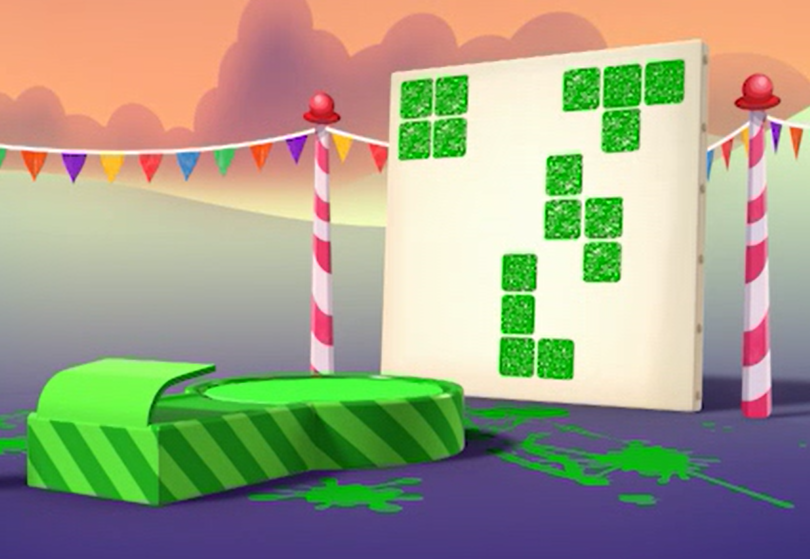
1G-2 Compose 2D and 3D shapes from smaller shapes
What do you notice about these different shapes. They were made by a Numberblock. Can you guess which one?
Will the other Numberblocks make the same or different shapes?
Can you use your own cubes and paint to make some Numberblock prints?
Can you guess which Numberblock your friend used to make their picture?

Slide 34
Year 1, Unit 4, Learning Outcome 4

Slide 35
Year 1, Unit 4, Learning Outcome 4

Slide 36
Year 1, Unit 4, Learning Outcome 5
Learning Outcome 5
Pupils investigate ways that four cubes can be composed into different 3D models
The following slides have been collated to support the teaching of this learning outcome.

Slide 37
Year 1, Unit 4
Spatial reasoning starter
Have a look at this photograph. It is another aerial view (picture taken from above). Describe the kind of things you can see in the picture.
Can you recognise that it is a plan of our school? This is where our classroom is. What other things can you see?
Can you describe what I walk past to get from the gate to our classroom? Where can you see those things on the photo?
[Look at the image of your school site on mapping software, or insert aerial photography of your school site from mapping software here]

Slide 38
Year 1, Unit 4, Learning Outcome 5
Additional teacher guidance for this outcome should be read first and can be found in the DfE Mathematics guidance. Page references relate to the 335-page document available as a download at the bottom of this web page.
Ready to progress criteria | Pages
1G-2 | 44-46

Slide 39
Year 1, Unit 4, Learning Outcome 5
You could use some of the following tasks to support this learning outcome:
Provide models of the 8 possible ways of arranging 4 cubes, and some of the many possible ways of arranging 5 cubes. Explore, discuss and compare them, including rotating pieces.
Make a different 4- or 5-cube model using linking cubes, and compare with models already made to see if it is the same or if it is a new one.
Copy a 4- or 5-cube model that the teacher or a friend has made.
Discuss models that are rotations or reflections of one another.
Describe how a particular 4- or 5-cube model can be transformed into another by moving some of the cubes.
Arrange the models so that they fit together without gaps.

Slide 40

Year 1, Unit 4, Learning Outcome 5

Slide 41
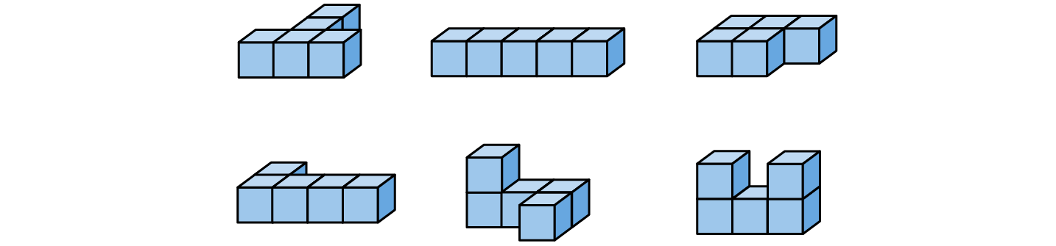
1G-2 Compose 2D and 3D shapes from smaller shapes
Can you pick up the same number of cubes as I have here?
What shapes can you make? Can you describe them to your friend?
Did you make any of these shapes?
Do they look different if you turn them around?
Can you make the same shapes as mine? What do these shapes look like when they stand up or lie down?

Slide 42
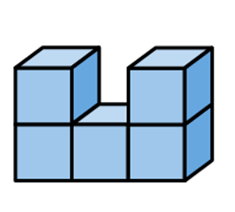
1G-2 Compose 2D and 3D shapes from smaller shapes
Pick up or make this shape
Can you change it to make it look like the shape below.
Describe what to do to make it look like the shape below and then build it.
a
To change shape a to shape b I must take off one of the bricks on top and join it to the bottom row.
b

Slide 43
Year 1, Unit 4, Learning Outcome 6
Learning Outcome 6
Pupils explore, discuss and compare 3D shapes
The following slides have been collated to support the teaching of this learning outcome.

Slide 44
Year 1, Unit 4
Spatial reasoning starter
I’ve made a pattern. Describe what you can see and what you notice.
I want it to repeat 6 times round the hexagon in the middle. Can you spot anywhere that the pattern is ‘broken’?
Can you help me make some changes so that it is the same all the way round?

Slide 45
Year 1, Unit 4, Learning Outcome 6
Additional teacher guidance for this outcome should be read first and can be found in the DfE Mathematics guidance. Page references relate to the 335-page document available as a download at the bottom of this web page.
Ready to progress criteria | Pages
1G-1 | 42-44

Slide 46





1G-1 Recognise common 2D and 3D shapes
Use a collection of 3D shapes, e.g. cylinders, cuboids (including cubes), spheres and pyramids. Also include corresponding everyday objects, e.g. tins, boxes, snack tubes.
Can you match the shapes to the objects you might find at home? Can you say why the cylinder reminds you of a baked beans tin? How is it similar? How is it different?
Can you find other objects in our classroom or around school which are similar to these shapes?
The cylinder and tin both have circles for faces and they both roll.

Slide 47
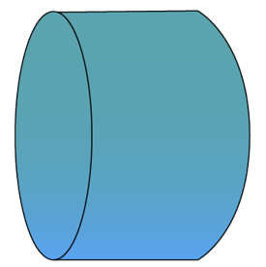
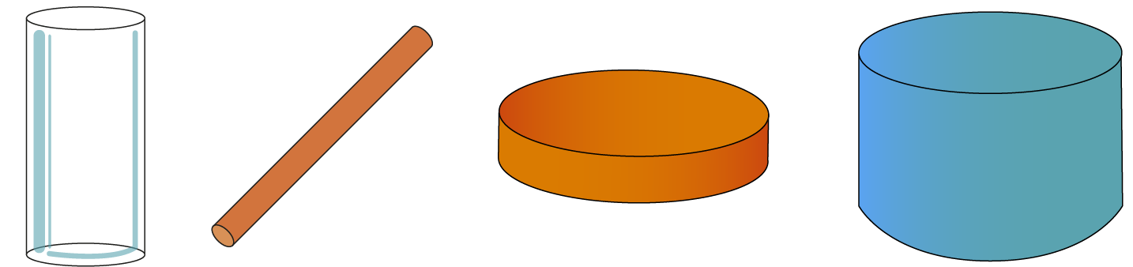
1G-1 Recognise common 2D and 3D shapes
Display a set of the same type of shapes, e.g. all cylinders, which have different proportions, as in the above image.
Look at the shapes on the table. Tell me anything you notice!
Can you show me some circular faces on each shape? How many circular faces do they all have?
So what do you think we can say that is the same about all these shapes?
Can you see and describe anything that is different about two of the cylinders?
All cylinders have two circular faces.
This one is short and fat and this one is long and thin.

Slide 48
1G-1 Recognise common 2D and 3D shapes
Can you guess my rule and complete my sorting? Carefully examine each shape and sort into hoops using two criteria, e.g. shapes which do/do not have a square face. Can you choose your own way to sort 3D shapes into two sets, using do/do not and find ways to describe the shapes in each set?
Can you guess the shape in my feely bag from my description? For example, ‘My shape has a curved surface, and it can roll.’
Can you help our puppet? Say whether she is right or wrong and explain why. For example, puppet picks up a cuboid saying, ‘I think this is a cylinder because it has a square face.’
Our puppet has hidden one of our shapes and will only give it back if you can describe or name the hidden shape! Place a selection of 3D shapes on a tray and the puppet hides one shape at a time.
These shapes all have square faces, and these do not.
Your shape could be a sphere or a cylinder because they can both roll.

Slide 49
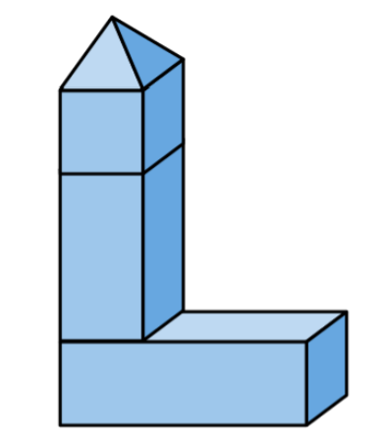
1G-2 Compose 2D and 3D shapes from smaller shapes
Can you choose your own shapes to use to make your own building?
Can you describe the building I have made here? Can you find the same shapes I used to make it and copy it?
Can you find and name some shapes which are the best ones for making a tall building? Which ones are not so good? Why?

Slide 50
Year 1, Unit 4, Learning Outcome 7
Learning Outcome 7
Pupils identify 2D shapes within 3D shapes
The following slides have been collated to support the teaching of this learning outcome.

Slide 51
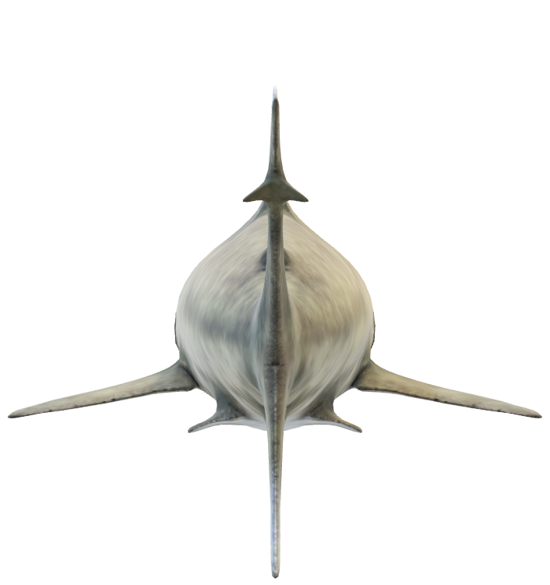
Year 1, Unit 4
Spatial reasoning starter
Look at the picture. Let’s describe the details we can see.
We have looked at aerial views before. I wonder if this is another aerial view? I wonder what the object could be?
I wonder what some other animals might look like from behind? What might a hamster look like from behind?
I wonder what some animals might look like from underneath? What might a snail look like from underneath?

Slide 52
Year 1, Unit 4, Learning Outcome 7
Additional teacher guidance for this outcome should be read first and can be found in the DfE Mathematics guidance. Page references relate to the 335-page document available as a download at the bottom of this web page.
Ready to progress criteria | Pages
1G-1 | 42-44

Slide 53
Year 1, Unit 4, Learning Outcome 7
You could use some of the following tasks to support this learning outcome:
Describe the shapes of individual faces on 3D shapes. Print different 2D shapes using 3D shapes.
Sort shapes according to faces they have in common and guess the sorting rule, e.g. triangular face/no triangular face.
Make shadows with different shapes. What shaped shadows could be made with a cylinder? With a cube? Can you find all of the shapes that can make a rectangular shadow?
Make 3D shapes with geometric construction shapes and open to reveal the net.
Take apart boxes and packaging to reveal the nets.
Imagine making cuts through objects, or cutting fruit, and discuss different cross sections.

Slide 54
Year 1, Unit 4, Learning Outcome 8
Learning Outcome 8
Pupils explore, discuss and compare 2D shapes
The following slides have been collated to support the teaching of this learning outcome.

Slide 55
Year 1, Unit 4
Spatial reasoning starter
Imagine a row of three red cubes.
Now imagine that on top of the middle red cube I put a yellow cube. Is this what you saw?
Now close your eyes again.
Imagine that below the middle red cube I add a blue cube. Try to describe the shape I have made.
Is this what you saw?

Slide 56
Year 1, Unit 4, Learning Outcome 8
Additional teacher guidance for this outcome should be read first and can be found in the DfE Mathematics guidance. Page references relate to the 335-page document available as a download at the bottom of this web page.
Ready to progress criteria | Pages
1G-1 | 42-44

Slide 57
1G-1 Recognise common 2D and 3D shapes
Use a range of 2D shapes such as rectangles (including squares), circles and triangles.
Can you find shapes similar to these in our playground or around school? Are they the same shape even if they are much bigger? (e.g. markings on the playground or hall). Why do you think this is a square? How are these rectangles the same? How are they different?
Can you guess my sorting rule and complete my sorting? Include 2D shapes cut from paper in different sizes and relative proportions. Carefully examine each shape and sort into hoops using two criteria, e.g. triangles and not triangles.
Can you choose your own way to sort 2D shapes into two sets, using not? Can you describe how shapes in the same set are different? If the cheeky puppet moves some shapes about (including rotating a shape but leaving it in the correct set) can you see which shapes need to be corrected?
This is a long, thin rectangle and this is a wide rectangle.

Slide 58
1G-1 Recognise common 2D and 3D shapes
Use a range 2D shapes (continued).
Lay out a selection of 2D shapes. Can you check whether our puppet knows the correct names for our shapes?
The puppet points to a shape saying, I think this is a rectangle because it has 3 sides, am I right?
Can you explain why the puppet is right or wrong?
This is not a rectangle because a rectangle has 4 sides and this shape only has 3.

Slide 59
Year 1, Unit 4, Learning Outcome 9
Learning Outcome 9
Pupils explore, discuss and identify circles and shapes that are not circles from shape cut-outs
The following slides have been collated to support the teaching of this learning outcome.

Slide 60
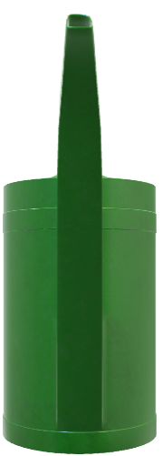
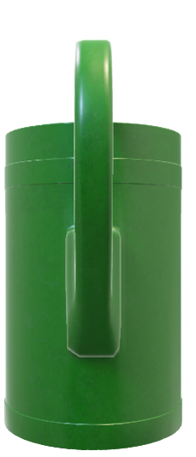
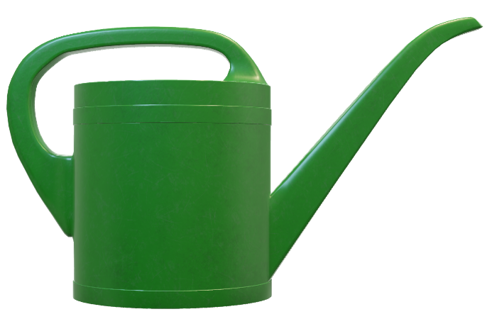
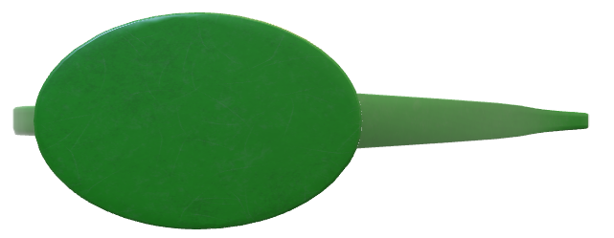

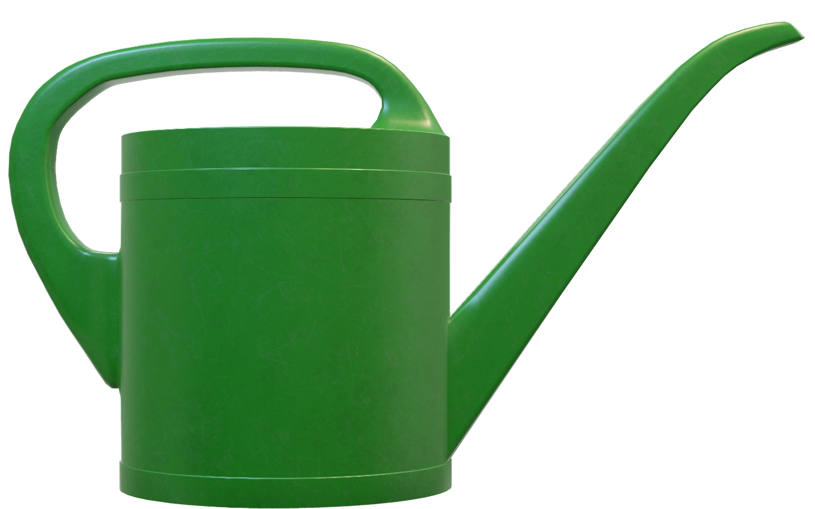
Year 1, Unit 4
Spatial reasoning starter
Have you all seen a watering can before? I have a picture of one here. Let’s describe the watering can. What is the purpose of the different parts?
Now imagine that you can crawl underneath the watering can and look up at it. Try to imagine what it would look like from below. You could have a go at drawing it on your whiteboard. Is this what you saw?
Now imagine it from above, from the front (with the spout facing you) and from the back (with the handle facing you).

Slide 61
Year 1, Unit 4, Learning Outcome 9
Additional teacher guidance for this outcome should be read first and can be found in the DfE Mathematics guidance. Page references relate to the 335-page document available as a download at the bottom of this web page.
Ready to progress criteria | Pages
1G-1 | 42-44

Slide 62
Year 1, Unit 4, Learning Outcome 9
You could use some of the following tasks to support this learning outcome:
Handle a range of cardboard cut-outs of ‘circle-like’ shapes so that children can run their fingers around the shapes (an example selection is shown on the next slide).
Look at the overall shapes and discuss whether they look like any everyday objects.
Encourage children to describe them using informal language, and model language for children to copy.
Sort the shapes according to different criteria (e.g. has a straight side / doesn’t have a straight side).
Try ‘rolling’ the cardboard cut-outs between your hand and the table. Which of them feel like they would make good wheels?
Identify shapes that are, and are not circles and discuss why.

Slide 63
Year 1, Unit 4, Learning Outcome 9

Slide 64
Year 1, Unit 4, Learning Outcome 10
Learning Outcome 10
Pupils explore, discuss and identify triangles and shapes that are not triangles from shape cut-outs
The following slides have been collated to support the teaching of this learning outcome.

Slide 65
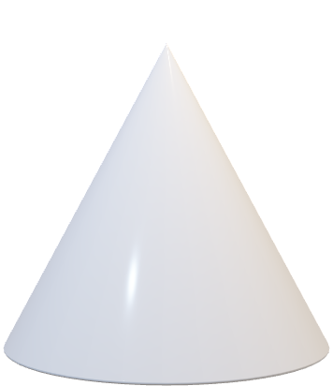
Year 1, Unit 4
Spatial reasoning starter
Close your eyes. Imagine a red cylinder. I’m rolling it along the table. Now I’m standing it on one of its circular faces so it can’t roll any more. Can you imagine that? Open your eyes. Was this what you saw? Your cylinder might have looked a bit different – if so tell me how it was different!
Close your eyes. Now imagine that I put the cylinder on top of a pink cube. Was this what you saw?
Finally I put a white cone on top of the cylinder, sitting on its circular face. Your image might well be a bit different to mine. If so, explain how it was different.

Slide 66
Year 1, Unit 4, Learning Outcome 10
Additional teacher guidance for this outcome should be read first and can be found in the DfE Mathematics guidance. Page references relate to the 335-page document available as a download at the bottom of this web page.
Ready to progress criteria | Pages
1G-1 | 42-44

Slide 67
Year 1, Unit 4, Learning Outcome 10
You could use some of the following tasks to support this learning outcome:
Handle a range of cardboard cut-outs of ‘triangle-like’ shapes so that children can run their fingers around the shapes (an example selection is shown on the next slide).
Encourage children to describe the shapes using informal language, and model language for children to copy.
Look at the shapes and discuss whether they look like any everyday objects - for example, road sign, wave, windmill, arrow.
Identify shapes that are triangles because they have 3 straight sides and 3 vertices (a point where two straight lines meet to make an angle – ‘tri’-angle).
Explain why some shapes are not triangles.
Feel the corners and find ones that are particularly ‘sharp’ or ones that look like a square corner.

Slide 68
Year 1, Unit 4, Learning Outcome 10

Slide 69


1G-1 Recognise common 2D and 3D shapes
Cut out shapes like those shown in the image.
Look at these shapes I have cut out. How would you describe each one? What does each shape remind you of? I think this one looks like a sail.
Run your finger around the edge of each shape. Are the sides straight or curved? Can you count the sides as you run your finger along each one?
Can you find a shape which you are sure is a triangle? Why did you choose this one? Are there any shapes which might not be triangles?
This is not a triangle because it has 6 sides.
This is not a triangle because it has a side which is curved.
This is a triangle because it has 3 straight sides.

Slide 70
Year 1, Unit 4, Learning Outcome 11
Learning Outcome 11
Pupils explore, discuss and compare rectangles (including squares) from shape cut-outs
The following slides have been collated to support the teaching of this learning outcome.

Slide 71
Year 1, Unit 4
Spatial reasoning starter
I’ve made a shape with some squares. Now imagine that the line is a big mirror. I can reflect my shape. Look!
I’m going to add a green square. Can you imagine where the reflection will appear?
How about for all of these squares? Each time I add a new one, try to imagine the reflection and point to where you think it might appear.
Look carefully at my finished shapes. They are not perfect reflections. Can you explain how I could make a perfect reflection?

Slide 72
Year 1, Unit 4, Learning Outcome 11
Additional teacher guidance for this outcome should be read first and can be found in the DfE Mathematics guidance. Page references relate to the 335-page document available as a download at the bottom of this web page.
Ready to progress criteria | Pages
1G-1 | 42-44

Slide 73
Year 1, Unit 4, Learning Outcome 11
You could use some of the following tasks to support this learning outcome:
Handle a range of cardboard cut-outs of ‘rectangle-like’ shapes so that children can run their fingers around the shapes (an example selection is shown on the next slide).
Encourage children to describe the shapes using informal language, and model language for children to copy.
Discuss which of the shapes look like other rectangles they know of – for example, are door-shaped or book-shaped.
Feel the corners and run fingers along two sides towards a vertex. Find ones that are particularly ‘sharp’ or ones that look like a square corner.
Order a set of rectangles from longest to shortest, and notice that one of the rectangles is a square rectangle (example given on a following slide).

Slide 74
Year 1, Unit 4, Learning Outcome 11

Slide 75
Year 1, Unit 4, Learning Outcome 11

