Slide 1
Connecting any two numbers by multiplication
KS3 Mastery PD Materials: Exemplified Key Ideas
Materials for use in the classroom or to support professional development discussions
(from 3.1 Understanding multiplicative relationships)
Summer 2021

Slide 2
About this resource
These slides are designed to complement the 3.1 Understanding Multiplicative Relationships Core Concept document and its associated Theme Overview document 3 Multiplicative Reasoning, both found in the Secondary Mastery Professional Development pages.
These slides re-present the key examples from the Core Concept document so that the examples can be used either directly in the classroom or with a group of teachers. There are prompt questions alongside the examples, and further clarification in the notes.
These slides do not fully replicate the Core Concept document, so should be used alongside it. Reference to specific page numbers, and to other useful NCETM resources, can be found in the notes for each slide.
This slide deck is not designed to be a complete PD session, rather it is a selection of resources that you can adapt and use as needed when planning a session with a group of teachers.

Slide 3
About this resource
The slides are structured as follows:
The big picture:
Where does this fit in?
What do students need to understand?
Why is this key idea important?
Prior learning
Misconceptions
Exemplified key ideas
Reflection questions
Appendices:
Key vocabulary
Representations and structure
Previous and Future learning
Useful links
The exemplified key idea slides have the following symbols to indicate how they have been designed to be used:
Into the classroom
The examples are presented on these slides so that they could be used in PD, but also directly in the classroom. The notes feature suggested questions and things teachers might consider when using with students.
PD discussion prompts
These slides look at the examples in more detail, with question prompts to promote discussion among maths teachers. The notes feature reference to further information and guidance within the Core Concepts document.

Slide 4
Where does this fit in?
The NCETM has identified a set of six ‘mathematical themes’ within Key Stage 3 mathematics that bring together a group of ‘core concepts’.
The third of these themes is Multiplicative reasoning, which covers the following interconnected core concepts:
3.1 Understanding multiplicative relationships
3.2 Trigonometry
Notes:
Linked on this slide is the Theme Overview document of Multiplicative reasoning. This document includes why it is important, the key underpinning knowledge and links to prior and future learning. There is also guidance about how the five big ideas of Teaching for Mastery relate specifically to this theme.

Slide 5
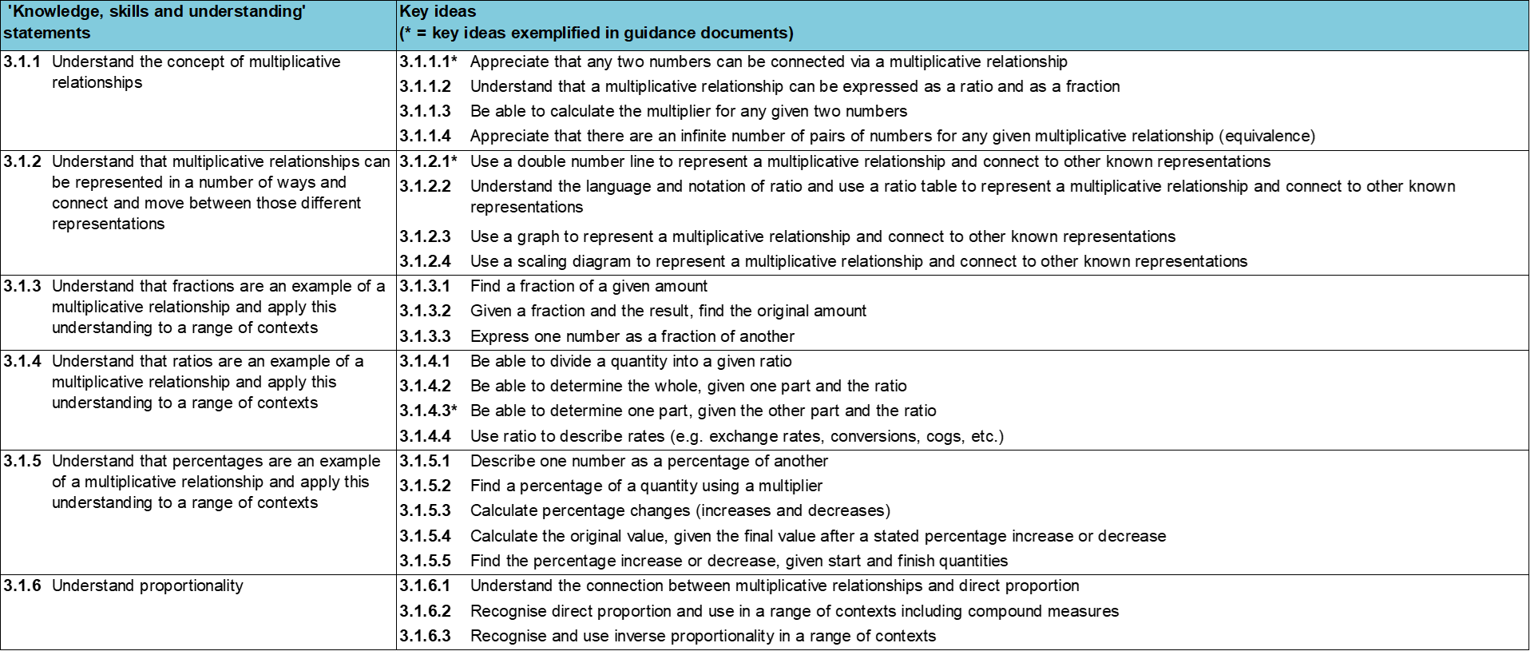
Where does this fit in?
Within this core concept, 3.1 Understanding multiplicative relationships, there are six statements of knowledge, skills and understanding.
These, in turn, are broken down into twenty three key ideas. The highlighted key idea is exemplified in this slide deck.
Notes:
For key ideas marked with an asterisk, we exemplified the common difficulties and misconceptions that students might have and included elements of what teaching for mastery may look like. We have provided examples of possible student tasks and teaching approaches.
Within these slides are ‘classroom-ready’ versions of the examples for the key idea that has been highlighted. There are also slides that may be useful for discussion in a professional development session.

Slide 6
What do students need to understand?
3.1.1.1 Appreciate that any two numbers can be connected via a multiplicative relationship
Interpret multiplication as scaling.
Interpret multiplication as a rate.
Understand that any number can be transformed into any other number by multiplying.
What prior knowledge might your students already have?
What language might they use to describe this key idea?
What questions might you want to ask to assess their prior learning?

Slide 7
Why is this key idea important?
Students may have previously met the idea of multiplication by thinking about equal groupings of objects and counting on in equal amounts from zero.
As the numbers with which students work with extend beyond integers to include fractions and decimals, the scaling view of multiplication becomes increasingly important.
It is important for students to see that multiplication is more than simply repeated addition. While students may recognise that, for example, three and six can be connected via a multiplication, it is much less likely that they will see three and five as being linked multiplicatively.
Offering students experiences that encourage them to look for multiplication rather than addition will support students in developing this more sophisticated view of multiplication (i.e. scaling, which they may have been introduced to in Key Stage 2). It will also lead to the important realisation that any two numbers can be linked in this way.
Multiplicative transformations give rise to ideas of ratio, proportionality, percentage increase and decrease, rates of change, enlargement and similarity, and trigonometric ratios.
Notes:
A more detailed overview of the core concept of Multiplicative reasoning can be found on page 2 of the 3.1 Core Concept document.
The background to each key idea is also explored in more detail on the following pages:
3.1.1 Understand the concept of multiplicative relationships – page 5
3.1.2 Understand that multiplicative relationships can be represented in a number of ways and connect and move between those different representations – page 5
3.1.3 Understand that fractions are an example of a multiplicative relationship and apply this understanding to a range of contexts – pages 5 and 6
3.1.4 Understand that ratios are an example of a multiplicative relationship and apply this understanding to a range of contexts – page 6
3.1.5 Understand that percentages are an example of a multiplicative relationship and apply this understanding to a range of contexts – pages 6 and 7
3.1.6 Understand proportionality – page 7

Slide 8
Prior learning
Upper Key Stage 2 Learning Outcome
Multiply proper fractions and mixed numbers by whole numbers, supported by materials and diagrams
Use all four operations to solve problems involving measure (for example, length, mass, volume, money) using decimal notation, including scaling
Solve problems involving the relative sizes of two quantities where missing values can be found by using integer multiplication and division facts
Solve problems involving the calculation of percentages (for example, of measures, and such as 15% of 360) and the use of percentages for comparison
Solve problems involving similar shapes where the scale factor is known or can be found
Solve problems involving unequal sharing and grouping, using knowledge of fractions and multiples
What prior knowledge might your students already have?
What language might they use to describe this key idea?
What questions might you want to ask to assess their prior learning?
Notes:
You may find it useful to speak to your partner schools to see how the above has been covered and the language used.
You can find further details regarding prior learning in the following segments of the NCETM primary mastery professional development materials (linked on final slide):
Year 4: 2.17 Structures: using measures and comparison to understand scaling
Year 6: 2.27 Scale factors, ratio and proportional reasoning
Year 6: 3.10 Linking fractions, decimals and percentages
Within the Multiplicative Reasoning Theme Overview document, you can also find a broader description of students’ potential previous learning (page 3), alongside further information about key underpinning knowledge (page 2).

Slide 9
Checking prior learning
The following slides contain questions for checking prior learning.
What representations might students use to support their understanding of these questions?
What variation might you put in place for these questions to fully assess students’ understanding of the concept?
How might changing the language of each question change the difficulty?
Why are these such crucial pre-requisites for this key idea?

Slide 10
Checking prior learning (1)
a)
If I share equally a 3m ribbon between five people, how long will each person’s ribbon be?
c)
Recipe for 8 Yorkshire Puddings:
2 cups of flour
4 eggs
200ml milk
How many eggs would be needed for 56 Yorkshire puddings?
How much milk would be needed for 6 Yorkshire puddings?
a)
A machine pours 250 millilitres of juice every 4 seconds. How many litres of juice does the machine pour every minute?
Notes:
References to the questions (links on final slide):
a) NCETM Primary assessment materials: Year 6, page 24
b) 2019 Key Stage 2 Mathematics Paper 2: Reasoning, question 19
c) NCETM Secondary assessment materials, page 32

Slide 11
Checking prior learning (2)
d)
The Angel of the North is a large statue in England.
It is 20 metres tall and 54 metres wide.
Ally makes a scale model of the Angel of the North.
Her model is 40 centimetres tall.
How wide is her model?
Notes:
References to the questions (links on final slide):
d) 2018 Key Stage 2 Mathematics Paper 3: Reasoning, question 9

Slide 12
Common difficulties and misconceptions
What aspects of this key idea might stuidents find challenging?
What misconceptions might students have?
When teaching this topic, you may find students encounter difficulties with…
Assuming relationships are additive
More information, and some suggestions for overcoming these challenges, can be found on the following slides.

Slide 13
Common difficulties and misconceptions (1)
Students often assume that relationships are additive, including in situations where the actual relationship is multiplicative (for example, in scaling and other proportional situations).
Because students may see multiplication as only repeated addition (as opposed to scaling) their methods often entail building up to an answer by dealing with small segments of the problem and then adding the answers together. When this is not possible, it is not uncommon for students to consider the difference a − b rather than the ratio a : b.
It is important that students experience a range of contexts and are encouraged to discern between additive and multiplicative situations.
Notes:
More detail can be found on page 8 of the 3.1 Core Concept document.

Slide 14
Interpret multiplication as scaling
Example 1
Put the following products in order of size from smallest to largest.
9
7
a) 1142 × 2
d) 1142 ×
19
9
17
9
b) 1142 ×
e) 1142 ×
7
9
4
9
c) × 1142
f) 2284 ×
Notes:
Suggested questioning:
Will the product be smaller or bigger than 1142?
Will the product be smaller or bigger than 2284?
Use this sentence structure to compare two products:
“I know part __ will be bigger/smaller than part __ because … “
Things for you to think about:
If students are struggling, which two might you ask them to compare as a starting point?
What might students do for part f?
Which products, or groups of products, might you draw students’ attention to and why?
What language or sentence structures might you want students to use to support their understanding?

Slide 15
Interpret multiplication as scaling
Example 1
Put the following products in order of size from smallest to largest.
Why might a number like 1142 have been chosen when designing this set of questions?
What language might students use to compare these products?
What images of multiplication might students have in their heads when considering these questions?
9
7
a) 1142 × 2
d) 1142 ×
19
9
17
9
b) 1142 ×
e) 1142 ×
7
9
4
9
c) × 1142
f) 2284 ×
Notes:
More detail about the decisions behind the sequencing of the questions can be found on page 8 of the 3.1 Core Concept document.

Slide 16
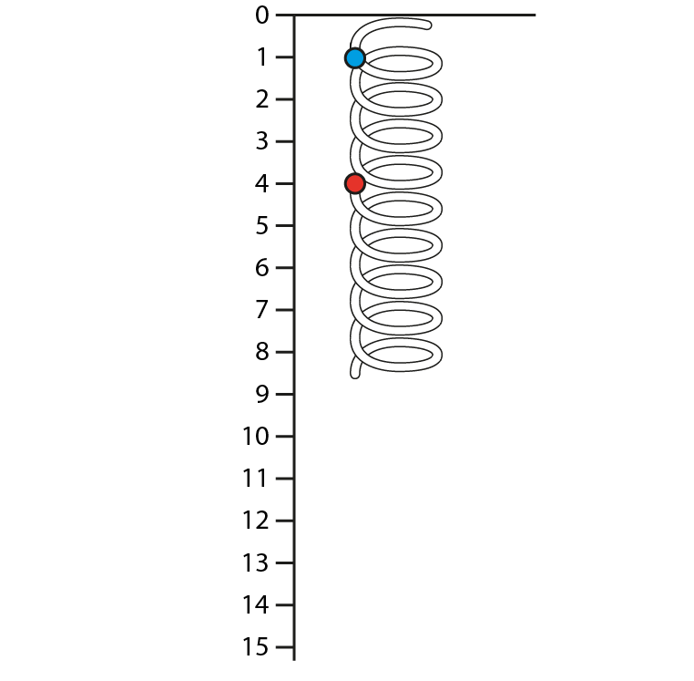
Interpret multiplication as scaling
Example 2
The spring is stretched so that the blue dot aligns with the 2cm mark. Where is the red dot?
The spring is stretched so that the red dot is on 6cm. Where is the blue dot?
The spring is compressed so that the red dot is on 3cm. Where is the blue dot?
At the moment the two dots are 3cm apart. Where is each dot if they are 12cm apart?
Notes:
Suggested questioning:
How do you picture the two dots on the spring as the string is stretched?
How does this spring show what happens when you multiply two numbers?
What multiplication would you be representing if you stretched the string so the red dot was on the 12?
What multiplication would you be representing if you stretched the string so the red dot was on the 10?
Things for you to think about:
Each of these questions asks students to imagine the spring in a different way. It might be worth asking students if they found any questions harder or easier to picture.
This is not an image of multiplication that students are likely to be familiar with – you may find that you want to be quite explicit about the links between a specific multiplication and how it would be represented on the spring.
What language might you use to support students to understand this representation?

Slide 17
Interpret multiplication as scaling
Example 2
What is the benefit of using a dynamic context like this to represent multiplication?
What prompts or questions might you need to use to support students to understand the representation?
What type of questions could you ask to ensure students’ understanding?
The spring is stretched so that the blue dot aligns with the 2cm mark. Where is the red dot?
The spring is stretched so that the red dot is on 6cm. Where is the blue dot?
The spring is compressed so that the red dot is on 3cm. Where is the blue dot?
At the moment the two dots are 3cm apart. Where is each dot if they are 12cm apart?
Notes:
Due to space constraints, the image on this PD discussion slide is very small. PD Leads might like to use or print the ‘in the classroom’ version of this slide for teachers to access during discussions.
Further guidance for this question can be found on page 9 of the Core Concept document. This includes some ides for introducing the spring representation and examples of questions you might ask to ensure students’ understanding.

Slide 18
Interpret multiplication as scaling
Example 2 (cont.)
Consider what responses you might expect from this task from your own students. Then watch video 5 of Mathematical Prompts for Deeper Thinking videos | NCETM
What strikes you about the responses and reasoning from these students?
Do these students show the same thinking that you expected?
Do you recognise a reluctance to think multiplicatively? Was an additive approach one of the answers that you predicted might be given?
The spring is stretched so that the blue dot aligns with the 2cm mark. Where is the red dot?
The spring is stretched so that the red dot is on 6cm. Where is the blue dot?
The spring is compressed so that the red dot is on 3cm. Where is the blue dot?
At the moment the two dots are 3cm apart. Where is each dot if they are 12cm apart?
Notes:
Due to space constraints, the image on this PD discussion slide is very small. PD Leads might like to use or print the ‘in the classroom’ version of this slide for teachers to access during discussions.
Further guidance for this question can be found on page 9 of the Core Concept document. This includes some ides for introducing the spring representation and examples of questions you might ask to ensure students’ understanding.
A downloadable PowerPoint presentation with further prompts and guidance can be found on the Mathematical Prompts for Deeper Thinking videos page on the NCETM website.

Slide 19
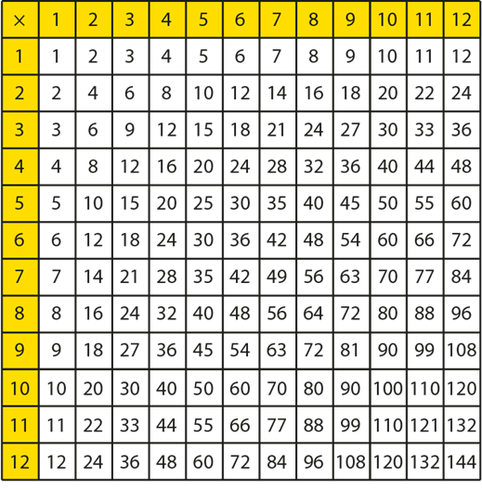
Interpret multiplication as scaling
Example 3
a) | Look at the 4s row. What does 4 need to be multiplied by:
 | (i) | to move to 8? | (ii) | to move to 28?
 | (iii) | to move to 16? | (iv) | to move to 20?
b) | Still within the 4s row, what does the 8 need to be multiplied by:
 | (i) | to move to 16? | (ii) | to move to 24?
 | (iii) | to move to 20? | (iv) | to move to 4?
c) | Consider corresponding entries in the 4s row and the 6s row.
 | (i) | What is the relationship between 8 and 12; 20 and 30; 40 and 60, etc.?
 | (ii) | Picture where 10 might be in the 4s row. What number would be in the corresponding position in the 6s row?
Notes:
Suggested questioning:
What is the same and different about the questions in part a) and part b)?
What is ‘between’ the numbers in the grid?
Things for you to think about:
How can this representation be used to think about multiplication both as ‘grouping’ and as ‘scaling’?
It might be worth drawing students’ attention to the fact that multiplication by a non-integer can ‘fill the gaps’ when moving from one number to another multiplicatively. For example, you could ask them where 1.5x4 would be represented in the grid.

Slide 20
Interpret multiplication as scaling
Example 3
a) | Look at the 4s row. What does 4 need to be multiplied by:
 | (i) | to move to 8? | (ii) | to move to 28?
 | (iii) | to move to 16? | (iv) | to move to 20?
b) | Still within the 4s row, what does the 8 need to be multiplied by:
 | (i) | to move to 16? | (ii) | to move to 24?
 | (iii) | to move to 20? | (iv) | to move to 4?
c) | Consider corresponding entries in the 4s row and the 6s row.
 | (i) | What is the relationship between 8 and 12; 20 and 30; 40 and 60, etc.?
 | (ii) | Picture where 10 might be in the 4s row. What number would be in the corresponding position in the 6s row?
How do the questions in part a) and b) build up student understanding of multiplicative relationships?
How do the questions in part c support students to understand multiplication as scaling?
What other questions could you ask to draw students’ attention to how multiplication by non-integers would fit into this representation?
Notes:
Due to space constraints, the image on this PD discussion slide is very small. PD Leads might like to use or print the ‘in the classroom’ version of this slide for teachers to access during discussions.
Further guidance on this example, including how you might use a multiplication square to explore multiplication by non-integers, can be found on page 10 of the Core Concept document.

Slide 21
Interpret multiplication as scaling
Comparing Examples 2 and 3
What is the same/different about these two representations?
How could you show 3 x 4 using both representations?
How about $\frac{5}{2}$ x 4?
Notes:
Suggested questioning:
What is the same and different?
What calculations are easier to show with the spring? What calculations are easier to show with the table?
Things for you to think about:
How could you use each of these representations to support students to understand multiplication as scaling?

Slide 22
Interpret multiplication as scaling
Comparing Examples 2 and 3
What is the same/different about these two representations?
How do they both contribute to students’ understanding of multiplication as scaling?
What is the same/different about these two representations?
How could you show 3 x 4 using both representations?
How about $\frac{5}{2}$ x 4?
Notes:
Due to space constraints, the image on this PD discussion slide is very small. PD Leads might like to use or print the ‘in the classroom’ version of this slide for teachers to access during discussions.

Slide 23
Interpret multiplication as scaling
Example 4
a) | 1 2 | 1 |  | b) | 1 | 1.1
 | 3 | 6 |  |  | 2 | 2.2
c) | 3 | 4 |  | d) | 2 | 4
 | 7 | 8 |  |  | 6 | 8
e) | 8 | 4 |  | f) | 4 | 3
 | 16 | 8 |  |  | 1 | 0.75
Which sets of numbers show a proportional relationship?
Explain your choices.
Notes:
Suggested questioning:
Look at a non-example. How could you change one number so that it did show a proportional relationship? Is there more than one way to do this?
Things for you to think about:
Example 4 uses ratio tables to provide some examples and non-examples of proportional relationships. The numbers have been selected to offer fractions and decimals, and to show proportional relationships where the value is increasing (as read from left to right) and decreasing.
An addition to this task might be to select one of the tables that students correctly identify as being proportional, and to then rewrite it, swapping the numbers, asking if the relationship is still proportional.

Slide 24
Interpret multiplication as scaling
Example 4
What does the selection of numbers in these examples and non-examples reveal about proportional relationships?
Consider the non-examples. What misconception might these help address?
How do the examples in parts e) and f) further build pupils understanding of this representation?
a) | $$\text{1}$$ $$\text{2}$$ | 1 |  | b) | 1 | 1.1
 | 3 | 6 |  |  | 2 | 2.2
c) | 3 | 4 |  | d) | 2 | 4
 | 7 | 8 |  |  | 6 | 8
e) | 8 | 4 |  | f) | 4 | 3
 | 16 | 8 |  |  | 1 | 0.75
Which sets of numbers show a proportional relationship?
Explain your choices.
Notes:
Due to space constraints, the image on this PD discussion slide is very small. PD Leads might like to use or print the ‘in the classroom’ version of this slide for teachers to access during discussions.
Further guidance on this example, including some suggestions for depth, can be found on page 11 of the Core Concept document.

Slide 25
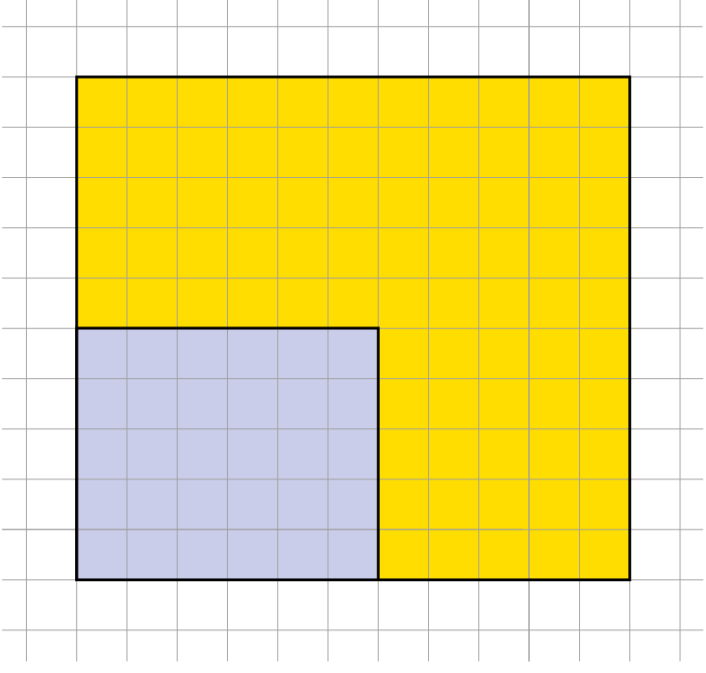
Interpret multiplication as scaling
Example 5
Are these rectangles similar shapes?
How do you know?
Notes:
Suggested questioning:
How could you change one dimension to ensure that these rectangles were similar? Is there more than one way to do this?
How could drawing a diagonal help you decide if the rectangles are similar?
Things for you to think about:
Given how common the misconception of adding as opposed to multiplying when working with a proportional relationship is, it can be useful to offer a task in which this misconception can be exposed. Example 5 gives students a (potentially) dynamic geometric context in which to discuss relationships. In this example, the rectangles have been chosen so that the larger one looks like it might be an enlargement of the smaller one; only on closer inspection can it be seen that the rule ‘add five to each side’ has been used. The use of a dynamic geometry program (or even just a drawing tool in a word processor) can add to the scaling narrative when exploring this problem with students. Drawing a diagonal through the smaller rectangle (or inviting students to do so) might help them to see that the rectangles are not similar.

Slide 26
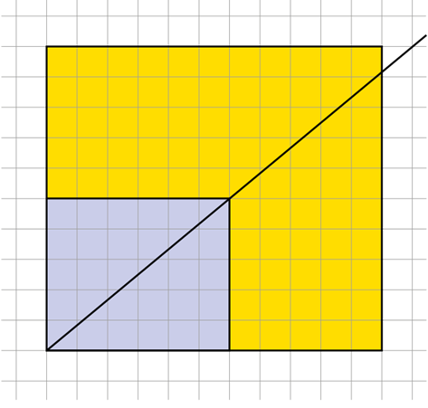
Interpret multiplication as scaling
Example 5
What misconceptions around proportional relationships might be exposed through this task?
What sentence structures might you use with students to compare corresponding lengths within the rectangles?
How might drawing a diagonal through one of the rectangles help?
Are these rectangles similar shapes?
How do you know?
Notes:
Further guidance on Example 5, including how it might link to future work on y=mx, can be found on page 12 of the Core Concepts document.

Slide 27
Interpret multiplication as rate
Example 6a
This double number line can be used to convert between pounds and dollars. £3 is equivalent to $4.
Describe how you would use the double number line to roughly convert $4.50 to pounds.
Describe how you would use the double number line to accurately convert $4.50 to pounds.
Notes:
Suggested questioning:
For every £1, how many dollars?
For every $1, how many pounds?
How can you use this to convert?
Things for you to think about:
The use of a rate for multiplication provides a context in which some different representations can be introduced and explored. The double number line is introduced in Example 6 to convert between pounds and dollars. Ensure that students are given enough time to familiarise themselves with this representation.

Slide 28
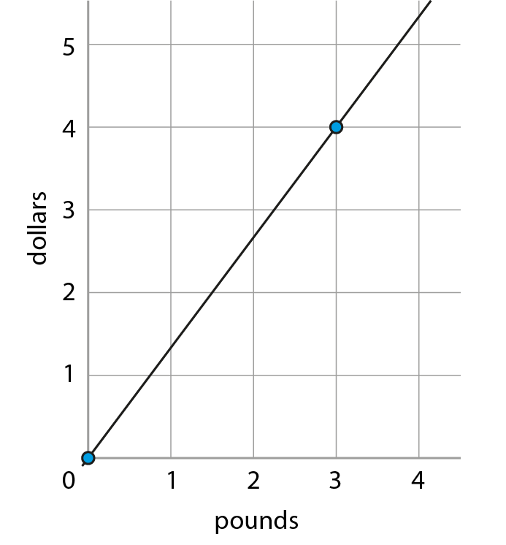
Interpret multiplication as rate
Example 6b
This graph can be used to convert between pounds and dollars.
What features of the graph show that the rate of exchange is £3 for every $4?
What features of the double number line in part a) show that the rate of exchange is £3 for every $4?
Describe how the graph would change if the rate of exchange changed to £3 for every $5.
Describe how the double number line would change if the rate of exchange changed to £3 for every $5.
Notes:
Suggested questioning:
Where is £2 in the representation? Where is $3?
Which representation do you prefer?
Things for you to think about:
The same rate from part a) can be represented using a graph, as shown in part b). The same questions can be asked to encourage students to explore the use of the graph in the context of a rate. The idea of rate can be reinforced in part b) by drawing students’ attention to the fact that they would receive $4 for every £3. Stressing the ‘for every’ part of this statement is useful in providing an image for students to work with. This language could be explored further by asking students to state other equivalent quantities of dollars and pounds that they know would align if the two number lines or the graph axes were extended.

Slide 29
Interpret multiplication as rate
Example 6c
What is the same/different about these representations?
Which do you find easier to understand?
Notes:
Suggested questioning:
What other contexts could you think of for this relationship?
Which representation makes most sense to you?
Where is £2 on each representation? Where is $3?
Things for you to think about:
It is important to allow students to see the connections between the language and the two graphical representations. Considering what features the different representations have in common, and how these might change in a different situation, may help to make these connections more explicit to students. Applying the same numbers and relationship to a different context may help students to further understand rate. For example, you might discuss a journey that was made at the rate of three miles every four minutes and consider how this would look on a double number line and a Cartesian graph.

Slide 30
Interpret multiplication as rate
Example 6a
If a double number line is unfamiliar to students, how might you introduce it before this task?
What impact, if any, do you think the use of a different exchange rate (e.g. £6:$7) might have on students’ understanding?
This double number line can be used to convert between pounds and dollars. £3 is equivalent to $4.
Describe how you would use the double number line to roughly convert $4.50 to pounds.
Describe how you would use the double number line to accurately convert $4.50 to pounds.
Notes:
Due to space constraints, the image on this PD discussion slide is very small. PD Leads might like to use or print the ‘in the classroom’ version of this slide for teachers to access during discussions.
Some explanation to these questions, as well as further guidance on this task, can be found on pages 13 and 14 of the Core Concept Document.

Slide 31
Interpret multiplication as rate
Example 6b
What are the benefits of introducing different representations of the same relationship? What are the challenges?
What other contexts might you or your students be able to find where the same relationship applies?
This graph can be used to convert between pounds and dollars.
What features of the graph show that the rate of exchange is £3 for every $4?
What features of the double number line in part a) show that the rate of exchange is £3 for every $4?
Describe how the graph would change if the rate of exchange changed to £3 for every $5.
Describe how the double number line would change if the rate of exchange changed to £3 for every $5.
Notes:
Due to space constraints, the image on this PD discussion slide is very small. PD Leads might like to use or print the ‘in the classroom’ version of this slide for teachers to access during discussions.
Some explanation to these questions, as well as further guidance on this task, can be found on pages 13 and 14 of the Core Concept Document.

Slide 32
Interpret multiplication as rate
Example 6c
Predict what responses students might give to the ‘What’s the same, what’s different’ prompt.
What classroom routines and structures would need to be established to enable you to draw out students’ understanding?
What is the same/different about these representations?
Which do you find easier to understand?
Notes:
Due to space constraints, the image on this PD discussion slide is very small. PD Leads might like to use or print the ‘in the classroom’ version of this slide for teachers to access during discussions.
Some explanation to these questions, as well as further guidance on this task, can be found on pages 13 and 14 of the Core Concept Document.

Slide 33
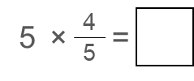
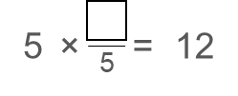
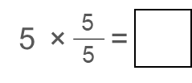
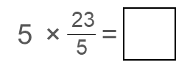
Understand that any number can be transformed into another number by multiplying
Example 7
The examples on this slide are ordered vertically, down the page.
a)
e)
i)
b)
f)
j)
c)
g)
k)
d)
h)
Notes:
Suggested questioning:
Look at parts a) to d). Is the product less than, greater than, or equal to 5?
Look at parts e, g, h and i. How do you know if the fraction will be greater or less than one?
Do you always need to calculate?
Is it always possible to go from one number to another by multiplying?
Things for you to think about:
Example 7 has been sequenced to prompt discussion about the size of the product. See pages 14-15 of the 3.1 Core Concept document for more information about the intentions behind this sequencing.

Slide 34
Understand that any number can be transformed into another number by multiplying
Example 7
What discussions might be prompted by the sequencing of these questions?
Which of these questions might you encourage pupils to answer without calculating?
Which of these questions have multiple or no possible solutions? What discussions might these prompt?
5
×
4
=
5
×
=
12
17
×
=
12
a) |  | e) |  |  | i)
b) |  | f) |  |  | j)
c) |  | g) |  |  | k)
d) |  | h)
5
5
5
×
6
=
5
×
17
=
10
×
=
0
5
5
×
5
=
14
×
=
10
5
5
×
=
0
5
×
23
=
14
5
9
×
=
Notes:
Due to space constraints, the image on this PD discussion slide is very small. PD Leads might like to use or print the ‘in the classroom’ version of this slide for teachers to access during discussions.
More detail about the decisions behind the sequencing of the questions can be found on pages 14 and 15 of the 3.1 Core Concept document.

Slide 35
Reflection questions
What other mathematical concepts will be supported by students’ stronger understanding of this key idea?
What mathematical language will you continue to use to support pupils to make connections with other areas?
Which representations might you continue to use to further develop students’ understanding?

Slide 37
Appendices
You may choose to use the following slides when planning or delivering a PD session. They cover:
Key vocabulary
Representations and structure
Previous learning
Future learning
Library of links

Slide 38
Key vocabulary
Term | Definition
proportion | A part-to-whole comparison. Example: Where £20 is shared between two people in the ratio 3 : 5, the first receives £7.50, which is $\frac{3}{8}$ of the whole £20. This is the first person’s proportion of the whole. If two variables x and y are related by an equation of the form y = kx, then y is directly proportional to x; it may also be said that y varies directly as x. When y is plotted against x, this produces a straight line graph through the origin. If two variables x and y are related by an equation of the form xy = k, or equivalently $y= \frac{k}{x}$, where k is a constant and x ≠ 0, y ≠ 0, they vary in inverse proportion to each other.
ratio | A part-to-part comparison. The ratio of a to b is usually written a : b. Example: In a recipe for pastry, fat and flour are mixed in the ratio 1 : 2, which means that the fat used has half the mass of the flour. That is, $\frac{amount of fat}{amount of flour}=\frac{1}{2}$ . Thus, ratios are equivalent to particular fractional parts.

Slide 39
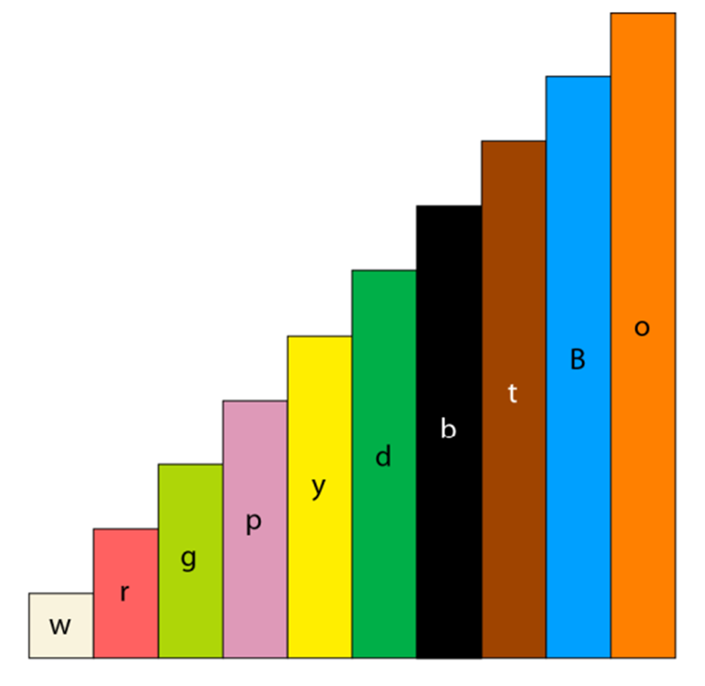
Representations and structure (1)
There are a number of different representations that you may wish to use to support students’ understanding of this key idea. These might include:
Arrays
An array is a rectangular arrangement of dots in rows and columns, where each column has the same number of dots. When the rectangle has continuous measures for the dimensions, it becomes a useful way of thinking about the product of any two numbers including decimals and fractions.
Cuisenaire™ rods
These colour rods of varying sizes from 1cm to 10cm long are a powerful representation to support students’ understanding of multiplicative relationships. By allowing the value of any particular rod to vary, the multiplicative relationships between them can be explored.
Notes:
More information about the representations and structure involved in this key idea can be found:
On pages 6-7 of the Multiplicative Reasoning Theme Overview document
In the NCETM’s resource on Using mathematical representations at KS3
Links to all of these can be found on the final slide.

Slide 40
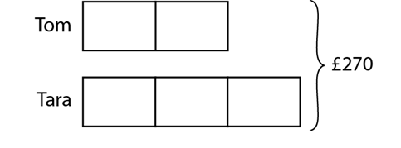
Representations and structure (2)
There are a number of different representations that you may wish to use to support students’ understanding of this key idea. These might include:
Bar models
Bar models can be very useful to support students in representing (literally, re-presenting) problems in order to reveal multiplicative structures (as appropriate) and thus become aware of how to proceed to a solution.
Ratio tables and double number lines (also known as ‘stacked number lines’)
The comparison of corresponding entries in two different sets of multiples, such as from a multiplication table, can be a useful context in which to explore multiplicative relationships.
Tom and Tara share £270 between them in the ratio 2 : 3. How much do they each receive?
Notes:
More information about the representations and structure involved in this key idea can be found:
On page 7 of the Multiplicative Reasoning Theme Overview document
Links to all of these can be found on the final slide.

Slide 41
Previous learning
From Upper Key Stage 2, students will bring experience of:
multiplying proper fractions and mixed numbers by whole numbers, supported by materials and diagrams
recognising the per cent symbol (%) and understanding that per cent relates to ‘number of parts per hundred’, and writing percentages as a fraction with denominator 100, and as a decimal
using all four operations to solve problems involving measure (for example, length, mass, volume, money) using decimal notation, including scaling
solving problems involving the relative sizes of two quantities where missing values can be found by using integer multiplication and division facts
solving problems involving the calculation of percentages (for example, of measures, and such as 15% of 360) and the use of percentages for comparison
solving problems involving similar shapes where the scale factor is known or can be found
solving problems involving unequal sharing and grouping, using knowledge of fractions and multiples.
Notes:
Theme 3 Multiplicative reasoning

Slide 42
Future learning
In KS4, students will build on the core concepts in this mathematical theme to:
compare lengths, areas and volumes using ratio notation and/or scale factors; make links to similarity (including trigonometric ratios)
convert between related compound units (speed, rates of pay, prices, density, pressure) in numerical and algebraic contexts
understand that $X$ is inversely proportional to $Y$ is equivalent to $X$ is proportional to $\frac{1}{Y}$
{construct and} interpret equations that describe direct and inverse proportion
interpret the gradient of a straight-line graph as a rate of change; recognise and interpret graphs that illustrate direct and inverse proportion
{interpret the gradient at a point on a curve as the instantaneous rate of change; apply the concepts of instantaneous and average rate of change (gradients of tangents and chords) in numerical, algebraic and graphical contexts}
set up, solve and interpret the answers in growth and decay problems, including compound interest {and work with general iterative processes}.
Please note: Braces { } indicate additional mathematical content to be taught to more highly attaining students.
Notes:
Theme 3 Multiplicative reasoning

Slide 43
Library of links
The following resources from the NCETM website have been referred to within this slide deck:
NCETM Secondary Mastery Professional Development
3 Multiplicative Reasoning Theme Overview Document
3.1 Understanding Multiplicative Relationships Core Concept Document
Using mathematical representations at KS3 | NCETM
Insights from experienced teachers | NCETM
Mathematical Prompts for Deeper Thinking videos | NCETM
NCETM primary mastery professional deelopment materials
NCETM primary assessment materials
NCETM secondary assessment materials
There are also references to:
Standards & Testing Agency’s past mathematics papers

