Slide 1
Year 1, Unit 2
Comparison of quantities and part-whole relationships

Slide 2
Year 1, Unit 2
These materials heavily reflect the prioritisation approach of the ready-to-progress criteria in the DfE Primary Mathematics Guidance 2020 and on the PPTs that exemplify them on the NCETM website. They also include other relevant National Curriculum content. Related sections of the NCETM Primary Mastery Professional Development Materials provide small-step teaching guidance.
Ready-to-progress criteria addressed by this unit
Teaching of this unit supports the following criteria from the ‘DfE Mathematics Guidance: key stages 1 & 2’ (the 335-page document available as a download)
1NPV-1 Page 18
1NPV-2 Page 20
Previous Experience
If the children have the following previous experience, contained in the same DfE guidance document as above, they will be ready to start this unit.
Previous experience prior to 1NPV-1 Page 16
Previous experience prior to 1NPV-2 Page 16

Slide 3
Contents
The links below take you to the starting slide of each learning outcome.
1 | Pupils explain that items can be compared using length and height
2 | Pupils explain that items can be compared using weight/mass and volume/capacity
3 | Pupils count a set of objects
4 | Pupils compare sets of objects
5 | Pupils use equality and inequality symbols to compare sets of objects
6 | Pupils use equality and inequality symbols to compare expressions
7 | Pupils explain what a whole is
Click the arrow button to return to this Contents slide.

Slide 4
Contents
The links below take you to the starting slide of each learning outcome.
8 | Pupils explain that a whole can be split into parts
9 | Pupils explain that a whole can represent a group of objects
10 | Pupils identify a part of a whole group
11 | Pupils explain what a part-whole model is
12 | Pupils use a part-whole model to represent a whole partitioned into two parts
13 | Pupils use a part-whole model to represent a whole partitioned into more than two parts
Click the arrow button to return to this Contents slide.

Slide 5
Year 1, Unit 2, Learning Outcome 1
Learning Outcome 1
Pupils explain that items can be compared using length and height
The following slides have been collated to support the teaching of this learning outcome.

Slide 6
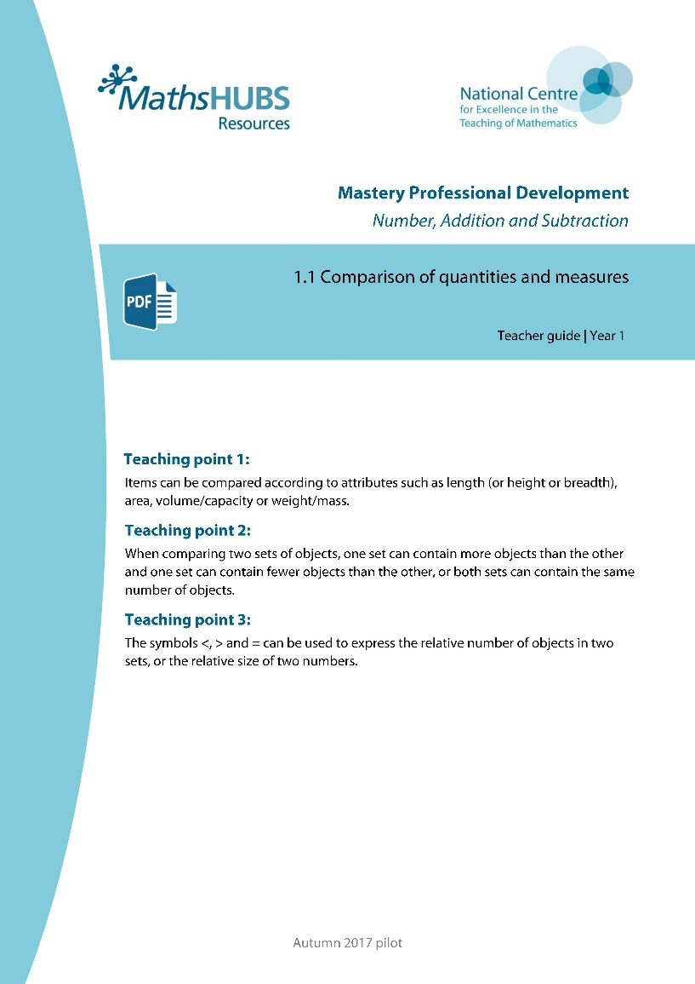
Year 1, Unit 2, Learning Outcome 1
Additional teacher guidance for this outcome should be read first and can be found in this segment of the NCETM Primary Mastery Professional Development Materials:
1.1 Comparison of quantities and measures
The spine materials are divided into ‘teaching points’ and ‘steps in learning’.
Teaching point | Steps in learning | Pages
1 | 1:1-1:6 | 3-6

Slide 7

1.1 Comparisons of quantities and measures – step 1:1

Slide 8


1.1 Comparisons of quantities and measures – step 1:2

Slide 9
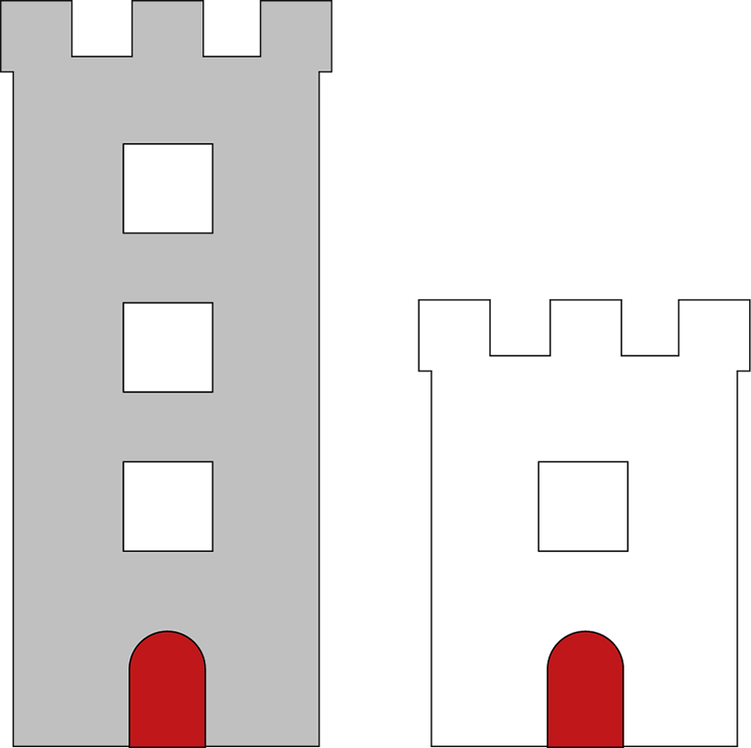
1.1 Comparisons of quantities and measures – step 1:2

Slide 10

1.1 Comparisons of quantities and measures – step 1:3

Slide 11
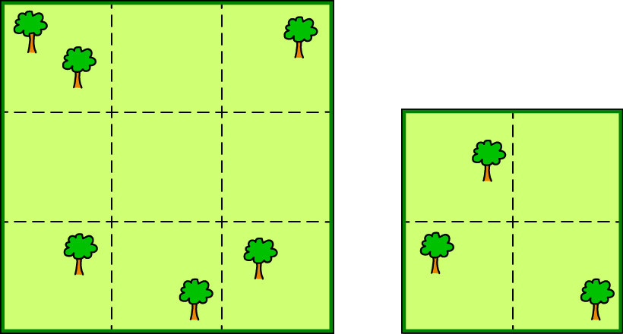
1.1 Comparisons of quantities and measures – step 1:4

Slide 12


1.1 Comparisons of quantities and measures – step 1:5

Slide 13
Year 1, Unit 2, Learning Outcome 2
Learning Outcome 2
Pupils explain that items can be compared using weight/mass and volume/capacity
The following slides have been collated to support the teaching of this learning outcome.

Slide 14
Year 1, Unit 2, Learning Outcome 2
Additional teacher guidance for this outcome should be read first and can be found in this segment of the NCETM Primary Mastery Professional Development Materials:
1.1 Comparison of quantities and measures
The spine materials are divided into ‘teaching points’ and ‘steps in learning’.
Teaching point | Steps in learning | Pages
1 | 1:1-1:6 | 3-6

Slide 15

1.1 Comparisons of quantities and measures – step 1:2

Slide 16


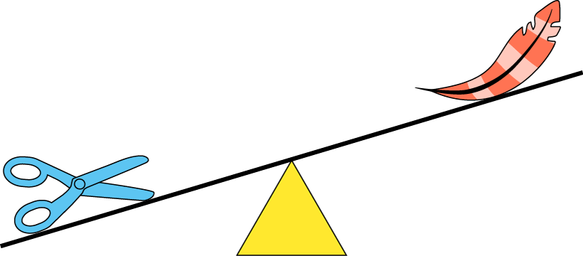

1.1 Comparisons of quantities and measures – step 1:3

Slide 17
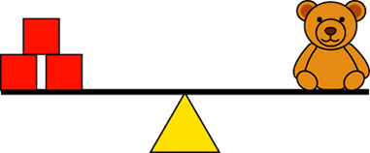
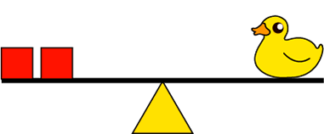
1.1 Comparisons of quantities and measures – step 1:5

Slide 18
Year 1, Unit 2, Learning Outcome 3
Learning Outcome 3
Pupils count a set of objects
The following slides have been collated to support the teaching of this learning outcome.

Slide 19
Year 1, Unit 2, Learning Outcome 3
Additional teacher guidance for this outcome should be read first and can be found in this segment of the NCETM Primary Mastery Professional Development Materials:
1.1 Comparison of quantities and measures
The spine materials are divided into ‘teaching points’ and ‘steps in learning’.
Teaching point | Steps in learning | Pages
2 | 2:1-2:5 | 7-10

Slide 20
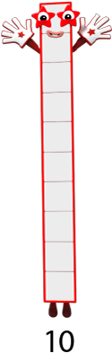









1.1 Comparisons of quantities and measures – step 2:1
Images © 2017 Alphablocks Ltd. All Rights Reserved.

Slide 21









1.1 Comparisons of quantities and measures – step 2:1
1
2
3
4
5
6
7
8
9
10

Slide 22










1.1 Comparisons of quantities and measures – step 2:1

Slide 23








1.1 Comparisons of quantities and measures – step 2:2
5
2
1
4
3
7
6

Slide 24


1.1 Comparisons of quantities and measures – step 2:3
eight
seven
three
one
two
four
five
six

Slide 25




1.1 Comparisons of quantities and measures – step 2:4
1
2
3
4

Slide 26
1.1 Comparisons of quantities and measures – step 2:4
4
3
2
1

Slide 27

1.1 Comparisons of quantities and measures – step 2:4

Slide 28

1.1 Comparisons of quantities and measures – step 2:4

Slide 29

1.1 Comparisons of quantities and measures – step 2:4

Slide 30

1.1 Comparisons of quantities and measures – step 2:5

Slide 31
Year 1, Unit 2, Learning Outcome 4
Learning Outcome 4
Pupils compare sets of objects
The following slides have been collated to support the teaching of this learning outcome.

Slide 32
Year 1, Unit 2, Learning Outcome 4
Additional teacher guidance for this outcome should be read first and can be found in this segment of the NCETM Primary Mastery Professional Development Materials:
1.1 Comparison of quantities and measures
The spine materials are divided into ‘teaching points’ and ‘steps in learning’.
Teaching point | Steps in learning | Pages
2 | 2:6-2:9 | 11-14

Slide 33

1.1 Comparisons of quantities and measures – step 2:6

Slide 34
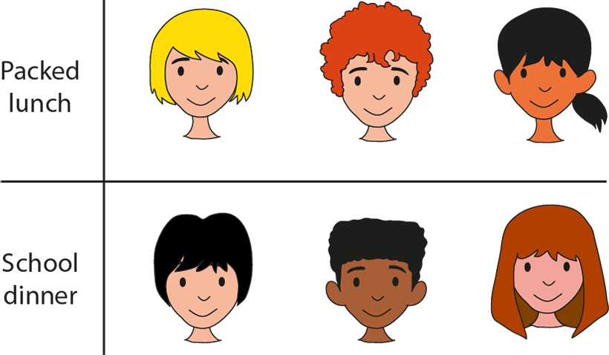
1.1 Comparisons of quantities and measures – step 2:6

Slide 35


1.1 Comparisons of quantities and measures – step 2:7

Slide 36



1.1 Comparisons of quantities and measures – step 2:7

Slide 37
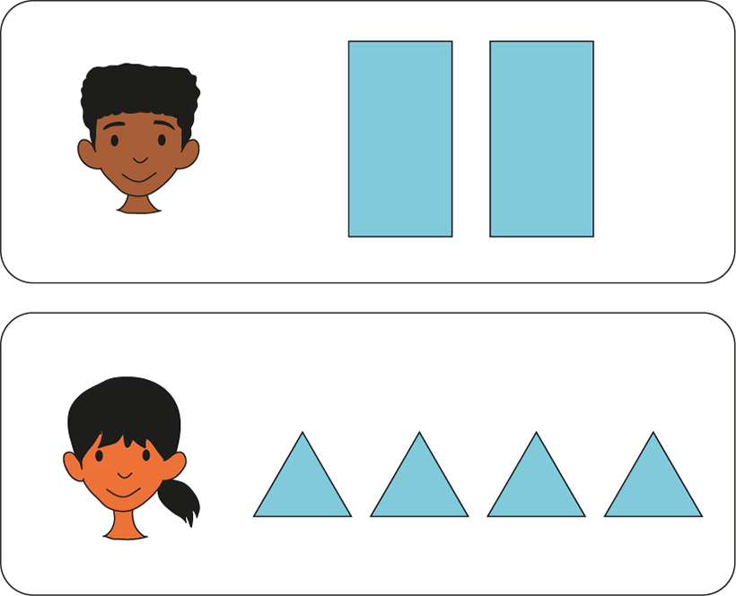
1.1 Comparisons of quantities and measures – step 2:8

Slide 38
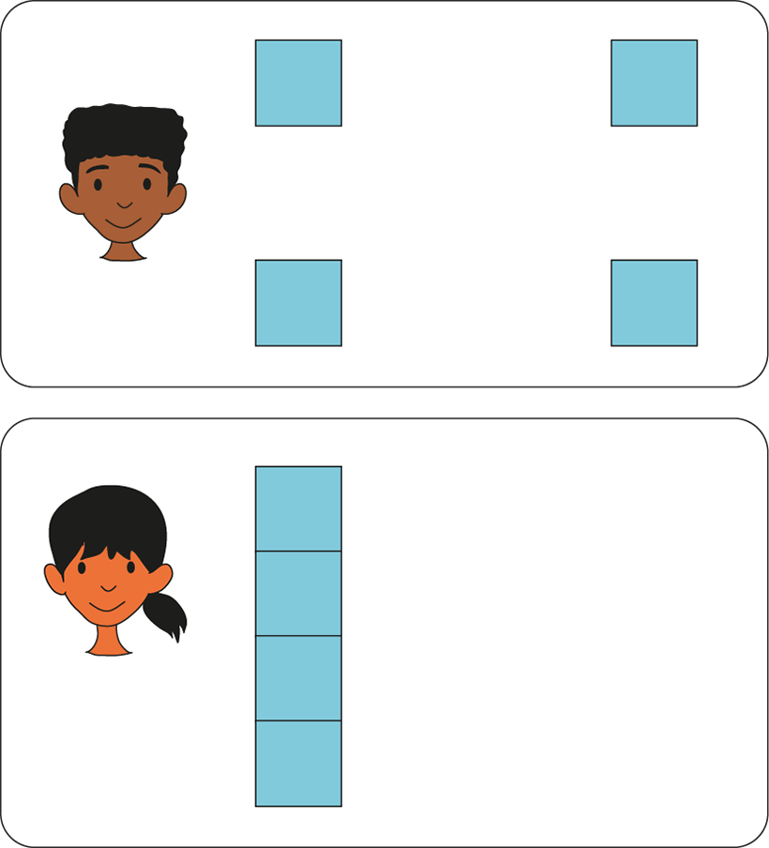
1.1 Comparisons of quantities and measures – step 2:8

Slide 39

1.1 Comparisons of quantities and measures – step 2:9
Adam
Nick
Tom

Slide 40

1.1 Comparisons of quantities and measures – step 2:9
Clare
Joe
Aisha
?

Slide 41
Year 1, Unit 2, Learning Outcome 5
Learning Outcome 5
Pupils use equality and inequality symbols to compare sets of objects
The following slides have been collated to support the teaching of this learning outcome.

Slide 42
Year 1, Unit 2, Learning Outcome 5
Additional teacher guidance for this outcome should be read first and can be found in this segment of the NCETM Primary Mastery Professional Development Materials:
1.1 Comparison of quantities and measures
The spine materials are divided into ‘teaching points’ and ‘steps in learning’.
Teaching point | Steps in learning | Pages
3 | 3:1-3:4 | 15-16

Slide 43
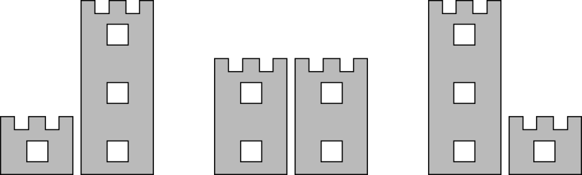






1.1 Comparisons of quantities and measures – step 3:1
1
<
3
2
=
2
3
>
1

Slide 44
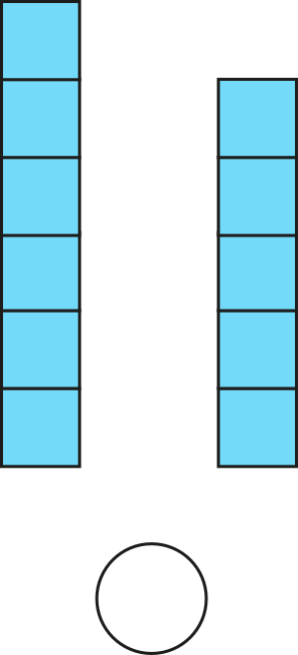
1.1 Comparisons of quantities and measures – step 3:2
6
>
5

Slide 45
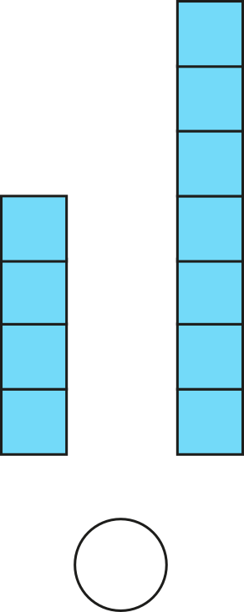
1.1 Comparisons of quantities and measures – step 3:2
4
<
7

Slide 46
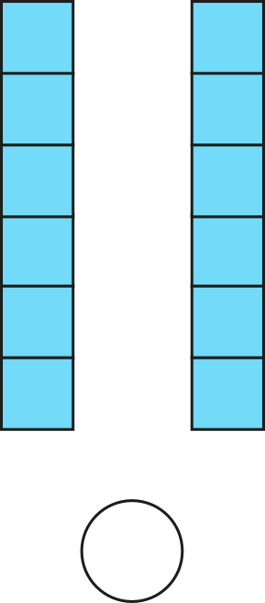
1.1 Comparisons of quantities and measures – step 3:2
6
=
6

Slide 47
Year 1, Unit 2, Learning Outcome 6
Learning Outcome 6
Pupils use equality and inequality symbols to compare expressions
The following slides have been collated to support the teaching of this learning outcome.

Slide 48
Year 1, Unit 2, Learning Outcome 6
Additional teacher guidance for this outcome should be read first and can be found in this segment of the NCETM Primary Mastery Professional Development Materials:
1.1 Comparison of quantities and measures
The spine materials are divided into ‘teaching points’ and ‘steps in learning’.
Teaching point | Steps in learning | Pages
3 | 3:5-3:6 | 16-17

Slide 49



1.1 Comparisons of quantities and measures – step 3:4
6
>
5
5
<
6

Slide 50




1.1 Comparisons of quantities and measures – step 3:5
5

Slide 51





1.1 Comparisons of quantities and measures – step 3:5
5
7
increase
decrease
5
<
7

Slide 52
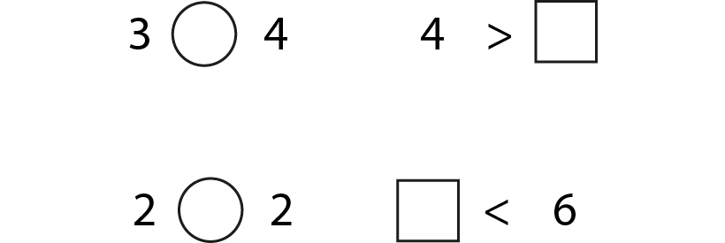
1.1 Comparisons of quantities and measures – step 3:6

Slide 53
Year 1, Unit 2, Learning Outcome 7
Learning Outcome 7
Pupils explain what a whole is
The following slides have been collated to support the teaching of this learning outcome.

Slide 54
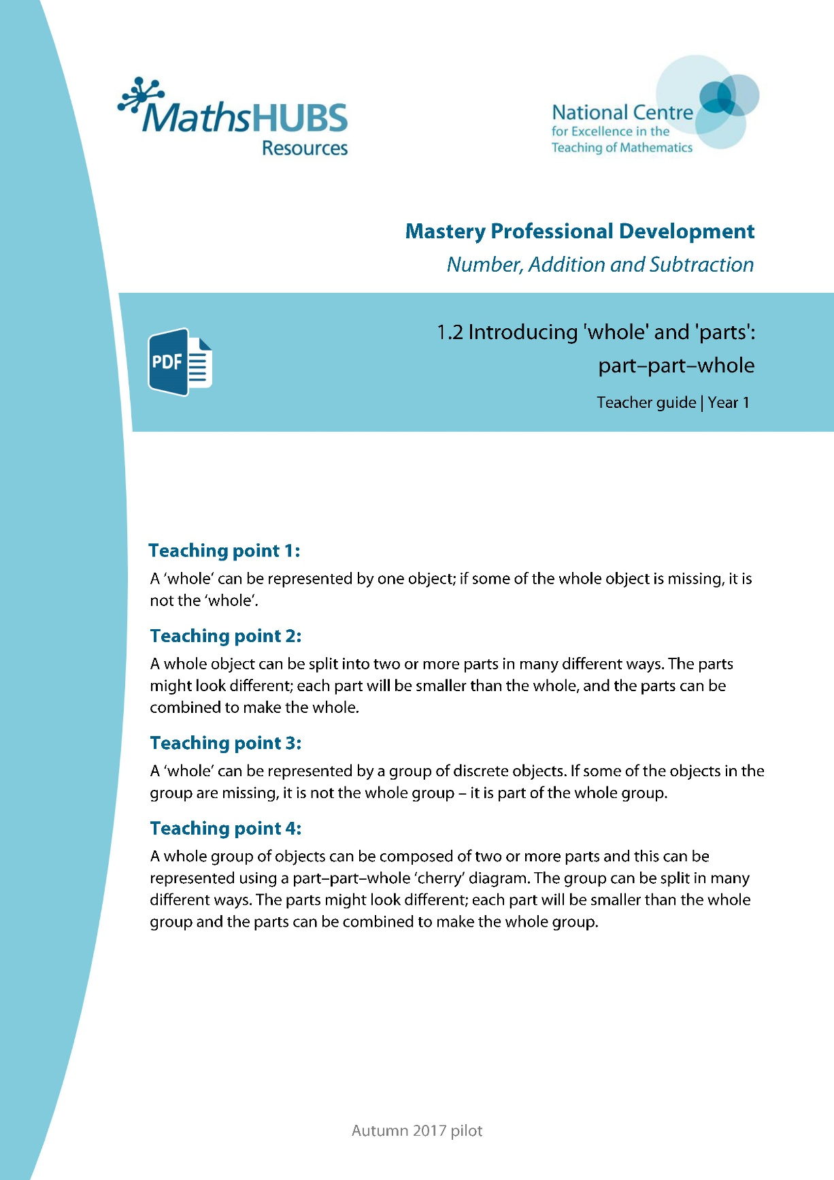
Year 1, Unit 2, Learning Outcome 7
Additional teacher guidance for this outcome should be read first and can be found in this segment of the NCETM Primary Mastery Professional Development Materials:
1.2 Introducing ‘whole’ and ‘parts’: part-part-whole
The spine materials are divided into ‘teaching points’ and ‘steps in learning’.
Teaching point | Steps in learning | Pages
1 | 1:1-1:3 | 3-5

Slide 55

1.2 Part–part–whole – step 1:1

Slide 56

1.2 Part–part–whole – step 1:1

Slide 57

1.2 Part–part–whole – step 1:2

Slide 58


1.2 Part–part–whole – step 1:3

Slide 59
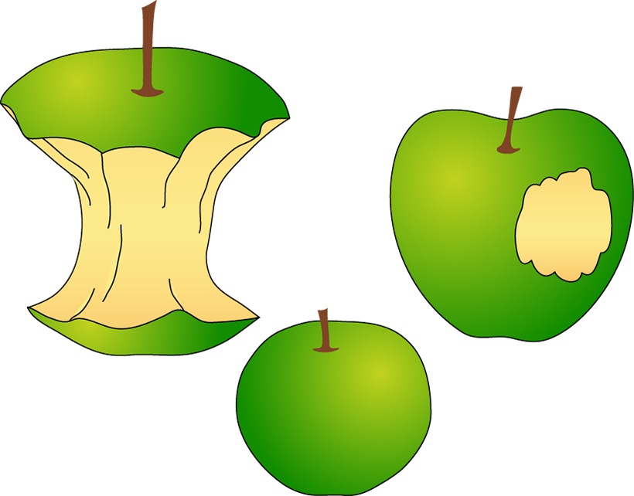
1.2 Part–part–whole – step 1:3

Slide 60
Year 1, Unit 2, Learning Outcome 8
Learning Outcome 8
Pupils explain that a whole can be split into parts
The following slides have been collated to support the teaching of this learning outcome.

Slide 61
Year 1, Unit 2, Learning Outcome 8
Additional teacher guidance for this outcome should be read first and can be found in this segment of the NCETM Primary Mastery Professional Development Materials:
1.2 Introducing ‘whole’ and ‘parts’: part-part-whole
The spine materials are divided into ‘teaching points’ and ‘steps in learning’.
Teaching point | Steps in learning | Pages
2 | 2:1-2:3 | 6-8

Slide 62
















1.2 Part–part–whole – step 2:1

Slide 63
1.2 Part–part–whole – step 2:1

Slide 64

1.2 Part–part–whole – step 2:3

Slide 65
Year 1, Unit 2, Learning Outcome 9
Learning Outcome 9
Pupils explain that a whole can represent a group of objects
The following slides have been collated to support the teaching of this learning outcome.

Slide 66
Year 1, Unit 2, Learning Outcome 9
Additional teacher guidance for this outcome should be read first and can be found in this segment of the NCETM Primary Mastery Professional Development Materials:
1.2 Introducing ‘whole’ and ‘parts’: part-part-whole
The spine materials are divided into ‘teaching points’ and ‘steps in learning’.
Teaching point | Steps in learning | Pages
3 | 3:1-3:4 | 9-12

Slide 67

1.2 Part–part–whole – step 3:1

Slide 68
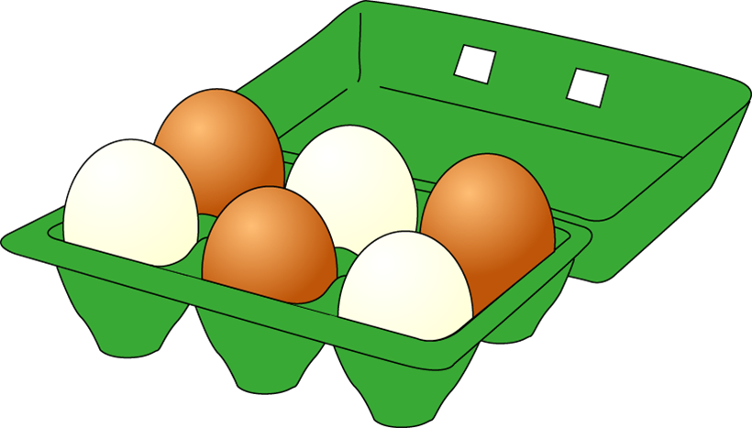
1.2 Part–part–whole – step 3:2

Slide 69
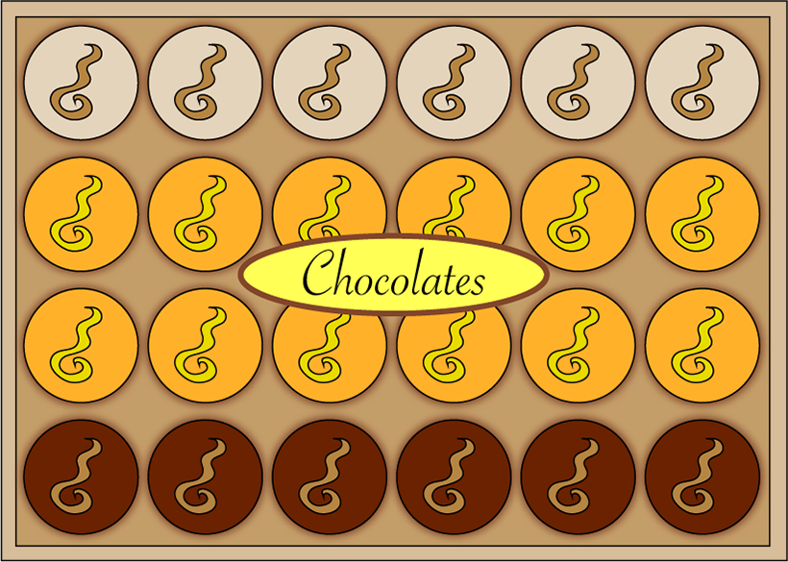
1.2 Part–part–whole – step 3:2

Slide 70
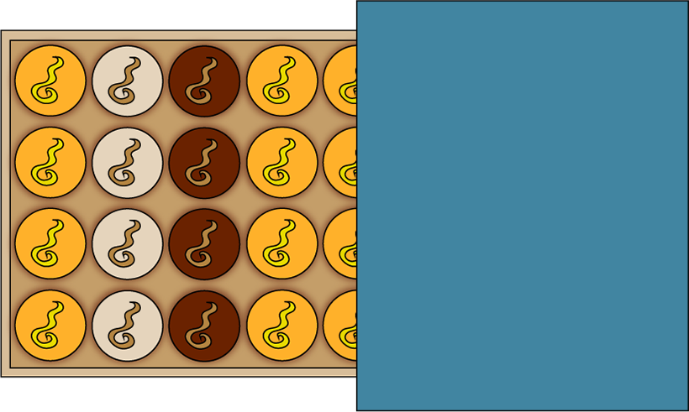
1.2 Part–part–whole – step 3:2

Slide 71
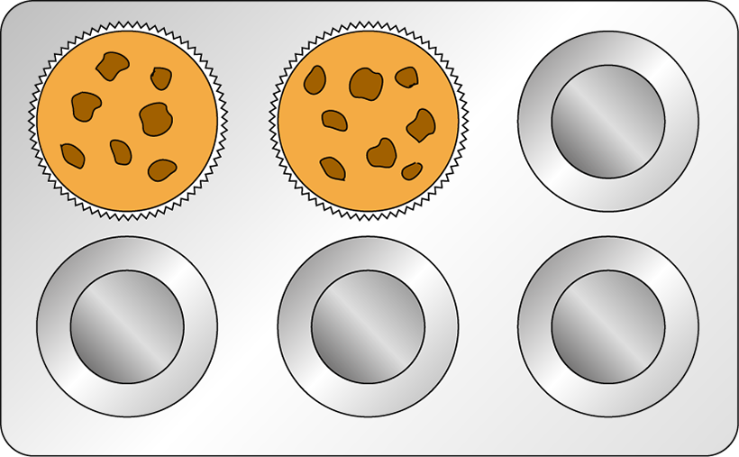
1.2 Part–part–whole – step 3:3

Slide 72


1.2 Part–part–whole – step 3:3

Slide 73
Year 1, Unit 2, Learning Outcome 10
Learning Outcome 10
Pupils identify a part of a whole group
The following slides have been collated to support the teaching of this learning outcome.

Slide 74
Year 1, Unit 2, Learning Outcome 10
Additional teacher guidance for this outcome should be read first and can be found in this segment of the NCETM Primary Mastery Professional Development Materials:
1.2 Introducing ‘whole’ and ‘parts’: part-part-whole
The spine materials are divided into ‘teaching points’ and ‘steps in learning’.
Teaching point | Steps in learning | Pages
3 | 3:5-3:6 | 12-14

Slide 75

1.2 Part–part–whole – step 3:5

Slide 76

1.2 Part–part–whole – step 3:5

Slide 77


1.2 Part–part–whole – step 3:6

Slide 78
1.2 Part–part–whole – step 3:6

Slide 79
1.2 Part–part–whole – step 3:6

Slide 80
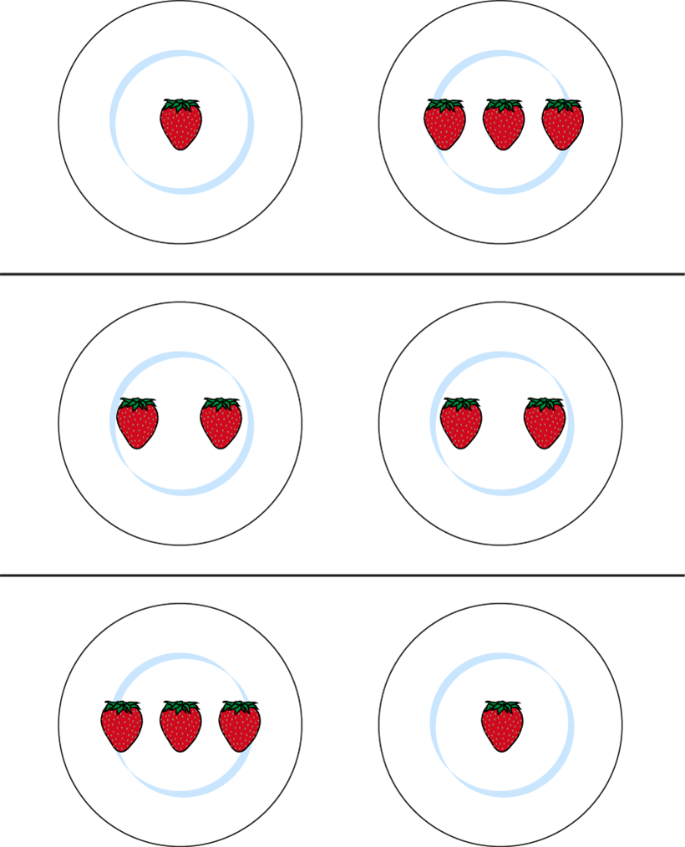
1.2 Part–part–whole – step 3:6

Slide 81
Year 1, Unit 2, Learning Outcome 11
Learning Outcome 11
Pupils explain what a part-whole model is
The following slides have been collated to support the teaching of this learning outcome.

Slide 82
Year 1, Unit 2, Learning Outcome 11
Additional teacher guidance for this outcome should be read first and can be found in this segment of the NCETM Primary Mastery Professional Development Materials:
1.2 Introducing ‘whole’ and ‘parts’: part-part-whole
The spine materials are divided into ‘teaching points’ and ‘steps in learning’.
Teaching point | Steps in learning | Pages
4 | 4:1-4:4 | 15-19

Slide 83

1.2 Part–part–whole – step 4:4

Slide 84
1.2 Part–part–whole – step 4:4

Slide 85
1.2 Part–part–whole – step 4:4

Slide 86
1.2 Part–part–whole – step 4:4
5
3
2

Slide 87
1.2 Part–part–whole – step 4:4
5
2
3

Slide 88
1.2 Part–part–whole – step 4:4
1.2 Part–part–whole – Steps 4:4
5
1
4

Slide 89
1.2 Part–part–whole – step 4:4
5
4
1

Slide 90
Year 1, Unit 2, Learning Outcome 12
Learning Outcome 12
Pupils use a part-whole model to represent a whole partitioned into two parts
The following slide supports the teaching of this learning outcome.

Slide 91
Year 1, Unit 2, Learning Outcome 12
Additional teacher guidance for this outcome should be read first and can be found in this segment of the NCETM Primary Mastery Professional Development Materials:
1.2 Introducing ‘whole’ and ‘parts’: part-part-whole
The spine materials are divided into ‘teaching points’ and ‘steps in learning’.
Teaching point | Steps in learning | Pages
4 | 4:5-4:6 | 19-20

Slide 92
Year 1, Unit 2, Learning Outcome 13
Learning Outcome 13
Pupils use a part-whole model to represent a whole partitioned into more than two parts
The following slides have been collated to support the teaching of this learning outcome.

Slide 93
Year 1, Unit 2, Learning Outcome 13
Additional teacher guidance for this outcome should be read first and can be found in this segment of the NCETM Primary Mastery Professional Development Materials:
1.2 Introducing ‘whole’ and ‘parts’: part-part-whole
The spine materials are divided into ‘teaching points’ and ‘steps in learning’.
Teaching point | Steps in learning | Pages
4 | 4:7 | 20-21

Slide 94

1.2 Part–part–whole – step 4:7

Slide 95
1.2 Part–part–whole – step 4:7

