Slide 1
Year 3, Unit 6
2, 4, 8 times tables

Slide 2
Year 3, Unit 6
These materials heavily reflect the prioritisation approach of the ready-to-progress criteria in the DfE Primary Mathematics Guidance 2020 and on the PPTs that exemplify them on the NCETM website. They also include other relevant National Curriculum content. Related sections of the NCETM Primary Mastery Professional Development Materials provide small-step teaching guidance.
Ready-to-progress criteria addressed by this unit
Teaching of this unit supports the following criteria from the ‘DfE Mathematics Guidance: key stages 1 & 2’ (the 335-page document available as a download)
3NF-2 Page 100
3MD-1 Page 117
3NF-3 Page 103
Prior learning
If the following ready-to-progress criteria, contained in the same DfE guidance document as above, were secured in Year 1, children will be ready to start on this unit.
1NF-2 Page 26

Slide 3
Contents
The links below take you to the starting slide of each learning outcome.
1 | Pupils represent counting in fours as the 4 times table
2 | Pupils use knowledge of the 4 times table to solve problems
3 | Pupils explain the relationship between adjacent multiples of four
4 | Pupils explain the relationship between multiples of 2 and multiples of 4
5 | Pupils use knowledge of the relationships between the 2 and 4 times tables to solve problems
Click the arrow button to return to this Contents slide.

Slide 4
Contents
The links below take you to the starting slide of each learning outcome.
6 | Pupils represent counting in eights as the 8 times table
7 | Pupils explain the relationship between adjacent multiples of eight
8 | Pupils explain the relationship between multiples of 4 and multiples of 8
9 | Pupils use knowledge of the relationships between the 4 and 8 times tables to solve problems
10 | Pupils explain the relationship between multiples of 2, 4 and multiples of 8
Click the arrow button to return to this Contents slide.

Slide 5
Contents
The links below take you to the starting slide of each learning outcome.
11 | Pupils use knowledge of the relationships between the 2, 4 and 8 times tables to solve problems
12 | Pupils use knowledge of the divisibility rules for divisors of 2 and 4 to solve problems
13 | Pupils use knowledge of the divisibility rules for divisors of 8 to solve problems
14 | Pupils scale known multiplication facts by 10
15 | Pupils scale division derived from multiplication facts by 10
Click the arrow button to return to this Contents slide.

Slide 6
Year 3, Unit 6, Learning Outcome 1
Learning Outcome 1
Pupils represent counting in fours as the 4 times table
The following slides have been collated to support the teaching of this learning outcome.

Slide 7
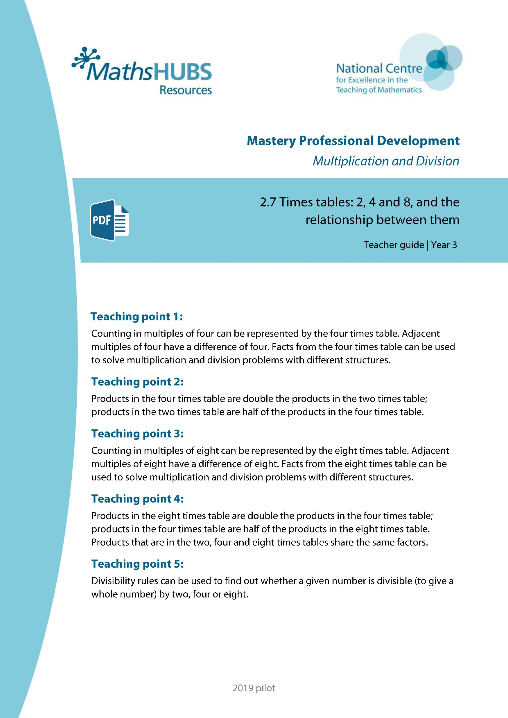
Year 3, Unit 6, Learning Outcome 1
Additional teacher guidance for this outcome should be read first and can be found in this segment of the NCETM Primary Mastery Professional Development Materials:
2.7 Times tables: 2, 4 and 8 and the relationship between them
The spine materials are divided into ‘teaching points’ and ‘steps in learning’.
Teaching point | Steps in learning | Pages
1 | 1:1-1:6 and 1:11 | 3-8 and 15-16

Slide 8
2.7 The 2, 4 and 8 times tables Step 1:1
0
2
4
6
8
10
12
14
16
18
20
22
24

Slide 9
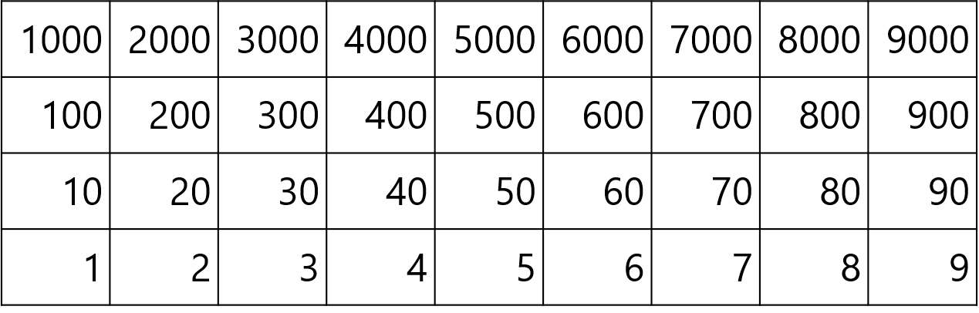
2.7 The 2, 4 and 8 times tables Step 1:1

Slide 10






2.7 The 2, 4 and 8 times tables Step 1:1
10
12
14
16
18
20
22
24
0
4
2
6
8
twenty-four
twenty-two
eighteen
fourteen
sixteen
twenty
twelve
eight
zero
four
two
ten
six

Slide 11
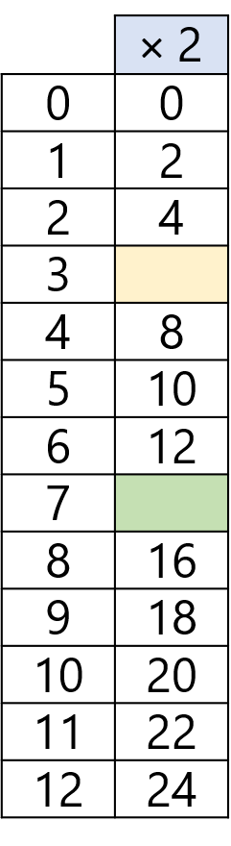
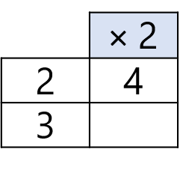
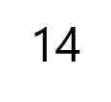

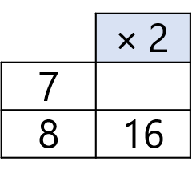


2.7 The 2, 4 and 8 times tables Step 1:1
↑ − 2
↓ + 2
3 × 2 = 2 × 2 + 2
7 × 2 = 8 × 2 − 2
+ 2
− 2
0
2
4
6
8
10
12
14
16
18
20

Slide 12



2.7 The 2, 4 and 8 times tables Step 1:2
How many wheels? Count in groups of 4.
There are 20 wheels.
5 × 4 = 20
4 × 5 = 20
Notes:
There are five groups of four. There are four, five times.
There are twenty altogether.
Five is a factor. Four is a factor.
The product of five and four is twenty.
Twenty is the product of five and four.

Slide 13






2.7 The 2, 4 and 8 times tables Step 1:3
1 × 4 = 4 4 × 1 = 4
3 × 4 = 12 4 × 3 = 12
2 × 4 = 8 4 × 2 = 8
0 × 4 = 0 4 × 0 = 0
Notes:
When zero is a factor, the product is zero.

Slide 14
2.7 The 2, 4 and 8 times tables Step 1:4
0
4
8
12
16
20
24
28
32
36
40
44
48

Slide 15
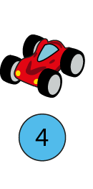
2.7 The 2, 4 and 8 times tables Step 1:5
Number of cars
Total number of wheels
0
1
2
3
4
5
6
0
4
8
12
16
20
24
0
3 × 4 = 12 4 × 3 = 12
6 × 4 = 24 4 × 6 = 24
4 × 4 = 16 4 × 4 = 16
5 × 4 = 20 4 × 5 = 20
0 × 4 = 0 4 × 0 = 0
1 × 4 = 4 4 × 1 = 4
2 × 4 = 8 4 × 2 = 4

Slide 16
2.7 The 2, 4 and 8 times tables Step 1:6
Number of cars | Total number of wheels
0 | 0
1 | 4
2 | 8
3 | 12
4 | 16
5 | 20
6 | 24
7 | 28
8 | 32
9 | 36
10 | 40
11 | 44
12 | 48
0 × 4 = 0 | 4 × 0 = 0
1 × 4 = 4 | 4 × 1 = 4
2 × 4 = 8 | 4 × 2 = 8
3 × 4 = 12 | 4 × 3 = 12
4 × 4 = 16 | 4 × 4 = 16
5 × 4 = 20 | 4 × 5 = 20
6 × 4 = 24 | 4 × 6 = 24
7 × 4 = 28 | 4 × 7 = 28
8 × 4 = 32 | 4 × 8 = 32
9 × 4 = 36 | 4 × 9 = 36
10 × 4 = 40 | 4 × 10 = 40
11 × 4 = 44 | 4 × 11 = 44
12 × 4 = 48 | 4 × 12 = 48

Slide 17
Year 3, Unit 6, Learning Outcome 2
Learning Outcome 2
Pupils use knowledge of the 4 times table to solve problems
The following slides have been collated to support the teaching of this learning outcome.

Slide 18
Year 3, Unit 6, Learning Outcome 2
Additional teacher guidance for this outcome should be read first and can be found in this segment of the NCETM Primary Mastery Professional Development Materials:
2.7 Times tables: 2, 4 and 8 and the relationship between them
The spine materials are divided into ‘teaching points’ and ‘steps in learning’.
Teaching point | Steps in learning | Pages
1 | 1:7-1:8 and 1.11 | 9-12 and 15-16

Slide 19
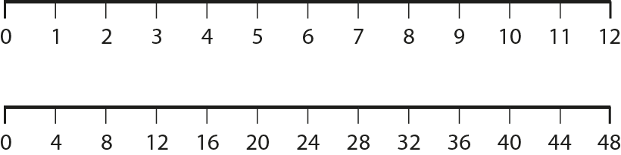
2.7 The 2, 4 and 8 times tables Step 1:7

Slide 20
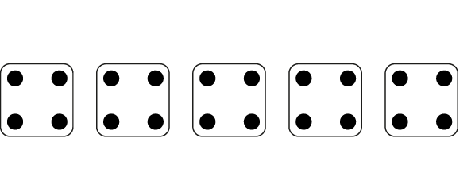
2.7 The 2, 4 and 8 times tables Step 1:8
5 × 4 =
20
4 × 5 =
20
Notes:
Complete the equations to show how many dots there are altogether.

Slide 21
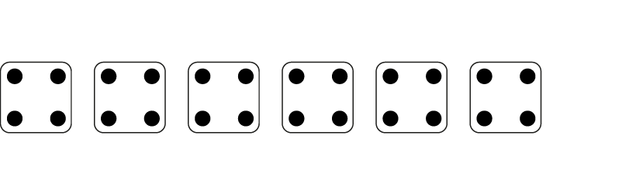
2.7 The 2, 4 and 8 times tables Step 1:8
6
× 4 =
24
4 ×
6
=
24
Notes:
Complete the equations to show how many dots there are altogether.

Slide 22
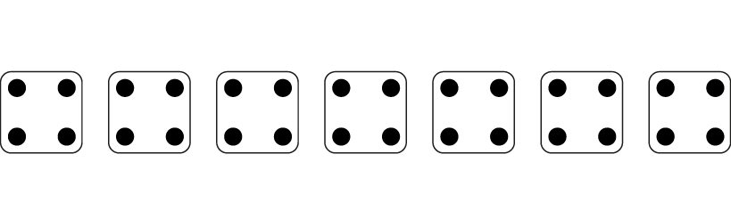
2.7 The 2, 4 and 8 times tables Step 1:8
7
×
4
=
28
4
×
7
=
28
Notes:
Complete the equations to show how many dots there are altogether.

Slide 23

2.7 The 2, 4 and 8 times tables Step 1:8
Eloise wrote this.
This shows 4 x 3 = 12.
Draw a picture like this to show 4 × 6 = 24.

Slide 24
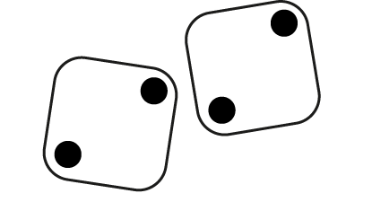

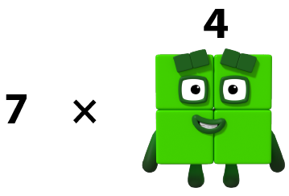
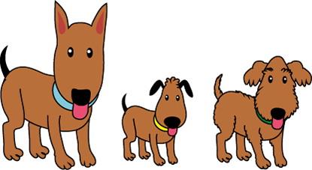

2.7 The 2, 4 and 8 times tables Step 1:8
Represents groups of 4?
© 2017 Alphablocks Ltd. All rights reserved.
Notes:
Two dice each showing two dots: does not show groups of four.
Numberblocks: does show groups of four.
4 × 7 = 28 7 × 4 = 28
Four dogs: does show groups of four.
Four groups of four legs.
4 × 4 = 16
Or one group of four dogs.
1 × 4 = 4 4 × 1 = 4
Four five-pointed stars: could show groups of four.
Four groups of five points: does not show groups of four.
One group of four stars: does show groups of four.
1 × 4 = 4 4 × 1 = 4
Three dogs: could show groups of four.
Three groups of four legs: does show groups of four.
3 × 4 = 12 4 × 3 = 12
One group of three dogs: does not show groups of four.

Slide 25
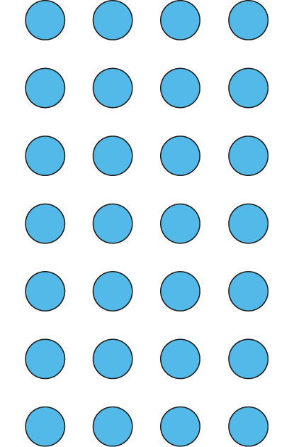
2.7 The 2, 4 and 8 times tables Step 1:11
Circle the groups of 4.
Circle the 4 equal groups.
4 ×
7
=
28
7
× 4 =
28
7
7
There are groups of 4.
There are 4 groups of .

Slide 26
3MD-1 Multiplication and division structures
How many counters can you see? Can you describe how they are arranged?
Use 20 counters and arrange them as an array as shown in the representation.
Describe how many groups you can see.
Describe how many counters are in each group.
Show these groupings with your own set of counters.
Can you explain why 4 x 5 and 5 x 4 are equal?
4 × 5 = 5 × 4

Slide 27
Year 3, Unit 6, Learning Outcome 3
Learning Outcome 3
Pupils explain the relationship between adjacent multiples of four
The following slides have been collated to support the teaching of this learning outcome.

Slide 28
Year 3, Unit 6, Learning Outcome 3
Additional teacher guidance for this outcome should be read first and can be found in this segment of the NCETM Primary Mastery Professional Development Materials:
2.7 Times tables: 2, 4 and 8 and the relationship between them
The spine materials are divided into ‘teaching points’ and ‘steps in learning’.
Teaching point | Steps in learning | Pages
1 | 1:9-1:11 | 13-16

Slide 29
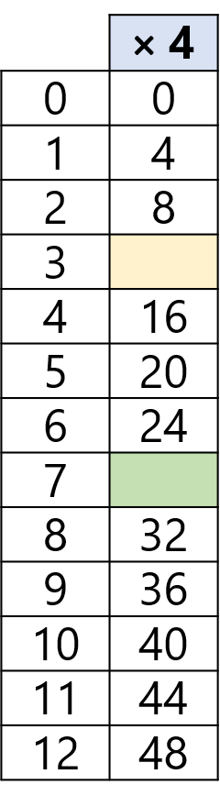
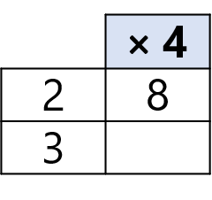
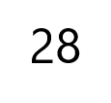
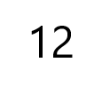
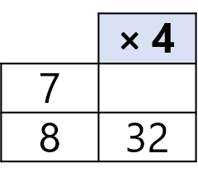
2.7 The 2, 4 and 8 times tables Step 1:9
↓ + 4
3 × 4 = 2 × 4 + 4
↑ − 4
7 × 4 = 8 × 4 − 4
+ 4
− 4
0
4
8
12
16
20
24
28
32
36
40

Slide 30
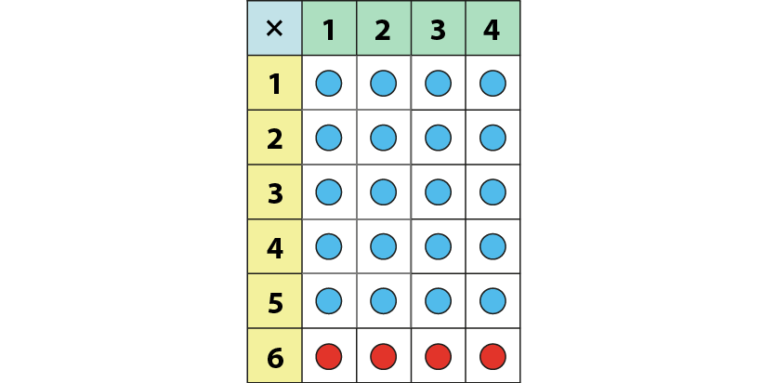
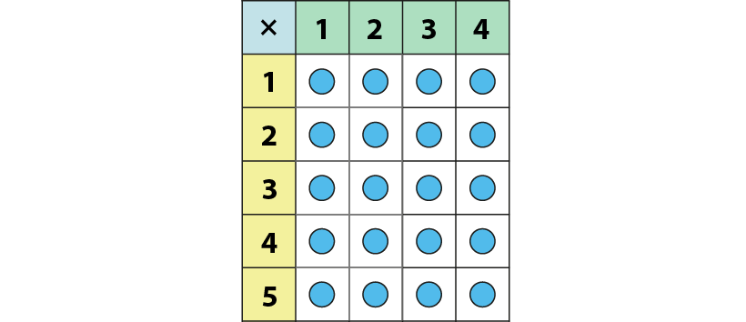
2.7 The 2, 4 and 8 times tables Step 1:9
6 × 4 = 5 × 4 + 4
= 24
5 × 4 = 20

Slide 31
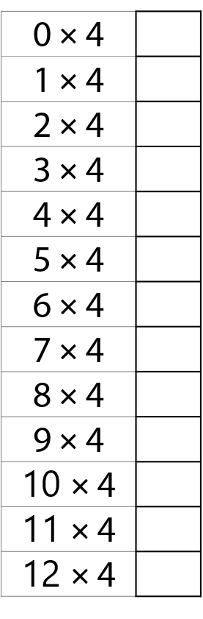



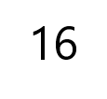
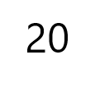
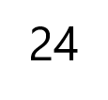
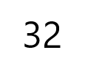
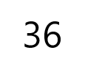
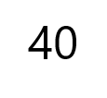
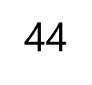
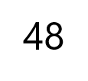
2.7 The 2, 4 and 8 times tables Step 1:9

Slide 32
Year 3, Unit 6, Learning Outcome 4
Learning Outcome 4
Pupils explain the relationship between multiples of 2 and multiples of 4
The following slides have been collated to support the teaching of this learning outcome.

Slide 33
Year 3, Unit 6, Learning Outcome 4
Additional teacher guidance for this outcome should be read first and can be found in this segment of the NCETM Primary Mastery Professional Development Materials:
2.7 Times tables: 2, 4 and 8 and the relationship between them
The spine materials are divided into ‘teaching points’ and ‘steps in learning’.
Teaching point | Steps in learning | Pages
2 | 2:1-2:5 | 17-22

Slide 34
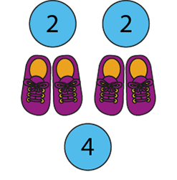
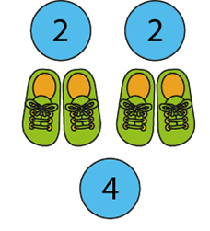
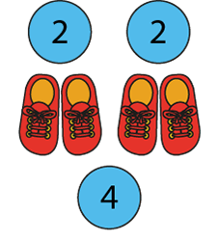
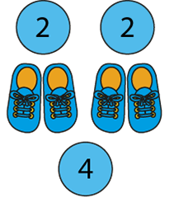
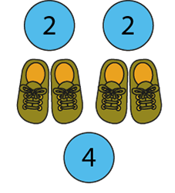
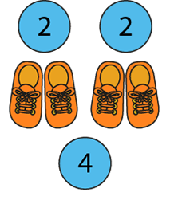
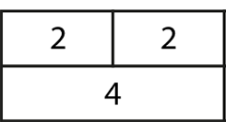
2.7 The 2, 4 and 8 times tables Step 2:2
Notes:
How many groups of two are there?
How many groups of four are there?
For every one group of four, there are two groups of two.

Slide 35
2.7 The 2, 4 and 8 times tables Step 2:3
0 × 2 = 0 | 0 × 4 = 0
1 × 2 = 2 | 1 × 4 = 4
2 × 2 = 4 | 2 × 4 = 8
3 × 2 = 6 | 3 × 4 = 12
4 × 2 = 8 | 4 × 4 = 16
5 × 2 = 10 | 5 × 4 = 20
6 × 2 = 12 | 6 × 4 = 24
7 × 2 = 14 | 7 × 4 = 28
8 × 2 = 16 | 8 × 4 = 32
9 × 2 = 18 | 9 × 4 = 36
10 × 2 = 20 | 10 × 4 = 40
11 × 2 = 22 | 11 × 4 = 44
12 × 2 = 24 | 12 × 4 = 48
Notes:
What’s the same?
What’s different?

Slide 36
2.7 The 2, 4 and 8 times tables Step 2:3
0 | × 2 = | 0 | = 4 × | 0
2 |  | 10 |  | 1
4 |  |  |  | 2
6 |  |  |  | 3
8 |  |  |  | 4
10 |  |  |  | 5
12 |  |  |  | 6
4
8
12
16
20
24

Slide 37
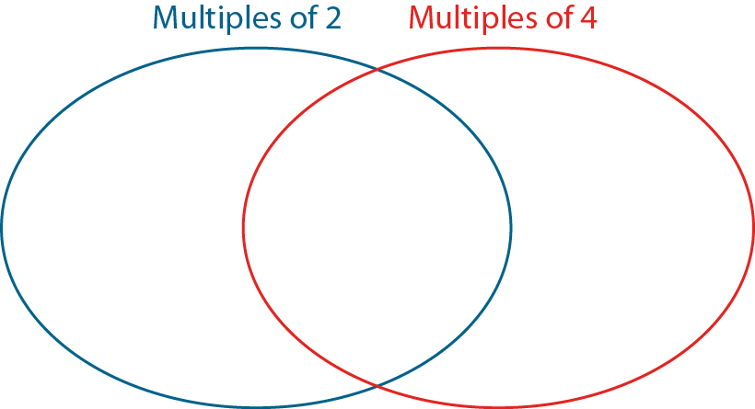
2.7 The 2, 4 and 8 times tables Step 2:3
0
2
4
23
14
31
20
16
40

Slide 38








2.7 The 2, 4 and 8 times tables Step 2:4
6 twos
3 fours
Notes:
Three times four is equal to twelve, so double-three times two is equal to twelve.
Six times two is equal to twelve, so half-of-six times four is equal to twelve.

Slide 39
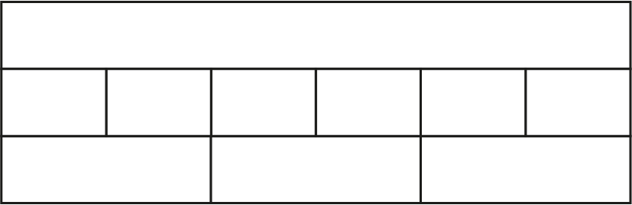
2.7 The 2, 4 and 8 times tables Step 2:4
12
2
2
2
2
2
2
4
4
4

Slide 40

2.7 The 2, 4 and 8 times tables Step 2:5
20
10
× 4 =
40
× 2 =
40

Slide 41
2.7 The 2, 4 and 8 times tables Step 2:5
10
× 4 =
40
10
× 2 =
20

Slide 42
2.7 The 2, 4 and 8 times tables Step 2:1
0
2
4
6
8
10
12
14
16
18
20
22
24

Slide 43
2.7 The 2, 4 and 8 times tables Step 2:1

Slide 44
2.7 The 2, 4 and 8 times tables Step 2:1
Number | 0 | 1 | 2 | 3 | 4 | 5 | 6 | 7 | 8 | 9 | 10 | 11 | 12 | 13 | 14 | 15 | 16 | 17 | 18 | 19 | 20 | 21 | 22 | 23 | 24
Counting in 2s
Counting in 4s
✓
✓
✓
✓
✓
✓
✓
✓
✓
✓
✓
✓
✓
✓
✓
✓
✓
✓
✓
✓

Slide 45
2.7 The 2, 4 and 8 times tables Step 2:2
Notes:
How many groups of two are there?
How many groups of four are there?
For every one group of four, there are two groups of two.

Slide 46
Year 3, Unit 6, Learning Outcome 5
Learning Outcome 5
Pupils use knowledge of the relationships between the 2 and 4 times tables to solve problems
The following slides have been collated to support the teaching of this learning outcome.

Slide 47
Year 3, Unit 6, Learning Outcome 5
Additional teacher guidance for this outcome should be read first and can be found in this segment of the NCETM Primary Mastery Professional Development Materials:
2.7 Times tables: 2, 4 and 8 and the relationship between them
The spine materials are divided into ‘teaching points’ and ‘steps in learning’.
Teaching point | Steps in learning | Pages
2 | 2:6-2:8 | 22-24

Slide 48







2.7 The 2, 4 and 8 times tables Step 2:6

Slide 49
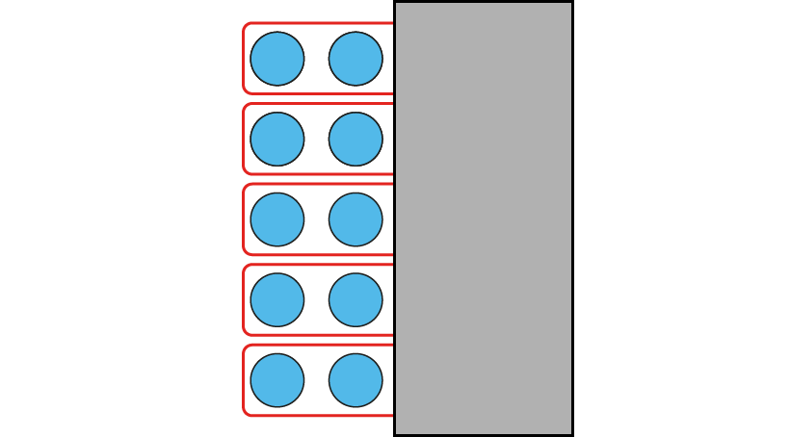
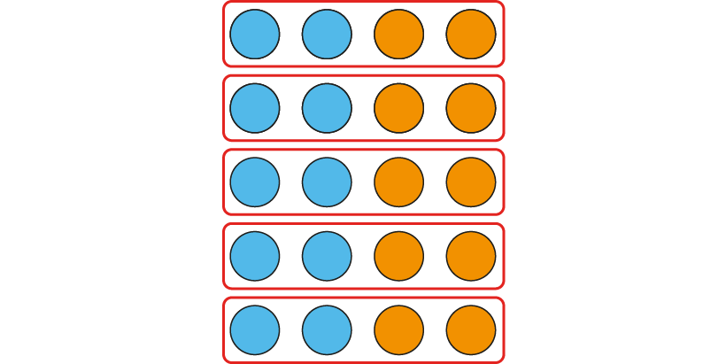
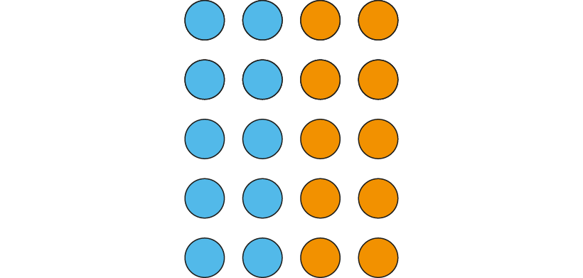
2.7 The 2, 4 and 8 times tables Step 2:7
5 groups of 2
5 groups of 4
5 × 2 = 10 five 2s are 10
5 × 4 = 20 five 4s are 20
4 × 5 = 20 4, five times is 20
2 × 5 = 10 2, five times is 10
Notes:
Four is double two, so five fours is double five-twos.
Two is half of four, so five twos is half of five-fours.

Slide 50
2.7 The 2, 4 and 8 times tables Step 2:7
5 groups of 4
5 groups of 2
5 × 4 = 20 five 4s are 20
5 × 2 = 10 five 2s are 10
4 × 5 = 20 4, five times is 20
2 × 5 = 10 2, five times is 10
Notes:
Four is double two, so five fours is double five-twos.
Two is half of four, so five twos is half of five-fours.

Slide 51
Year 3, Unit 6, Learning Outcome 6
Learning Outcome 6
Pupils represent counting in eights as the 8 times table
The following slides have been collated to support the teaching of this learning outcome.

Slide 52
Year 3, Unit 6, Learning Outcome 6
Additional teacher guidance for this outcome should be read first and can be found in this segment of the NCETM Primary Mastery Professional Development Materials:
2.7 Times tables: 2, 4 and 8 and the relationship between them
The spine materials are divided into ‘teaching points’ and ‘steps in learning’.
Teaching point | Steps in learning | Pages
3 | 3:1-3:7 | 25-31

Slide 53
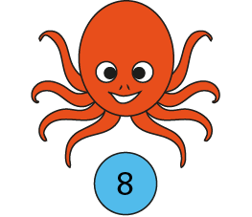
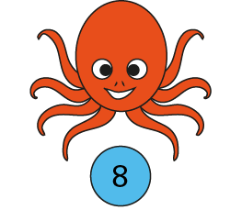
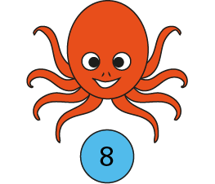



2.7 The 2, 4 and 8 times tables Step 3:1
How many tentacles? Count in groups of 8.
0
8
16
24
There are 24 tentacles.
3 × 8 = 24
8 × 3 = 24
Notes:
There are three groups of eight; there are eight, three times.
There are twenty-four altogether.
Three is a factor. Eight is a factor.
The product of three and eight is twenty-four.
Twenty-four is the product of three and eight.

Slide 54
2.7 The 2, 4 and 8 times tables Step 3:3
0
8
16
24
32
40
48
56
64
72
80
88
96

Slide 55

2.7 The 2, 4 and 8 times tables Step 3:4
Number of octopuses
Total number of tentacles
0
1
2
3
4
5
6
0
8
16
24
32
40
48
0
2 × 8 = 16 8 × 2 = 16
3 × 8 = 24 8 × 3 = 24
6 × 8 = 48 8 × 6 = 48
4 × 8 = 32 8 × 4 = 32
5 × 8 = 40 8 × 5 = 40
0 × 8 = 0 8 × 0 = 0
1 × 8 = 8 8 × 1 = 8

Slide 56
2.7 The 2, 4 and 8 times tables Step 3:5
Number of octopuses | Total number of tentacles
0 | 0
1 | 8
2 | 16
3 | 24
4 | 32
5 | 40
6 | 48
7 | 56
8 | 64
9 | 72
10 | 80
11 | 88
12 | 96
0 × 8 = 0 | 8 × 0 = 0
1 × 8 = 8 | 8 × 1 = 8
2 × 8 = 16 | 8 × 2 = 16
3 × 8 = 24 | 8 × 3 = 24
4 × 8 = 32 | 8 × 4 = 32
5 × 8 = 40 | 8 × 5 = 40
6 × 8 = 48 | 8 × 6 = 48
7 × 8 = 56 | 8 × 7 = 56
8 × 8 = 64 | 8 × 8 = 64
9 × 8 = 72 | 8 × 9 = 72
10 × 8 = 80 | 8 × 10 = 80
11 × 8 = 88 | 8 × 11 = 88
12 × 8 = 96 | 8 × 12 = 96

Slide 57
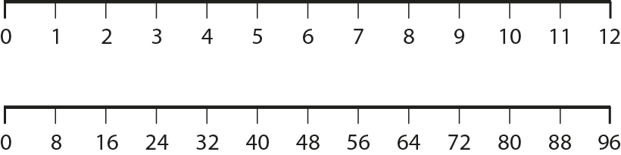
2.7 The 2, 4 and 8 times tables Step 3:6

Slide 58

2.7 The 2, 4 and 8 times tables Step 3:7
How many legs?
5 × 8 =
40
8 × 5 =
40
Notes:
Complete the equations to show how many legs altogether.

Slide 59

2.7 The 2, 4 and 8 times tables Step 3:7
How many legs?
6
× 8 =
48
8 ×
6
=
48
Notes:
Complete the equations to show how many legs altogether.

Slide 60
2.7 The 2, 4 and 8 times tables Step 3:7
How many legs?
7
×
8
=
56
8
×
7
=
56
Notes:
Complete the equations to show how many legs altogether.

Slide 61


2.7 The 2, 4 and 8 times tables Step 3:7
Hari wrote this.
This shows 4 × 8 = 32.
Draw a picture like this to show 7 × 8 = 56.

Slide 62
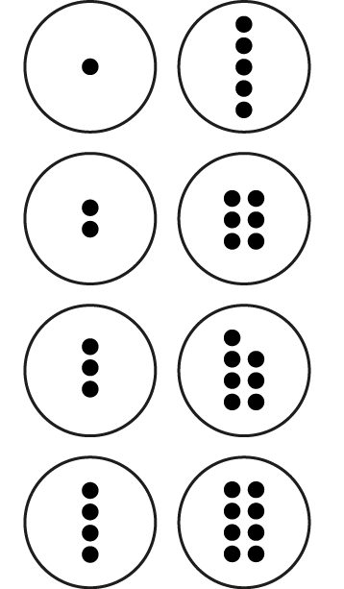

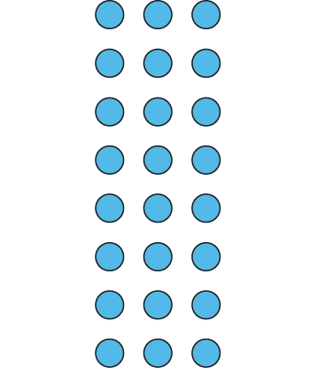
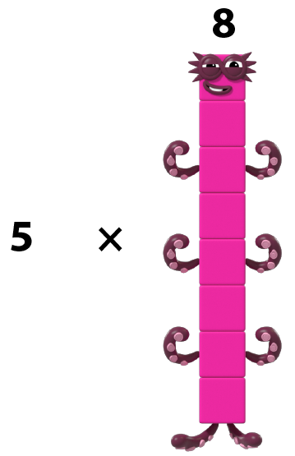

2.7 The 2, 4 and 8 times tables Step 3:7
Represents groups of 8?
© 2017 Alphablocks Ltd. All rights reserved.
Notes:
Eight dice each showing two dots: does not show groups of eight.
Numberblocks: does show groups of eight.
5 × 8 = 40 8 × 5 = 40
Counters with dots: does not show groups of eight.
Array of blue counters: does show groups of eight.
8 × 3 = 24 3 × 8 = 24
Eight triangles: could show groups of eight.
Eight groups of three sides (or eight groups of three corners): does not show groups of eight.
3 × 4 = 12 4 × 3 = 12
One group of eight triangles: does show groups of eight.
1 × 8 = 8 8 × 1 = 8

Slide 63
Year 3, Unit 6, Learning Outcome 7
Learning Outcome 7
Pupils explain the relationship between adjacent multiples of eight
The following slides have been collated to support the teaching of this learning outcome.

Slide 64
Year 3, Unit 6, Learning Outcome 7
Additional teacher guidance for this outcome should be read first and can be found in this segment of the NCETM Primary Mastery Professional Development Materials:
2.7 Times tables: 2, 4 and 8 and the relationship between them
The spine materials are divided into ‘teaching points’ and ‘steps in learning’.
Teaching point | Steps in learning | Pages
3 | 3:8-3:10 | 32-36

Slide 65




2.7 The 2, 4 and 8 times tables Step 3:8
↓ + 8
7 × 8 = 8 × 8 − 8
↑ − 8
3 × 8 = 2 × 8 + 8
+ 8
− 8
0
8
16
24
32
40
48
56
64
72
80

Slide 66


2.7 The 2, 4 and 8 times tables Step 3:8
5 × 8
− 8 = 4 × 8
= 32

Slide 67

2.7 The 2, 4 and 8 times tables Step 3:8
0
8
16
24
32
40
48
56
64
72
80
88
96

Slide 68

2.7 The 2, 4 and 8 times tables Step 3:10
Circle the groups of 8.
Circle the 8 equal groups.
8 ×
3
=
24
3
× 8 =
24
There are groups of 8.
3
3
There are 8 groups of .

Slide 69

2.7 The 2, 4 and 8 times tables Step 3:10
8 × 3 = 24 3 × 8 = 24

Slide 70




2.7 The 2, 4 and 8 times tables Step 3:10
12 cupcakes in a pack. 4 chocolate and the rest vanilla.
How many vanilla cupcakes in 3 packs?
packs of 12
8
vanilla cupcakes
4
chocolate cupcakes
8
vanilla cupcakes
4
chocolate cupcakes
3 × 8 = 24
Total number of vanilla cupcakes =

Slide 71
Year 3, Unit 6, Learning Outcome 8
Learning Outcome 8
Pupils explain the relationship between multiples of 4 and multiples of 8
The following slides have been collated to support the teaching of this learning outcome.

Slide 72
Year 3, Unit 6, Learning Outcome 8
Additional teacher guidance for this outcome should be read first and can be found in this segment of the NCETM Primary Mastery Professional Development Materials:
2.7 Times tables: 2, 4 and 8 and the relationship between them
The spine materials are divided into ‘teaching points’ and ‘steps in learning’.
Teaching point | Steps in learning | Pages
4 | 4:1-4:5 | 37-42

Slide 73
2.7 The 2, 4 and 8 times tables Step 4:1
0
4
8
12
16
20
24
28
32
36
40
44
48

Slide 74
2.7 The 2, 4 and 8 times tables Step 4:1

Slide 75
2.7 The 2, 4 and 8 times tables Step 4:1
Number | 0 | 1 | 2 | 3 | 4 | 5 | 6 | 7 | 8 | 9 | 10 | 11 | 12 | 13 | 14 | 15 | 16 | 17 | 18 | 19 | 20 | 21 | 22 | 23 | 24
Counting in 4s
Counting in 8s
✓
✓
✓
✓
✓
✓
✓
✓
✓
✓
✓

Slide 76

2.7 The 2, 4 and 8 times tables Step 4:2
© 2017 Alphablocks Ltd.
All rights reserved.
Notes:
For every one group of eight there are two groups of four.

Slide 77
2.7 The 2, 4 and 8 times tables Step 4:3
4 × 0 = 0 | 8 × 0 = 0
4 × 1 = 4 | 8 × 1 = 8
4 × 2 = 8 | 8 × 2 = 16
4 × 3 = 12 | 8 × 3 = 24
4 × 4 = 16 | 8 × 4 = 32
4 × 5 = 20 | 8 × 5 = 40
4 × 6 = 24 | 8 × 6 = 48
4 × 7 = 28 | 8 × 7 = 56
4 × 8 = 32 | 8 × 8 = 64
4 × 9 = 36 | 8 × 9 = 72
4 × 10 = 40 | 8 × 10 = 80
4 × 11 = 44 | 8 × 11 = 88
4 × 12 = 48 | 8 × 12 = 96
Notes:
What’s the same?
What’s different?

Slide 78
2.7 The 2, 4 and 8 times tables Step 4:3
0 | × 4 = | 0 | = 8 × | 0
2 |  | 10 |  | 1
4 |  |  |  | 2
6 |  |  |  | 3
8 |  |  |  | 4
10 |  |  |  | 5
12 |  |  |  | 6
8
16
24
32
40
48

Slide 79

2.7 The 2, 4 and 8 times tables Step 4:3
0
4
8
45
12
31
24
44
40

Slide 80




2.7 The 2, 4 and 8 times tables Step 4:4
© 2017 Alphablocks Ltd.
All rights reserved.
6 fours
3 eights
Notes:
Three times eight is equal to twenty-four, so double-three times four is equal to twenty-four.
Six times four is equal to twenty-four, so half-of-six times eight is equal to twenty-four.

Slide 81
2.7 The 2, 4 and 8 times tables Step 4:4
24
4
4
4
4
4
4
8
8
8
Notes:
Three times eight is equal to twenty-four, so double-three times four is equal to twenty-four.
Six times four is equal to twenty-four, so half-of-six times eight is equal to twenty-four.

Slide 82


2.7 The 2, 4 and 8 times tables Step 4:5
Tables can seat 8 or 4 people. Tables of 4: 6 tables needed. Tables of 8: ? tables needed.
6 × 4
= 3 × 8
Notes:
A class of children can sit around tables in eights or in fours.
If they sit around tables in fours, they need six tables.
How many tables will they need if they sit in eights?

Slide 83
2.7 The 2, 4 and 8 times tables Step 4:5
How many tables for 32 to sit in 4s?
8 × 4 = 32
How many tables to sit in 8s?
4 × 8 = 32
Notes:
There are 32 children in a class. How many tables will
be needed if each table can seat four children? How
many tables would be needed if each table can seat 8 children?

Slide 84
Year 3, Unit 6, Learning Outcome 9
Learning Outcome 9
Pupils use knowledge of the relationships between the 4 and 8 times tables to solve problems
The following slides have been collated to support the teaching of this learning outcome.

Slide 85
Year 3, Unit 6, Learning Outcome 9
Additional teacher guidance for this outcome should be read first and can be found in this segment of the NCETM Primary Mastery Professional Development Materials:
2.7 Times tables: 2, 4 and 8 and the relationship between them
The spine materials are divided into ‘teaching points’ and ‘steps in learning’.
Teaching point | Steps in learning | Pages
4 | 4:6-4:8 | 42-44

Slide 86



2.7 The 2, 4 and 8 times tables Step 4:6

Slide 87



2.7 The 2, 4 and 8 times tables Step 4:7
5 groups of 8
5 groups of 4
5 × 8 = 40 five 8s are 40
5 × 4 = 20 five 4s are 20
8 × 5 = 40 8, five times is 40
4 × 5 = 20 4, five times is 20
Notes:
Eight is double four, so five eights is double five-fours.
Four is half of eight, so five fours is half of five-eights.

Slide 88
2.7 The 2, 4 and 8 times tables Step 4:7
5 groups of 8
5 groups of 4
5 × 8 = 40 five 8s are 40
5 × 4 = 20 five 4s are 20
8 × 5 = 40 8, five times is 40
4 × 5 = 20 4, five times is 20
Notes:
Eight is double four, so five eights is double five-fours.
Four is half of eight, so five fours is half of five-eights.

Slide 89


2.7 The 2, 4 and 8 times tables Step 4:8
The same number of octagons, how many corners?
6 squares, how many corners?
6 × 4 =
24
6 × 8 =
48
Notes:
Felicity has six squares. How many corners does she have altogether?
Hamid has the same number of octagons. How many corners does he have altogether?

Slide 90
Year 3, Unit 6, Learning Outcome 10
Learning Outcome 10
Pupils explain the relationship between multiples of 2, 4 and multiples of 8
The following slides have been collated to support the teaching of this learning outcome.

Slide 91
Year 3, Unit 6, Learning Outcome 10
Additional teacher guidance for this outcome should be read first and can be found in this segment of the NCETM Primary Mastery Professional Development Materials:
2.7 Times tables: 2, 4 and 8 and the relationship between them
The spine materials are divided into ‘teaching points’ and ‘steps in learning’.
Teaching point | Steps in learning | Pages
4 | 4:9-4:11 | 44-48

Slide 92
2.7 The 2, 4 and 8 times tables Step 4:9

Slide 93
2.7 The 2, 4 and 8 times tables Step 4:9

Slide 94
2.7 The 2, 4 and 8 times tables Step 4:9
Number | 0 | 1 | 2 | 3 | 4 | 5 | 6 | 7 | 8 | 9 | 10 | 11 | 12 | 13 | 14 | 15 | 16 | 17 | 18 | 19 | 20 | 21 | 22 | 23 | 24
Counting in 2s
Counting in 4s
Counting in 8s
✓
✓
✓
✓
✓
✓
✓
✓
✓
✓
✓
✓
✓
✓
✓
✓
✓
✓
✓
✓
✓
✓
✓
✓

Slide 95
2.7 The 2, 4 and 8 times tables Step 4:10
8 × 1 = 8
4 × 2 = 8
2 × 4 = 8
1 × 8 = 8

Slide 96


2.7 The 2, 4 and 8 times tables Step 4:11

Slide 97
2.7 The 2, 4 and 8 times tables Step 4:11
16 × 1 = 16
8 × 2 = 16
4 × 4 = 16
2 × 8 = 16

Slide 98





2.7 The 2, 4 and 8 times tables Step 4:11
9 sticks, how many 2-stick mountains?
9 = 4 × 2 + 1
Notes:
Basil has nine sticks. How many two-stick mountains can he make?

Slide 99


2.7 The 2, 4 and 8 times tables Step 4:11
9 sticks, how many squares?
9 = 2 × 4 + 1
Notes:
How many squares can he make?

Slide 100

2.7 The 2, 4 and 8 times tables Step 4:11
9 sticks, how many octagons?
9 = 1 × 8 + 1
Notes:
How many octagons can he make?

Slide 101





2.7 The 2, 4 and 8 times tables Step 4:11
15 sticks; make as many squares as possible.
2 × 4 + 7
3 × 4 + 3
15 =
✗
Do you agree?
✓
Notes:
Nickolay has fifteen sticks. He makes as many sauares as possible.
Do you agree with his representation and equation?

Slide 102
Year 3, Unit 6, Learning Outcome 11
Learning Outcome 11
Pupils use knowledge of the relationships between the 2, 4 and 8 times tables to solve problems
The following slides have been collated to support the teaching of this learning outcome.

Slide 103
Year 3, Unit 6, Learning Outcome 11
Additional teacher guidance for this outcome should be read first and can be found in this segment of the NCETM Primary Mastery Professional Development Materials:
2.7 Times tables: 2, 4 and 8 and the relationship between them
The spine materials are divided into ‘teaching points’ and ‘steps in learning’.
Teaching point | Steps in learning | Pages
4 | 4:12-4:13 | 49-52

Slide 104
2.7 The 2, 4 and 8 times tables Step 4:12
5 × 2 =
10
5 × 4 =
20
5 × 8 =
40

Slide 105
2.7 The 2, 4 and 8 times tables Step 4:12
6 spiders, how many legs?
Ben
Ben says, ‘I know that 6 eights are 48.’
6 x 8 = 48
✓
Notes:
Some children are calculating how many
legs there are on six spiders.
Whose method do you like best? Why?

Slide 106
2.7 The 2, 4 and 8 times tables Step 4:12
6 spiders, how many legs?
Akisha
Akisha says, ‘5 times 8 is 40, so 6 times 8 is 40 plus 8.’
6 x 8 = 5 x 8 + 8
= 40 + 8
6 x 8 = 48
✓
Notes:
Some children are calculating how many
legs there are on six spiders.
Whose method do you like best? Why?

Slide 107
2.7 The 2, 4 and 8 times tables Step 4:12
6 spiders, how many legs?
Tasha
6 x 4 = 24
double 24 = double 20 + double 4
= 40 + 8
= 40 + 4
= 48
= 44
✗
6 x 8 = 48
✓
6 x 8 = 44
Notes:
Some children are calculating how many
legs there are on six spiders.
Whose method do you like best? Why?

Slide 108


2.7 The 2, 4 and 8 times tables Step 4:12
6 spiders, how many legs?
Elliot
0
8
16
24
32
40
48
✓
6 x 8 = 48
✗
6 x 8 = 56
Notes:
Some children are calculating how many
legs there are on six spiders.
Whose method do you like best? Why?

Slide 109

2.7 The 2, 4 and 8 times tables Step 4:12
6 spiders, how many legs?
Mandy
✓
Notes:
Some children are calculating how many
legs there are on six spiders.
Whose method do you like best? Why?

Slide 110

2.7 The 2, 4 and 8 times tables Step 4:13
Notes:
A shop sells socks in packs of four pairs.
How many socks are there in one pack?
How many pairs are there in three packs?
How many socks are there in three packs?
If I buy thirty-two socks, how many packs is this?
How many pairs of socks is this?

Slide 111


2.7 The 2, 4 and 8 times tables Step 4:13
8 guests (4 pairs) at each table.
2 guests at the head of each table.
Fill in the missing numbers.
Tables | Guests (× 8) | Pairs of guests (× 4) | Guests at head of tables (× 2)
1 | 8 | 4 | 2
2 | 16 |  | 4
3 | 24 | 12
4 |  | 16 | 8
 | 40 |  | 10
Notes:
Guests at a party sit at tables like this.
There are eight guests at each table.
There are four pairs of guests at each table.
There are two guests at the head of each table.

Slide 112
2.7 The 2, 4 and 8 times tables Step 4:13
8
162
12
72
31
34
480
223
99
5
700
Can be divided by 2 | Can’t be divided by 2

Slide 113
Year 3, Unit 6, Learning Outcome 12
Learning Outcome 12
Pupils use knowledge of the divisibility rules for divisors of 2 and 4 to solve problems
The following slides have been collated to support the teaching of this learning outcome.

Slide 114
Year 3, Unit 6, Learning Outcome 12
Additional teacher guidance for this outcome should be read first and can be found in this segment of the NCETM Primary Mastery Professional Development Materials:
2.7 Times tables: 2, 4 and 8 and the relationship between them
The spine materials are divided into ‘teaching points’ and ‘steps in learning’.
Teaching point | Steps in learning | Pages
5 | 5:1-5:4 | 53-55

Slide 115

2.7 The 2, 4 and 8 times tables Step 5:2

Slide 116
2.7 The 2, 4 and 8 times tables Step 5:3
Known multiple of 4 | Halve the number; is it even? | Halve the 1s digit; is it even? | Halve the final 2 digits; is it even?
156
288
78
3
28
144
4
44
Divisibility rule works, but we have to halve the 3-digit number
Not a divisibility rule for 4.
For numbers with more than 2 digits: if the final 2 digits are divisible by 4 then the number is divisible by 4.
Notes:
For numbers with more than two digits: if the final two
digits are divisible by four then the number is divisible by four.

Slide 117






2.7 The 2, 4 and 8 times tables Step 5:3

Slide 118
2.7 The 2, 4 and 8 times tables Step 5:4
Circle the numbers that are divisible by 4.
48 | 214 | 96
148 | 224 | 106
948 | 234 | 996

Slide 119
Year 3, Unit 6, Learning Outcome 13
Learning Outcome 13
Pupils use knowledge of the divisibility rules for divisors of 8 to solve problems
The following slides have been collated to support the teaching of this learning outcome.

Slide 120
Year 3, Unit 6, Learning Outcome 13
Additional teacher guidance for this outcome should be read first and can be found in this segment of the NCETM Primary Mastery Professional Development Materials:
2.7 Times tables: 2, 4 and 8 and the relationship between them
The spine materials are divided into ‘teaching points’ and ‘steps in learning’.
Teaching point | Steps in learning | Pages
5 | 5:5-5:7 | 56-57

Slide 121

2.7 The 2, 4 and 8 times tables Step 5:5

Slide 122
2.7 The 2, 4 and 8 times tables Step 5:7
Circle the numbers that are divisible by 8.
48 | 52 | 96
148 | 152 | 104
248 | 252 | 114

Slide 123
Year 3, Unit 6, Learning Outcome 14
Learning Outcome 14
Pupils scale known multiplication facts by 10
The following slides have been collated to support the teaching of this learning outcome.

Slide 124

Year 3, Unit 6, Learning Outcome 14
Additional teacher guidance for this outcome should be read first and can be found in the DfE Mathematics guidance. Page references relate to the 335-page document available as a download at the bottom of this web page.
Ready to progress criteria | Pages
3NF-3 | 103-105

Slide 125
3NF-3 Scaling number facts by 10
Click and compare the frame with ones with the frame with tens. What is the same/different?
Explain how you can use place value to use the first calculation to solve the second calculation. How else can we say 20 tens?
What other calculations using multiplication can you write?
Repeat for other similar calculations.
10
1
10
1
10
1
10
1
10
1
10
1
10
1
10
1
10
1
10
1
10
1
10
1
10
1
10
1
10
1
10
1
10
1
10
1
10
1
10
1
5 × 4 = 20
5 times 4 is equal to 20.
5 times 4 tens is equal to 20 tens.
20 tens is equal to 200.
5 × 4 tens = 20 tens
5 × 40 = 200

Slide 126
3NF-3 Scaling number facts by 10
Complete these calculations and make up some of your own to build fluency.
2 x 4 = 8
2 x 40 =
8 ÷ 4 = 2
80 ÷ 2 =
6 x 5 = 30
6 x 50 =
30 ÷ 5 = 6
300 ÷ 5 =
6 x 2 = 12
6 x 20 =
12 ÷ 2 =
120 ÷ 20 =
3 x 8 = 24
3 x 80 =
24 ÷ 8 =
240 ÷ 8 =

Slide 127
Year 3, Unit 6, Learning Outcome 15
Learning Outcome 15
Pupils scale division derived from multiplication facts by 10
The following slides have been collated to support the teaching of this learning outcome.

Slide 128
Year 3, Unit 6, Learning Outcome 15
Additional teacher guidance for this outcome should be read first and can be found in the DfE Mathematics guidance. Page references relate to the 335-page document available as a download at the bottom of this web page.
Ready to progress criteria | Pages
3NF-3 | 103-105

Slide 129
3NF-3 Scaling number facts by 10
We’re going to think about this representation in two different ways.
How many tens are there? What do you notice about the representation?
Can you see 20 tens divided into 5 equal parts? This is a sharing model. How many tens are there in each equal part? What is the value of each part?
Can you see 20 tens divided into groups of 4 tens (40)? This is a grouping model. How many groups of 40 are in 200?
What does each number in the division equations represent?
10
10
10
10
10
10
10
10
10
10
10
10
10
10
10
10
10
10
10
10
200 ÷ 5 = 40
200 ÷ 40 = 5

Slide 130
3NF-3 Scaling number facts by 10
Complete these calculations and make up some of your own to build fluency.
2 x 4 = 8
2 x 40 =
8 ÷ 4 = 2
80 ÷ 2 =
6 x 5 = 30
6 x 50 =
30 ÷ 5 = 6
300 ÷ 5 =
6 x 2 = 12
6 x 20 =
12 ÷ 2 =
120 ÷ 20 =
3 x 8 = 24
3 x 80 =
24 ÷ 8 =
240 ÷ 8 =

