Slide 1
Numberblocks
Support Materials
Series 2, Episode 3
Eight

Slide 2
Practitioner Notes

Slide 3
Episode Description
Seven meets One and asks her to show him how high she can hop. She hops so high she lands on top of Seven and they turn into Numberblock Eight, who has eight arms/legs/tentacles and goes by the superhero name Octoblock. The others sing a dramatic Bond/Dangermouse-like theme song - Octoblock! - about all the things super Eight can do - he can stand tall, run fast, climb high, swim and so on. Each time, Octoblock ‘powers up’ in a different body shape to activate and show off his superpower. Other powers include cooking, knitting, dancing, skating, and hugging his friends with lots of arms and legs.

Slide 4
Maths in the Episode
Saying the counting numbers up to 8
Throughout this episode Eight counts his legs saying the number names from 1 to 8. Children should recognise the cardinal principle of counting that the last number counted represents the entire set of objects counted.
Partitioning and combining to 8
At the beginning of the episode Eight is formed from combining One and Seven and then partitioned again.

Slide 5
Using Mathematical Language
Use these stem sentences to rehearse the cardinal principle of counting:
“I can see 1, 2, 3, 4, 5, 6, 7, 8 (while pointing), eight windows.”
As children begin to experience numbers partitioned, they can use stem sentences of the form:
“Eight is one more than seven”
or:
“One less than eight is seven.”

Slide 6
Talk and Discuss Together

Slide 7
Talk and Discuss Together
Watch the episode of Numberblocks. First ask the children what they noticed and allow them to talk to you and each other. The following slides are designed to stimulate children and adults to talk about the episode and draw out some key aspects of the mathematics.

Slide 8
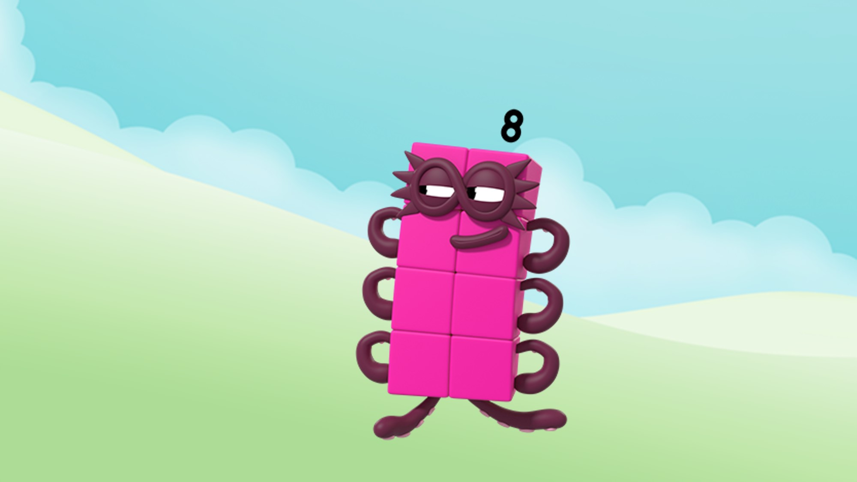
Images © 2017 Alphablocks Ltd. All Rights Reserved.
Notes:
Discuss the episode. Who does Eight remind you of (a superhero)?
Why does Eight call himself ‘Octoblock’?
‘Oct’ is a clue that the word is about ‘eight’. What other words can you think of that begin with ‘Oct’ (octopus, Octonaut, octagon)?
Before watching the episode put out some images and things to do with 8:
tipper truck with 8 wheels
spider
octopus
building bricks of 8
octagonal trampoline
playing card for eight
Octonaut characters etc.
Send the children off on an 8-treasure hunt to collect the pictures.
Bring the pictures/items together, and each collector describes the ‘eightness’ and demonstrates by counting.

Slide 9
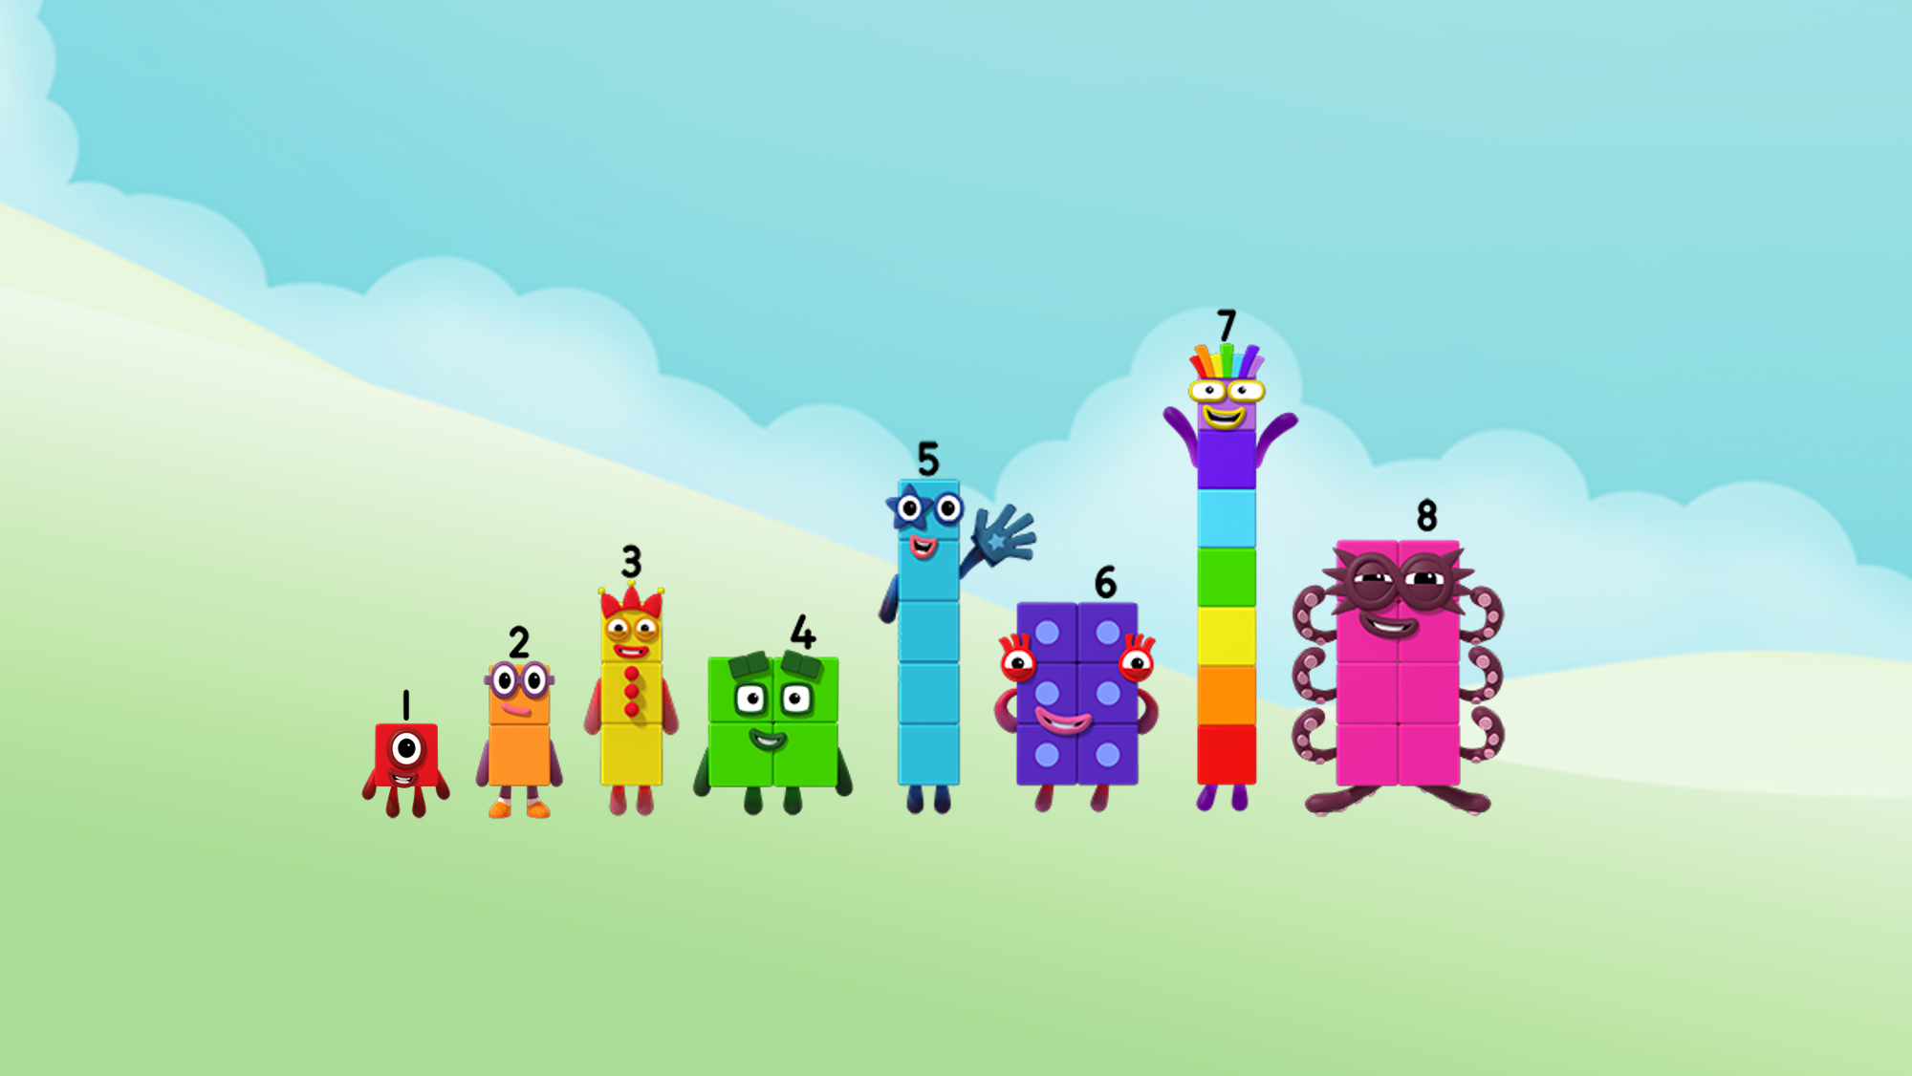
Images © 2017 Alphablocks Ltd. All Rights Reserved.
Notes:
Use this slide to practise counting up to 8.

Slide 10

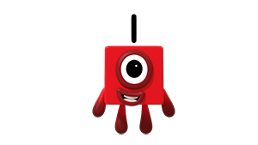
Images © 2017 Alphablocks Ltd. All Rights Reserved.
Notes:
How high can you jump?
This slide is animated and linked to the next slide.
Click once to demonstrate how One can jump up in the air, and click a second time to see One land on the other side of the bar.
Use this idea to build up real large blocks and a cane that the children can jump over. Who can jump over the cane laid on a tower of 1 or 2 or 3 or 4… or even 8 blocks?

Slide 11
Images © 2017 Alphablocks Ltd. All Rights Reserved.
Notes:
One lands on the other side of the bar.

Slide 12
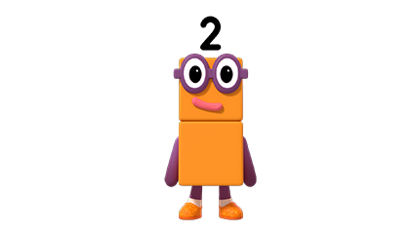
Images © 2017 Alphablocks Ltd. All Rights Reserved.
Notes:
Click once to demonstrate how Two can jump up in the air, and click a second time to see Two land on the other side of the bar.

Slide 13
Images © 2017 Alphablocks Ltd. All Rights Reserved.
Notes:
Two lands on the other side of the bar.
Use this idea in the outside area to build up real large blocks and a cane that the children can jump over. Who can jump over the cane laid on a tower of 1 or 2 or 3 or 4… or even 8 blocks?

Slide 14
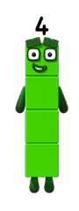
Images © 2017 Alphablocks Ltd. All Rights Reserved.
Notes:
How far can you jump?
This slide is animated.
Watch Four jump the length of 4 blocks.
Set up a space with blocks in the outside area to measure how far the children can jump – 1, 2, 3, 4… or even 8 blocks long.

Slide 15
Enabling Environments

Slide 16
Enabling Environments
Playing and Exploring
Use old clean odd socks and dried pulses to make octopuses for an underwater class display. See https://www.bbc.co.uk/cbeebies/makes/octonauts-socktonaut for instructions.
Active Learning
Notice how confidently children use the principles of counting for quantities up to 8 during their play, and recheck when they are not sure.
Creating and Thinking Critically
Using outdoor materials encourage the children to design an obstacle course so that they can do activities where they have to count up to 8, e.g. hurdles, long jump (using blocks), beanbags and buckets, etc. Provide clipboards to encourage the children to record scores using their own mark making.

Slide 17
Learning Together in Y1

Slide 18





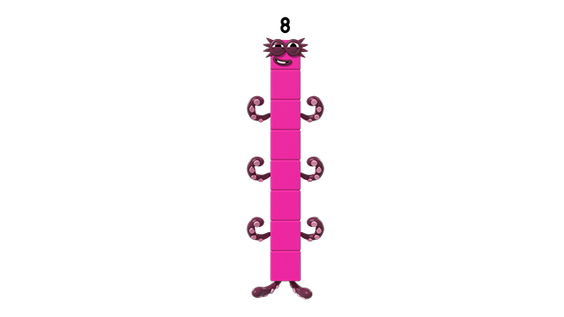
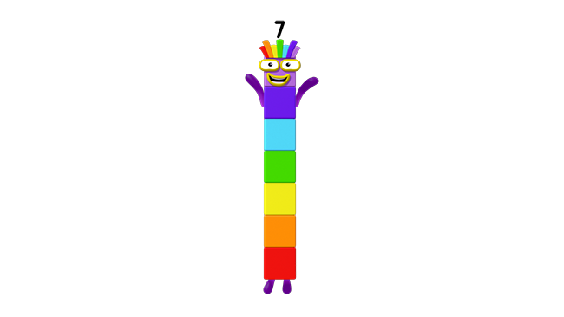
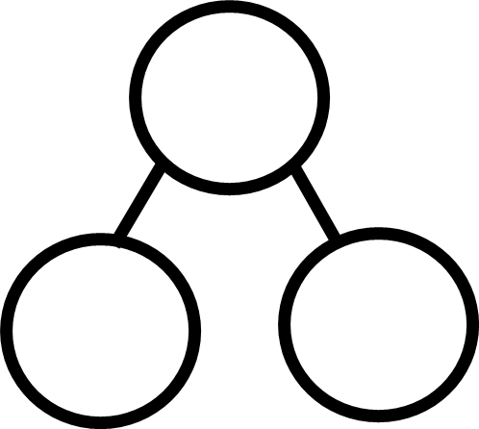
8 is one more than 7.
Images © 2017 Alphablocks Ltd. All Rights Reserved.
Notes:
Use this slide to confirm the combination of 1 and 7 to make 8.
Discuss the episode. What sort of character is Eight?
How was Eight made?
Ask the children to demonstrate with blocks in front of them.
This slide is animated to demonstrate how One and Seven combine to make Eight. Discuss and compare the different representations used.
Ask children to discuss the equation required to represent the combining of 1 and 7 to total 8. Reveal the equation and discuss what each number represents.

Slide 19

One less than 8 is 7.
Images © 2017 Alphablocks Ltd. All Rights Reserved.
Notes:
Use this slide to confirm the partitioning of 8 into 7 and 1.
This slide is animated to demonstrate how 8 partitions into 7 and 1. Discuss and compare the different representations used.
Ask children to discuss the equation required to represent the partitioning of 8 into 7 and 1. Reveal the equation and discuss what each number represents.

Slide 20
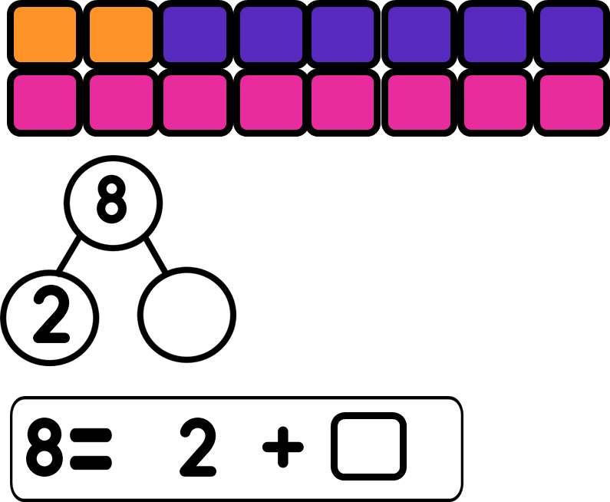
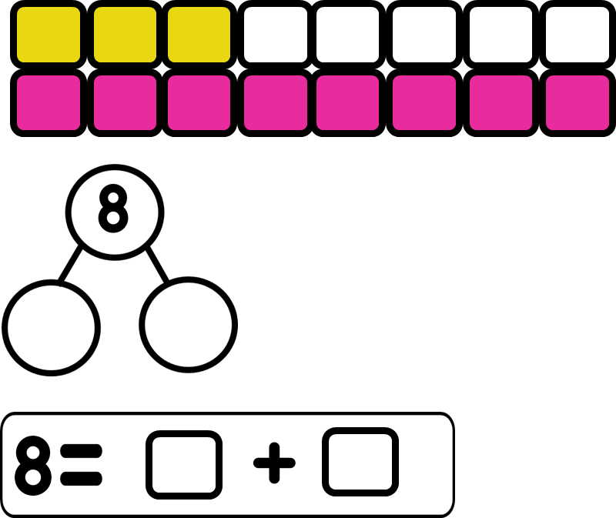
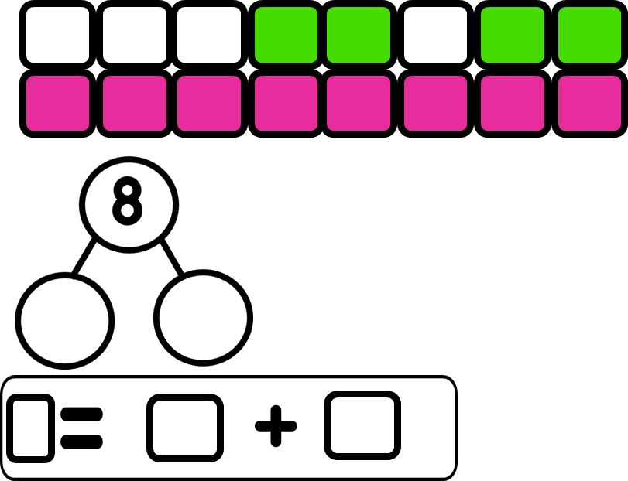
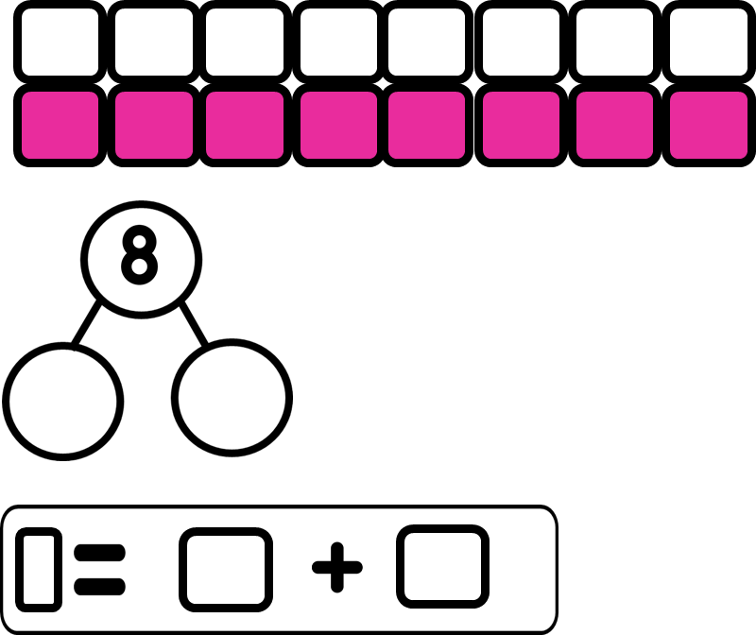
Images © 2017 Alphablocks Ltd. All Rights Reserved.
Notes:
Use this for individual work. Children complete the missing pictures or the missing numbers.

Slide 21
Images © 2017 Alphablocks Ltd. All Rights Reserved.
Notes:
Use this slide to deduce which diagrams represent eight and which don’t by looking for subitised patterns of parts of 8, e.g. two 4s, or 5 and 3.

