Slide 1
Year 5, Unit 10
Angles

Slide 2
Year 5, Unit 10
These materials heavily reflect the prioritisation approach of the ready-to-progress criteria in the DfE Primary Mathematics Guidance 2020 and on the PPTs that exemplify them on the NCETM website. They also include other relevant National Curriculum content. Related sections of the NCETM Primary Mastery Professional Development Materials provide small-step teaching guidance.
Ready-to-progress criteria addressed by this unit
Teaching of this unit supports the following criteria from the ‘DfE Mathematics Guidance: key stages 1 & 2’ (the 335-page document available as a download)
5G-1 Page 265

Slide 3
Contents
The links below take you to the starting slide of each learning outcome.
1 | Pupils compare the size of angles where there is a clear visual difference
2 | Pupils use the terms acute, obtuse and reflex when describing the size of angles or amount of rotation with relation to right angles
3 | Pupils use a unit called degrees (°) as a standard unit to measure angles
4 | Pupils estimate the size of angles in degrees using angle sets
5 | Pupils measure the size of angles accurately using a protractor
Click the arrow button to return to this Contents slide.

Slide 4
Year 5, Unit 10, Learning Outcome 1
Learning Outcome 1
Pupils compare the size of angles where there is a clear visual difference
The following slides have been collated to support the teaching of this learning outcome.

Slide 5
Year 5, Unit 10, Learning Outcome 1
Additional teacher guidance for this outcome should be read first and can be found in the DfE Mathematics guidance. Page references relate to the 335-page document available as a download at the bottom of this web page.
Ready to progress criteria | Pages
5G-1 | 265

Slide 6
Year 5, Unit 10, Learning Outcome 1
You will need 2 pieces of card and a split pin:

Slide 7
Year 5, Unit 10, Learning Outcome 1
Starting with the strips on top of one another:
Turn one strip a very small amount
Turn it about half way round
Turn it all of the way around
Look at the clock on the wall and try to arrange your strips to match the hands on it
Discuss the relative size of the angles that you are making each time. Which are bigger? Which are smaller?

Slide 8
Year 5, Unit 10, Learning Outcome 1
Your original equipment:
Now make two more using shorter pieces of card and longer pieces of card.

Slide 9
Year 5, Unit 10, Learning Outcome 1
Turn each of your angle-makers about the same amount.

Slide 10
Year 5, Unit 10, Learning Outcome 1
The pieces of card are different lengths, but all of these angles are the same.

Slide 11
Year 5, Unit 10, Learning Outcome 1
Which of these angles is the biggest?.

Slide 12
Year 5, Unit 10, Learning Outcome 1
Which of these angles is the biggest?.

Slide 13
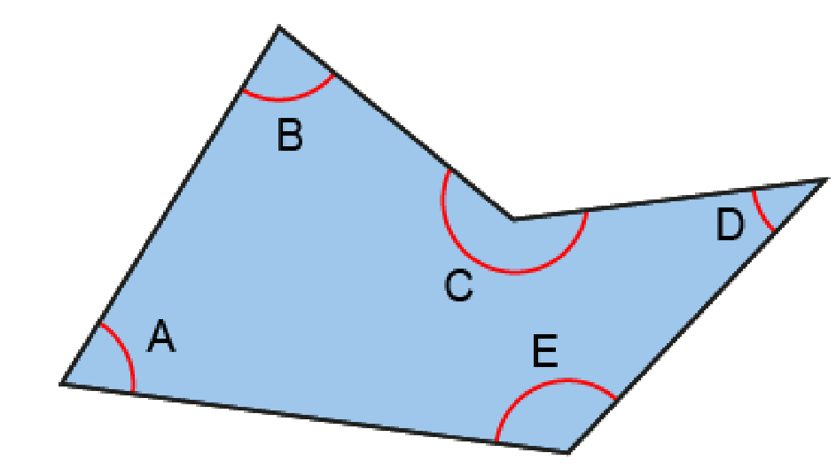
5G-1 Compare, estimate, measure and draw angles
The shape shown has been created by joining five points drawn on a piece of paper.
Can you see, just by looking, the largest and smallest angle in the shape? Think about the amount of ‘turn’ between the two sides at each vertex.
On a blank piece of paper mark five points with crosses. Accurately join these points.
How could you arrange the points to make a shape with one very large angle when joined? A very small angle? Angles that are roughly the same size?
Repeat with other shapes made from 4, 5 and 6 points.

Slide 14
Year 5, Unit 10, Learning Outcome 2
Learning Outcome 2
Pupils use the terms acute, obtuse and reflex when describing the size of angles or amount of rotation with relation to right angles
The following slides have been collated to support the teaching of this learning outcome.

Slide 15
Year 5, Unit 10, Learning Outcome 2
Additional teacher guidance for this outcome should be read first and can be found in the DfE Mathematics guidance. Page references relate to the 335-page document available as a download at the bottom of this web page.
Ready to progress criteria | Pages
5G-1 | 265

Slide 16
Year 5, Unit 10, Learning Outcome 2
Take any scrap of paper
Make sure it lines up along the first fold
Fold again
Fold anywhere on the paper

Slide 17
Year 5, Unit 10, Learning Outcome 2
Open your angle-checker so that your ‘square corner’ fits exactly in side.
The angle at a ‘square corner’ is called a right angle.
It is also a one-quarter turn.

Slide 18
Year 5, Unit 10, Learning Outcome 2
Now turn it through another right angle.
Can you see that you have a straight line?
Two right angle turns make a straight line.
Two right angle turns are a half turn
With your angle maker, make
An angle that is smaller than a right angle
An angle that is bigger than a right angle but smaller than a straight line
An angle that has turned beyond a straight line.

Slide 19
Year 3, Unit 3, Learning Outcome 3
Right angle
Smaller than a right angle:
Acute angle
Larger than a right angle: Obtuse angle
An acute angle is smaller than a right angle
An obtuse angle is larger than a right angle but less than the angle on a straight line

Slide 20
Year 3, Unit 3, Learning Outcome 3
Larger than a straight line:
Reflex angle
Straight line
An acute angle is smaller than a right angle
An obtuse angle is larger than a right angle but less than the angle on a straight line
A reflex angle is larger than the angle on a straight line, but less than the angle in a full turn.

Slide 21
Year 5, Unit 10, Learning Outcome 3
Learning Outcome 3
Pupils use a unit called degrees (°) as a standard unit to measure angles
The following slides have been collated to support the teaching of this learning outcome.

Slide 22
Year 5, Unit 10, Learning Outcome 3
Additional teacher guidance for this outcome should be read first and can be found in the DfE Mathematics guidance. Page references relate to the 335-page document available as a download at the bottom of this web page.
Ready to progress criteria | Pages
5G-1 | 266

Slide 23
Year 5, Unit 10, Learning Outcome 3
When we measure the length of lines or distances, sometimes we need to be really precise. If we were building a bridge we would need to be really precise about how long each piece is that we are using.
The same is true with angles. We have learnt to compare the size of angles by looking, but sometimes we need to be much more precise and be able to measure them exactly, just like we can measure distances exactly using rulers, and standard units like m, cm and mm.
I wonder how on earth we could measure an angle? Have a play around with your angle maker and see what ideas you can come up with.

Slide 24
Year 5, Unit 10, Learning Outcome 3
To measure an angle we measure the amount of ‘turn’ between two lines.
Remember the size of the lines/sides isn’t important. We can have long lines which have very little turn between them, or short sides that have a lot of turn.
In fact, we use a unit called a ‘degree’ to measure how much turn there is between two lines, and how big angles are at vertices.
Let me show you how big 1 degree is:

Slide 25
Year 5, Unit 10, Learning Outcome 3
10 degrees / 10°
90 degrees / 90°

Slide 26
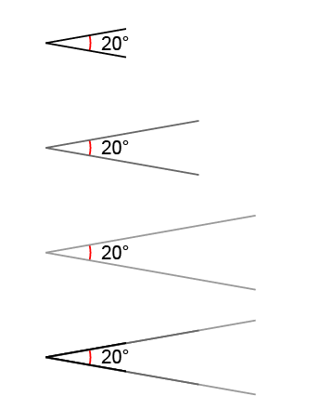
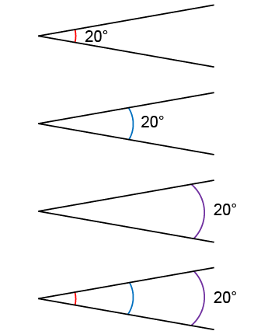
5G-1 Compare, estimate, measure and draw angles
Look at the images shown. What’s the same? What’s different?
Give pupils the opportunity to draw angles of different sizes between lines of different length to experience the different ways angles could be labelled.
The angle between each line is the same.
The length of each pair of lines is different.
The angle between each line is the same.
The position of the arc indicating the angle is drawn in different locations.

Slide 27
Year 5, Unit 10, Learning Outcome 4
Learning Outcome 4
Pupils estimate the size of angles in degrees using angle sets
The following slides have been collated to support the teaching of this learning outcome.

Slide 28
Year 5, Unit 10, Learning Outcome 4
Additional teacher guidance for this outcome should be read first and can be found in the DfE Mathematics guidance. Page references relate to the 335-page document available as a download at the bottom of this web page.
Ready to progress criteria | Pages
5G-1 | 266

Slide 29
5G-1 Compare, estimate, measure and draw angles
Give children labelled pieces of card and paper as shown. Allow them to explore the classroom or plastic shapes and find angles that are similar to, or smaller/greater than their cut-out benchmark.
Provide children with drawn examples and ask them to estimate the size of the angles based on known values. This could include combining known angles together to calculate an angle size.
Interactive teaching tools can also be used: children shout stop when they think a line has turned a required angle, to develop their ability to visually estimate.

Slide 30
Year 5, Unit 10, Learning Outcome 5
Learning Outcome 5
Pupils measure the size of angles accurately using a protractor
The following slides have been collated to support the teaching of this learning outcome.

Slide 31
Year 5, Unit 10, Learning Outcome 4
Additional teacher guidance for this outcome should be read first and can be found in the DfE Mathematics guidance. Page references relate to the 335-page document available as a download at the bottom of this web page.
Ready to progress criteria | Pages
5G-1 | 267

Slide 32
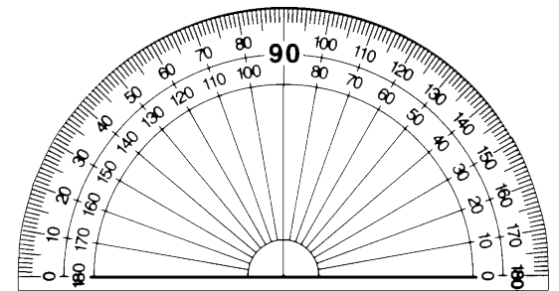
5G-1 Compare, estimate, measure and draw angles
What is your estimate for the size of angle A?
What are the key features of an angle measurer (protractor)?
What important parts of the protractor need to be positioned accurately?
What do you notice about the scales on the protractor? Which should be used? Why?
What is the size of angle A?
Repeat measuring other internal angles and those of other shapes given to or drawn by children.
Angle A is an acute angle. It is 66°.

Slide 33
5G-1 Compare, estimate, measure and draw angles
What steps should be taken to draw an angle of 102º
Narrate the steps shown by the animations describing the critical features of the protractor and important steps where mistakes could occur.
Allow children to work in pairs where one child follows the verbal instructions of their partner, drawing angles of different sizes.

