Slide 1
Unit 0 School Task

Slide 2
The Unit 0 task
Slide 9.1
Unit 0 questions
Unit 0 questions to be attempted by KS3 classes
Following completion of questions, pupils work in pairs explaining their approaches and thinking.
Analysis of pupil thinking
Evidence of pupil thinking collected by teacher (diagrams annotation, posters, audio )
Evidence discussed by core teachers and examples highlighting issues related to pupil conceptual difficulties selected for sharing at next TIME (Teachers Improving Mathematics Education) workshop.
Assessment interviews and pupil progress study
Short recorded interviews of selected pupils (one or two pairs or individuals) used by core teachers to reflect on nature of understanding and implications for teaching. Experiences to be shared at next TIME workshop.
Recording stored for comparison with post teaching re-interview to determine progress in understanding (pupil progress study)

Slide 3
Planning considerations
Slide 9.2
Which resources
Which classes
What evidence you might collect
What data collection techniques you might use
Ways in which you can collaborate
Challenges, issues and barriers and how they might be overcome

Slide 4
Unit 0 Questions

Slide 5
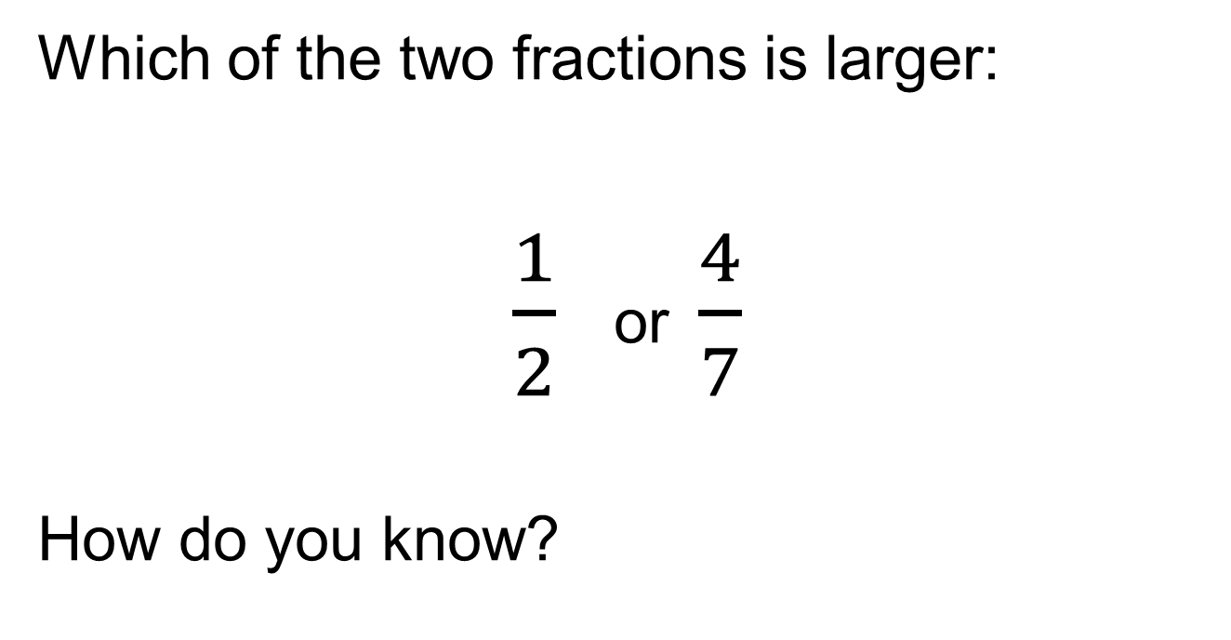
MR Question 1
Slide 5.2

Slide 6
MR Question 2
Slide 5.3
These two letters are the same shape, but one is larger than the other.
How long is the curve AB?
4cm
5cm
A
10cm
B

Slide 7
MR Question 3
Slide 5.4
Three friends rent a go-kart and agree to share the cost.
Annie travels 3 laps, Barry travels 5 laps and Carol travels 8 laps.
The total cost is £3.20.
How much should each person pay for it to be fair?

Slide 8


MR Question 4
Slide 5.5
The picture shows some buttons sewn onto a piece of ribbon. There are no gaps between the buttons.
A button is ¹/₃ inch wide.
Roughly how many buttons will fit onto a ribbon 3½ inches long?
¹/₃ inch

