Slide 1
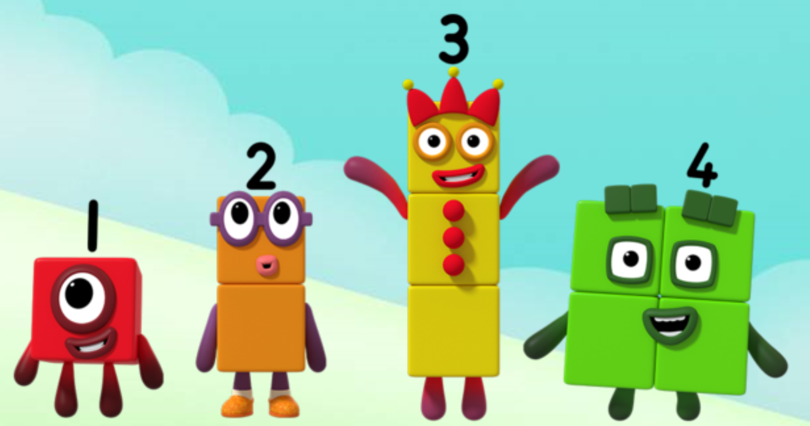
Series 1 Episode 7
Five

Slide 2
Maths in the Episode
To watch this episode, please go to BBC iPlayer – Numberblocks. Look for Series 1: Five.
‘Fiveness’ of 5
In this episode Five appears when One and Four combine. Children can see lots of things which come in fives, for example, a 5-pointed star, 5 fingers on one hand.
Ordering numbers
When the Numberblocks stand in order, they look like a staircase. Five stands next to Four and this helps children see that five is made of four and one more.

Slide 3
Talk and discuss together
Watch the episode together.
Ask your child what they noticed and be interested in anything they have to say.
Use the following pictures and activities to explore and talk about the maths involved.

Slide 4
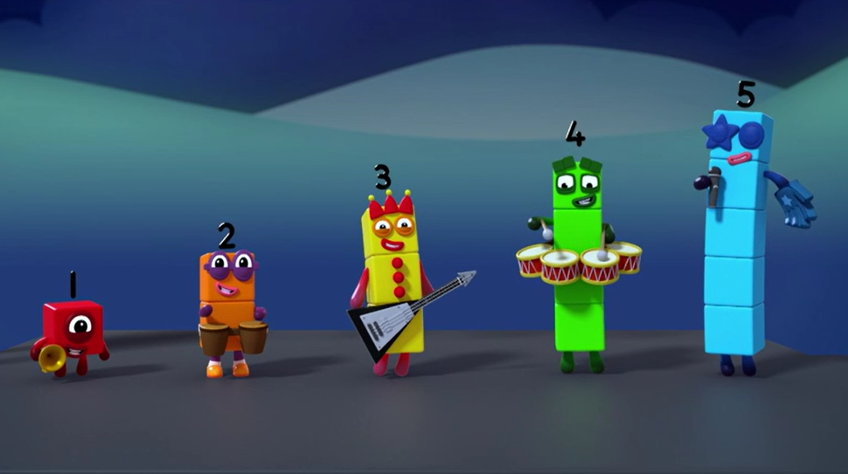
Five members in the band!

Slide 5
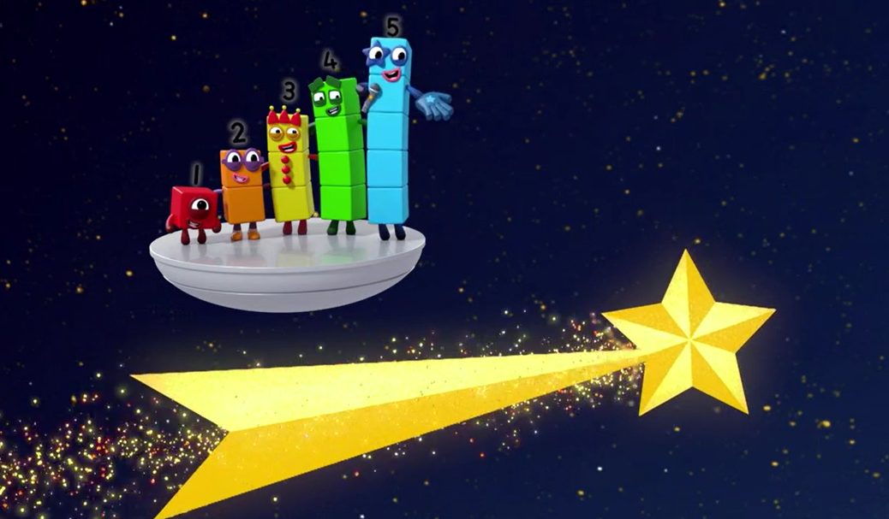
Five points on a shooting star!

Slide 6
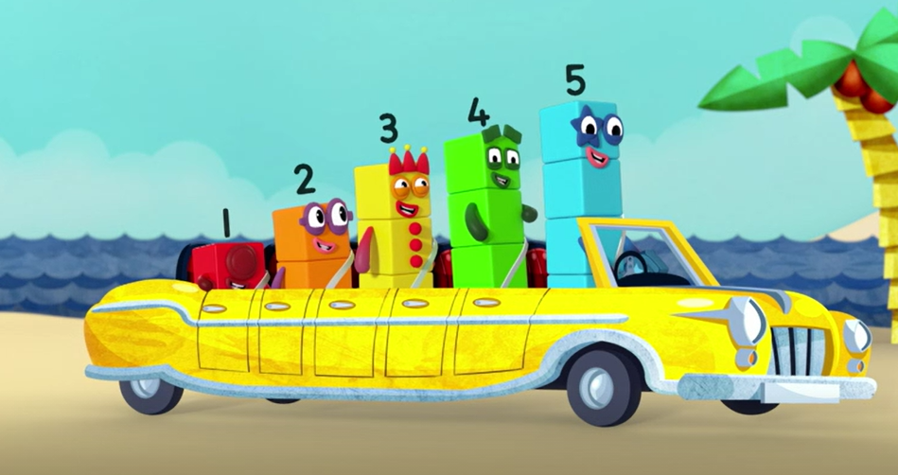
Five seats in my motor car!

Slide 7
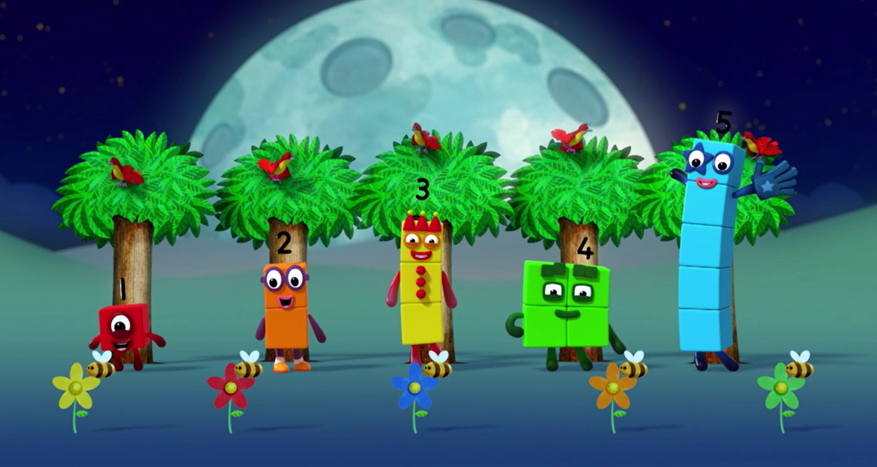
What can you see five of?

Slide 8
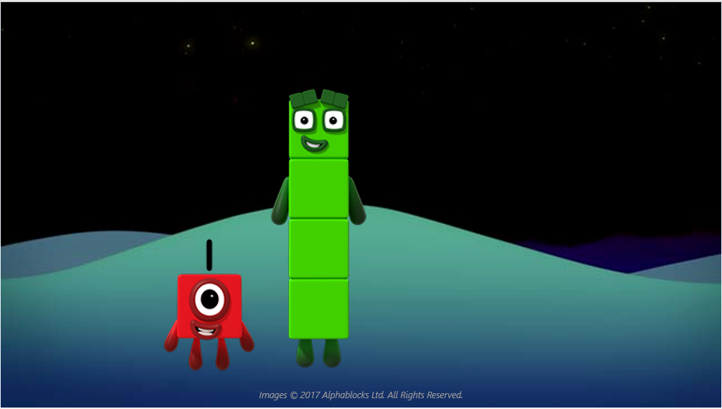
Look at us!
We can make five!

Slide 9
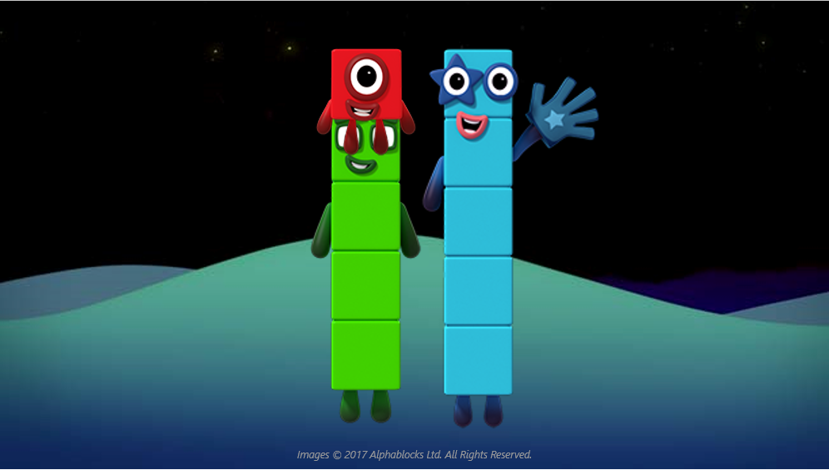
Four and one more makes five!

Slide 10
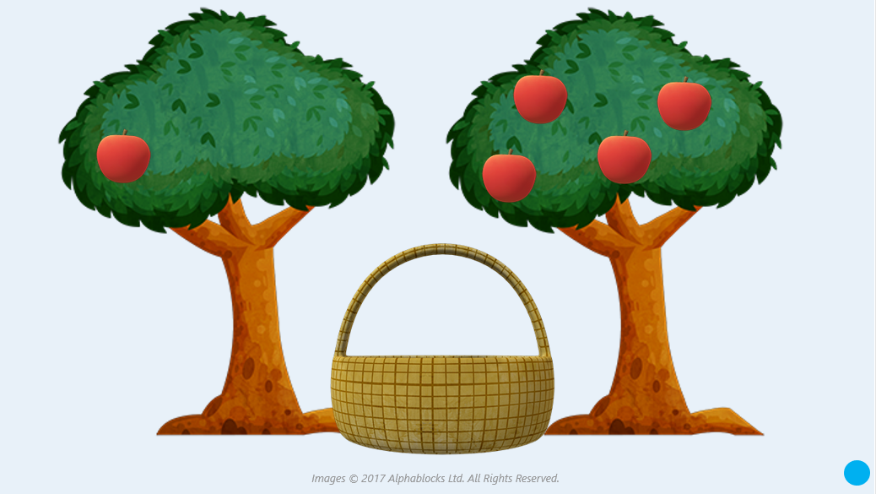
How many apples will we have if we put them all in our basket?

Slide 11

Around the home
What did you see five of in the episode?
Practise counting to five and putting up one finger at a time. Now try with the other hand!
Where can you see five things inside or outside your home? Can you take a picture or draw them?
Get five toys and make a toy picnic! Get five plates, five cups, five spoons and give one to each of your toys. Can you still see the five spoons and five cups?
Collect lots of buttons or one penny coins. Can you put them into groups of five?
Choose an action, for example, clapping, jumping, hopping, stamping. Can you do four hops and one more hop to make five hops? Five claps? Try to keep count as you do each action.
With an adult, draw around your hand and put a 5-pointed star on it to remind you of Five’s ‘High Five’!

Slide 12
General tips that can make a difference in maths
Provide lots of opportunities to say how many things you can see (up to 5) without counting.
Whenever you talk about a small set of objects, say the number. For example, please pick up those 3 teddies or look at those 2 dogs.
Count up (starting from one) when walking upstairs and count back when walking downstairs.
Count lots of different objects, big and small, and ask ‘How many are there?’ Your child should be able to tell you without going back and re-counting. If they can’t, then tell them: ‘There are 6 altogether’.
Play with fingers, firstly practise counting fingers.
Ask your child to put their fingers down and then say or hold up a number such as 3. Can they do it without counting? Can they do it using different fingers? Can they do it using fingers from two hands?
Play board games with your child which involve moving along numbered tracks, such as ‘Snakes and Ladders’. Check that your child counts along the track correctly, moving one square for each number counted.
Regular use of these simple ideas, whenever the opportunity arises, will improve your child’s maths.

Slide 13
General tips that can make a difference in maths
Notice when there are two amounts and one is more than the other, or they are the same. For example, I have 2 eyes and 2 ears, or I have more chips than peas.
Talk about and describe shapes you can see outside or around your home. For example, count corners, talk about straight/curved edges, flat/curved surfaces. If you have building blocks then talk about and describe the things that are built.
In the bath or at the sink, play with containers, pouring water, counting how many small pots are needed to fill the big container.
Encourage your child to draw a picture of their number work and explain their mark-making to you, for example, how many leaves they find on a walk. This doesn’t necessarily mean writing the numerals (1, 2, 3, 4… etc.).
Sing counting songs and rhymes. You can find some on the internet, but children love it if you join in with them!
Make a deliberate maths mistake from time to time and ask your child to explain why you are wrong. For example, say that 4 is bigger than 5.
Regular use of these simple ideas, whenever the opportunity arises, will improve your child’s maths.

