Slide 1

Checkpoints
Year 7 diagnostic mathematics activities
Arithmetic procedures
Thirty-seven Checkpoint activities
Fourteen additional activities
Published in 2021/22

Slide 2
About this resource
This resource is designed to be used in the classroom with Year 7 students, although it may be useful for other students.
The Checkpoints are grouped around the key ideas in the core concept document, 2.1 Arithmetic procedures, part of the NCETM Secondary Mastery Professional Development materials.
Before each set of Checkpoints, context is explored, to help secondary teachers to understand where students may have encountered concepts in primary school.
The 10-minute Checkpoint tasks might be used as assessment activities, ahead of introducing concepts, to help teachers explore what students already know and identify gaps and misconceptions.
Each Checkpoint has an optional question marked . This will provide further thinking for those students who have completed the rest of the activities on the slide.
The notes for each Checkpoint give answers (if appropriate), some suggested questions and things to consider.
After each Checkpoint, a guidance slide explores suggested adaptations, potential misconceptions and follow-up tasks. These may include the additional activities at the end of this deck.

Slide 3
Checkpoints 1–10
Checkpoint | Underpins | Code
1: January temperatures | Addition and subtraction of positive and negative integers | 2.1.1*
2: Two rulers
3: Ant journeys
4: Dots | Understand place value in decimals, including recognising exponent and fractional representations of the column headings | 1.1.1.2
5: Representing negatives
6: Shapes for digits | Addition and subtraction with decimals
7: Impossible calculations
8: Subtraction gaps
9: Largest and smallest differences
10: Decimal differences
*This three-digit code refers to the statement of knowledge, skills and understanding in the NCETM’s Sample Key Stage 3 Curriculum Framework (see notes below for more information).
Notes:
In the Sample Key Stage 3 Curriculum Framework, statements of knowledge, skills and understanding are arranged to give an example teaching order. The three-digit code for each statement in the framework is a clickable hyperlink to documents with more detailed information, including the key ideas contained within that statement. These key ideas are also shown on slides 7–8 in this deck.

Slide 4
Checkpoints 11–20
Checkpoint | Underpins | Code
11: Ordering multiplications | Multiplication and division of positive and negative integers | 2.1.2*
12: Ordering divisions
13: Stories
14: Largest and smallest product | Understand place value in decimals, including recognising exponent and fractional representations of the column headings | 1.1.1.2
15: Largest and smallest quotient
16: Grouping and sharing | Addition and subtraction with decimals
17: 327
18: Dividing by 15
19: Partitioning 98
20: Dealing with remainders
*This three-digit code refers to the statement of knowledge, skills and understanding in the NCETM’s Sample Key Stage 3 Curriculum Framework (see notes below for more information).
Notes:
In the Sample Key Stage 3 Curriculum Framework, statements of knowledge, skills and understanding are arranged to give an example teaching order. The three-digit code for each statement in the framework is a clickable hyperlink to documents with more detailed information, including the key ideas contained within that statement. These key ideas are also shown on slides 7–8 in this deck.

Slide 5
Checkpoints 21–28
Checkpoint | Underpins | Code
21: Product is 21 | Multiplication with decimals | 2.1.2*
22: Equivalent calculations
23: Missing decimal points
24: Adds to 18 | Division with decimals | 1.1.1.2
25: Quotient is 40
26: Division cards | Addition and subtraction with decimals
27: Adjusting calculations
28: Changing 2.16
*This three-digit code refers to the statement of knowledge, skills and understanding in the NCETM’s Sample Key Stage 3 Curriculum Framework (see notes below for more information).
Notes:
In the Sample Key Stage 3 Curriculum Framework, statements of knowledge, skills and understanding are arranged to give an example teaching order. The three-digit code for each statement in the framework is a clickable hyperlink to documents with more detailed information, including the key ideas contained within that statement. These key ideas are also shown on slides 7–8 in this deck.

Slide 6
Checkpoints 29–37
Checkpoint | Underpins | Code
29: Order, order! | Priority of operations | 2.1.5*
30: Left to right?
31: 4, 5, 6, 7
32: The four 4s
33: Nelsons | Associative, distributive and commutative laws | 1.1.1.2
34: 7 × 19 rectangle
35: Lucky 13 | Addition and subtraction with decimals
36: Secretly multiplying by 1
37: Chains of three
*This three-digit code refers to the statement of knowledge, skills and understanding in the NCETM’s Sample Key Stage 3 Curriculum Framework (see notes below for more information).
Notes:
In the Sample Key Stage 3 Curriculum Framework, statements of knowledge, skills and understanding are arranged to give an example teaching order. The three-digit code for each statement in the framework is a clickable hyperlink to documents with more detailed information, including the key ideas contained within that statement. These key ideas are also shown on slides 7–8 in this deck.

Slide 7
Key ideas
Understand and use the structures that underpin addition and subtraction strategies | Code
Understand the mathematical structures that underpin addition and subtraction of positive and negative integers | 2.1.1.1*
Generalise and fluently use written addition and subtraction strategies, including columnar formats, with decimals | 2.1.1.2*
Understand and use the structures that underpin multiplication and division strategies | Code
Understand the mathematical structures that underpin multiplication and division of positive and negative integers | 2.1.2.1
Factorise multiples of 10n in order to simplify multiplication and division of both integers and decimals, e.g. 300 × 7 000, 0.3 × 0.007, 0.9 ÷ 0.03, etc. | 2.1.2.2
Generalise and fluently use written multiplication strategies to calculate accurately with decimals | 2.1.2.3
Generalise and fluently use written division strategies to calculate accurately with decimals | 2.1.2.4
*‘There are additional resources exemplifying these key ideas in the Secondary Mastery Professional Development | NCETM.

Slide 8
Key ideas
Use the laws and conventions of arithmetic to calculate efficiently | Code
Know the commutative law and use it to calculate efficiently | 2.1.5.1
Know the associative law and use it to calculate efficiently | 2.1.5.2
Know the distributive law and use it to calculate efficiently | 2.1.5.3
Calculate using priority of operations, including brackets, powers, exponents and reciprocals | 2.1.5.4
Use the associative, distributive and commutative laws to flexibly and efficiently solve problems | 2.1.5.5*
Know how to fluently use certain calculator functions and use a calculator appropriately | 2.1.5.6
*‘There are additional resources exemplifying these key ideas in the Secondary Mastery Professional Development | NCETM.

Slide 9
Addition and subtraction of positive and negative integers
Checkpoints 1–5

Slide 10
Addition and subtraction of positive and negative integers
Previous learning | In Key Stage 3 students need to
Key Stage 2 curriculum: Year 4: count backwards through zero to include negative numbers Year 5: interpret negative numbers in context… Year 6: use negative numbers in context and calculate intervals across zero Year 6 (geometry): extend their knowledge of one quadrant to all four quadrants, including the use of negative numbers. Year 6 (non-statutory guidance): using the number line, pupils use, add and subtract positive and negative integers for measures such as temperature Further information about how students may have experienced this key idea in Key Stage 2: Primary Mastery Professional Development, Spine 1 Number, Addition and Subtraction, Year 5 Segment 1.27: Negative numbers: counting, comparing and calculating There is no reference negative numbers in Teaching mathematics in primary schools, so students are potentially less likely to have had experience of these in Years 5 and 6. | Extend the domain in which they understand the additive structure to include negative numbers. Be able to calculate with numbers of ‘any size’. Appreciate that assumptions based on calculating with positive numbers (i.e. adding a number ‘always increases’ and subtracting a number ‘always decreases’) do not hold when adding and subtracting with negative numbers. The terms minuend and subtrahend are used throughout these notes for clarity. Subtrahend is the number being subtracted, and minuend is the number being subtracted from. minuend – subtrahend = difference

Slide 11
Checkpoint 1: January temperatures
The table shows the average temperature in January in eight cities.
Alice Springs | 29º C
Jaipur | 22º C
London | 5º C
Los Angeles | 13º C
Moscow | ˗8º C
New York | 2ºC
Quebec | ˗7º C
Tromsø | ˗6º C
Draw a number line and mark these temperatures on it.
Which two cities have the greatest difference in temperature and which have the least difference?
What is the difference in temperature between London and Los Angeles? Find another pair of cities with the same temperature difference.
Tromsø is __º C warmer than ______ and __º C colder than ________.
New York is __º C warmer than ______ and __º C colder than ______.
Imagine that the average temperature in February is 4º C lower for each city. How would this affect your answers?
Notes:
This slide is animated. Each question will appear separately so you can choose the pace at which to work with your class.
A blank number line, with the table printed next to it, is available in ‘Printable resources’ section, on slide 113.
Answers
b) The greatest difference is between Alice Springs (29° C) and Moscow (˗8° C): a difference of 37° C. The least difference could be between Quebec (˗7° C) and Tromsø (˗6° C) or Moscow (˗8° C) and Quebec (˗7°C): a difference of 1°C.
c) 8° C; New York (2° C) and Tromsø (˗6° C) also have a difference of 8° C.
d) Answers could include: Tromsø is 1º C warmer than Quebec and 11º C colder than London. Only Quebec or Moscow can be written in the second gap; any of the other cities can be in the fourth gap.
e) Answers could include: New York is 9º C warmer than Quebec and 3º C colder than London. Only Quebec, Tromsø or Moscow can be written in the second gap; any of the other cities can be in the fourth gap.
? The answers would remain the same since all cities have changed by the same temperature, so the differences remain the same.
Suggested questioning
How does drawing a number line help to make sense of the questions?
What is the warmest/coldest temperature? Which cities are closest in temperature?
Do you know where any of these cities are and what the climate is like there?
Things to think about
This first checkpoint offers a context for negative numbers that is likely to be familiar for students. The questions encourage students to compare numbers, or find differences, through zero. Some students may find the number line a helpful tool to support counting back through zero; those who are most fluent will be able to use their knowledge of addition and subtraction facts to bridge zero.

Slide 12
Checkpoint 1: Guidance
Adaptations | Assessing understanding
Support You could start with a more limited table for students to explore – for example, focusing on just London, Los Angeles and New York – so that you can first assess their understanding of differences with positive numbers before extending to negatives by then including Tromsø. Challenge Students could be challenged to include new temperatures on their number line, based upon relationships with other temperatures. For example, ‘twice as cold as Quebec’, or ‘halfway between the temperatures of Moscow and New York’. Representations The number line is the most useful representation to support this task. Guidance on using number lines can be found in Using mathematical representations at KS3 | NCETM. Consider the orientation of number lines. In secondary school, a horizontal line is commonly used, but it is likely that students are more familiar with a vertical number line from KS2, as this more closely resembles practical contexts such as thermometers or depth. A selection of number lines for this task is available in ‘Printable resources’. | Students may be reliant on the number line for all of these calculations/comparisons. If they are using the number line, take note of whether they are still ‘counting back’ through zero, or whether they feel confident to make larger jumps to and from zero. For those students that are not reliant on the number line, observe their level of fluency with addition and subtraction facts and whether they are able to apply these to negative numbers. Some facts are likely to be ‘known’ (such as 8 + 2 = 10, and therefore the difference between 2 and ˗8 is 10). Other facts are more likely to involve strategies (such as bridging 0 to recognise that the difference between ˗6 and 5 is the same as 6 + 5, and then using ‘near doubles’ to recognise that this is the same as 1 + 5 + 5).
Additional resources Primary Assessment Materials | NCETM offer further contexts for negative numbers, on p10 of the Year 4 materials and p11 of the Year 6 materials.

Slide 13
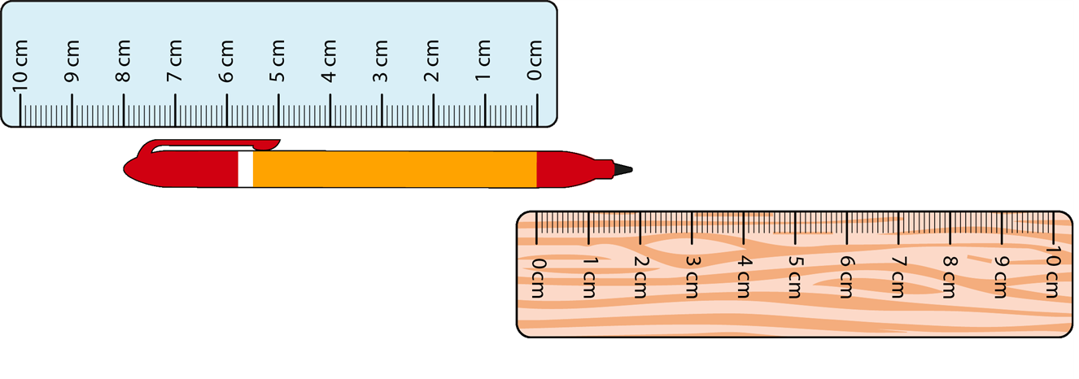
Checkpoint 2: Two rulers
How long is the pen in the picture?
A piece of string is placed so that one end is at 9 cm on the blue ruler, and the other end is at 10 cm on the wooden ruler. How long is it?
A pencil is placed with its tip at 5 cm on the blue ruler. It’s 12 cm long. Where on the wooden ruler is the end of the pencil?
A piece of string is 10 cm long. It is stretched out so that one end is on the blue ruler and the other end is on the wood ruler.
Where might the ends be?
Notes:
This slide is animated. Each question will appear separately so you can choose the pace at which to work with your class.
Answers
a) The pen is 10cm long.
b) The string is 19 cm long.
c) The end of the pencil is at 7cm on the wooden ruler.
? Any pair of numbers which sum to 10.
Suggested questioning
What number might be represented by the crossover of the two rulers?
If an object is __ long, where might one end be on the blue ruler? How about on the wooden ruler? Can you think of any different answers?
How else could we think about the numbers on the blue ruler?
Things to think about
This checkpoint offers students the opportunity to reason and use the skills they will have gained at KS2 without explicitly referencing negative numbers. Whether or not students make the connection without prompting, the task should also enable teachers to assess students’ fluency with addition and subtraction facts.

Slide 14
Checkpoint 2: Guidance
Adaptations | Assessing understanding
Support Give students two rulers so that they can properly visualise and explore this task. A further support might be to model the pen (or string) initially being measured from 0 on the wooden ruler, and then moving it down the plastic ruler in steps of 1 each time. Challenge Ask students to imagine this situation at a larger scale – for example, using metre sticks and larger objects. Asking them to identify possibilities given constraints will further challenge them, such as identifying possible start and end points where an object is 25.5 cm long. Representations Here, two rulers are used as physical representations of the number line. Students may find one being upside down to be initially confusing, but the intention is to familiarise the negative ‘half’ of the number line and emphasise its symmetry around 0. Guidance on using number lines can be found in Using mathematical representations at KS3 | NCETM. | Negative numbers are not mentioned in this activity; notice whether students independently make this connection, or whether it needs to be made more explicit. As with Checkpoint 1, students’ reliance on counting back through zero will be an indicator of their confidence with negative numbers. Listen to the strategies that students use to gauge their fluency with addition and subtraction facts. Which facts do they ‘just know’? Which do they have an efficient strategy for? Which do they find more challenging?
Additional resources Within Topic 1.27 of the Primary mastery professional development materials, teaching point 5 looks at calculating intervals across zero: Negative numbers: counting, comparing and calculating | NCETM.

Slide 15
Checkpoint 3: Ant journeys
An ant starts at 10 on the number line.
It then walks to -9, then back to 8, then to -7, 6, -5 and so on until it reaches 0, where it stops.
How far does the ant walk in total?
What if it starts at 11, then walks to -10, 9, -8…?
Try starting at different numbers.
Can you predict how far the ant would walk if it starts at 100?
How do you know?
Notes:
A printable number line to support this Checkpoint is available in the ‘Printable resources’ section, on slide 114.
Answers
The ant will walk 100 ‘units’ in total:
[(10 + 9) + (9 + 8) + (8 + 7) + (7 + 6) + (6 + 5) + (5 + 4) + (4 + 3) + (3 + 2) + (2 + 1) +1]
= [19 + 17 + 15 + 13 + 11 + 9 + 7 + 5 + 3 + 1].
b) Starting at 11 adds a journey of 21 ‘steps’ so the total is 121.
? Students may notice that the answer is the square of the start number (so 100 × 100 = 10 000). If students do not make this connection, they may still notice that the ant’s journey is the sum of all the odd numbers up to 2n-1 (where n is the start number) and attempt to use this generalisation to calculate 999 + 997 + 995 etc.
Suggested questioning
How do you calculate the journey each time? What is the role of 0 in your method?
What do you notice about each stage of the ant’s journey? Is there a pattern?
Suggest a part of the ant’s journey that will be __ steps long?
Are any stages of the ant’s journey an even number of steps? Why or why not?
Things to think about
This checkpoint is a classic example of a ‘low floor, high ceiling’ activity. At its most basic, the activity offers an opportunity to practise counting through zero and using addition/subtraction facts to do this more fluently. A deeper understanding leads students to consider the pattern of steps that is created each time, and the connection with square numbers. Whilst this is an interesting connection to make, the most important focus in terms of assessment here is to check students’ confidence and fluency with calculations that bridge zero.

Slide 16
Checkpoint 3: Guidance
Adaptations | Assessing understanding
Support Students may wish to use counters alongside physical number lines to ‘act’ out the ant’s journey and record the steps. In this case, it is advised that the start number is lower so that there are fewer sets of steps to record initially. Encourage students to count total jumps to zero rather than individual steps, to strengthen fluency with addition/subtraction facts. A printable version of the number lines used in this activity can be found in ‘Printable resources’, slide 114. Challenge Much of the potential challenge is built into this task, as the pattern of differences and link to square numbers offer a rich vein for exploration. Ask students to reason about why this is the case – or give them a total number of steps and ask which number the ant may have started on. Is there more than one possible answer? Representations The primary representation here is the number line. The intention is to move students away from counting individual steps and towards jumps through zero or linking to known addition/subtraction facts. Guidance on using number lines can be found in Using mathematical representations at KS3 | NCETM. | As with Checkpoints 1 and 2, the efficiency of students’ calculations through zero is a key point of assessment. Here, there is the additional element of the pattern of reducing odd numbers. Students may notice this and realise that they can arrive at an answer an alternative way. This therefore offers not only an opportunity to assess students’ understanding of calculating through zero, but also of the way in which they approach tasks. Are they looking for patterns and efficiencies? Do they organise their workings in a way that supports them to notice patterns? Do they ‘leap’ to the answer without needing to write down their thoughts?
Additional resources Within Topic 1.27 of the Primary mastery professional development materials, teaching point 5 looks at calculating intervals across zero: Negative numbers: counting, comparing and calculating | NCETM.

Slide 17
Checkpoint 4: Dots
Grace places a dot on a number line.
It is five away from zero.
Where might Grace’s dot be?
Emily places a dot on a number line.
It is one hundred away from one.
Where might Emily’s dot be?
Max places a dot on a number line.
It is seven away from three.
Where might Max’s dot be?
Adam places a dot on a number line.
It is one away from one quarter.
Where might Adam’s dot be?
In each situation there are two possible answers.
How far apart are the dots for the two answers?
Can you explain why this is the answer?
Notes:
This slide is animated. Each question will appear separately so you can choose the pace at which to work with your class.
Answers
Grace: 5 or ˗5
Max: 10 or ˗4
Emily: 101 or ˗99
Adam: 5/4 or ˗3/4
? In each example, the difference between the two numbers will be twice the ‘distance’ stated in the question.
Suggested questioning
What is the first answer you think of? Is this the only answer?
Will there always be a positive and a negative answer?
Can you think of a similar question where both answers are positive? Or both answers are negative?
Things to think about
This Checkpoint starts from a position of using 0 as a point of symmetry on the number line, and then develops to include other numbers as a starting point. A fractional example is included to assess students’ confidence with applying their understanding of the number line and negative numbers to non-integer examples.

Slide 18
Checkpoint 4: Guidance
Adaptations | Assessing understanding
Support Providing students with physical number lines may support them to visualise the two possible answers each time. If they find the concept of negative numbers challenging, then repeat more questions in the style of Grace and Max. Challenge Further exploration of situations such as Adam’s, for example those involving decimals or fractions a certain distance from a non-zero value, will challenge students to apply their understanding of negative numbers beyond integers. Setting two end points and asking students to find the midpoint (such as the point halfway between −2.4 and 0.5) adds further challenge. Representations As with the previous Checkpoints, this task uses a number line representation. However, this time, students are starting to rely upon a mental image more than a visual one. This is an important stage in their understanding of the mathematical structure of negative numbers. | Assess whether students instinctively select a negative answer, or whether they need to be prompted to also consider numbers below zero. An interesting point of discussion will be how students generate their pairs of answers: do they use the same strategy for positive and negative? Are they reliant on counting or do they use known addition and subtraction facts?
Additional resources Within Topic 1.27 of the Primary mastery professional development materials, teaching point 5 looks at calculating intervals across zero: Negative numbers: counting, comparing and calculating | NCETM. Additional activities A and B explore different ways of representing additions and subtractions with negatives.

Slide 19

Checkpoint 5: Representing negatives
Match each number line to a calculation.
Match each pair from part a to a set of double-sided counters and calculation. How do you know they match?
5 ˗ 3
˗2
0
3
+
-
+
5 + ˗3
+
+
3 ˗ 5
+
-
˗5
˗2
0
-
˗5 + 3
-
˗3
0
2
-
+
3 + ˗5
-
+
-3 + 5
-
+
0
2
5
-
Draw a set of number lines that represent some possible additions and subtractions connecting 2 and ˗7. Can you also represent these calculations using double-sided counters?
Notes:
This slide is animated. Part b and the ‘further thinking’ question will appear separately so you can choose the pace at which to work with your class.
A printable version of this Checkpoint is available in the ‘Printable resources’ section, on slide 115.
Answers
a) The first number line matches to 3 ˗ 5; the second matches to ˗5 + 3; the third matches to ˗3 + 5; the fourth matches to 5 ˗ 3.
b) 5 + -3 matches to both the third and fourth number lines (and therefore to 5 ˗ 3 and ˗3 + 5); 3 + ˗5 matches to both the first and second number lines (and therefore to 3 ˗ 5 and ˗5 + 3).
? Number lines representing any calculation from: -7 + 2 = -5, -7 – 2 = -9, 2 + -7 = -5, 2 - -7 = 9, 2 – 9 = -7, -7 + 9 = 2. Please note that subtracting a negative is entirely unfamiliar and so students may not suggest and will not yet have an answer to 2 - -7 = 9. However, some may be able to use the double-sided counters to reason about a likely answer.
Suggested questioning
What is the same? What is different?
What is the difference being represented?
Where is the ˗2 in this representation? (Depending on the calculation, you might ask students to identify the 2, ˗2, 3, ˗3, 5 or ˗5.)
Things to think about
This Checkpoint offers an opportunity to discuss the number line representation alongside a set of four related additions/subtractions. In all of these, draw attention to where, for example, 5 is marked on the number line and where it is represented by the difference between the two numbers. Part b introduces double-sided counters as a representation: these, much like the calculations given alongside the images, are not something that students will be familiar with from primary school. The intention is that, by introducing double-sided counters alongside the more familiar number line, teachers will be able to assess how readily students adapt to the representation and that this information will support planning for future teaching of operating with negative numbers.

Slide 20
Checkpoint 5: Guidance
Adaptations | Assessing understanding
Support Question a is not animated, so it can be used as a matching activity. You could change the animation so that the four calculations are already visible, but the number lines appear one at a time. This will reduce the amount that students have to process and allow them to focus on why the number line is not one of the other three options. Pupils could also use the printable version of this Checkpoint found in ‘Printable resources’, slide 115. Challenge This is a relatively straightforward activity, but the introduction of the double-sided counter representation uses students’ knowledge of negatives in a less familiar context. Provide students with an image of a calculation represented using the double-sided counters, and ask them to represent this on a number line in as many ways as they can. Representations Double-sided counters are introduced alongside the more familiar number line. This is not likely to be a familiar representation from primary school but may be useful for teaching calculations with negative numbers at Key Stage 3. Guidance on how to use double-sided counters can be found within the secondary mastery PD materials (see link below). | Part a explores whether students understand how subtraction and addition through zero can be represented on a number line. Part b introduces the double-sided counter as an alternative representation for these calculations. The intention here is not that teachers assess whether students understand them, as they are likely to be unfamiliar, but rather how readily students begin to interpret them. An interesting point of discussion will be why there are only two sets of double-sided counters, but four sets of number lines.
Additional resources Within the 2.1 Arithmetic procedures document, found in Theme 2 of Secondary Mastery Professional Development | NCETM, there are numerous tasks exemplifying how double-sided counters can be used to explore the structures behind the addition and subtraction of negative numbers.

Slide 21
Addition and subtraction with decimals
Checkpoints 6–10

Slide 22
Addition and subtraction with decimals
Previous learning | In Key Stage 3 students need to
Key Stage 2 curriculum: Add and subtract ‘numbers with up to ___ digits’ using formal written methods of columnar addition and subtraction: Year 3: ‘numbers up to three digits’ Year 4: ‘numbers up to four digits’ Year 5: ‘whole numbers with more than four digits’ Year 5 (non statutory guidance): practise adding and subtracting decimals, including a mix of whole numbers and decimals, decimals with different numbers of decimal places, and complements of 1 (for example, 0.83 + 0.17 = 1). Further information about how students may have experienced this key idea in Key Stage 2: Teaching mathematics in primary schools. 3AS–2: Add and subtract up to three-digit numbers using columnar methods (pp109–12)* Primary Mastery Professional Development, Spine 1 Number, Addition and Subtraction * Page numbers reference the complete Years 1–6 document | Deeply understand the structures underpinning the standard columnar format for addition and subtraction. Generalise this structure to include decimals (rather than regarding calculation with decimals as a ‘separate method’). Apply the concept of ‘unitising’ to understand why, in the standard columnar method with decimal numbers, the decimals need to be aligned (so that hundreds are added to hundreds, tens to tens, ones to ones, tenths to tenths, hundredths to hundredths, etc.). There is no requirement for students to be familiar with the terms minuend and subtrahend, but they are used throughout these notes for clarity. Subtrahend is the number being subtracted, and minuend is the number being subtracted from. minuend ˗ subtrahend = difference

Slide 23
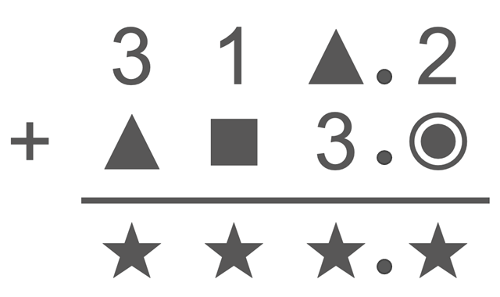
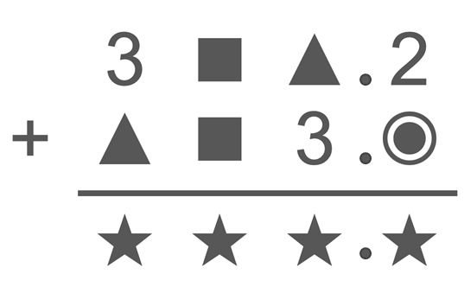
Checkpoint 6: Shapes for digits
In this calculation, the four digits have each been replaced by different shapes.
Which digit(s) could the ★ represent?
Explain why:
the ▲ can’t represent 7
the ■ can’t represent 4
the ★ can’t represent 4.
What happens to the number of possible solutions in this version of the calculation?
Notes:
Answers
a) The star symbol can only be 7, 8 or 9.
b)
The triangle can’t represent 7 as that would mean that the ones column would total 10, but if the tenths column had totalled ten we would need to add the one that had been carried from there.
The square can’t represent 4 as that would mean that the star had a value of 5, and therefore the triangle and circle would need to be 2 and 3 respectively and these are already stated in the calculation not as shapes.
The star can’t represent 4 for the same reason (so, for example, the circle would need to be 2 – but 2 is already stated).
Suggested questioning
What is the lowest/highest each symbol could be?
Would this question change if the decimal point was moved? Why or why not?
Things to think about
Checkpoint 6 features decimal addition as a context, but the inclusion of a decimal point is irrelevant to the task – save to perhaps act as an indication of students’ confidence when faced with calculations with decimals. Students will need to reason about what the digits can possibly sum to, which will both demonstrate their understanding of the structures that underpin the algorithm for column addition, as well as their fluency with the addition and subtraction facts needed for efficient calculation.

Slide 24
Checkpoint 6: Guidance
Adaptations | Assessing understanding
Support For an easier version, with more possibilities, just show the ones and tenths columns; once students have understood more fully, the tens and hundreds columns could be introduced. Including the decimal point has no real effect on the challenge of the task, but may help to ‘normalise’ calculating with decimals if students feel less confident. An alternative could be to remove the decimal point at first, and ask the question “how does this change the answers?” when it is replaced. Challenge Covering more numbers with symbols can increase challenge, as can introducing additional restraints such as ‘the star must not be even’. Representations The column method uses place value to align each unit. The use of Dienes blocks or place-value counters may help students visualise the problem and whether solutions work. Further guidance can be found in Using mathematical representations at KS3 | NCETM. | This activity offers numerous points for assessment, so that teachers can gauge students’ confidence and accuracy when adding and subtracting with decimals. It is not just about understanding the written algorithm, although this is an important feature of the task, but also about how readily students can access the single-digit addition and subtraction facts that underpin it. This may be through recall or reasoning. Can students, for example, readily reason that the value of the circle must be one more than the value of the triangle, since 2 + circle and 3 + triangle equal the same number?
Additional resources Primary Assessment Materials | NCETM offer further activities for addition and subtraction, which could easily be adapted to include decimals, on pages 13 and 14 of the Year 4 materials. Within the 2.1 Arithmetic procedures document, found in Theme 2 of Secondary Mastery Professional Development | NCETM, there are numerous examples exploring addition and subtraction with decimals.

Slide 25
Checkpoint 7: Impossible calculations
▲ and █ represent different digits. Explain why these are impossible calculations.
a)
▲
▲
b)
█
▲
c)
▲
▲
d)
█
▲
+
▲
▲
+
▲
█
−
█
█
−
▲
█
1
0
0
1
0
0
0
0
1
1
How could you change the answer to these calculations so that they are possible?
Is there more than one way to do this?
Create your own impossible additions and subtractions.
How do you know they are impossible?
Notes:
This slide is animated. Each question will appear separately so you can choose the pace at which to work with your class.
Answers
a) If ▲ + ▲ = 10 in the tenths column, then one would be carried into the ones column so here you would need to do ▲ +▲ + 1. This calculation can be corrected by changing the sum, for example to 2.2, 4.4, 6.6, 8.8, 11.0, 13.2, 15.4, 17.6 or 19.8.
b) Much as with part a, if ▲ and █ sum to 10, then one would be carried into the ones column so here you would need to do ▲ + █ + 1. This calculation can be corrected by changing the sum, for example to 11.0. (There are too many possible answers to list here!)
c) Only digits that are the same have a difference of 0. This calculation could be corrected by switching ▲ and █ in either the ones or tenths column.
d) If ▲ − █ = 1, and therefore █ is less than ▲, this calculation will not have a positive solution. This calculation could be corrected by switching ▲ and █ in either the ones or tenths column. Alternatively, students may realise that █ could be greater than ▲, in which case ten tenths would have been exchanged from the ones column. In this instance, ▲ must equal 0 and █ must equal 9 (since 10 − 9 is the only possible calculation that could result in a 1 in this column). This would give a calculation of 8 – 0 in the ones column, so the calculation could also be corrected by amending the answer to 8.1
Suggested questioning
What do you know about adding/subtracting two numbers that are the same?
What would happen in d if █ was less than ▲? How about if █ was more than ▲?
Does the answer to ▲ + ▲ change depending on its position?
Things to think about
Much like Checkpoint 6, Checkpoint 7 asks students to demonstrate their understanding of the structure of column addition – and, here, subtraction as well – by considering what digits could be represented by symbols. In this case, all of the calculations are impossible and so students will need to articulate why this is the case. Specific features are focussed upon (such as carrying between columns in part a) so that teachers can assess students’ understanding of the structure behind the algorithm.

Slide 26
Checkpoint 7: Guidance
Adaptations | Assessing understanding
Support Present students with examples that build towards the understanding needed for this activity to help them to access it. For example, before part a, present students with a similarly arranged calculation featuring just ▲ + ▲= █. Discuss what ▲ and █ could and couldn’t represent, and what would happen to the answer if ▲was 5 or greater. Challenge The ‘further thinking’ question suggests asking students to create their own impossible questions; adding constraints around properties of number could further deepen this activity. Representations Representations are not explicitly referred to here, but the use of Dienes blocks or place-value counters may help students visualise the problem and whether solutions work. Further guidance can be found in Using mathematical representations at KS3 | NCETM. | Removing numbers from this activity means that the focus on assessment is less on fluency and more on the understanding of the mathematical structures behind the process. A particular focus here is on place value. For addition, can students explain what happens within a column when the total is greater than 9? For subtraction, can they explain what happens within and across the columns when a subtrahend digit is greater than a minuend digit? Listen to the language that students use: do they show an appreciation for place value in their explanations? For example, do they explain that ‘1 ten’, rather than ‘1’, has been carried for the final part of the calculation in part a? See the Guidance slide of Checkpoint 8 for more detail about the language of subtraction.
Additional resources Within the Primary mastery professional development materials, Topics 1.20 and 1.21 look at the algorithms for column addition and subtraction: Algorithms: column addition | NCETM and Algorithms: column subtraction | NCETM.

Slide 27
Checkpoint 8: Subtraction gaps
3
7
4
3
7
4
3
7
4
Here are three slightly different subtractions.
−
2
3
−
2
5
−
2
5
0
0
8
Without calculating, explain why the following statements are false.
  The blue digit must be 1 in each calculation as the tenths digits are one apart.
  The orange digit must be 7 in both cases as the difference is 0.
  The purple digit must be 1 in all three calculations as 3 − 2 = 1.
Find the missing digits.
Create your own missing digit subtraction problem that has a solution of 10.5. Is there more than one way to do this?
Notes:
This slide is animated. Each question will appear separately so you can choose the pace at which to work with your class.
Answers
The statement around the blue digit unpicks a common mistake where students subtract ‘up’ when the subtrahend is greater than the minuend within a column. Students should understand that, in the second and third calculation, the blue digit will be the difference between 14 and 5, not 4 and 5.
The statement around the orange digit is true for the first calculation, but not for the second and third because one from this column will have been exchanged for ten tenths. In these calculations, 7 ones are now 6 ones. (NB the third calculation uses a green square as the difference is 8 not 0 here).
The statement around the purple digit picks apart a similar misconception to the orange number; the answer digit of 8 is an indication that exchange was needed. This statement also draws attention to the fact that column subtraction should always start in the column with the lowest place value.
b) 37.4 ˗ 27.3 = 10.1; 37.4 ˗ 26.5 = 10.9; 37.4 ˗ 28.5 = 8.9
Suggested questioning
If the blue number is not 1, what could it be?
If the orange number is not 7, what could it be?
If the purple number is not 1, what could it be?
What happens when you need to subtract a digit from a smaller digit? Why is this possible?
Things to think about
Checkpoint 8 is a classic missing box problem using the context of decimal subtraction. The addition of part a provides some structure for discussion, highlighting some common mistakes with the algorithm for column subtraction. This may support those who are less confident to access part b, and also offer an opportunity to listen to how students articulate their responses. It should be noted that, in this activity, the colours of the boxes are to indicate digits that should be compared/discussed, not to illustrate that they have the same value (as can be common in some other missing value problems).

Slide 28
Checkpoint 8: Guidance
Adaptations | Assessing understanding
Support Remove the third calculation and just compare the first two. This may also help those who are less confident to really focus on what is the same/different each time. Teachers might also like to remove the decimal point at first, and ask the question “how does this change the answers?” when it is replaced. Challenge The ‘further thinking’ question asks students to create their own problems; this can be further extended by asking them to think about what is the minimum information they need to include to make their problem solvable, or to make it have a specified number of solutions. Representations Dienes blocks or place-value counters, alongside a place-value grid, may be a useful tool for modelling exchange and making explicit what is the same/different between the calculations. Further guidance can be found in Using mathematical representations at KS3 | NCETM. | This Checkpoint draws attention to some particularly common misconceptions with column subtraction. The answers in the notes go into more detail about the specifics of each one. Consider the language that they use and how confident they are with the place-value structures that underpin the process. Pay particular attention to the language that students use when explaining the blue box in the second and third calculations: while the term ‘borrowing’ might be more familiar to some secondary teachers, it is more likely that students have been taught to use the term ‘exchange’. This more accurately describes the process of ‘exchanging’, for example, 1 ten for 10 ones. As with previous Checkpoints, the context of decimals is not the main focus, but decimals are included so as to ‘normalise’ students’ experience of calculating with them.
Additional resources Within the Primary mastery professional development materials, Topic 1.21 looks at the algorithm for column subtraction: Algorithms: column subtraction | NCETM.

Slide 29
Checkpoint 9: Largest and smallest differences
−
Arrange these cards onto the grid to create:
the largest possible positive difference
the smallest possible positive difference.
4
6
8
5
7
9
How would your answers change if the grid looked like this:
−
Notes:
Printable digit cards and a place value grid to support this Checkpoint are available in the ‘Printable resources’ section, on slides 116-127.
Answers
a) 98.7 ˗ 45.6 = 53.1
b) 74.5 ˗ 69.8 = 4.7
? Largest difference: 98.7 – 4.56 = 94.14
? Smallest difference: 45.6 – 9.87 = 35.73
Suggested questioning
What is the largest number you can create? What is the smallest? How does this help you?
Why is 57.9 ˗ 46.8 = 11.1 not the smallest difference?
How can you make sure your difference doesn’t have a digit in the tens column?
Things to think about
At its most basic, Checkpoint 9 offers an opportunity to practise column subtraction. Reasoning about creating the largest possible difference is relatively straightforward, but to created the smallest possible difference students will need to consider how to ensure that their calculations feature exchange from the tens and ones columns. This encourages much deeper thinking about the structure of place value that underpins the column method for subtraction.

Slide 30
Checkpoint 9: Guidance
Adaptations | Assessing understanding
Support This is a low-floor/high-ceiling activity and so there should be a point of access for almost all students. To further increase accessibility, give students one number and ask them to arrange the remaining three cards – with the intention that students have an opportunity to really focus upon their reasoning about digit placement. Challenge The ‘further thinking’ question can be developed further with different arrangements of digits and decimal points. Students can also be challenged to justify how they know they have found the smallest difference. A further point for discussion might be how this task would change if the word ‘positive’ was removed. Representations Pace-value cards may help students to organise their thinking. This may be supported by a grid with place-value headings. Cards and grids are provided in ‘Printable resources’ section of this deck. | Check students’ proficiency with the algorithm for column subtraction – and whether students lean towards more efficient mental methods where possible. More importantly, use the opportunity to assess students’ reasoning: most students should be able to identify that the greatest difference is achieved through the largest and smallest possible combination of digits, and be able to reason about how to achieve this. More challenging is reasoning around the smallest difference: students need to really understand exchange and how this will affect the differences in the ones and tens columns as the process unfolds.
Additional resources Within the 2.1 Arithmetic procedures document, found in Theme 2 of Secondary Mastery Professional Development | NCETM, there are numerous examples exploring addition and subtraction with decimals.

Slide 31
Checkpoint 10: Decimal differences
Complete these calculations. Is there more than one possible answer?
a)
−
=
6
2
b)
−
=
0
2
c)
−
=
9
2
Choose six different digits to complete this calculation:
−
=
Notes:
This slide is animated. Each question will appear separately so you can choose the pace at which to work with your class.
Answers
a) One possible answer is 14 – 7.8; answers may range from 16 – 9.8 to 10 – 3.8.
b) 10 – 9.8; there is only one possible answer.
c) e.g. 16 – 6.8 (answers may range from 19 – 9.8 to 10 – 0.8)
? Any valid answer with the correct number of digits, for example 10 – 7.6 = 2.4
Suggested questioning
What is the largest the minuend must be? How do you know?
Why can’t any of these questions start with 20?
Why is there only one solution to part b?
Things to think about
Checkpoint 10 practises column subtraction where the two numbers have different numbers of decimal places; specifically, where the minuend is an integer and the subtrahend is not. The numbers have been carefully selected to encourage discussion about the mathematical structures underpinning the calculation. Part b, for example, only has one answer as any integer greater than 10 would require a subtrahend with a tens column (i.e. _ _ . _) to have a difference of 0.2. For the same reason, the largest the minuend can be in part a is 16. Students should be encouraged to think about the limits of possibility for each number: what is the smallest and largest it could be?

Slide 32
Checkpoint 10: Guidance
Adaptations | Assessing understanding
Support Provide students with place-value grids to support them with laying out the column subtractions; alternatively additional activity C could be used (see below). Challenge Asking students to think about the possible range of solutions will encourage them to think more deeply; for example, can they amend the second question so that it has more than one possible solution? What needs to change? Representations A number line may be a helpful representation in discussing the possible solutions. For example, for part a, showing how the difference of 6.2 can ‘shift’ up the number line to show the possible values for the minuend and subtrahend. | Students may be drawn to use the column method to check if their suggested digits work. This offers the opportunity to assess their understanding of aligning the correct place value when subtracting a decimal from an integer. Students may be tempted, as both numbers have two digits and one has no visible decimal point, to align the digits rather than the correct place value columns. Asking students how many possible answers there are, and why, will offer insight both into their understanding of difference and their appreciation of how the structure of this task sets limitations on place value. Can students identify the maximum and minimum values for the minuend, and explain why?
Additional resources Additional activity C presents a similar task with the structure of column subtraction already given to support students to understand how to align the decimal points.

Slide 33
Multiplication and division of positive and negative integers
Checkpoints 11–20

Slide 34
Multiplication and division of positive and negative integers
Previous learning | In Key Stage 3 students need to
Key Stages 1 and 2 curriculum: Year 2: arrays and repeated addition Year 3: include positive integer scaling problems and correspondence problems in which n objects are connected to m objects Year 4: solve problems including using the distributive law Year 5: multiply and divide whole numbers and those involving decimals by 10, 100 and 1 000 There is no multiplication or division of negative numbers in the primary curriculum. Further information about how students may have experienced this key idea in Key Stages 1 and 2: Teaching mathematics in primary schools, 5MD–1: Multiply and divide numbers by 10 and 100… (pp241–43); 6AS/MD–1: Understand that 2 numbers can be related additively or multiplicatively and quantify … multiplicative relationships… (pp298–301) Primary Mastery Professional Development, Spine 2 Multiplication and division. Particularly, Year 4 2.17: Structures: using measures and comparison to understand scaling; Year 6 2.27: Scale factors, ratio and proportional reasoning * Page numbers reference the complete Years 1–6 document | Extend the domain in which they understand the multiplicative structure to include negative numbers. Be able to calculate with numbers of ‘any size’. Appreciate that assumptions based on calculating with positive numbers (i.e. multiplying by a number ‘always increases’ and dividing a number ‘always decreases’) do not hold when multiplying and dividing with negative numbers. Not just learn rules by rote, but have an appreciation of why they work: for example, the structure ˗a × 0 = ˗a × (+ b + ˗b) together with the application of the distributive law can be used to give meaning to the fact that the product of two negative numbers is a positive number.

Slide 35
Checkpoint 11: Ordering multiplications
Is it possible to put these calculations in order from least to greatest product without calculating?
18 × 23 9 × 47 17 × 23 18 × 24 38 × 12
Write a multiplication with a product that is larger than all of these.
Write a multiplication with a product that is not quite the smallest!
Notes:
Answers
17 × 23 = 391, 18 × 23 = 414, 9 × 47 = 423, 18 × 24 = 432, 38 × 12 = 456
Ideally the correct order results from reasoning, without the answers being calculated.
? A correct answer could be 39 × 12 (or anything greater than 38 × 12).
? A correct answer could be 17.5 × 23 (or anything less than 18 × 23 and greater than 17 × 23).
Suggested questioning
How could you think about these products without calculating?
How could we write 18 × 23 so it can be compared easily with 9 × 47?
How could we compare 9 × 47 and 18 × 24?
How do we know that 38 × 12 is larger/greater than 18 × 24, without working the answer out?
Things to think about
Checkpoint 11 explores multiplication, with the intention that students would be able to order the products without calculating. There are many approaches to this task, and seeing what students choose to do will help teachers to assess both their confidence with multiplication and also their ability to estimate and reason about related calculations..

Slide 36
Checkpoint 11: Guidance
Adaptations | Assessing understanding
Support To support students to access this task, teachers may be tempted to change the numbers; there is a danger that, in doing this, students become more not less inclined to calculate rather than reason. Instead, offer students specific pairs and ask them to reason about which is greater, and then introduce other calculations to their list one-by-one. Challenge Asking students to create products that would fit in between the products on their ordered list will encourage them to think deeply. Students may also be challenged to reason about the same calculations, but with the introduction of some decimal points. Representations Students are likely to be able to reason about relationships between products without the support of a representation. Arrays or rectangles might be used to compare products or to model, for example, how 9 × 47 could be rewritten as 18 × 23.5. | This Checkpoint asks students to order rather than calculate, to encourage them to reason about the products. Students are likely to recognise relationships between products where one number is the same but may need prompting to work out how others (e.g. 38 × 12) can be usefully rewritten. Students need to understand how to rewrite their products as equivalent calculations: for example, if they make one of their numbers twice as big, they will need to make the other half as big. There is also therefore an opportunity to check fluency with doubling and halving. Ask students to use written methods to find the products and check their order; this help to gain an understanding of which methods students are familiar with, and their level of accuracy in using them.
Additional resources If students need more practice in considering relationships between multiplication calculations, p 15 of Year 6 in Primary Assessment Materials | NCETM offers an alternative task. Additional activity G looks more explicitly at written methods for multiplication.

Slide 37
Checkpoint 12: Ordering divisions
Is it possible to put these calculations in order from least to greatest quotient without calculating?
18 ÷ 23 17 ÷ 24 23 ÷ 24 17 ÷ 23
Write a division with a quotient that is larger than all of these.
Write a division with a quotient that is not quite the smallest!
Notes:
Answers
17 ÷ 24, 17 ÷ 23, 18 ÷ 23, 23 ÷ 24
? For example, 23 ÷ 23 or anything larger/greater than 23 ÷ 24
Not quite the smallest: e.g. 17 ÷ 23.5
Suggested questioning
How do we know that 17 ÷ 24 is less than 17 ÷ 23, without working the answer out?
How do we know that 18 ÷ 23 is larger/greater than 17 ÷ 23, without working the answer out?
Can we be sure that 23 ÷ 24 is larger/greater than 18 ÷ 23?
How do we know that all of these answers are less than 1?
Things to think about
Checkpoint 12 is an opportunity to explore division. As with Checkpoint 11, there are many approaches to this task, and seeing what students choose to do will help teachers to assess both their confidence with division and also their ability to estimate and reason about related calculations. The intention is that students would be able to order the quotients without calculating. Unlike Checkpoint 11, teachers should not ask students to calculate to check. This is because they will not have been taught to handle quotients that are irrational and less than one at primary school, and any method that uses fractions would distract from the purpose of the task. There are further opportunities to explore students’ proficiency with the algorithm for division in checkpoints 17 and 18.

Slide 38
Checkpoint 12: Guidance
Adaptations | Assessing understanding
Support To support students to access this task, teachers may be tempted to change the numbers; there is a danger that, in doing this, students become more not less inclined to calculate rather than reason. Instead, offer students specific pairs and ask them to reason about which is greater, and then introduce other calculations to their list one-by-one. Challenge Asking students to create divisions that would fit in between the quotients on their ordered list will encourage them to think deeply. Students may also be challenged to reason about the same calculations, but with the introduction of some decimal points. Representations Students should be able to reason about relationships between quotients without the support of a representation. Indeed, the number selection here makes it likely that any representation would further complicate the activity. | This Checkpoint asks students to order, rather than calculate, to encourage them to reason about the quotients. Students may be confused by the divisor being greater than the dividend; this is an opportunity to discuss how we know that the quotient must therefore be less than 1, and that we do not need to calculate it exactly here. Comparing pairs of quotients is a helpful way to support students’ reasoning. For example, thinking about what is the same/different between 17 ÷ 23 with 17 ÷ 24, and then comparing 17 ÷ 23 with 18 ÷ 24 will encourage students to think more specifically about the effect of a larger divisor and then a larger dividend.
Additional resources On p15 of Year 5 in Primary Assessment Materials | NCETM there are two activities looking at equivalent divisions.

Slide 39
Checkpoint 13: Stories
A story that fits the calculation 12 + 3 is:
  Carol has 12 biscuits and Richard has 3 biscuits.
  Altogether Carol and Richard have 12 + 3 biscuits.
Write a story that fits each calculation:
  12 × 3
  3 × 12
  12 ÷ 3
  3 ÷ 12
Which of 12 ÷ 3 and 3 ÷ 12 gives the greater answer?
Write a division calculation that gives an answer between the two.
Notes:
Answers
Any appropriate story to fit 12 × 3, such as Carol has 3 packets of biscuits. Each packet has 12 biscuits. Altogether, Carol has 12 × 3 biscuits.
Any appropriate story to fit 12 × 3, such as Carol has 3 packets of biscuits. Each packet has 12 biscuits. Altogether, Carol has 3 × 12 biscuits.
Any appropriate story to fit 12 ÷ 3, such as Richard has 12 biscuits. He shares them with 3 friends. Each person will have 12 ÷ 3 biscuits.
Any appropriate story to fit 3 ÷ 12, such as Richard has 3 biscuits. There are 12 biscuits in a packet. He has 3 ÷ 12 packets.
? 12 ÷ 3 is greater than 1 and 3 ÷ 12 is less than 1, so 12 ÷ 3 gives the greatest answer.
Examples such as 12 ÷ 4 or 3 ÷ 10 would give an answer between the two.
Suggested questioning
How might an array help you imagine a story for multiplication?
Can you think of a multiplication context where something is scaled to be 3 or 12 times bigger?
Is your division story an example of grouping or sharing?
Things to think about
In Checkpoint 13, students are asked to suggest contexts for calculations. Using the same numbers throughout draws attention to commutativity: draw attention to how the two stories for parts a and b can be the same but the stories for c) and d) cannot. Students may find it more challenging to create stories for multiplication and division than for addition and subtraction. The selection of 12 and 3 is deliberate so that it is easier for students to make sense of part d), which has a fractional quotient; Additional Activity D offers an alternative number selection.

Slide 40
Checkpoint 13: Guidance
Adaptations | Assessing understanding
Support Write some stories and ask students to match them to the calculations. It could develop students’ understanding to offer several different stories for one calculation. Challenge The beauty of an open-ended activity such as this is that it is always possible to ask ‘and another?’. Can students think of different contexts? Can they think of a context from their everyday life? Can they think of a context that nobody else has thought of? Representations The most appropriate representations here will be entirely determined by the context of the story. For example, if the story for 3 × 12 relates to rows of chairs in the classroom, then an array is an ideal visual. If it relates to the number of biscuits in 3 packets, then a bar model may be better suited. | This Checkpoint takes a common challenge for students – identifying which operation to perform in a worded problem – and reverses it. This enables you to see if students have understood the structure of multiplication and division and how it can be applied in context. Students may be more confident about creating stories for addition and subtraction and need some prompts to trigger recognition of situations where multiplication and division. Source some images (such as arrays of chairs in the school hall, or rows of biscuit packets on a supermarket shelf) to support this. Draw attention to the fact that stories may be the same for parts a and b, but need to be different for c and d, since division is not commutative.
Additional resources There are some worded contexts for multiplication and division on pp16 and 17 of Year 6 in Primary Assessment Materials | NCETM Additional Activity D offers the same task but using the numbers 15 and 17, so that students can apply their understanding of the contexts/structures to less straightforward calculations.

Slide 41
Checkpoint 14: Largest and smallest product
Choosing digits from 1 to 9, and using each digit only once, place one digit in each box so that the product is:
  as small as possible
  as large as possible.
×
Can you make a larger or smaller product if you’re able to move the × card?
Notes:
Additional Activity E offers an alternative task so that, if you wish, students can start with a two-digit by one-digit multiplication before working on this three-digit by one-digit multiplication.
Answers
a) The smallest product is 234 × 1 = 234.
b) The largest product is 876 × 9 = 7 884.
? If you can move the multiplication symbol to create a two-digit by two-digit multiplication, then the largest product is 87 × 96 = 8 352. The smallest product is unchanged.
Suggested questioning
Why will you not use the digit 9 for part a?
Why will you not use the digit 1 for part b?
How can you use your biggest and smallest digits so that they do have the greatest impact on the magnitude/size of the answer?
Things to think about
In Checkpoint 14, students are asked to think about how the size of the numbers they create will affect the size of the product. The activity practises methods for multiplication, but the main focus for assessment is whether students can reason about what combinations of numbers will produce the biggest and smallest products. Make a judgment call about the length of time to allocate to this open-ended activity; 10 minutes may not be sufficient.

Slide 42
Checkpoint 14: Guidance
Adaptations | Assessing understanding
Support Use the digit cards provided in ‘Printable resources’ so that students can manipulate them to create their own calculations. There is also a two-digit by one-digit version of this task available (see below) this does not build up to long multiplication, so use the Checkpoint as well. Challenge Remove certain digit cards or add constraints, such as that products need have certain properties. Representations Place-value counters and place-value grids may be useful for modelling why 9 lots of 8 hundreds, 7 tens and 6 ones will be bigger than any other multiple of 9 hundreds, _ tens and _ ones. | There are two main foci for assessment here: whether students can reason about which combinations of digits will produce the greatest product, and whether students can accurately use written algorithms for multiplication. The former relies upon understanding of place value: students may be tempted to place the 9 digit in the hundreds place, and so an interesting point of discussion is why a greater product is produced by multiplying by the 9 instead. To fully assess the written algorithm, encourage all students to attempt the ‘further thinking’ question, to see how they approach two-digit by two-digit multiplication.
Additional resources Additional activity E features a two-digit by one-digit version of this task, which might be used as a more accessible starting point. Additional activity G more explicitly explores written methods for multiplication. Within Primary Mastery Professional Development | NCETM, Topic 2.23 explores Multiplication strategies for larger numbers and long multiplication | NCETM

Slide 43
Checkpoint 15: Largest and smallest quotient
Choosing digits from 1 to 9, and using each digit only once, place one digit in each box so that the quotient is:
  as small as possible
  as large as possible.
÷
Can you make a larger or smaller quotient if you’re able to move the ÷ card?
Notes:
Additional Activity F offers an alternative task so that, if you wish, students can start with a two-digit by one-digit division before working on this three-digit by one-digit.
Answers
a) 123 ÷ 9 = 13.6666666... If students have been taught to write the remainder exactly, this is likely to be as a fraction so 6/9 or 2/3.
b) 987 ÷ 1 = 987
? Yes and no! Moving the division card so that you can divide a one-digit number by a three-digit number will result in the smallest quotient, in this case 1 ÷ 987. The largest quotient will remain the same.
Suggested questioning
Will you use a one-digit for part a? Why or why not?
What is the biggest number you can create? Will you use this in part a or part b?
How can you make the biggest quotient?
Things to think about
Checkpoint 15 is the ‘partner’ of Checkpoint 14 and asks students to think deeply about how the relative size of the dividend and divisor affects the quotient. There is also an opportunity for students to practise written methods of division to check whether their assumptions are correct. Make a judgment call about the length of time to allocate to this open-ended activity; 10 minutes may not be sufficient.

Slide 44
Checkpoint 15: Guidance
Adaptations | Assessing understanding
Support Use the digit cards provided in ‘Printable resources’ so that students can manipulate them to create their own calculations. There is also a two-digit by one-digit version of this task available (see below). Challenge Remove certain digit cards or add constraints, such as that quotient need have certain properties. Representations Bar models may be useful for representing why, for example, a divisor of 9 will produce a smaller quotient than a divisor of 8. If bar models are drawn approximately to scale, they could also be used to compare different dividends as well. | While the activity does offer an opportunity to practice methods for division, the main focus for assessment is whether students can reason about what combinations of numbers will produce the biggest and smallest quotients. Students may be able to do this through reasoning rather than trial and error. While the largest quotient is, in fact, an integer, teachers may find that students trial combinations of numbers that do not result in an integer quotient. This means that they can also assess students’ confidence with remainders and whether they understand how to write them as fractions.
Additional resources Additional activity F features a two-digit by one-digit version of this task, which might be used as a more accessible starting point. Within Primary Mastery Professional Development | NCETM, Topic 2.15 explores Division: partitioning leading to short division | NCETM and Topic 2.24 explore Division: dividing by two-digit divisors | NCETM.

Slide 45
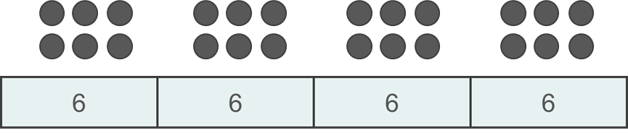
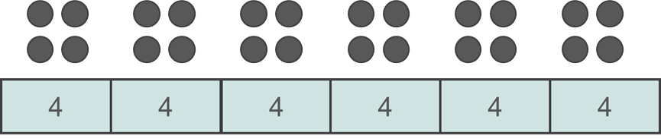
Checkpoint 16: Grouping and sharing
Ayesha and Zoe both represent 24 ÷ 6 = 4 using bar models and dots.
My diagram shows that 4 groups of 6 make 24.
My diagram shows that 24 shared between 6 is 4.
Ayesha
Zoe
How can they both be correct?
Draw diagrams to represent the following divisions. Are you grouping or sharing?
    350 ÷ 7 350 ÷ 50 350 ÷ 70 350 ÷ 2
Write some divisions that you can complete using mental methods. Do you use grouping or sharing?
Notes:
This slide is animated. Each section will appear separately so you can choose the pace at which to work with your class.
Answers
a) Because 4 groups of 6 is equivalent to 6 groups of 4 and/or division is the inverse of multiplication
b) Students may represent these calculations in any way that makes sense to them, although they may be more likely to use the bar models and arrays shown. It is likely that the relative size of the numbers will affect whether their representation uses grouping or sharing. For example, 350 ÷ 7 is likely to show 350 shared between 7, as 50 groups of 7 would be time consuming to draw! Conversely, 350 ÷ 50 is likely to show 350 made up of groups of 50 (as 7 groups of 50 is quicker to draw than a model sharing 350 between 50.
Suggested questioning
What does ‘grouping’ mean to you? What about ‘sharing’? Could you draw diagram to explain them?
Do you always think of division as sharing or grouping?
Which divisions do you think of as grouping? Which as sharing?
When you do a written method of division, are you grouping or sharing?
Things to think about
Checkpoint 17 addresses the two different ways to represent division: the partitive (sharing) model and the quotitive (grouping) model. Explore whether students understand that division can be represented both ways, and if they are aware of which model they use when calculating. Be aware of the language you use when talking about division: you may tend towards one model more than the other in explanations of division. Often, this is the sharing model – but the written algorithm for division relies upon grouping.
These are written as context-free problems, to focus on the representations and the structure. However, looking at contextual problems may be an interesting next step. Consider whether the context of the problem leads students towards either model, or whether the number selection has the bigger influence.

Slide 46
Checkpoint 16: Guidance
Adaptations | Assessing understanding
Support Give students 24 counters and ask them to model other divisions using both the partitive (sharing) and quotative (grouping) structures, to ensure they are fully confident with both. Provide students with a context to support them to see the difference. Challenge Challenge students to create a worded context that leads to one or other structure. Can they write a problem that uses the partitive structure, but where the quotitive structure is more useful for the actual calculation? Representations Both bar models and arrays are used here to model how both can be used to represent both structures. With larger numbers, as in part b, it is likely that a bar model is the most useful and efficient of the two. | Students may be able to use a written method for division, or recall division facts, without recognising that there are two distinct structures for thinking about division. This Checkpoint examines this explicitly, to assess whether these are familiar structures and to explore what language students use to explain them. Some students may use sharing/grouping while others have had experience of the terms partitive/quotitive. Students may find that their bar model for 350 ÷ 7 looks the same as their bar model for 350 ÷ 50, as they are unlikely to draw 50 parts in a bar. Are they able to explain that, for their first model, they have shared 350 between 7 parts and, for their second, they have made 350 out of groups of 50?
Additional resources Additional activity I uses place value counters to model the written algorithm for division, which relies on students being able to use grouping. Within Primary Mastery Professional Development | NCETM, the terms quotitive and partitive are explained more fully in Topic 2.6 Structures: quotitive and partitive division | NCETM.

Slide 47
Checkpoint 17: 327
3
3
7
2
3
7
2
3
3
2
3
7
3
3
2
7
3
7
3
2
3
2
7
3
Can you think of a different three-digit number that will give an integer answer, when divided by 3? How do you know this will work? What happens when you rearrange the digits and divide by 3?
Notes:
This slide is animated. Each question will appear separately so you can choose the pace at which to work with your class.
Answers
372 ÷ 3 = 124
327 ÷ 3 = 109
723 ÷ 3 = 241
732 ÷ 3 = 244
237 ÷ 3 = (0)79
273 ÷ 3 = (0)91
Suggested questioning
What’s the same and what’s different about each question?
Which was the most difficult calculation to do? Why?
Why do all the calculations give an integer answer?
Things to think about
Checkpoint 18 is an opportunity to practise the written algorithm for division and to check whether students know how to use it. The structure of the activity is designed to build up the complexity of the process each time; it is suggested that students complete the pairs in the order that they appear. Different misconceptions might reveal themselves in each question (see guidance slide). There is also the opportunity to touch on the rules of divisibility, in explaining why all rearrangements of 372 will be divisible by 3.

Slide 48
Checkpoint 17: Guidance
Adaptations | Assessing understanding
Support The number selection here is about as straightforward as possible, while creating the assessment points around remainders. Students may, however, find it helpful to have some place-value counters to model the remainders being exchanged and grouped at each stage. Challenge Students who are confident with division, and who are not prone to errors, may be challenged through missing-box problems, where the quotient is given but parts of the dividend are covered up. Representations Place-value counters can be used to model grouping at each stage, then carrying the remainder and exchanging in the next place-value column. Additional activity I gives an example of this for the calculation 900 ÷ 4. | The calculations have been ordered to elicit some common misconceptions: In 372 ÷ 3 and 327 ÷ 3, the first digit divides exactly, so students only deal with a remainder once. In the second question, students need to remember to write 0 as the second answer digit. In 723 ÷ 3 and 732 ÷ 3 = 244, students immediately need to deal with a remainder. They only deal with a further reminder in the second calculation. In 237 ÷ 3 and 273 ÷ 3, students will need to think about the alignment of the digits in their answer, as the first digit is not divisible by 3.
Additional resources Additional activity H explores some further common errors with the written method for division, while I looks at how it can be modelled using place-value counters. Within Primary Mastery Professional Development | NCETM, Topic 2.15 explores the written method for division in Division: partitioning leading to short division | NCETM.

Slide 49
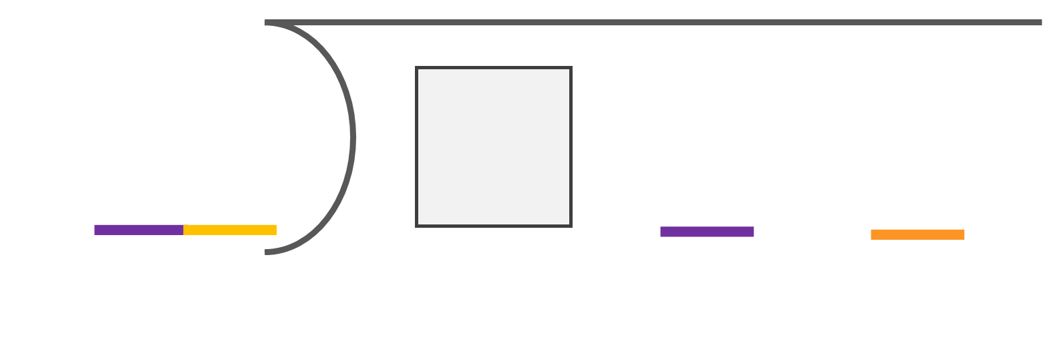
Checkpoint 18: Dividing by 15
a) Choose a single digit to go into the box, then complete the calculation.
b) Is it possible to have an integer answer?
15
1
5
Create another problem using this format:
Can you create one that will have only one integer answer?
Notes:
Answers
a)
For 0, answer is 1
For 1, answer is 7 10/15
For 2, answer is 14 5/15
For 3, answer is 21
For 4, answer is 27 10/15
For 5, answer is 24 5/15
For 6, answer is 41
For 7, answer is 47 10/15
For 8, answer is 54 5/15
For 9, answer is 61
b) Integers are possible when the digits 0, 3, 6 or 9 are chosen, as these multiples of 100 are divisible by 15.
? Students must think about what multiples of 100 their chosen number is a factor of. For example, 25 is a factor of 100 so all possible solutions to □25 ÷ 25 will be integers; 16 is a factor of 400 and 800, so □16 ÷ 16 will be an integer when the box is filled with 4 or 8 (416 ÷ 16 = 26 and 816 ÷ 16 = 51). To create a problem with only one integer answer, students need to choose a two-digit number that is a factor of only one of the possible multiples of 100. For example, 45 is a factor of only 900, so □45 ÷ 45 will be an integer when the box is filled with a 9 (945 ÷ 45 = 21).
Suggested questioning
Did you notice that the last two digits of the dividend is the same as the divisor?
How might we ensure that we are left with no remainder at the end of this calculation? How does this influence our decision about the missing digit?
If we think about the dividend as a multiple of 100, plus the 15, then which multiples of 100 can be divided exactly by 15?
Things to think about
When given a division to explore, some students may approach it as a ‘trial and error’ activity; there is still great value for assessment in this approach (see Guidance). Students who think more deeply about the mathematical structure of this problem may also begin to reason about how the digit chosen for the hundreds column affects the answer. If □00 is divisible by 15, then the answer will be an integer.

Slide 50
Checkpoint 18: Guidance
Adaptations | Assessing understanding
Support Students may wish to explore the same structure with a single-digit number first. Replace the divisor of 15 with 5 or 3 (but keeping the 15 in the dividend). Or replace the 15 in both the divisor and the dividend with any single-digit number. Another alternative is also available at Additional activity J. Challenge If students really deeply understand the structure of this problem, they could be challenged to create their own that have a specific number of integer solutions. Representations Students really need to think about this activity in terms of multiples of the divisor to be able to really understand why certain digits create an integer answer (e.g. where that multiple of 100 is divisible by 100). Have a multiplication grid available to support them to spot the patterns of multiples as they extend into the hundreds. | Even if students do not notice some of the subtleties in the structure of this task, and simply substitute digits in and then divide, teachers will be able to learn a lot about their level of competence with long division. It will also help to gauge their confidence both with working with numbers beyond the commonly known multiplication facts up to 12 × 12, as well as with handling remainders. Students with a deeper understanding of this task should be asked to explain why certain digits produce multiple answers: expect to hear reference to both the language of multiples and to place value in these explanations.
Additional resources Within Primary Mastery Professional Development | NCETM, Topic 2.24 explores Division: dividing by two-digit divisors | NCETM Additional activity J offers a version of this activity with a single-digit divisor.

Slide 51
Checkpoint 19: Partitioning 98
Below are some different ways to partition 98.
Can you think of any more?
Which method of partitioning is most useful for each of these calculations?
      98 ÷ 7
      98 ÷ 2
      98 ÷ 4
      98 ÷ 5
      98 ÷ 3
95 + 3
90 + 8
70 + 28
98
80 + 18
50 + 48
Erika is doing a calculation involving division and has chosen to partition her dividend into 40 + 16. What number might her divisor be? What might her divisor be if she partitioned it into 50 + 6?
Notes:
This slide is animated. Each question will appear separately so you can choose the pace at which to work with your class.
Answers
a) Examples could be 60 + 38, 40 + 58, 30 + 68, etc.
b) Students may choose different partitions for each question, although lend themselves to certain calculations.
For example, 70 + 28 is the only partition that really makes logical sense for 98 ÷ 7, as both numbers are divisible by 7.
For 98 ÷ 2, students are likely to choose a pair of numbers that are both even.
The calculations 98 ÷ 4, 98 ÷ 5 and 98 ÷ 3 will not produce integer quotients; students may choose to partition these numbers using a multiple of the divisor as a starting point.
? If she partitioned her dividend into 40 + 16, her divisor might be 4 or 8. If she partitioned it into 50 + 6, her divisor might be 10 or 5.
Suggested questioning
Look at 90 + 8. If your divisor was 10, how does partitioning in this way help you to ‘see’ the quotient/answer?
What can you ‘see’ inside 70 + 28?
What might we think about when deciding how best to partition a number before dividing?
Things to think about
Checkpoint 19 looks at division without explicitly referencing written methods, and asks students to consider the most efficient way to partition a number to complete a division. It is likely that students will choose to partition their number differently for some of the divisions in part b, and their choice of number offers interesting points for both assessment and discussion (see Guidance slide).

Slide 52
Checkpoint 19: Guidance
Adaptations | Assessing understanding
Support This task uses a number beyond the familiar multiplication facts, so any adaptations need to be mindful of this. Students may find partitioning the number 52, and then exploring divisors of 2, 4 and 5, to be more accessible. Challenge While larger numbers don’t always lead to more mathematical challenge, there is potential for students to think more deeply about how best to partition with a three- or four-digit dividend. Representations Students are likely to be familiar with a part–part–whole ‘cherry’ diagram from primary school; use this familiar representation for students to record their ideas for part a. It is likely that other physical representations would not add anything meaningful to this activity: 98 is a relatively large number to represent with counters, and using Dienes blocks leads students towards answers that can be represented using tens. | This Checkpoint uses partitioning as a starting point, but leads onto efficient methods for mental division. Students’ selection of partitioning methods may be revealing. For example, their number selection for 98 ÷ 2 may reveal which doubles they are most confident with. Similarly, for 98 ÷ 4, the multiple of 4 used as a starting point for partitioning will have an impact on how challenging the rest of the division is. Students may recognise that, if they partition 90 into 70 + 28, they are effectively ‘doing’ the written method for division in their heads – make explicit the link between partitioning and the written method in class discussion.
Additional resources Topic 2.15 from Primary Mastery Professional Development | NCETM looks in more detail about how partitioning leads to written methods for division: Division: partitioning leading to short division | NCETM. The ‘cherry’ diagram is first introduced in Topic 1.2: Introducing 'whole' and 'parts': part–part–whole | NCETM.

Slide 53
Checkpoint 20: Dealing with remainders
What is the same and different about each of these questions?
What will be the same and different about the answers?
Cliff has 63p. Chocolate bars cost 10p each. How many chocolate bars can he buy?
A meal costs £63, to be split equally between 10 friends. How much do they each pay?
Dave is a waiter and has 63 plates to collect. He can carry 10 plates at a time. How many trips does he need to make?
37 ÷ 5 = 7.4
Can you write a worded context for this division calculation?
Can you write a context where 7 would be the most appropriate answer? How about 8?
Notes:
Answers
Same: in all the questions, the numbers are the same and the operation is division i.e. 63 is the dividend and 10 is the divisor
Different: the first answer has to be rounded down to 6, the second answer will be exactly £6.30 and the third answer has to be rounded up to 7.
Suggested questioning
Why is the answer to the first question not the same as the answer to the second question?
Can you think of another context where the answer would need to be exact?
Things to think about
Checkpoint 20 offers three questions based around the same calculation. The variation in this question is designed to allow discussions to focus on what is different each time, which is that the answer needs to be treated differently according to the context. Students need to be able to understand whether rounding up or down is the most appropriate way to deal with a remainder, as well as be able to write the answer exactly if needed.

Slide 54
Checkpoint 20: Guidance
Adaptations | Assessing understanding
Support Change the contexts to those more familiar to students, or which can be more easily modelled in the classroom. For example, Dave’s plates might be replaced by students needing tables. Challenge This problem could be posed in reverse: the correct answer to a question involving 63 ÷ 10 is 7. What could the question have been? Representations Consider different representations for the different contexts. For example, a bar model is ideally suited to divisions where exact answers can be given. Grouping or sharing counters/cubes are more suited to divisions where a decision needs to be made about the remainder. | Checkpoint 20 gives three identical calculations so students can focus on what is different: how the remainder is dealt with in the answer. Teachers will wish to check first whether students can recognise all three contexts as problems involving division, and then whether students understand why the remainder is treated differently each time. Ten has been chosen as the divisor as this is a calculation that students are likely to be able to perform mentally: if teachers a different divisor, note that students may have been taught to write remainders as fractions but likely will not have been taught how to calculate exact decimal answers.
Additional resources If students need more support to consider when to round up or down with remainders, additional examples can be found in Division with remainders | NCETM, which is topic 2.12 of Primary Mastery Professional Development | NCETM.

Slide 55
Multiplication with decimals
Checkpoints 21–23

Slide 56
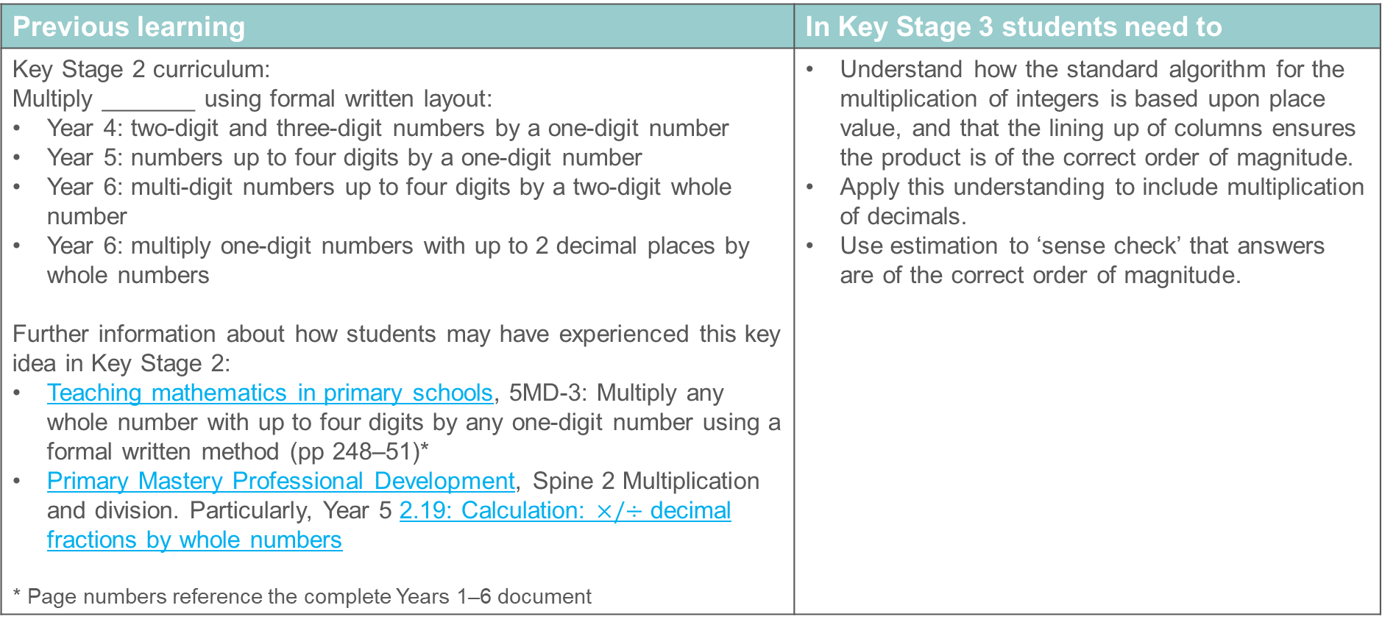
Multiplication with decimals
Previous learning | In Key Stage 3 students need to
Key Stage 2 curriculum: Multiply _______ using formal written layout: Year 4: two-digit and three-digit numbers by a one-digit number Year 5: numbers up to four digits by a one-digit number Year 6: multi-digit numbers up to four digits by a two-digit whole number Year 6: multiply one-digit numbers with up to 2 decimal places by whole numbers Further information about how students may have experienced this key idea in Key Stage 2: Teaching mathematics in primary schools, 5MD-3: Multiply any whole number with up to four digits by any one-digit number using a formal written method (pp 248–51)* Primary Mastery Professional Development, Spine 2 Multiplication and division. Particularly, Year 5 2.19: Calculation: $×/÷$ decimal fractions by whole numbers * Page numbers reference the complete Years 1–6 document | Understand how the standard algorithm for the multiplication of integers is based upon place value, and that the lining up of columns ensures the product is of the correct order of magnitude. Apply this understanding to include multiplication of decimals. Use estimation to ‘sense check’ that answers are of the correct order of magnitude.

Slide 57
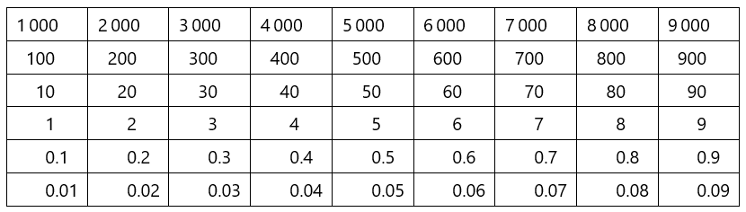
Checkpoint 21: Product is 21
A pair of numbers is highlighted on the Gattegno chart.
The product of this pair of numbers is 21
Find more pairs of numbers, on the chart, with a product of 21.
Is the product of 0.00007 and 30,000 more than, less than or equal to 21? Explain how you know.
How would the options change if the target product were 24?
Are there more options? How many more? How do you know?
Notes:
A printable Gattegno chart to support this Checkpoint is available in the ‘Printable resources’ section, on slide 128.
Answers
a) Other pairs of numbers with a product of 21: 7 × 3, 700 × 0.03, 30 × 0.7, 300 × 0.07
b) The product of 0.00007 and 30 000 would be less than 21 because 0.00007 is 100 000 times smaller than 7 but 30 000 is only 10 000 times larger than 3.
? If the target product was 24, there would be 10 options instead of five options because the digit pairs 6 and 4 or 8 and 3 could be used to give a product of 24.
Suggested questioning
I could place the red rectangle on 7 and the yellow rectangle on 3. If I move the red rectangle up a row, why does the yellow rectangle need to move down a row to keep the product as 21?
Why can I not place the red rectangle on 7 000? How would the Gattegno chart need to change?
Things to think about
Checkpoint 21 supports reasoning about the relative magnitude of related calculations. Students will need to reason about how moving one number up or down a row would change the calculation, and what needs to happen to the other number in order to ensure that the product remains the same.

Slide 58
Checkpoint 21: Guidance
Adaptations | Assessing understanding
Support Give students their own Gattegno chart and counters, to reinforce the relationships between the rows that each factor is on. A printable version is available in ‘Printable Resources’ at the end of the slide deck. Challenge Ask students to find as many possible pairs of numbers that could be used to produce a certain product. Representations This Checkpoint uses the Gattegno chart to support students to see where decimal multiplications have equivalent value. It is a useful representation for exploring concepts that rely upon place value; more information can be found in Using mathematical representations at KS3 | NCETM. | Check students’ understanding of related calculations, and how numbers with the same digits have the correct place value to produce a certain product. This is an important requisite skill for using integer products in decimal multiplication. The Gattegno chart supports students with their reasoning, but also consider the language that students use in their explanations and what it reveals about their understanding. Using a consistent language structure may also continue to support students to reason with decimal multiplications when the chart is no longer there as a visual.
Additional resources If students need more practice in considering how a multiplicative change to one number affects a multiplication or division, additional examples can be found in Using compensation to calculate | NCETM, which is topic 2.25 of Primary Mastery Professional Development | NCETM.

Slide 59
Checkpoint 22: Equivalent calculations
Placing 2 into this set of function machines gives the outcome of 60.
2
×10
×10
×10
×3
×10
÷10
÷10
÷10
60
2 000
0.03
This can be written as an equivalent calculation, 2 000 × 0.03 = 60
a) Make other equivalent calculations by rearranging all the machines.
b) Do they all give the same outcome? Explain why.
Create your own machine using the functions on the right. What would be the most efficient way to calculate if your input was 5? Would this change if your input was 50? Or 0.5?
×10
×10
×10
÷10
×8
÷10
Notes:
Answers
The function machines can be written in any order and will always give the outcome of 60.
This is because multiplication and division have equal precedence/priority.
? Any valid machine, for example ×10, ×10 × 8, ÷ 10 ×10, ÷ 10. There is no ‘right’ answer to the most efficient ways to calculate, but comparing students’ methods may make for interesting discussion. For example, if the input was 5 it might be most efficient to × 8 first then group the × 10 and ÷ 10. If using 50, students may suggest that it is easier to do one ÷ 10 function first, so that they are working with 5. If using 0.5, students may suggest that it is easier to do one × 10 first, so that they are working with 5.
Suggested questioning
Which function machines did you choose to group together? Why?
What happens if we group three of the red function machines and the three yellow function machines together? Why?
Things to think about
In Checkpoint 22, function machines are used as a tool for exploring equivalent calculations involving multiples of 10.

Slide 60
Checkpoint 22: Guidance
Adaptations | Assessing understanding
Support Build up to this number of function machines, starting with one red, one blue and one yellow to rearrange. Adding more reds and yellows individually will help students to build up their understanding. Challenge Ask students to create a function machine with an input of _, an output of _ and exactly _ steps. For example, an input of 8, an output of 0.24 and exactly 6 steps. Representations Modelling the steps of the function machine on a place-value chart with place-value counters, or using a Gattegno chart may be helpful to some students. More information about both of these can be found at Using mathematical representations at KS3 | NCETM. | This activity assesses whether students understand how repeated multiplication or division by 10 affects place value, and the multiple ways in which it can be written. This is a useful prerequisite skill for multiplying with decimals, where students will need to adjust integer calculations to ensure that digits have the correct place value. Pay attention to their confidence with place value; fluency with division and multiplication by powers of 10; understanding of the equivalent priority of multiplication and division; and recognition of equivalent calculations. Some students may already be able to reason that all of the calculations are equivalent, based upon their understanding of the priority of operations; ask them to create different function machines with the same output, to refocus their thinking onto decimal multiplication.
Additional resources An example of mistakes that might be made when using a written method for multiplication of decimals can be found in Additional activity K. If students need more practice in considering how a multiplicative change to one number affects a multiplication or division, additional examples can be found in Using compensation to calculate | NCETM, which is topic 2.25 of Primary Mastery Professional Development | NCETM.

Slide 61
Checkpoint 23: Missing decimal points
Some of the decimal points have fallen out of these calculations!
The answers are all correct, so where should the decimal points be in the questions?
Is there more than one possibility for each?
32 × 14 = 4.48
241 × 19 = 45.79
32 × 14 = 0.448
241 × 19 = 457.9
32 × 14 = 44.8
241 × 19 = 4.579
Write your own set of decimal multiplications using this calculation as a starting point:
95 × 782 = 7 429
Notes:
This slide is animated. Each set of questions will appear separately so you can choose the pace at which to work with your class.
Answers
32 × (0).14 = 4.48 or (0).32 × 14 = 4.48 or 3.2 × 1.4 = 4.48
3.2 × (0).14 = 0.448 or (0).32 × 1.4 = 0.448
32 × 1.4 = 44.8 or 3.2 × 14 = 44.8
241 × (0).19 = 45.79 or 24.1 × 1.9 =45.79 or 2.41 × 19 = 45.79
241 × 1.9 = 457.9 or 24.1 × 19 = 457.9
24.1 × (0).19 = 4.579 or 2.41 x 1.9 = 4.579 or (0).241 × 19 = 4.579
? For example, 95 × 7.82 = 742.9 or 9.5 × 78.2 = 742.9 or (0).95 × 782 = 742.9
95 × (0).782 = 74.29 or 9.5 × 7.82 = 74.29 or 0.95 × 78.2 = 74.29
(0).95 × 7.82 = 7.429 or 9.5 × (0).7429 = 7..249
(0).95 × (0).782 = 0.7429
This is not an exhaustive list of potential calculations, but the most likely for students to choose!
Suggested questioning
How do you know the calculations are wrong?
Is there more than one way to correct each calculation?
If is __ times smaller, what must __ be?
Things to think about
In Checkpoint 23, students are given the correct digits so that they do not have to think about calculating the answer. Instead, they need to reason about the magnitude of the answer and how to ensure the calculation is also of the correct magnitude. Do students use their reasoning and estimation skills, for example to recognise that an answer of 4.48 must be close to 3.2 × 1.4 rather than 32 × 1.4.

Slide 62
Checkpoint 23: Guidance
Adaptations | Assessing understanding
Support It may help students to see the integer calculation written correctly (e.g. 32 × 14 = 448) to support them to then reason about what needs to change in each of the calculations. Challenge Challenge students to see how many different possible answers they can create, particularly if they are allowed to include zero placeholders in their answers. Representations Model the change to the integers/decimals on a place-value chart with place-value counters or use a Gattegno chart. More information about both of these can be found at Using mathematical representations at KS3 | NCETM. | This Checkpoint explores whether students know that a decimal multiplication can be calculated by adjusting the integer multiplication that uses the same digits. Students need to understand that, if there is a multiplicative change to one factor, then the product changes by the same scale factor. By starting with the product, teachers can assess whether students understand that this multiplicative change can affect either or both factors. Students may approach this task through estimation, by referring to a Gattegno chart as used in Checkpoint 21, or by thinking about making numbers 10 or 100 times bigger/smaller. The different approaches that students take will help to assess their understanding of decimal multiplication, as well as act as useful starting points for comparison and discussion across the class.
Additional resources An example of mistakes that might be made when using a written method for multiplication of decimals (and therefore why using and adjusting related integer calculations is necessary) can be found in Additional activity K. If students need more practice in considering how a multiplicative change to one number affects a multiplication or division, additional examples can be found in Using compensation to calculate | NCETM, which is Topic 2.25 of Primary Mastery Professional Development | NCETM.

Slide 63
Division with decimals
Checkpoints 24–28

Slide 64
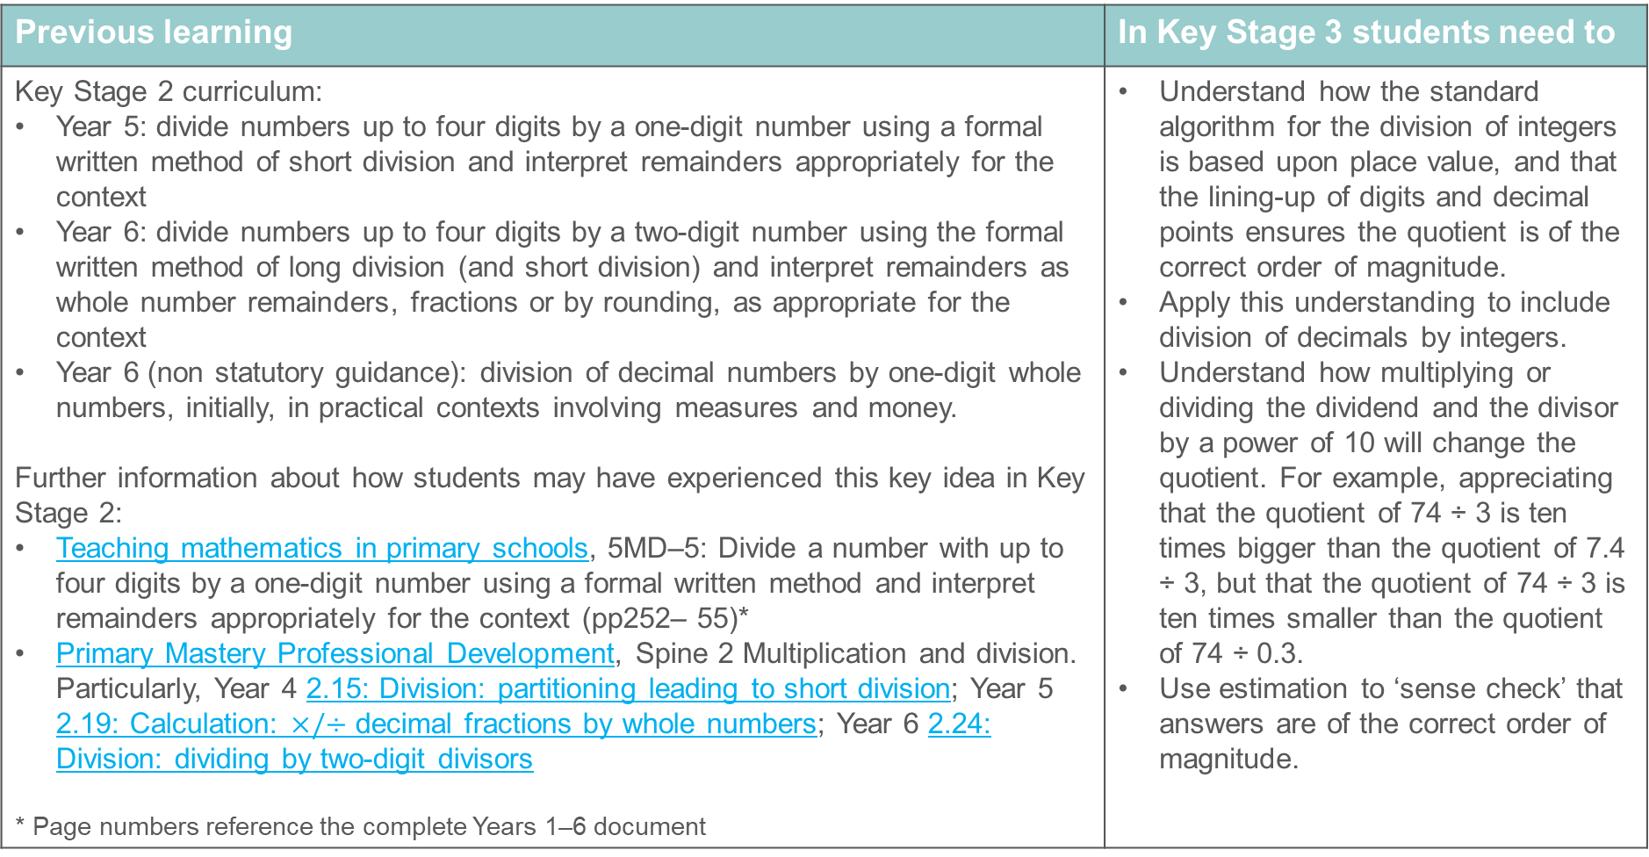
Division with decimals
Previous learning | In Key Stage 3 students need to
Key Stage 2 curriculum: Year 5: divide numbers up to four digits by a one-digit number using a formal written method of short division and interpret remainders appropriately for the context Year 6: divide numbers up to four digits by a two-digit number using the formal written method of long division (and short division) and interpret remainders as whole number remainders, fractions or by rounding, as appropriate for the context Year 6 (non statutory guidance): division of decimal numbers by one-digit whole numbers, initially, in practical contexts involving measures and money. Further information about how students may have experienced this key idea in Key Stage 2: Teaching mathematics in primary schools, 5MD–5: Divide a number with up to four digits by a one-digit number using a formal written method and interpret remainders appropriately for the context (pp252– 55)* Primary Mastery Professional Development, Spine 2 Multiplication and division. Particularly, Year 4 2.15: Division: partitioning leading to short division; Year 5 2.19: Calculation: $×/÷$ decimal fractions by whole numbers; Year 6 2.24: Division: dividing by two-digit divisors * Page numbers reference the complete Years 1–6 document | Understand how the standard algorithm for the division of integers is based upon place value, and that the lining-up of digits and decimal points ensures the quotient is of the correct order of magnitude. Apply this understanding to include division of decimals by integers. Understand how multiplying or dividing the dividend and the divisor by a power of 10 will change the quotient. For example, appreciating that the quotient of 74 ÷ 3 is ten times bigger than the quotient of 7.4 ÷ 3, but that the quotient of 74 ÷ 3 is ten times smaller than the quotient of 74 ÷ 0.3. Use estimation to ‘sense check’ that answers are of the correct order of magnitude.

Slide 65
Checkpoint 24: Adds to 18
Fill in the yellow boxes to make a four-digit number so that the total is 18 when all four digits are added.
÷
3
Divide your four-digit number by 3. Is there a remainder?
Try other numbers with digits that add to18.
What happens if the number is a decimal? What do you notice about your answers?
÷
3
What happens if the decimal point moves position? What about if there are more than four digits?
Explore whether you always get a quotient with no remainder.
Notes:
This slide is animated. Each question will appear separately so you can choose the pace at which to work with your class.
Answers
a) Any four-digit number with a digit sum of 18 will not have a remainder, as 18 is a multiple of 3 and numbers are divisible by 3 if their digits add to a multiple of 3.
b) The same rule follows, but now all answers will have one decimal place.
Suggested questioning
Will you get a remainder? Why or why not?
What is the same/different about your answers to part a and part b?
Things to think about
Checkpoint 24 offers an opportunity to explore division, and to extend that to situations where the dividend is a decimal. Students may choose to use a written method for division, giving the opportunity to assess their accuracy with this, and also (in part b) their confidence with applying this to situations where the dividend is a decimal. Depending upon the order of your scheme of learning, students may recall the divisibility rules for 3 from earlier work on factors.

Slide 66
Checkpoint 24: Guidance
Adaptations | Assessing understanding
Support If students need further support, then using three digits that sum to 18 instead of four will reduce the number of steps required within each division. It is still suggested that students are given experience of decimals as dividends. Challenge To extend students beyond the further thinking question, ask if they can create a problem like this for different divisors. Is it possible to use the total of digits to ensure there is no remainder for every divisor, or are other constraints needed? Representations Place-value counters might be used to represent the process for written division; see additional activity I for more information. | This Checkpoint offers lots of practice of division, both with an integer and a decimal as a dividend. Teachers can therefore assess fluency with multiplication facts, as well as confidence with the algorithm for division, and deduce whether further practice is necessary. If students choose to use a written method for division, assess their accuracy with this. What sets this activity apart from previous Checkpoints on division is the introduction of the decimal point in part b: students should recognise that the process is no different, so long as they remember to include the decimal point in their quotient. Discussion may arise about the term ‘remainder’ when a decimal divides exactly by 3 – in this activity, we have determined that there is no remainder when there are no additional decimal places to the dividend. Some students may also recognise the relevance of the divisibility rules for 3 here.
Additional resources If students need more practice of written methods for division, Additional activities H, I and J can easily be adapted to have decimals as a divisor, as can Checkpoints 12, 15, 17 and 18.

Slide 67
Checkpoint 25: Quotient is 40
A pair of numbers is highlighted on the Gattegno chart.
The quotient of the larger number and smaller number is 40.
Find more pairs of numbers from the chart, with a quotient of 40.
Is the quotient of 0.08 and 0.002 more than, less than or equal to 40? Explain how you know.
How would the options change if the target quotient were 20?
Are there more options? How many more? How do you know?
Notes:
A printable Gattegno chart to support this Checkpoint is available in the ‘Printable resources’ section, on slide 128.
Answers
a) 8 000 and 200, 80 and 2, 8 and 0.2, 0.8 and 0.02. Or 4 000 and 100, 400 and 10, 40 and 1, 4 and 0.1, 0.4 and 0.01.
b) The quotient of 0.08 and 0.002 is equal to 40.
? If the target quotient were 20, the divisor for each would need to be doubled, i.e. 8 000 and 400, 800 and 40, 80 and 4, etc. Or the dividend would need to be halved, i.e. 4 000 and 200, 400 and 20, etc. There are also more options: 6 000 and 300, etc. and 2 000 and 100, etc.
Suggested questioning
What is the relationship between the numbers on the first row and the numbers on the second row of the Gattegno chart?
What would happen to the quotient if the yellow rectangle was moved down a row? How is this different to if the red number was moved down a row?
Things to think about
Much like Checkpoint 21, Checkpoint 25 uses the Gattegno chart as a representation to support reasoning about the relative magnitude of related calculations. Students will need to reason about how moving one number up or down a row would change the calculation, and what needs to happen to the other number in order to ensure that the quotient remains the same.

Slide 68
Checkpoint 25: Guidance
Adaptations | Assessing understanding
Support Give students their own Gattegno chart and counters, in order to reinforce the relationships between the rows that the dividend and divisor are on. A printable version is available in ‘Printable Resources’ at the end of the slide deck. Challenge Challenge students to find as many pairs of numbers as possible that could be used to produce a certain quotient. Representations This Checkpoint uses the Gattegno chart to support students to see where decimal divisions have equivalent value. It is a useful representation for exploring concepts that rely upon place value; more information can be found in Using mathematical representations at KS3 | NCETM. | The chart acts to support students with their reasoning, but consider the language that students use in their explanations and what it reveals about their understanding. Using a consistent language structure – and being explicit about how this is the same/different as the language structures for Checkpoint 21 – may also continue to support students to reason with decimal divisions when the chart is no longer there as a visual. Consider how this process is different when you change the divisor compared to when you change the dividend. Drawing attention to what is the same and what is different when you move just the red number, or just the yellow number, will be an important part of assessing students’ understanding of this.
Additional resources If students need more practice in considering how a multiplicative change to one number affects a multiplication or division, additional examples can be found in Using compensation to calculate | NCETM, which is Topic 2.25 of Primary Mastery Professional Development | NCETM.

Slide 69
Checkpoint 26: Division cards
a)
Use the numbers on the cards to complete the divisions. You may use each card only once.
How many ways can this be done?
520
130
÷
= 4
52
13
÷
= 0.4
5.2
1.3
÷
= 40
0.52
0.13
b)
Write a division with the remaining pair of cards.
Can you arrange the cards so that they all have a quotient of 4? How about 0.4? Why is this different?
Notes:
Answers
a) 520 ÷ 130 = 4, 5.2 ÷ 13 = 0.4, 52 ÷ 1.3 = 40 b) 0.52 ÷ 0.13 = 4
or
a) 520 ÷ 130 = 4, 0.52 ÷ 1.3 = 0.4, 5.2 ÷ 0.13 = 40 b) 52 ÷ 13 = 4
or
a) 52 ÷ 13 = 4, 0.52 ÷ 1.3 = 0.4, 5.2 ÷ 0.13 = 40 b) 520 ÷ 130 = 4
or
a) 5.2 ÷ 1.3 = 4, 52 ÷ 130 = 0.4, 520 ÷ 13 = 40 b) 0.52 ÷ 0.13 = 4
or
a) 0.52 ÷ 0.13 = 4, 52 ÷ 130 = 0.4, 520 ÷ 13 = 40 b) 5.2 ÷ 1.3 = 4
or
a) 0.52 ÷ 0.13 = 4, 5.2 ÷ 13 = 0.4, 52 ÷ 1.3 = 40 b) 520 ÷ 130 = 4
? They can be rearranged so all have a quotient of 4: 520 ÷ 130, 52 ÷13, 5.2 ÷ 1.3, 0.52 ÷ 0.13
It is not possible for a quotient of 0.4 because 520 would need to be divided by 1 300 and this card is not given.
Suggested questioning
When you find a pair of numbers with a quotient of 4, how might this help you find numbers for the other two calculations?
When the quotient is 0.4, what do you know about the dividend and the divisor?
Things to think about
Checkpoint 26 encourages students to reason about the magnitude of division calculations. It should be noted that students will not have experienced calculations where the divisor is a decimal at primary school; the intention here is that they should think about how the calculations are related in order to draw their conclusions.

Slide 70
Checkpoint 26: Guidance
Adaptations | Assessing understanding
Support Look at each quotient in turn, and decide all of the pairs that would satisfy that equation. Challenge Challenge students to write their own sets of calculations with certain quotients and conditions, such as ‘a pair of numbers less than 1, with a quotient of 20’. Some students may choose to use negative numbers to satisfy that condition! Representations A Gattegno chart, such as that used in Checkpoints 21 and 25, might be a familiar representation to support students to think about related calculations and how to adjust them. A bar model is also a useful visual tool to help students understand that when the divisor is made 10 times smaller, 10 times more of them ‘fit’ into the dividend. | The quotients are given so that students are not tempted to calculate and can instead focus on using their understanding of place value and skills of estimation. Students are not taught to divide by a decimal at primary school, and so this is not the focus of assessment here. Instead, focus on whether students can reason about which pairs of numbers will result in a quotient of that magnitude. The arrangement of number cards mimics the Gattegno chart, so students can reason about the different ‘rows’ of place value that each number of the pair is in and how this changes. Some students may use estimation to support their reasoning; this demonstrates good number sense in a potentially unfamiliar situation. An understanding of students’ number sense will help in planning a starting point for teaching division by a decimal.
Additional resources If students need more practice in considering how a multiplicative change to one number affects a multiplication or division, additional examples can be found in Using compensation to calculate | NCETM, which is Topic 2.25 of Primary Mastery Professional Development | NCETM.

Slide 71
Checkpoint 27: Adjusting calculations
One of the statements below is not true. Which one and why?
Complete the right-hand side of these equations so that they are correct.
1.2 × 3 = 12 × 3 ÷ 10
7.5 × 5 = 75 × 5
12 × 0.3 = 12 × 3 ÷ 10
75 × 0.05 = 75 × 5
1.2 ÷ 3 = 12 ÷ 3 ÷ 10
7.5 × 0.5 = 75 × 5
12 ÷ 0.3 = 12 ÷ 3 ÷ 10
7.5 ÷ 5 = 75 ÷ 5
75 ÷ 50 = 75 ÷ 5
75 ÷ 0.5 = 75 ÷ 5
Write your own set of related calculations using 4 × 5 as a starting point.
Notes:
This slide is animated. Each question from part b, and the further thinking question, will appear separately so you can choose the pace at which to work with your class.
Answers
a) 12 ÷ 0.3 = 12 ÷ 3 ÷ 10 is not true. If the divisor is made ten times larger, the dividend (or the answer) will need to be made ten times larger to compensate
b) The operation in bold should be added to the right hand side:
7.5 x 5 = 75 x 5 ÷10
75 x 0.05 = 75 x 5 ÷ 100
7.5 x 0.5 = 75 x 5 ÷ 100
7.5 ÷ 5 = 75 ÷ 5 ÷ 10
75 ÷ 50 = 75 ÷ 5 ÷ 10
75 ÷ 0.5 = 75 ÷ 5 × 10
Suggested questioning
Why do I divide by 10 to adjust three of these calculations? When will it not work?
Why does dividing by 0.3 result in a bigger answer than dividing by 3?
How can I adjust 12 ÷ 3 to be the same answer as 12 ÷ 0.3?
Things to think about
Checkpoint 27 looks at the calculations that need to happen to adjust a decimal multiplication or division, once the equivalent integer calculation has been completed. Students will NOT have divided by a decimal at primary school, and is not intended that this Checkpoint is assessing this: rather, it is to help teachers to gauge students’ number sense and reasoning around related calculations and the magnitude of their answers. Teachers’ questioning should therefore try to unpick whether students can see that 12 ÷ 0.3 will have a greater answer than 12 ÷ 3.

Slide 72
Checkpoint 27: Guidance
Adaptations | Assessing understanding
Support The focus here is on reasoning around division, and understanding the different effect of increasing the divisor when compared with the dividend. The calculations can therefore be scaled if students find it easier to reason around multiples of 10 rather than decimals. For example, students may find the questions easier to model and visualise if they are comparing 120 ÷ 3 with 120 ÷ 30. Challenge The ‘further thinking’ question asks students to write their own sets of questions. Tell students the calculation that was done to compensate, and asking them to suggest options for the original calculation. Representations A Gattegno chart, such as that used in Checkpoints 21 and 25, might be a familiar representation to support students to think about related calculations and how to adjust them. A bar model is also a useful visual tool to help students understand that when the divisor is made 10 times smaller, 10 times more of them ‘fit’ into the dividend. | As with Checkpoint 26, the intention here is to ask students to think about how related integer calculations need to be adjusted – and for them to reason why the same process cannot be applied when the dividend is a decimal as when the divisor is a decimal. By telling students that one of the (otherwise identical) questions in part a is wrong, students may well deduce this themselves and so assessment should focus on how readily they come to this understanding, as well as how they explain their reasoning.
Additional resources If students need more practice in considering how a multiplicative change to one number affects a multiplication or division, additional examples can be found in Using compensation to calculate | NCETM, which is Topic 2.25 of Primary Mastery Professional Development | NCETM.

Slide 73
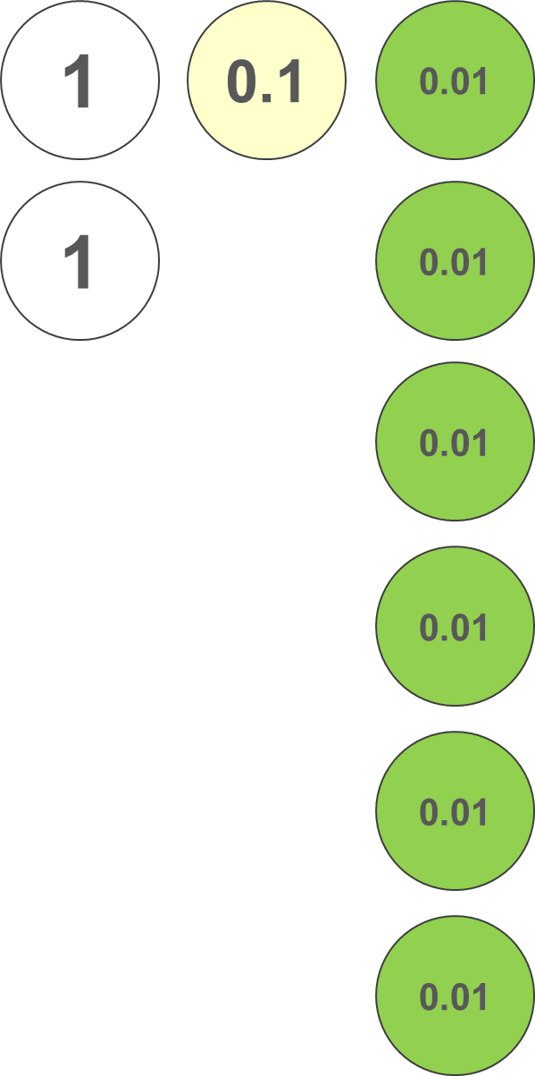
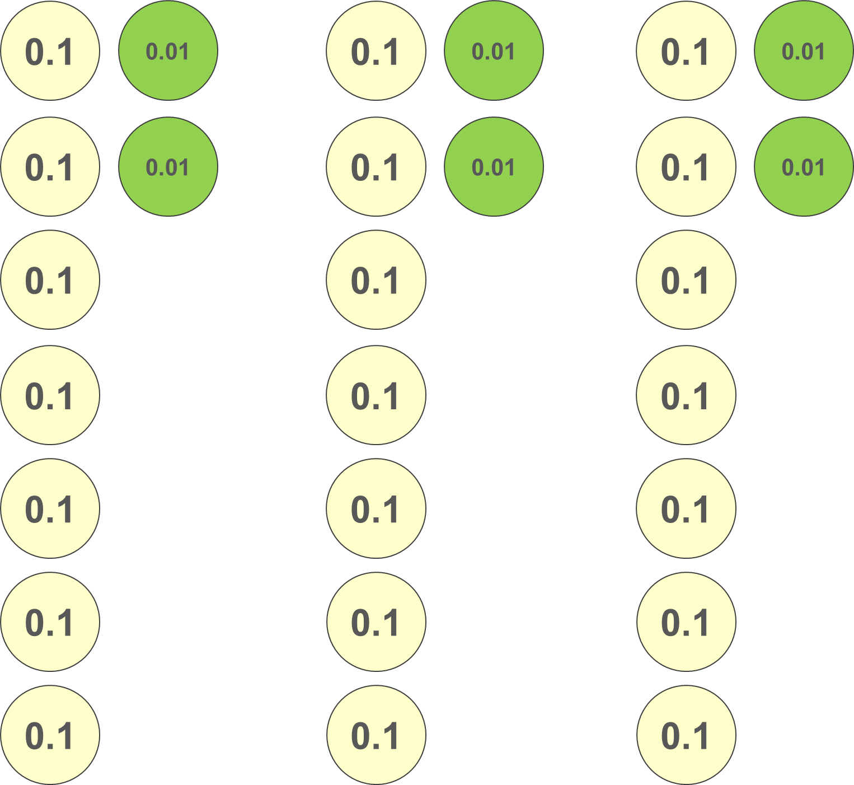
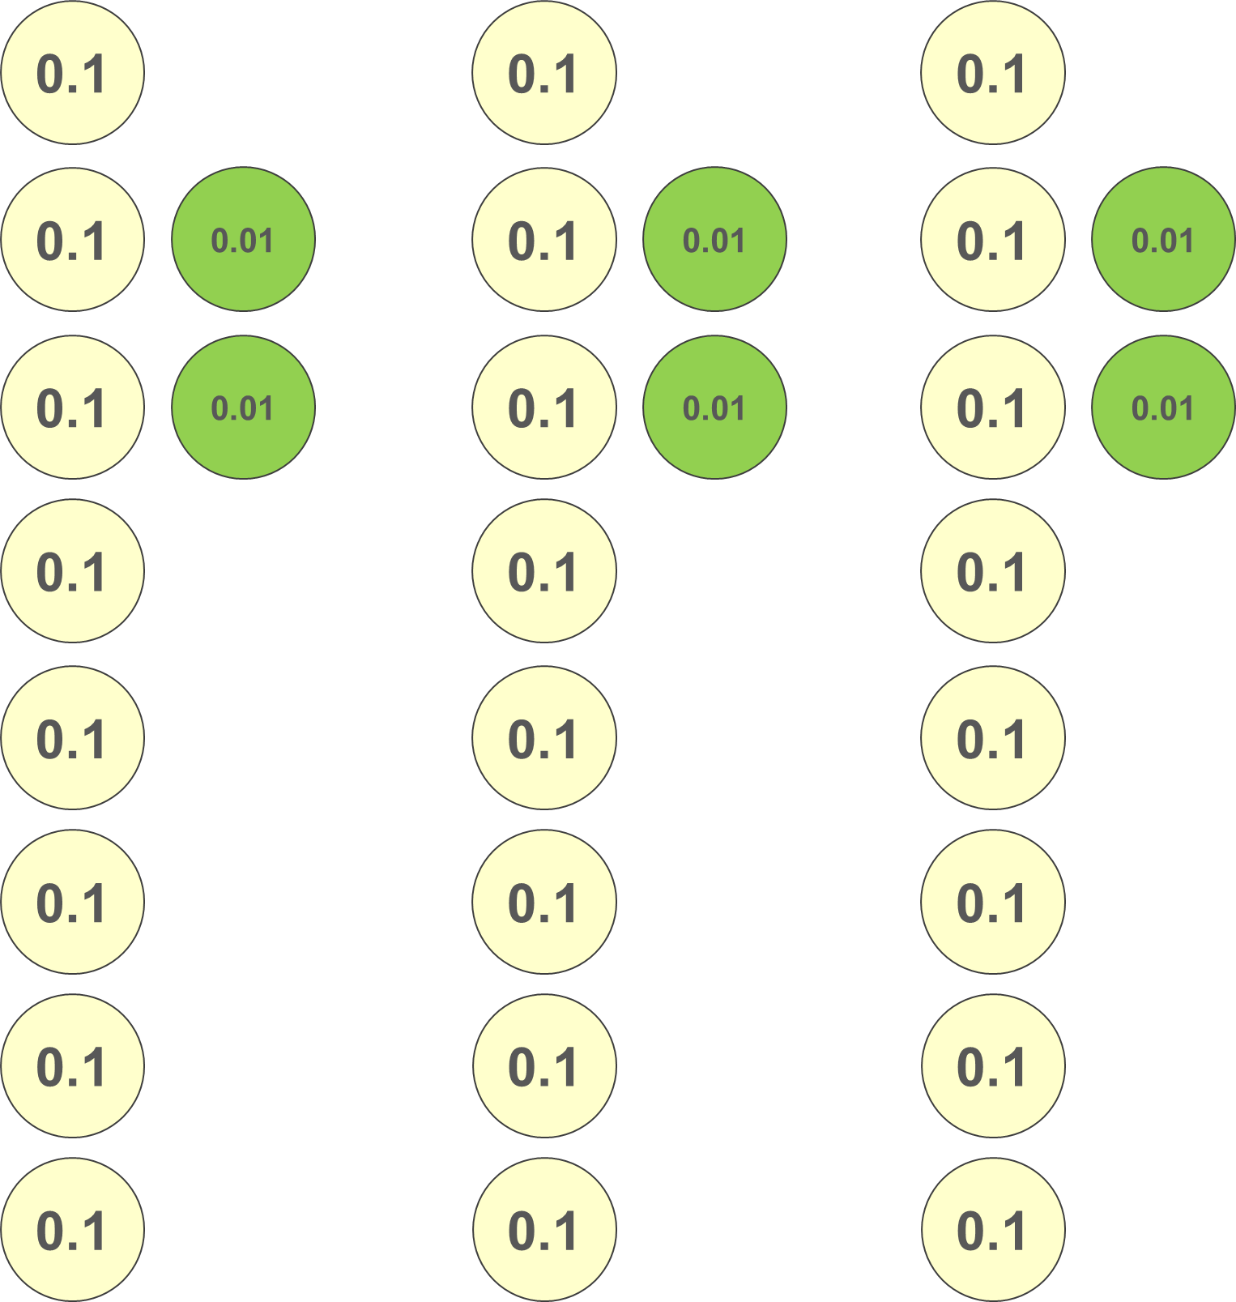
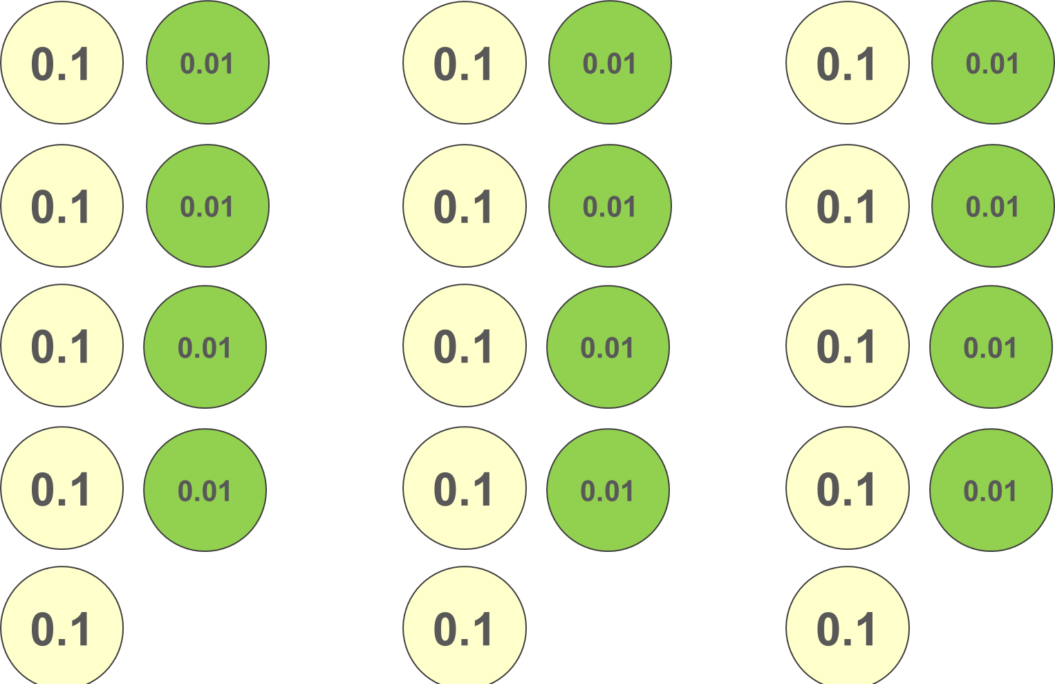
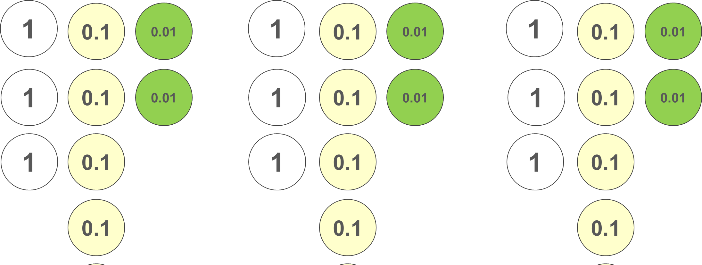
Checkpoint 28: Changing 2.16
Simone has some place value counters.
Simone represents some more ÷ 3 calculations. What might the calculation be if the outcome is:
She starts with:
She ends with:
What calculation might Simone be representing between the starting and ending pictures?
Notes:
This slide is animated. Each question will appear separately so you can choose the pace at which to work with your class.
Answers
2.16 ÷ 3 = 0.72
?
Blue: 2.46 ÷ 3 = 0.82
Green: 1.62 ÷ 3 = 0.54
Purple: 10.26 ÷ 3 = 3.42
Suggested questioning
What is the same and what is different about the total represented in the starting and ending pictures?
How has 2.16 been rearranged? What calculation might this represent?
Things to think about
Checkpoint 28 uses place-value counters to model a division: this is a representation that students are likely to be familiar with from primary school, although they may not have used place-value counters in this context before. The intention is that students will recognise that the total of the place-value counters has not changed and therefore that 2.16 has grouped into three groups of 0.72. Use place-value counters model alongside this to represent how two ‘ones’ are exchanged for twenty ‘tenths’.
The further thinking question offers an opportunity for students to reason further about related calculations. All three have three groups, so the calculation is still __ ÷3. Draw attention to what has changed from the orange image: for example, in the blue image, each group still has two hundredths, but now also has an additional tenth to make 8 tenths. The dividend must therefore have been three tenths greater than in Simone’s original example, so the calculation is 2.46 ÷ 3.

Slide 74
Checkpoint 28: Guidance
Adaptations | Assessing understanding
Support Connecting the starting and ending images is challenging. Model ‘live’ the process of exchanging 2 ones for 20 tenths, then sharing into three piles, and regrouping (find virtual place-value counters online). Stress that, although it looks different, the total value isn’t changed. Rather the exchange allows three groups of equal value to be created. Challenge Ask students to create their own ‘final images’ by making changes to the orange image, and to then deduce what the start calculation must have been to provide challenge beyond the existing ‘further thinking’ questions. They could also try Additional activity L (see below). Representations Place-value counters are used here to model division and support students to deduce what must have changed in the calculation when the quotient has changed. It should be noted that the place-value counters are being used here to represent a partitive model for division: they are shared into three piles. In Additional activity I, which uses place-value counters to represent the written method for division, a quotitive model is used: the counters are grouped into groups of the divisor. If using both activities with students, be clear about the difference to prevent confusion. | The first point of assessment is whether students can recognise that the total value of the red picture is the same as the total value of the orange picture. Students may recognise that a division by three has taken place because there are now three ‘piles’; model how the ones counters have been exchanged for tenths in order for this to happen. The ‘further thinking’ question offers a real opportunity to assess students’ depth of understanding: can they recognise that any change in the three piles will be represented by three times that change in the dividend?
Additional resources Additional activity L offers the same task structure without the visual representation of the place-value counters.

Slide 75
Priority of operations
Checkpoints 29–32

Slide 76
Priority of operations
Previous learning | In Key Stage 3 students need to
Key Stage 2 curriculum: Number – addition, subtraction, multiplication and division: Year 6: use their knowledge of the order of operations to carry out calculations involving the four operations Year 6: (non-statutory guidance): Pupils explore the order of operations using brackets; for example, 2 = 1 × 3 = 5 and (2 + 1) × 3 = 9. Further information about how students may have experienced this key idea in Key Stage 2: Primary Mastery Professional Development, Spine 2 Multiplication and division. Particularly, Year 5 2.22: Combining multiplication with addition and subtraction; Year 6 2.28: Combining division with addition and subtraction There is no reference the order of operations in Teaching mathematics in primary schools, so students are less likely to have had experience of these in Years 5 and 6. | Have a deep and connected understanding of mathematical operations, recognising the structures they have in common, and those that are different Have an awareness of concepts such as unitising when working additively, and scaling when multiplying. Use both of the above to understand and use the correct priority of operations.

Slide 77
Checkpoint 29: Order, order!
10 − 6 + 4
What is the answer? Does everyone in the class have the same answer?
Reja says the answer is 0. Josh says the answer is 8. Their explanations are below. Who do you agree with?
Addition and subtraction are equally important, so you work left to right. 10 ˗ 6 is 4, so you can think of this as 4 + 4.
Addition comes before subtraction. You do 6 + 4 = 10, so you can think of this as 10 ˗ 10.
Reja
Josh
How would the order in which you approach this calculation change if you replaced the subtract and add symbols with different operations?
Notes:
This slide is animated. Each stage appears separately so you can choose the pace at which to work with your class.
Answers
Josh is correct, the answer is 8. His explanation is correct.
Suggested questioning
Will we always work from left to right when finding the answer to a calculation?
Are some operations more important than others?
Is addition more important than subtraction?
Things to think about
Checkpoint 29 focuses specifically on a key misconception with the order of operations: that addition has a higher priority than subtraction. This may arise when students have an over-reliance on acronyms such as ‘BIDMAS’ or ‘PEMDAS’. A key point of discussion is that addition and subtraction are inverse operations, but that you can also think of them both as one ‘additive structure’ for number. You may wish to explore an equivalent calculation involving multiplication and division, such as 3 × 12 ÷ 4.

Slide 78
Checkpoint 29: Guidance
Adaptations | Assessing understanding
Support There is little additional support needed for this very accessible task, but consider in advance how to handle sensitively students who are convinced by Josh’s approach. Some normally capable and confident mathematicians are among this group! Challenge Challenge students to create an example where the same outcome is achieved by both Reja and Josh.. Representations Using counters would be straightforward for the correct answer (start with 10 counters, remove 6, then add 4), but becomes more challenging for the incorrect answer (6 + 4 can be physically modelled, but then that ’10’ needs to be removed from another existing 10, which is confusing). Similar issues occur when using a number line. Therefore, the numbers used are straightforward enough to not require any representations. | A single calculation is used here to explore a common misconception around the order of operations: that addition has a higher priority than subtraction. Where students have experienced the order of operations previously, this may have been through the lens of an acronym such as ‘BIDMAS’, ‘BODMAS’ or ‘PEMDAS’ (see notes). This can lead to students mistakenly thinking that this is a rigid order, rather than a tool to support remembering. A key consideration here is whether it is helpful to think in terms of ‘two relationships’ (additive and multiplicative) rather than four operations. Teachers may wish to explore how closely students already connect addition and subtraction within their own thinking.
Additional resources Additional activity M looks at the same numbers, but explores the order of operations with division and similar misconceptions that can arise.
Notes:
BIDMAS (Brackets, Indices, Division, Multiplication, Addition, Subtraction), BODMAS (as BIDMAS but with ‘Power of’ in place of Indices) and PEMDAS (Parentheses, Exponents, Multiplication, Division, Addition, Subtraction) are all common acronyms used to teach the order of operations. These acronyms do not support understanding of the equivalence of multiplication and division or of addition and subtraction and can lead to calculation errors and misconceptions in later work on algebra.

Slide 79
Checkpoint 30: Left to right?
Ginny tries to solve all of these calculations from left to right. For which will she get the correct answer?
30 × 6 × 9 ÷ 3
30 × 6 + 9 ÷ 3
30 ÷ 6 × 9 ÷ 3
30 − 6 + 9 ÷ 3
For those that were correct, is left to right always the most efficient way to work out the answer?
Notes:
Answers
Correct answers will be reached for: 30 ÷ 6 × 9 ÷ 3 and 30 × 6 × 9 ÷ 3.
? For 30 × 6 × 9 ÷ 3, it is more efficient to calculate the 9 ÷ 3 first, so that the calculation becomes 30 × 6 × 3.
For 30 ÷ 6 × 9 ÷ 3, it is more efficient to calculate the 30 ÷ 6 and 9 ÷ 3 first, so that the calculation becomes 5 × 3.
Suggested questioning
Why will Ginny not get the correct answer for 30 – 6 + 9 ÷ 3 if she works from left to right?
Which operation or operations should always be done first?
Is there another way to show that we need part of a calculation to be completed before any other parts?
Things to think about
Checkpoint 30 explores the priority of operations by exploring whether calculating from left to right is a correct approach. If students have little experience of this, it offers a good opportunity to probe whether they understand that multiplication and division have a higher priority than addition and subtractions. If students do have experience of this, they may have used acronyms such as ‘BODMAS’ or ‘PEMDAS’ and therefore mistakenly believe that ‘division’ has a higher priority than ‘multiplication’; 30 × 6 × 9 ÷ 3 can be used to explore this misconception.

Slide 80
Checkpoint 30: Guidance
Adaptations | Assessing understanding
Support The key focus here is on identifying the order of operations, so precede this task by asking students to complete the individual calculations needed, so that the answers are readily accessible. Challenge Students could create further calculations with the same numbers, some of which can be completed in any order, and some of which can’t. Representations As with the other tasks within this section, no specific representation is suggested as any representation that is effective for one operation may not support understanding for another (see the Guidance slide for Checkpoint 37 for an example of this). | As with Checkpoint 29, this example has been designed to explore some common misconceptions around the order of operations – this time extending beyond addition and subtraction to consider multiplication and division as well. The variation here (same numbers, different operations) helps to highlight these issues. Teachers might particularly like to highlight 30 ÷ 6 × 9 ÷ 3 and discuss why it is not necessary to do the multiplication first (for students who have used PEMDAS) or the division first (for those that have used BIDMAS). Where these can be solved left to right, interesting discussions can arise about efficiency. Are students aware of which calculations they can manipulate the order of, and which they cannot?
Additional resources pp11 and 12 of Secondary Assessment Materials | NCETM feature some further activities involving the priority of operations. On p13 of the Year 6 Primary Assessment Materials | NCETM, there are some tasks involving operations and brackets.

Slide 81
Checkpoint 31: 4, 5, 6, 7
Fill in the gaps with +, − , ÷, × and brackets where necessary, so that the calculations are correct.
4 5 6 7 = 12
4 5 6 7 = 8
4 5 6 7 = 62
4 5 6 7 = 117
4 5 6 7 = 7
4 5 6 7 = 90
4 5 6 7 = 308
4 5 6 7 = 21
4 5 6 7 = 69
4 5 6 7 = 0
Fill in the gaps with +, − , ÷, × and brackets where necessary so that result is:
the smallest possible positive number
the smallest possible number.
Notes:
This slide is animated. Each set appears separately so you can choose the pace at which to work with your class.
Answers
a) 4 – 5 + 6 + 7=12
b) 4 + 5 + 6 – 7 =8
c) 4 × 5 + 6 × 7 = 62
d) (4 + 5) × (6 + 7) = 117
e) 4 × 5 – 6 – 7 = 7
f) 4 × (5 + 6 + 7) = 72
g) 4 × (5 + 6) × 7 = 308
h) 4 × 5 – 6 + 7 = 21
i) 4 + 5 × (6 + 7) = 69
j) 4 − (5 + 6) + 7 = 0
? a) 4 ÷ (5 × 6 × 7) = 0.0047619…
b) 4 − (5 × 6 × 7) = -206
Suggested questioning
What operation might be needed to get an answer of the right magnitude?
Will I be able to get close to __ (e.g. 117) by __ (e.g. adding)?
When might you need to use brackets? Why?
Things to think about
Checkpoint 31 asks students to reason about what operations are needed with the same set of four numbers to reach certain target answers. It is an opportunity to particularly assess their understanding of the need for brackets.

Slide 82
Checkpoint 31: Guidance
Adaptations | Assessing understanding
Support Place one or two correct operations and ask students to find the remaining ones. You could also tell them that none of the calculations require division. Challenge The ‘further thinking’ question offers two suggestions for constraints that challenge students to create more solutions. Additional constraints that could be included involving properties of number – for example, ensuring that the outcome is odd, even or a multiple of a certain number. Asking students to create a number that is a multiple of a number other then 4, 5, 6 or 7 is particularly challenging! Representations As with any activity involving multiple operations, there is a danger that a representation that is effective for one operation may not support understanding for another (see the Guidance slide for Checkpoint 37 for an example of this). Instead, the focus for representation for this Checkpoint may be around thinking how best to support students to represent their answers, and particularly this might help them spot connections between related solutions (such as all the ones that begin with ‘4 ×’). | This activity assesses students’ understanding of the priority of operations. Some students may be prone to mistakes in recording even where they have correctly identified the operations needed. For example, in part d, they may not recognise the need for brackets around ‘4 + 5’ if they have been working left to right. Students may calculate using the numbers in a different order to 4, 5, 6, 7, and so need to know that brackets will be required. Explore students’ fluency with mental calculations with all four operations. While written methods may be needed for some (such as parts g and h), students should be able to use mental reasoning for questions like d, which falls just outside the likely known multiplication facts.
Additional resources On p13 of the Year 6 Primary Assessment Materials | NCETM, there are some examples that ask students to insert operations or brackets to reach a specific target number.

Slide 83
Checkpoint 32: The four 4s
Use exactly four 4s, but no other numbers, together with any mathematical symbols you know [for example, +, –, ×, ÷, ( ) ] to write calculations giving answers of: 1, then 2, then 3… up to 20. As an example, 8 has been done for you.
1 = | 6 = | 11 = | 16 =
2 = | 7 = | 12 = | 17 =
3 = | 8 = 4 × 4 − 4 − 4 | 13 = | 18 =
4 = | 9 = | 14 = | 19 =
5 = | 10 = | 15 = | 20 =
Can you keep going? Can you reach 44?
Notes:
Answers
These solutions are not exhaustive! Further solutions for the Four 4s from 0–32, including those solutions below that involve factorials, can be found by typing ‘Four 4s solutions’ into a search engine. The solutions in italics feature decimals, which you may or may not wish to include as part of the premise of this task. A small number of solutions require maths that students will not yet have encountered. Let them know that they might not be able to find all 20, and/or revisit this task once students have encountered all the maths involved.
1 = 4 ÷ 4 + 4 − 4
2 = 4 – ( 4 + 4) ÷ 4
3 = (4 + 4 + 4)÷ 4
4 = (4 + 4) × 4 ÷ 4
5 = (4 × 4 + 4) ÷ 4
6 = (4 + 4) ÷ 4 + 4
7 = 4 + 4 − 4 ÷ 4
8 = 4 ÷ 4 × 4 + 4
9 = 4 ÷ 4 + 4 + 4
10 = (44 − 4) ÷ 4 There is a solution that uses just the number 4 (not combining to make 44), but this uses square roots: (4 + 4 + 4)−√4.
11 = The solutions to this use factorials, which it is unlikely your students have encountered.
12 = 4 ×(4 − 4 ÷ 4)
13 = (4 −.4)÷.4 + 4 There is a solution that uses 4 as an integer, but this requires factorials which it is unlikely your students have encountered.
14 = 4 × 4 − 4 ÷√4 Not all of your students may have encountered square roots, or be confident in using them in a situation such as this.
15 = 4 × 4 − 4 ÷ 4
16 = 4 × 4 + 4 − 4
17 = 4 × 4 + 4 ÷ 4
18 = 4 × 4 + 4 −√4 (see notes for 14 above).
19 = (4 + 4 −.4)÷.4
20 = 4 ×(4 ÷ 4 + 4)
Suggested questioning
Why won’t 4 × 4 × 4 × 4 be an appropriate solution?
Why are the multiples of 4 easier to find?
How might brackets help you?
Things to think about
Checkpoint 32 is a classic problem that may well take longer than ten minutes! The purpose is to assess both fluency with operations and number sense, but also to check confidence with the priority of operations and the use of brackets. Teachers will need to decide whether to let the task run for longer so students can complete the full set, or whether the activity serves its purpose for assessment in a shorter period of time.

Slide 84
Checkpoint 32: Guidance
Adaptations | Assessing understanding
Support Give a reduced number of ‘target’ numbers initially, such as just 1–10, or just 7, 8 and 9. Challenge Challenge students either to find multiple ways to achieve the target numbers from 1–20, or to extend their list beyond 20. Alternatively, introduce the notation of the square root and see if students can include it in as many of their answers as possible. Representations As with Checkpoint 31, the focus for representation for this Checkpoint may be around thinking about how best to support students represent their answers, and particularly this might help them spot connections between related solutions (such as the ones given for 3 and 6). | There are many layers to assessment in this activity. Foremost, it offers an insight into how students approach an open-ended task: are they happy to ‘have a go’? Do they organise their thoughts effectively? Do they work logically through the options? This task also allows teachers to assess students’ mental fluency with all four operations. Finally, there is an opportunity to consider students’ understanding of the priority of operations through their recording of each calculation. Teachers might like to ask students to rewrite their operations in a different order, using brackets where required, in order to further probe their understanding of priority when operations are combined.
Additional resources NRICH offers an alternative version of this Checkpoint: Four Goodness Sake (maths.org)

Slide 85
Associative, distributive and commutative laws
Checkpoints 33–37

Slide 86
Associative, distributive and commutative laws
Previous learning | In Key Stage 3 students need to
Key Stages 1 and 2 (Number – addition and subtraction; Number – multiplication and division): Year 2 (non-statutory): check their calculation including by adding to check subtraction and adding numbers in a different order. This establishes commutativity and associativity of addition. Year 3 (non-statutory): develop efficient mental methods, for example, using commutativity and associativity… Further information about how students may have experienced this key idea in Key Stages 1 and 2: Teaching mathematics in primary schools, 4MD–2: Manipulate multiplication and division equations and understand and apply the commutative property of multiplication (pp173–77)*, 4MD–3: Understand and apply the distributive property of multiplication (pp178–81)* Primary Mastery Professional Development, Spine 1 Number, Addition and Subtraction. Particularly, Year 2 1.11 Addition and subtraction: bridging 10 (associativity and commutativity) Primary Mastery Professional Development, Spine 2 Multiplication and division. Particularly, Year 4 2.10 Connecting multiplication and division and the distributive law; Year 6 2.25 Using compensation to calculate * Page numbers reference the complete Years 1–6 document | Know and notice examples of the commutative law [ab = ba, a + b = b + a]. Know and notice examples of the associative law [abc = (ab)c = a(bc); a + b + c = (a + b) + c = a + (b + c)]. Know and notice examples of the distributive law [a(b + c) = ab + ac]. Calculate fluently with the full range of different types of numbers, exploiting these laws to increase the efficiency of calculation. Use these laws in problem-solving contexts.

Slide 87
Checkpoint 33: Nelsons
10 × (7 × ___ + ___ × 4) + ___
Fill the three gaps in this calculation with the same single-digit number.
Try a different single-digit number.
What do you notice? Can you explain why this happens?
Can you write a different calculation that does the same thing as this one? Maybe with just two gaps, or with four gaps?
Notes:
Answers
e.g. 10 × (7 × 2 + 2 × 4) + 2 = 222
10 × (7 × 9 + 9 × 4) + 9 = 999.
Every solution is a three-digit number with the original number repeated in each column. This is because, for any number a, this calculation 10 × (7 × a + a × 4) + a can be rewritten as 10 × 11a + a, or 110a + a. This means that any outcome will be 111a.
Suggested questioning
What do you notice? Why does this happen?
Can you write this calculation another way?
Can you write this calculation for any general number, a?
Things to think about
Checkpoint 33 is an engaging application of the distributive law. A ‘Nelson’ is a common term in cricket, referring to a score of 111 (and subsequent multiples of 111 – for example, 222 is a ‘double Nelson’). By trialling different one-digit numbers, students may notice that their answer is a three-digit number consisting only of their original number; encourage students to recognise this as a multiple of 111. Class discussions should unpick why this works; particularly noting that the calculation (7 × ___ + ___ × 4) is an example of the distributive law, and can be rewritten as (11 × ___).

Slide 88
Checkpoint 33: Guidance
Adaptations | Assessing understanding
Support It may be tempting to change the bracket to ‘11 × _’ as a simplification, but this changes the meaning of the task away from the distributive law. An alternative task with slightly fewer steps is provided in Additional activity N – re-order the bracket to (7 × _ + 3 × _) at first, to support recognition of the distributive law. Challenge Asking students to create their own structure that will result in ‘Nelsons’ will challenge students, and also offer useful assessment as to the depth of their understanding of the distributive law. Representations A counter (or any object) could be used to represent the ‘gap’ within the brackets. This may help students to appreciate that, no matter what value is chosen, there will be 11 of them. | Students may initially approach this task using trial and error: substituting values, and then exploring the outcomes. Key to assessment is whether students can explain why the outcomes are always Nelsons. Some may recognise that the calculation inside the bracket is equivalent to ‘11 × _’, but can they explain this in terms of the distributive law? Notice students’ use of other mathematical language in explanations: for example, do they automatically frame their discussion in terms of ‘multiples’ of 11, or (potentially less likely) describe the missing number as a ‘factor’? If not, consider how to encourage and embed this mathematical language in any classroom discussions.
Additional resources Within the 2.1 Arithmetic procedures document, found in Theme 2 of Secondary Mastery Professional Development | NCETM, there are numerous examples exploring the distributive law.

Slide 89
Checkpoint 34: 7 × 19 rectangle
Alex wants to find the area of this rectangle. She starts writing this calculation:
  (5 × 10) + (_ × 10) + (5 × _) + (_ × _)
Complete Alex’s calculation.
Show how Alex split the rectangle.
How many other ways can you find to split the rectangle to find the area?
19 cm
7 cm
How many different ways can you find to represent the calculation 28 × 82? Which are most helpful?
Notes:
Answers
a) (5 × 10) + (2 × 10) + (5 × 9) + (2 × 9)
b) Alex has split the rectangle into four smaller rectangles by partitioning 7 into 5 and 2 and 19 into 10 and 9.
c) This answer will be dependent on student responses. Some may not partition the 7, so just create two 7 × 10 and 7 × 9 rectangles. Others may prefer to partition the 7 differently, for example into lengths of 3 and 4. Students are less likely to partition the 19 differently, and an interesting point of discussion might be why this is.
Suggested questioning
Where is the 5 in the rectangle? Where is the 10?
How did you split the rectangle? Why was this most logical for you
How does this link to the grid method for multiplication? How does it link to the column method?
Things to think about
Checkpoint 34 offers an opportunity to discuss the distributive law, but also has strong links to the grid method of multiplication. Students should recognise that the calculation 7 × 10 is equivalent to (5 × 10) + (2 × 10). The representation of the rectangle here is designed to provide a visual support for students in recognising this relationship; later checkpoints ask students to begin to recognise the relationship in calculations.

Slide 90
Checkpoint 34: Guidance
Adaptations | Assessing understanding
Support Build up to this this task by introducing each of the brackets as a rectangle: for example, first ask students to find the area of a 5 × 10 rectangle, then extend one side to be 7 × 10. Challenge Challenge students to make adaptions to the initial representation and consider the impact of the change. For example, if the 5 is increased by 1.5, what also has to happen? How does this change the value of each bracket? This might be made clearer using the image of the rectangle and ‘shifting’ the lines. Representations In Checkpoint 34, a rectangle is used as a representation to support understanding of the distributive law. This links to area, arrays and the grid model for multiplication; make these links explicit. These connections may be particularly supportive of later work on multiplying algebraic expressions in brackets. Further information about the use of arrays and area models can be found in Using mathematical representations at KS3 | NCETM. | Parts a and b offer a structure to delve into students’ understanding of partitioning and the area model for multiplication, and also their confidence in representing these calculations using brackets. Underpinning all of this is the distributive law: teachers will need to decide how explicitly to discuss this at this stage, if students do not offer this language as part of their discussion. Part c offers an opportunity to explore students’ thinking and can offer real insight both into their fluency and reasoning. Offering the same task but with slightly different numbers (such as 7 × 16) and seeing if students choose the same or different approaches will further develop teachers’ understanding of students’ flexibility and confidence when calculating
Additional resources Checkpoints 18 and 19 from Deck 4: expressions and equations offer a similar context to explore the distributive law.

Slide 91
Checkpoint 35: Lucky 13
There are ten 1.3s in each of these calculations.
Use this information to find the 1.3s and explain why the answer to each calculation is 13.
1.3 × 5.2 + 1.3 × 4.8
1.3 × 5.2 + 1.3 × 3.8 + 2.6 ÷ 2
2 × (3.9 × 1 + 1 × 1.3 + 1.3)
2 × (3.9 × 1 + 1 × 1.3 ) + 2.6
4 × (3 × 0.9 + 3 × 0.4 ˗ 0.5 × 1.3)
Change exactly one digit in each calculation so that the answer to each is now 14.3.
Notes:
Answers
a) 1.3 × 5.2 + 1.3 × 4.8 = 1.3 × (5.2 + 4.8) = 1.3 × 10 = 13
b) 1.3 × 5.2 + 1.3 × 3.8 + 2.6 ÷ 2 = 1.3 × 5.2 + 1.3 × 3.8 + 1.3 ÷ 1 = 1.3 × (5.2 + 3.8 + 1) = 1.3 × 10 = 13
c) 2 × (3.9 × 1 + 1 × 1.3 + 1.3) = 2 × (1.3 × 3 × 1 × 1.3 + 1.3) = 2 × (1.3 × 5) = 10 × 1.3 = 13
d) 2 × (3.9 × 1 + 1 × 1.3 ) + 2.6 = 2 × (1.3 × 3 + 1 × 1.3 ) + 1.3 × 2 = 2 × (1.3 × 4) + 1.3 × 2 = 8 × 1.3 + 1.3 × 2 = 10 × 1.3 = 13
e) 4 × (3 × 0.9 + 3 × 0.4 – 0.5 × 1.3) = 4 × (3 × (0.9 + 0.4) – 0.5 × 1.3) = 4 × (3 × 1.3 – 0.5 × 1.3) = 4 × ((3 – 0.5) × 1.3) = 4 × 2.5 × 1.3 = 10 × 1.3 = 13
All these examples have been manipulated so that the penultimate stage is 10 × 1.3, to emphasise the connection to the distributive law. Students may take alternative routes, such as 2 × 6.5 for the penultimate stage of part c.
? 143 = 1.3 × 11. Given that each calculation can be written as 1.3 × 10, adding one 1 to each one of the black numbers will mean that the calculation becomes 1.3 × 11. For example, part a could be rewritten as either 1.3 × 6.2 + 1.3 × 4.8, or 1.3 × 5.2 × 1.3 × 5.8. If students are struggling to get started, you could give them one of the correct answers to part a and ask them to first think about why it works.
Suggested questioning
Why is 1.3 in red? How are the red numbers that aren’t 1.3 linked to 1.3?
How can we change (e.g. 3.9 × 1) to be a calculation involving 1.3?
How can we rewrite these calculations?
Things to think about
In Checkpoint 35, the common factors that link to 1.3 are highlighted in red, so that recognition of multiples of 1.3 is not a barrier to the task. This should enable the focus of the task to be upon the application of the distributive law. Much as in Checkpoint 34, the focus for assessment here is whether students can recognise that calculations of the form a × 1.3 + b × 1.3 can be rewritten as (a + b) × 1.3.

Slide 92
Checkpoint 35: Guidance
Adaptations | Assessing understanding
Support Precede this task with some examples that use 1.3 and some of the more familiar integer bonds to 10, such as 1.3 × 4 + 1.3 × 6. Challenge Challenge students to create their own calculations with the same outcome. Can they make an adjustment to one of the existing calculations? Can they create their own? What is the most complex calculation they can create? Representations The concept of unitising is one that can be represented using any generic item. For example, in the simplified example given for ‘support’ above, the 1.3 could be represented by a counter. This would support the understanding that, in this calculation, ‘1.3’ could be replaced by any ‘unit’ and there would still be a total of 10 of those ‘units’. | The use of red to highlight the common factor of 1.3 in each calculation is designed to remove a stage of thinking from the problem. Therefore, in this task, the focus is less on whether students can recognise the common factors and more on whether they can explain, using the distributive law, how these calculations can be rearranged. There is some variation between pairs of questions: for example, the minimal differences between a and b, or c and d. Students may notice these themselves, but if not, draw attention to them to see if students can explain them. For example, how has the reduction of 4.8 in part a to 3.8 in part b been compensated for?
Additional resources Within the Primary mastery professional development materials, Topics 2.22 and 2.28 look at combining addition and subtraction with multiplication and division respectively, with specific reference to the distributive law: Combining multiplication with addition and subtraction | NCETM and Combining division with addition and subtraction | NCETM.

Slide 93
Checkpoint 36: secretly multiplying by 1
Ahmed says that the answer to this calculation is 5 as it is ‘secretly’ multiplying by 1. What has Ahmed noticed?
5 × 0.75 + 5 × 0.25
Which of these calculations are ‘secretly’ multiplying by 1? Could you change the ones that aren’t so that they are?
0.69 × 2 + 2 × 0.31 | 6 × 0.75 + 6 × 0.35
9 × 0.85 ˗ 9 × 0.15 | 7 × 1.2 ˗ 0.5 × 7 + 7 × 0.3
4 × 0.5 + 8 × 0.25 | 3 × 0.8 + 6 × 0.4
Write a calculation that looks complicated, but is secretly multiplying by 1. What is the most challenging calculation you can create?
Notes:
Answers
a) Ahmed has noticed that 0.75 + 0.25 = 1 so, using the distributive law, this can be rewritten as 5 × (0.75 + 0.25) = 5 × 1
b) 0.69 × 2 + 2 × 0.31 = 2 × (0.69 + 0.31) = 2 × 1
6 × 0.75 + 6 × 0.35 = 6 ×( 0.75 + 0.35) = 6 × 1.1; students could adjust the 0.75 to 0.65 or the 0.35 to 0.25 to make this 6 × 1.
9 × 0.85 – 9 × 0.15 = 9 × 0.7; students may be caught out by the fact that 0.85 + 0.15 = 1, but the products are being subtracted here – amending to an addition would make it a ‘×1’ calculation.
7 × 1.2 ˗ 0.5 × 7 + 7 × 0.3 = 7 × (1.2 ˗ 0.5 +0.3) = 7 × 1
4 × 0.5 + 8 × 0.25 = 4 × 0.5 + 4 × 0.5 = 4 × (0.5 + 0.5) = 4 × 1; students may need some prompting to recognise that 4 is a factor of 8 × 0.25, and so this can be rewritten as 4 × 0.5. Students may also potentially choose to adjust the calculation to take out a factor of 8, 0.25 or 0.5 instead.
3 × 0.8 + 6 × 0.4 = 3 × 0.8 + 3 × 0.8 = 3 × (0.8 + 0.8) = 3 × 1.6; students may also adjust this calculation using 6, 0.4 or 0.8 as a factor. This does not simplify to a ‘×1’ calculation; students may be tempted, for example, to divide both the 6 and the 0.4 by 2, to make 3 × 0.2 and not realise that, if they make the 6 half as big, they need to make the 0.4 twice as big to maintain equivalence. To make it a ‘×1’ calculation, there are multiple ways to amend, but two likely suggestions are: 3 × 0.2 + 6 × 0.4 or 3 × 0.8 + 6 × 0.1
Suggested questioning
Is there a number (factor) that is common to each product in the calculation? Could you rewrite the calculation as this number × (_ + _)?
Do the terms in the bracket sum to 1?
Could you adjust the calculation so that there is a factor common to each product?
Things to think about
Checkpoint 36 looks at the distributive law and how it can be applied, where products share a factor, to make calculations simpler to compute. Students may be familiar with the distributive law but not have used it to make given calculations more efficient; as such, this task is structured to be accessible, even if students have not explicitly practised this skill previously. Proficiency with using the distributive law to calculate lays the foundations for later learning on algebraic factorisation.

Slide 94
Checkpoint 36: Guidance
Adaptations | Assessing understanding
Support keeping the structure of the task the same, substitute some numbers to be more ‘obvious’ bonds to 1. Use the highlighting of factors, as in Checkpoint 35, to support students. Challenge Present students with examples which, as in the bottom row of the table in part b, can be rewritten several different ways according to which factor is taken out. For example, 1.5 × 0.4 + 0.2 × 3 + 0.2 × 1.5; here, students could adjust the calculation to take out a factor of 1.5, 3, 0.2 or 0.4. Representations No specific representation is suggested to support this checkpoint. However, the concept of unitising is one that can be represented using any generic item – as discussed in Checkpoints 33 and 35. | Checkpoint 36 builds on Checkpoint 35 but makes less explicit the factors that can be ‘taken out’ each time; therefore there is an opportunity to assess whether students are able to notice when a calculation could be rewritten using the distributive law. Consider students’ fluency with addition and subtraction facts that ‘bond’ to 1 (or, as they may think of it, 100). Students’ fluency with multiplication facts, and their understanding of scaling, is further assessed by the bottom row of part b: do students understand how to ‘compensate’ for multiplying one number and maintain the value of the overall expression?
Additional resources Within the Primary mastery professional development materials, Topics 2.22 and 2.28 look at combining addition and subtraction with multiplication and division respectively, with specific reference to the distributive law: Combining multiplication with addition and subtraction | NCETM and Combining division with addition and subtraction | NCETM

Slide 95
Checkpoint 37: Chains of three
Dina and Karam both try the same set of four calculations. Dina does the calculation in red first. Karam does the calculation in blue first.
Dina
Karam
6 + 4 + 2
6 − 4 − 2
6 + 4 + 2
6 − 4 − 2
6 × 4 × 2
6 ÷ 4 ÷ 2
6 × 4 × 2
6 ÷ 4 ÷ 2
Without calculating, predict whether Dina and Karam will get the same answers for all of their questions? Why or why not?
Check your prediction by completing the questions as Dina and Karam suggest.
Choose three different numbers to create the same set of calculations; will Dina and Karam’s methods still work for the same calculations? Is there ever a set of numbers where all four calculations will be correct with both methods?
Notes:
Answers
a) Student responses will determine the discussions that arise from this question. Some students may refer to the language of commutativity (recognising that addition and multiplication are commutative, but subtraction and division are not). This task more specifically looks at the associative law: for example, Dina’s approach of (6 + 4) + 2 is equivalent to Karam’s approach of 6 + (4 + 2). Addition and multiplication are associative, whilst subtraction and division are not:
(6 + 4) + 2 = 6 + (4 + 2)
(6 × 4) × 2 = 6 × (4 × 2)
(6 ˗ 4) ˗ 2 ≠ 6 ˗ (4 ˗ 2)
(6 ÷ 4) ÷ 2 ≠ 6 ÷ (4 ÷ 2)
b) (6 + 4) + 2 = 6 + (4 + 2) = 12
(6 × 4) × 2 = 6 × (4 × 2) = 48
(6 ˗ 4) ˗ 2 = 0; 6 ˗ (4 ˗ 2) = 4
(6 ÷ 4) ÷ 2 =0.75; 6 ÷ (4 ÷ 2) = 3
Suggested questioning
Will Dina and Karam get the same answer for __? Why or why not?
What is the same/different about Dina and Karam’s approaches?
Can you use this activity to write a general rule for addition, subtraction, multiplication and division?
Things to think about
Checkpoint 37 explores the associative law. Students may not be familiar with the term from Key Stage 2 but they should be able to recognise where strings of calculations can and cannot be grouped to maintain equivalence. The numbers have been chosen to only include one division with a decimal quotient, and for all divisors to be integers.

Slide 96
Checkpoint 37: Guidance
Adaptations | Assessing understanding
Support Teachers may wish to compare the approaches to each calculation in pairs, focusing just on one operation in order to not overwhelm less confident pupils. Challenge Those who are more confident with the associative law might be challenged to think about longer strings of calculations, or to generalise using letters or symbols. Representations A significant challenge with this activity is that there are four operations being considered, and so the same representation is unlikely to satisfactorily support understanding of every calculation. For example, counters may be easily used to represent the addition, but the representation is complicated by the other three operations (see notes below). For this reason, the numbers used have been selected to be straightforward enough to not require physical representation. | The first point of assessment in this Checkpoint is whether students can identify that Karam’s approach will not give the same result for subtraction and division. From the language the students use, teachers can gauge the depth of understanding students have of the structure of the four operations, and whether they are aware of the term ‘associative’. An additional point of assessment is how students approach 6 ÷ 4 and then 1.5 ÷ 2 : does these calculations throw them? How do they reason about the answers? Teachers may like to make links back to the priority of operations, and ask students which approach is correct for subtraction and division, or what notation needs to be included to justify Karam’s approach.
Additional resources The last set of examples in the 2.1 Arithmetic procedures core concept document from the NCETM Secondary Mastery Professional Development explore using the associative, commutative and distributive laws to solve problems.
Notes:
Examples of the challenges that may be encountered if using counters as representations for the calculations are given below.
Multiplication: a 6 × 4 array could be created. This array could then be made 2 × longer or wider. However, it might feel more in keeping with the concept of volume to use multilink cubes and then the × 2 is represented by a third dimension.
Division: 6 ÷ 4 would require counters to be split in half!
Subtraction: this is relatively straightforward when representing Dina’s approach, as 6 counters are first reduced by 4 and then by 2. However, representing Karam’s approach has real potential to confuse: first 4 counters are reduced by 2, but then 6 counters need to be introduced and those 2 counters ‘taken away’. Similar challenges occur with double-sided counters.

Slide 97
Additional activities
Activities A–M

Slide 98
Activity A: Counters
Max has some + and − counters.
He has 10 of one type, and 3 of the other type.
What might Max’s score be?
Grace has some + and − counters.
She has 5 more of one type than the other type.
What might Grace’s score be?
Emily has some + and − counters.
She has 100 of one type, and just 1 of the other type.
What might Emily’s score be?
If all of Max, Grace and Emily’s counters are combined, what are the possible scores?
Notes:
Answers
Grace’s score will be +5 or ˗5.
Max’s score will be +7 or -7.
Emily’s score will be +99 or -99.
?
+5 +7 +99 = 111
+5 +7 -99 = -87
+5 -7 +99 = 97
-5 +7 +99 = 101
+5 -7 -99 = -101
-5 +7 -99 = -97
-5 -7 +99 = 87
-5 -7 -99 = -111
Suggested questioning
If Grace has 5 more of the + counters than the ˗ counters, why will her score definitely be +5?
Why does it not matter exactly how many counters Grace has in total?
If Max has ten + counters and 3 ˗ counters, we could write his score as +10 -3 = 7. How would we write it if he has ten ˗ counters and 3 + counters?
Things to think about
Activity A builds on Checkpoint 5, where the representation of the double-sided counter is introduced. Students do not need to be familiar with this representation to access the task though, and how students approach this activity will help to inform teachers about their readiness to learn to calculate with negative numbers. Once students have established the differences between their counter totals, they may be drawn to the more familiar number line representation to demonstrate the two possible scores.

Slide 99

Activity B: In and out of the bag
A bag contains some marbles. Matilda takes out 3 marbles, then Elinor puts in 5.
a) Are there more marbles now than at the beginning? How many more or less?
A bag contains some footballs. Alex puts 3 footballs in the bag, then Charlotte takes 5 out.
b) Are there more footballs now than at the beginning? How many more or less?
Emily records Elinor and Matilda’s marble moves as -3 +5 = +2.
c) How would Emily write Alex and Charlotte’s football moves?
Grace and Adam have a bag and some tennis balls. Emily writes +9 − 4.
d) Write a description of what Grace and Adam put in or took out of the bag.
e) Are there more tennis balls than at the beginning? How many more or less?
Emily recorded Grace and Adam’s moves as +9 -4. The same outcome would occur if the moves were +11 -6
How many other ways can you find to achieve the same outcome?
Notes:
Answers
There are more; 2 more.
There are less; 2 less.
+3 – 5 = -2
Grace puts 9 tennis balls into the bag. Adam takes 4 tennis balls out (names could be reversed).
There are 5 more tennis balls in the bag than there were at the beginning.
? Any pairs that result in +5
Suggested questioning
How do we know that there are more marbles than what we started with at the end of question a?
What do we know about the number of footballs in the bag at the start of question b?
Things to think about
Activity B offers an opportunity to think about addition as augmentation, by representing a subtraction as a negative number (for example, Matilda’s taking of 3 marbles being recorded as ‘-3’ at the start of the calculation ‘-3 + 5’. Familiar representations such as the number line may be used to support understanding – particularly of how the difference of 2 will be constant, regardless of the starting point in the bag. Students will not necessarily have explored negative numbers in this way, but the activity can act as an assessment tool for teachers to gauge students’ readiness to move on to thinking about negative numbers in calculations.

Slide 100
Activity C: More decimal differences
Complete these calculations. Is there more than one possible answer?
a)
b)
c)
−
−
−
4
3
0
3
8
3
Choose six different digits to complete this calculation:
−
Notes:
Answers
a) 10 ˗ 5.7 or 11 ˗ 6.7 or 12 ˗ 7.7 or 13 ˗ 8.7 or 14 ˗ 9.7
b) 10 ˗ 9.7
c) 10 ˗ 1.7 or 11 ˗ 2.7 or 12 ˗ 3.7 or 13 ˗ 4.7 or 14 ˗ 5.7 or 15 ˗ 6.7 or 16 ˗ 7.7 or 17 ˗ 8.7 or 18 ˗ 9.7
Suggested questioning
What is the largest the minuend must be? How do you know?
Why can’t any of these questions start with 20?
Why is there only one solution to part b?
Things to think about
Activity C represents the structure of Checkpoint 10, with different numbers and with the calculations already set out in columns. This removes the need for students to think for themselves about alignment of columns, but more explicitly brings up the question of how to subtract within the tenths columns. Both activities offer an opportunity to practise column subtraction where the two numbers have different numbers of decimal places; specifically, where the minuend is an integer and the subtrahend is not. As with Checkpoint 10, the numbers have been carefully selected to encourage discussion about the mathematical structures underpinning the calculation. Part b, for example, only has one answer as any integer greater than 10 would require a subtrahend with a tens column (i.e. _ _ . _) to have a difference of 0.3. For the same reason, the largest the minuend can be in part a is 18. Students should be encouraged to think about the limits of possibility for each number: what is the smallest and largest it could be?

Slide 101
Activity D: Stories
A story that fits the calculation 17 + 15 is:
  Carol has 17 biscuits and Richard has 15 biscuits.
  Altogether Carol and Richard have 17 + 15 biscuits.
Write a story that fits each calculation:
  17 × 15
  15 × 17
  17 ÷ 15
  15 ÷ 17
Which of 17 ÷ 15 and 15 ÷ 17 gives the greatest answer?
Write a division calculation that gives an answer between the two.
Notes:
Answers
Any appropriate story to fit 17 × 15, such as Carol has 17 packets of biscuits. Each packet has 15 biscuits. Altogether, Carol has 17 × 15 biscuits.
Any appropriate story to fit 15 × 17, such as Carol has 17 packets of biscuits. Each packet has 15 biscuits. Altogether, Carol has 17 × 15 biscuits.
Any appropriate story to fit 17 ÷ 15, such as Richard has 17 biscuits. There are 15 biscuits in a packet. He has 17 ÷ 15 packets.
Any appropriate story to fit 15 ÷ 17, such as Richard has 15 biscuits. He shares them with 17 friends. Each person will have 15 ÷ 17 biscuits.
? 17 ÷ 15 is greater than 1 and 15 ÷ 17 is less than 1, so 17 ÷ 15 gives the greatest answer.
Examples such as 17 ÷ 17 or 15 ÷ 15 would give an answer between the two.
Suggested questioning
How might an array help you imagine a story for multiplication?
Can you think of a multiplication context where something is scaled to be 15/17 times bigger?
Is your division story an example of grouping or sharing?
Things to think about
Additional Activity D is an alternative to Checkpoint 13. The selection of 15 and 17 here is deliberate to ensure the focus is on the story rather than finding an answer. However, as they are not divisible by each other, it does add a layer of challenge, particularly when creating stories for division. This layer of challenge may be useful in assessing students’ depth of understanding of multiplicative structures in context. Teachers may choose to use it with some students to replace Checkpoint 13, or to use it as a follow-on task with the whole class to see if students can apply the same understanding with less familiar numbers.

Slide 102
Activity E: Greatest and least product
Choosing digits from 1 to 9 and using each digit only once, place one digit in each box so that the product is:
  as small as possible
  as large as possible.
×
Can you make a larger or smaller product if you’re able to move the × card?
Notes:
Answers
a) The smallest product is 23 × 1 = 23
b) The largest product is 87 × 9 = 786
? No, because if we move the multiplication symbol in front of the yellow card, we still have a two-digit by one-digit calculation.
Suggested questioning
Why will you not use the digit 9 for part a? Why will you not use the digit 1 for part b?
How can you use your biggest and smallest digits so that they do have the greatest impact on the magnitude/size of the answer?
Things to think about
Activity E is a simplified version of Checkpoint 14. While it offers some opportunities to check recall of key multiplication facts, the main purpose of the activity is to assess students’ reasoning around multiplication. Students are asked to think about how the size of the numbers they create will affect the size of the product.

Slide 103
Activity F: Greatest and least quotient
Choosing digits from 1 to 9 and using each digit only once, place one digit in each box so that the quotient is:
  as small as possible
  as large as possible.
÷
Can you make a larger or smaller product if you’re able to move the ÷ card?
Notes:
Answers
a) 12 ÷ 9 = 1.3333333… Based upon experience at primary school, students are more likely to write the remainder as 3/9.
b) 98 ÷ 1 = 98
? Yes and no. Moving the division so that you can divide a one-digit number by a two-digit number will result in the smallest quotient, in this case 1 ÷ 98. The largest quotient will remain the same.
Suggested questioning
Will you use a 1 digit for part a? Why or why not?
What is the biggest number you can create? Will you use this in part a or part b?
How can you make the biggest quotient?
Things to think about
Activity F is a simplified version of Checkpoint 15 and asks students to think deeply about how the relative sizes of the dividend and divisor affect the quotient. While the activity does offer an opportunity to practise methods for division (or recall key division facts), the main focus for assessment is whether students can reason about what combinations of numbers will produce the biggest and smallest quotients. In this version, the smallest quotient is not an integer and so teachers can also assess students’ confidence with remainders and whether they understand how to write them as fractions.

Slide 104
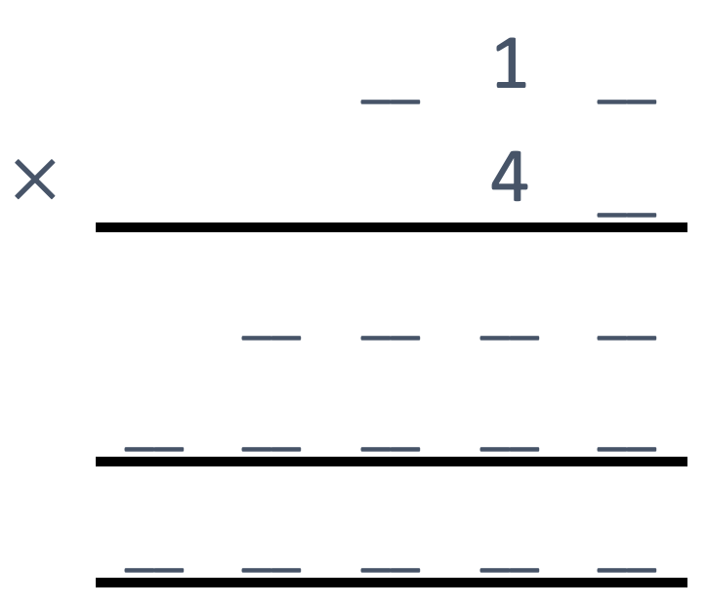
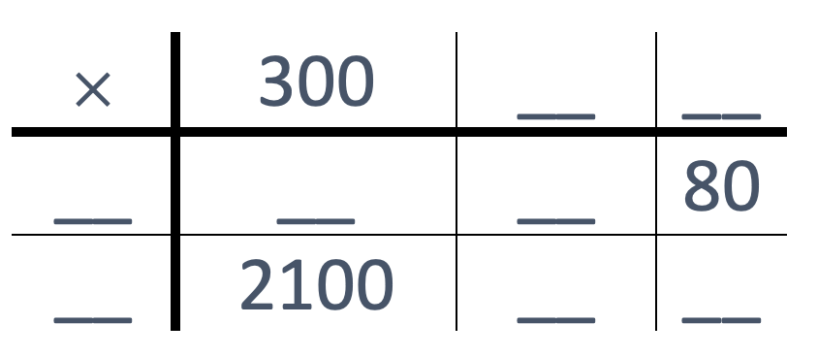
Activity G: Fill in the gaps
Steph and Cain are working out the same calculation.
They use different methods.
Fill in the gaps in the two calculations.
Which method do you prefer?
Steph’s method
Cain’s method
Whose method would you use to calculate 2 456 × 7? Why? Whose method would you use to calculate 3 254 × 287? Why?
Notes:
Answers
a)
Steph’s method – missing numbers from left to right along each row: 10, 2, 40, 12000, 400, 7, 70, 14.
Cain’s method – missing digits from left to right along each row: 3, 2, 7, 2, 1, 8, 4, 1, 2, 4, 8, 0, 1, 4, 6, 6, 4.
b) There is no ‘correct’ answer for this question, but it will be interesting to hear students’ responses.
The column method is generally considered to be more efficient, but some students find it challenging to remember that the second row of multiplication is 10 × bigger.
The grid method makes the place value more explicit, but can lead to errors with 0s and involves a long string of additions at the end with potential for error.
? As with part b, there is no ‘correct’ answer but it could be argued that the grid method would be inefficient and likely to cause errors for a multi-digit calculation such as 3 254 × 287.
Suggested questioning
How might Cain’s method help you find some of the missing numbers for Steph’s method?
Which parts of Steph’s method could you complete without looking at Cain’s method?
Where might Steph make a mistake using her method?
Where might Cain make a mistake using his method?
Things to think about
Teachers may have been able to assess students’ confidence with written methods through Checkpoints 11 and 14. If needed, Activity G more formally explores the two most common written algorithms for multiplication: the grid and column methods. To be able to complete this task, students will need to have an understanding of the structures behind each method and so recognise where each digit and product is represented. For example, they need to understand that the ‘1’ in Cain’s method is actually ‘10’ and that the ‘4’ is ‘40’. The ‘further thinking’ question invites students to think about whether the numbers within the calculation lend themselves more to one method or another, and so to be able to justify the efficiency of the process they choose.

Slide 105
Activity H: Division mistakes
Three students start this calculation.
Who is on track to the right answer? What do they need to do next?
What has gone wrong for the others?
2
1
6
1
2
4
3
7
3
8
3
7
3
8
3
7
1
3
8
Jasmine
Kye
Isaac
Imagine that the three students are attempting the division 952 ÷ 4 and make exactly the same mistakes. What would their workings look like? How would you explain what to do differently?
Notes:
Answers
a) Isaac: is on track for the right answer. He needs to ensure that the remainder of 1 is carried over to the next column, to make 18 ones, and then divide this by 6 for the final digit.
b) Jasmine: has correctly identified that there are 2 groups of 3 in 7 (as 2 × 3 = 6), but has forgotten to carry the remainder of 1 to the tens column, so divided 3 by 3 rather than 13.
Kye: has also correctly identified that there are 2 groups of 3 in 7 (as 2 × 3 = 6), but has written the 6 as the solution, rather than 2.
?
Jasmine would have written 1 instead of 2 in her answer as 7 ÷ 4 = 1 r 3. She would need to be reminded to carry the remaining 3 hundreds.
Kye would have written 4 instead of 6 in his answer as 1× 4 = 4. He would need to be reminded that it is the 1 that is written there, and then to carry the remaining 3.
Isaac would have written 1 in place of 2, but carried 3 hundreds this time. Then he would have written 8 in place of 4 and been ready to carry 1 ten.
Suggested questioning
What has __ done right? What have they done wrong?
Why might someone make this mistake?
How could you explain to them how to do it properly?`
Things to think about
Activity H is a supplementary activity designed to support the Checkpoints on division. Use this if students are not confident with the written algorithm for division, or are prone to errors in their method. The mistakes that Jasmine and Kye have made are common issues with the method: students need to be able to hold a lot of information in their head when using this algorithm, and make sure that they write the right information down in the right place. For example, in the first stage, dividing 7 hundreds by 3, students need to recognise that the nearest multiple of 3 below 7 is 6; that 6 ÷ 3 = 2, so the quotient will start with 2; and that 7 – 6 is 1, so there is still 1 hundred remaining. In Jasmine’s working, all but the last stage has been managed. In Kye’s working, although he has correctly identified 6 as the multiple of 3 that is relevant, he has mistakenly written this rather than 2 in the solution. By presenting students with these mistakes, teachers can probe whether students are prone to similar errors, and also if they understand how to correct them. This helps to assess whether there are deeper misconceptions lying underneath the mistakes.

Slide 106
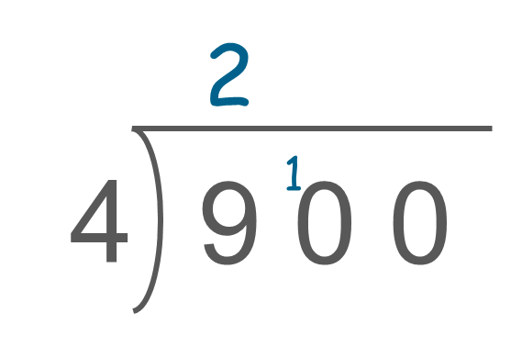
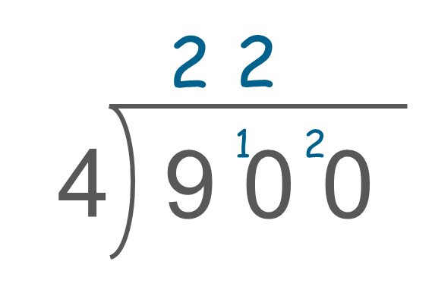
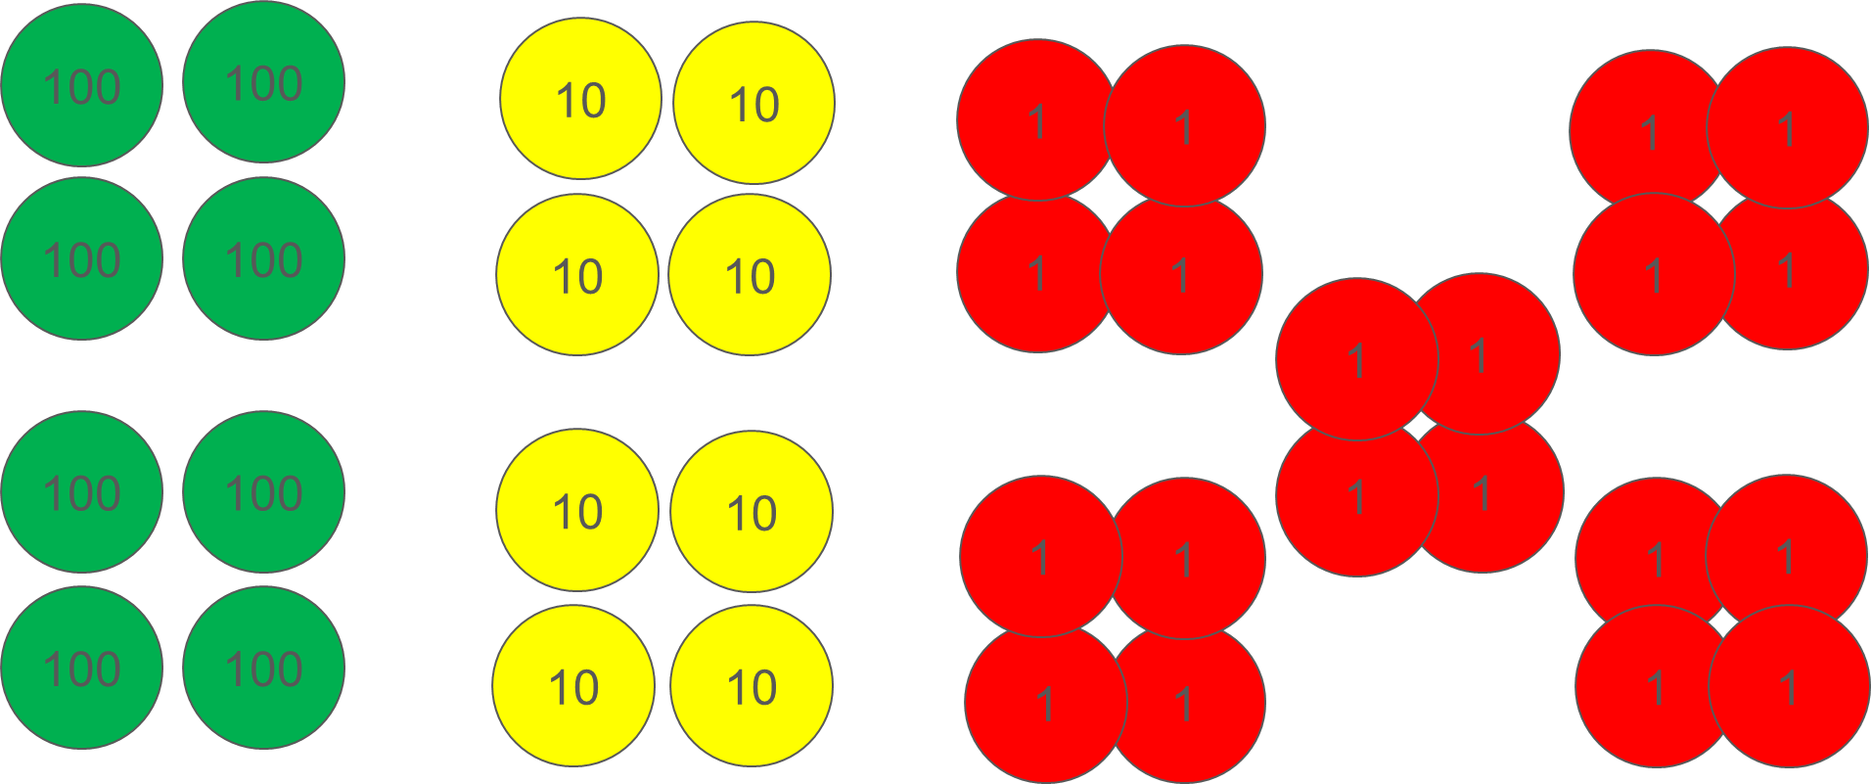
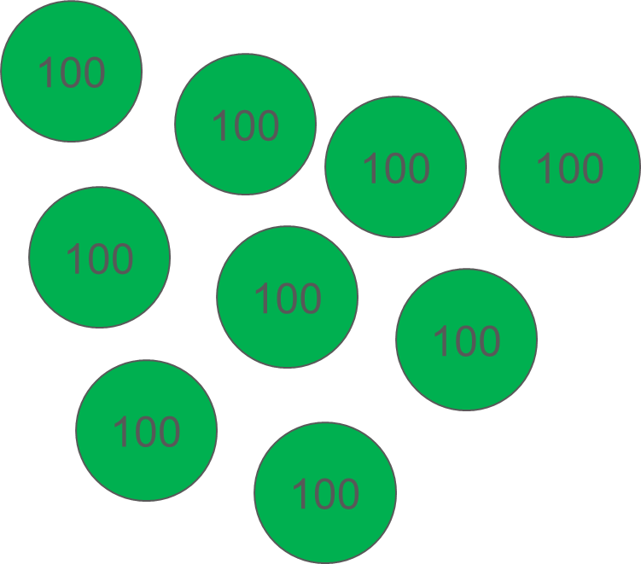
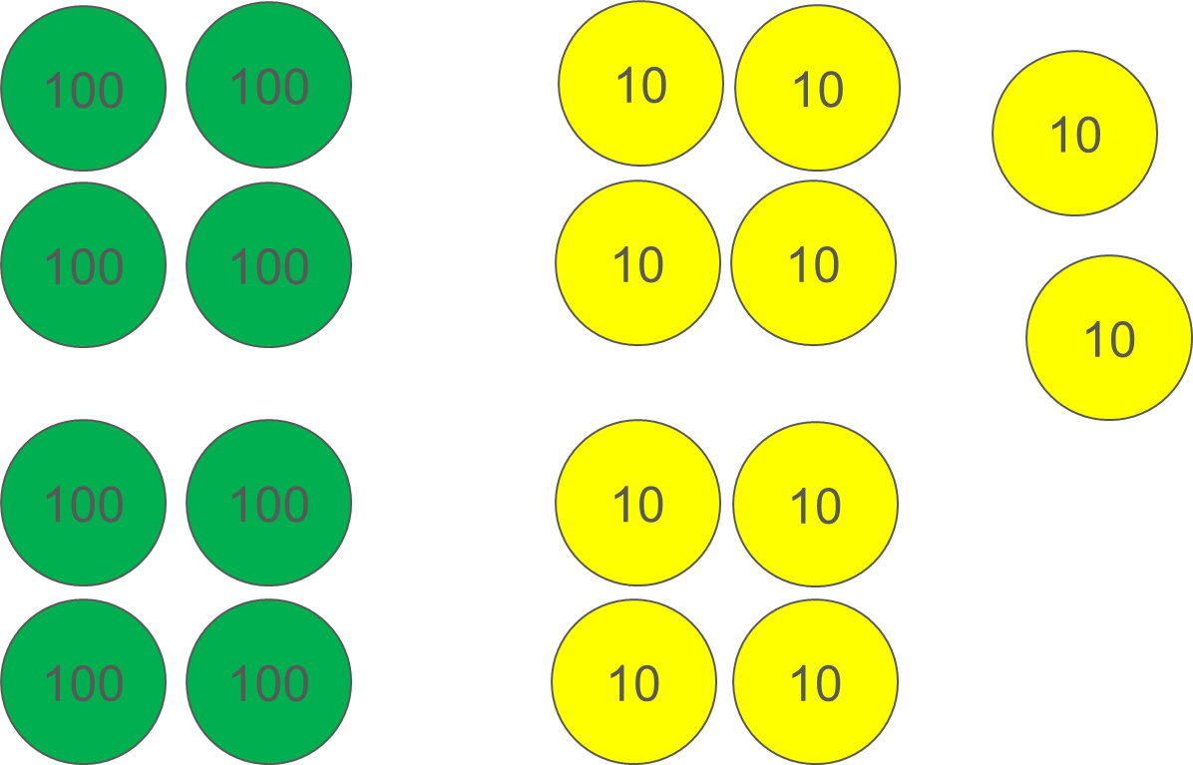
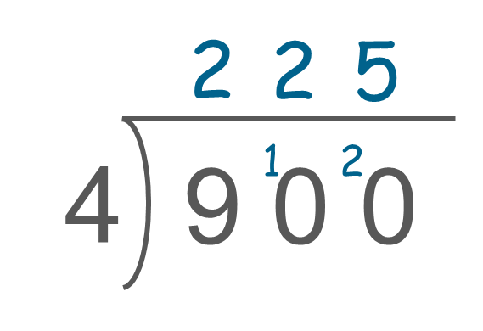
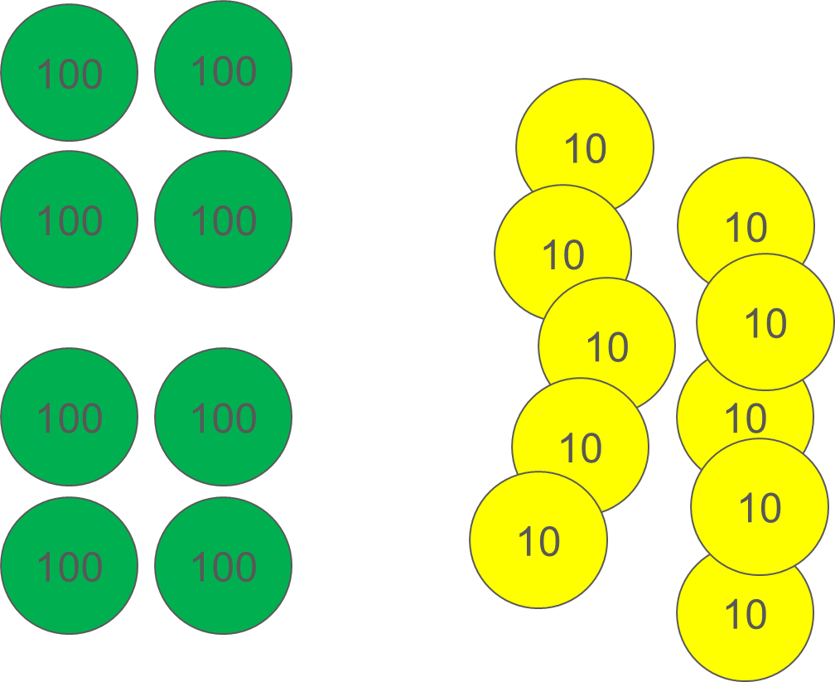
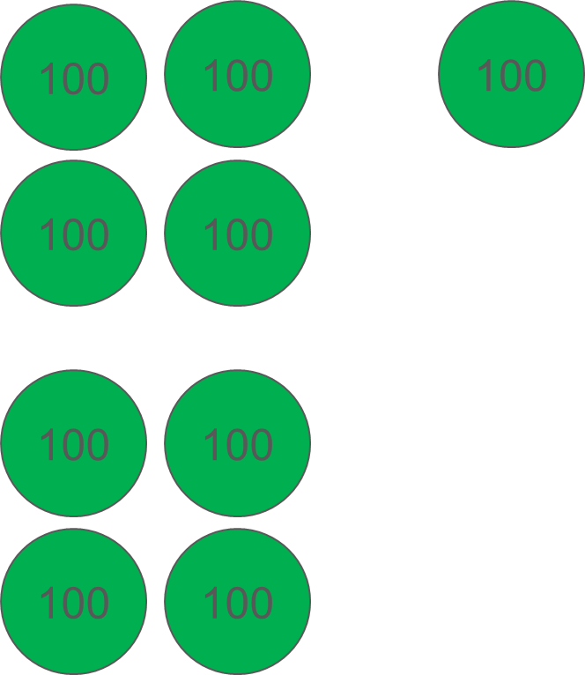
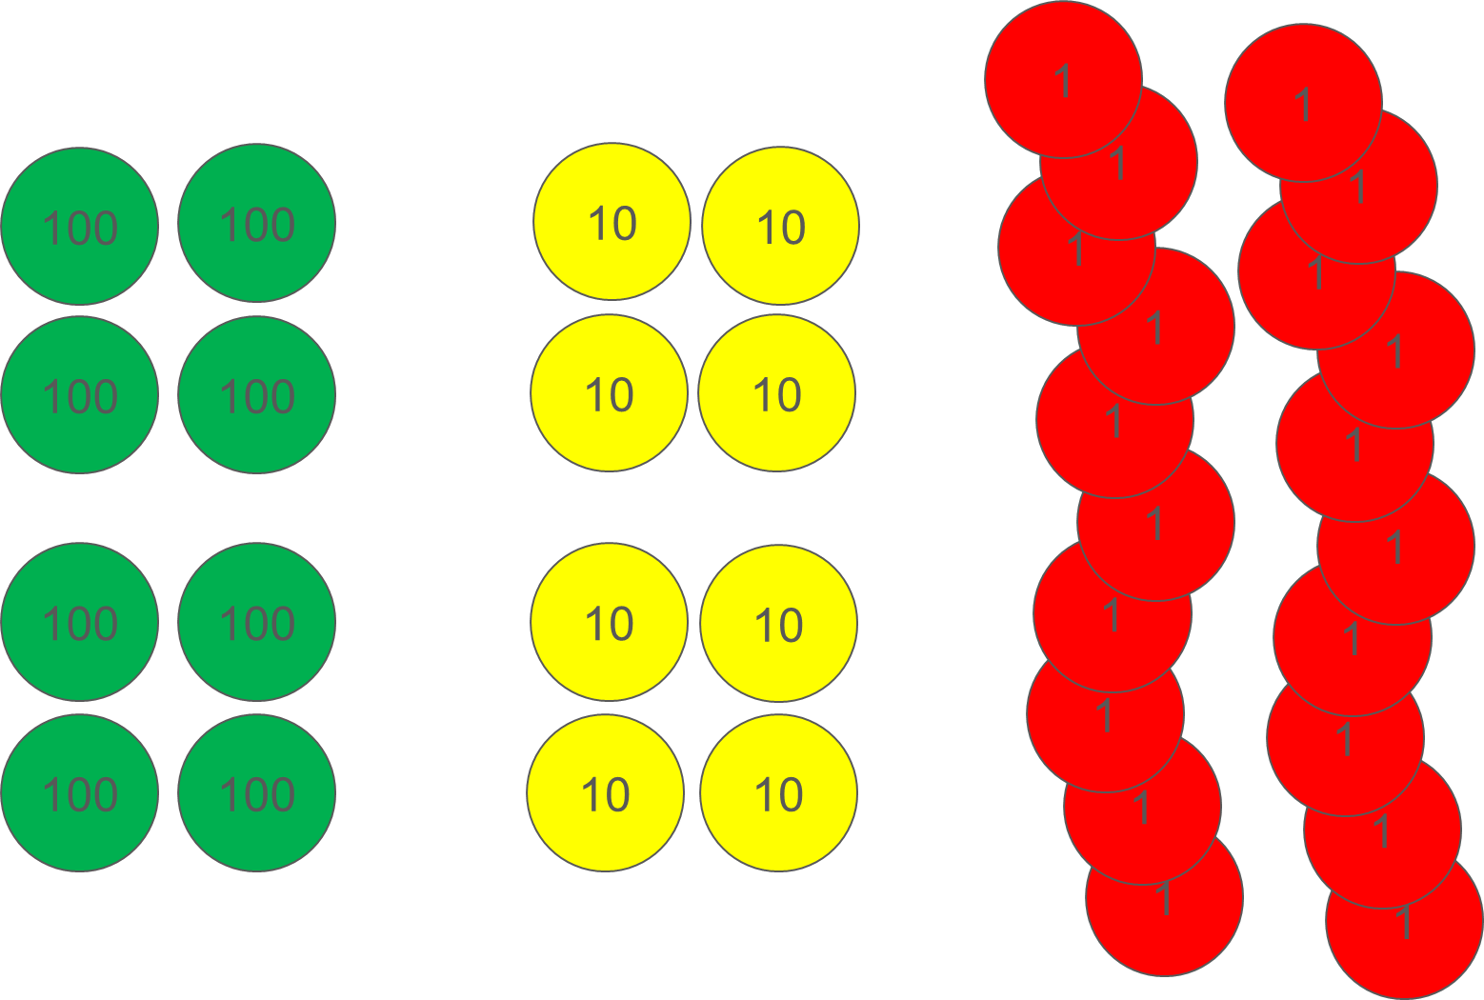
Activity I: modelling division
Bella uses place-value counters to help her explain 900 ÷ 4.
For each stage of her workings, match the two diagrams that represent the calculation and explain what is happening.
Stage 1:
A
B
C
Stage 2:
D
E
F
Stage 3:
What would the final representation look like if the calculation was 903 ÷ 4? What is it was 907 ÷ 4?
Notes:
Answers
Stage 1: B and then E (as 9 hundreds is grouped into 2 groups of 4, with 1 hundred remaining).
Stage 2: D and then C (as 1 hundred is exchanged for 10 tens, and then ground into 2 groups of 4, with 2 tens remaining).
Stage 3: F and then A (as 2 tens are exchanged for 20 ones, and then grouped into 5 groups of 4, with no remainder).
Suggested questioning
What is the same/different between the two pictures for each stage?
What is the same/different between the last picture of stage 1 and the first picture of stage 2?
How does the picture relate to what has been written down?
Things to think about
Activity I offers a representation alongside the written algorithm for division, so that teachers can check whether students understand the structure behind the process. Each stage matches to two pictures, showing the ‘before’ and ‘after’ for the division being carried out (see ‘answers’ above for explanation). The number 900 has been chosen so that the carrying of remainders, and subsequent exchange, is more explicit. It also means that students can see first 1 hundred, and then 2 tens being carried, to prevent the misconception that it is always ‘1’ that is exchanged (as in subtraction). Students are likely to be familiar with place-value counters, and may have used them for division. Even if they have not, the representation can act as a prompt for the language of students’ explanations, and teachers can gauge whether students have a secure understanding of place value within the structure of division

Slide 107
Activity J: Dividing by 4
Choose a single digit to go into the box. Then complete the calculation. Is it possible to have an integer answer?
4
3
2
Create another problem like this. Can you create one that will have more than one integer answer?
Notes:
Answers
Since 32 ÷ 4 = 8, and any multiple of 100 is also divisible by 4, the different solutions to this question can be achieved by reasoning rather than calculation:
For 0, answer is 8
For 1, answer is 25 + 8 = 33
For 2, answer is 50 + 8 = 58
For 3, answer is 75 + 8 = 83
For 4, answer is 100 + 8 = 108
For 5, answer is 125 + 8 = 133
For 6, answer is 150 + 8 = 158
For 7, answer is 175 + 8 = 183
For 8, answer is 200 + 8 = 208
For 9, answer is 225 + 8 = 233
? There are numerous solutions, and so only some likely approaches are illustrated here. As a starting point, students might like to adapt the existing problem by keeping either the 4 or the 32 the same. For example, they could replace the 32 with a different multiple of 4. Or they might recognise that, since 8 is a factor of 200, 400, 600 and 800, then □ 32 ÷ 8 will be an integer when 2, 4, 6 and 8 are selected for the box. To think more generally about this problem, students will need to identify what multiples of 100 their chosen number is a divisor of, and choose two final digits that also divide by this number. For example, 5 is a factor of 100 so if their divisor is 5, and their dividend ends in a multiple of 5, then all possible solutions will be integers.
Suggested questioning
Did you notice that the last two digits of the dividend is a multiple of the divisor?
Will there be a remainder at the end of this calculation? How does this change when we change the missing digit?
If we think about the dividend as a multiple of 100, plus the 32, then which multiples of 100 can be divided exactly by 4? How would this change if you changed the divisor? How about the dividend? How about both?
Things to think about
In Checkpoint 19, students were given a division to explore; Activity J uses the same structure with simpler numbers. Some students may still approach this as a ‘trial and error’ activity. There is still some value for assessment in this approach, in gauging their level of confidence with the algorithm for division, but the simplifications to the activity are designed to make it easier for students to recognise the mathematical structures behind the problem. Students may recognise that the digit chosen for the hundreds column will not matter, since all multiples of 100 are divisible by 4 and the remaining number, 32, is also divisible by 4. Encourage students to work logically through the different digits that could be chosen for the box, to explore the pattern of the different solutions. This activity can act as a starting point for numerous discussions that might reveal how deeply students have understood the structures behind division of numbers beyond their familiar multiplication facts up to 12 × 12.

Slide 108
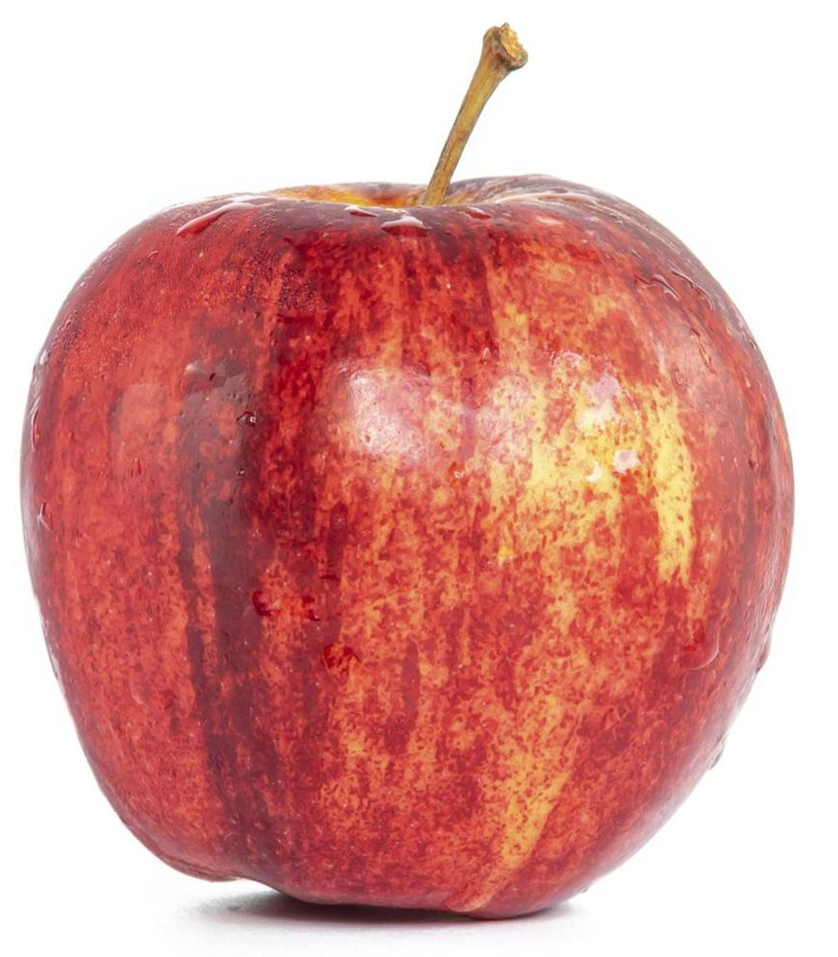
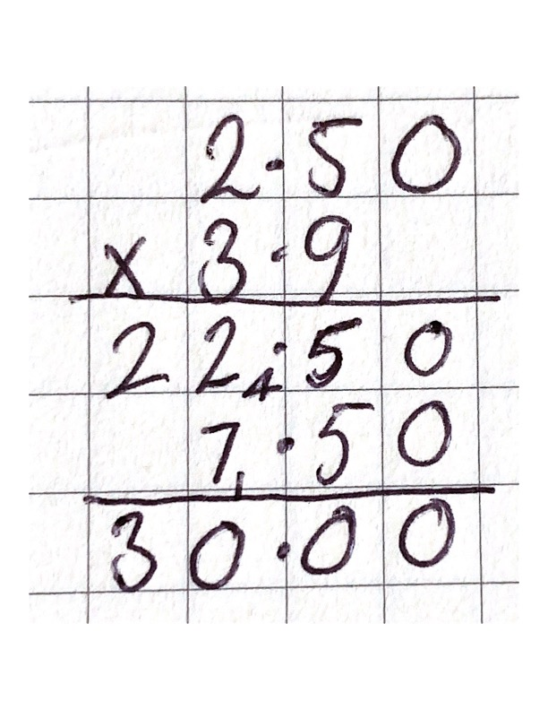
Activity K: Apples
Lewis buys 3.9 kg of apples at £2.50 per kg.
He estimates that the price of the apples will be around £10. How might he have done this?
Will his estimate be a little too big or small? How do you know?
Lewis tries to calculate the exact cost of the apples using a column method. He notices the answer looks too large, although he lined up the decimal points.
c) What mistake has Lewis made?
Calculate exactly how much the 3.9 kg of apples will cost.
Find three different ways to reach the right answer.
Notes:
Answers
a) Lewis might have estimated the answer using 4 kg 4 × 2.5 = 10
b) His estimate will be a little too big because he rounded the 3.9 up.
c) Lewis has lined up his decimal points. He has copied the 0 into the hundredths column for 22.5, which he found by multiplying the digits in the tenths and ones columns. In the next row, he did put a placeholder 0 in the tenths column, but did not make use of this in his calculation 10 × due to the decimal point. This has resulted in the wrong digits being lined up when he adds the two parts of his multiplication together.
? 3.9 kg costs £9.75
Suggested questioning
How do you know that the price will be around £10?
How can you tell if an estimate will be too big or too small?
Why does lining up the decimal points not work?
Why is estimation helpful when multiplying decimals?
Things to think about
Activity K offers teachers another opportunity to explore decimal multiplication, with a more specific focus on using estimation to check the magnitude of answers. Gauge students’ confidence with rounding and the language associated with it, as well as their understanding of estimation. Students may attempt to use ‘lining up the decimal points’ as a strategy to adapt the column method for integer multiplication, based on their earlier work on decimal addition and subtraction. This activity gives an example of how this might look when followed through in workings, and gives students an opportunity to discuss why it hasn’t worked.

Slide 109
Activity L: 2.16 again
2.16 ÷ 4 = 0.54
Use this calculation to fill in the gaps below
a) __.__ __ ÷ 4 = 0.74 b) __ __.__ __ ÷ 4 = 3.54
How could you use the information above to fill in this gap?
__.__ __ ÷ 4 = 0.57
Notes:
Answers
a) 2.96 (as there are 2 more tenths in the quotient, so there needs to be 4 × 2 more tenths in the original dividend: 2.16 + 0.8 = 2.96)
b) 14.16 (as there are 3 more ones in the quotient, so there needs to be 4 × 3 more ones in the original dividend: 2.16 + 12 =14.16)
? The quotient is 0.03 greater than the original answer. So, the dividend needs to be 4 × 0.03 greater than the original dividend. 2.16 + 0.12 = 2.28
Suggested questioning
If 15 ÷ 3 = 5, what can be divided by 3 to give 20?
What is the difference between the original answer (quotient) and the answer for a? If the answer for a is 0.2 larger – and it has already been divided by 4 – how much larger must the dividend be?
Things to think about
Activity L draws directly upon Checkpoint 28, but removes the support of the place-value counters. Refer students back to the previous activity, or offer place-value counters either as a support or as part of any explanation. Check whether students can think deeply about the structure of division, and use the original calculation to reason about what must have changes in subsequent calculations. Students need to be able to recognise that any change in the quotient represents a change that is 4 × that change in the dividend.

Slide 110
Activity M: priority of division
Ellie says all of these calculations will have the same answer. Is she correct?
10 + 6
4
10 + 6
4
10 + 6 ÷ 4
(10 + 6) ÷ 4
One of each pair of questions has the correct answer. Change the other question so that both answers are correct.
30 − 6 ÷ 2 = 12
12 + 18 ÷ 5 = 6
15 × 6 + 30 ÷ 3 = 240
30 − 6 ÷ 2 = 27
12 + 18 ÷ 5 = 15.6
15 × 6 + 30 ÷ 3 = 100
If you were able to place brackets anywhere, are there any other possible answers for any of the calculations in part b? Why or why not?
Notes:
This slide is animated. Each question will appear separately so you can choose the pace at which to work with your class
Answers
a) Ellie is not correct. The blue and purple calculations both have an answer of 11.5, as the division part of the calculation needs to be completed first. The orange and red calculations have an answer of 4.
b) (30 - 6) ÷ 2 = 12 and 30 - 6 ÷ 2 = 27; (12 + 18) ÷ 5 = 6 and 12 + 18 ÷ 5 = 15.6; 15 × (6 + 30 ÷ 3) = 240 and 15 × 6 + 30 ÷ 3 = 100
? There is another answer for the third column, as there are more than three numbers so more options for placing the brackets: 15 × (6 + 30) ÷ 3 = 180. Any other possible arrangement of brackets would not affect the answer.
Suggested questioning
What is the same/different about each calculation in part a?
How do you know which part of the calculation is being divided? What do the brackets/vinculum tell you?
Which part of this calculation has been done first? Is this correct? If it is not correct, how can we show that this part should be done first?
Things to think about
This additional activity explicitly addresses some common misconceptions with the priority of operations and may be of use within a unit of teaching on priority of operations. Part a introduces fraction notation for division. While students should be familiar with the concept of fractions as divisions from Key Stage 2, they may not have used fraction notation in calculations. The red calculation further offers an opportunity to discuss the fact that division is distributive over addition, so it can also be written as 10/4 + 6/4. Part b offers some pairs of identical calculations; it checks whether students consistently apply the order of operations, and further challenges them to add brackets to manipulate the order in which a calculation is completed.

Slide 111
Activity N: Mini Nelsons
(7 × ___ + ___ × 3) + ___
a) Fill the three gaps in this calculation with the same single-digit number. Try a different single-digit number.
b) What do you notice? Can you explain why this happens?
Can you write a different calculation that does the same thing as this one? Maybe with just two gaps? Or with four gaps?
Notes:
Answers
For any single digit number, a, the calculation can be rewritten as 10a + a or 11a. For example, inputting the number 4 will result in an output of 44.
Suggested questioning
What do you notice? Why do you think this happens?
Is there another way of writing the calculation in the brackets? Why is this possible?
Is there another way of writing the whole calculation?
Things to think about
This activity is a slightly simplified version of Checkpoint 33: ‘Nelsons’. Students should notice that the output of the calculation is always 11 times the number they inputted. They may be able to explain that this is because 7 × _ + _ × 3 can be rewritten as 10 × __ and that adding the number back on is effectively the same as writing the whole calculation as 11 × __. This task is an opportunity for students to see the distributive law in a straightforward context, and as such it may be worth explicitly using this language and asking students to consider other situations where they may have encountered the distributive law.

Slide 112
Printable resources

Slide 113
Alice Springs | 29ºC
Jaipur | 22ºC
London | 5ºC
Los Angeles | 13ºC
Moscow | -8ºC
New York | 2ºC
Quebec | -7ºC
Tromsø | -6ºC
Notes:
This is a printable resources that may be used alongside Checkpoint 1: January temperatures. Multiple number lines have been offered; choose which are most suitable for students or see which number lines their students select.

Slide 114
Notes:
These may be used alongside Checkpoint 3: Ant journeys

Slide 115
Match each number line to a calculation
Match each pair from part a to a set of double-sided counters and calculation. How do you know they match?
5 - 3
-2
0
3
+
-
+
+
+
5 + -3
3 - 5
-
+
-
-5
-2
0
-5 + 3
-
-
+
3 + -5
-
+
-3
0
2
-
+
-
-3 + 5
0
2
5
Notes:
This is a printable version of Checkpoint 5: Representing negatives

Slide 116
Hundreds | Tens | Ones | Tenths | Hundredths
Notes:
This place-value grid might be used in conjunction with the digit cards provided on slides 117–27, for example to support Checkpoint 9.

Slide 117
Printable 0–9 digit cards
You may wish to print slides 118–127 to create sets of 0–9 digit cards.
Stack and clip the set of 10 pages and cut along the lines to produce eighteen sets.

Slide 118
0 | 0 | 0 | 0 | 0 | 0
0 | 0 | 0 | 0 | 0 | 0
0 | 0 | 0 | 0 | 0 | 0

Slide 119
1 | 1 | 1 | 1 | 1 | 1
1 | 1 | 1 | 1 | 1 | 1
1 | 1 | 1 | 1 | 1 | 1

Slide 120
2 | 2 | 2 | 2 | 2 | 2
2 | 2 | 2 | 2 | 2 | 2
2 | 2 | 2 | 2 | 2 | 2

Slide 121
3 | 3 | 3 | 3 | 3 | 3
3 | 3 | 3 | 3 | 3 | 3
3 | 3 | 3 | 3 | 3 | 3

Slide 122
4 | 4 | 4 | 4 | 4 | 4
4 | 4 | 4 | 4 | 4 | 4
4 | 4 | 4 | 4 | 4 | 4

Slide 123
5 | 5 | 5 | 5 | 5 | 5
5 | 5 | 5 | 5 | 5 | 5
5 | 5 | 5 | 5 | 5 | 5

Slide 124
6 | 6 | 6 | 6 | 6 | 6
6 | 6 | 6 | 6 | 6 | 6
6 | 6 | 6 | 6 | 6 | 6

Slide 125
7 | 7 | 7 | 7 | 7 | 7
7 | 7 | 7 | 7 | 7 | 7
7 | 7 | 7 | 7 | 7 | 7

Slide 126
8 | 8 | 8 | 8 | 8 | 8
8 | 8 | 8 | 8 | 8 | 8
8 | 8 | 8 | 8 | 8 | 8

Slide 127
9 | 9 | 9 | 9 | 9 | 9
9 | 9 | 9 | 9 | 9 | 9
9 | 9 | 9 | 9 | 9 | 9

Slide 128
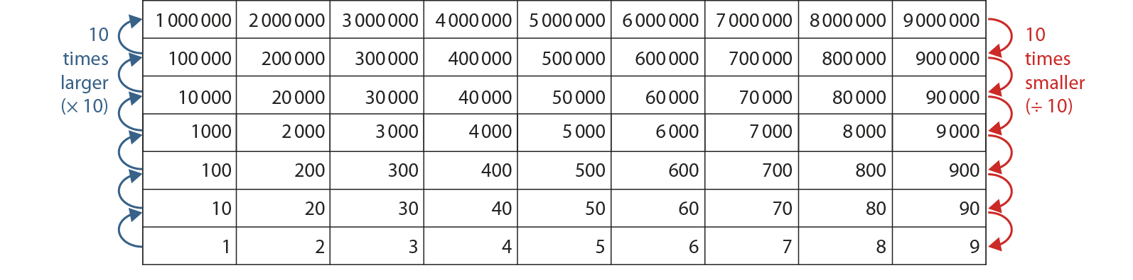
Notes:
These printable Gattegno charts may be useful to support Checkpoints 21 and 25.

