Slide 1
Series 3 Episode 9
Peekaboo

Slide 2
Practitioner Notes

Slide 3
Episode Description
The Numberblocks take turns hiding behind each other in a song and dance all about bigger and smaller. Learn about comparing numbers with the Numberblocks.

Slide 4
Maths in the Episode
Comparing numbers to 10
In this episode the Numberblocks try to hide behind one another. Some Numberblocks can be completely hidden when they stand behind another, but others cannot because they are taller or wider. The song uses the language of comparison including smaller than and bigger than. Different contexts for comparing length and height are also introduced. We are also reintroduced to the inequality symbols <> and the language of ‘greater than’ and ‘less than’.

Slide 5
Using Mathematical Language
Use these stem sentences to rehearse the mathematical ideas in the programme:
“<3> is smaller than <7>.”
“<3 and 1> together are smaller than <7>.”
“<7> is bigger than <3>.”
“<7> is bigger than <3> and <1> together.”
Notes:
< > indicates what can be changed in the stem sentence.

Slide 6
Talk and Discuss Together

Slide 7
Talk and Discuss Together
Watch the episode of Numberblocks. Use the following picture as a stimulus. First ask the children what they noticed about some of the Numberblocks when they stood behind another Numberblock. Can you find someone you can stand behind to hide?
The following slides are designed to stimulate children and adults to talk about the episode and draw out some key aspects of the mathematics.

Slide 8
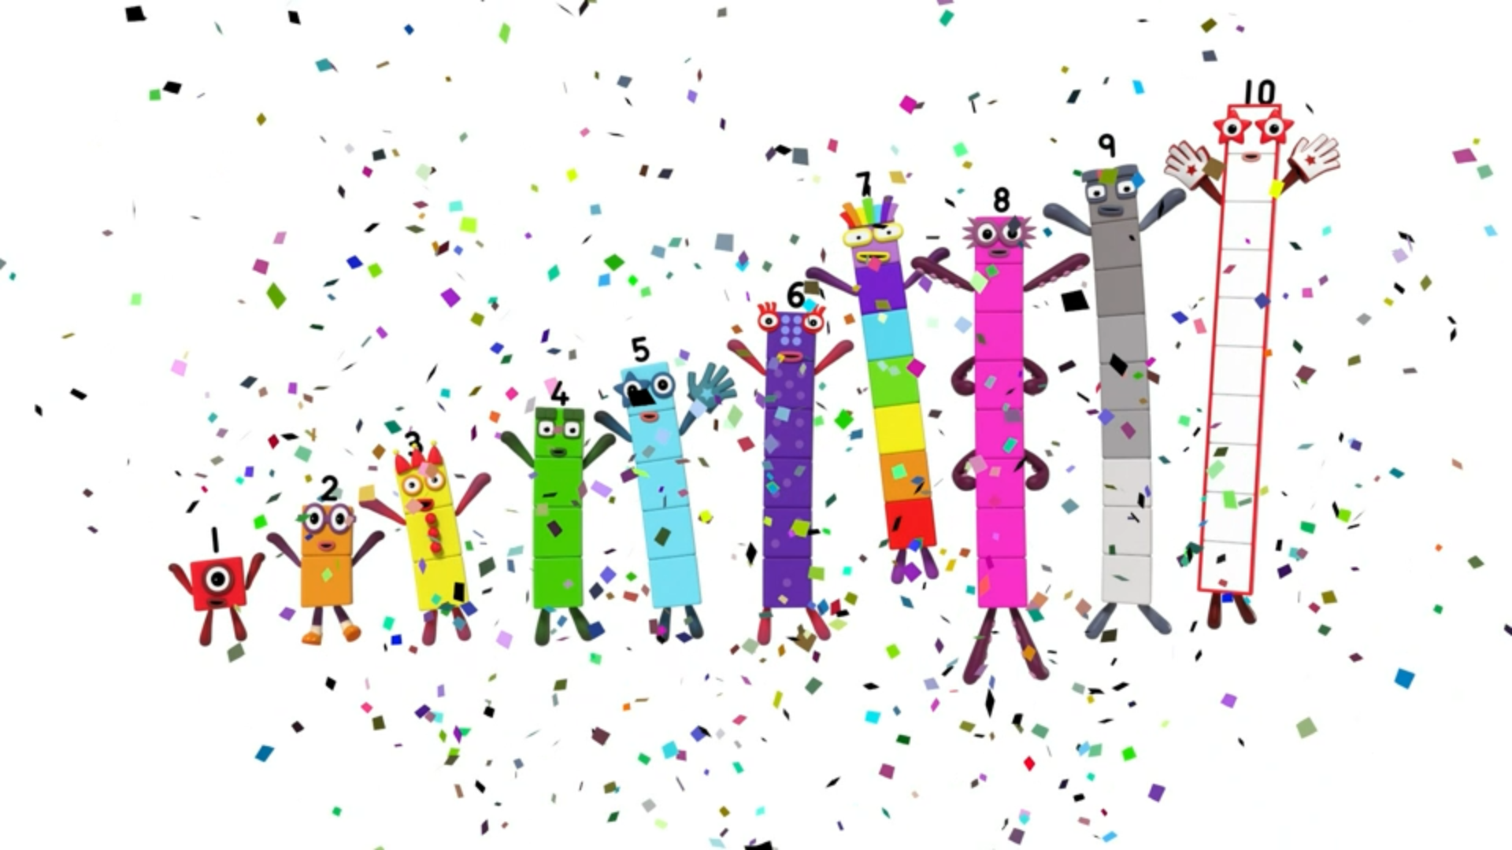
Notes:
Use this picture as the stimulus for Talk and Discussion (slide 7).

Slide 9
Enabling Environments in Reception

Slide 10
Enabling Environments
Playing and Exploring Make small world characters play hide and seek: hide animals behind other animals or behind an object that is taller than it.
Active Learning Look for opportunities in the block play area to see when the heights or lengths of the blocks are taller or longer. For example, when building a bridge, “I wonder if this pillar is taller than this one?”.
Creating and Thinking Critically
Play Peekaboo hide and seek. Someone counts to ten while the other children have to arrange themselves to hide behind another person who is taller than them. The finder has to work out who is hiding behind a person.
Make Numberblocks with cubes. Explore which Numberblocks can hide behind each other.

Slide 11
Learning Together in Y1

Slide 12
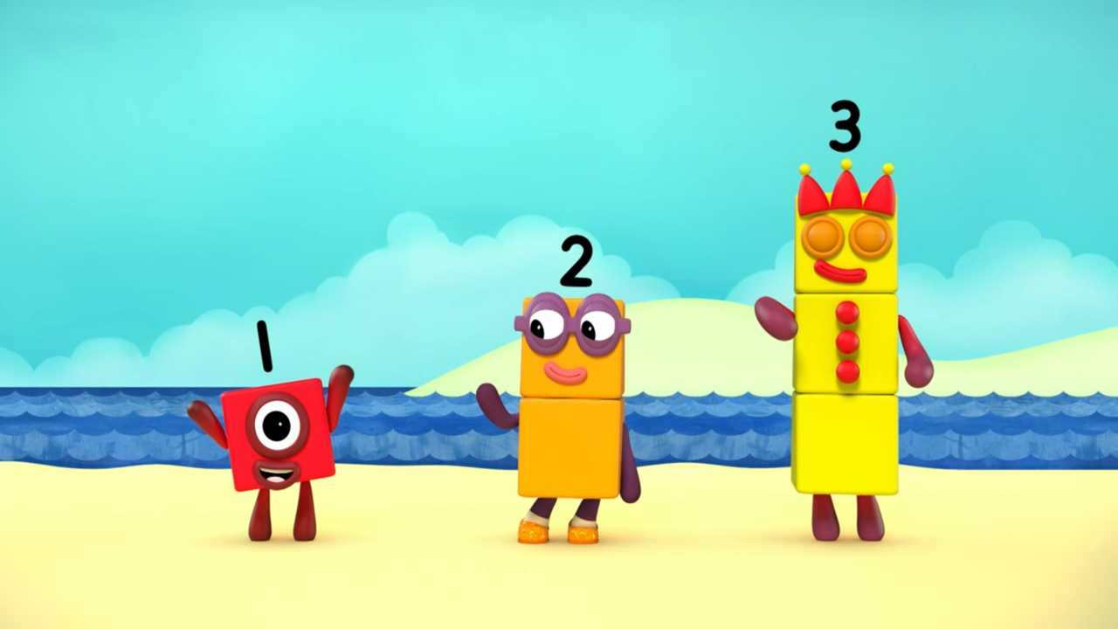
Images © 2017 Alphablocks Ltd. All Rights Reserved.
Notes:
Use this slide to reveal the children’s use of language to compare One, Two and Three.
(When describing taller than/ shorter than, you could gesture with your hand moving upwards and downwards to support understanding.)
How many ways can we compare One, Two and Three? (bigger than/ smaller than, taller than/ shorter than)
Who is bigger/taller than One? Who is bigger/taller than Two?
Who is smaller/ shorter than Two? Who is smaller/ shorter than Three?

Slide 13
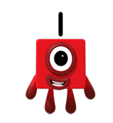
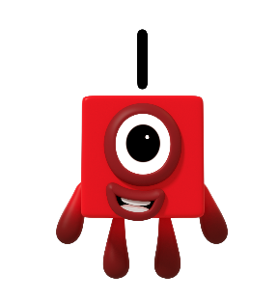
Who is hiding behind Three?
Peekaboo!
Peekaboo!
Images © 2017 Alphablocks Ltd. All Rights Reserved.
Notes:
Use this slide to see that when a Numberblock is taller than another Numberblock, it can hide the smaller Numberblock.
Discuss as slide animates:
Who could be hiding behind Three?
Why couldn’t we see Two? (Two is smaller/ shorter than Three. Three is bigger/ taller than Two.)
Why couldn’t we see One? (One is smaller/ shorter than Three. Three is bigger/ taller than One. Three is bigger than One.)
Why is One still hiding? (One is smaller/ shorter than Two. Two is bigger/ taller than One. Two is bigger than One.)

Slide 14
I am smaller than ___
I am smaller than ___
Images © 2017 Alphablocks Ltd. All Rights Reserved.
Notes:
Use this slide to practise using the language to compare.
Read the speech bubble together and discuss which numbers are missing.
Could One say she is smaller than each of the other numbers?

Slide 15
I am bigger than ___
I am bigger than ___
Images © 2017 Alphablocks Ltd. All Rights Reserved.
Notes:
As for previous slide, use this to practise using the language to compare.
Read the speech bubble together and discuss what missing numbers could be.

Slide 16
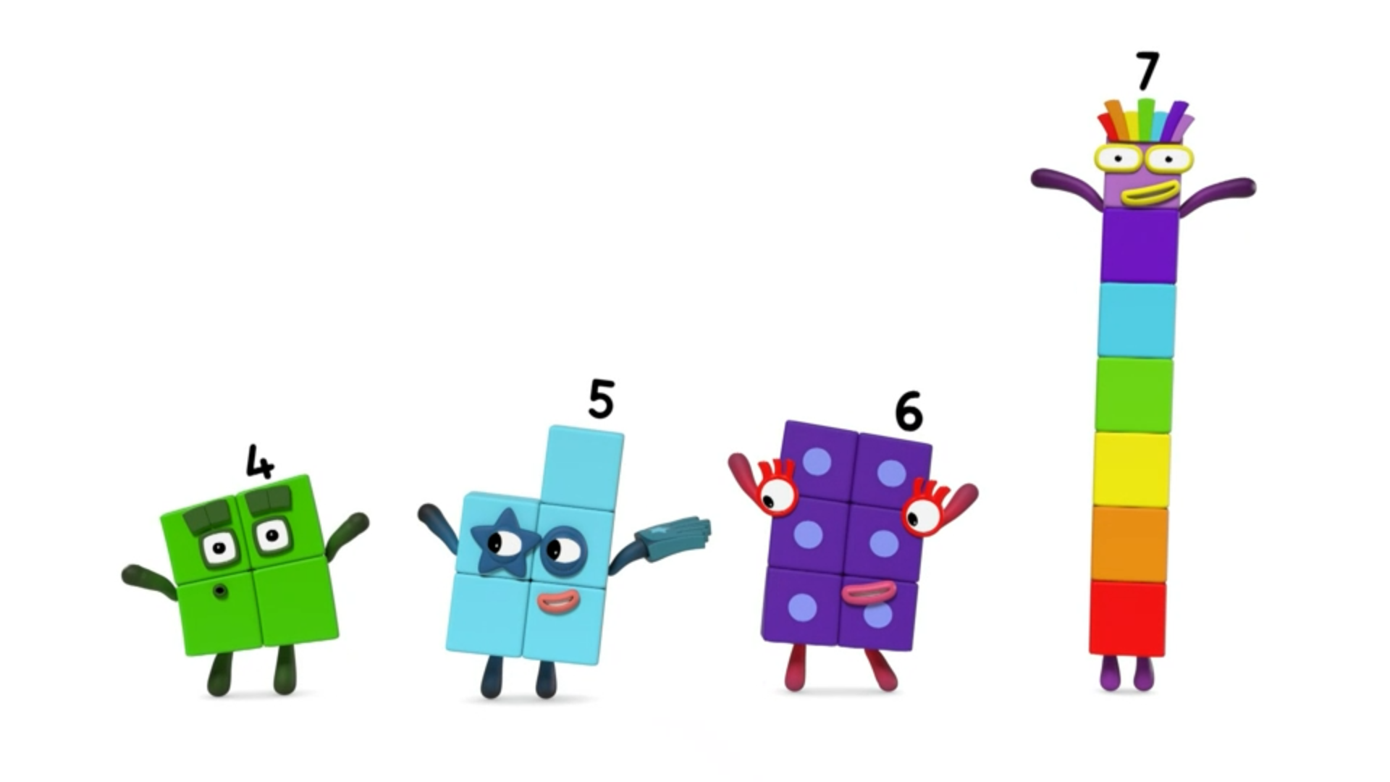
___ is smaller than ____
___ is bigger than ____
Images © 2017 Alphablocks Ltd. All Rights Reserved.
Notes:
Use this slide to compare the Numberblocks in the picture.
Do you think any Numberblocks would need to change shape to play the Peekaboo game?
Discuss which numbers could go in the sentences to make them correct.
How many different ways can you find to complete the sentences?

Slide 17
Further activities for Y1
Use a different pair of Numberblocks to compare. Use the Numberblocks (1-wide) to say, complete or write compare sentences.
Extend thinking by asking children to find two Numberblocks where one is only a bit bigger/smaller than another one or quite a lot bigger/ smaller than another.
Use 2-wide Numberblocks to show how one Numberblock is more than another in a different shape.
Give children completed comparing sentences and ask them to make a Numberblocks model to match the sentence. Are there any pairs of sentences which need the same model? (For example, 5 is bigger than 3 and 3 is smaller than 5, so both need Numberblocks Three and Five.)
Find 3 people you are taller than. Find 3 people you are shorter than.

Slide 18
Learning Together in Y2

Slide 19
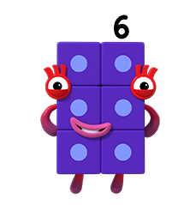
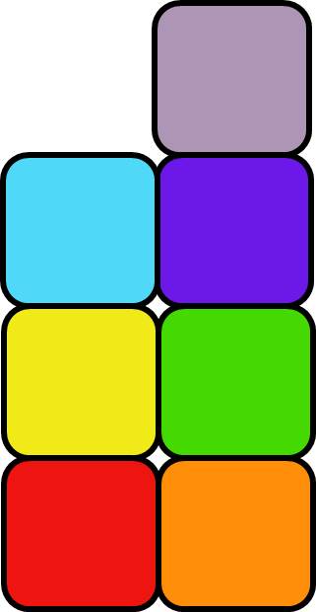
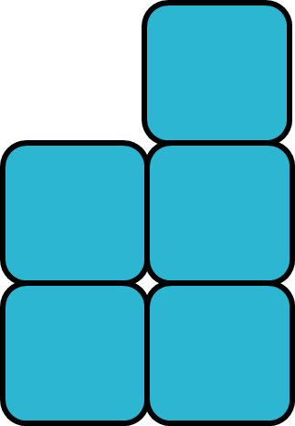
Who can hide behind who?
Images © 2017 Alphablocks Ltd. All Rights Reserved.
Notes:
Use this slide to explore the possibilities of who can hide behind who.
Discuss which Numberblocks will need to change shape to play the game.

Slide 20
Further activities for Y2
Explore combining 2 Numberblocks to compare with another Numberblock. For example, One and Two together are the same as Three or are smaller than Four.
Use a bar model to represent the comparison of two Numberblocks (this will help children move between the vertical towers of the blocks and the horizontal bars).
Extend thinking by exploring how the combination of two numbers is more or less than another number, and represent this with a bar model.
Investigate mathematical statements with the < and > symbols. Use cubes to support finding the missing numbers if needed.
For example, make this equation correct: 2 + 3 > o; 2 + o < 8.

