Slide 1
Year 6, Unit 13
Mean average

Slide 2
Year 6, Unit 13
These materials heavily reflect the prioritisation approach of the ready-to-progress criteria in the DfE Primary Mathematics Guidance 2020 and on the PPTs that exemplify them on the NCETM website. They also include other relevant National Curriculum content. Related sections of the NCETM Primary Mastery Professional Development Materials provide small-step teaching guidance.
There are no specific ready-to-progress criteria supported by this unit.

Slide 3
Contents
The links below take you to the starting slide of each learning outcome.
1 | Pupils explain the relationship between the mean and sharing equally
2 | Pupils explain how to calculate the mean of a set of data
3 | Pupils explain how the mean changes when the total quantity or number of values changes
4 | Pupils explain how to calculate the mean when one of the values in the data set is zero or missing
5 | Pupils explain how to use the mean to make comparisons between two sets of information
6 | Pupils explain when the mean is not an appropriate representations of a set of data
Click the arrow button to return to this Contents slide.

Slide 4
Year 6, Unit 13, Learning Outcome 1
Learning Outcome 1
Pupils explain the relationship between the mean and sharing equally
The following slides have been collated to support the teaching of this learning outcome.

Slide 5
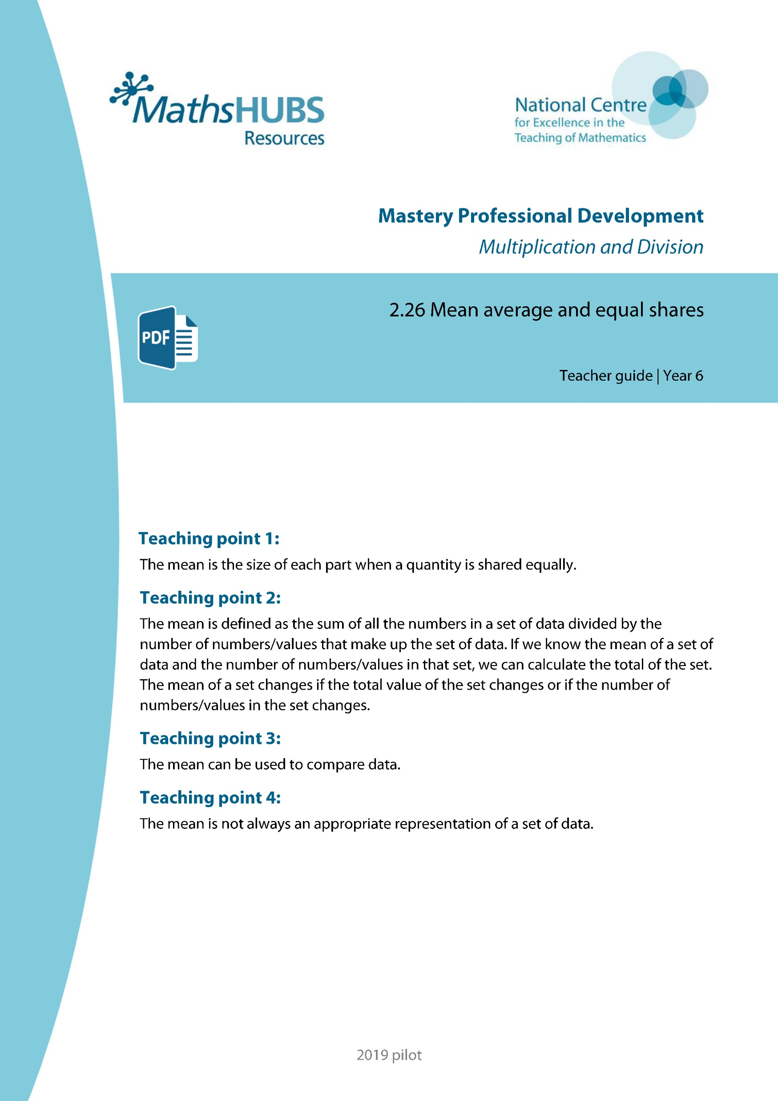
Year 6, Unit 13, Learning Outcome 1
Additional teacher guidance for this outcome should be read first and can be found in this segment of the NCETM Primary Mastery Professional Development Materials:
2.26 Mean average and equal shares
The spine materials are divided into ‘teaching points’ and ‘steps in learning’.
Teaching point | Steps in learning | Pages
1 | 1:1-1:4 | 3-7

Slide 6
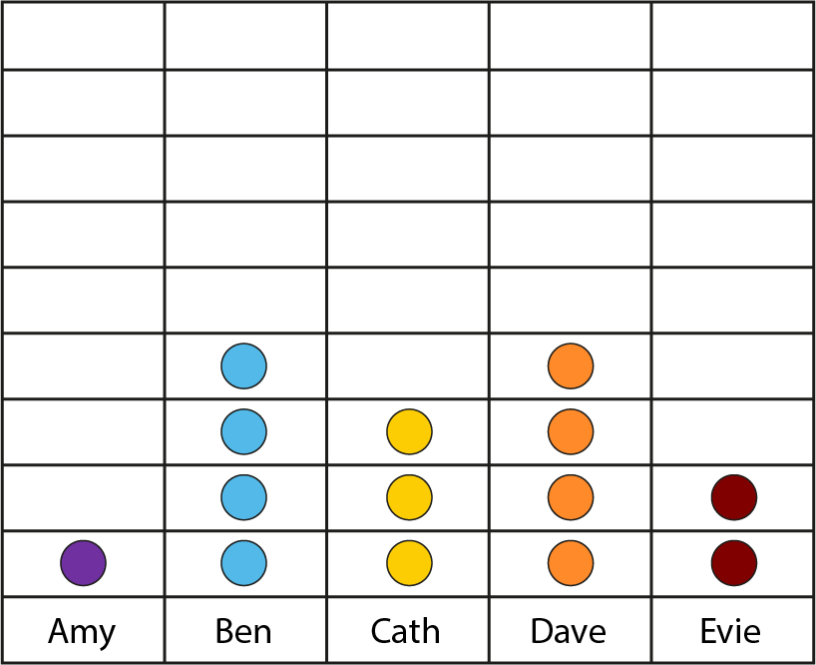


2.26 Mean average Step 1:1
How many each if shared equally?
Notes:
Amy has one card, Ben has five cards, Cath has three cards, Dave has nine cards and Evie has two cards.
How many do they have each if they share them equally?
Please note that this data set is used for problems from steps 1:1 to 1:4. The data set information has not been repeated in the notes to all slides.

Slide 7
2.26 Mean average Step 1:1
How many each if shared equally?
Notes:
Dave could give two of his cards to Cath and two of his cards to Evie.

Slide 8
2.26 Mean average Step 1:1
How many each if shared equally?
Notes:
If Ben, Cath and Dave each give one card to Amy, she will have four.
The cards have been shared equally.

Slide 9
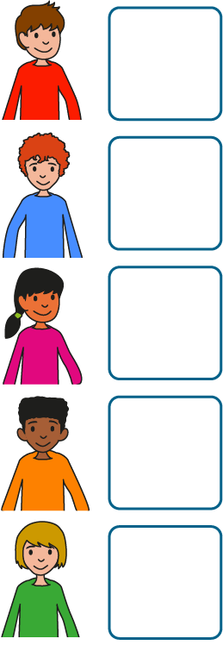

2.26 Mean average Step 1:2
20 conkers, shared equally between 5 children. How many each?
Each child gets 4 conkers.
Notes:
I have twenty conkers and I share them equally between five children. How many conkers does each child get?

Slide 10
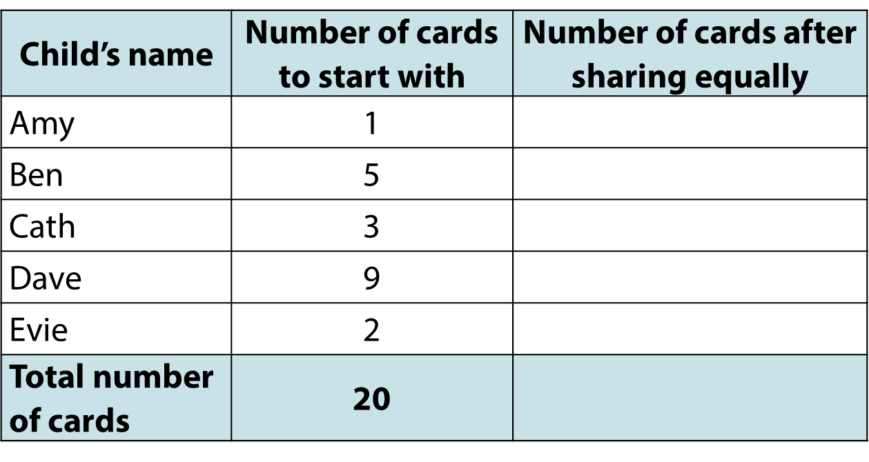
2.26 Mean average Step 1:2
4
4
4
4
4
20

Slide 11
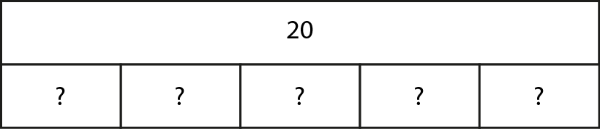
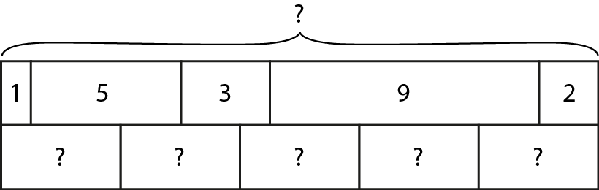
2.26 Mean average Step 1:3
4
4
4
4
4
20
4
4
4
4
4

Slide 12
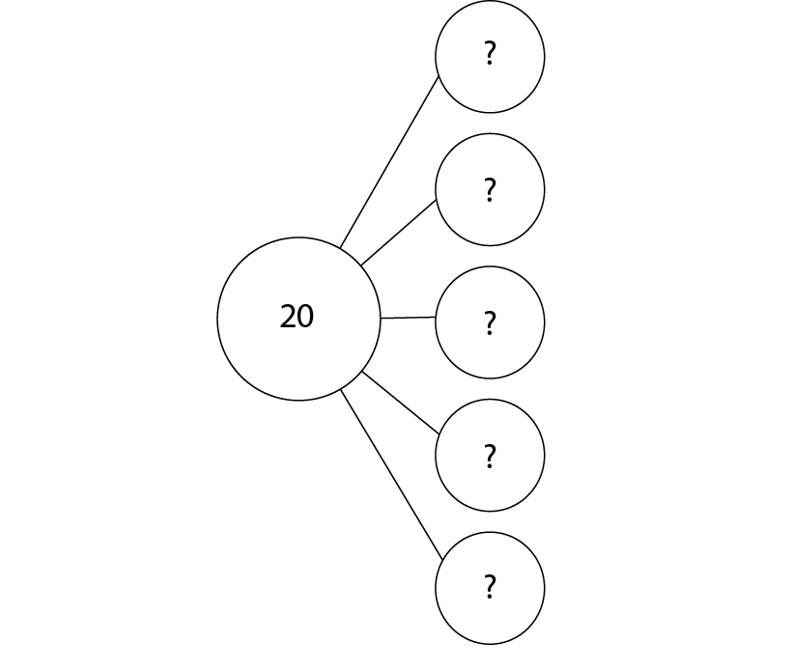
2.26 Mean average Step 1:4

Slide 13
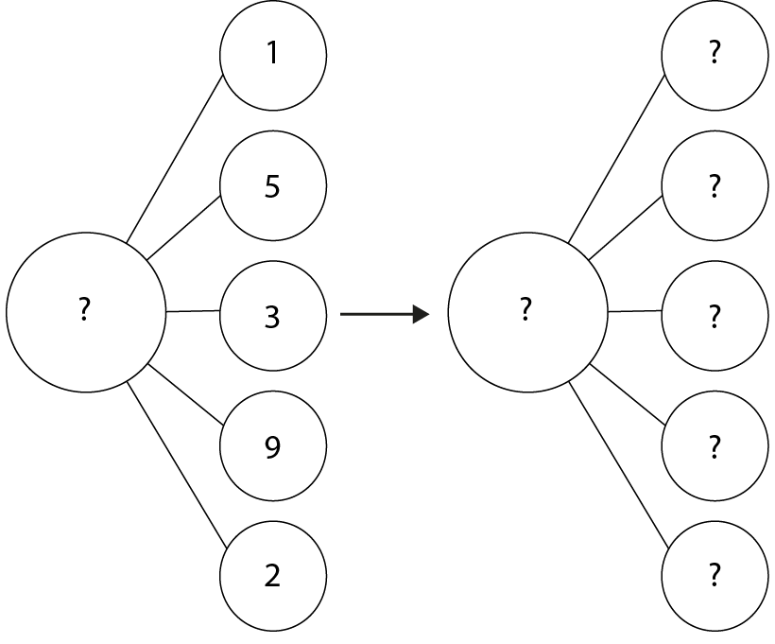
2.26 Mean average Step 1:4
unequal
equal

Slide 14
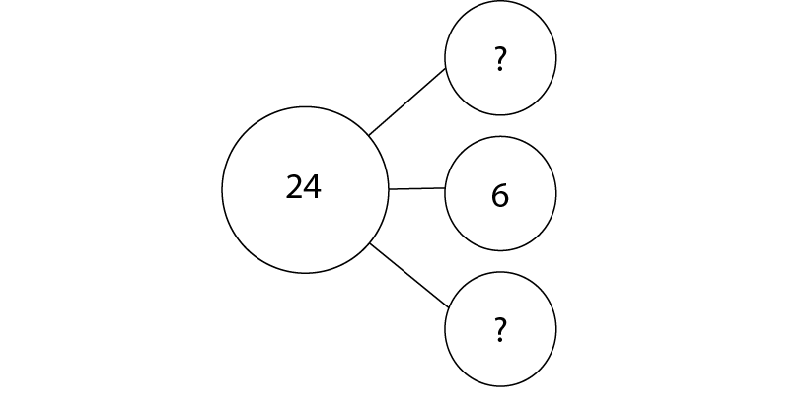
2.26 Mean average Step 1:4
Notes:
Complete this part–part–part–whole model using unequal shares.
Is there more than one possibility?

Slide 15
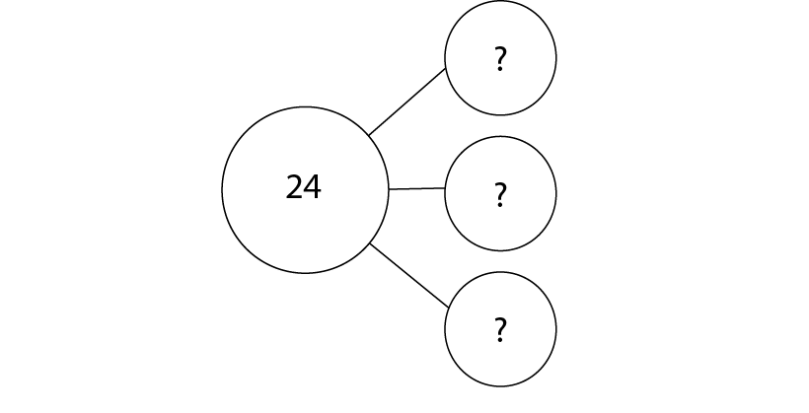
2.26 Mean average Step 1:4
Notes:
Now complete it using equal shares.

Slide 16
Year 6, Unit 13, Learning Outcome 2
Learning Outcome 2
Pupils explain how to calculate the mean of a set of data
The following slides have been collated to support the teaching of this learning outcome.

Slide 17
Year 6, Unit 13, Learning Outcome 2
Additional teacher guidance for this outcome should be read first and can be found in this segment of the NCETM Primary Mastery Professional Development Materials:
2.26 Mean average and equal shares
The spine materials are divided into ‘teaching points’ and ‘steps in learning’.
Teaching point | Steps in learning | Pages
2 | 2:1-2:4 | 8-12

Slide 18
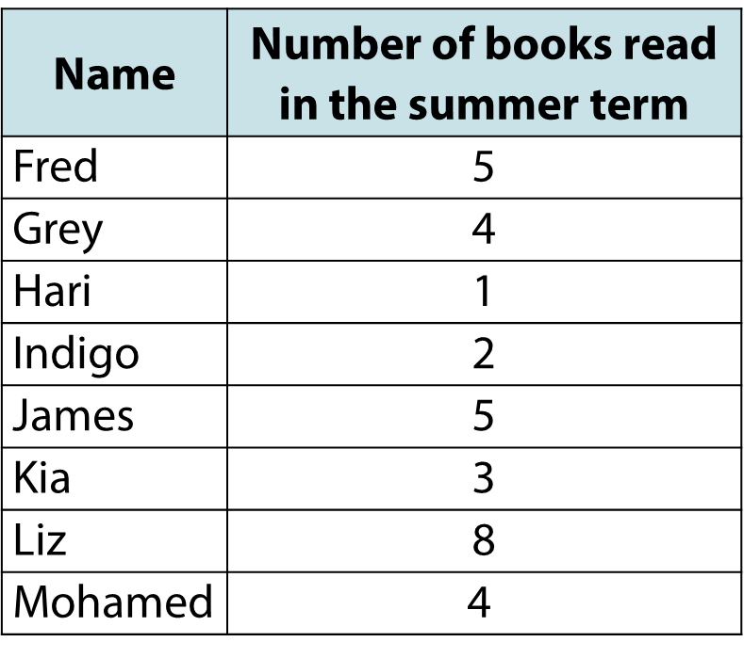
2.26 Mean average Step 2:2
Notes:
What is the mean number of books read in the summer term?
The dividend is '32' (5 + 4 + 1 + 2 + 5 + 3 + 8 + 4).
The divisor is '8' because there are eight children.
The mean is 32 ÷ 8 = 4.

Slide 19

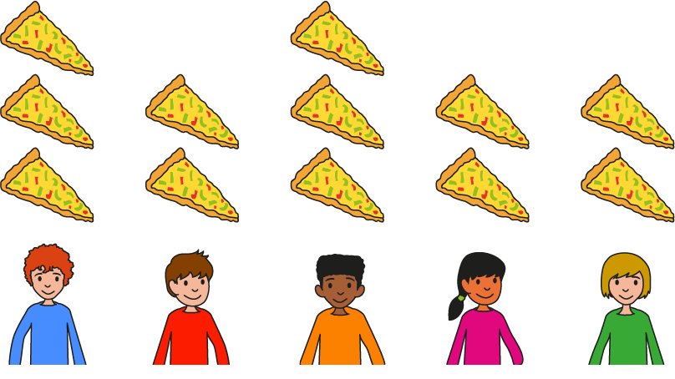
2.26 Mean average Step 2:2
Notes:
The dividend is '15' (4 + 2 + 5 + 2 + 2).
The divisor is '5' because there are five children.
The mean is 15 ÷ 5 = 3.

Slide 20
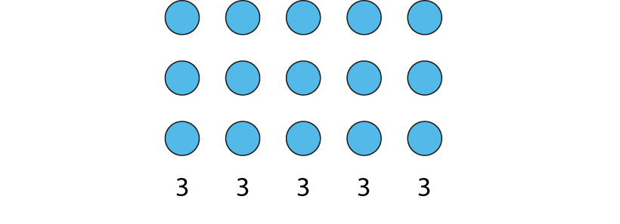
2.26 Mean average Step 2:3
5 children are given slices of pizza.
The mean number of slices is 3.
What is the total number of slices?
Notes:
There are five groups of three.
5 × 3 = 15
The total number of slices is fifteen.

Slide 21
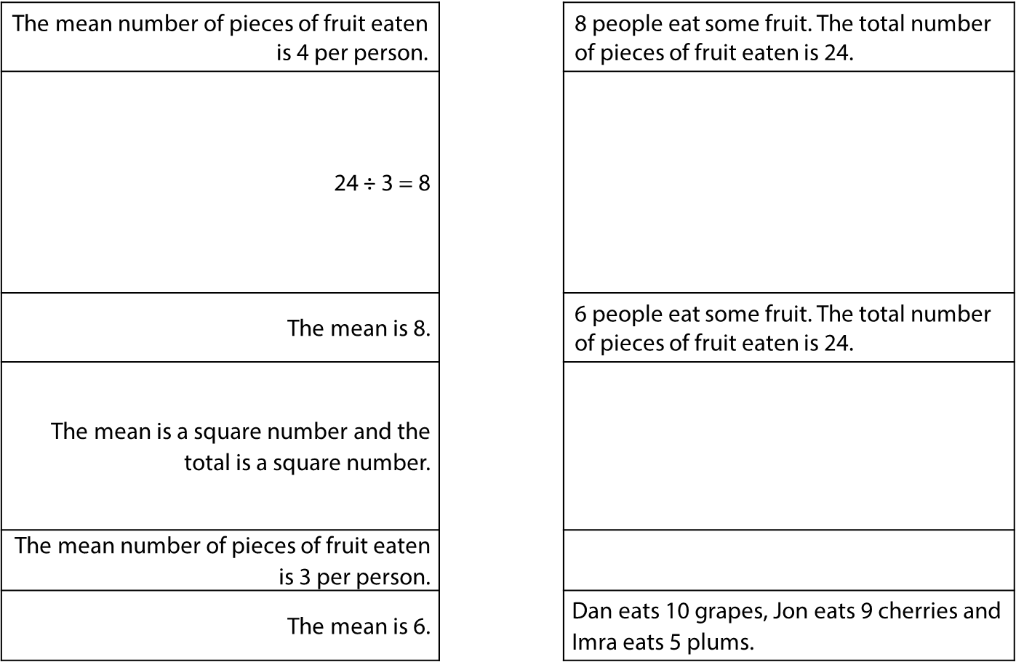
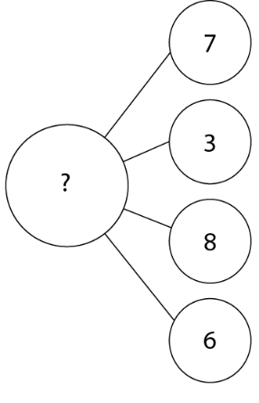
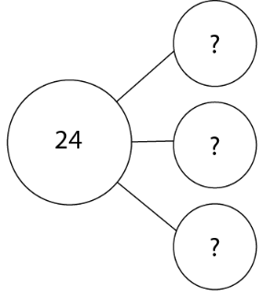

2.26 Mean average Step 2:4
Notes:
Draw lines to join the information on the left to the matching information on the right.

Slide 22
Year 6, Unit 13, Learning Outcome 3
Learning Outcome 3
Pupils explain how the mean changes when the total quantity or number of values changes
The following slides have been collated to support the teaching of this learning outcome.

Slide 23
Year 6, Unit 13, Learning Outcome 3
Additional teacher guidance for this outcome should be read first and can be found in this segment of the NCETM Primary Mastery Professional Development Materials:
2.26 Mean average and equal shares
The spine materials are divided into ‘teaching points’ and ‘steps in learning’.
Teaching point | Steps in learning | Pages
2 | 2:5-2:6 | 12-15

Slide 24
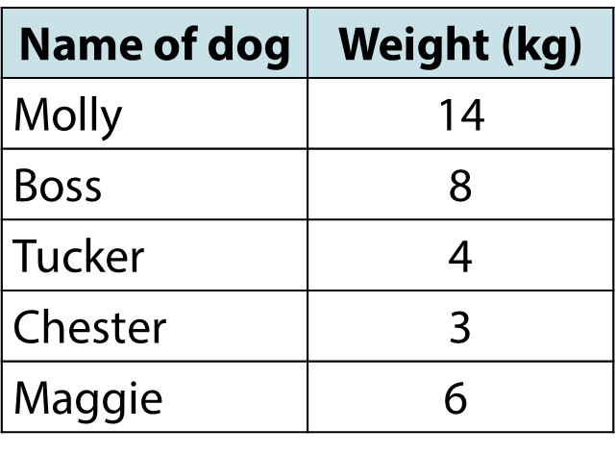
2.26 Mean average Step 2:5
Notes:
This table shows the weights of some dogs in kilograms.
What is the mean weight?
The dividend is 4 + 8 + 4 + 3 + 6 = 35
The divisor is '5' because there are five dogs.
The mean is 35 kg ÷ 5 = 7 kg

Slide 25

2.26 Mean average Step 2:5
Notes:
This table shows the weights of the same dogs a year later.
What is the mean weight now?
The dividend is 15 + 10 + 4 + 4 + 7 = 40
The divisor is '5' because there are five dogs.
The mean is 40 kg ÷ 5 = 8 kg

Slide 26

2.26 Mean average Step 2:5
Notes:
This table shows the weights of the same dogs two years later.
What is the mean weight now?
The dividend is 12 + 8 + 3 + 2 + 5 = 30
The divisor is '5' because there are five dogs.
The mean is 30 kg ÷ 5 = 6 kg

Slide 27
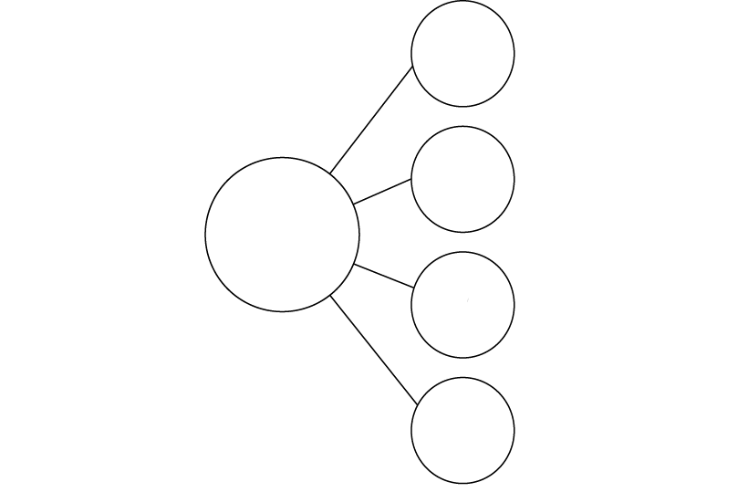
2.26 Mean average Step 2:6
6
?
6
?
24
6
?
6
?
Notes:
On Monday, four friends shared twenty-four sweets.
What is the mean number of sweets per friend?

Slide 28
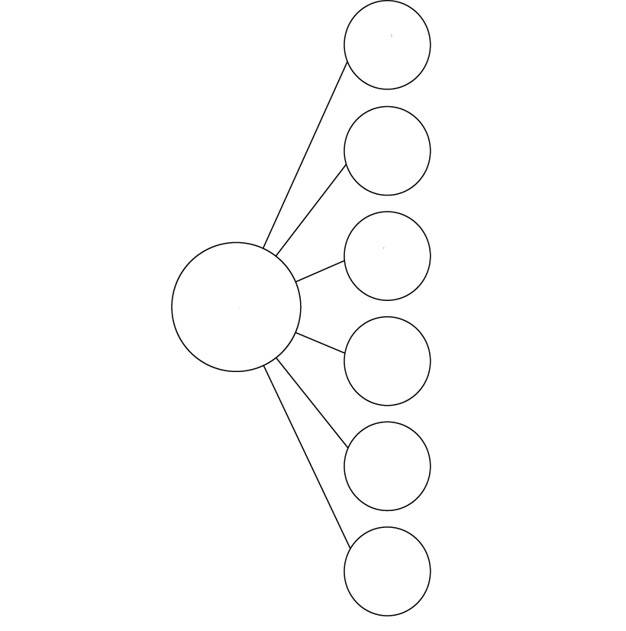
2.26 Mean average Step 2:6
4
?
6
4
?
6
4
?
24
24
6
4
?
6
4
?
4
?
Notes:
On Tuesday, six friends shared twenty-four sweets.
What is the mean number of sweets per friend?

Slide 29
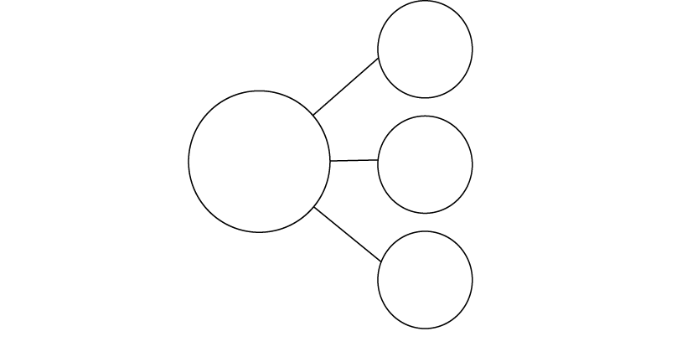
2.26 Mean average Step 2:6
4
6
4
8
?
6
4
24
24
8
24
?
6
4
8
?
6
4
4
Notes:
On Wednesday, three friends shared twenty-four sweets.
What is the mean number of sweets per friend?

Slide 30
Year 6, Unit 13, Learning Outcome 4
Learning Outcome 4
Pupils explain how to calculate the mean when one of the values in the data set is zero or missing
The following slides have been collated to support the teaching of this learning outcome.

Slide 31
Year 6, Unit 13, Learning Outcome 4
Additional teacher guidance for this outcome should be read first and can be found in this segment of the NCETM Primary Mastery Professional Development Materials:
2.26 Mean average and equal shares
The spine materials are divided into ‘teaching points’ and ‘steps in learning’.
Teaching point | Steps in learning | Pages
2 | 2:7-2:8 | 15-18

Slide 32
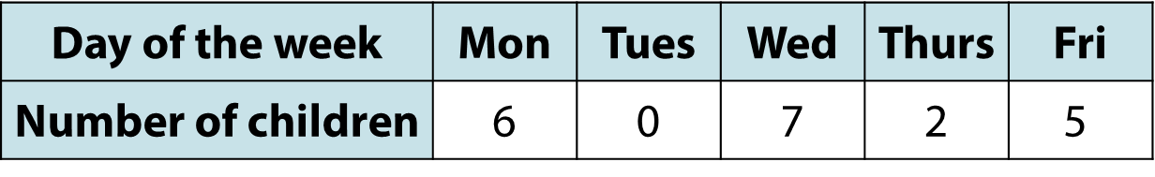
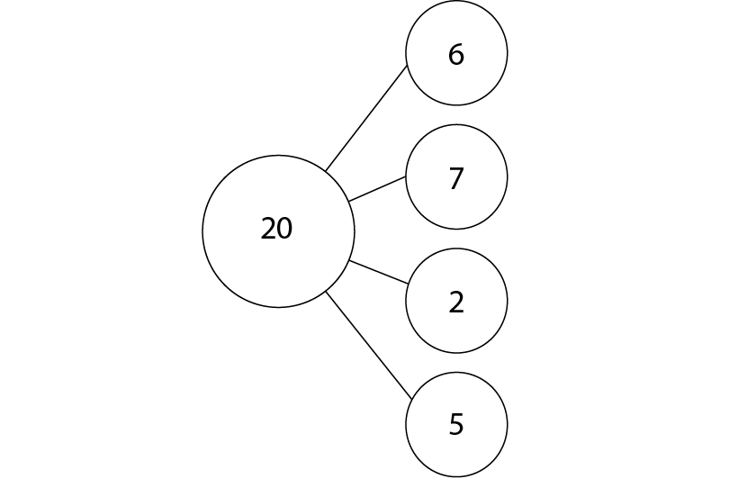
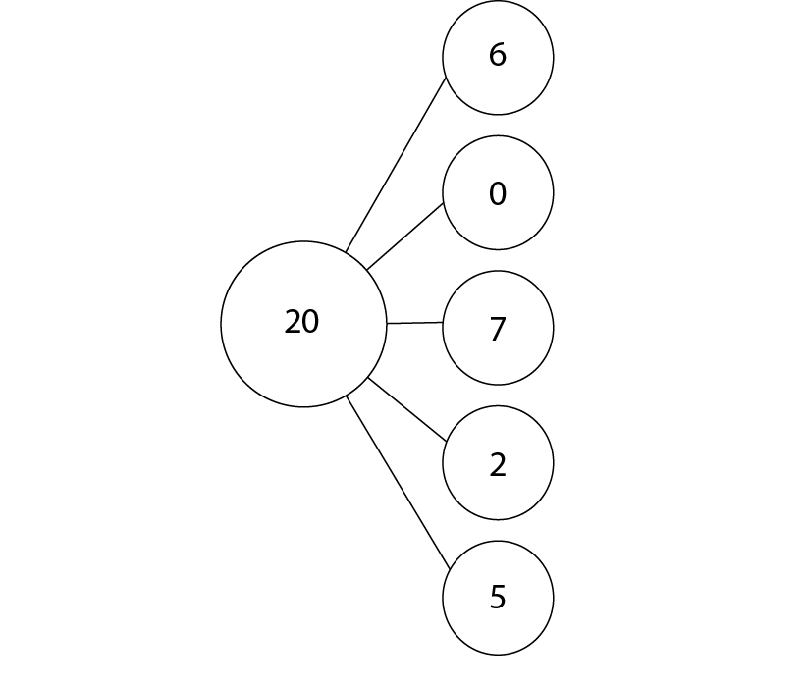
2.26 Mean average Step 2:7
Fatima’s method
Alicia’s method
(6 + 7 + 2 + 5) ÷ 4 = 5
(6 + 0 + 7 + 2 + 5) ÷ 5 = 4
Notes:
What is the mean number of children per day?

Slide 33
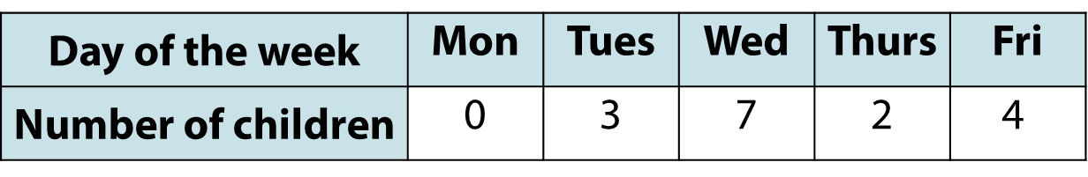
2.26 Mean average Step 2:7
Notes:
The following week there is a Bank Holiday and so the school is shut on Monday.
What is the mean number of children per day for this week?

Slide 34
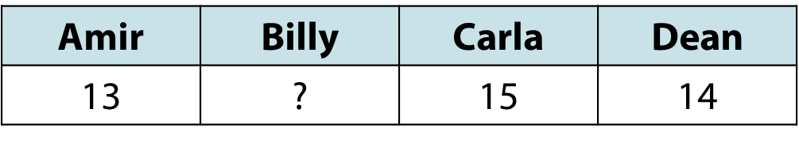
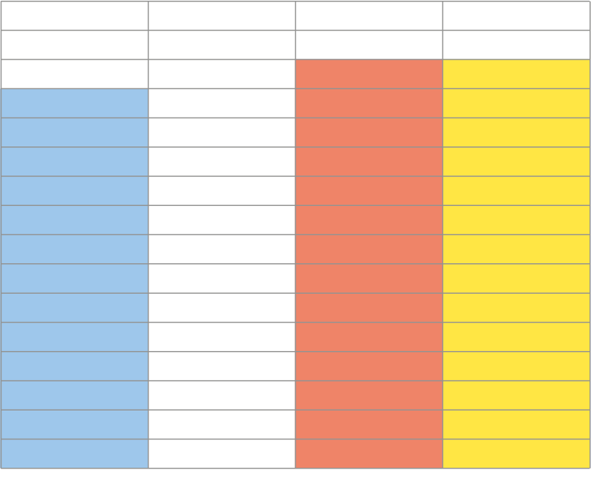


2.26 Mean average Step 2:8
Mean time is 14 minutes. What could Billy’s time be?
Amir
Billy
Carla
Dean
Notes:
The mean time in minutes for a 3 kilometre race is 14 minutes.
What could Billy’s time be?

Slide 35
Year 6, Unit 13, Learning Outcome 5
Learning Outcome 5
Pupils explain how to use the mean to make comparisons between two sets of information
The following slides have been collated to support the teaching of this learning outcome.

Slide 36
Year 6, Unit 13, Learning Outcome 5
Additional teacher guidance for this outcome should be read first and can be found in this segment of the NCETM Primary Mastery Professional Development Materials:
2.26 Mean average and equal shares
The spine materials are divided into ‘teaching points’ and ‘steps in learning’.
Teaching point | Steps in learning | Pages
3 | 3:1-3:2 | 19-20

Slide 37
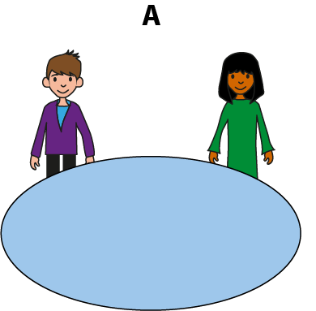
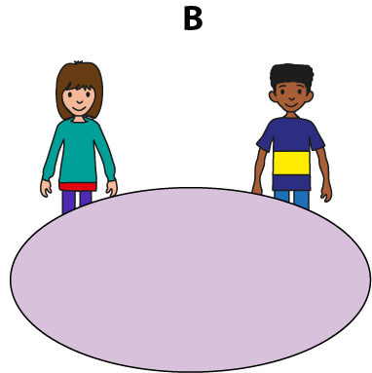

2.26 Mean average Step 3:1

Slide 38
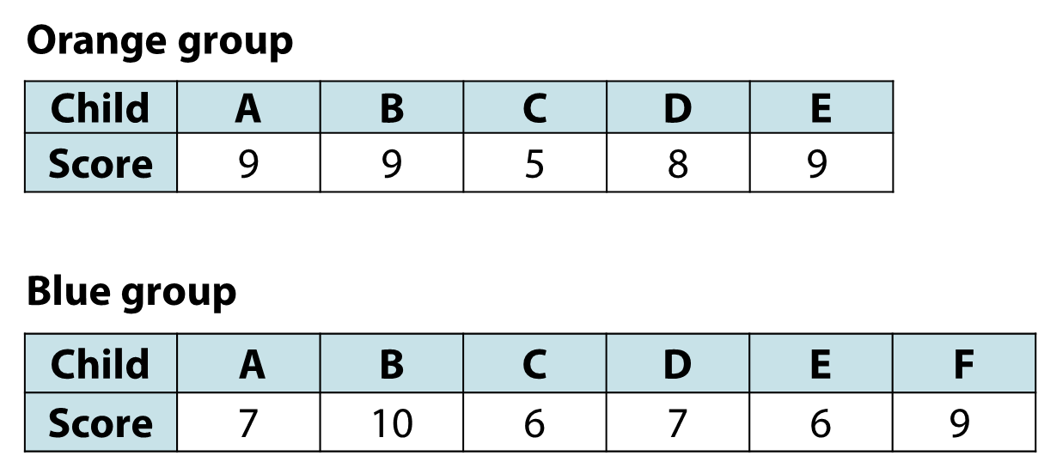
2.26 Mean average Step 3:2

Slide 39
Year 6, Unit 13, Learning Outcome 6
Learning Outcome 6
Pupils explain when the mean is not an appropriate representations of a set of data
The following slides have been collated to support the teaching of this learning outcome.

Slide 40
Year 6, Unit 13, Learning Outcome 6
Additional teacher guidance for this outcome should be read first and can be found in this segment of the NCETM Primary Mastery Professional Development Materials:
2.26 Mean average and equal shares
The spine materials are divided into ‘teaching points’ and ‘steps in learning’.
Teaching point | Steps in learning | Pages
4 | 4:1-4:2 | 21-22

Slide 41
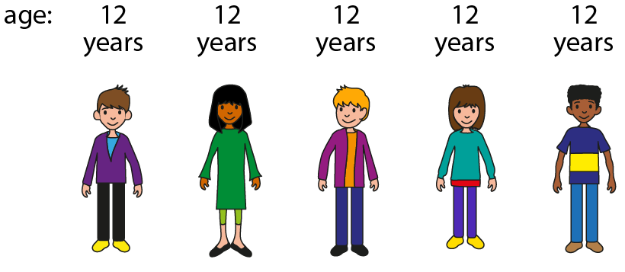
2.26 Mean average Step 4:1
Notes:
What is the mean age of the people in this picture?

Slide 42
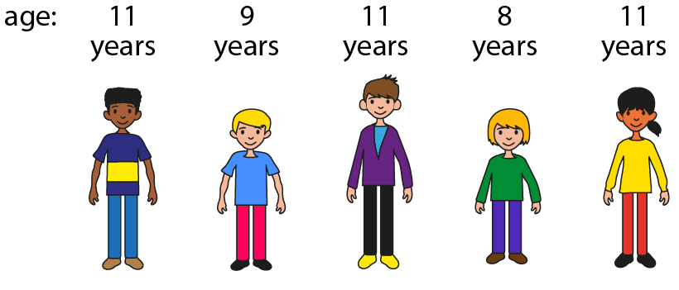
2.26 Mean average Step 4:1
Notes:
What is the mean age of the people in this picture?

Slide 43
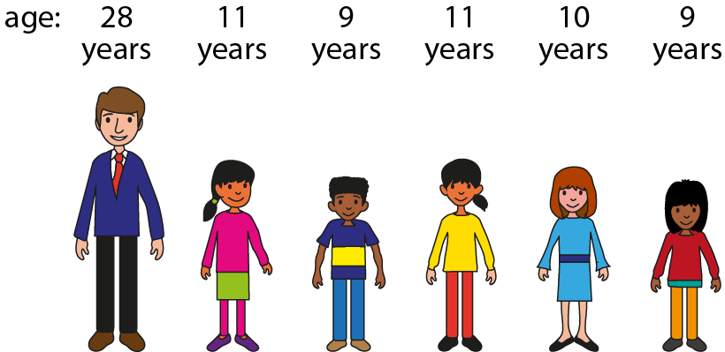
2.26 Mean average Step 4:1
Notes:
What is the mean age of the people in this picture?

Slide 44
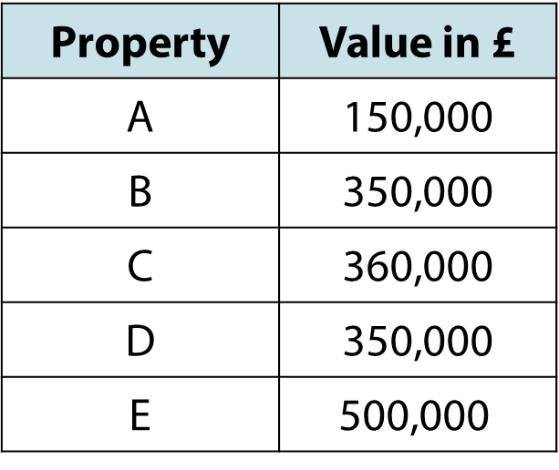
2.26 Mean average Step 4:2
Notes:
On Sunny Avenue there is a row of terraced houses.
House A is derelict and has been left empty for several years.
House E is very modern with a large garden.
What is the typical price of a house on Sunny Avenue?

