Slide 1
Series 3 Episode 13
Five and Friends

Slide 2
Practitioner Notes

Slide 3
Episode Description
Five arranges a ball for herself and all her friends. But when Six, Seven, Eight, Nine and Ten are there, there is no sign of the others. When One, Two, Three, Four and Five Fives are at the ball there is no sign of the others until they realise that they are all just Five and friends.

Slide 4
Maths in the Episode
Five and ‘a bit’
Understanding that a number between 5 and 10 can be partitioned into ‘5 and a bit’ is useful for mental calculation strategies. For example, adding 5 and 7 can be made easier by thinking of 7 as ‘5 and 2’, combining the two 5s and then adding the 2. ‘Five and a bit’ is visible when representing 6 -10 on our fingers or on a tens frame.

Slide 5
Using Mathematical Language
Use these stem sentences to rehearse the mathematical ideas in the programme:
“<6> is <5> and <1> more.”
“<5> and <1> together make <6>.”
“<6> is made of <5> and <1>.”
Notes:
< > indicates what can be changed in the stem sentence.

Slide 6
Talk and Discuss Together

Slide 7
Talk and Discuss Together
Watch the episode of Numberblocks. Use the following picture as a stimulus for discussion. What did they notice in the programme? Why did One, Two, Three, Four and Five keep disappearing when Six, Seven, Eight, Nine and Ten were in the ballroom?
The following slides are designed to stimulate children and adults to talk about the episode and draw out some key aspects of the mathematics.

Slide 8
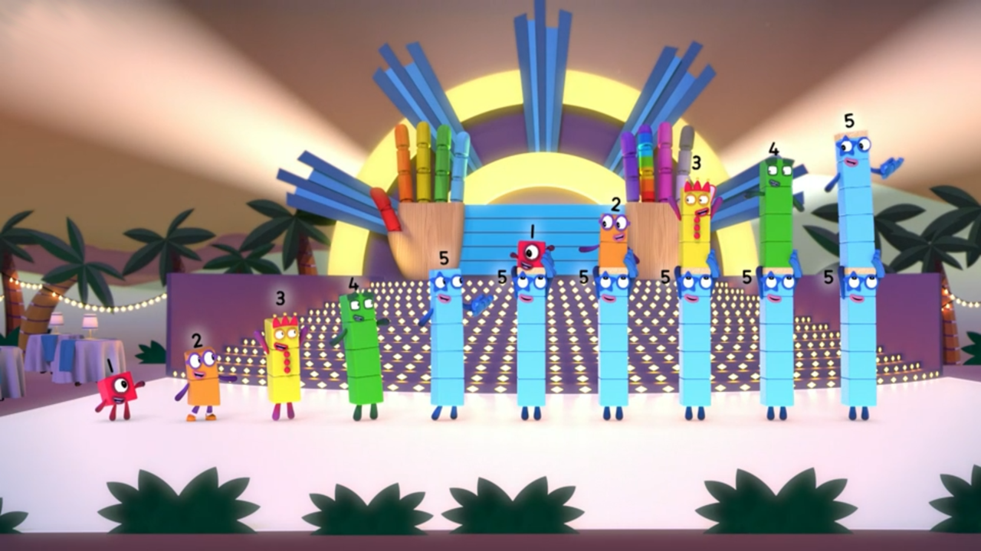
Images © 2017 Alphablocks Ltd. All Rights Reserved.
Notes:
Use this picture as the stimulus for Talk and Discussion (slide 7).

Slide 9
Enabling Environments in Reception

Slide 10
Enabling Environments
Playing and Exploring
Provide children with a range of equipment with which to explore making 6-9 as ‘five and a bit’. For example, they could use a Numicon ‘five’ piece and join it with other pieces to make 6-9, or find ‘five and a bit’ pieces on dominoes.
Active Learning
Use tens frames as a label for areas in the setting that are restricted to certain numbers of children. Accompany the labels with the numerals.
Creating and Thinking Critically
Practise representing numbers 1-10 on fingers that have been shown on tens frames. Turn over a tens-frame card and show how many with fingers - start with ‘grow it’ so children can count out fingers if they need, then ‘show it’, putting up fingers without counting, then ‘throw it’, putting out their fingers without looking at them first.
Count out some objects into a feely bag and agree the quantity; ask children, ‘can I take five out of the bag if there are six in there?’ Look for children who know how many will be left. Sometimes put fewer than five objects, see if children know that they cannot take five out of four.

Slide 11
Learning Together in Y1

Slide 12

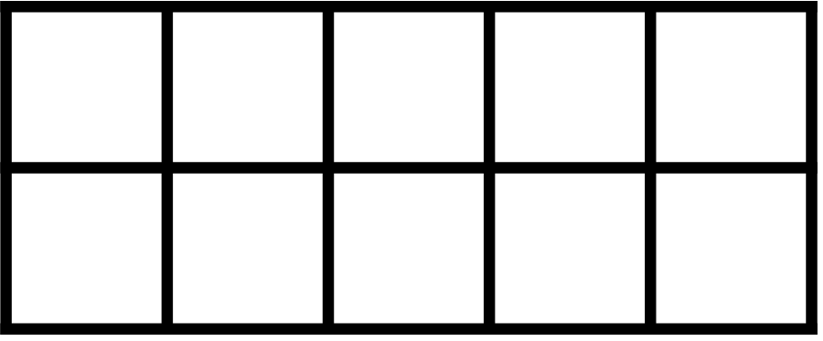
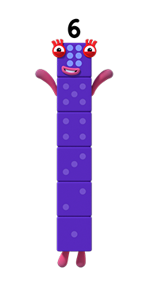
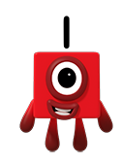
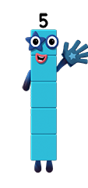

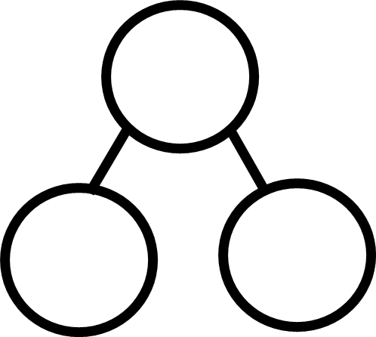




Find the Five in me!
Images © 2017 Alphablocks Ltd. All Rights Reserved.
Notes:
Use the next few slides to compare representations of ‘five and a bit’.
Where is Five in Six? The Numberblobs can help us find Five!
Can we find the five in six on the tens frame? (Clicking on the counters on the top row turns them yellow.)
Look at the part-whole diagram.
What does each number represent? What is the whole? What are the parts?
Say, “6 is made of 5 and 1.”
Can you show me 6 on your fingers so that I can see that 6 is made of 5 and 1?

Slide 13
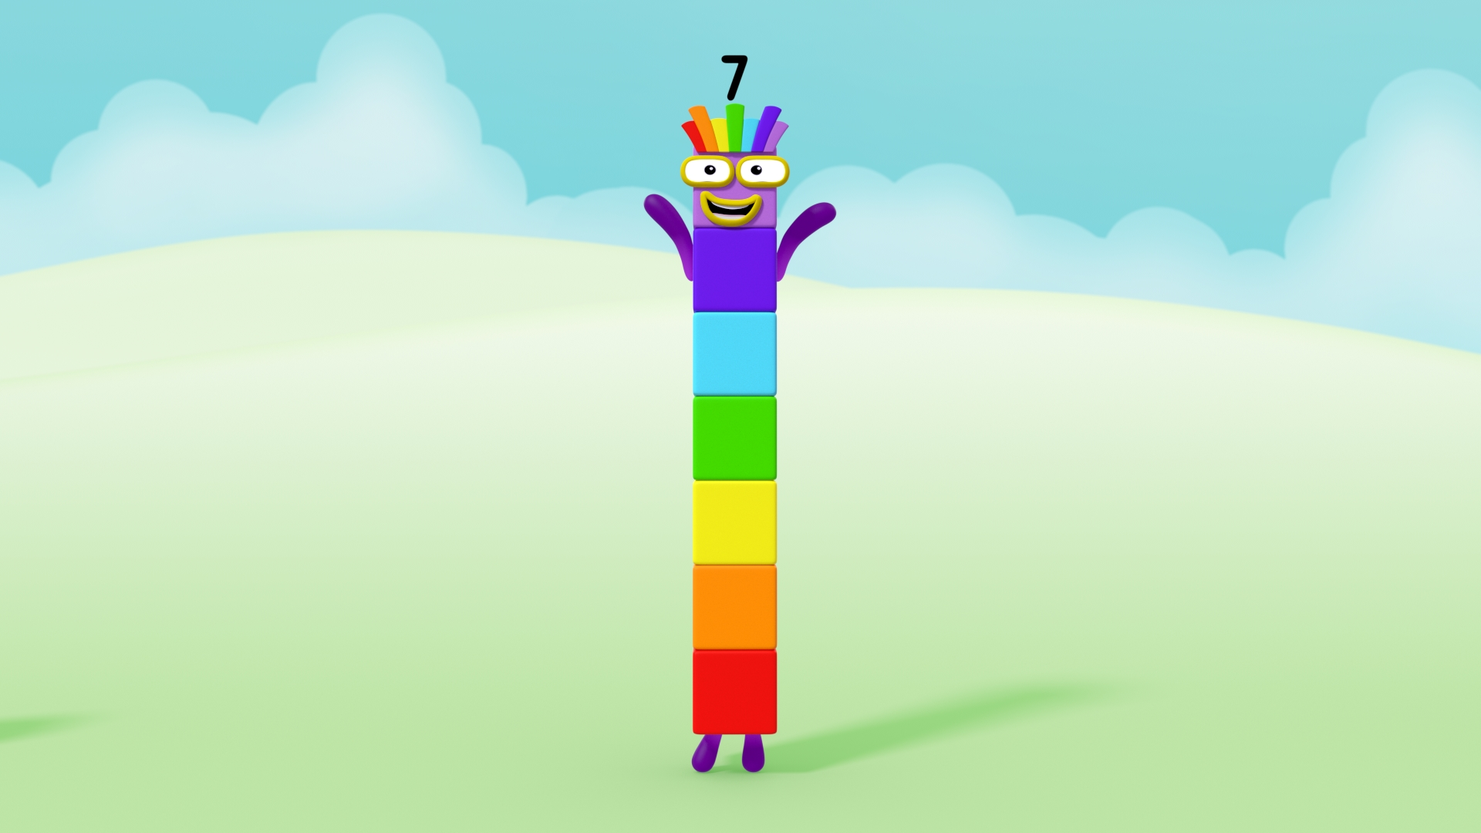
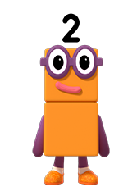
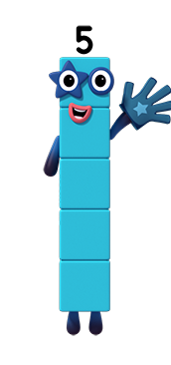


Find the Five in me!
Images © 2017 Alphablocks Ltd. All Rights Reserved.
Notes:
Where is Five in Seven?
Children could make an arrangement of double-sided counters on a tens frame to show 7 as ‘five and a bit’ and record on a part-whole diagram.
Click to reveal the counters and numbers in the part-whole diagram.
Say: “7 is made of 5 and 2.”
Can you show me 7 on your fingers so I can see that 7 is made of 5 and 2?

Slide 14
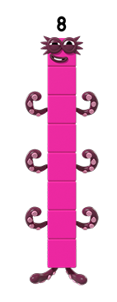
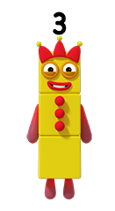


Find the Five in me!
Images © 2017 Alphablocks Ltd. All Rights Reserved.
Notes:
Where is Five in Eight?
Children could make an arrangement of double-sided counters on a tens frame to show 8 as ‘five and a bit’ and record on a part-whole diagram.
Click to reveal the counters and numbers in the part-whole diagram.
Say, “8 is made of 5 and 3.”
Can you show me 8 on your fingers so I can see that it is made of 5 and 3?

Slide 15
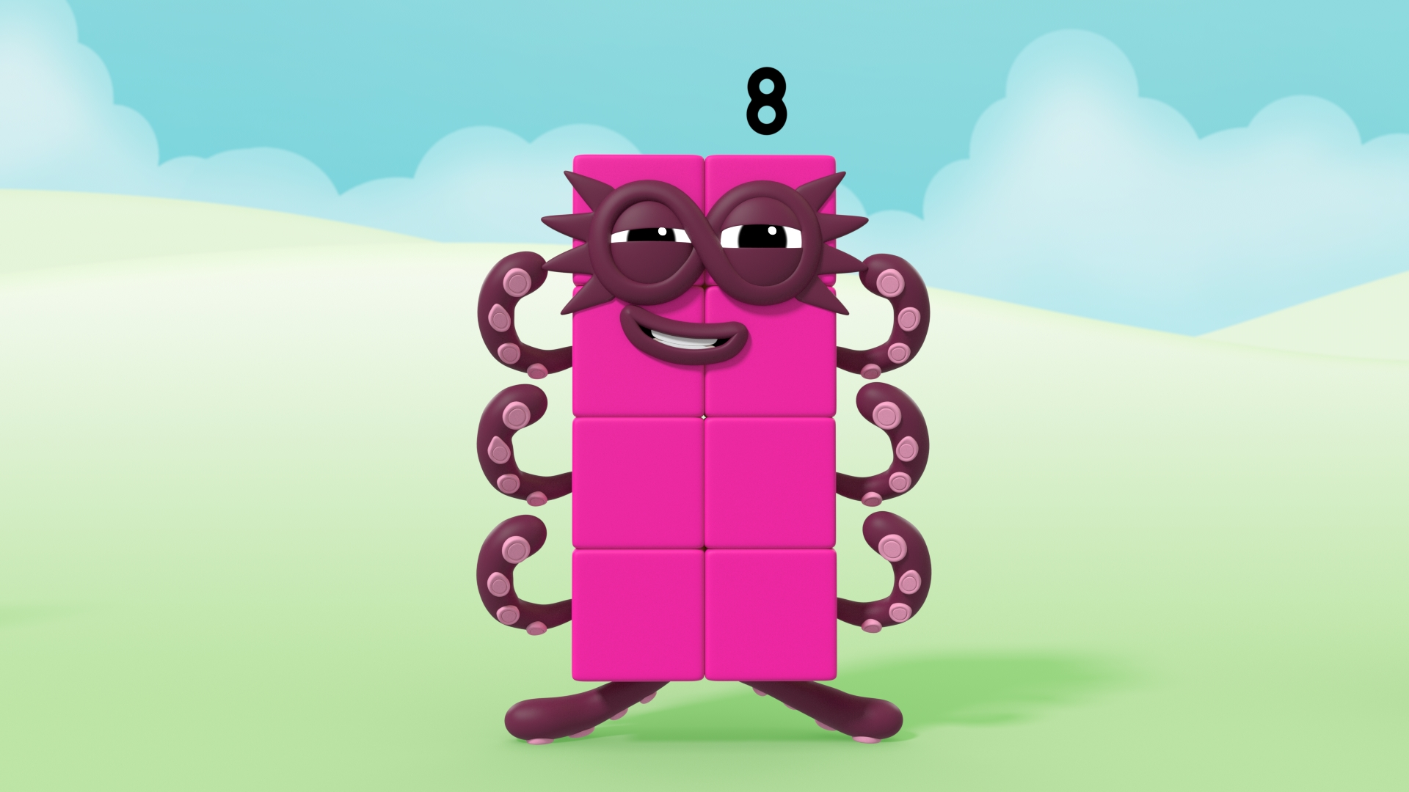
Find the Five in me!
Images © 2017 Alphablocks Ltd. All Rights Reserved.
Notes:
Do you think we can find Five hiding in Octoblock now he has changed shape?
How could Five be arranged in Eight?
How can we find five in the eight counters on the tens frame? Will it be the same as the arrangement of five in Octoblock or different?

Slide 16
Further activities for Y1
Talk about where we see ‘five and a bit’ in everyday life, e.g. seven days in the week, five school days and two days at the weekend.
Practise regularly representing 6, 8, 9 and 10 with fingers (shown first on a tens frame/ ten bead string and then as a spoken number). Support children in learning to do this without counting (subitising). E.g. use a ‘grow it, show it, throw it’ approach, encouraging children to start with five (without counting) and grow the fingers on the other hand to make the given number, until they can just ‘throw it’ without needing to look at their fingers.
Explore finding 5 and its friend in 6, 7, 8, 9 and 10 with different representations e.g. with Numicon.
Record five and its friend using part-part-whole models, e.g the ‘cherry’ diagram or a bar model.
Play matching pairs games with images of representations of tens frames, fingers, Numberblocks for the numbers 6, 7, 8 and 9.
When playing games with two dice, if five is rolled, encourage children to notice it as ‘five and a bit’ to encourage recall of the set of number facts 5 + 1, 5 + 2, 5 + 3, 5 + 4, 5 + 5.

Slide 17
Learning Together in Y2

Slide 18
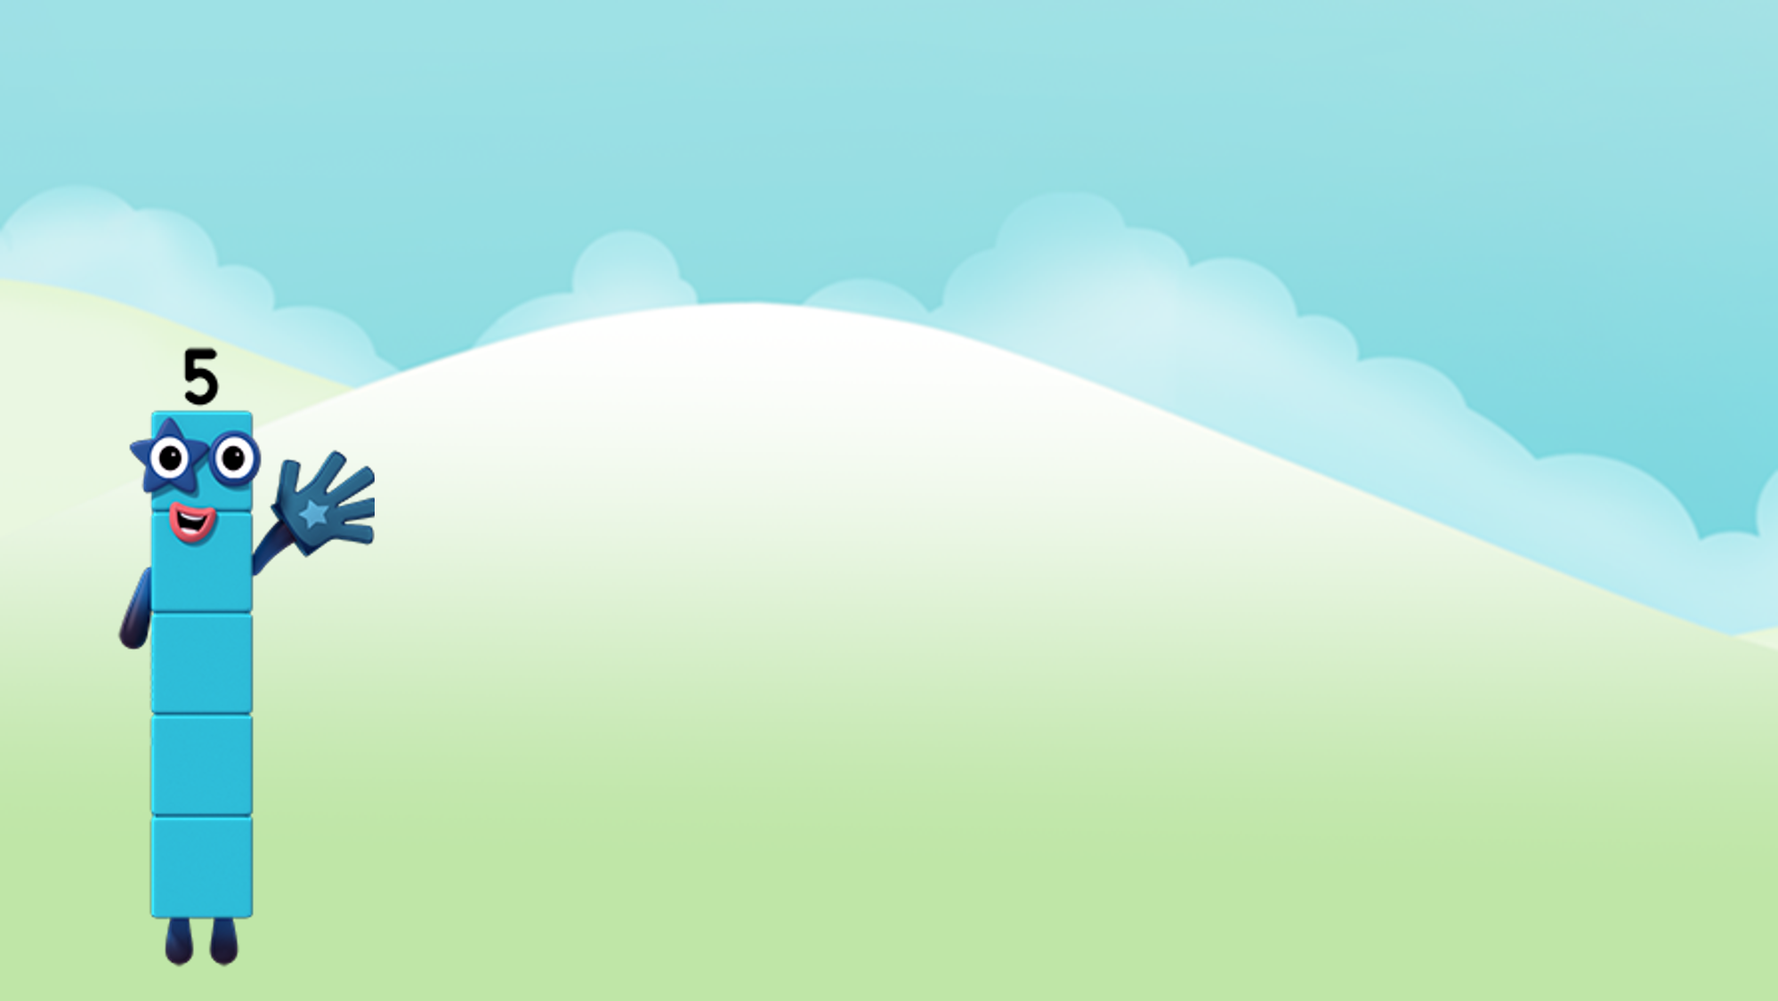
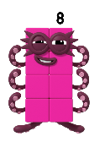


Who’s my friend in Eight?
Images © 2017 Alphablocks Ltd. All Rights Reserved.
Notes:
Use this slide to discuss the complement to 5 to make 8 using different representations.
Ask children to show where the ‘whole’ 8 is and where they can see the ‘part’ which is 5 in each representation.

Slide 19
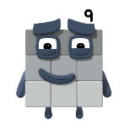


Who’s my friend in Nine?
Images © 2017 Alphablocks Ltd. All Rights Reserved.
Notes:
Use this slide to discuss the complement to 5 to make 9 using different representations.

Slide 20
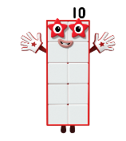
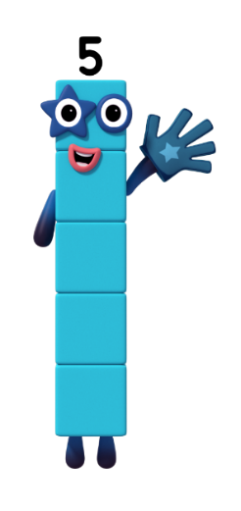

Who’s my friend in Ten?
Images © 2017 Alphablocks Ltd. All Rights Reserved.
Notes:
Use this slide to discuss the complement to 5 to make 10 using different representations.

Slide 21
Further activities for Y2
Using fingers, show the friend for 5 to make 6, 7, 8, 9 and 10 without counting.
Represent with concrete and pictorial representations how to solve problems such as 8 + 5 by partitioning the 8 into 5 and 3.
Rewrite equations of the sort 6 + 8 as 5 + 1 + 5 + 3.
Use 5 and a bit solve addition problems mentally. For example, 7 + 5 is 5 + 5 + 2 which equals 12.
Explore numbers to make this expression correct 5 + o > 5 + o

