Slide 1
2.20 Multiplication with three factors and volume
Representations | Year 5
Multiplication and Division

Slide 2
How to use this presentation
You can find the teacher guide 2.20 Multiplication with three factors and volume by following the link below.

Slide 3
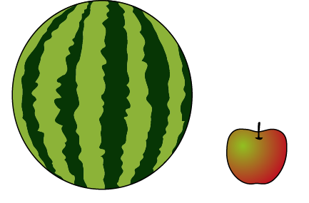
2.20 Multiplying three factors Step 1:1
Notes:
Which takes up more space, the melon or the apple?
The amount of space the ____ takes up is its volume.
The melon has a larger volume than the apple.

Slide 4
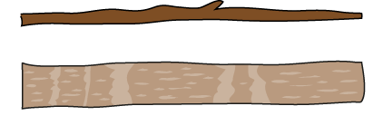
2.20 Multiplying three factors Step 1:2
Notes:
Which stick has a larger volume?

Slide 5

2.20 Multiplying three factors Step 1:2
Notes:
Which book has a larger volume?

Slide 6
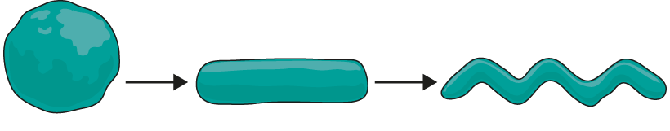
2.20 Multiplying three factors Step 1:3
Notes:
Although objects might look different, they can have the same volume.

Slide 7
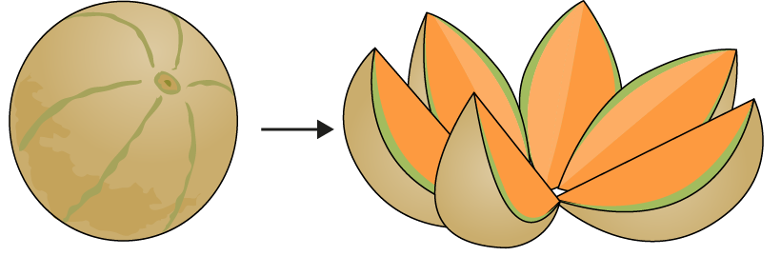
2.20 Multiplying three factors Step 1:3

Slide 8
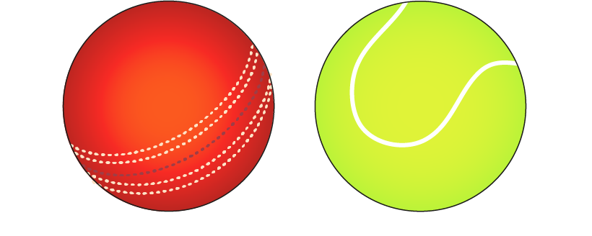
2.20 Multiplying three factors Step 1:4
Notes:
What’s the same and what’s different?
The shape is the same.
The volume is the same.
The mass is different.

Slide 9
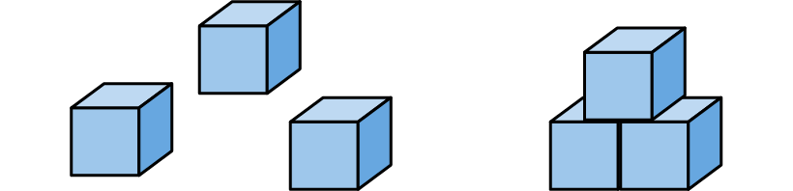
2.20 Multiplying three factors Step 1:5
Notes:
Evie says that the three separate bricks have a larger volume than the stack
of three bricks, because they take up more space when they are separate.
Do you agree or disagree? Explain your answer.

Slide 10
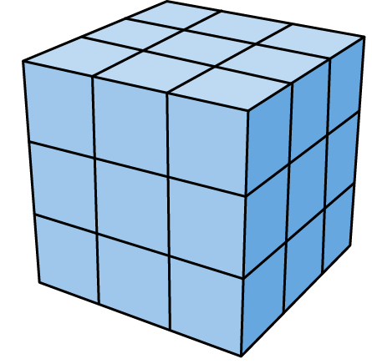
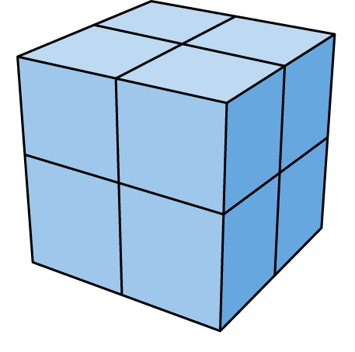
2.20 Multiplying three factors Step 2:1
A: Made using 27 cubes
B: Made using 8 cubes
Notes:
Shape A must be larger because it is made using more cubes. True or false?

Slide 11
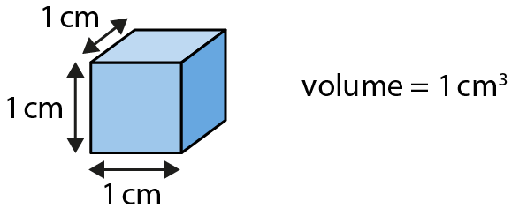
2.20 Multiplying three factors Step 2:2

Slide 12
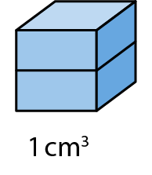
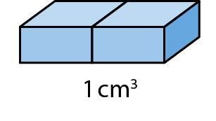
2.20 Multiplying three factors Step 2:3

Slide 13
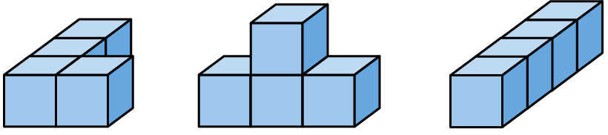
2.20 Multiplying three factors Step 2:4
Notes:
What is the volume of each shape?

Slide 14
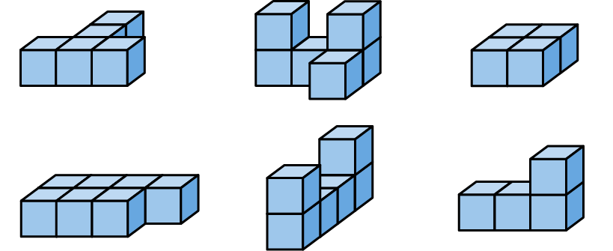
2.20 Multiplying three factors Step 2:5
Notes:
What is the volume of each shape?

Slide 15
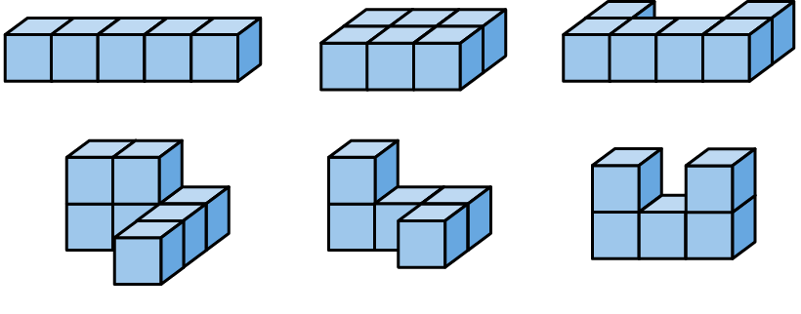
2.20 Multiplying three factors Step 2:5
Notes:
Which of these shapes have a volume of 6 cm³?

Slide 16
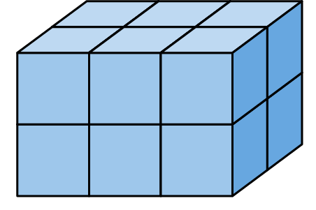
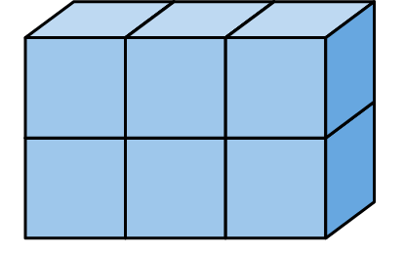
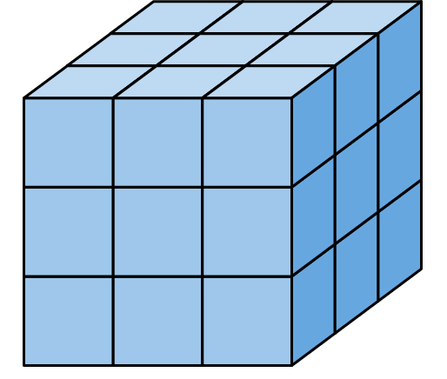
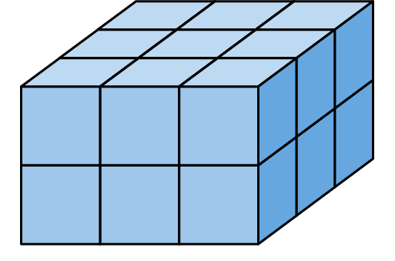
2.20 Multiplying three factors Step 2:6
6 cm³
12 cm³
18 cm³
27 cm³
Notes:
Count the small cubes to find the volume of each shape.
What’s the same?
The width
The size of each small cube
What’s different?
The volume

Slide 17
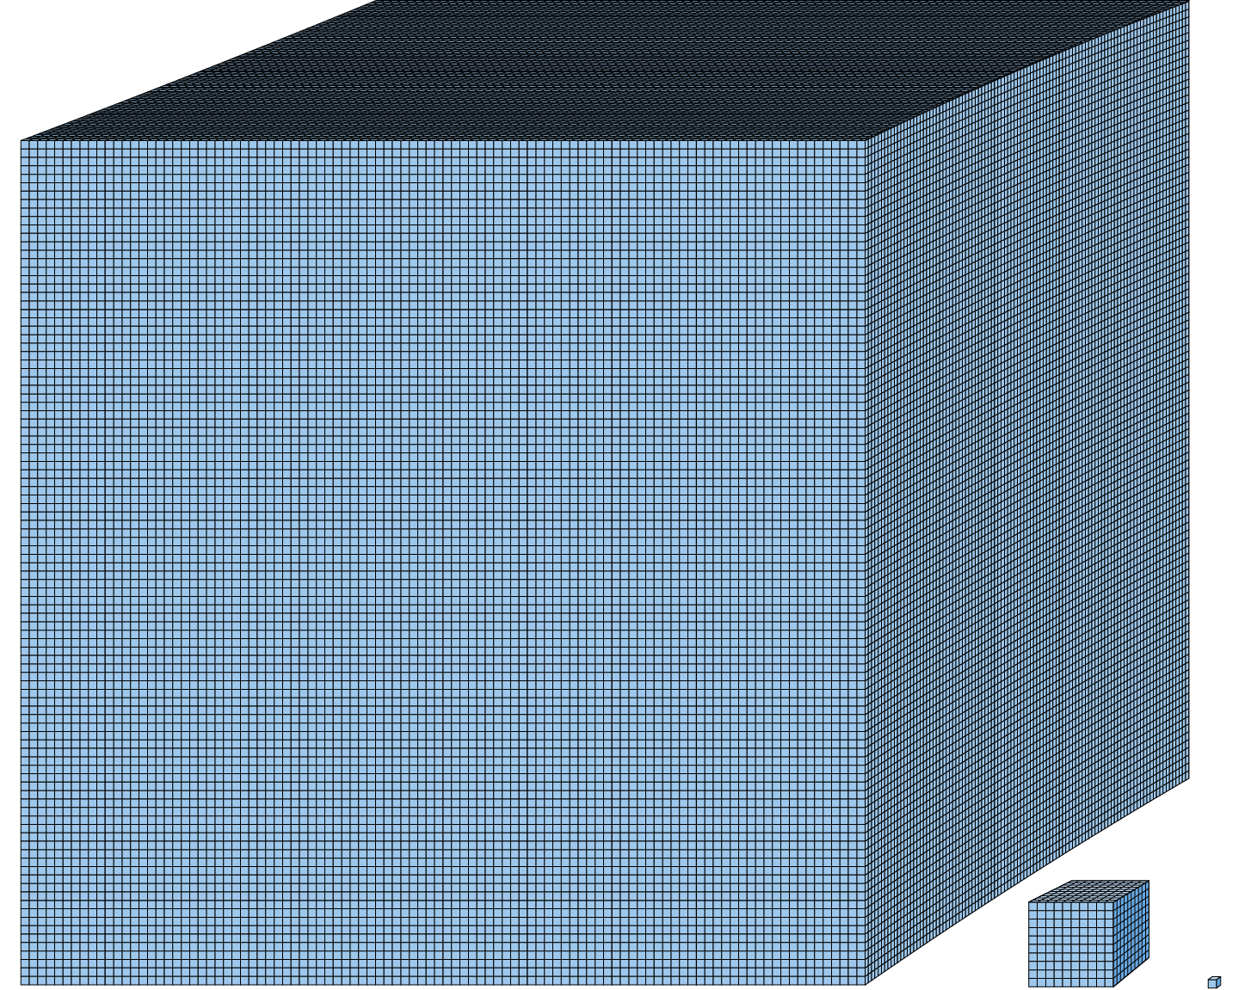
2.20 Multiplying three factors Step 2:8
1,000,000 cm³ (or 1 m³)
1,000 cm³
1 cm³

Slide 18
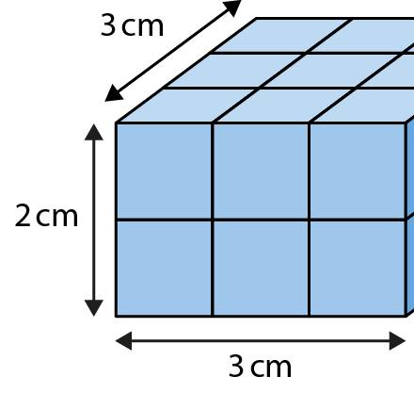
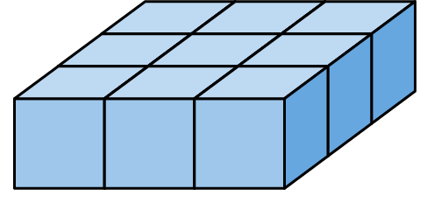
2.20 Multiplying three factors Step 3:2
What is the volume of this cuboid?
18 cm³
9 cm³
3 × 3 = 9
9 × 2 = 18
3 cm × 3 cm × 2 cm = 18 cm³

Slide 19
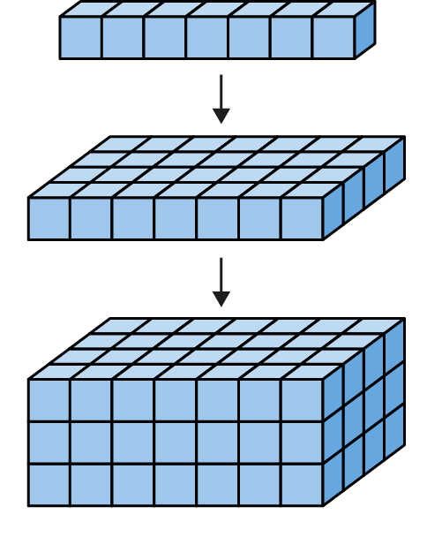
2.20 Multiplying three factors Step 3:2
Notes:
What is the volume of this cuboid?
7 cm × 4 cm × 3 cm = 84 cm³

Slide 20
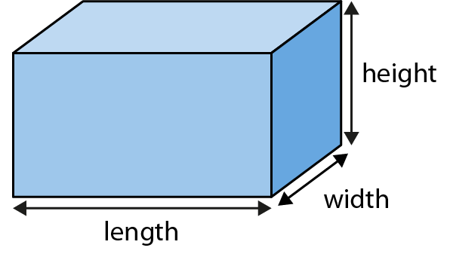
2.20 Multiplying three factors Step 3:3
Notes:
Finding the volume of a cuboid

Slide 21
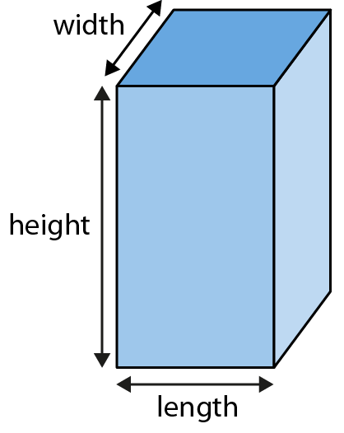
2.20 Multiplying three factors Step 3:4

Slide 22
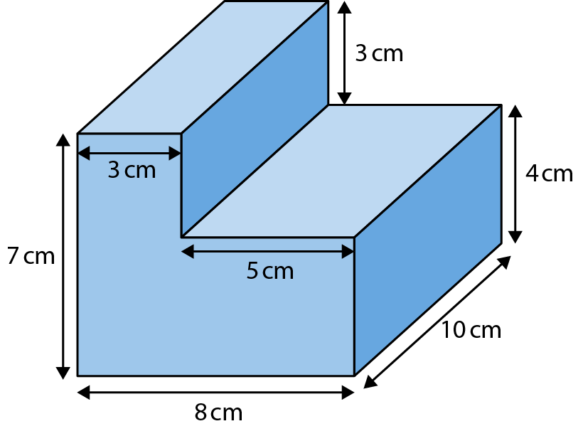
2.20 Multiplying three factors Step 3:10
Notes:
What is the volume of this shape?
Cuboid 1: 7 cm × 3 cm × 10 cm
Cuboid 1: 5 cm × 4 cm × 10 cm
V = 7 cm × 3 cm × 10 cm + 5 cm × 4 cm × 10 cm
V = 410 cm³

Slide 23
2.20 Multiplying three factors Step 3:10
Notes:
Cuboid 1: 3 cm × 3 cm × 10 cm
Cuboid 2: 8 cm × 4 cm × 10 cm
V = 3 cm × 3 cm × 10 cm + 8 cm × 4 cm × 10 cm
V = 410 cm³

Slide 24
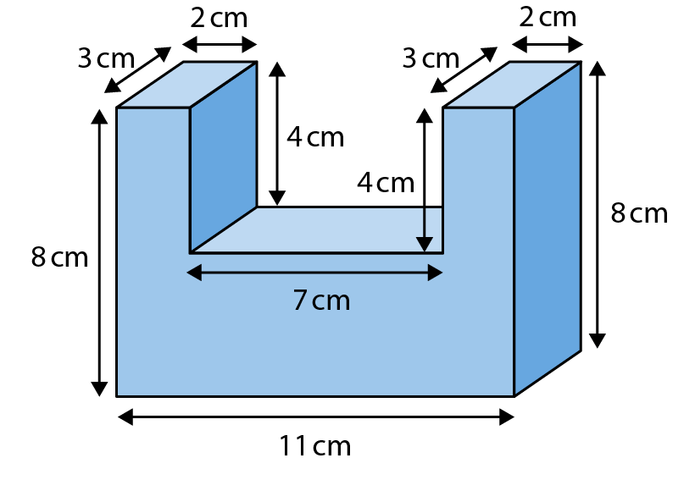
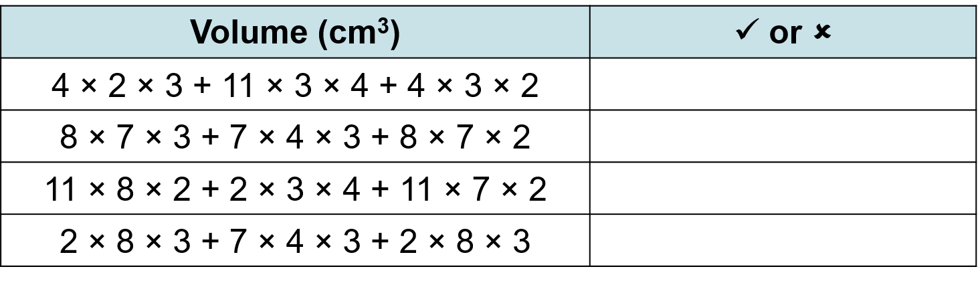
2.20 Multiplying three factors Step 3:10
What is the volume of this shape?

Slide 25
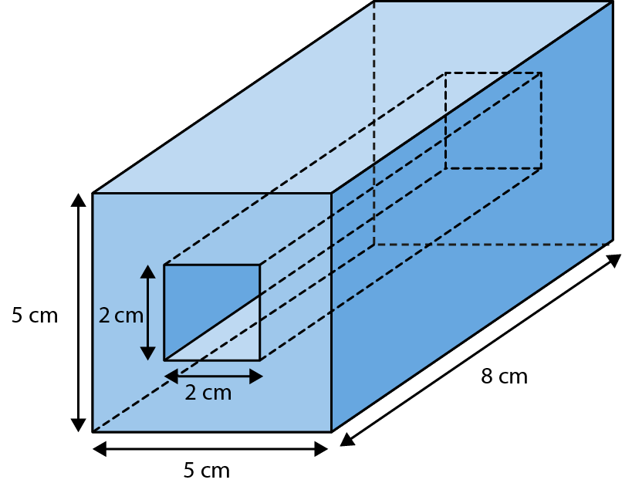
2.20 Multiplying three factors Step 3:11
Notes:
This cuboid has a hole in the middle.
Find the volume of the surrounding shape.

Slide 26
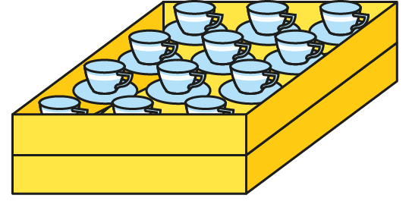
2.20 Multiplying three factors Step 4:1
If we stack up two trays,
how many teacups will there be in total?

Slide 27
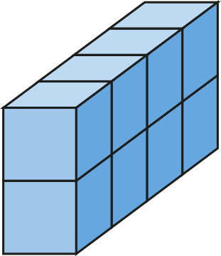
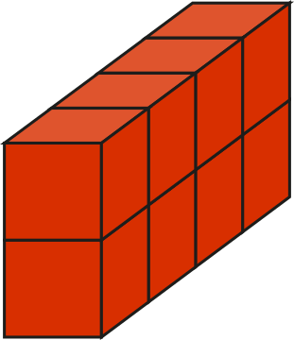
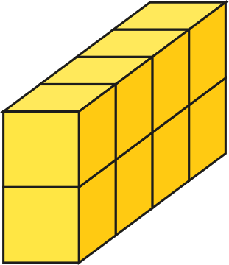
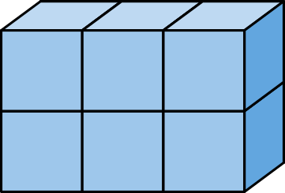
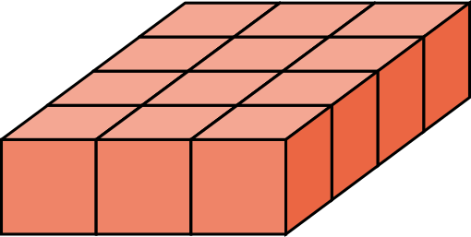
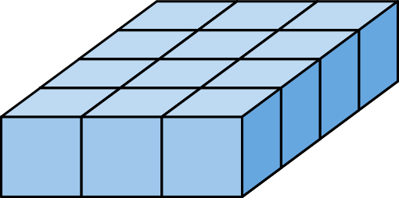
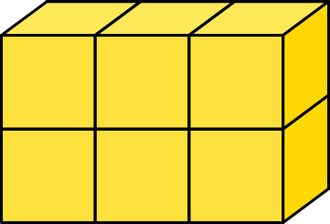
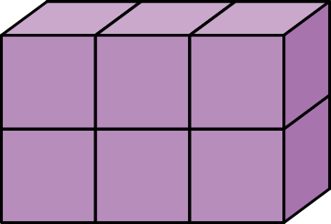
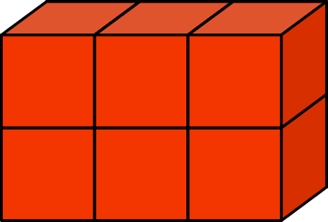
2.20 Multiplying three factors Step 4:2
How many cubes are there?
3 × 4
4 × 2
3 × 2
× 2
× 3
× 4
= 12 × 2
= 6 × 4
= 8 × 3
= 24
= 24
= 24

Slide 28




2.20 Multiplying three factors Step 5:2
18 × 5
= 9 × 2 × 5
5 × 2 × 9 = 10 × 9
= 90
Notes:
An equation can be made easier to solve by expressing
one of the factors as a multiplication of two factors.
We could think of 18 as 9 × 2.
We could choose to multiply 2 × 5 first,
to get 10, and then work out 9 × 10 = 90.

