Slide 1
1.11 Addition: three single-digit numbers and bridging ten
Representations | Year 2
Number, Addition and Subtraction

Slide 2
How to use this presentation
You can find the teacher guide 1.11 Addition: three single-digit numbers and bridging ten by following the link below.

Slide 3
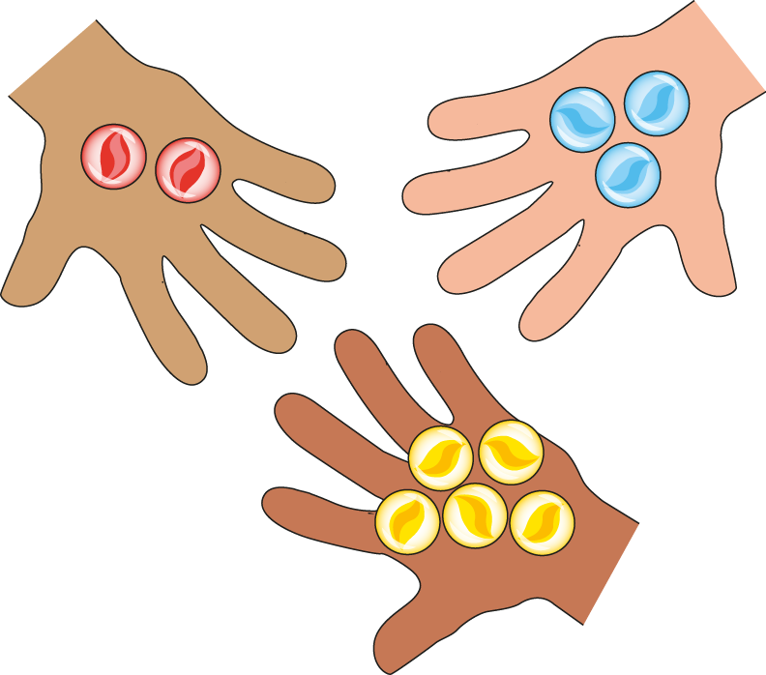
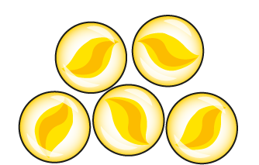
1.11 Addition: three numbers and bridging 10 – step 1:1
2 + 3 + 5
= 10

Slide 4
1.11 Addition: three numbers and bridging 10 – step 1:1
6 + 0 + 3
= 9
Notes:
The children play a game. Now Madison has six marbles, Charlie has no marbles and Asif has three marbles. They have nine marbles altogether.

Slide 5
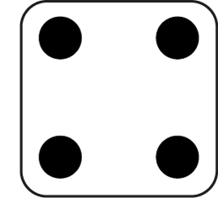
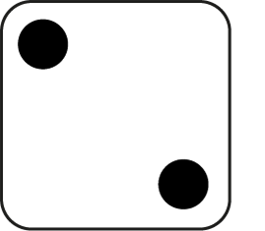
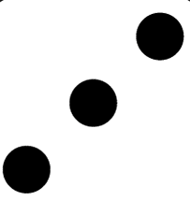
1.11 Addition: three numbers and bridging 10 – step 1:1
2
+
3
+
4
= 9

Slide 6
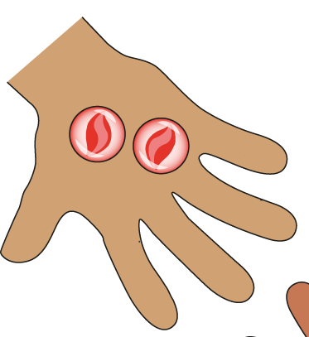
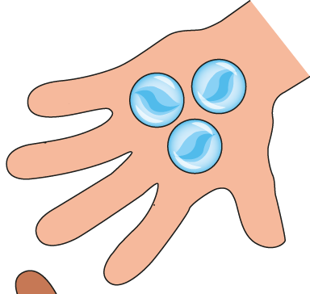
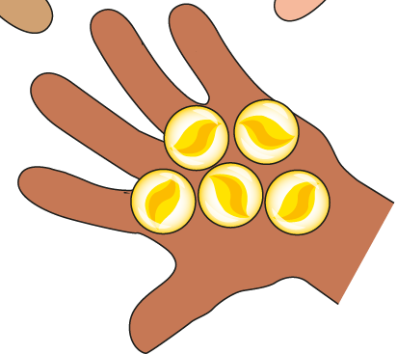
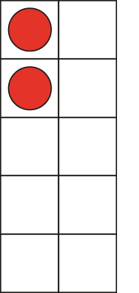
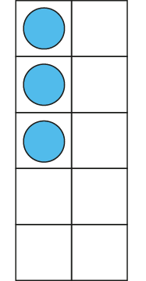
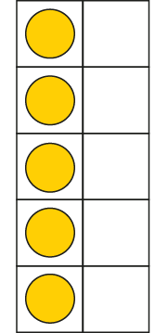
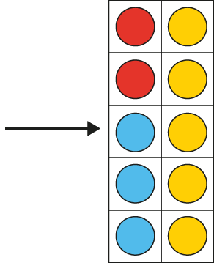
1.11 Addition: three numbers and bridging 10 – step 1:2
2 + 3 + 5
= 10

Slide 7
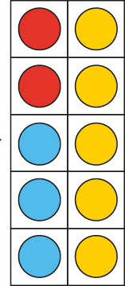
1.11 Addition: three numbers and bridging 10 – step 1:2
10 = 2 + 3 + 5
Notes:
Madison has two red marbles, Charlie has three blue marbles and Asif has five yellow marbles. They have ten marbles altogether.

Slide 8
1.11 Addition: three numbers and bridging 10 – step 1:3
2 + 3 + 5
= 10
Notes:
Madison has two red marbles, Charlie has three blue marbles and Asif has five yellow marbles. They have ten marbles altogether.

Slide 9
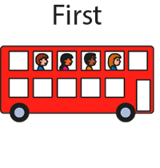
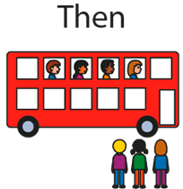
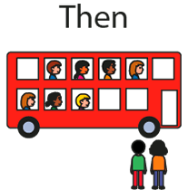
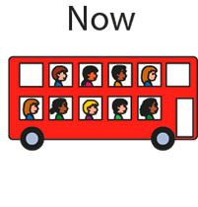
1.11 Addition: three numbers and bridging 10 – step 2:1

Slide 10
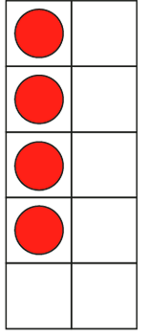
1.11 Addition: three numbers and bridging 10 – step 2:2
First, four children were sitting on a bus.
Then, three more children got on the bus…
… and then two more children got on.
Now, nine children are sitting on the bus.

Slide 11
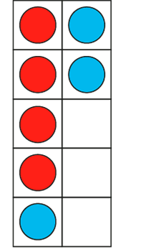
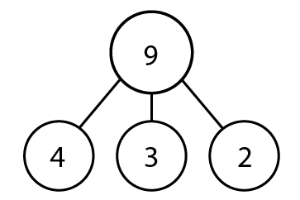
1.11 Addition: three numbers and bridging 10 – step 2:2
9 = 4 + 3 + 2

Slide 12
1.11 Addition: three numbers and bridging 10 – step 2:3
4 + 3 + 2 = 9

Slide 13
1.11 Addition: three numbers and bridging 10 – step 2:4
Notes:
A snail is two centimetres up a flower stalk. Then it crawls up four centimetres, and then one centimetre more. How high up the stalk is it now?’

Slide 14
1.11 Addition: three numbers and bridging 10 – step 2:5
Which equation matches this number line?
3 + 3 = 6
0 + 3 + 3 = 6
3 + 3 + 6 = 12

Slide 15
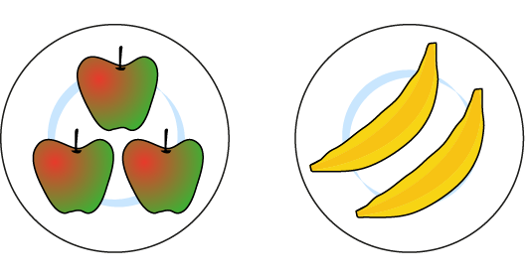
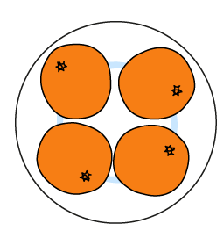
1.11 Addition: three numbers and bridging 10 – step 3:1
3 + 2
+ 4
5
+ 4
3 + 2
+ 4 =
+ 4
= 9
5

Slide 16
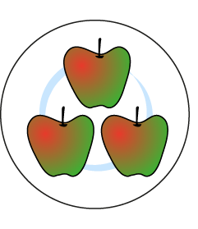
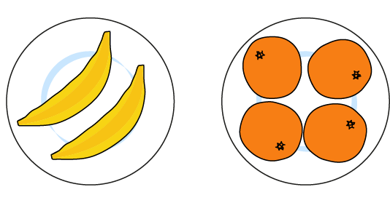
1.11 Addition: three numbers and bridging 10 – step 3:1
3 +
2 + 4
3 +
6
= 9
6
3 +
2 + 4
=
3 +

Slide 17
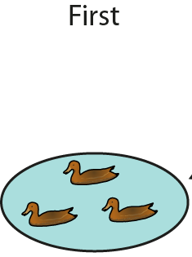
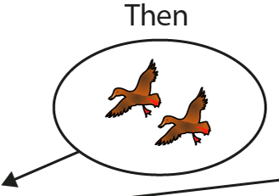
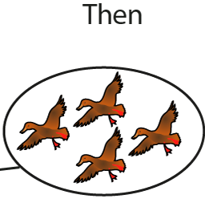
1.11 Addition: three numbers and bridging 10 – step 3:2

Slide 18
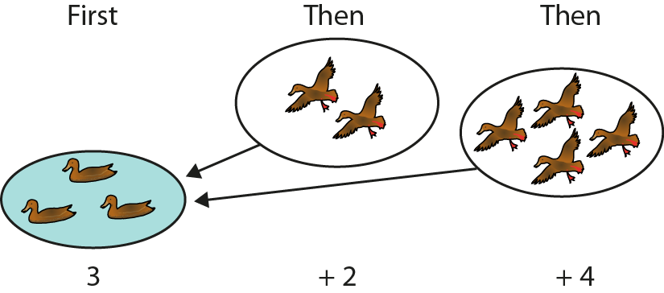
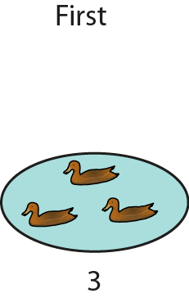
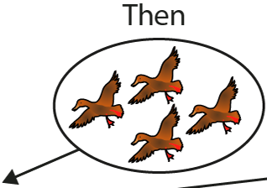
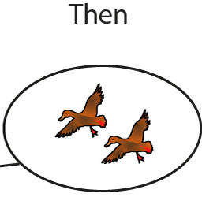
1.11 Addition: three numbers and bridging 10 – step 3:2
3 + 2 + 4 = 3 + 4 + 2

Slide 19
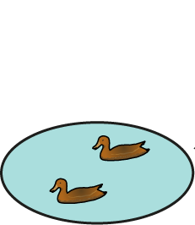
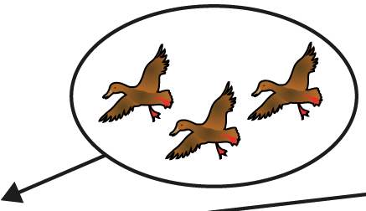
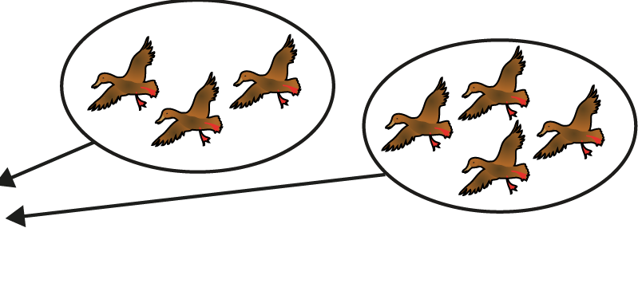
1.11 Addition: three numbers and bridging 10 – step 3:2
3 + 2 + 4 = 2 + 3 + 4

Slide 20
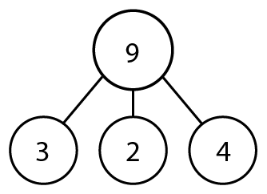
1.11 Addition: three numbers and bridging 10 – step 3:3

Slide 21
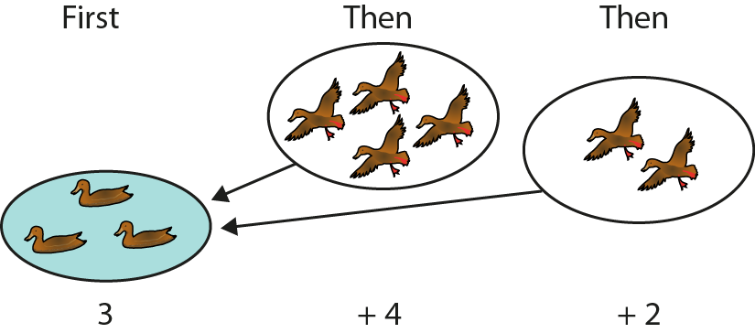
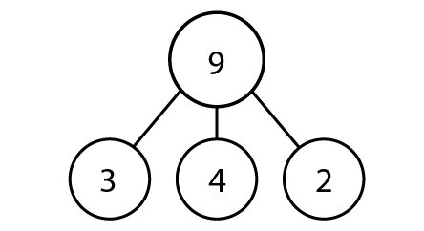
1.11 Addition: three numbers and bridging 10 – step 3:3

Slide 22
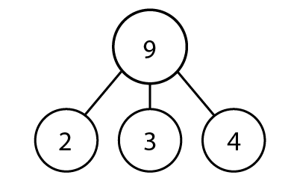
1.11 Addition: three numbers and bridging 10 – step 3:3
2

Slide 23
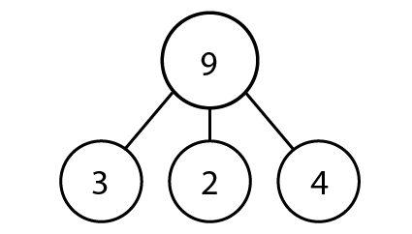
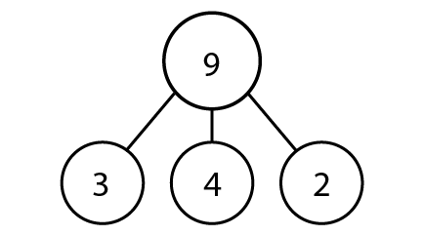
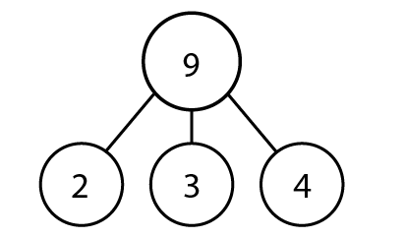
1.11 Addition: three numbers and bridging 10 – step 3:3

Slide 24
1.11 Addition: three numbers and bridging 10 – step 3:4
3 + 2 + 4
= 2 + 4 + 3

Slide 25
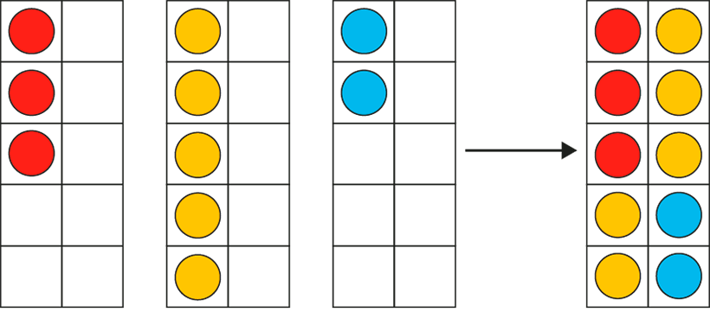
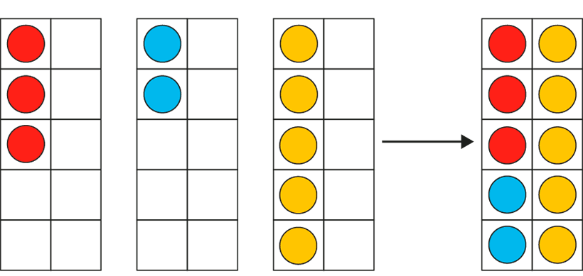
1.11 Addition: three numbers and bridging 10 – step 4:1
Notes:
In my toy box, I have three red cars, five yellow cars and two blue cars. I have ten cars altogether.’

Slide 26
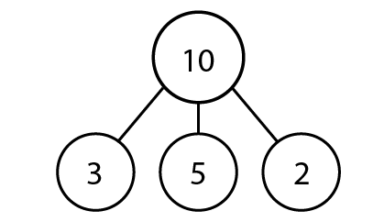
1.11 Addition: three numbers and bridging 10 – step 4:2

Slide 27
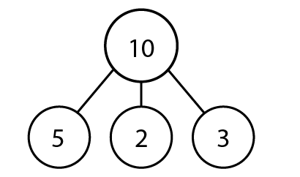
1.11 Addition: three numbers and bridging 10 – step 4:2

Slide 28
1.11 Addition: three numbers and bridging 10 – step 4:3
6
9
2 + 4 + 3 = + 3 =

Slide 29
1.11 Addition: three numbers and bridging 10 – step 4:3
5
9
2 + 4 + 3 = + 4 =

Slide 30
1.11 Addition: three numbers and bridging 10 – step 4:3
7
9
2 + 4 + 3 = + 2 =

Slide 31
1.11 Addition: three numbers and bridging 10 – step 4:3
3
4
7
2 + 1 + 4 = + =

Slide 32
1.11 Addition: three numbers and bridging 10 – step 4:3
2
5
7
2 + 1 + 4 = + =

Slide 33
1.11 Addition: three numbers and bridging 10 – step 4:3
6
1
7
2 + 1 + 4 = + =

Slide 34
1.11 Addition: three numbers and bridging 10 – step 4:4
Fill in the missing squares, using the numbers 0, 1, 2, 4, 5 and 6, so that each row and column adds up to the same number.
4
5
0
3
3
3
2
1
6

Slide 35
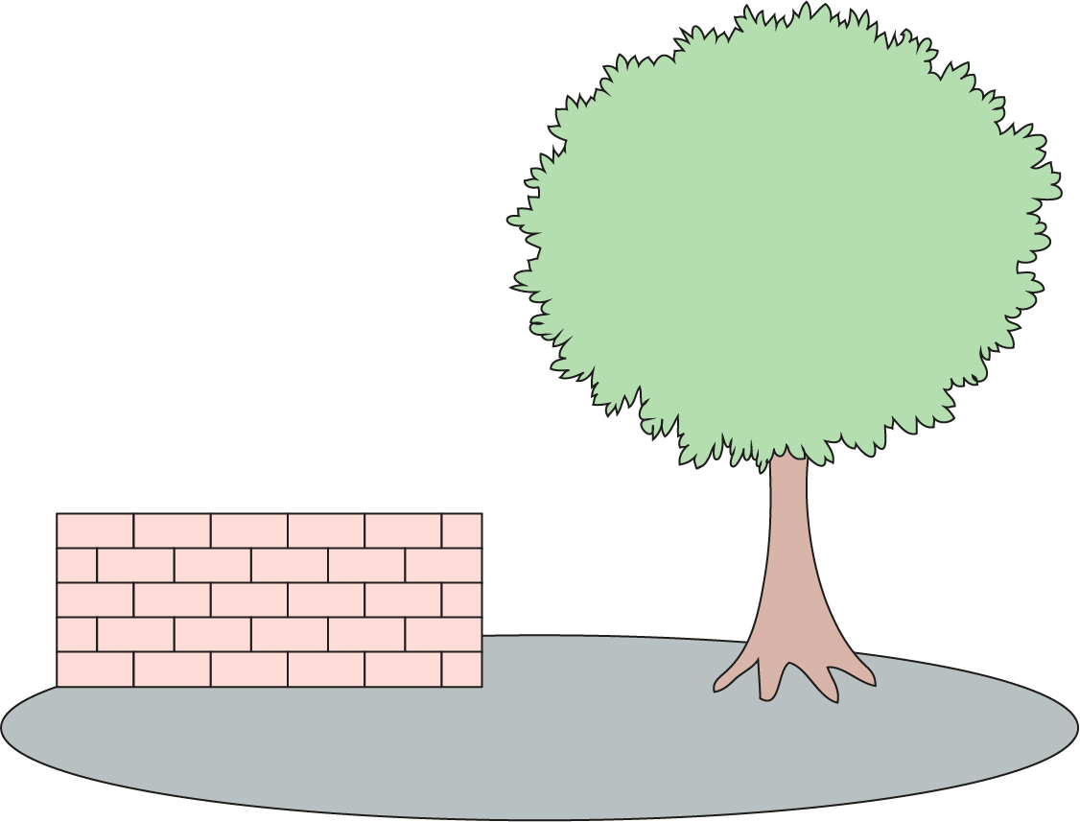
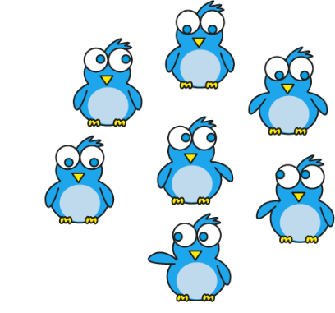
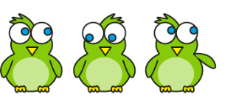
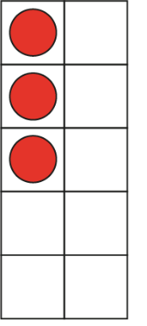
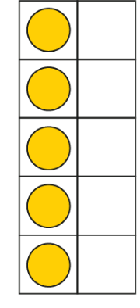
1.11 Addition: three numbers and bridging 10 – step 4:5
5
+ 10
3
+ 5
+ 7
= 5 + 10
3
+ 5
+ 7

Slide 36
1.11 Addition: three numbers and bridging 10 – step 4:6
5 + 6 + 5 =
16

Slide 37
1.11 Addition: three numbers and bridging 10 – step 4:6
3 + 3 + 7 =
13

Slide 38
1.11 Addition: three numbers and bridging 10 – step 4:6
7 + 4 + 3 =
14

Slide 39
1.11 Addition: three numbers and bridging 10 – step 4:6
8 + 4 + 2 =
14

Slide 40
1.11 Addition: three numbers and bridging 10 – step 4:6
2 + 8 + 6 =
16

Slide 41
1.11 Addition: three numbers and bridging 10 – step 4:7
7 + 5 + 5
4 + 8 + 5
7 + 6 + 2
1 + 3 + 9
Can make 10 | Cannot make 10

Slide 42
1.11 Addition: three numbers and bridging 10 – step 4:9
Notes:
Ask questions such as ‘How many sweets do Jayesh, Sam and Sara have together?’ (2 + 6 + 8).

Slide 43
1.11 Addition: three numbers and bridging 10 – step 5:1
7 + 5
= 7 + 3 + 2
= 10 + 2
Notes:
A ride at the funfair has ten seats in each carriage. You have to fill up the whole carriage before children can get in a new one. There are seven children in the first carriage. Five more get on. How many children are there altogether?’
‘Three children can get in the first carriage and two children get in the next carriage.

Slide 44
1.11 Addition: three numbers and bridging 10 – step 5:2
7
+
5
3
2
7 + 3
= 10
10 + 2
= 12

Slide 45
1.11 Addition: three numbers and bridging 10 – step 5:4

Slide 46
1.11 Addition: three numbers and bridging 10 – step 6:1

Slide 47
1.11 Addition: three numbers and bridging 10 – step 6:1
− 4
− 2
− 2
8
10
12

Slide 48
1.11 Addition: three numbers and bridging 10 – step 6:1

Slide 49
1.11 Addition: three numbers and bridging 10 – step 6:1
2
2
12 −
2
= 10
10 −
2
= 8
12 −
4
= 8

Slide 50
1.11 Addition: three numbers and bridging 10 – step 6:2

Slide 51
1.11 Addition: three numbers and bridging 10 – step 6:2
4
10
2
10
−
4
=
6
6
+
2
= 8
12 −
4
= 8

Slide 52
1.11 Addition: three numbers and bridging 10 – step 6:3
12 − 4 = 8
12 −
10
−
4
= 6
2
= 10
6
2
= 8
10 −
+
2
= 8
12 −
4
= 8
12 −
4
= 8

Slide 53
1.11 Addition: three numbers and bridging 10 – step 6:4
15 − 9
5
4
15
− 5
= 10
10
− 4
= 6
15
− 9
= 6

Slide 54
1.11 Addition: three numbers and bridging 10 – step 6:4
− 9
− 4
− 5
6
10
15

Slide 55
1.11 Addition: three numbers and bridging 10 – step 6:4

Slide 56
1.11 Addition: three numbers and bridging 10 – step 6:4
15 − 9
10
5
15
= 1
10
− 9
1
+ 5
= 6
15
− 9
= 6

Slide 57
1.11 Addition: three numbers and bridging 10 – step 6:4
15 − 9 = 6
5
= 10
15 −
10
−
9
= 1
4
= 6
5
= 6
10 −
1
+
9
= 6
9
= 6
15 −
15 −

Slide 58
1.11 Addition: three numbers and bridging 10 – step 6:5
12 − 3
= 9
2
= 10
12 −
10 −
1
= 9

Slide 59
1.11 Addition: three numbers and bridging 10 – step 6:5
= 6
14 − 8
8
= 2
10 −
2 +
4
= 6

Slide 60
1.11 Addition: three numbers and bridging 10 – step 6:5

Slide 61
1.11 Addition: three numbers and bridging 10 – step 6:5

Slide 62
1.11 Addition: three numbers and bridging 10 – step 6:5

