Slide 1
1.5 Additive structures: introduction to aggregation and partitioning
Representations | Year 1
Number, Addition and Subtraction

Slide 2
How to use this presentation
You can find the teacher guide 1.5 Additive structures: introduction to aggregation and partitioning by following the link below.

Slide 3

1.5 Aggregation and partitioning – step 1:1
4
+
5

Slide 4
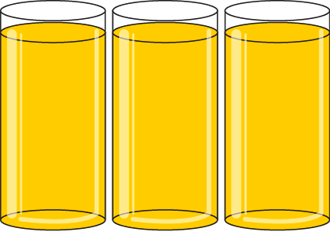
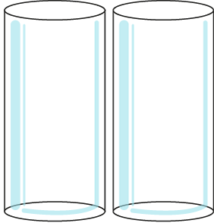
1.5 Aggregation and partitioning – step 1:2
3
+
2

Slide 5

1.5 Aggregation and partitioning – step 1:2
2
+
4
4
+
2

Slide 6

1.5 Aggregation and partitioning – step 1:2
4
+
3
3
+
4

Slide 7


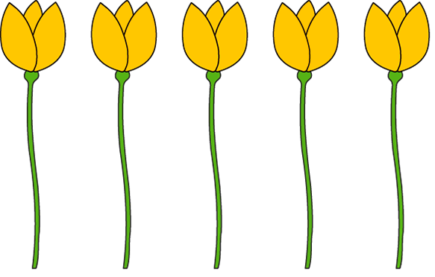

1.5 Aggregation and partitioning – step 1:3
5
+
2
2
+
5

Slide 8
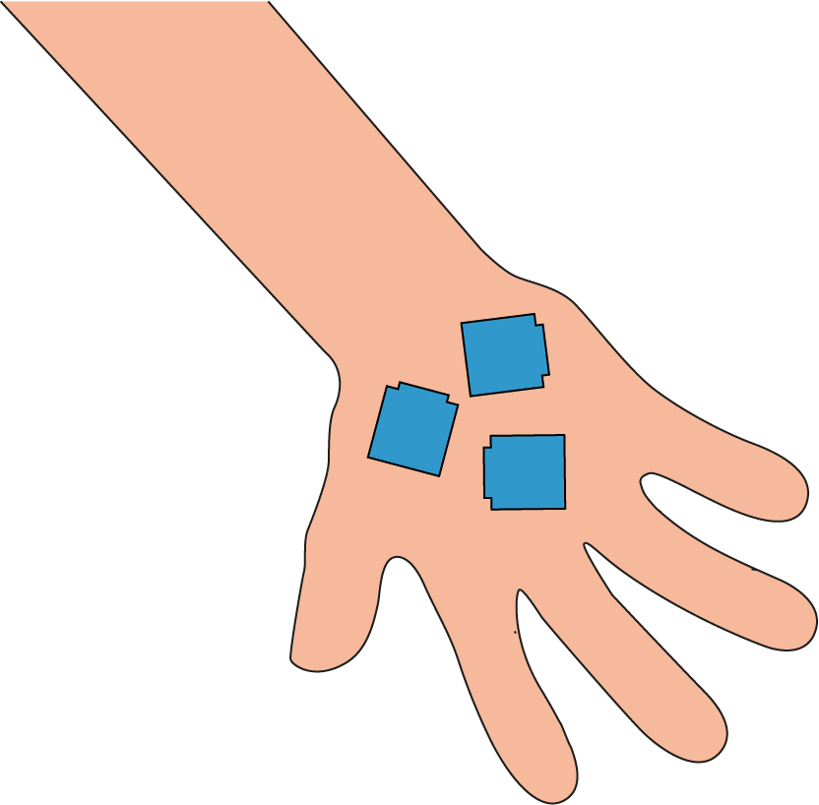
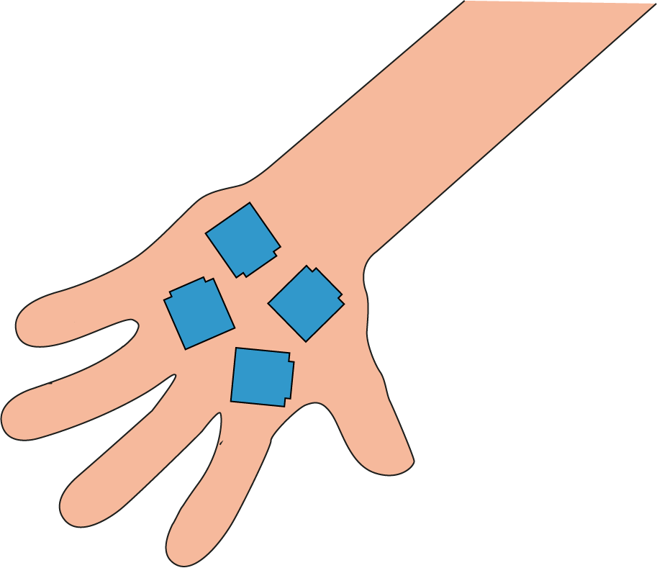
1.5 Aggregation and partitioning – step 1:4
3
+
4

Slide 9
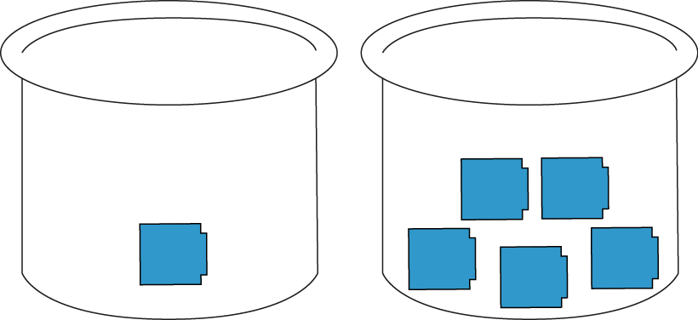
1.5 Aggregation and partitioning – step 1:4
1
+
5
5
+
1

Slide 10







1.5 Aggregation and partitioning – step 1:6
2
5
+
+
5
5
2
4
+
+
3
2
3
+
4
2
+
5

Slide 11





1.5 Aggregation and partitioning – step 2:1
5
=
2
+
3
2
+
3
=
5

Slide 12
1.5 Aggregation and partitioning – step 2:1
2
3
5
+
+
=
3
2
3
=
=
+
5
5
2

Slide 13
1.5 Aggregation and partitioning – step 2:1
2
2
+
+
5
5
3
=
5
4
+
+
3
2
5
=
2
+
3
3
+
2
=
5
5
=
3
=
2

Slide 14
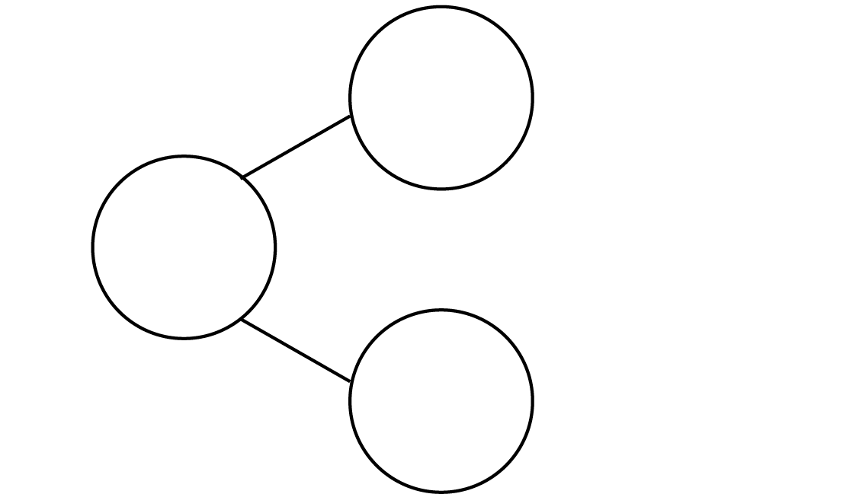





1.5 Aggregation and partitioning – step 2:2
3
5
2

Slide 15
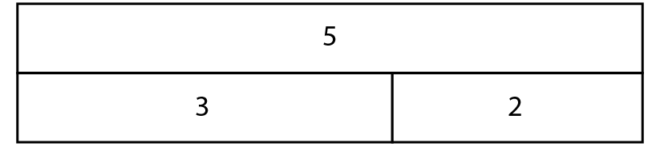


1.5 Aggregation and partitioning – step 2:2
5
3
2

Slide 16
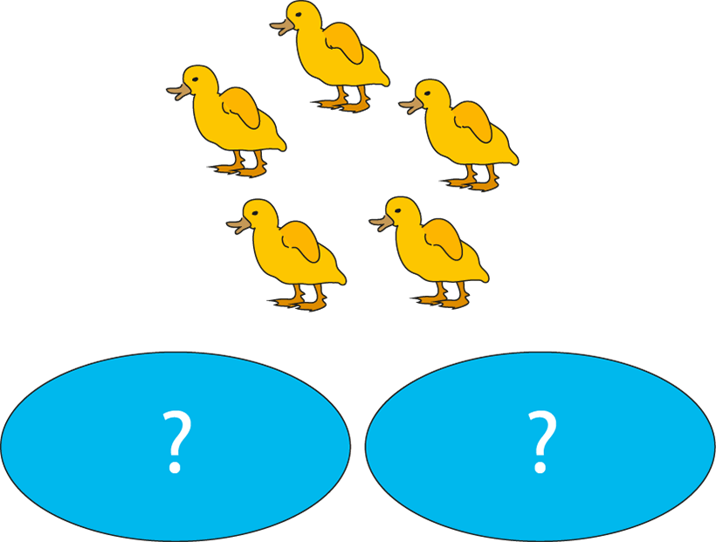
1.5 Aggregation and partitioning – step 2:3

Slide 17


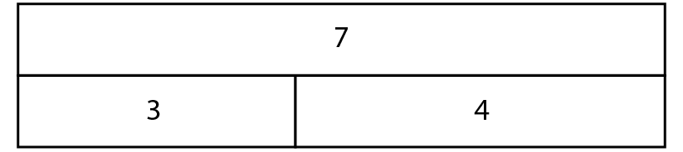
1.5 Aggregation and partitioning – step 2:4

Slide 18



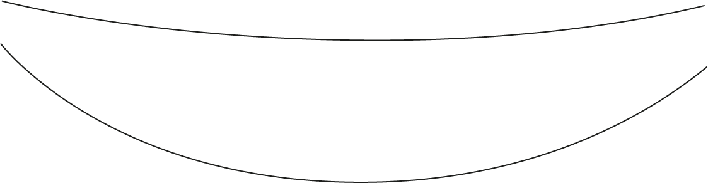






1.5 Aggregation and partitioning – step 2:5
9
4
9
=
+
=
3
5
3
+
=
+
6
9
2
6
9
+
=
3
3
=
+
5
6
4
+
5
=
9

Slide 19
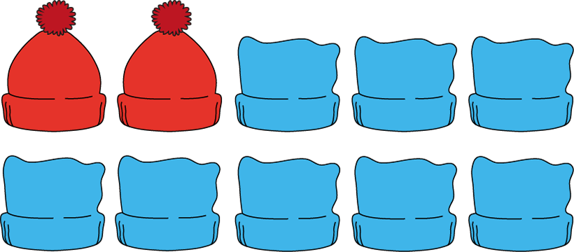

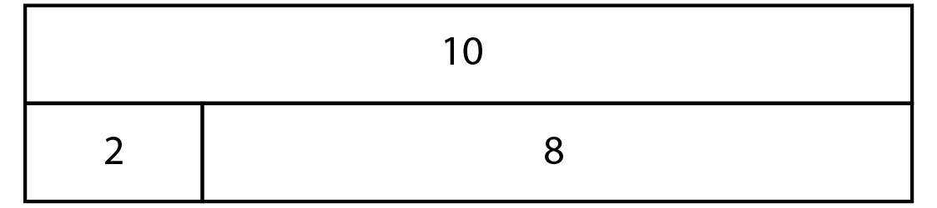
1.5 Aggregation and partitioning – step 3:1
?
?

Slide 20

1.5 Aggregation and partitioning – step 3:2
8
3
5

Slide 21

1.5 Aggregation and partitioning – step 3:2
3
+
5
=
8
5
+
3
=
8
8
=
3
+
5
8
=
5
+
3

Slide 22
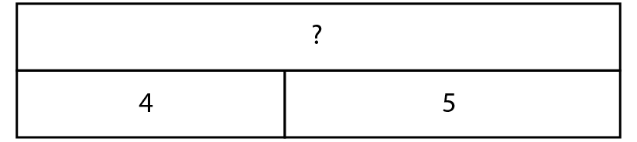
1.5 Aggregation and partitioning – step 3:2

Slide 23


1.5 Aggregation and partitioning – step 3:2
4
+
5
=
9
5
+
4
=
9
9
=
4
+
5
9
=
5
+
4

Slide 24

1.5 Aggregation and partitioning – step 3:3
3
+
3
=
6
4
+
3
=
7
5
=
4
+
1
8
=
4
+
3

Slide 25

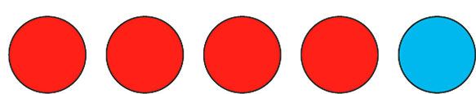



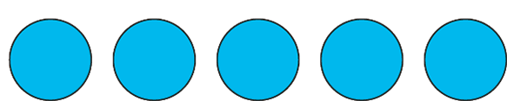
1.5 Aggregation and partitioning – step 3:4
5
=
5
+
0
5
=
4
+
1
5
=
3
+
2
5
=
2
+
3
5
=
1
+
4
5
=
0
+
5

Slide 26
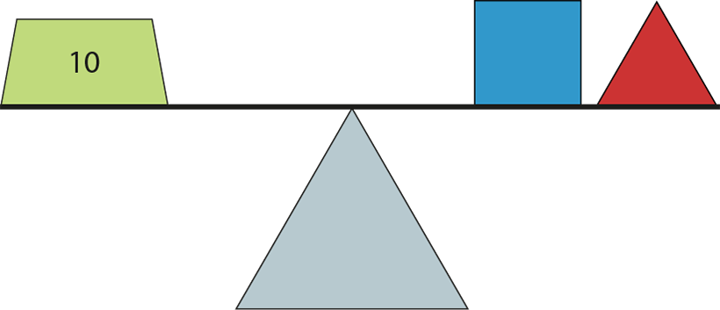
1.5 Aggregation and partitioning – step 3:6

Slide 27
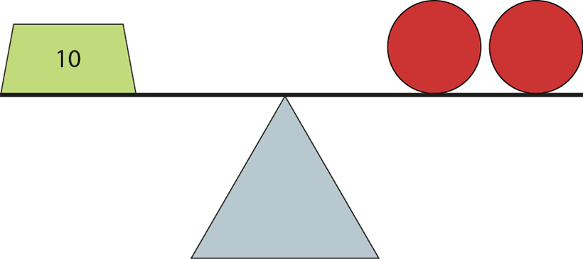
1.5 Aggregation and partitioning – step 3:6
5
5
10
=
5
+
5

Slide 28
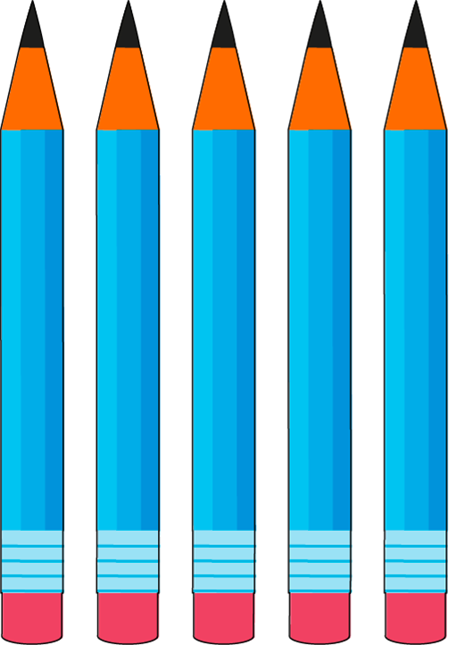

1.5 Aggregation and partitioning – step 4:1
5
?
3

Slide 29






1.5 Aggregation and partitioning – step 4:2
6
−
2
=
4

Slide 30
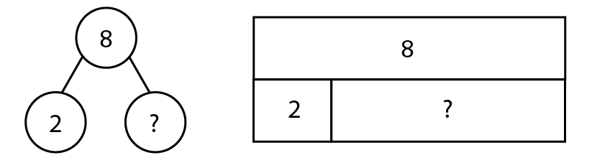
1.5 Aggregation and partitioning – step 4:2
8
8
2
6
?
?
2
6
8
−
2
=
?
6

Slide 31


1.5 Aggregation and partitioning – step 4:2
Putting together
Taking apart
Addition
Subtraction

Slide 32
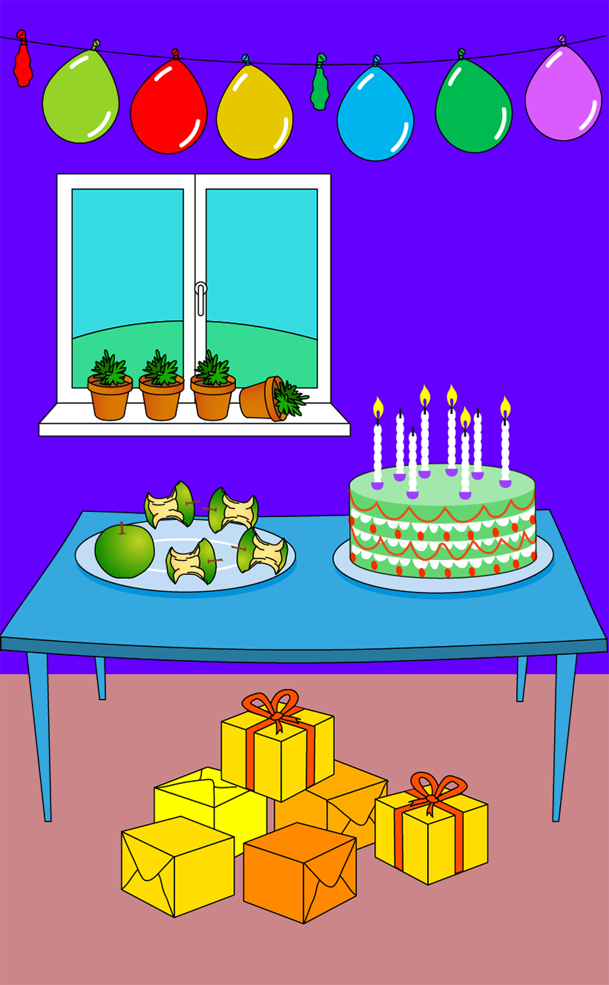
1.5 Aggregation and partitioning – step 4:2

