Slide 1
Year 2, Unit 4
Addition and Subtraction of two-digit numbers – part 1

Slide 2
Year 2, Unit 4
These materials heavily reflect the prioritisation approach of the ready-to-progress criteria in the DfE Primary Mathematics Guidance 2020 and on the PPTs that exemplify them on the NCETM website. They also include other relevant National Curriculum content. Related sections of the NCETM Primary Mastery Professional Development Materials provide small-step teaching guidance.
Ready-to-progress criteria addressed by this unit
Teaching of this unit supports the following criteria from the ‘DfE Mathematics Guidance: key stages 1 & 2’ (the 335-page document available as a download)
2AS-3 Page 62
Prior learning
Add and subtract within 10, for example: 6 + 3 =9; 6 – 2 = 4; Know that a multiple of 10 is made up from a number of tens, for example, 50 is 5 tens.

Slide 3
Contents
The links below take you to the starting slide of each learning outcome.
1 | Pupils add and subtract one to and from a two-digit number
2 | Pupils add and subtract one to and from a two-digit number that crosses a tens boundary
3 | Pupils add and subtract one from any two-digit number
4 | Pupils use number facts to add a single-digit number to a two-digit number
5 | Pupils use number facts to subtract a single-digit number from a two-digit number
6 | Pupils use a part-part-whole model to represent addition and subtraction
7 | Pupils use number bonds to ten to add a single-digit number to a two-digit number
Click the arrow button to return to this Contents slide.

Slide 4
Contents
The links below take you to the starting slide of each learning outcome.
8 | Pupils use number bonds to ten to subtract a single-digit number from a two-digit number
9 | Pupils use knowledge of ‘make ten’ to add a 1-digit number to a two-digit number
10 | Pupils use knowledge of ‘make ten’ to subtract a multiple of ten or a single-digit from a two-digit number
11 | Pupils solve problems using knowledge of addition and subtraction
12 | Pupils find ten more or ten less than a two-digit number (1)
13 | Pupils find ten more or ten less than a two-digit number (2)
14 | Pupils add and subtract ten to/from a two-digit number
15 | Pupils explain the patterns when adding and subtracting ten
Click the arrow button to return to this Contents slide.

Slide 5
Contents
The links below take you to the starting slide of each learning outcome.
16 | Pupils use knowledge of adding and subtracting ten to solve problems
17 | Pupils use number facts to add a multiple of ten to a two-digit number
18 | Pupils use number facts to subtract a multiple of ten from a two-digit number
19 | Pupils partition a two-digit number into parts in different ways (two and three parts)
20 | Pupils use knowledge of adding and subtracting multiples of ten to solve problems
Click the arrow button to return to this Contents slide.

Slide 6
Year 2, Unit 4, Learning Outcome 1
Learning Outcome 1
Pupils add and subtract one to and from a two-digit number
The following slides have been collated to support the teaching of this learning outcome.

Slide 7
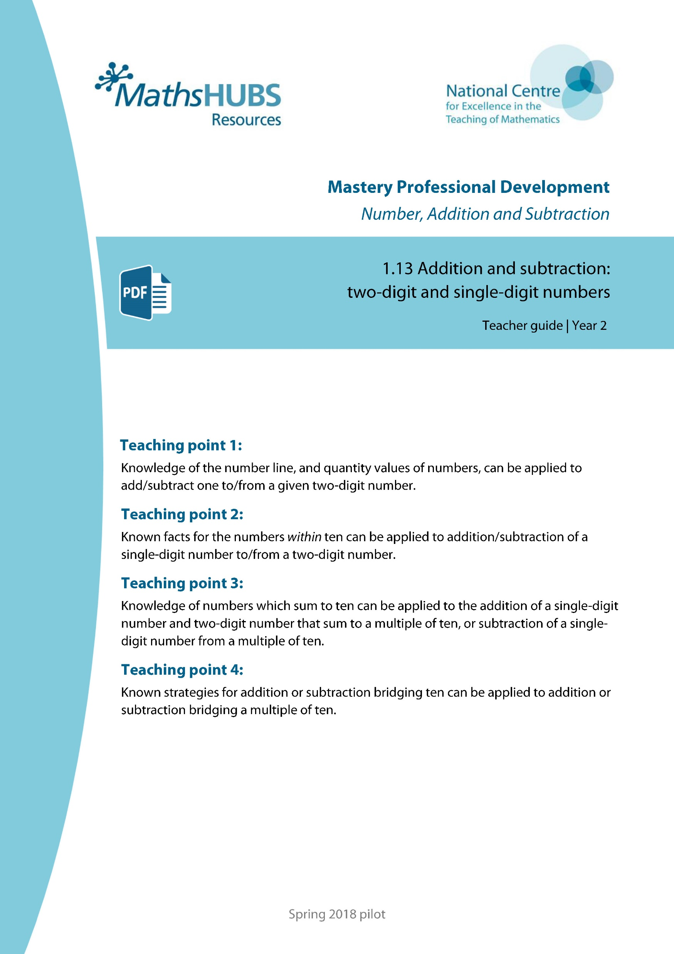
Year 2, Unit 4, Learning Outcome 1
Additional teacher guidance for this outcome should be read first and can be found in this segment of the NCETM Primary Mastery Professional Development Materials:
1.13 Addition and Subtraction: two-digit and single-digit numbers
The spine materials are divided into ‘teaching points’ and ‘steps in learning’.
Teaching point | Steps in learning | Pages
1 | 1:1 - 1:5 | 3-7

Slide 8
1.13 Calculation: two-digit +/− single-digit – step 1:1
one more
one less

Slide 9
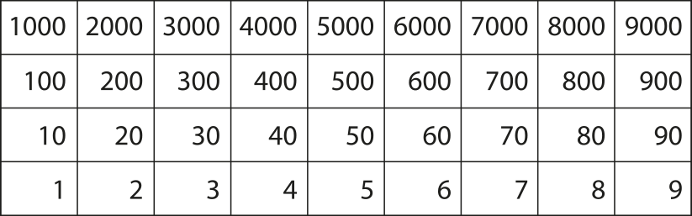
1.13 Calculation: two-digit +/− single-digit – step 1:1

Slide 10
1.13 Calculation: two-digit +/− single-digit – step 1:2

Slide 11
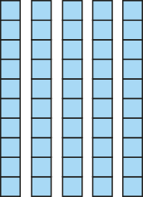

1.13 Calculation: two-digit +/− single-digit – step 1:2
10s | 1s
5
3
4
53 + 1 = 54
54 – 1 = 53

Slide 12
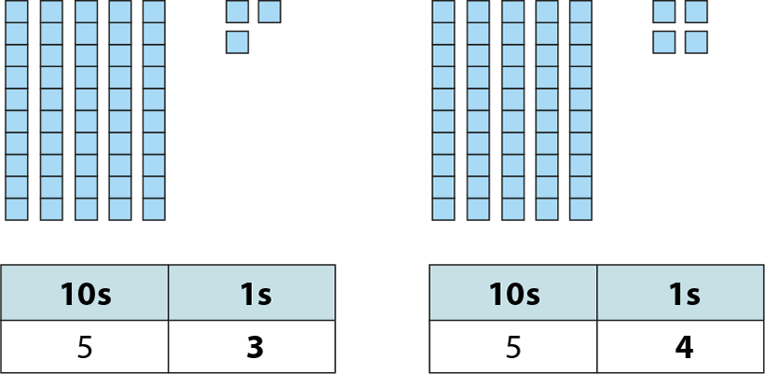
1.13 Calculation: two-digit +/− single-digit – step 1:3

Slide 13
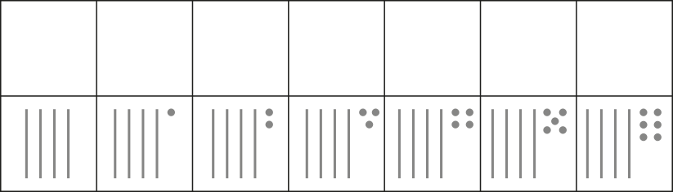
1.13 Calculation: two-digit +/− single-digit – step 1:4
40
41
42
43
44
45
46

Slide 14
1.13 Calculation: two-digit +/− single-digit – step 1:5
1
35
34
?

Slide 15
Year 2, Unit 4, Learning Outcome 2
Learning Outcome 2
Pupils add and subtract one to and from a two-digit number that crosses a tens boundary
The following slides have been collated to support the teaching of this learning outcome.

Slide 16
Year 2, Unit 4, Learning Outcome 2
Additional teacher guidance for this outcome should be read first and can be found in this segment of the NCETM Primary Mastery Professional Development Materials:
1.13 Addition and Subtraction: two-digit and single-digit numbers
The spine materials are divided into ‘teaching points’ and ‘steps in learning’.
Teaching point | Steps in learning | Pages
1 | 1:6 - 1:8 | 7-9

Slide 17

1.13 Calculation: two-digit +/− single-digit – step 1:6
39

Slide 18
1.13 Calculation: two-digit +/− single-digit – step 1:7
+1
– 1

Slide 19

1.13 Calculation: two-digit +/− single-digit – step 1:7

Slide 20
1.13 Calculation: two-digit +/− single-digit – step 1:7
19
+
1
=
20

Slide 21
1.13 Calculation: two-digit +/− single-digit – step 1:7
20
–
1
=
19

Slide 22
1.13 Calculation: two-digit +/− single-digit – step 1:7
20
19
1

Slide 23

1.13 Calculation: two-digit +/− single-digit – step 1:8
+1
+1
+1
+1

Slide 24
1.13 Calculation: two-digit +/− single-digit – step 1:8
+1
+1
+1
+1

Slide 25
1.13 Calculation: two-digit +/− single-digit – step 1:8
+1
+1
+1

Slide 26
1.13 Calculation: two-digit +/− single-digit – step 1:8
+1
–1
+1
–1
+1
–1
+1
–1

Slide 27
1.13 Calculation: two-digit +/− single-digit – step 1:8
+1
–1
+1
–1
+1
–1
+1
–1

Slide 28
1.13 Calculation: two-digit +/− single-digit – step 1:8
+1
–1
+1
–1
+1
–1

Slide 29
Year 2, Unit 4, Learning Outcome 3
Learning Outcome 3
Pupils add and subtract one from any two-digit number
The following slide supports the teaching of this learning outcome.

Slide 30
Year 2, Unit 4, Learning Outcome 3
Additional teacher guidance for this outcome should be read first and can be found in this segment of the NCETM Primary Mastery Professional Development Materials:
1.13 Addition and Subtraction: two-digit and single-digit numbers
The spine materials are divided into ‘teaching points’ and ‘steps in learning’.
Teaching point | Steps in learning | Pages
1 | 1:9 | 9-10

Slide 31
Year 2, Unit 4, Learning Outcome 4
Learning Outcome 4
Pupils use number facts to add a single-digit number to a two-digit number
The following slides have been collated to support the teaching of this learning outcome.

Slide 32
Year 2, Unit 4, Learning Outcome 4
Additional teacher guidance for this outcome should be read first and can be found in this segment of the NCETM Primary Mastery Professional Development Materials:
1.13 Addition and Subtraction: two-digit and single-digit numbers
The spine materials are divided into ‘teaching points’ and ‘steps in learning’.
Teaching point | Steps in learning | Pages
2 | 2:1 - 2:4 | 11-13

Slide 33
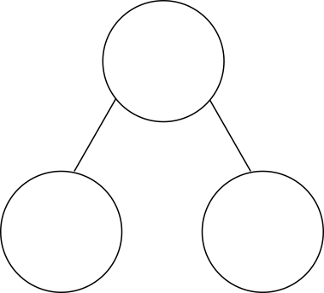
1.13 Calculation: two-digit +/− single-digit – step 2:1
3
+
6
=
9

Slide 34

1.13 Calculation: two-digit +/− single-digit – step 2:1
23
+
6
=
29

Slide 35

1.13 Calculation: two-digit +/− single-digit – step 2:1
3
+
6
=
9
2
3
+
6
=
2
9

Slide 36

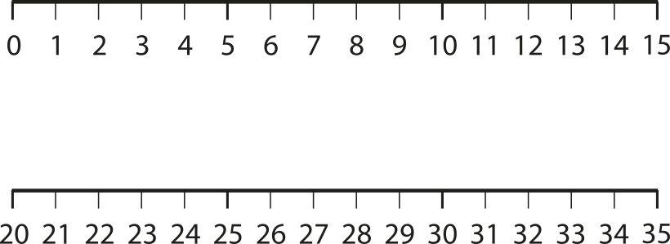
1.13 Calculation: two-digit +/− single-digit – step 2:2
+6
+6

Slide 37





1.13 Calculation: two-digit +/− single-digit – step 2:2
+3
4 + 3 =
7
+3
14 + 3 =
17
+3
24 + 3 =
27
+3
34 + 3 =
37

Slide 38



1.13 Calculation: two-digit +/− single-digit – step 2:2
+3
4 + 3 =
7
+3
44 + 3 =
47
+3
54 + 3 =
57
+3
64 + 3 =
67

Slide 39



1.13 Calculation: two-digit +/− single-digit – step 2:2
+3
4 + 3 =
7
+3
74 + 3 =
77
+3
84 + 3 =
87
+3
94 + 3 =
97

Slide 40
1.13 Calculation: two-digit +/− single-digit – step 2:3
1
2
3
4 + 3 = 7
1
2
3

Slide 41
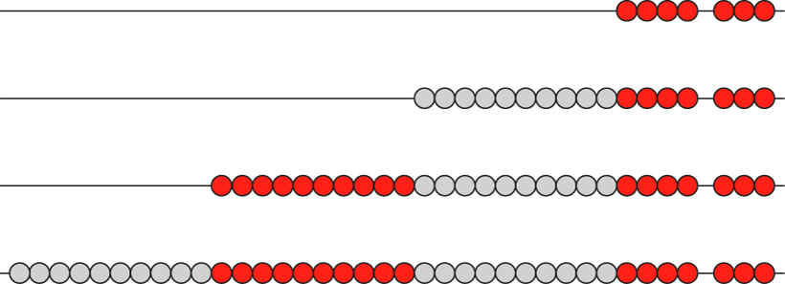
1.13 Calculation: two-digit +/− single-digit – step 2:3

Slide 42
Year 2, Unit 4, Learning Outcome 5
Learning Outcome 5
Pupils use number facts to subtract a single-digit number from a two-digit number
The following slides have been collated to support the teaching of this learning outcome.

Slide 43
Year 2, Unit 4, Learning Outcome 5
Additional teacher guidance for this outcome should be read first and can be found in this segment of the NCETM Primary Mastery Professional Development Materials:
1.13 Addition and Subtraction: two-digit and single-digit numbers
The spine materials are divided into ‘teaching points’ and ‘steps in learning’.
Teaching point | Steps in learning | Pages
2 | 2:5 | 14

Slide 44
1.13 Calculation: two-digit +/− single-digit – step 2:5
–3
9 – 3 =
6
–3
19 – 3 =
16
–3
29 – 3 =
26
–3
39 – 3 =
36

Slide 45
1.13 Calculation: two-digit +/− single-digit – step 2:5
–3
9 – 3 =
6
–3
49 – 3 =
46
–3
59 – 3 =
56
–3
69 – 3 =
66

Slide 46
1.13 Calculation: two-digit +/− single-digit – step 2:5
–3
9 – 3 =
6
–3
79 – 3 =
76
–3
89 – 3 =
86
–3
99 – 3 =
96

Slide 47
Year 2, Unit 4, Learning Outcome 6
Learning Outcome 6
Pupils use a part-part-whole model to represent addition and subtraction
The following slides have been collated to support the teaching of this learning outcome.

Slide 48
Year 2, Unit 4, Learning Outcome 6
Additional teacher guidance for this outcome should be read first and can be found in this segment of the NCETM Primary Mastery Professional Development Materials:
1.13 Addition and Subtraction: two-digit and single-digit numbers
The spine materials are divided into ‘teaching points’ and ‘steps in learning’.
Teaching point | Steps in learning | Pages
2 | 2:6 - 2:9 | 14-17

Slide 49
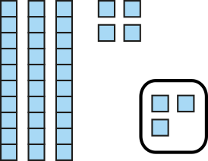
1.13 Calculation: two-digit +/− single-digit – step 2:6
34
44
54
47
37
57
3

Slide 50
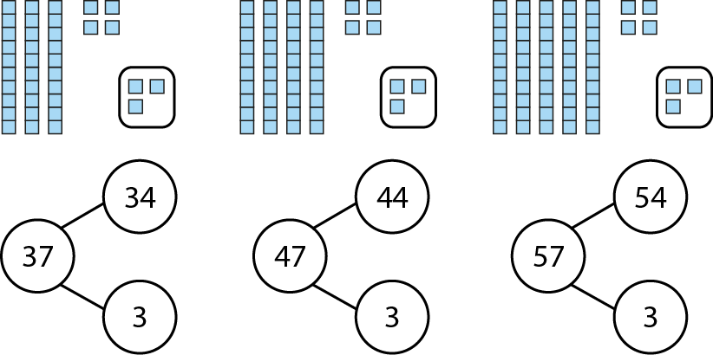
1.13 Calculation: two-digit +/− single-digit – step 2:6

Slide 51
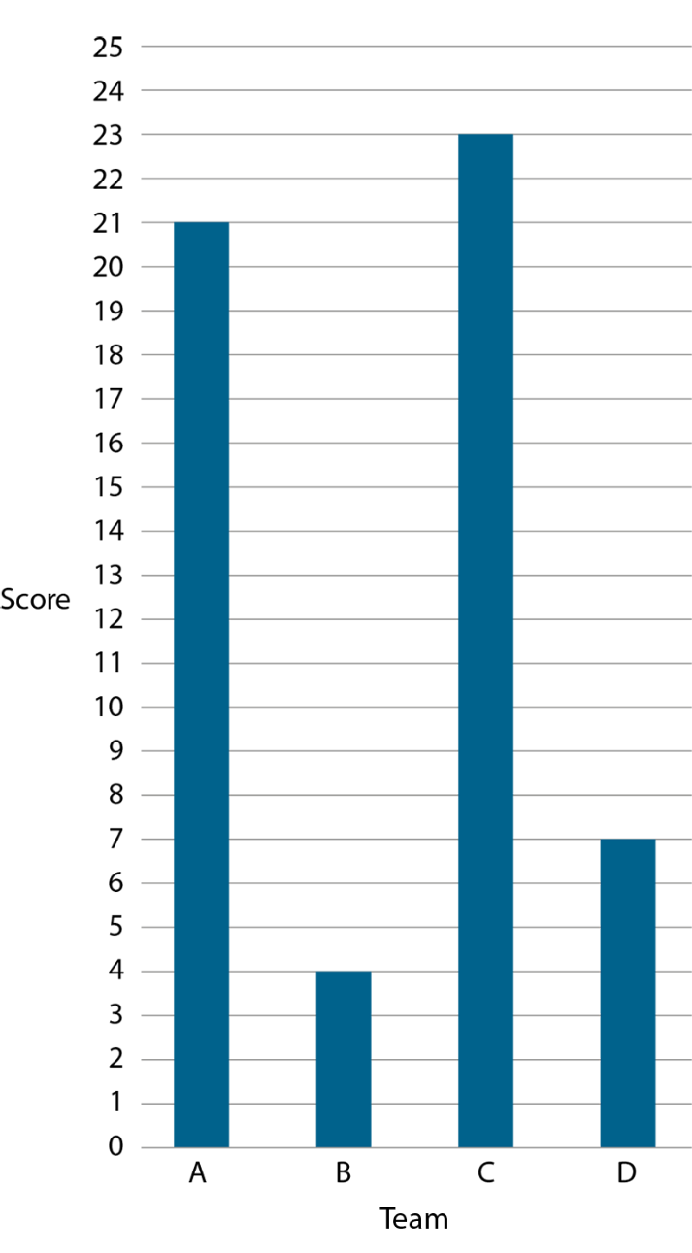
1.13 Calculation: two-digit +/− single-digit – step 2:9
Notes:
What is the total of Team A and Team D’s scores? Which addition fact can help us answer this? Why?
What is the difference between Team B and Team C’s scores? Which addition fact can help us answer this? Why?

Slide 52
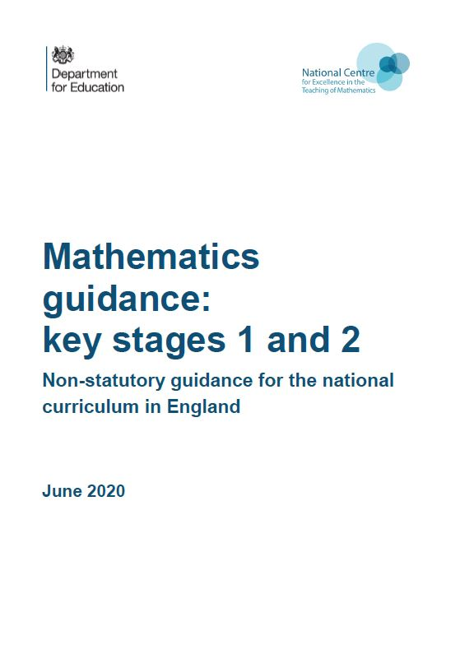
Year 2, Unit 4, Learning Outcome 6
Additional teacher guidance for this outcome should be read first and can be found in the DfE Mathematics guidance. Page references relate to the 335-page document available as a download at the bottom of this web page.
Ready to progress criteria | Pages
2AS-3 | 62-65

Slide 53




2AS-3 Add and subtract within 100 – part 1
73
73
73
73
30
63
10
53
20
43
30
43
20
53
Watch the blocks as they partition and combine. What changes each time, the ones or the tens?
Using your own blocks and a part-part-whole diagram, can you partition and combine some numbers in the same way, making sure you keep the ones together? Can you record your partitions as a jotting?

Slide 54
Year 2, Unit 4, Learning Outcome 7
Learning Outcome 7
Pupils use number bonds to ten to add a single-digit number to a two-digit number
The following slides have been collated to support the teaching of this learning outcome.

Slide 55
Year 2, Unit 4, Learning Outcome 7
Additional teacher guidance for this outcome should be read first and can be found in this segment of the NCETM Primary Mastery Professional Development Materials:
1.13 Addition and Subtraction: two-digit and single-digit numbers
The spine materials are divided into ‘teaching points’ and ‘steps in learning’.
Teaching point | Steps in learning | Pages
3 | 3:1 - 3:3 | 18-20

Slide 56


1.13 Calculation: two-digit +/− single-digit – step 3:1
1
2
6
+
4
=
2
3
1
0

Slide 57
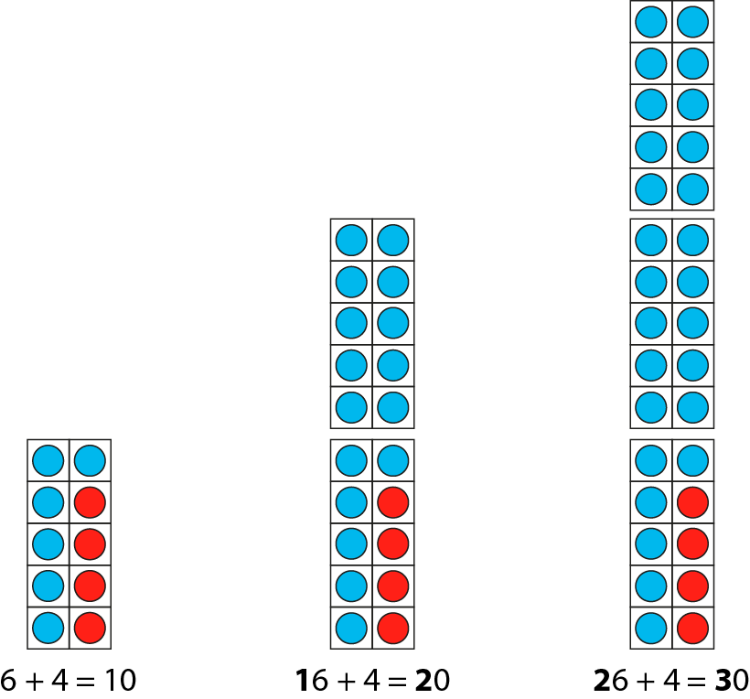
1.13 Calculation: two-digit +/− single-digit – step 3:1

Slide 58
1.13 Calculation: two-digit +/− single-digit – step 3:1
2
1
3
0
1
2
6
4

Slide 59
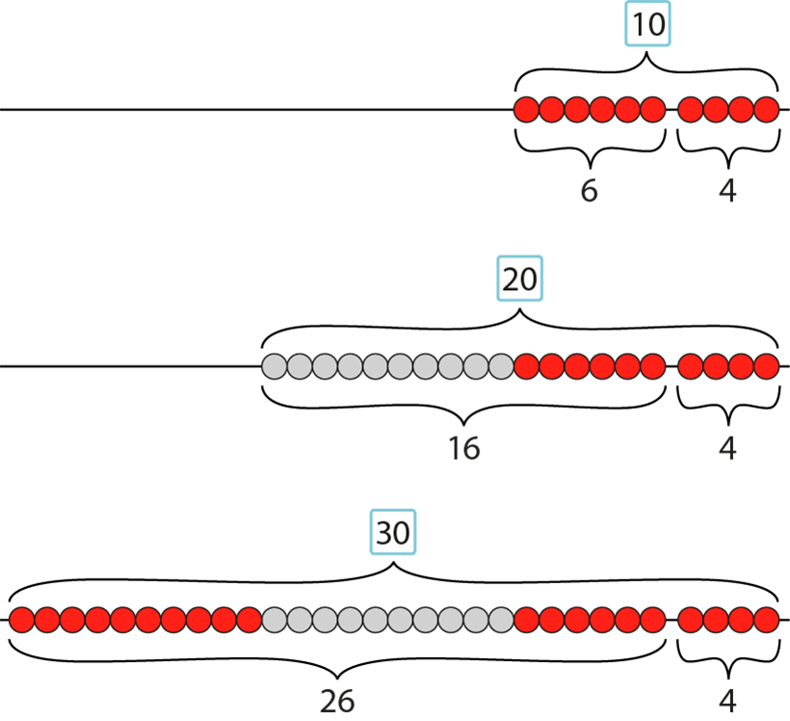
1.13 Calculation: two-digit +/− single-digit – step 3:1

Slide 60
1.13 Calculation: two-digit +/− single-digit – step 3:2
+3
+3
+3
+3
+3
+3
+3
+3
+3
17
20
27
30
37
40
47
50
57
60
67
70
77
80
87
90
97
100

Slide 61
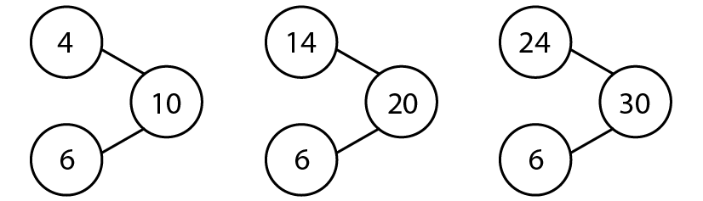
1.13 Calculation: two-digit +/− single-digit – step 3:3

Slide 62
Year 2, Unit 4, Learning Outcome 7
Additional teacher guidance for this outcome should be read first and can be found in the DfE Mathematics guidance. Page references relate to the 335-page document available as a download at the bottom of this web page.
Ready to progress criteria | Pages
2AS-3 | 62-65

Slide 63
2AS-3 Add and subtract within 100 – part 1
Look at the first part-part-whole diagram. What addition equation can we write if we combine the cubes?
What’s the same and what’s different about the second part-part-whole diagram?
What do you notice about the total when we combine the cubes?
What’s the same about the ones digits in each calculation? What’s different about the totals? Can you explain why?
3 + 6 = 9
23 + 6 = 29
3 plus 6 is equal to 9, so I know that
23 plus 6 is equal to 29.

Slide 64
2AS-3 Add and subtract within 100 – part 1
+3
4 + 3 =
7
Look carefully at each number line. What can you say about the numbers at the start and end of each line?
Look at the calculations. What’s the same about each calculation? What’s different?
If you know that 4 plus 3 is equal to 7, can you predict what some of the totals will be without counting?
What do you notice about the totals? Can you explain why the ones digit has stayed the same? What do you notice about how the tens digit has changed? Can you explain why?
+3
14 + 3 =
17
+3
24 + 3 =
27
+3
34 + 3 =
37

Slide 65
Year 2, Unit 4, Learning Outcome 8
Learning Outcome 8
Pupils use number bonds to ten to subtract a single-digit number from a two-digit number
The following slides have been collated to support the teaching of this learning outcome.

Slide 66
Year 2, Unit 4, Learning Outcome 8
Additional teacher guidance for this outcome should be read first and can be found in this segment of the NCETM Primary Mastery Professional Development Materials:
1.13 Addition and Subtraction: two-digit and single-digit numbers
The spine materials are divided into ‘teaching points’ and ‘steps in learning’.
Teaching point | Steps in learning | Pages
3 | 3:4 - 3:6 | 20-23

Slide 67
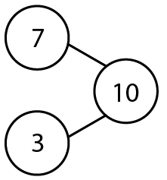
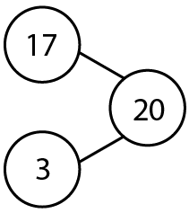
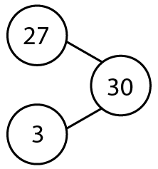
1.13 Calculation: two-digit +/− single-digit – step 3:4

Slide 68



1.13 Calculation: two-digit +/− single-digit – step 3:4
3
2
2
1
10
7
0
– 3
=
7

Slide 69
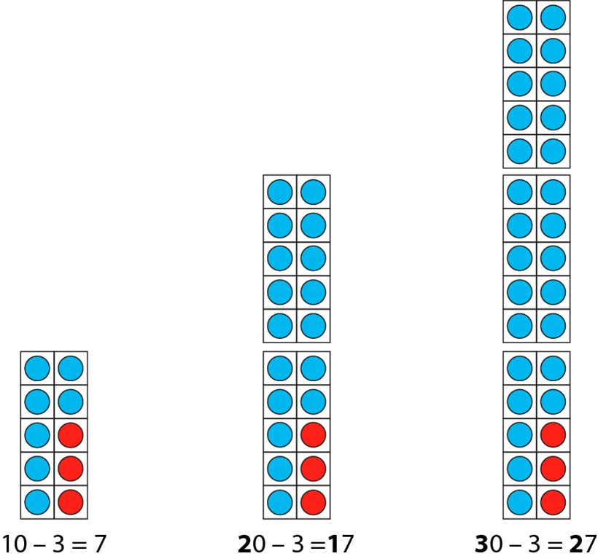
1.13 Calculation: two-digit +/− single-digit – step 3:4

Slide 70
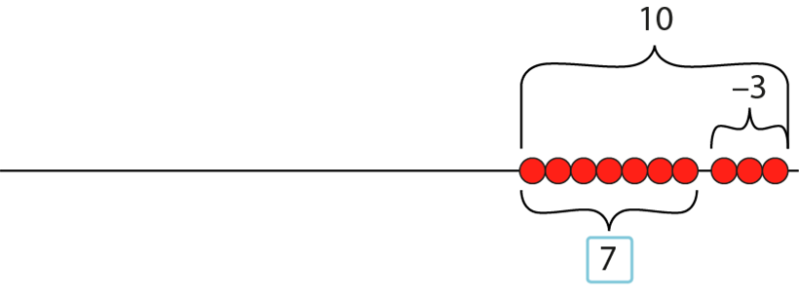
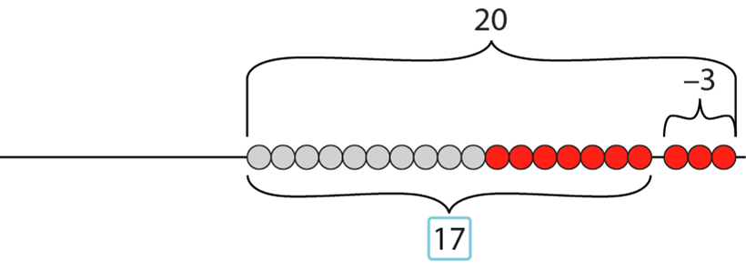
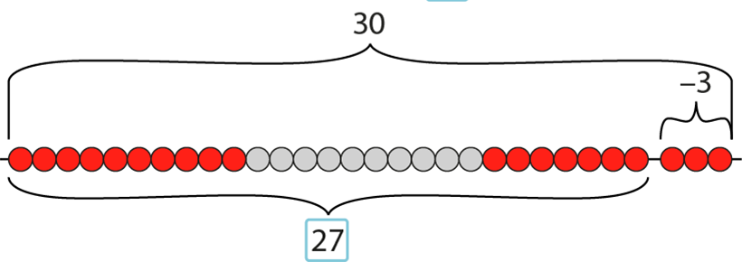
1.13 Calculation: two-digit +/− single-digit – step 3:4

Slide 71
1.13 Calculation: two-digit +/− single-digit – step 3:5
– 3
– 3
– 3
– 3
– 3
– 3
– 3
– 3
–3
17
20
27
30
37
40
47
50
57
60
67
70
77
80
87
90
97
100

Slide 72
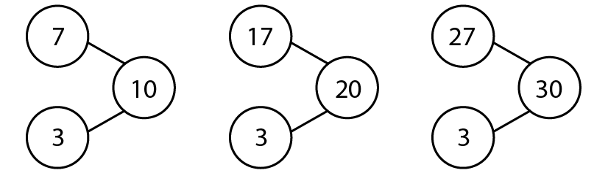
1.13 Calculation: two-digit +/− single-digit – step 3:6

Slide 73
Year 2, Unit 4, Learning Outcome 8
Additional teacher guidance for this outcome should be read first and can be found in the DfE Mathematics guidance. Page references relate to the 335-page document available as a download at the bottom of this web page.
Ready to progress criteria | Pages
2AS-3 | 62-65

Slide 74
2AS-3 Add and subtract within 100 – part 1
-3
Look carefully at each number line. What can you say about the numbers at the start and end of each line?
Look at the calculations. What’s the same about each calculation? What’s different?
If you know that 7 minus 3 is equal to 4, can you predict what the differences will be without counting?
What do you notice about the differences? Can you explain why the ones digit has stayed the same? What do you notice about how the tens digit has changed?
7 – 3 =
4
-3
17 – 3 =
14
-3
27 – 3 =
24
-3
37 – 3 =
34

Slide 75
Year 2, Unit 4, Learning Outcome 9
Learning Outcome 9
Pupils use knowledge of ‘make ten’ to add a single-digit number to a two-digit number
The following slides have been collated to support the teaching of this learning outcome.

Slide 76
Year 2, Unit 4, Learning Outcome 9
Additional teacher guidance for this outcome should be read first and can be found in this segment of the NCETM Primary Mastery Professional Development Materials:
1.13 Addition and Subtraction: two-digit and single-digit numbers
The spine materials are divided into ‘teaching points’ and ‘steps in learning’.
Teaching point | Steps in learning | Pages
4 | 4:1 - 4:4 | 24-28

Slide 77

1.13 Calculation: two-digit +/− single-digit – step 4:1
8 + 3 =
11
2
1

Slide 78

1.13 Calculation: two-digit +/− single-digit – step 4:1
3 + 8 =
11
7
1

Slide 79


1.13 Calculation: two-digit +/− single-digit – step 4:1
8
+ 3
=
11
2
1
+2
+1
8
10
11
+3

Slide 80


1.13 Calculation: two-digit +/− single-digit – step 4:1
3
+ 8
=
11
7
1
+7
+1
3
10
11
+8

Slide 81
1.13 Calculation: two-digit +/− single-digit – step 4:1
11
– 3
=
8
1
2
–2
–1
8
10
11
–3

Slide 82
1.13 Calculation: two-digit +/− single-digit – step 4:1
11
– 8
=
3
1
7
–7
–1
3
10
11
–8

Slide 83

1.13 Calculation: two-digit +/− single-digit – step 4:2
8
+ 3
=
11
2
1
8 + 3 = 8 + 2 +1
= 10 + 1
= 11

Slide 84

1.13 Calculation: two-digit +/− single-digit – step 4:2
18
+ 3
=
21
2
1
18 + 3 = 18 + 2 + 1
= 20 + 1
= 21

Slide 85
1.13 Calculation: two-digit +/− single-digit – step 4:2
28
+ 3
=
31
2
1
28 + 3 = 28 + 2 + 1
= 30 + 1
= 31

Slide 86



1.13 Calculation: two-digit +/− single-digit – step 4:3
+2
+1
+3
+2
+1
+3
+2
+1
+3
+2
+1
+3

Slide 87
1.13 Calculation: two-digit +/− single-digit – step 4:3
+2
+1
+3
+2
+1
+3
+2
+1
+3
+2
+1
+3

Slide 88
1.13 Calculation: two-digit +/− single-digit – step 4:3
+2
+1
+3
+2
+1
+3
+2
+1
+3

Slide 89
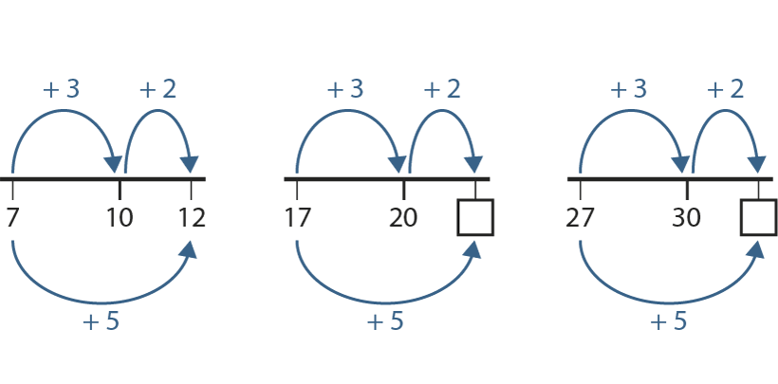
1.13 Calculation: two-digit +/− single-digit – step 4:4
22
32

Slide 90
Year 2, Unit 4, Learning Outcome 10
Learning Outcome 10
Pupils use knowledge of ‘make ten’ to subtract a multiple of ten or a single- digit from a two-digit number
The following slides have been collated to support the teaching of this learning outcome.

Slide 91
Year 2, Unit 4, Learning Outcome 10
Additional teacher guidance for this outcome should be read first and can be found in this segment of the NCETM Primary Mastery Professional Development Materials:
1.13 Addition and Subtraction: two-digit and single-digit numbers
The spine materials are divided into ‘teaching points’ and ‘steps in learning’.
Teaching point | Steps in learning | Pages
4 | 4:5 - 4:8 | 28-31

Slide 92
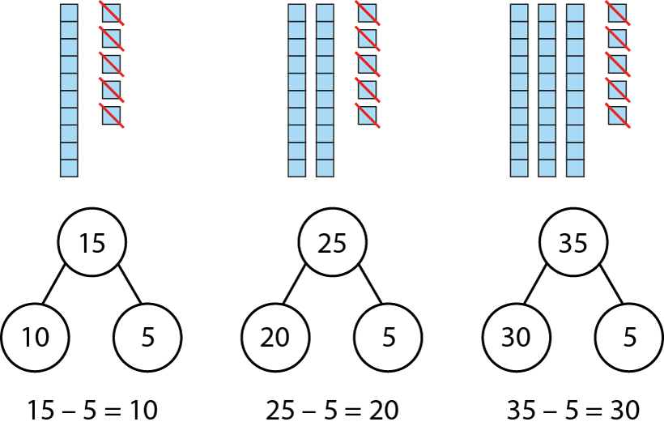
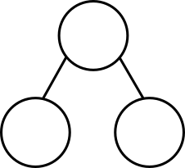
1.13 Calculation: two-digit +/− single-digit – step 4:5
1
2
3
5
0
1
2
3
5
1
2
3
5
– 5
=
1
2
3
0

Slide 93
1.13 Calculation: two-digit +/− single-digit – step 4:6
11
– 3
=
8
1
2
11 – 3 = 11 – 1 – 2
= 10 – 2
= 8

Slide 94
1.13 Calculation: two-digit +/− single-digit – step 4:6
21
– 3
=
18
1
2
21 – 3 = 21 – 1 – 2
= 20 – 2
= 18

Slide 95
1.13 Calculation: two-digit +/− single-digit – step 4:6
31
– 3
=
28
1
2
31 – 3 = 31 – 1 – 2
= 30 – 2
= 28

Slide 96
1.13 Calculation: two-digit +/− single-digit – step 4:7
–2
–1
–3
–2
–1
–3
–2
–1
–3
–2
–1
–3

Slide 97
1.13 Calculation: two-digit +/− single-digit – step 4:7
–2
–1
–3
–2
–1
–3
–2
–1
–3
–2
–1
–3

Slide 98
1.13 Calculation: two-digit +/− single-digit – step 4:7
–2
–1
–3
–2
–1
–3
–2
–1
–3

Slide 99
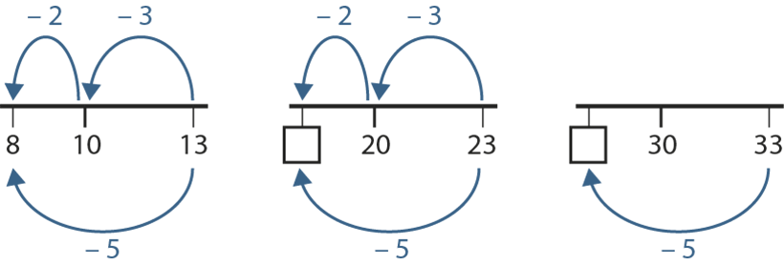
1.13 Calculation: two-digit +/− single-digit – step 4:8
18
28

Slide 100
Year 2, Unit 4, Learning Outcome 11
Learning Outcome 11
Pupils solve problems using knowledge of addition and subtraction
The following slides have been collated to support the teaching of this learning outcome.

Slide 101
Year 2, Unit 4, Learning Outcome 11
Additional teacher guidance for this outcome should be read first and can be found in this segment of the NCETM Primary Mastery Professional Development Materials:
1.13 Addition and Subtraction: two-digit and single-digit numbers
The spine materials are divided into ‘teaching points’ and ‘steps in learning’.
Teaching point | Steps in learning | Pages
4 | 4:9 | 31-32

Slide 102
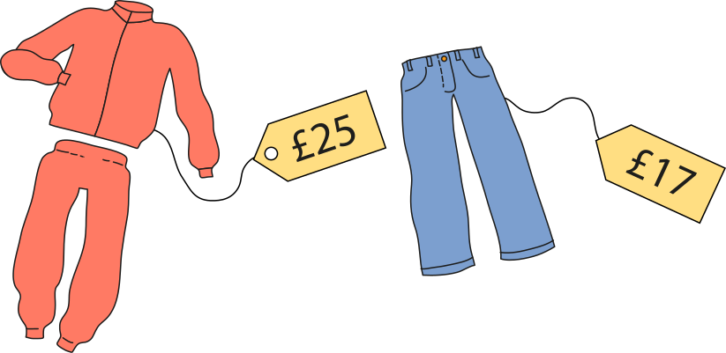

1.13 Calculation: two-digit +/− single-digit – step 4:9

Slide 103
Year 2, Unit 4, Learning Outcome 12
Learning Outcome 12
Pupils find ten more or ten less than a two-digit number (1)
The following slides have been collated to support the teaching of this learning outcome.

Slide 104
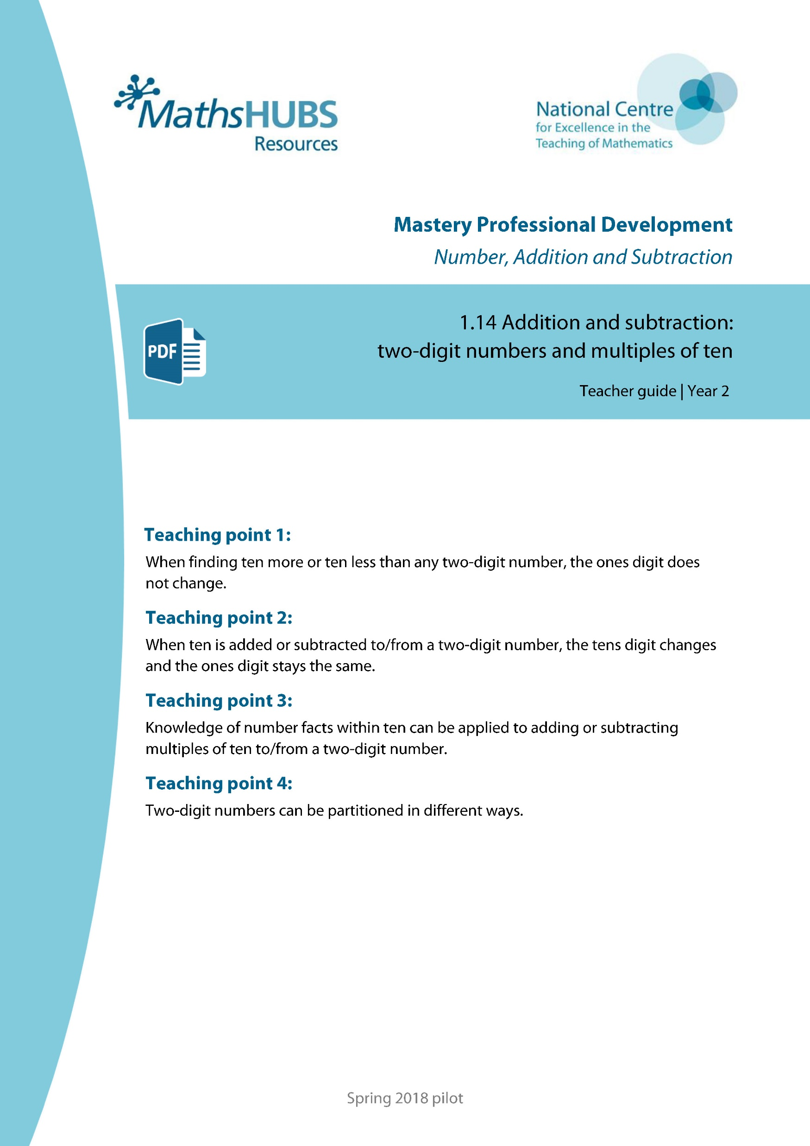
Year 2, Unit 4, Learning Outcome 12
Additional teacher guidance for this outcome should be read first and can be found in this segment of the NCETM Primary Mastery Professional Development Materials:
1.14 Addition and Subtraction: two-digit numbers and multiples of ten
The spine materials are divided into ‘teaching points’ and ‘steps in learning’.
Teaching point | Steps in learning | Pages
1 | 1:1 - 1:3 | 3-5

Slide 105
1.14 Calculation: two-digit +/− tens – step 1:1

Slide 106
1.14 Calculation: two-digit +/− tens – step 1:2

Slide 107


1.14 Calculation: two-digit +/− tens – step 1:2

Slide 108
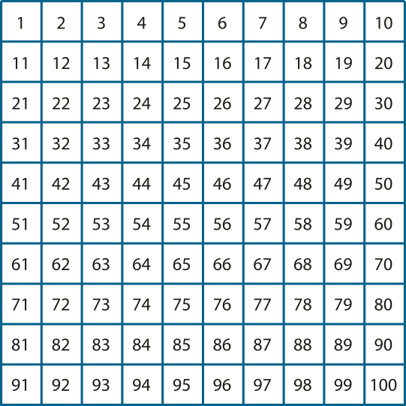
1.14 Calculation: two-digit +/− tens – step 1:3

Slide 109
Year 2, Unit 4, Learning Outcome 13
Learning Outcome 13
Pupils find ten more or ten less than a two-digit number (2)
The following slides have been collated to support the teaching of this learning outcome.

Slide 110
Year 2, Unit 4, Learning Outcome 13
Additional teacher guidance for this outcome should be read first and can be found in this segment of the NCETM Primary Mastery Professional Development Materials:
1.14 Addition and Subtraction: two-digit numbers and multiples of ten
The spine materials are divided into ‘teaching points’ and ‘steps in learning’.
Teaching point | Steps in learning | Pages
1 | 1:4 - 1:5 | 6-7

Slide 111
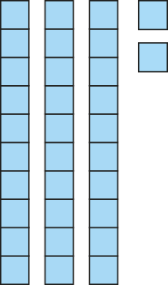

1.14 Calculation: two-digit +/− tens – step 1:4
10 more
32
42

Slide 112
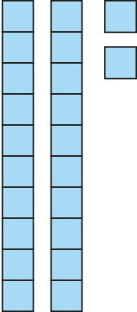
1.14 Calculation: two-digit +/− tens – step 1:4
10 less
32
22

Slide 113
1.14 Calculation: two-digit +/− tens – step 1:5
38
58
78
98

Slide 114
Year 2, Unit 4, Learning Outcome 14
Learning Outcome 14
Pupils add and subtract ten to/from a two-digit number
The following slides have been collated to support the teaching of this learning outcome.

Slide 115
Year 2, Unit 4, Learning Outcome 14
Additional teacher guidance for this outcome should be read first and can be found in this segment of the NCETM Primary Mastery Professional Development Materials:
1.14 Addition and Subtraction: two-digit numbers and multiples of ten
The spine materials are divided into ‘teaching points’ and ‘steps in learning’.
Teaching point | Steps in learning | Pages
2 | 2:1 - 2:2 | 8-9

Slide 116
1.14 Calculation: two-digit +/− tens – step 2:1
14 + 10 =
24
24 + 10 =
34
34 + 10 =
44
44 + 10 =
54
54 + 10 =
64
64 + 10 =
74
74 + 10 =
84
84 + 10 =
94

Slide 117
1.14 Calculation: two-digit +/− tens – step 2:1
24 – 10 =
14
34 – 10 =
24
44 – 10 =
34
54 – 10 =
44
64 – 10 =
54
74 – 10 =
64
84 – 10 =
74
94 – 10 =
84

Slide 118
1.14 Calculation: two-digit +/− tens – step 2:1
14 + 10 =
24
24 – 10 =
14
24 + 10 =
34
34 – 10 =
24
34 + 10 =
44
44 – 10 =
34
44 + 10 =
54
54 – 10 =
44
54 + 10 =
64
64 – 10 =
54
64 + 10 =
74
74 – 10 =
64
74 + 10 =
84
84 – 10 =
74
84 + 10 =
94
94 – 10 =
84

Slide 119
Year 2, Unit 4, Learning Outcome 15
Learning Outcome 15
Pupils explain the patterns when adding and subtracting ten
The following slides have been collated to support the teaching of this learning outcome.

Slide 120
Year 2, Unit 4, Learning Outcome 15
Additional teacher guidance for this outcome should be read first and can be found in this segment of the NCETM Primary Mastery Professional Development Materials:
1.14 Addition and Subtraction: two-digit numbers and multiples of ten
The spine materials are divided into ‘teaching points’ and ‘steps in learning’.
Teaching point | Steps in learning | Pages
2 | 2:3 - 2:4 | 9-10

Slide 121
1.14 Calculation: two-digit +/− tens – step 2:3
46
46
36
10
10
36
36 + 10 = 46
10 + 36 = 46

Slide 122


1.14 Calculation: two-digit +/− tens – step 2:4

Slide 123
1.14 Calculation: two-digit +/− tens – step 2:4

Slide 124
Year 2, Unit 4, Learning Outcome 16
Learning Outcome 16
Pupils use knowledge of adding and subtracting ten to solve problems
The following slides have been collated to support the teaching of this learning outcome.

Slide 125
Year 2, Unit 4, Learning Outcome 16
Additional teacher guidance for this outcome should be read first and can be found in this segment of the NCETM Primary Mastery Professional Development Materials:
1.14 Addition and Subtraction: two-digit numbers and multiples of ten
The spine materials are divided into ‘teaching points’ and ‘steps in learning’.
Teaching point | Steps in learning | Pages
2 | 2:5 - 2:6 | 10-12

Slide 126

1.14 Calculation: two-digit +/− tens – step 2:5
82
?
10
72
82
= 10 + 72
72 = – 10
82

Slide 127

1.14 Calculation: two-digit +/− tens – step 2:5
56
46
10
46 = 56 10
–
56 = 46 10
+

Slide 128
Year 2, Unit 4, Learning Outcome 17
Learning Outcome 17
Pupils use number facts to add a multiple of ten to a two-digit number
The following slides have been collated to support the teaching of this learning outcome.

Slide 129
Year 2, Unit 4, Learning Outcome 17
Additional teacher guidance for this outcome should be read first and can be found in this segment of the NCETM Primary Mastery Professional Development Materials:
1.14 Addition and Subtraction: two-digit numbers and multiples of ten
The spine materials are divided into ‘teaching points’ and ‘steps in learning’.
Teaching point | Steps in learning | Pages
3 | 3:1 - 3:5 | 13-16

Slide 130
1.14 Calculation: two-digit +/− tens – step 3:1
5
5
tens
50
3
2
3
tens
2
tens
30
20

Slide 131

1.14 Calculation: two-digit +/− tens – step 3:2
45
55
65
75

Slide 132
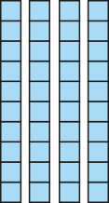
1.14 Calculation: two-digit +/− tens – step 3:3
45 =
40
+ 5

Slide 133

1.14 Calculation: two-digit +/− tens – step 3:3
45
+
30
= 75

Slide 134
1.14 Calculation: two-digit +/− tens – step 3:3
45
+ 30
=
75
40
5
10s | 1s
4
+
7
3
5

Slide 135
1.14 Calculation: two-digit +/− tens – step 3:3
45
+
30
5
40
70
45 + 30 = 75

Slide 136
1.14 Calculation: two-digit +/− tens – step 3:4
42
52
62
32
10
32
20
32
30

Slide 137
1.14 Calculation: two-digit +/− tens – step 3:4
45
55
65
15
30
25
30
35
30

Slide 138
1.14 Calculation: two-digit +/− tens – step 3:5
43
63
?
20

Slide 139
1.14 Calculation: two-digit +/− tens – step 3:5
32
72
?
40

Slide 140
1.14 Calculation: two-digit +/− tens – step 3:5
39
59
?
20

Slide 141
Year 2, Unit 4, Learning Outcome 17
Additional teacher guidance for this outcome should be read first and can be found in the DfE Mathematics guidance. Page references relate to the 335-page document available as a download at the bottom of this web page.
Ready to progress criteria | Pages
2AS-3 | 62-65

Slide 142


2AS-3 Add and subtract within 100 – part 1
What do you notice about how the blocks are arranged? How does the part-part-whole diagram represent this?
What is the same and what is different about the blocks and part-part-whole diagram now? Can you say the number that is 7 tens?
Collect 9 tens blocks and a part-part-whole diagram to do this activity. Pick up some of your blocks and put them into two piles. Your partner can fill in the part-part-whole diagram to represent your arrangement. Check they are right!
7
7 tens
4
3
4 tens
3 tens

Slide 143
2AS-3 Add and subtract within 100 – part 1
If we know that 4 plus 3 is equal to 7, what else do we know?
Look at the blocks. What do you notice?
4 + 3 = 7
40 + 30 = 70
Did you notice that there are 4 tens and 3 tens? How many tens do you think that is altogether? What multiple of ten is this number of tens?
How could we write an addition to represent combining the groups of tens? What can you say you know?
Repeat the activity with a different number of 10 blocks.
4 plus 3 is equal to 7, so 4 tens plus 3 tens is equal to 7 tens.
So I know that 40 plus 30 is equal to 70.

Slide 144
2AS-3 Add and subtract within 100 – part 1
7 – 4 = 3
If we know that 7 minus 4 is equal to 3, what else can you say, using this sentence:
___ tens minus ___ tens is equal to ___ tens.
Look carefully at the blocks, what could you do to them to show this?
Can you write the calculation using multiples of ten to represent this?
Repeat the activity with a different number of 10 blocks.
70 – 40 = 30
7 minus 4 is equal to 3, so 7 tens minus 4 tens is equal to 3 tens.
So I know that 70 minus 40 is equal to 30.

Slide 145
2AS-3 Add and subtract within 100 – part 1
Let’s think about how knowing that 6 plus 2 is equal to 8 can help us find 60 + 25.
Look at the blocks. How many tens are in 60 and in 20? So what will the total number of tens be? What number is this?
So if we have 8 tens as part of the total, what will the ones digit be? Where can you see this in the blocks? And in the calculation?
So if we have 8 in the tens and 5 in the ones, the total of 60 and 25 must be…?
Repeat with other calculations where one number is a multiple of 10. Try some without the blocks.
6 + 2 = 8
60 + 25 = 85
?

Slide 146
Year 2, Unit 4, Learning Outcome 18
Learning Outcome 18
Pupils use number facts to subtract a multiple of ten from a two-digit number
The following slides have been collated to support the teaching of this learning outcome.

Slide 147
Year 2, Unit 4, Learning Outcome 18
Additional teacher guidance for this outcome should be read first and can be found in this segment of the NCETM Primary Mastery Professional Development Materials:
1.14 Addition and Subtraction: two-digit numbers and multiples of ten
The spine materials are divided into ‘teaching points’ and ‘steps in learning’.
Teaching point | Steps in learning | Pages
3 | 3:6 - 3:9 | 16-18

Slide 148
1.14 Calculation: two-digit +/− tens – step 3:6
45
55
65
75

Slide 149
1.14 Calculation: two-digit +/− tens – step 3:7
75 =
70
+ 5

Slide 150
1.14 Calculation: two-digit +/− tens – step 3:7
75
–
30
= 45

Slide 151
1.14 Calculation: two-digit +/− tens – step 3:7
75
– 30
=
45
70
5
10s | 1s
7
4
–
3
5

Slide 152
1.14 Calculation: two-digit +/− tens – step 3:7
75
–
30
5
70
40
75 – 30 = 45

Slide 153
1.14 Calculation: two-digit +/− tens – step 3:8
97
97
97
87
10
77
20
67
30

Slide 154
1.14 Calculation: two-digit +/− tens – step 3:8
47
57
67
17
30
27
30
37
30

Slide 155
1.14 Calculation: two-digit +/− tens – step 3:9
48
68
?
20

Slide 156
1.14 Calculation: two-digit +/− tens – step 3:9
24
74
50
?

Slide 157
1.14 Calculation: two-digit +/− tens – step 3:9
43
?
63
20

Slide 158
Year 2, Unit 4, Learning Outcome 18
Additional teacher guidance for this outcome should be read first and can be found in the DfE Mathematics guidance. Page references relate to the 335-page document available as a download at the bottom of this web page.
Ready to progress criteria | Pages
2AS-3 | 62-65

Slide 159
2AS-3 Add and subtract within 100 – part 1
Look at the blocks. What number is represented? Can you see that number in the second expression?
How many tens are in 85 and in 60?
How could knowing that 8 minus 6 is equal to 2 help us with 85 minus 60? Does thinking about the number of tens help?
What do you notice about the ones digits in the minuend and difference?
8 – 6 = 2
85 – 60 = 25
If I know that 8 minus 6 is equal to 2,
I can use this to help find 85 minus 60.

Slide 160
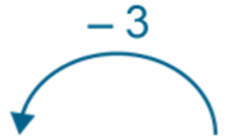
2AS-3 Add and subtract within 100 – part 1
How do you know 10 minus 3?
What’s the same and what’s different about the second calculation and number line?
How can knowing that 10 minus 3 is equal to 7 help us with 30 minus 3?
What do you notice is the same about 7 and 27? Why do you think this is the same?
0
7
10
10 – 3 = 7
0
10
20
27
30
30 – 3 = 27

Slide 161
Year 2, Unit 4, Learning Outcome 19
Learning Outcome 19
Pupils partition a two-digit number into parts in different ways (two and three parts)
The following slides have been collated to support the teaching of this learning outcome.

Slide 162
Year 2, Unit 4, Learning Outcome 19
Additional teacher guidance for this outcome should be read first and can be found in this segment of the NCETM Primary Mastery Professional Development Materials:
1.14 Addition and Subtraction: two-digit numbers and multiples of ten
The spine materials are divided into ‘teaching points’ and ‘steps in learning’.
Teaching point | Steps in learning | Pages
4 | 4:1 - 4:3 | 19-20

Slide 163
1.14 Calculation: two-digit +/− tens – step 4:1
73
30
43
20
53
73
73
73
63
10
53
20
43
30

Slide 164
1.14 Calculation: two-digit +/− tens – step 4:2
20
46
26
?

Slide 165
1.14 Calculation: two-digit +/− tens – step 4:2
30
?
59
29

Slide 166
1.14 Calculation: two-digit +/− tens – step 4:2
31
?
71
40

Slide 167
1.14 Calculation: two-digit +/− tens – step 4:3
73
33
30
10

Slide 168
Year 2, Unit 4, Learning Outcome 20
Learning Outcome 20
Pupils use knowledge of adding and subtracting multiples of ten to solve problems
The following slide supports the teaching of this learning outcome.

Slide 169
Year 2, Unit 4, Learning Outcome 20
Additional teacher guidance for this outcome should be read first and can be found in the DfE Mathematics guidance. Page references relate to the 335-page document available as a download at the bottom of this web page.
Ready to progress criteria | Pages
2AS-3 | 62-65

Slide 170
2AS-3 Add and subtract within 100 – part 1
Complete these calculations without blocks or a number line, but use what you know about addition and subtraction of small numbers.
4 + 2 =
24 + 2 =
34 + 2 =
6 + 2 =
68 + 20 =
28 + 60 =
9 – 3 =
99 – 3 =
59 – 3 =
6 – 2 =
66 – 20 =
56 – 20 =

Slide 171
2AS-3 Add and subtract within 100 – part 1
4 + 3 = 7
7 – 3 = 4
Read out the first pair of equations.
How does each new pair of equations relate to these?
Can you describe what’s the same and what’s different about each pair of additions and each pair of subtractions?
Can you write your own related equations for these pairs of numbers?
5 + 4 = 9 9 – 4 = 5
40 + 30 = 70
70 – 30 = 40
45 + 30 = 75
75 – 30 = 45
64 + 3 = 67
67 – 3 = 64

