Slide 1

Checkpoints
Year 7 diagnostic mathematics activities
Plotting coordinates
Nine Checkpoint activities
Five additional activities
Published in 2021/22

Slide 2
About this resource
This resource is designed to be used in the classroom with Year 7 students, although it may be useful for other students.
The Checkpoints are grouped around the key ideas in the core concept document 4.2 Graphical representations, part of the NCETM Secondary Mastery Professional Development materials.
Before each set of Checkpoints, context is explored, to help secondary teachers to understand where students may have encountered concepts in primary school.
The 10-minute Checkpoint tasks might be used as assessment activities, ahead of introducing concepts, to help teachers explore what students already know and identify gaps and misconceptions.
Each Checkpoint has an optional question marked . This will provide further thinking for those students who have completed the rest of the activities on the slide.
The notes for each Checkpoint give answers (if appropriate), some suggested questions and things to consider.
After each Checkpoint, a guidance slide explores suggested adaptations, potential misconceptions and follow-up tasks. These may include the additional activities at the end of this deck.

Slide 3
Checkpoints 1–9
Checkpoint | Underpins | Code
1: Ant moves | Describe and plot coordinates | 4.2.1*
2: Pirate treasure | Identify and explain whether a number is or is not a multiple of a given integer
3: High points and low points
4: Awkward axes
5: Origin stories
6: Triangle possibilities
7: A trio of triangles
8: Imagining triangles
9: Let’s go fly a kite
*This three-digit code refers to the statement of knowledge, skills and understanding in the NCETM’s Sample Key Stage 3 Curriculum Framework (see notes below for more information).
Notes:
In the Sample Key Stage 3 Curriculum Framework, statements of knowledge, skills and understanding are arranged to give an example teaching order. The three-digit code for each statement in the framework is a clickable hyperlink to documents with more detailed information, including the key ideas contained within that statement. These key ideas are also shown on the next slide in this deck.

Slide 4
Key ideas
Connect coordinates, equations and graphs | Code
Describe and plot coordinates, including non-integer values, in all four quadrants | 4.2.1.1
Solve a range of problems involving coordinates | 4.2.1.2
*‘There are additional resources exemplifying 52 of the key ideas in the Secondary Mastery Professional Development | NCETM.

Slide 5
Describe and plot coordinates
Checkpoints 1–9

Slide 6
Describe and plot coordinates
Previous learning | In Key Stage 3 students need to
Key Stage 2 curriculum: Year 6: describe positions on the full coordinate grid (all four quadrants) Year 6: draw and translate simple shapes on the coordinate plane and reflect them in the axes Year 6 (non-statutory guidance): predict missing coordinates using the properties of shapes Further information about how students may have experienced this key idea in Key Stage 2: Teaching mathematics in primary schools 4G–1: Draw polygons, specified by coordinates in the first quadrant, and translate within the first quadrant (pp192–96)* Primary Mastery Professional Development, Spine 1 Number, Addition and Subtraction, Year 5 Segment 1.27 Negative numbers Teaching Point 6 * Page numbers reference the complete Years 1–6 document | Be fluent at both reading and plotting coordinates involving negative and non-integer x- and y-values in all four quadrants. Be confident in solving problems that require them to be analytical, and be able to go beyond finding an answer to being able to give clear reasons based on the relationships between the coordinates. Understand the relationships between the x- and y-values of pairs of coordinates in linear functions. Plot sets of coordinates where the x- and y-values are connected by a rule, becoming aware of the connection between a rule expressed algebraically and the linear graph created by joining a set of points (including horizontal and vertical straight line graphs). Connect the concepts of gradient and intercept to their work on graphs and linear functions.

Slide 7
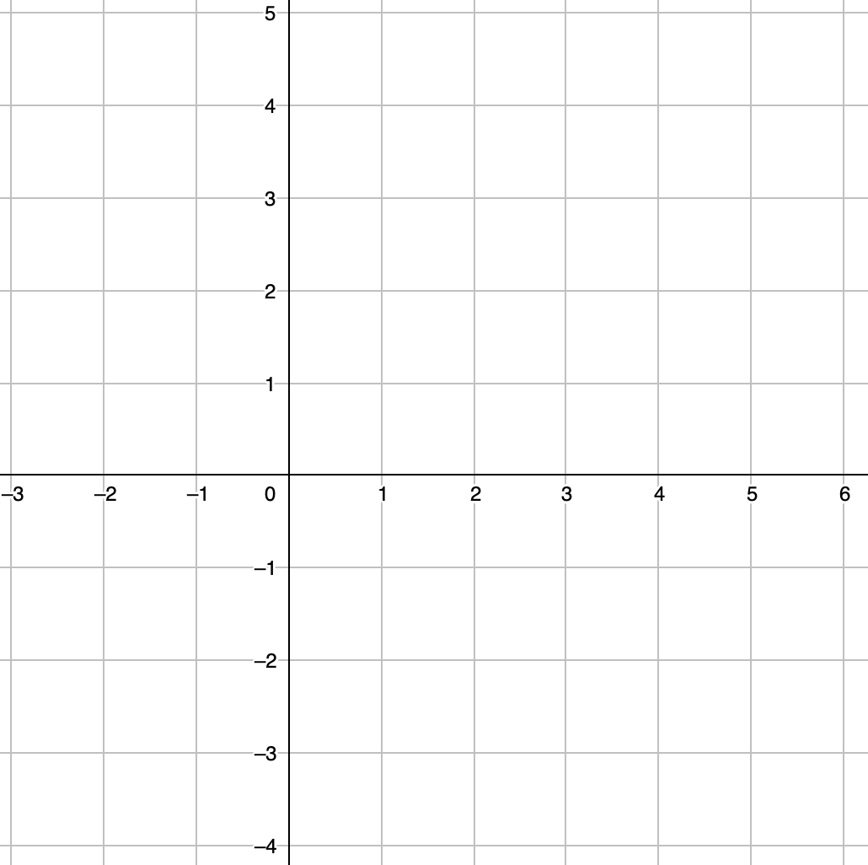

Checkpoint 1: Ant moves
y
An ant starts at (1, 2) on a coordinate grid. It can move only horizontally or vertically, along the grid lines. It always moves three units at a time.
Write the coordinates of all the points where the ant might stop.
x
How would your answers change if the ant started at (-1, 2)?
Notes:
Printable copies of the coordinate grid in this task are available in ‘Printable resources’, slide 32.
This slide is animated. An animation of the ant moving is included to demonstrate the ways in which the ant can move. It shows the ant moving three units vertically, down to (1, ˗1), and then one unit horizontally, one unit vertically and one unit horizontally from its initial position, to (3, 3). Each question will appear separately so you can choose the pace at which to work with your class.
Answers
(-2, 2), (-1, 1), (-1, 3), (0, 0), (0, 4), (1, -1), (1, 5), (2, 0), (2, 4), (3, 1), (3, 3) and (4, 2).
? If the ant started at (-1, 2) the places the ant might stop are: (-4, 2), (-3, 1), (-3, 3), (-2, 0), (-2, 4), (-1, -1), (-1, 5), (0, 0), (0, 4), (1, 1), (1, 3) and (2, 2).
Suggested questioning
Is there more than one route to each of the points where the ant might stop?
How can you be sure that you have found all the points where the ant might stop?
What do you notice about the positions of the points where the ant might stop?
Can the ant get to all four quadrants? Why or why not?
Things to think about
Checkpoint 1 offers a context for students to generate lots of coordinates, and is an opportunity to assess both their accuracy with coordinates and their approach to an open-ended task. Students may have assumed that a diagonal move counts as moving one unit, rather than two units (one unit horizontally and one unit vertically). Clarify this with a discussion about the number of units moved being found by adding the vertical and horizontal distances together and by making use of the animation of the ant moving.

Slide 8
Checkpoint 1: Guidance
Adaptations | Assessing understanding
Support The initial position of the ant means that possible moves take it into different quadrants. If crossing axes is problematic, shifting the starting point to the right may make the task more accessible. Challenge The context used is an example of ‘taxicab geometry’, examples of which are readily available online. Ask students to consider a situation where the ant always moves a distance of four units, or two units, and to reason about the results that they find. The resulting plot, a square aligned so that its diagonals are parallel with the axes, is an example of a constant distance from a point in a different geometry system. It’s unlikely that students will explore this further, but you could discuss with some students the similarities and differences between this and a circle. Representations The image of the ant, which is animated here, offers a context to help students visualise movement across the coordinate grid. Using movement with simple constraints gives students an opportunity to generate lots of different coordinates, and so allows teachers to check whether they understand how coordinates are used to represent different positions within a grid. | This activity gives an opportunity to observe and explore how confidently students use coordinates and the associated conventions to define a position on a grid (all four quadrants). Crossing axes and/or plotting points that lie on the axis may prove to be sticking points for some students. Look for the way that students approach the task and consider whether they are working systematically or in a more haphazard manner. When the starting point moves to (-1, 2), notice whether students rely on plotting all 12 points directly from the new starting position, or whether they can reason about how their existing set of coordinates will change.
Additional resources Additional activity B explores different ways of describing a position on a grid.

Slide 9
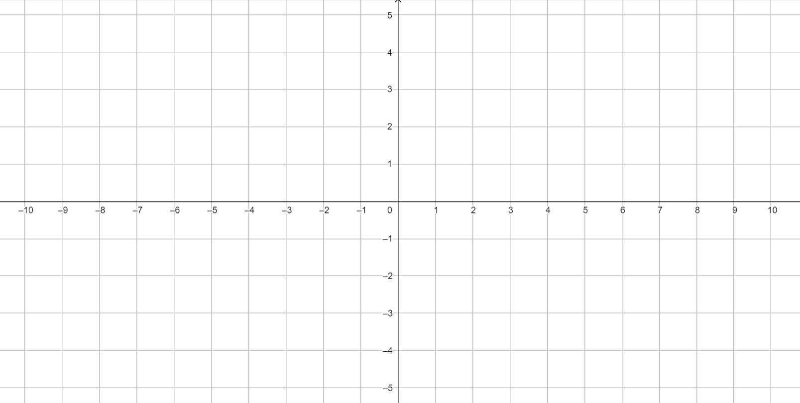

Checkpoint 2: Pirate treasure
y
Write the coordinates of point X.
X doesn’t mark the spot! Read the instructions below and write the coordinates after each step. Where is the treasure buried?
X
To find the treasure, move:
three steps left
one step down
four steps right and one down
five steps left.
The treasure is buried here!
x
The pirate’s map is back to front! Reflect your points in the y-axis. Where is the treasure now? How would this change if the map was upside down, and you reflected in the x-axis?
Notes:
Printable copies of the coordinate grid in this task are available in ‘Printable resources’, slide 33.
This slide is animated. Each question will appear separately so you can choose the pace at which to work with your class.
Answers
a) (2, 1)
b) (-1, 1), (-1, 0), (3, -1), (-2, -1). The treasure is buried at (-2, -1).
? When reflected in the y-axis, the sign of the x values change, whilst the y values remain the same (so (-2, 1) and
(1, 1), (1, 0), (-3, -1), (2, -1)).
If reflected in the x-axis, the x values are unchanged and the sign of the y values change (so (2, -1) and (-1, -1), (-1, 0), (3, 1), (-2, 1)).
Suggested questioning
What effect does moving three steps left have on the coordinate values of the starting point?
How would this change if the first instruction was to move three steps right? up? down?
Which quadrant does each instruction take you to?
Can you describe the shortest route to get from X to where the treasure is buried?
Things to think about
Checkpoint 2 uses translation of a single point to generate coordinates and check students’ confidence with moving around the coordinate grid. Their understanding of translation is assessed using the simplest case of a single point to check whether they can draw and translate points on the coordinate plane. As the full coordinate grid is used, this checkpoint also assesses understanding of negative numbers in the context of coordinates – particularly in the further thinking question, where reflection is also introduced.

Slide 10
Checkpoint 2: Guidance
Adaptations | Assessing understanding
Support Identify a position in the first quadrant and ask students how many steps you would have moved right/left/up/down (single directions initially) to get from X to that point. Challenge If students complete the further thinking easily, probe their understanding by asking them to consider the original coordinates of a set of points that have been reflected in the x- or y-axes. Can students generalise about the effect of reflecting in the axes by describing what happens to the coordinates? Representations Students should have experienced the four-quadrant coordinate grid in primary school and may also have experienced coordinates in the context of maps. This checkpoint conflates the two to expose misconceptions: check students understand that coordinates describe a point on the grid, rather then the ‘inside’ of the square. | In this activity students describe the positions of the different steps which make use of the full coordinate grid. The movements suggested check a coordinate in each quadrant, as well as one that lies on an axis. The further thinking question also asks them to reflect points: reflection in the axes is included in the primary curriculum, whilst reflection in other lines is not. Consider how this task might be adapted or repeated with changes to the instructions, to probe the coordinates that students find most challenging. It may be that students are more prone to slips in the second and fourth quadrants, where only one coordinate is negative. Further discussion about combining moves can be used to explore how there is more than one way to describe the route from one point on the grid to another. What is the most efficient way of getting from X to where the treasure is buried? (Four steps left and two steps down).
Additional resources Additional activity B explores different ways of describing a position on a grid, with diagrams A and B particularly focusing on the misconception that the coordinates describe the square, rather than the intersection of the gridlines.

Slide 11
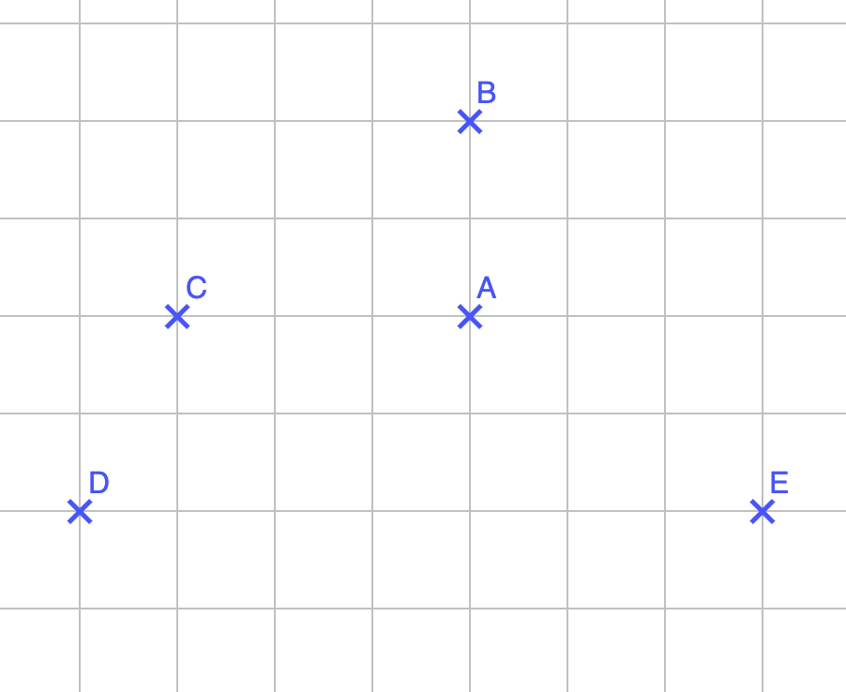
Checkpoint 3: High points and low points
Max zooms in on one part of the coordinate grid. Fill in the gaps to give the coordinates of each point:
Jodie zooms in on a different part of the
coordinate grid. Her points are in the same arrangement, but coordinates are different: A is now (1, -50). What are the other coordinates?
A (4, __)
B (__, 98)
C (1, __)
D (__, __)
E (__, 94)
What might your five coordinates be if you zoomed in on a different part of the coordinate grid?
Notes:
Printable copies of the coordinate grid in this task are available in ‘Printable resources’, slide 34.
This slide is animated. Each question will appear separately so you can choose the pace at which to work with your class.
Answers
a) A: (4, 96), B: (4, 98), C: (1, 96), D: (0, 94), E: (7, 94)
b) B: (1, -48), C: (-2, -50), D: (-3, -52), E: (4, -52)
? Students’ coordinates should take the form: A: (a, b), B: (a, b + 2), C: (a – 3, b), D: (a – 4, b – 2) and E: (a + 3, b – 2).
Suggested questioning
If the x-coordinate of A is 4, where would an x-coordinate of 0 be? How does this help us work out where the axes would be?
When two points lie on the same vertical/horizontal line, what does this tell us about the x and y values of the coordinates of the two points?
How do the coordinate values of the points A and B relate to each other? What about A and C? D and E?
Things to think about
Checkpoint 3 moves away from the area of the coordinate grid around the origin, and challenges students to apply their understanding in a less familiar context. Students might assume that each square represents one unit without using the information provided; draw attention to how the information given for points AE confirms this to be true.

Slide 12
Checkpoint 3: Guidance
Adaptations | Assessing understanding
Support If students can’t ‘imagine’ the coordinate grid without axes, step back from part a and complete the task with axes drawn on the first horizontal/vertical lines. Then build up to the larger values. For example, (_, 28) for B before (_, 98). Challenge Ask students to recreate the question in part a where the axes scaling is unequal, giving the x-value for point A and the y-value for points B and E. What’s the minimum additional information needed about the points for the scaling on the x-axis to be identifiable? Representations This Checkpoint goes beyond the familiar representation of four quadrants around two axes, to coordinates of a magnitude that students are unlikely to have worked with. They may need the support of dynamic graphing software (such as GeoGebra) to visualise this. Model scrolling ‘up’ the y-axis to reach these coordinates. | Can students work as confidently with coordinates, without the familiarity of the axes and the kind of values that they are more used to seeing? Students are likely to rely on counting between different points – watch for those that then struggle to identify the relevant coordinate. Listen to students’ justifications: some may demonstrate an understanding of the relationship between points that lie on the same vertical or horizontal line, and what will be the same about their coordinates. In part b, check if students understand how the negative scale on the y-axis works. In working out the y-coordinate of B, do they correctly add 2 to get -48, or do they suggest -52?
Additional resources Additional activity A draws students’ attention to the relationship between points that lie on the same vertical/horizontal lines. Additional activity C explores the same points A to E with unequal as well as equal spacing on the axes. Additional activity D uses the properties of isosceles triangles to expose the relationships between coordinate values for points that lie on the same vertical and horizontal lines, as well as for points that are equidistant between two other points.

Slide 13
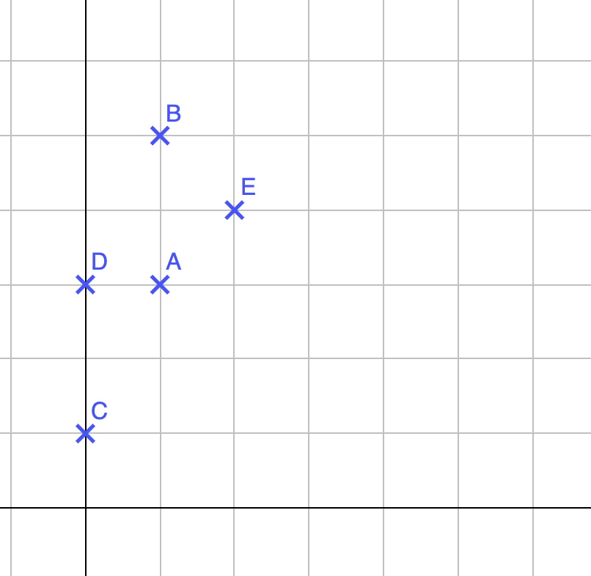
Checkpoint 4: Awkward axes
y
The coordinates of point A are (1, 6).
What values should be on the grid lines on the x- and y-axes?
Fill in the gaps to give the coordinates of each point:
B (__, __)
C (__, __)
D (__, __)
E (__, __)
Which of your coordinates would need to change if A was (5, 6)?
x
Notes:
This slide is animated. Each question will appear separately so you can choose the pace at which to work with your class.
Answers
a) x-axis, each square represents one unit; y-axis, each square represents two units.
b) B (1, 10), C: (0, 2), D (0, 6), E (2, 8)
? B would change to (5, 10) and E would change to (10, 8).
Suggested questioning
Why does changing the scale on the x-axis not affect the coordinate values of points C and D?
If the scaling on the x-axis was the same as the y-axis, what would the coordinates of the points A to E be?
If the y-axis was moved so that points A and B now lie on the axis, what would the coordinates of the points A to E be?
Things to think about
While Checkpoints 1 to 3 used a scale of one unit to one square, Checkpoint 4 challenges the notion that this is always the case. You could repeat this task with different coordinates for point A, to further explore scale and multiplicative reasoning.

Slide 14
Checkpoint 4: Guidance
Adaptations | Assessing understanding
Support Tell students that the coordinates of point A are (1, 3) and ask them to determine the coordinates of points B to E. Look at a grid where the scale is 1 unit per square and the scale is the same on both axes before identifying the coordinates of point A as (1, 6). Challenge Encourage students to consider different scales. Can they create a scale so that all the coordinates of all the points are even? How about a scale so that none of them is an integer? Representations Checkpoint 4 uses unequal spacing on the axes. It is important for students to recognise that one square on the coordinate grid doesn’t necessarily represent one unit and that the scaling on the two axes may not always be the same. Students may be more familiar with this idea from previous work on data, where they adapt the scale to fit the values they need to represent. | When describing positions on a coordinate grid, students often focus on how a point relates to the origin, and assume each square represents one unit. This Checkpoint challenges that assumption and assesses how confident students are in dealing with different scales and whether they look at the scale carefully when describing and plotting coordinates. Ask students to describe the position of the points to assess their approaches and how they differ from counting moves left/right and up/down using the grid’s squares. Notice whether students recognise the connection between the x-values in the coordinates for points C and D and the fact that these two points lie on the y-axis. Explore their understanding of different scales, and whether they understand multiplication as scaling as well as repeated addition. This will help planning for other teaching that relies upon multiplicative relationships.
Additional resources Additional activity B extends the idea of different axis scales to the use of different types of coordinate grid. Additional activity C provides an opportunity to explore further the relationships between points that lie on the same vertical or horizontal line as well as considering unequal scaling.

Slide 15
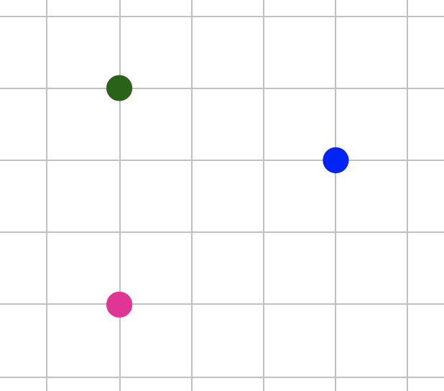
Checkpoint 5: Origin stories
Three points are plotted on a coordinate grid.
One of the points is (0, 0).
If the pink point is (0, 0), what are the possible coordinates of the green and blue points?
If the blue point is (0, 0), what are the possible coordinates of the pink and green points?
If the green point is (0, 0), what are the possible
coordinates of the blue and pink points?
The origin is between the green and the pink points. What might the coordinates of the blue point be?
Notes:
Printable copies of the coordinate grid in this task are available in ‘Printable resources’, slide 35.
This slide is animated. Each question will appear separately so you can choose the pace at which to work with your class.
To support any students with colour vision impairment, point to each colour point in turn and state its colour and describe its position (for example, ‘green, top left’).
Answers
a) The most likely answer students will give will assume that each square represents one unit, so the green point will be at (0, 3) and the blue point will be at (3, 2). However, it is also acceptable to give any pair of coordinates where the green has an x-coordinate of 0, and the y-coordinate of green is both positive and 1.5 times the y-coordinate of blue (i.e. green is of the form (0, 3n) and blue is of the form (3m, 2n).
b) Pink (-3, -2) and green (-3, 1) are possible, or any other pairs of coordinates where the x-coordinates are both negative and equal, and the y-coordinate of the pink is -2 times the (positive) y-coordinate of the green (i.e. pink is (-3m, -2n) and green is (-3m, n).)
c) Blue (3, -1) and pink (0, -3 ) are possible – or any other pairs of coordinates where the pink has an x-coordinate of 0, the pink’s y-coordinate is three times the blue’s y-coordinate, and both the pink and blue’s y-coordinates are negative, i.e. pink is (0, -3n) and blue is (3m, -n).
? If the origin is positioned closer to the pink point than the green point, then the coordinates of the blue point will be (3, 1), assuming equal scaling of one unit.
If the origin is positioned closer to the green point than the pink point, then the coordinates of the blue point will be (3, 0).
If the origin is positioned equidistant between the pink and green points, then the coordinates of the blue point will be (3, 0.5).
Suggested questioning
Is anything the same for these three points?
What have you assumed when determining the coordinates of the other two points?
How might unequal scaling on the two axes affect your answers?
If the blue point is (0, 1), what could the coordinates of the green point be?
Things to think about
Checkpoint 5 removes a familiar ‘anchor’ for students’ interpretation of coordinates, the axes/origin. Notice the language students use to describe one point in relation to another. For example, they may describe the blue point as being to the right of the pink and green points. The quadrants in which the other two points lie change as each points is selected as the origin, which might be a good discussion point. Before choosing their coordinates, can students first identify whether the coordinates will be negative or positive? For the further thinking question, do students consider the origin as being equidistant between the green and pink points? Are they happy to consider the associated non-integer coordinate values for the three points if unit spacing is assumed? Thinking about scale can help students to think more deeply about the relationships between the three points.

Slide 16
Checkpoint 5: Guidance
Adaptations | Assessing understanding
Support Model drawing the axes for part a to demonstrate how the pink point could be the origin. A printable version of this checkpoint is provided on slide 9. Give students at least three blank versions so that they can draw fresh axes each time. Challenge Thinking beyond each square representing one unit, encourage students to come up with lots of possible coordinates for the other two points. Can they generalise about the relationships between pairs of coordinates? Challenge them to think about properties of shapes. Can they add a fourth point to make a parallelogram? How many possible positions are there for the fourth point? Representations Students will have experienced points being plotted as both crosses and dots at primary school. To support with this familiarity, dots have been used in this checkpoint. Discuss why crosses are more accurate for denoting points and therefore used more commonly at secondary school. | This Checkpoint assesses understanding of the origin (although this term is not explicitly used until the ‘further thinking’ question) and whether students understand its relationship to the axes. Assess to what extent students understand how the coordinate grid works. The following suggested lines of questioning are in a suggested order of progression. Can they describe the coordinates of the other two points as greater than or less than the (0, 0) coordinate, based on whether they are to the left, right, up or down? Do students notice that the green and pink points always have the same x-value? Can they identify which quadrant each of the other two points are in, as the origin moves to be positioned at each of the three points? If students struggle with any aspect of these, consider how you might address any issues in future teaching.
Additional resources Additional activity A extends the idea of identifying the coordinates of a point based on information about another point, to estimating coordinates based on the distance between points, as a grid is not provided.

Slide 17
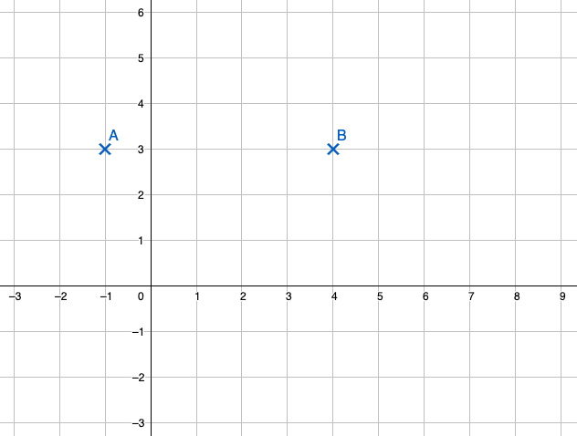
Checkpoint 6: Triangle possibilities
y
Two vertices of a triangle, A and B, are plotted.
Write the coordinate of a third point, C, to complete the shape. Is there more than one possible answer?
Can you find coordinates that make:
  a right-angled triangle
  an isosceles triangle
  a triangle with an x-coordinate that is greater than B?
x
Using A and B as your starting points, can you create a triangle with an area of 10 cm²?
Notes:
Printable copies of the coordinate grid in this task are available in ‘Printable resources’, slide 36.
This slide is animated. Each question will appear separately so you can choose the pace at which to work with your class.
Answers
a) Any point other than on the line y = 3 (x, 3) will result in a triangle being formed.
b)
(i) Any point of the form (-1, b) or (4, b) where b ≠ 3.
(ii) Possibilities include (-1, 8), (4, 8), (-1, -2) or (4, -2), and any point of the form (1.5, b) where b ≠ 3.
(iii) Any coordinate of the form (a, b) where a > 4 and b ≠ 3.
? If AB is the base then the triangle will have height 4.
Suggested questioning
Are there any coordinates that won’t make a triangle?
How many different right-angled triangles can you make?
Why does (1.5, -2) not create an equilateral triangle?
Things to think about
Checkpoint 6 explores triangles on a coordinate grid. It offers a further chance to assess students’ confidence and accuracy with coordinates, as well as their understanding of different properties of triangles. Language such as scalene and equilateral is not explicitly used here, so teachers might like to check understanding of these terms within their questioning.

Slide 18
Checkpoint 6: Guidance
Adaptations | Assessing understanding
Support Ask students first to determine the coordinates of two points that give a rectangle, providing an opportunity for them to consider vertical and horizontal sides before considering the sides of triangles. Challenge Ask students to find more than one of each of the different triangle types and encourage them to include non-integer coordinate values (which includes isosceles triangles where side AB has a different length to the other two sides). Can they identify an isosceles triangle with an x-coordinate that is greater than B? Representations Students are likely to have explored shapes on a coordinate grid at primary. The line segment AB is five units long to encourage students away from initially choosing points that make symmetrical triangles and offer more exploration of different properties. | This activity assesses how well students can use their understanding of properties of shapes to determine missing coordinates. Part a is more open: explore how flexibly students can think about triangles. Do they recognise different properties and orientations, or opt for the most ‘classic’ version of the shape? Part b includes constraints to further assess understanding of triangles and coordinates. The position of vertices A and B means that the coordinate of the midpoint between them (needed for part ii) has a non-integer x-value. This is an opportunity to assess students’ fluency at plotting coordinates involving non-integer values. Part iii nudges students towards triangles where the vertical height is ‘outside’ the shape, which will be useful for future work on triangles.
Additional resources From the Key Stage 2 SATs papers, 2018 Paper 3 (reasoning) question 10 features a similar problem, but with vertices of a square so that there is only one possible position for the missing vertex. Past papers can readily be found online. The predicting missing vertices problems on p35 of the Year 6 Primary Assessment Materials | NCETM offer a potential next step for this task, where students can consider possible coordinates without plotting them.

Slide 19
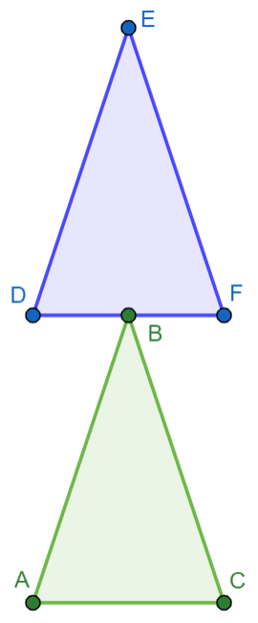
Checkpoint 7: A trio of triangles
The blue triangle is identical to the green triangle and directly above it.
The coordinates of the green triangle are:
A (3, 6)
B (4, 9)
C (5, 6)
Write down the coordinates of D, E and F.
A third identical triangle is to be drawn beside the blue triangle, so that they share a vertex at F. What are the
coordinates of the other two vertices of the new triangle?
Notes:
Printable copies of the triangles in this task on grids are available in ‘Printable resources’, slide 37.
This slide is animated. The introduction and instruction will appear separately so you can choose the pace at which to work with your class.
Answers
D (3, 9)
E (4, 12)
F (5, 9)
? Identifying the coordinates of the other two vertices as (7, 9) and (6, 12) is likely to be the most common response, as it retains the same orientation as the green and blue triangles.
Another possibility is coordinates (5, 11) and (8, 10).
Suggested questioning
D is directly above A, so which coordinate value will be the same?
Can you describe where the third triangle might be? Is there more than one answer?
Things to think about
In Checkpoint 7, the coordinate grid is not shown and so students need to reason about the relative points using properties of triangles. Students may notice that the blue triangle is a translation of the green triangle: translation of shapes is part of the primary curriculum. However, teachers should note that students will use language to describe the movement rather than the column vectors that are be introduced later in Key Stages 3 and 4. In the context of the Checkpoints, we suggest that teachers are mindful to use known language from primary school.

Slide 20
Checkpoint 7: Guidance
Adaptations | Assessing understanding
Support Using the printable resource with the triangles on a coordinate grid may help some students to access this activity. Challenge Ask students to describe the translation that takes the green triangle to the blue triangle. Can their third triangle be described as a translation of the blue and green triangles? Can it be described as a reflection of the blue triangle? As a rotation? Representations Thinking about the coordinates of one point in relation to another, without a visible coordinate grid, can support students in recognising the relationships between coordinate values of points that are on the same vertical or horizontal lines, as well as focussing their attention on the change in coordinate values. | In this Checkpoint, students’ reasoning around coordinates is assessed. Do students recognise that the x-coordinates of points D and F must be the same as point B? Do they recognise that the B and E share a y-coordinate? Do they use the same reasoning to work out the x-coordinates of D and F, or do they use the properties of the isosceles triangle? Checkpoint 7 also provides an opportunity to assess students’ understanding of position and direction and whether they can apply their knowledge of translating points/polygons within the first quadrant. A discussion about the positions of the triangles in terms of translation can help to assess students’ use of language and consolidate that when a shape is translated, its orientation and size remain the same. Based on experience at primary school, students may be more likely to use the word ‘move’ than ‘translate’ and will use directional language rather than vector notation, which has not yet been taught.
Additional resources In Additional activity D students are required to complete missing coordinate values for a series of different isosceles triangles, making use of vertical and horizontal lines as well as points that are equidistant between two other points.

Slide 21
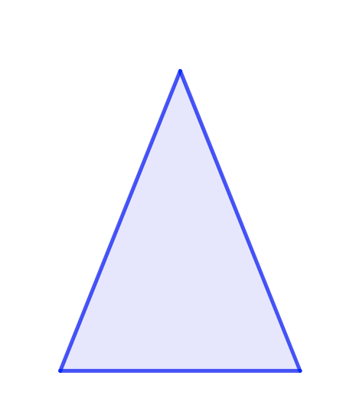
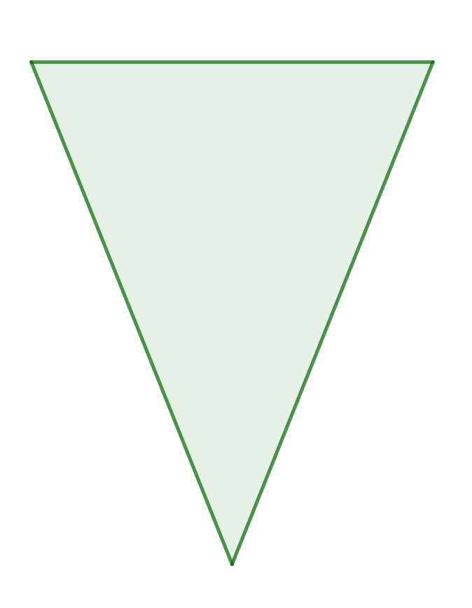
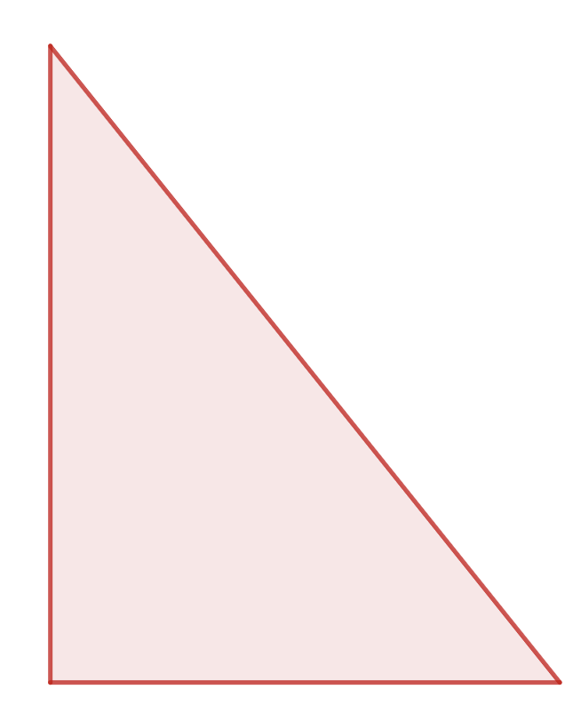
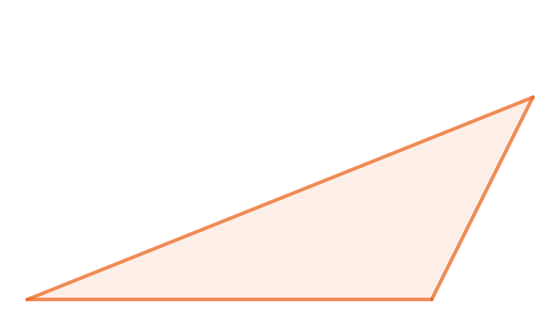
Checkpoint 8: Imagining triangles
a)
b)
Each set of coordinate pairs a to d is used to plot a triangle. Match the coordinates to the triangles.
(3, 6)
(7, 6)
(5,11)
(3, 6)
(7, 6)
(3,11)
Green
Orange
Red
Blue
c)
d)
(3, 6)
(7, 6)
(5,1)
(3, 6)
(7, 6)
(8, 8)
Create new sets of coordinate pairs describing the four triangles that include negative coordinate values.
Notes:
Printable copies of the triangles in this task on a square grid are available in ‘Printable resources’, slide 38.
This slide is animated. Each question will appear separately so you can choose the pace at which to work with your class.
Answers
Set a matches with the blue triangle.
Set b matches with the red triangle.
Set c matches with the green triangle.
Set d matches with the orange triangle.
? Any valid answers, if (3, 6) was changed to (-3, -6) for example, then the sets would now be:
Green (-3, -6), (1, -6), (-1, -11)
Orange (-3, -6), (1, -6), (2, -4)
Red (-3, -6), (1, -6), (-3, -1)
Blue (-3, -6), (1, -6), (-1, -1)
Suggested questioning
For each triangle, which coordinate values will be the same for two of the points? How does this help you?
For each set of coordinates, what is the same and what is different? How does this help you?
What is the height of each of the triangles? Explain how you know.
Things to think about
Much like Checkpoint 7, Checkpoint 8 asks students to reason about properties of shapes. Working with coordinates without the grid provides an opportunity to focus on what the differences in the x- and y-values of the coordinates tell us about the four triangles. Can students identify how the base of each triangle can be identified as being four units using the coordinate values?

Slide 22
Checkpoint 8: Guidance
Adaptations | Assessing understanding
Support Use the printable resource with the triangle images on a square grid with students who are struggling to get started. Challenge Make links to area. Do students understand that triangles with the same base and perpendicular height will have the same area, even though they may not look the same? Can they create coordinate pairs to describe a triangle that has the same area as each triangle, but looks different? Representations Presenting coordinates and corresponding triangles without the coordinate grid helps to assess whether students recognise that, for example, the points (3, 6) and (7, 6) lie on the same horizontal line with the point (7, 6) to the right of the point (3, 6). Removing students’ reliance on the coordinate grid helps them to develop a deeper understanding of position and how one point relates to another. | Checkpoint 8 uses coordinates as a lens to explore and compare four triangles. It offers assessment points for both properties of triangles and reasoning about coordinates. Key things to listen out for and prompt: Do students realise that all of the triangles have the same base length (from 3, 6) to (7, 6)? Do students recognise that when two or more points have the same y-value, the points lie on the same horizontal line; and when they have the same x-value, they lie on the same vertical line? In the context of these four triangles, this describes their base and perpendicular height. Do students understand that, for the isosceles triangles, the x-coordinate of the third point must be midway between 3 and 7? Can they use the y-coordinates to reason about the orientation of the green and blue triangles?
Additional resources Additional activity D also explores four triangles, but in this activity some of the coordinate values are missing. Students have to use their understanding of what’s the same and what’s different for points that lie on a vertical or horizontal line, as well as their knowledge of isosceles triangles to complete the missing coordinates.

Slide 23
Checkpoint 9: Let’s go fly a kite
y
The points (3, -4), (3, 2) and (5, -1) are marked on the coordinate grid. They are the first three vertices of a shape.
Add another coordinate to create a kite.
Choose another coordinate to create a different kite. How many different kites can you create with the same starting points?
x
Choose four coordinates to create a kite that is the same size as the one in part a, but rotated by 90°.
Notes:
Printable copies of the coordinate grid in this task are available in ‘Printable resources’, slide 39.
This slide is animated. Each question will appear separately so you can choose the pace at which to work with your class.
Answers
a) Any coordinate of the form (a, -1) where a is ≤ 2.
b) Students may state that there are six possible kites with the fourth point at (2, -1), (1, -1), (0, -1), (-1, -1), (-2, -1) and (-3, -1). There are, in fact, an infinite number of possible kites, so long as the y-coordinate is -1. This makes for an interesting discussion, but in the context of a 10-minute assessment activity teachers may like to limit the answers to those that are visible on the grid. Teachers may choose to specify only integer coordinates, or see if students suggest some decimal possibilities.
? This will depend on the kite created by students in part a. However, the original kite has one diagonal that is six units, so there should be two points with coordinates (a, b) and (a + 6, b) and a third coordinate (a + 3, b + 2). The fourth coordinate will depend on the length of the diagonal on the students’ kite but should have an x-value of a + 3.
Suggested questioning
What is the same and what is different about the coordinate values for the fourth vertex and the point (5, -1)?
What is special about the kite created when the fourth point is at (1, -1)?
If the fourth point was at (4, -1), would this still be a kite?
Things to think about
A kite has been chosen for Checkpoint 9 as it is a very recognisable shape, but one whose properties are often not deeply understood. It may be unfamiliar in this orientation. See the Guidance slide for Checkpoint 5 for a note about the use of dots instead of crosses to denote points on the grid.

Slide 24
Checkpoint 9: Guidance
Adaptations | Assessing understanding
Support Ask students to first plot the four vertices of a kite on a grid and describe what they notice about the relationships between the coordinate values for the four points. Challenge Kites can be both concave and convex. While convex kites will be most familiar to students, ask students to consider the coordinates of the points that produce concave kites, for example: (4, -1) or (6, -1). Can they use their understanding of the properties of a kite to justify why these arrowheads/darts are also kites? Representations The kite has been deliberately orientated so that the longest diagonal is horizontal – rather than vertical, as students might more usually have seen it. You can therefore assess the boundaries of students’ understanding of what a kite is. A kite is a quadrilateral with two pairs of adjacent sides of equal length with diagonals that intersect at right angles and where one diagonal bisects the other. A rhombus is a special kite where all four lengths are equal. | Use the coordinate grid to assess students’ understanding of the properties of shape in this activity. This provides an insight into their understanding of the features of kites, and may inform future teaching on properties of shapes (as well as more immediate teaching on coordinates). Students may assume that the point (5, -1) is the top of the kite and so prefer not to plot the fourth point at (2, -1), as the ‘upper’ section of a kite is often seen as being shorter in length than the ‘lower’ section. Further questions that you might want to consider include: Do students recognise that one diagonal of the kite bisects the other, and what this means for the relationship between the coordinates? Do they recognise that the diagonals of this kite lie on vertical and horizontal lines? In the further thinking question, can students use language such as clockwise or anticlockwise to describe the rotation?
Additional resources Additional activity E extends identifying missing coordinates to satisfy properties of shapes.

Slide 25
Additional activities
Activities A–E

Slide 26
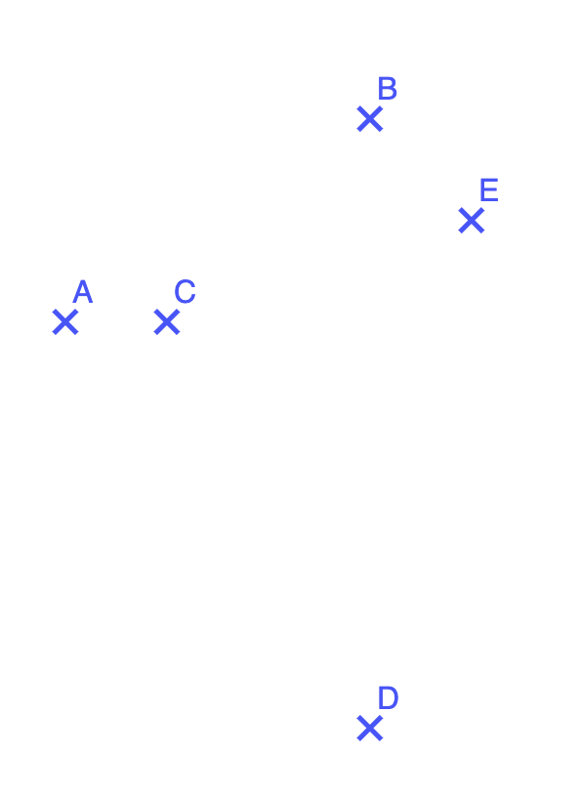
Activity A: Estimating points
Points A, B, C, D and E are plotted.
The coordinates of point B are (7, 7) and the coordinates of point C are (5, 5).
Estimate the coordinates of A and D.
Write the coordinates of three more points on the red line.
Write the coordinates of three more points on the orange line.
Where do the two lines cross? How do you know?
Estimate the coordinates of E. What other
coordinates would be on the horizontal line that goes through E? How about the vertical line?
Notes:
This slide is animated. Each question will appear separately so you can choose the pace at which to work with your class.
Answers
a) A (4, 5) and D (7, 1)
b) Any points of the form (x, 5). For example, (6, 5), (7, 5) and (8, 5).
c) Any points of the form (7, y). For example, (7, 2), (7, 3) and (7,4).
d) (7, 5), as the red line is y = 5 and the orange line is x = 7.
? E = (8, 6). Any points of the form (x, 6) lie on the horizontal line and any points of the form (8, y) lie on the vertical line that goes through E.
Suggested questioning
What is the change in x-value between points C and B? How does this help you to estimate the coordinates of point A?
What is the change in y-value between point B and the red line? How does this help?
Which axis is the red line parallel to? How do the y-values compare?
Can you draw a vertical and horizontal line that passes through point E? How does this help?
Things to think about
Activity A, much like Checkpoints 2 and 4, removes the familiarity of the axes and ask students to reason about the relative position of the coordinates given. It is important that students understand what it means to estimate the coordinates of a point, as it is likely that this will be unfamiliar to them. Students might assume that estimating the coordinates means that they ‘guess’ their position, rather than using the information provided about the points B and C to make some informed conjectures about the positions of the other points based on how their position relates to the two points that are known. Students’ responses might inform future teaching of horizontal and vertical lines.

Slide 27
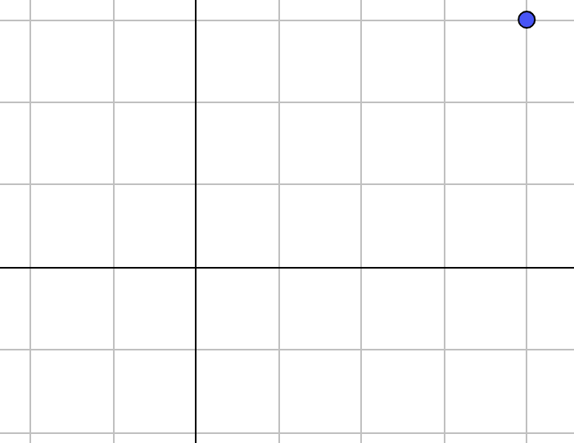
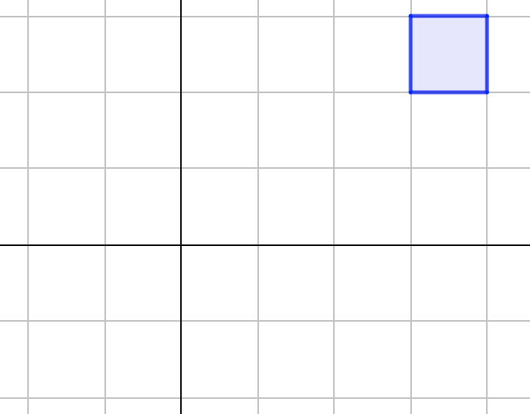
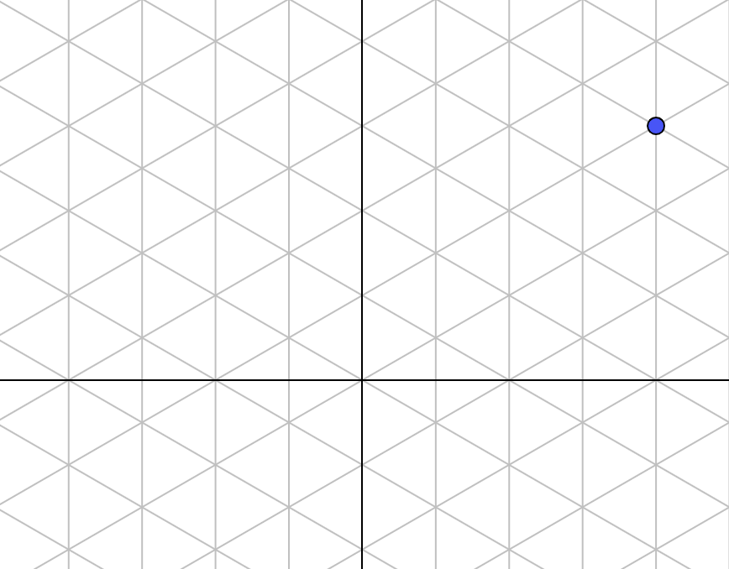
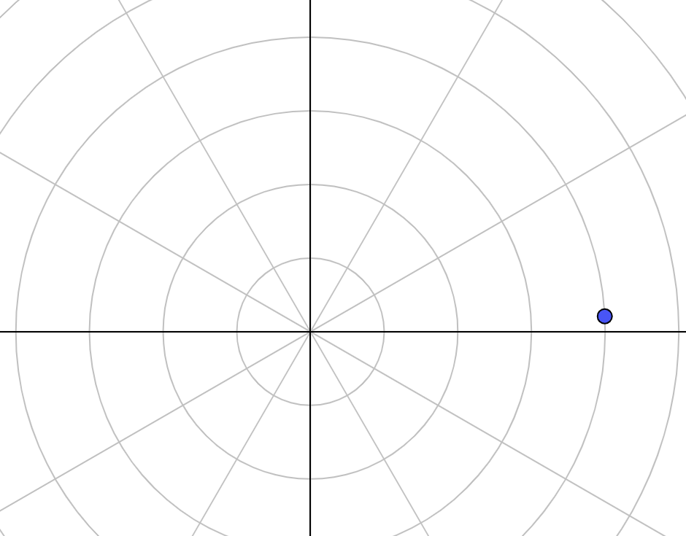
Activity B: (4, 3)?
A
B
What does (4, 3) have to do with each of these diagrams?
What’s the same and what’s different in each case?
C
D
How would the images change if one of the coordinate values was negative?
Notes:
Printable copies of the diagrams in this task are available in ‘Printable resources’, slide 40.
This slide is animated. Diagrams C and D appear after diagrams A and B so you can choose the pace at which to work with your class.
Answers
A The point is four units to the right of the vertical axis and three units up from the horizontal axis.
B The square is in the fourth column along from the vertical axis and in the third row up from the horizontal axis.
C The point lies on the fourth vertical line to the right of the vertical axis and is level with the third intersection of the diagonal lines up from the origin on the vertical axis.
D The point is on the fourth circle out from the origin at an angle of 3° measured anticlockwise from the horizontal axis.
Suggested questioning
How does the point in diagram A relate to the square in diagram B?
If we think about diagram C as a three-dimensional coordinate system, what would the coordinates of the point be? Which of the two axes would need to be removed from the diagram?
What angles can you see in diagram D? How might we use angles to describe the position of the point in relation to the horizontal axis?
Things to think about
Activity B explores how deeply students understand coordinates as describing position on a plane. Students often liken a coordinate grid to a map grid, where we are interested in the space inside the squares rather than the points where the grid squares intersect. Comparing diagrams A and B helps to establish that a Cartesian coordinate describes a point on the grid rather than a square. Diagrams C (an isometric grid) and D (polar coordinates) offer some interesting points for discussion, and are included so that teachers can listen to how students conjecture and explain their reasoning. Do students recognise that the ‘3’ for diagram D does not describe a vertical distance up from the horizontal axis but an angle measured anticlockwise from the origin?

Slide 28
Activity C: Where are the axes?
Where are the axes if:
A is (2, 3) and E is (5, 1)
A is (-2, 3) and E is (1, 1)
A is (3, -2) and E is (6, -6)
A is (-2, 3) and E is (1, -1)?
Where might the axes be if there was at least one point in all four quadrants?
Notes:
Printable copies of the coordinate grid in this task are available in ‘Printable resources’, slide 34.
This slide is animated. Each question will appear separately so you can choose the pace at which to work with your class.
Answers
a) The y-axis is one square (one unit) to the right of point C and the x-axis is one square (one unit) down from points D and E.
b) The y-axis is one square (one unit) to the left of point E and the x-axis is the same as for part a.
c) The y-axis goes through point C and the x-axis is one square (two units) down from point B.
d) The y-axis is the same as for part b and the x-axis is half a square (one unit) up from points D and E.
? A possible position for the axes is: the y-axis one square to the left of points A and B and the x-axis one square up from points D and E.
Points A and B will be in the first quadrant, point C will be in the second quadrant, point D will be in the third quadrant and point E will be in the fourth quadrant.
Suggested questioning
How is the scaling in parts c and d different to the scaling in parts a and b?
What is the same about the scaling in parts c and d compared with the scaling in parts
a and b?
Things to think about
This activity, much like Checkpoints 4 and 5, challenges students to think about the coordinate grid more flexibly, and so assesses how deeply they understand coordinates as a representation of position. The difficulty builds with each part – from each square representing one unit for both axes in part a, to one axis having a different scale in part b, to both axes having a different scale in part c. If students find this hard to access, prompt them to think about the difference between pairs of x- or y-values and what each square must represent because of this. Students may find it particularly challenging to draw the x-axis between the grid lines for part d. This is included to help teachers assess the limits of students’ understanding; don’t dwell on this part if it proves a step too far.
Another point of discussion might be the signs of the coordinate values within each of the four quadrants. Students are unlikely to be familiar with the convention for numbering the quadrants, but should be able to identify whether each coordinate is positive or negative if the quadrants are identified by pointing:
First quadrant: x- and y-values are both positive.
Second quadrant: x-values are negative and y-values are positive.
Third quadrant: x-values and y-values are both negative.
Fourth quadrant: x-values are positive and y-values are negative.

Slide 29
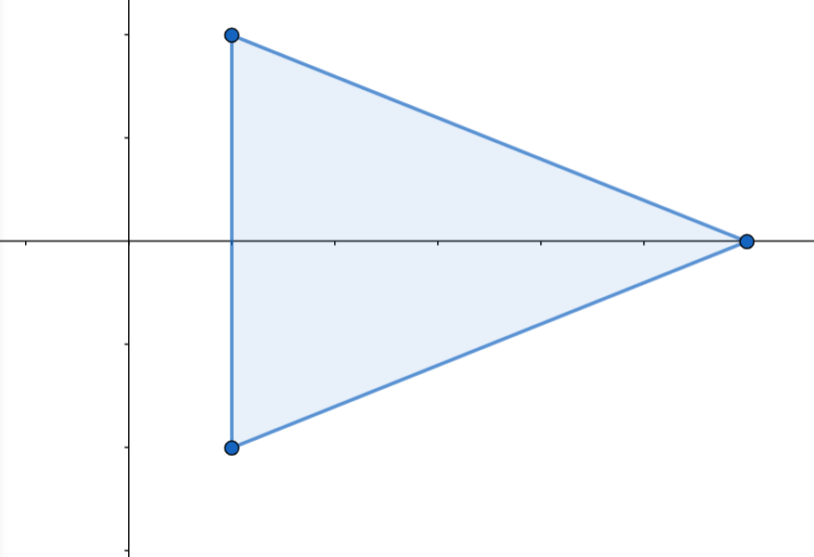
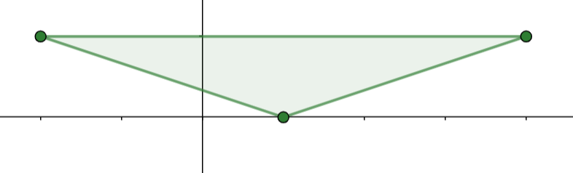
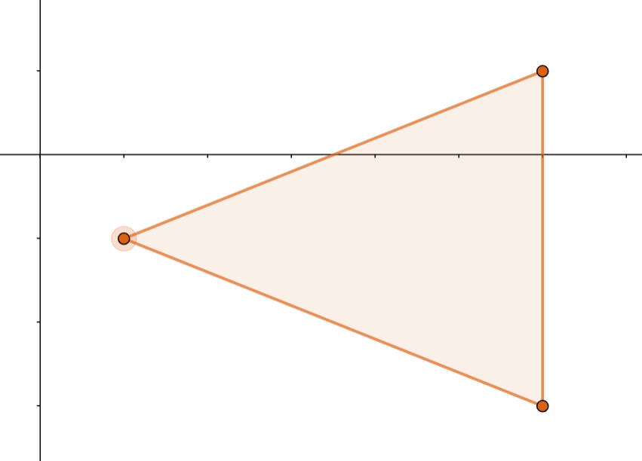
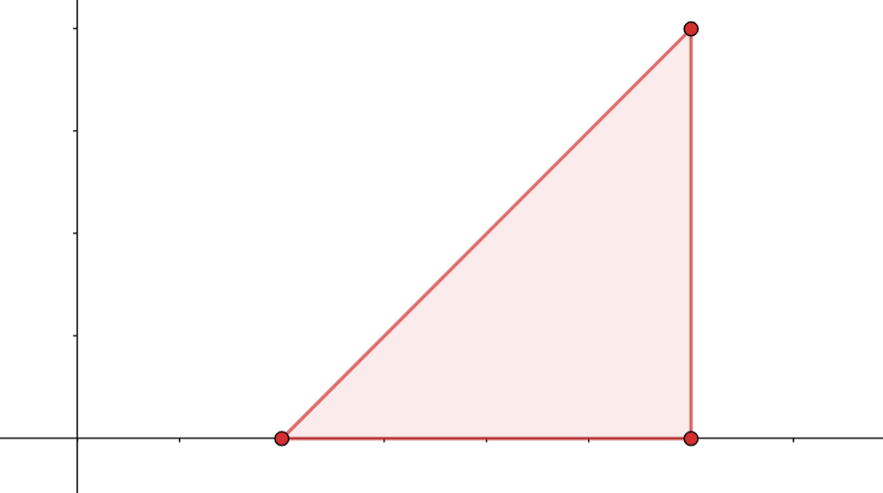
Activity D: Missing coordinates
Write the missing coordinates for each of these isosceles triangles.
(_, _)
(-2, 1)
(4, _)
(6, _)
Plot your own isosceles triangle.
What is the minimum information you must give to make all the
coordinates identifiable?
(_, _)
(1, -2)
(6, 4)
(_, 1)
(1, _)
(6, -3)
(_, _)
(_, _)
Notes:
This slide is animated. The further thinking question will appear separately so you can choose the pace at which to work with your class.
Answers
Blue triangle coordinates: (1, 2) and (6, 0).
Green triangle coordinates: (1, 0) and (4, 1).
Orange triangle coordinates: (1, -1) and (6, 1).
Red triangle coordinates: (2, 0) and (6, 0).
? Students’ responses to this will vary, depending on the coordinates that they give. For example, they will need to give less information if they make use of identifiable points on the grid such as the axes or origin, or if their triangle has specific properties such as being isosceles or having vertical/horizontal sides.
Suggested questioning
What can you say about the coordinate values for points that lie on the same x-/y- axis? What’s the same and what’s different?
What can you say about the coordinate values for points that lie on the same vertical/horizontal line? What’s the same and what’s different?
Which two triangles have the same area? How do you know?
Things to think about
Activity D assesses students’ reasoning with the properties of triangles and how they can be used to identify missing coordinates. If students struggle, discuss what is half-way between, or the same distance again from, two points before introducing the context of the triangle. Students may need support with applying the properties of isosceles triangles within the coordinate grid. Can they identify the horizontal lines of symmetry in the blue and orange triangles? How does the vertical line of symmetry on the green triangle help to determine the missing coordinate values? How is the symmetry of the red triangle different to the other triangles? Can they explain why this is?

Slide 30
Activity E: Changing the triangle
Using the coordinate grid:
Write three coordinate pairs that make a triangle using only whole-number coordinates.
Change one of your coordinate pairs so that the triangle has a vertex on the y-axis.
Change one of your coordinate pairs so that the triangle has an edge that is vertical.
Change one number in your coordinates so that the triangle becomes taller.
Change two coordinate pairs so that each vertex of the triangle is in a different quadrant.
Change one coordinate pair so that the triangle has a right angle.
Try this again with a different set of coordinates but without using the coordinate grid to help you.
Notes:
Printable copies of the coordinate grid in ‘Printable resources’, slide 41, should be supplied to students to use with this activity.
This slide is animated. Each question will appear separately so you can choose the pace at which to work with your class.
Answers
A possible solution:
(1, 1), (1, 4) and (3, 1)
Change (1, 1) to (0, 1)
Change (1, 4) to (0, 4)
Change (0, 4) to (0, 5)
Change (0, 1) to (-1, -1) and (0, 5) to (-1, 5)
Change (3, 1) to (3, -1)
Suggested questioning
What can you say about the coordinate values for a point that lies on the y-axis?
When can you choose which coordinate pair to change and when do you only have one option?
Things to think about
Activity E asks students to suggest coordinates for the starting points, and to then make changes according to specific constraints. This activity could be used as a whole class discussion, providing an opportunity to clarify some vocabulary and support students in making connections between coordinate values and how they affect the properties of shapes. Students can compare what is the same and different about the sets of coordinates that they offer at each stage of the question.

Slide 31
Printable resources

Slide 32
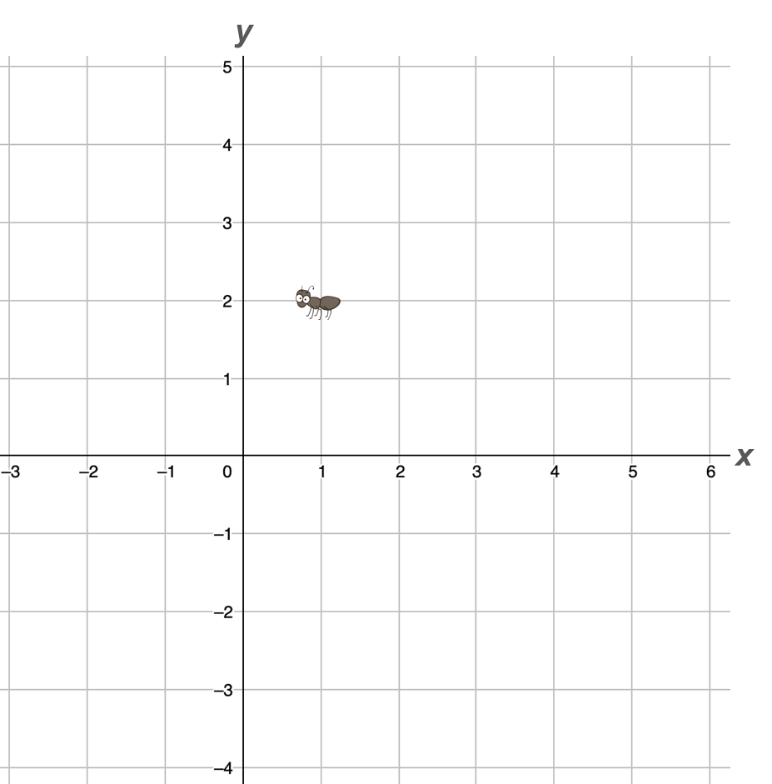
Notes:
This set of grids may be used with Checkpoint 1.

Slide 33
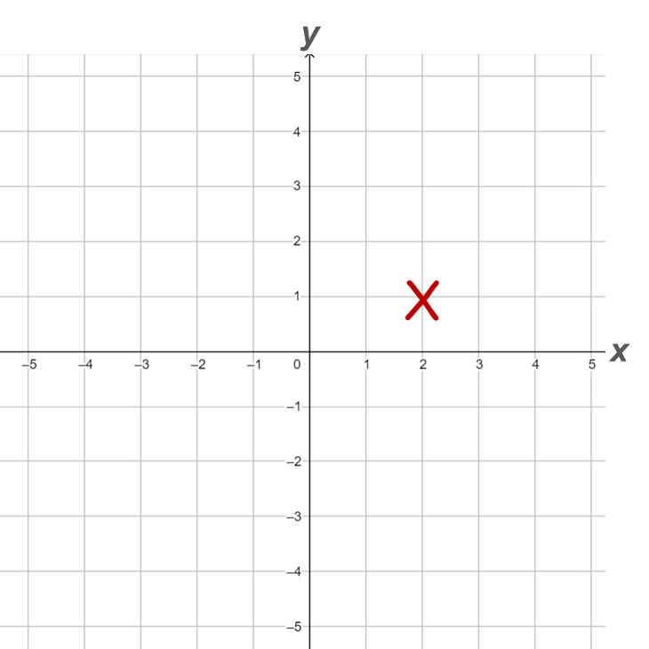
Notes:
This set of grids may be used with Checkpoint 2.

Slide 34
Notes:
This set of grids could be used with either Checkpoint 3 or Additional activity C.

Slide 35
Notes:
This set of grids could be used with Checkpoint 5.

Slide 36
y
y
x
x
Notes:
These two grids may be used with Checkpoint 6.

Slide 37
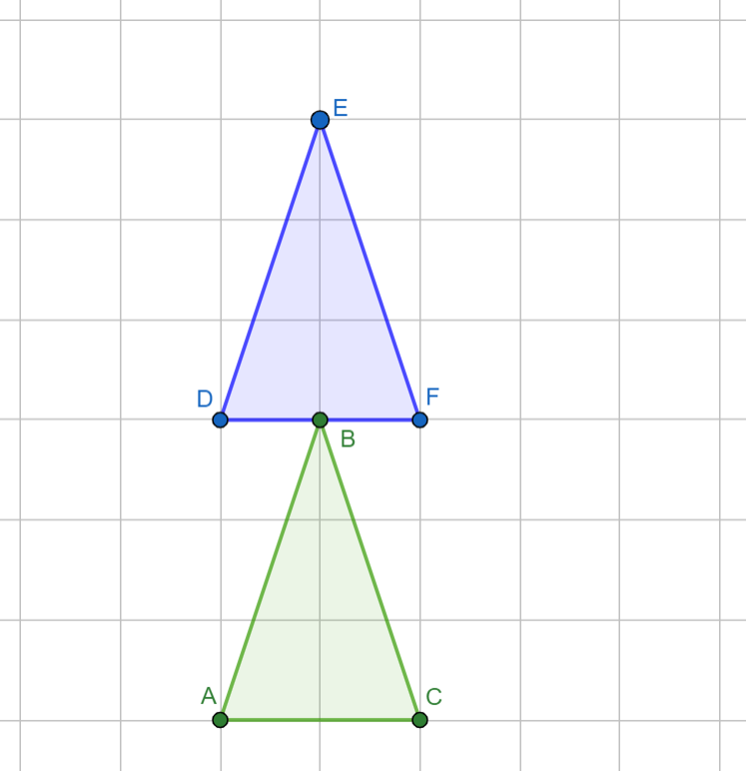
Notes:
This set of grids may be used as support with Checkpoint 7.

Slide 38
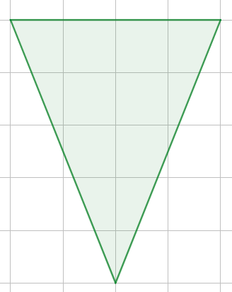
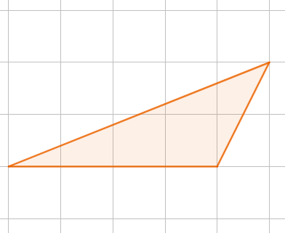
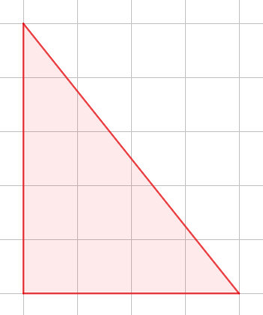
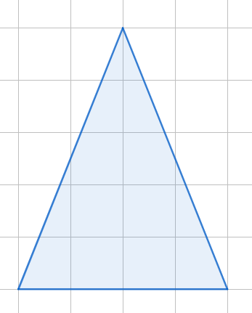
Green
Orange
Red
Blue
Green
Orange
Red
Blue
Notes:
These sets of triangles could be used as support with Checkpoint 8.

Slide 39
y
y
x
x
Notes:
This set of grids could be used with Checkpoint 9.

Slide 40
A
B
C
D
A
B
C
D
A
B
C
D
Notes:
This set of grids could be used with Additional activity B

Slide 41
y
x
Notes:
This coordinate grid is for use with Additional activity E, but may be used throughout the deck.

