Slide 1
2.18 Using equivalence to calculate
Representations | Year 5
Multiplication and Division

Slide 2
How to use this presentation
You can find the teacher guide 2.18 Using equivalence to calculate by following the link below.

Slide 3
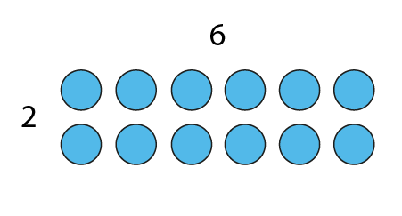
2.18 Equivalence Step 1:1
6 × 2 = 12

Slide 4
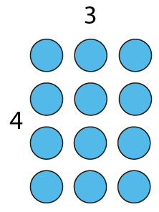
2.18 Equivalence Step 1:1
3 × 4 = 12

Slide 5
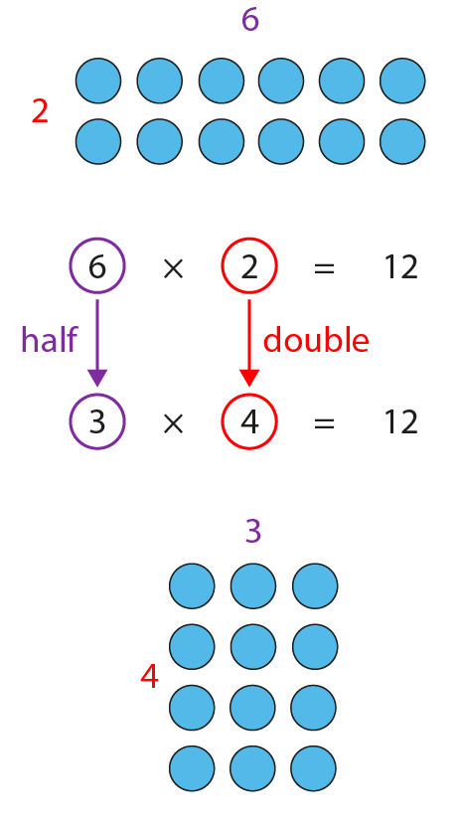
2.18 Equivalence Step 1:1

Slide 6

2.18 Equivalence Step 1:3
9
18
9
5
10
5
5
×
18
=
90
×
2
÷
2
10
×
9
=
90

Slide 7
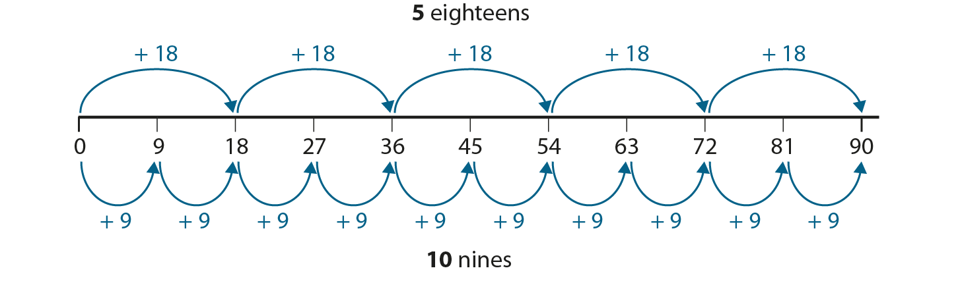
2.18 Equivalence Step 1:3

Slide 8
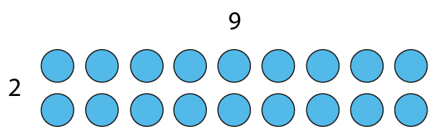
2.18 Equivalence Step 1:6
2 × 9 = 18

Slide 9
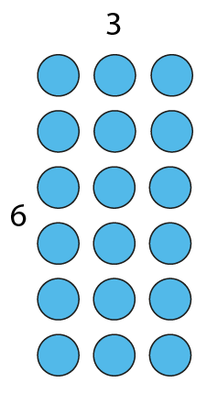
2.18 Equivalence Step 1:6
6 × 3 = 18

Slide 10
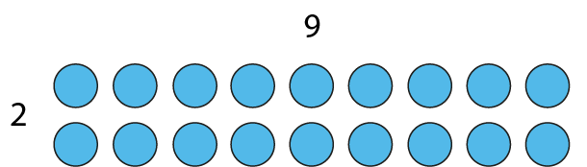
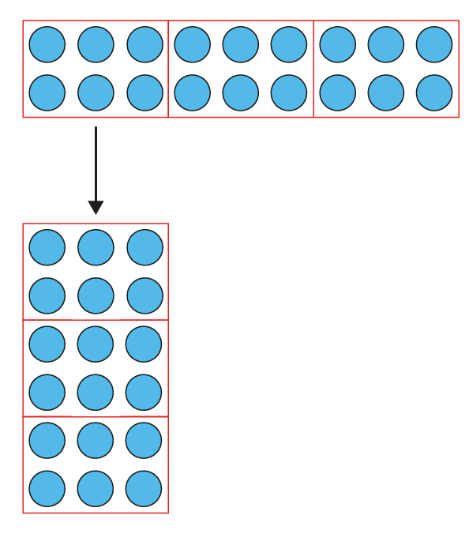
2.18 Equivalence Step 1:6

Slide 11
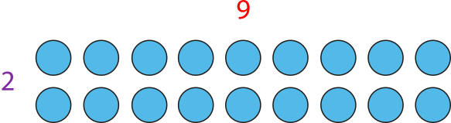
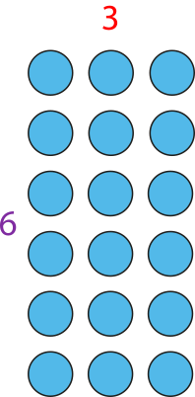
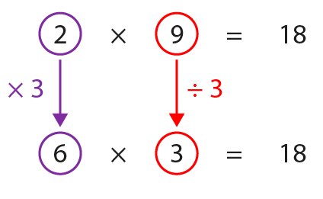
2.18 Equivalence Step 1:6

Slide 12
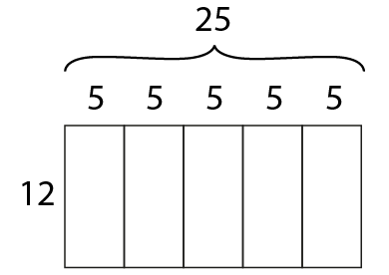
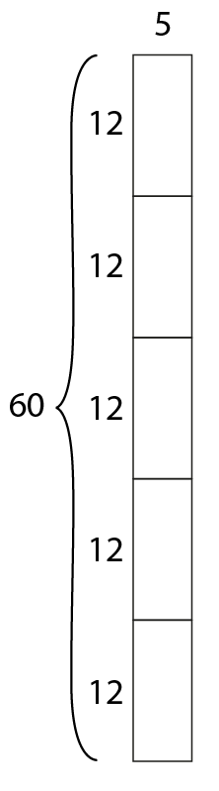
2.18 Equivalence Step 1:7

Slide 13
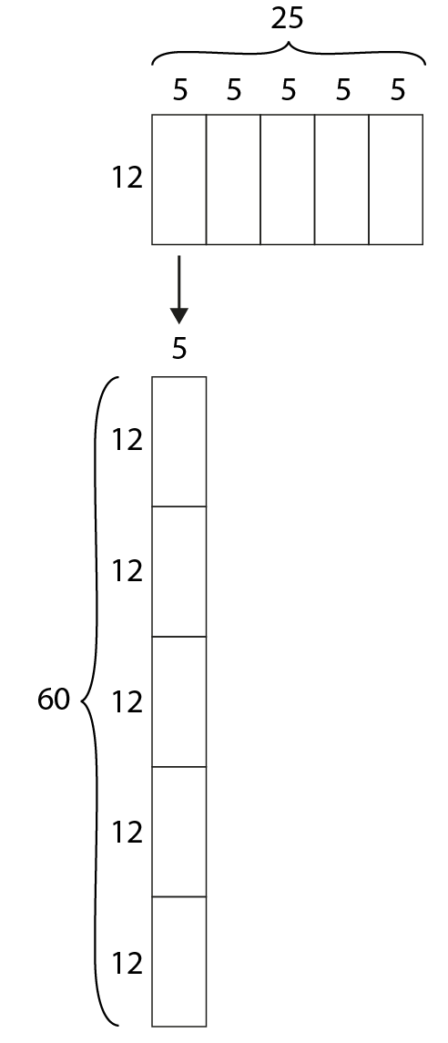
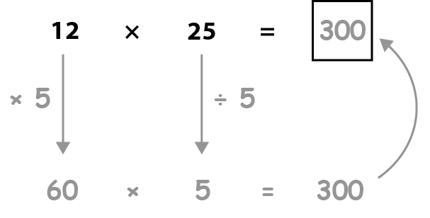
2.18 Equivalence Step 1:7

Slide 14
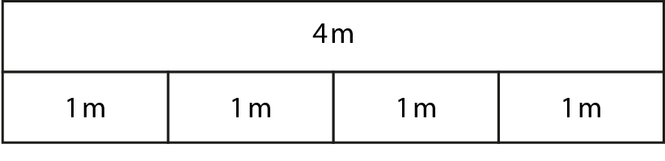
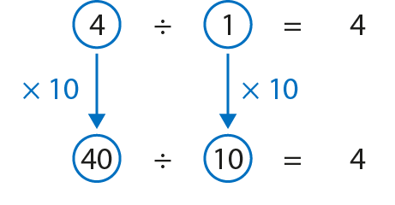
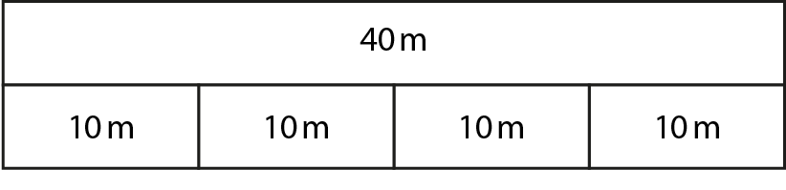
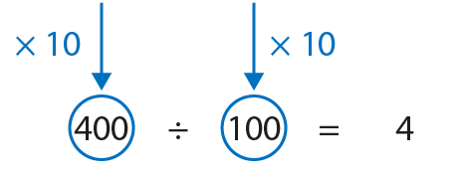
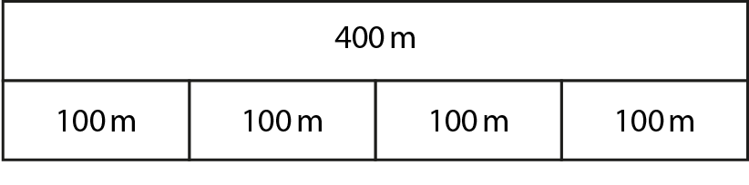
2.18 Equivalence Step 2:1

Slide 15
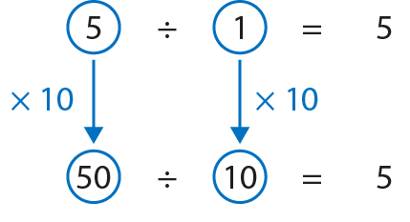
2.18 Equivalence Step 2:2

Slide 16
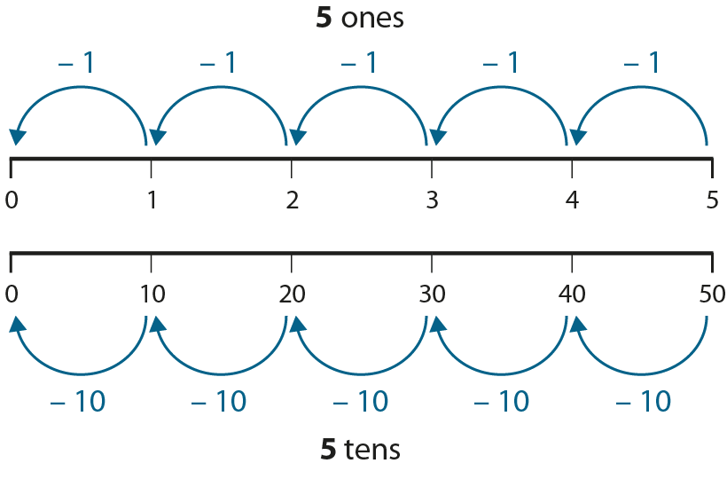
2.18 Equivalence Step 2:2

Slide 17
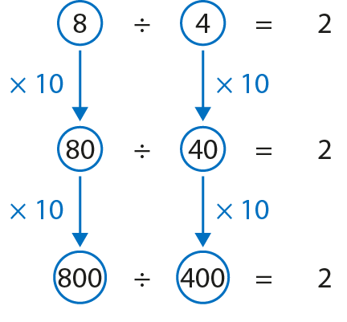
2.18 Equivalence Step 2:3

Slide 18
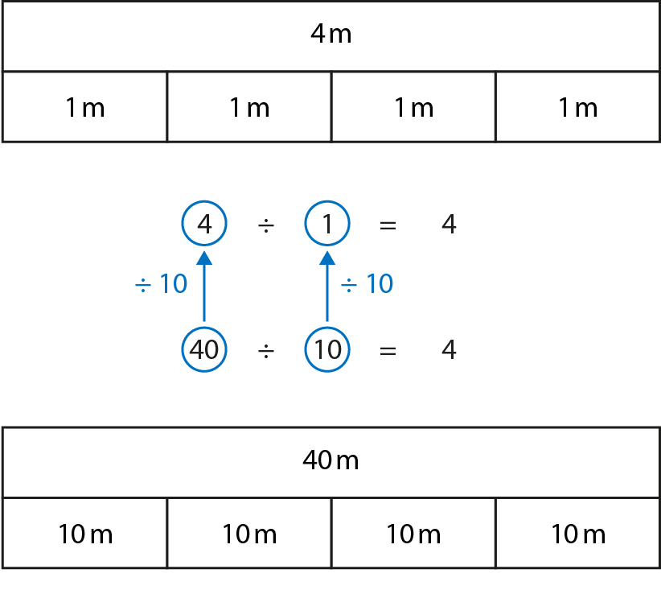
2.18 Equivalence Step 2:4

Slide 19
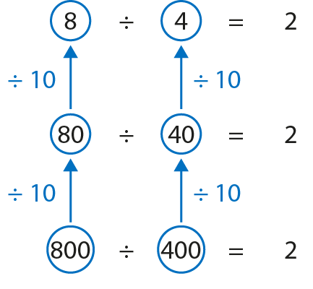
2.18 Equivalence Step 2:4

Slide 20

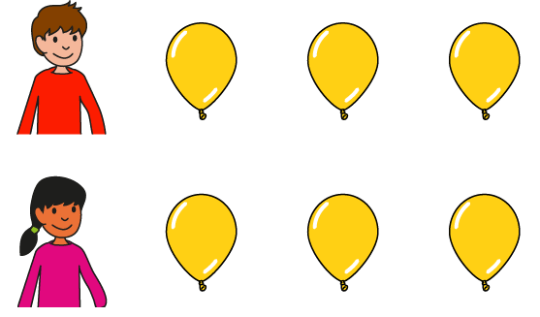

2.18 Equivalence Step 2:6
Notes:
Three balloons are ‘shared’ equally between one child. How many balloons does the child get?
Six balloons are ‘shared’ equally between two children. How many balloons does each child get?

Slide 21
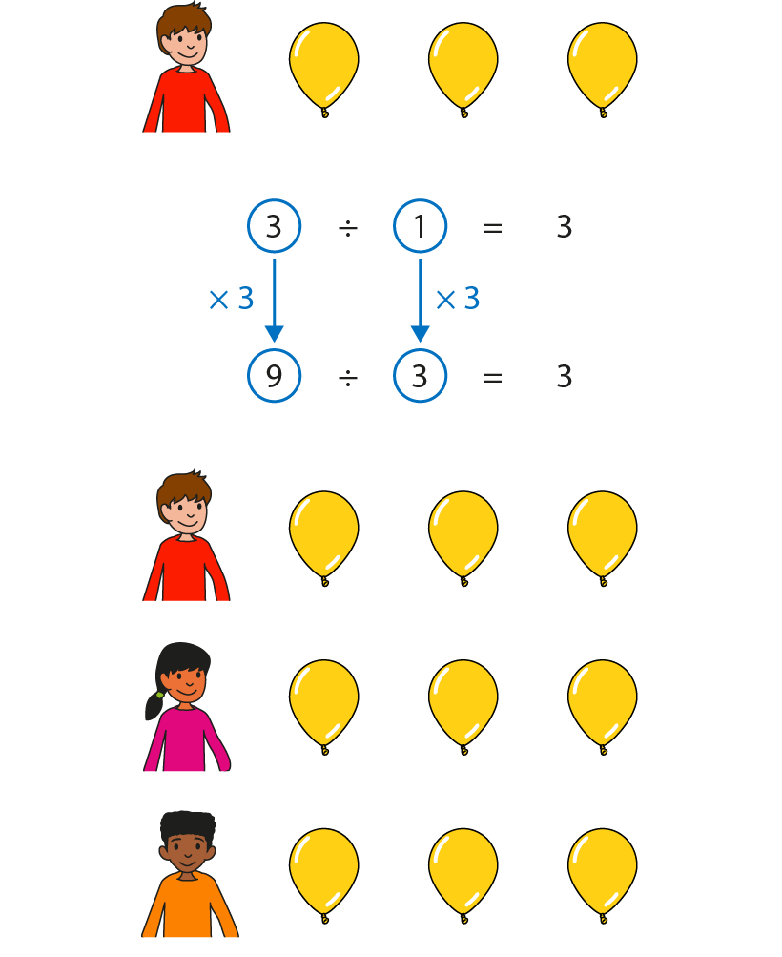
2.18 Equivalence Step 2:7

Slide 22
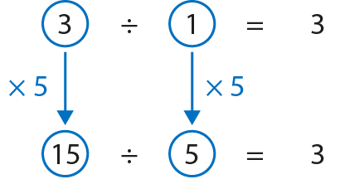
2.18 Equivalence Step 2:8
Notes:
If I multiply the dividend by five I must multiply the divisor by five for the quotient to stay the same.

Slide 23
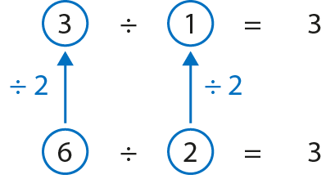
2.18 Equivalence Step 2:9
Notes:
If I divide the dividend by two I must divide the divisor by two for the quotient to stay the same.

Slide 24
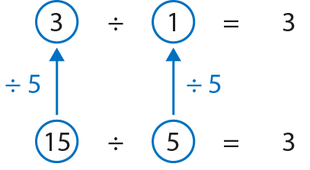
2.18 Equivalence Step 2:9
Notes:
If I divide the dividend by five I must divide the divisor by five for the quotient to stay the same.

