Slide 1
1.27 Negative numbers: counting, comparing and calculating
Representations | Year 5
Number, Addition and Subtraction

Slide 2
How to use this presentation
You can find the teacher guide 1.27 Negative numbers: counting, comparing and calculating by following the link below.

Slide 3
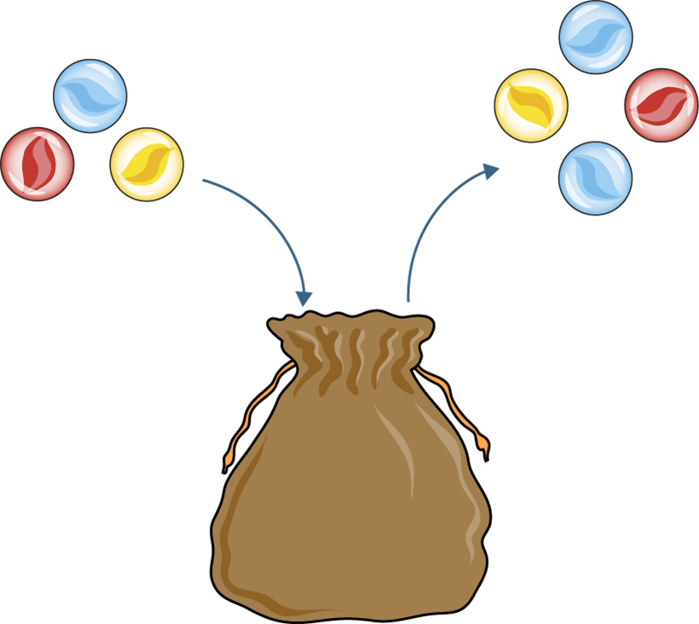
1.27 Negative numbers – step 1:1
3 − 4 = −1

Slide 4
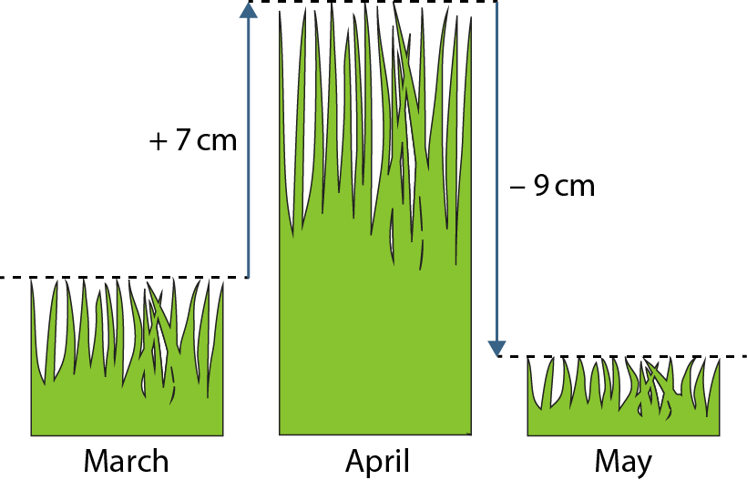
1.27 Negative numbers – step 1:4
−2 cm
7 − 9 = −2
Notes:
Between March and April, the grass in Bill’s garden grew 7 cm. At the beginning of May, Bill cut the grass by 9 cm. How long is the grass in May compared to March?

Slide 5



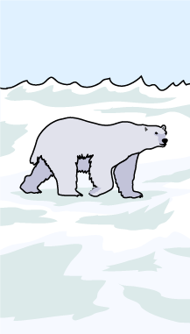
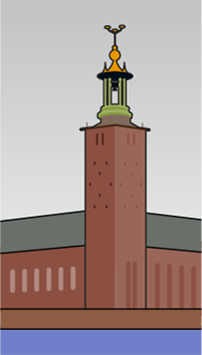
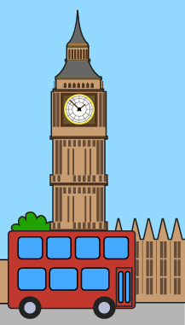
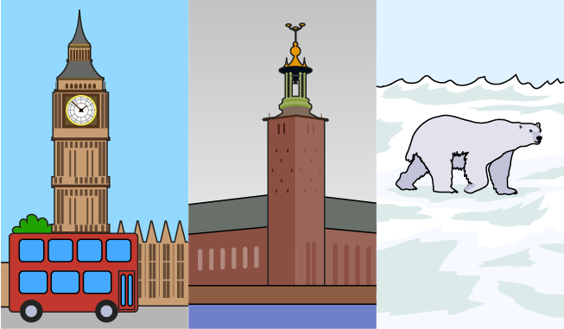
1.27 Negative numbers – step 2:1
North Pole
Stockholm, Sweden
London, England

Slide 6
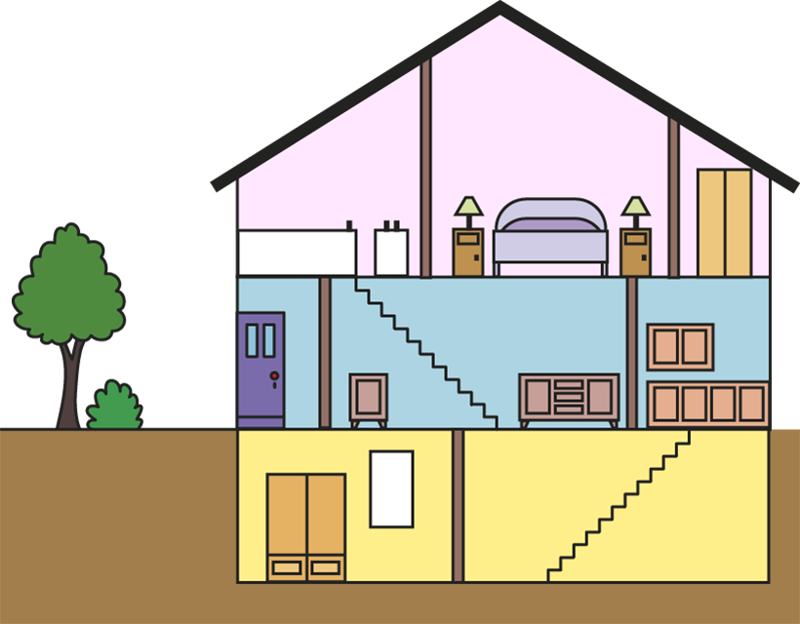
1.27 Negative numbers – step 2:2

Slide 7
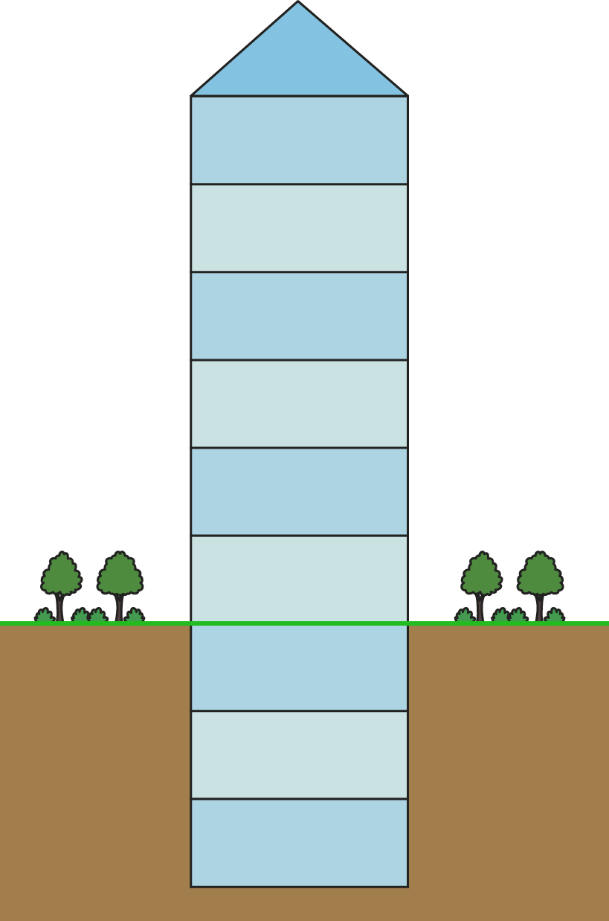
1.27 Negative numbers – step 2:2

Slide 8
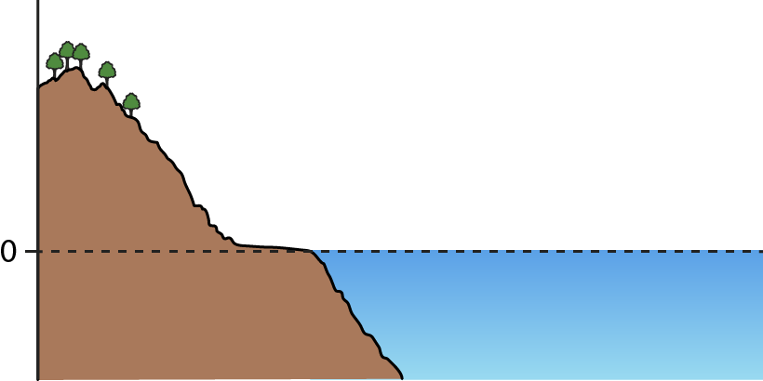
1.27 Negative numbers – step 2:3

Slide 9
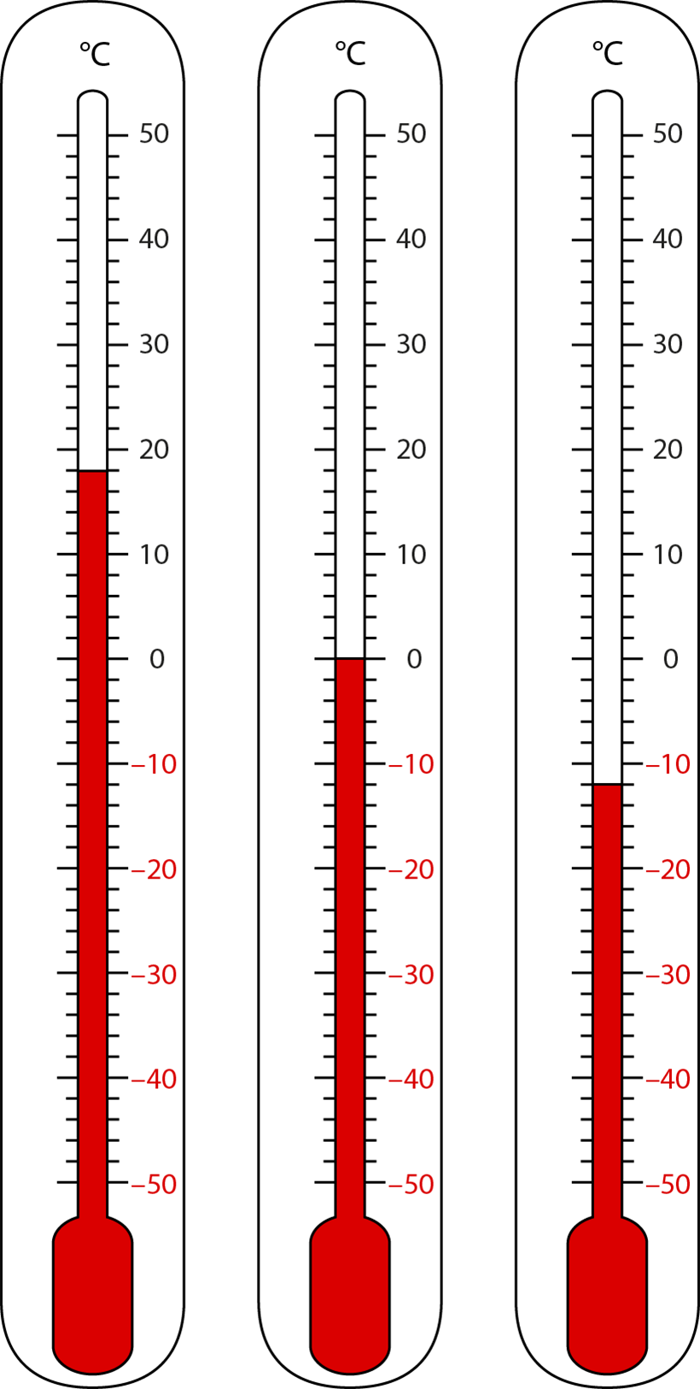
1.27 Negative numbers – step 3:1

Slide 10
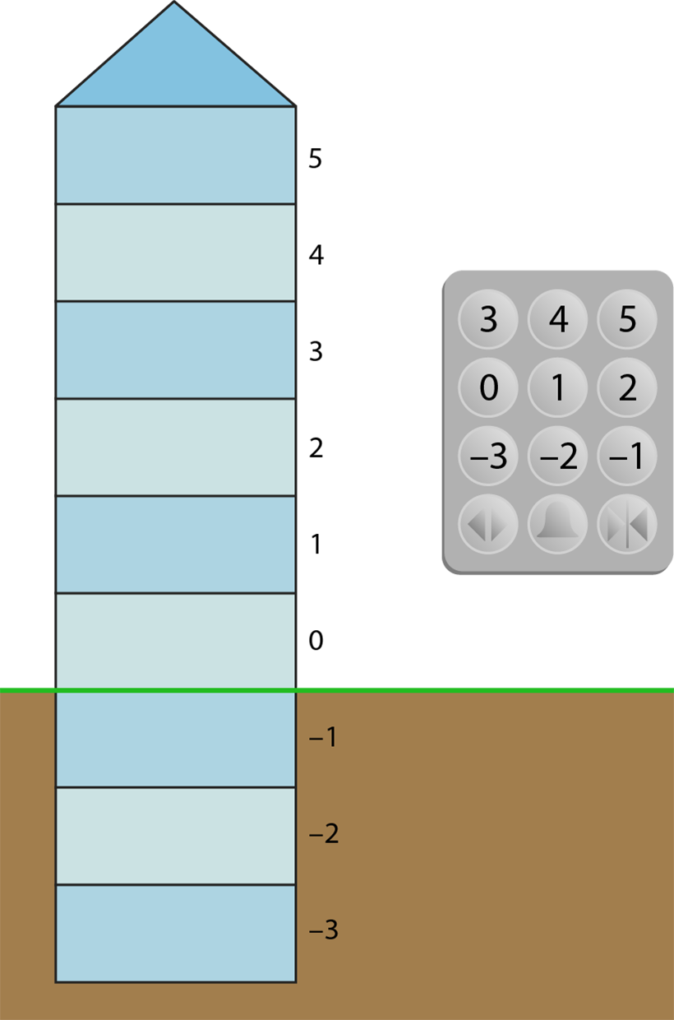
1.27 Negative numbers – step 3:1

Slide 11
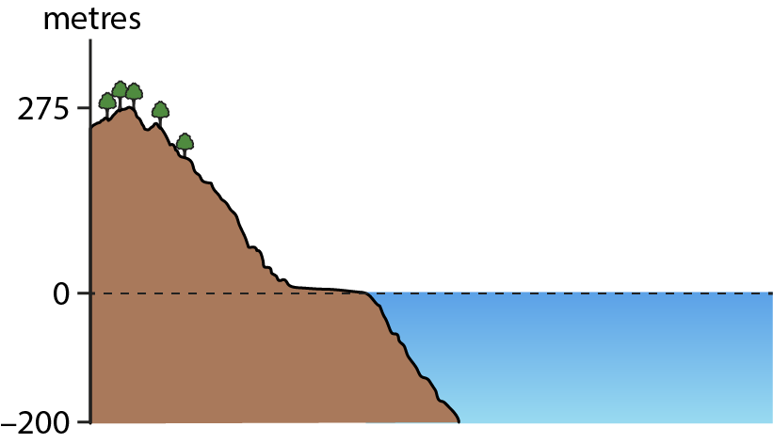
1.27 Negative numbers – step 3:1

Slide 12
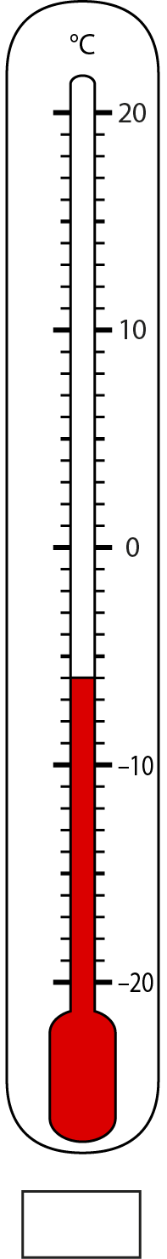
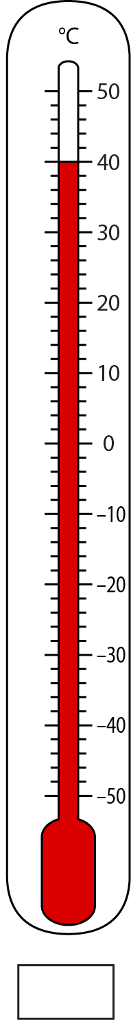
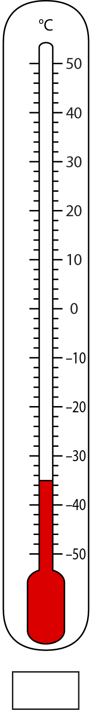
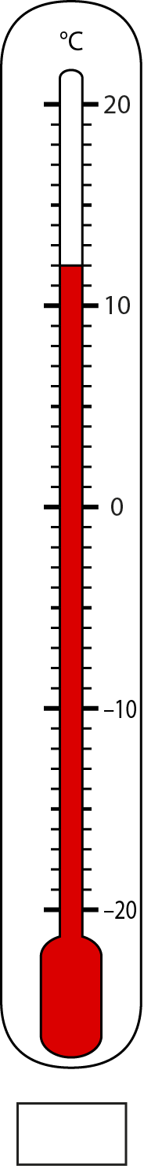
1.27 Negative numbers – step 3:3
−35
−6
40
12
Notes:
Write down the temperature shown on each thermometer, in degrees Celsius.

Slide 13
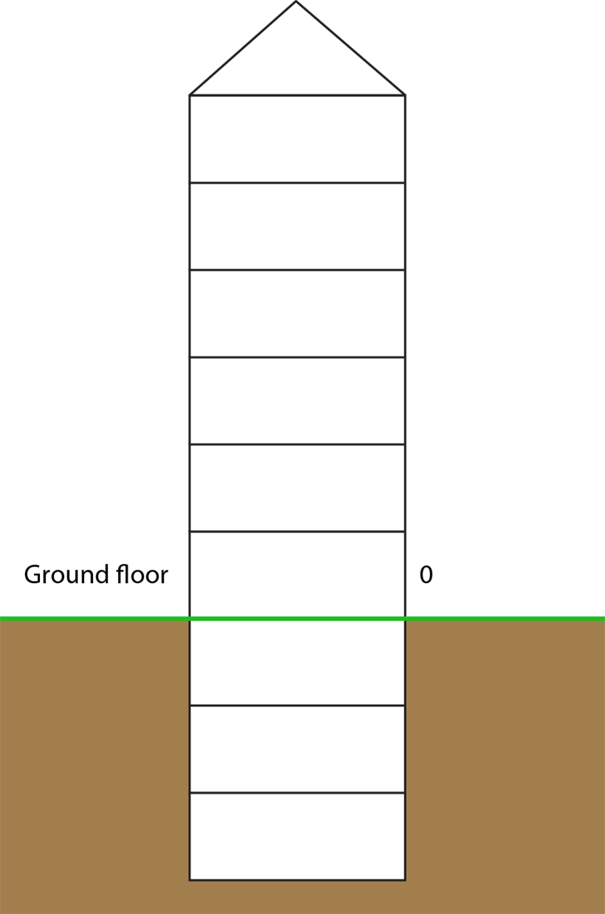
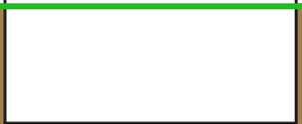
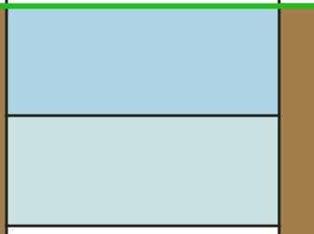
1.27 Negative numbers – step 3:3
−2
Notes:
Nicky gets into a lift at the ground floor. She presses the button labelled ‘−2’. Shade in the floor the lift takes her to.’

Slide 14
1.27 Negative numbers – step 3:3
Elevation
Object
15 m
submarine
0 m
kite
−30 m
boat
Notes:
Match each elevation, relative to sea level, to the correct object.

Slide 15
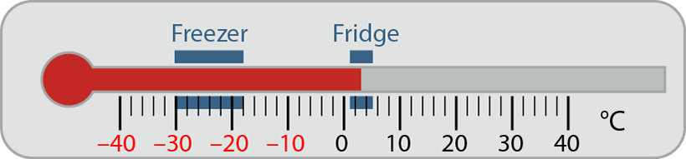
1.27 Negative numbers – step 4:1

Slide 16
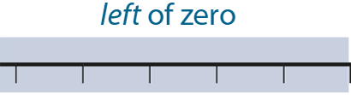
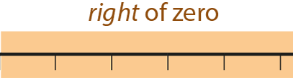









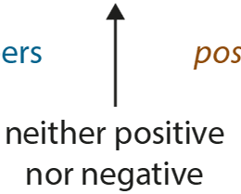


1.27 Negative numbers – step 4:1

Slide 17






1.27 Negative numbers – step 4:3

Slide 18
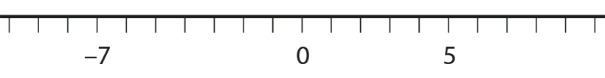

1.27 Negative numbers – step 4:3
Circle the number that is further from zero.
Notes:
For each number line, circle the number that is further from zero.

Slide 19
1.27 Negative numbers – step 4:3
Number pair |  | Positive number further from zero | Negative number further from zero | Both numbers same distance from zero
−6 | 12
−12 | 6
−6 | 6
10 | −1
10 | −10
10 | −100
✓
✓
✓
✓
✓
✓
Notes:
For each pair, put a tick in the correct column.

Slide 20
1.27 Negative numbers – step 4:4

Slide 21

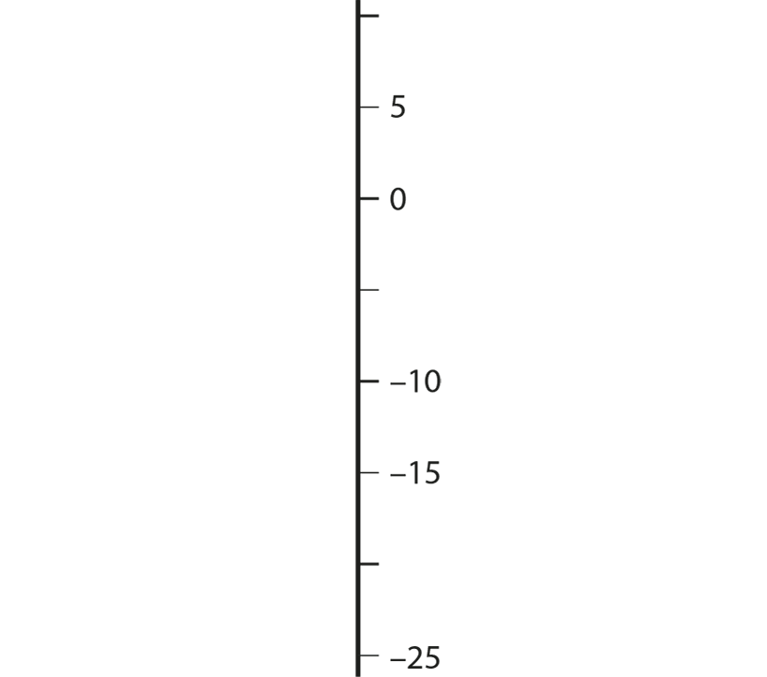


1.27 Negative numbers – step 4:4

Slide 22




1.27 Negative numbers – step 4:4

Slide 23




1.27 Negative numbers – step 4:5
Notes:
Fill in the missing numbers.

Slide 24
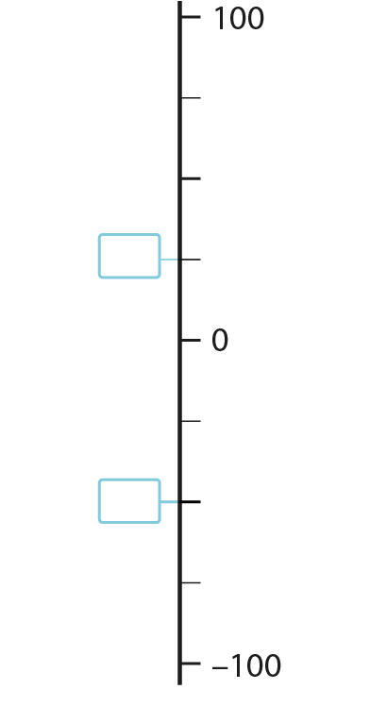

1.27 Negative numbers – step 4:5
Notes:
Fill in the missing numbers.

Slide 25
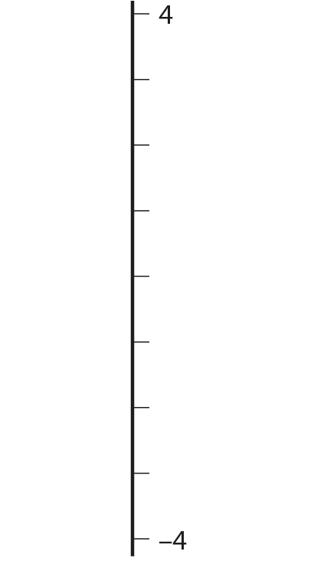




1.27 Negative numbers – step 4:5
Notes:
Place negative two on this number line.

Slide 26

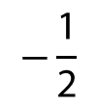
1.27 Negative numbers – step 4:6
0.5
$$−\frac{\text{1}}{\text{2}}$$
$$\frac{\text{1}}{\text{4}}$$
1.5
−2.5
Notes:
Place the following numbers on the number line.

Slide 27
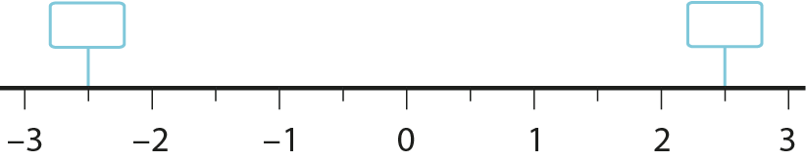




1.27 Negative numbers – step 4:6
−2
$$\frac{\text{1}}{\text{2}}$$
2
$$\frac{\text{1}}{\text{2}}$$
Notes:
Fill in the missing numbers.

Slide 28
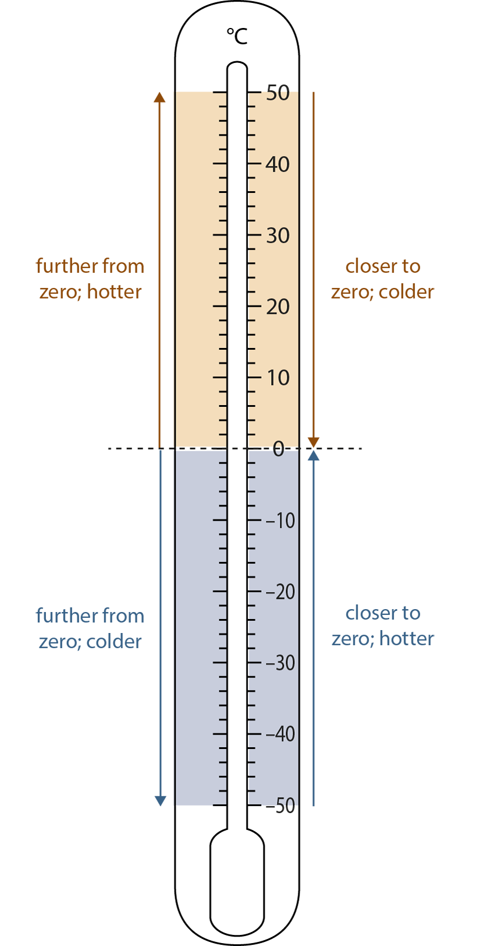
1.27 Negative numbers – step 4:7
 | South Pole |  | London
 | Min (°C) | Max (°C) | Min (°C) | Max (°C)
Jan | −30 | −26 | 2 | 8
Feb | −43 | −38 | 2 | 8
Mar | −57 | −50 | 4 | 11
Apr | −61 | −53 | 6 | 14
May | −62 | −54 | 9 | 18
Jun | −63 | −54 | 12 | 21
Jul | −63 | −55 | 14 | 23
Aug | −63 | −55 | 14 | 23
Sep | −62 | −54 | 11 | 20
Oct | −54 | −48 | 8 | 16
Nov | −40 | −36 | 5 | 11
Dec | −29 | −26 | 3 | 8
Notes:
Table: Average monthly temperatures for the South Pole and London.

Slide 29
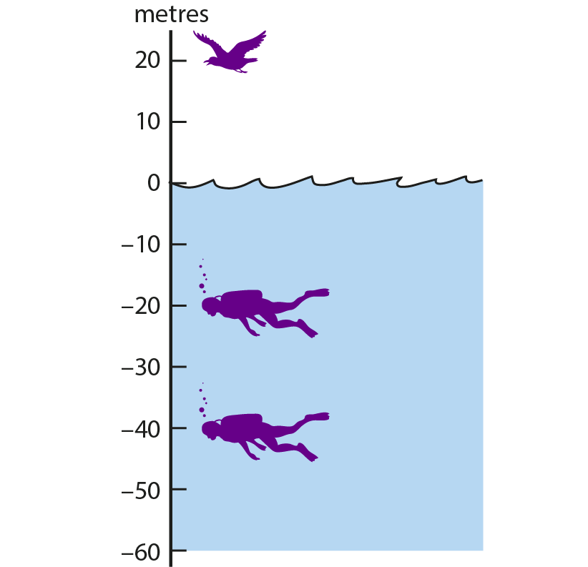
1.27 Negative numbers – step 4:7

Slide 30
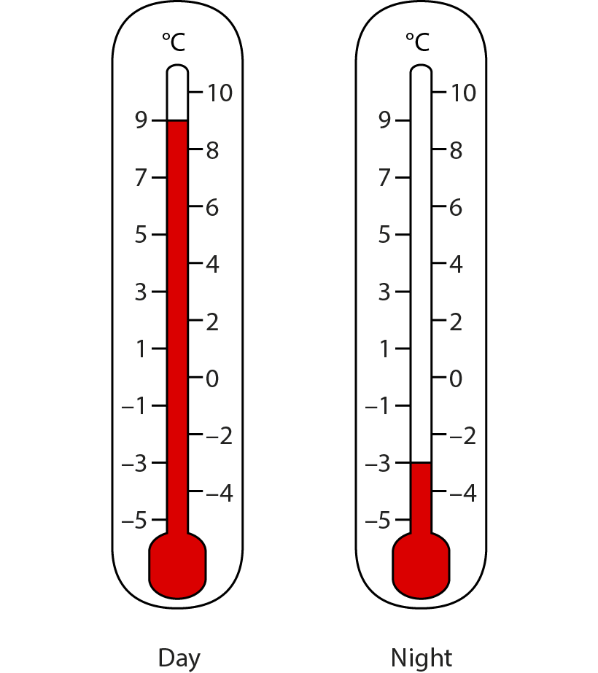




1.27 Negative numbers – step 5:1
9
12
3
9 ˚C
−3 ˚C
Notes:
The temperature was 9 ˚C in the day, then it dropped to −3 ˚C at night. What was the change in temperature?

Slide 31



1.27 Negative numbers – step 5:1
3
9
12
9˚C
−3˚C
Notes:
The temperature was 9 ˚C in the day, then it dropped to −3 ˚C at night. What was the change in temperature?

Slide 32

1.27 Negative numbers – step 5:2
Notes:
What temperature does the thermometer show?
The temperature rises by 16 °C. Mark the new temperature reading on the thermometer.
The temperature falls from 14 °C to –4 °C. By how many degrees does the temperature fall?
The temperature rises from −4 °C by 10 °C. What is the new temperature?
The temperature falls from 10 °C by 16 °C. What is the new temperature?
The temperature falls from −6 °C by 3 °C. What is the new temperature?
The temperature is −9 °C. By how much must it rise to reach −2 °C?

Slide 33
1.27 Negative numbers – step 5:3
Date | Paid in | Paid out | Amount in account
31 December |  |  | £150
5 January |  | £30
10 January |  | £50 | £70
11 January |  | £100
12 January | £10 |  | −£20
16 January | £20 | £130
£120
−£30
−£130
Notes:
Mr Money has £150 in his bank account at the end of December. The table shows money he paid in and out, and the amount in the account over the next few weeks. Fill in the missing numbers.

Slide 34
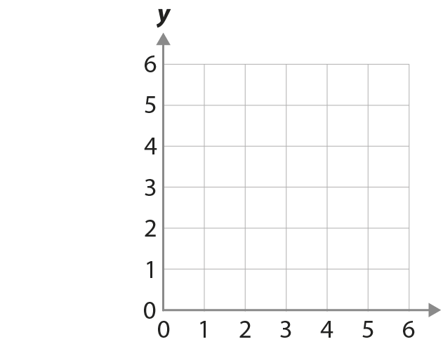









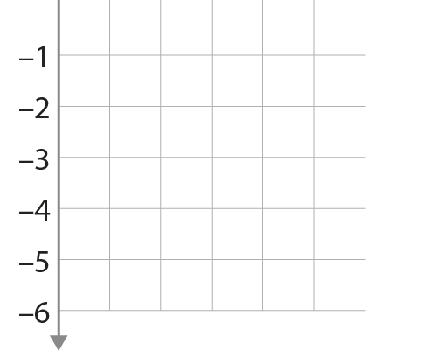



1.27 Negative numbers – step 6:1

Slide 35
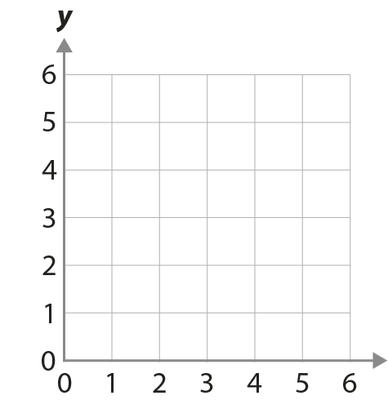
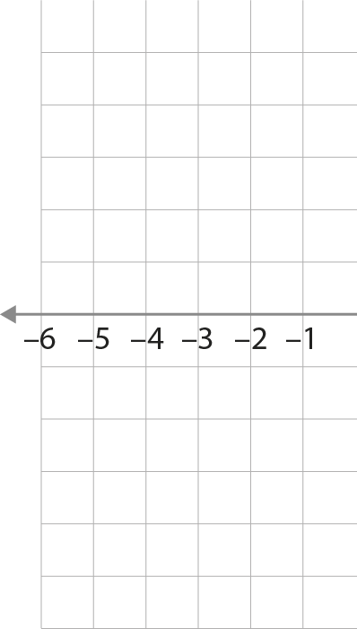












1.27 Negative numbers – step 6:2

Slide 36


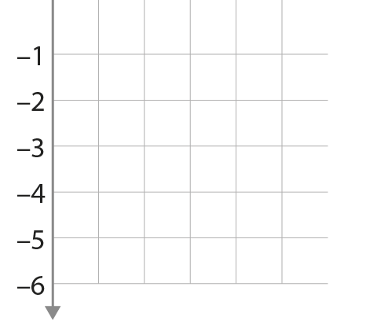


1.27 Negative numbers – step 6:2

Slide 37


1.27 Negative numbers – step 6:3
Notes:
Draw a square of side-length 6, centred on the origin, (0, 0).
Draw a shape with vertices (−4, −1), (2, −1), (−5, −5) and (1, −5). What type of shape is this?

Slide 38


1.27 Negative numbers – step 6:3
Notes:
The points (–2, 0), (1, 4) and (5, 1) are three of the four vertices of a square. What are the coordinates of the fourth vertex?

Slide 39
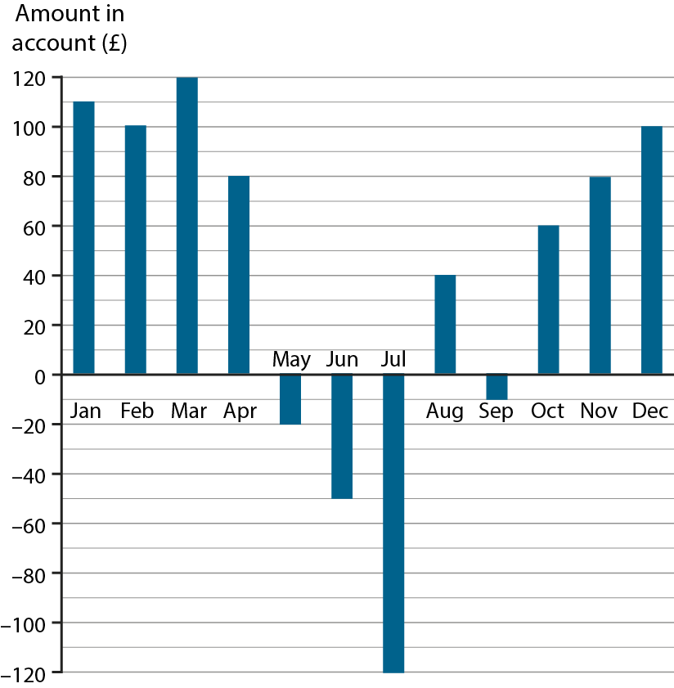
1.27 Negative numbers – step 6:4
Notes:
The bar chart shows the amount of money in a bank account at the end of each month.
What and when was the most amount of money in the account?
What and when was the least amount of money in the account?
What was the difference between the most and least amounts in the account?
How much money was paid into the account between July and August?
How much money was paid out of the account between August and September?

Slide 40
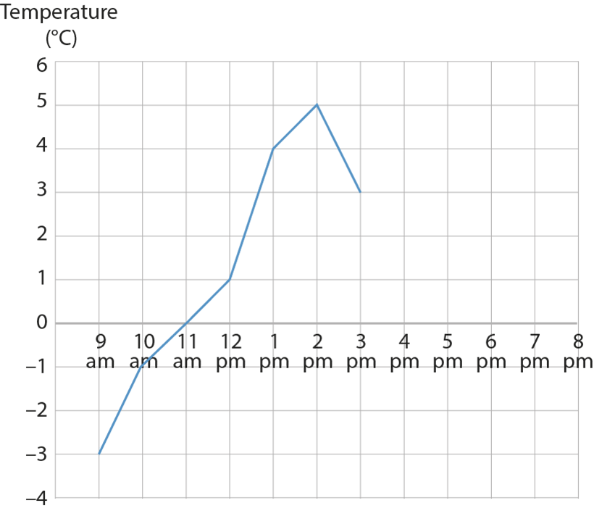
1.27 Negative numbers – step 6:4
Notes:
The graph shows the temperature in a school’s nature garden during one day.
What was the lowest temperature?
What was the highest temperature?
What was the difference between the lowest and highest temperatures?
By 8 pm the temperature had dropped to −1 °C. Plot this point on the graph. What was the change in temperature between 3 pm and 8 pm?

Slide 41
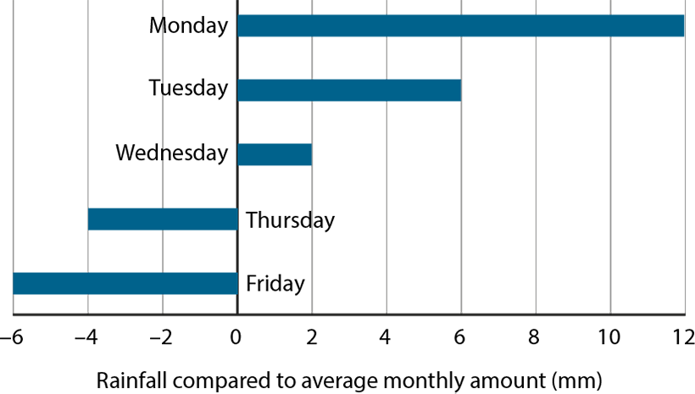
1.27 Negative numbers – step 6:4
Notes:
The bar chart shows the amount of rain that fell in the nature garden on different days of the week. The amounts are measured compared to the average monthly rainfall for that time of year.
What is the difference in rainfall between Wednesday and Thursday?
If the average monthly rainfall is 8 mm, how much rain fell on each day?
Why couldn’t the average monthly rainfall for this period be 4 mm?

