Slide 1
1.28 Common structures and the part–part–whole relationship
Representations | Year 5
Number, Addition and Subtraction

Slide 2
How to use this presentation
You can find the teacher guide 1.28 Common structures and the part–part–whole relationship by following the link below.

Slide 3
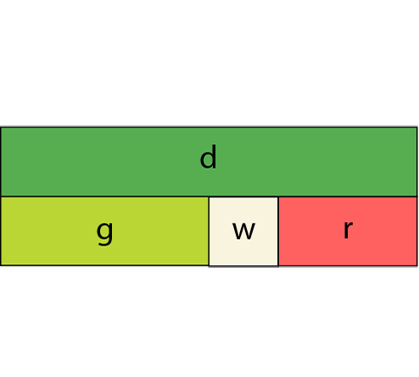
1.28 Common structures – step 1:1
Notes:
Additive – combining or partitioning

Slide 4
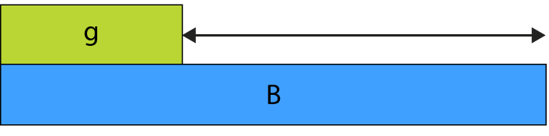
1.28 Common structures – step 1:1
Notes:
Additive – comparative

Slide 5
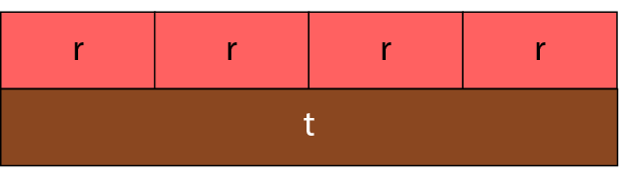
1.28 Common structures – step 1:1
Notes:
Additive or multiplicative

Slide 6
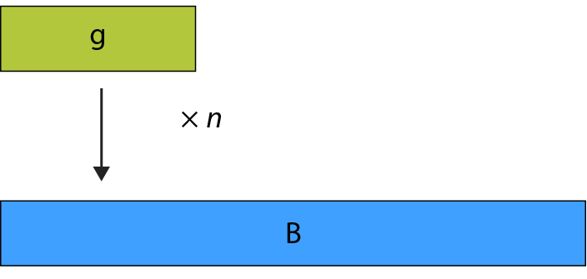
1.28 Common structures – step 1:1
Notes:
Multiplicative – scaling

Slide 7
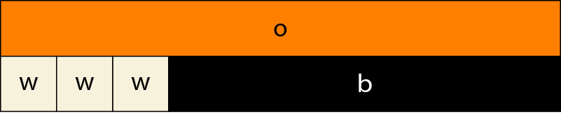
1.28 Common structures – step 1:1
Notes:
Additive and multiplicative combined

Slide 8
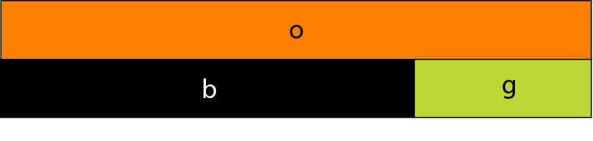
1.28 Common structures – step 1:2
black + light green = orange
b + g = o
orange = black + light green
o = b + g
Notes:
Pair of two different rods (additive)

Slide 9
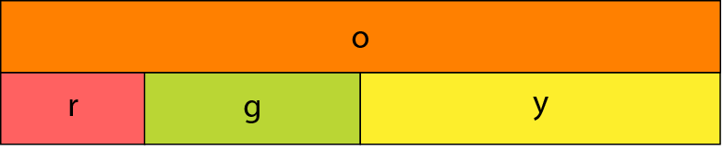
1.28 Common structures – step 1:2
red + light green + yellow = orange
r + g + y = o
Notes:
Group of three different rods (additive)

Slide 10
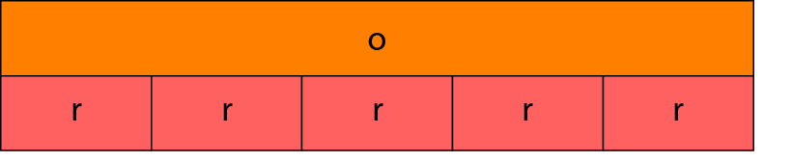
1.28 Common structures – step 1:2
5 × r = o
or
r + r + r + r + r = o
Notes:
Group of identical rods (multiplicative/repeated addition)

Slide 11
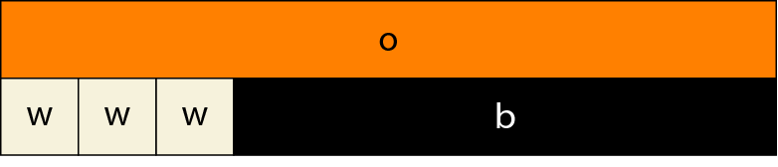
1.28 Common structures – step 1:2
3 × w + b = o
or
w + w + w + b = o
Notes:
A group of identical rods and a different rod (additive and multiplicative)

Slide 12
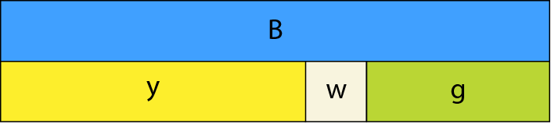
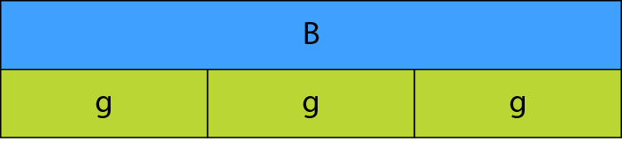
1.28 Common structures – step 1:3
B = y + w + g
B = g + g + g
B = 3 × g
Notes:
Model A (top): additive
Model B (bottom): multiplicative/repeated addition

Slide 13
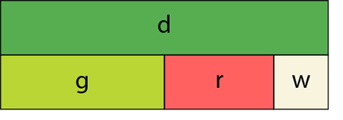
1.28 Common structures – step 1:4
Notes:
Additive: A bowl of fruit contains more apples than oranges, and more oranges than bananas.

Slide 14
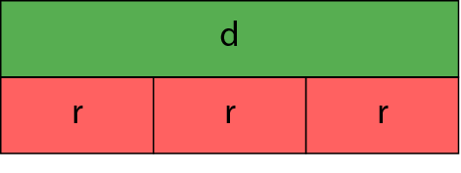
1.28 Common structures – step 1:4
Notes:
Multiplicative/repeated addition: A bowl of fruit contains equal quantities of apples, oranges and bananas.

Slide 15
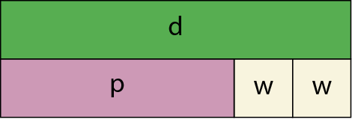
1.28 Common structures – step 1:4
Notes:
Additive and multiplicative combined: A bowl of fruit contains mostly apples, and equal numbers of oranges and bananas.

Slide 16
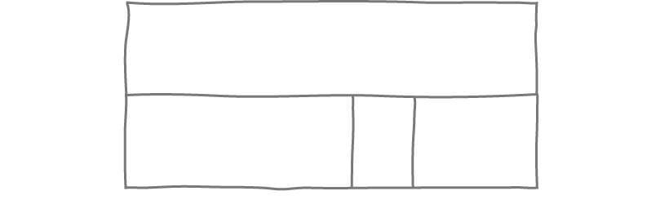
1.28 Common structures – step 1:5
Notes:
Additive: I have a four-metre length of wood. I cut it into three pieces of 2.2 m, 0.6 m and 1.2 m.

Slide 17
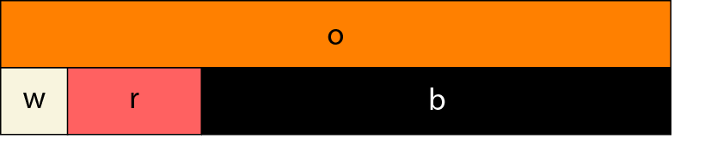
1.28 Common structures – step 1:7
Notes:
All parts known/no missing parts

Slide 18
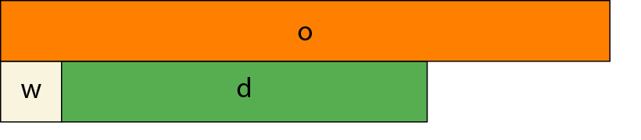
1.28 Common structures – step 1:7
Notes:
Two parts known/one part missing

Slide 19
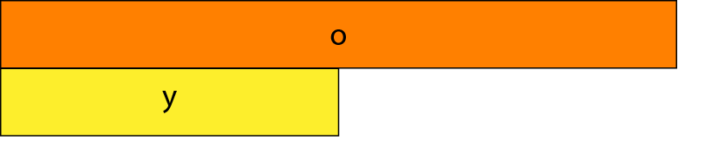
1.28 Common structures – step 1:7
Notes:
One part known/two parts missing

Slide 20
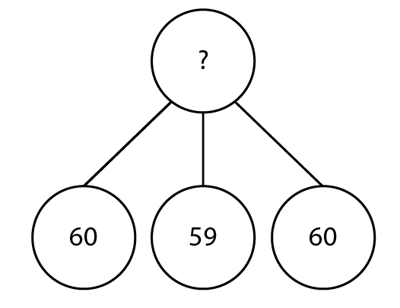
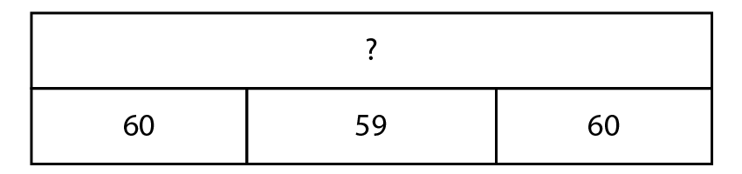
1.28 Common structures – step 2:1
Year group | Number of children
Reception | 60
Year 1 | 59
Year 2 | 60
Notes:
Draw a diagram to represent the total number of children in Reception, Year One and Year Two.

Slide 21
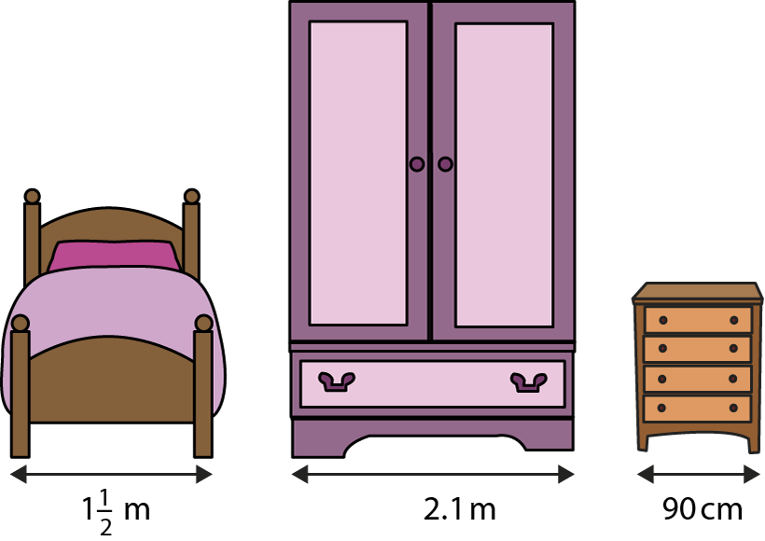
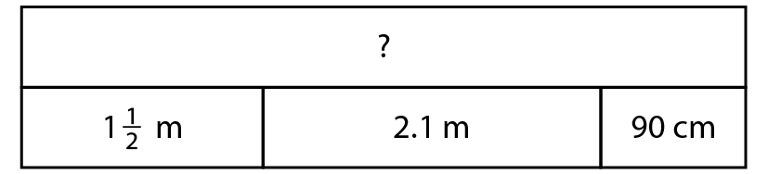
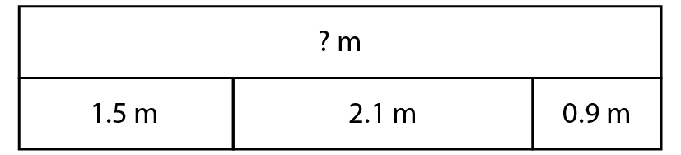
1.28 Common structures – step 2:3
Notes:
If I line the three pieces of furniture up along a wall, side-by-side, how much width do they take up?

Slide 22
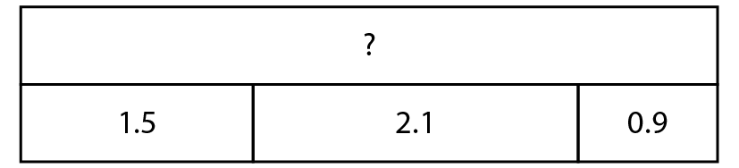
1.28 Common structures – step 2:4
Notes:
Tell a story to go with this representation.

Slide 23
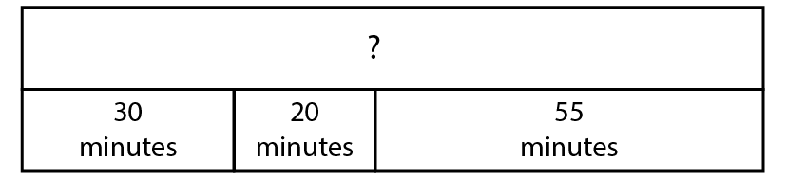
1.28 Common structures – step 2:5
30 + 20 + 55
= 50 + 55
= 105
60
45
= 1 hr 45 mins
55 + 5 = 60
1 hr 45 mins
30 + 15 = 45
Notes:
Tell a story to go with this representation.

Slide 24
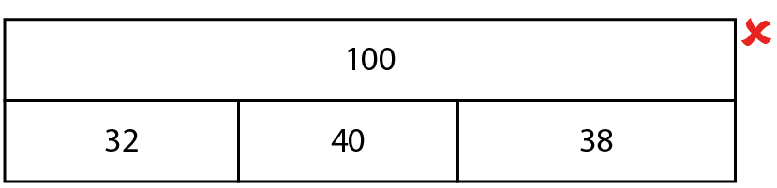
1.28 Common structures – step 2:6
Notes:
100 children choose a sport at an activity afternoon. 32 choose football, 40 choose basketball and 38 choose rounders.
How could you change the bar model to make it correct?

Slide 25
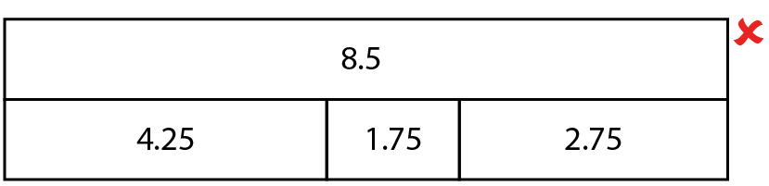
1.28 Common structures – step 2:7
Notes:
Noah draws this diagram.
Is it correct?
How could you change it to make it correct?
Can you think of another way?
And another?

Slide 26
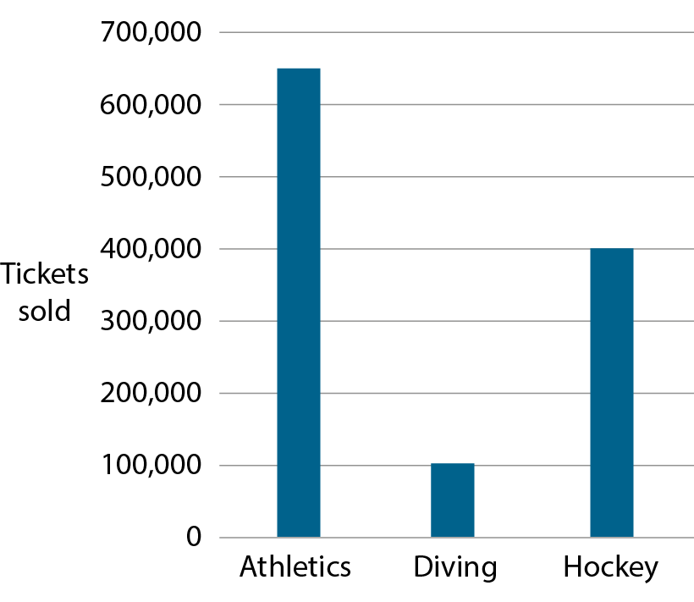
1.28 Common structures – step 2:7
Source: London Datastore
Public sector information licensed under the
Open Government Licence v2.0
Notes:
The graph shows the approximate number of tickets sold for three different events at the 2012 London Olympics. Each value is rounded to the nearest 50,000.
Felicity says that about 1,100,000 tickets were sold in total for these three events. Is she correct?
Source: London Datastore, Public sector information licensed under the Open Government Licence v2.0
http://www.nationalarchives.gov.uk/doc/open-government-licence/version/2/

Slide 27
1.28 Common structures – step 2:7
Island | Approximate population in 2016 (thousands)
Isle of Wight
Isle of Man
Guernsey
Jersey
140
83
62
104
Notes:
The table shows the population of four islands. What is the total population of all four islands?

Slide 28
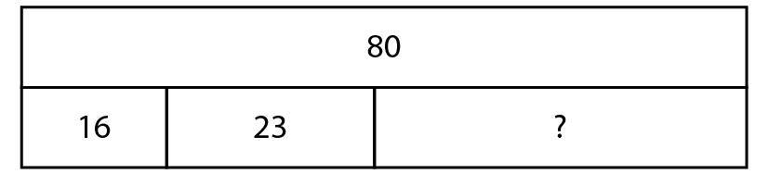

1.28 Common structures – step 3:1
80 – 16 = 64
64 – 23 = 41
16 + 23 = 39
80 – 39 = 41
Notes:
80 children chose an orange, apple or banana for fruit break. 16 children chose oranges and 23 chose apples. How many chose bananas?

Slide 29
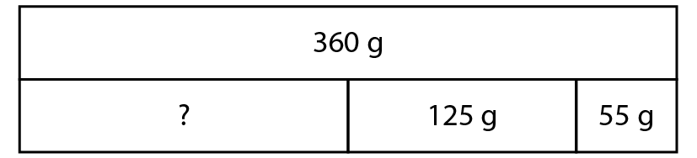

1.28 Common structures – step 3:4
0
Notes:
Jack mixes together some flour, 125 g butter and 55 g sugar. All the ingredients together weigh 360 g. How much flour does Jack use?

Slide 30
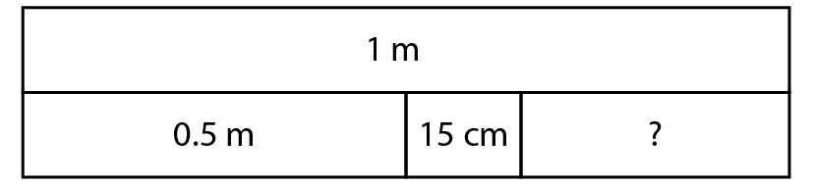
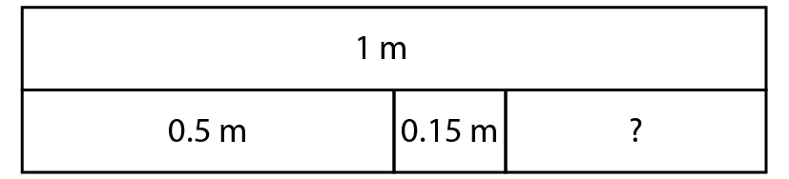

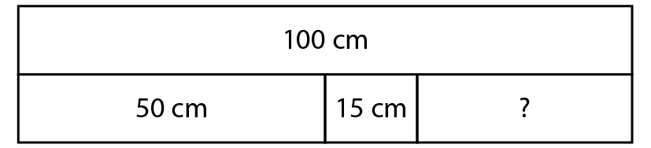

1.28 Common structures – step 3:4
0
0
0
Notes:
I have 1 m of ribbon. I cut off 0.5 m to use for a hair tie and another 15 cm to use for a bracelet. How much do I have left?

Slide 31
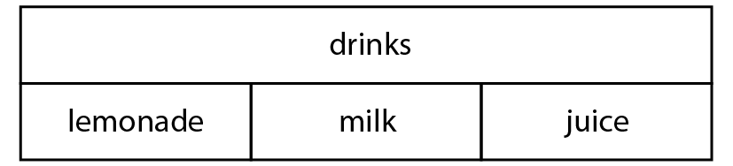

1.28 Common structures – step 3:5
 | True or false?
lemonade + milk + juice = drinks
drinks – lemonade = milk + juice
milk = drinks – juice
✓
✓
Notes:
Rahul is solving a word problem involving favourite drinks. He draws this representation.
Use Rahul’s model to decide whether the following equations are true or false.

Slide 32
1.28 Common structures – step 3:5
juice = drinks – lemonade – milk
_______ = drinks – lemonade – juice
milk
lemonade = _______ – milk – ______
drinks
juice
Notes:
Rahul writes a correct equation. Complete the similar equations.

Slide 33
1.28 Common structures – step 3:5
 | Year 1 | Year 2 | Year 3
Number of children asked about their favourite drink | 62 | 58 | 59
Number who like milk best |  | 13 | 21
Number who like lemonade best | 20 |  | 18
Number who like juice best | 12 | 35
30
10
20
Notes:
Use the equations to complete this table of data about different year groups’ favourite drinks.

Slide 34
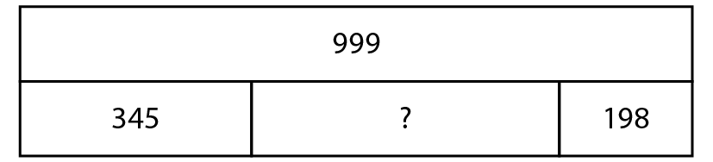
1.28 Common structures – step 3:6
999
=
345 + +198
whole
three parts

Slide 35
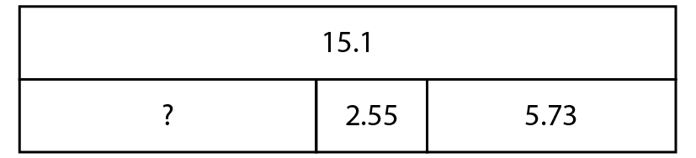
1.28 Common structures – step 3:6
15.1
=
+ 2.55 + 5.73
whole
three parts

Slide 36
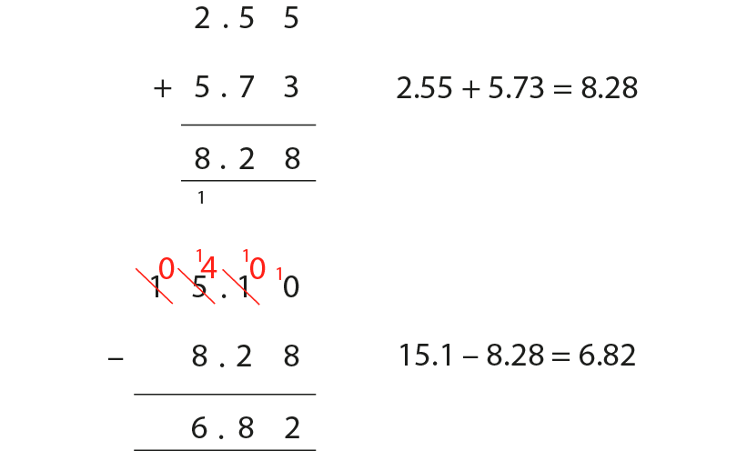
1.28 Common structures – step 3:6

Slide 37
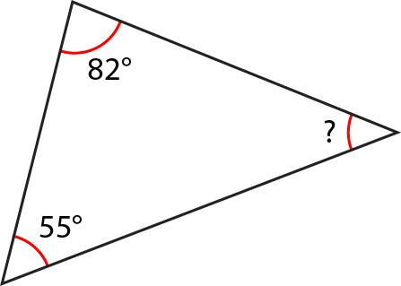

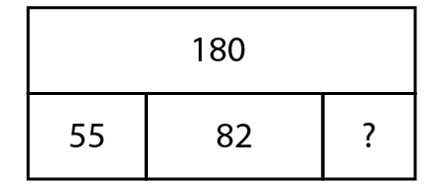

1.28 Common structures – step 4:2
Notes:
Calculate the missing angle.

Slide 38
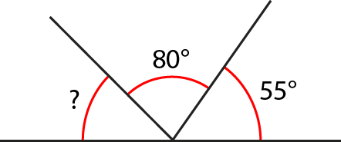

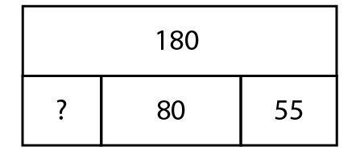

1.28 Common structures – step 4:2
Notes:
Calculate the missing angle.

Slide 39
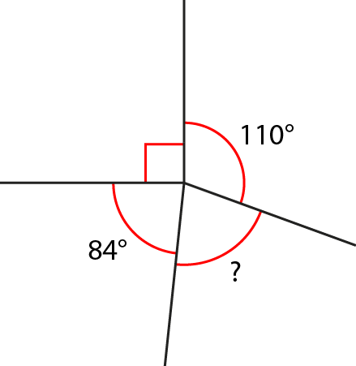
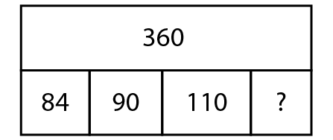
1.28 Common structures – step 4:2
76°
76
Notes:
Calculate the missing angle.

Slide 40
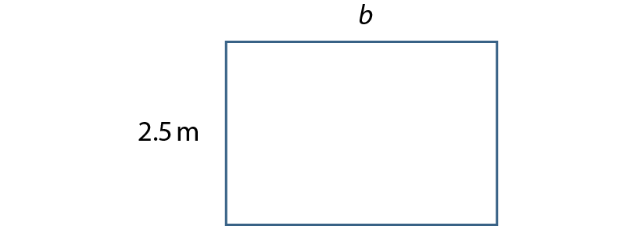

1.28 Common structures – step 4:2
Notes:
The rectangle has a perimeter of 13 m. Find the value of length b.

Slide 41

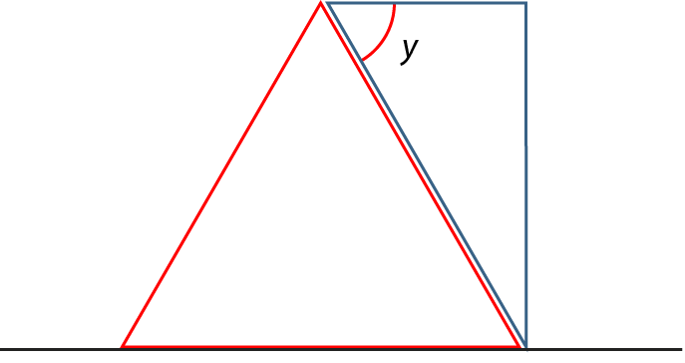



1.28 Common structures – step 4:2
Notes:
An equilateral triangle and a right-angled triangle are positioned on a straight line. What is the value of angle y?

Slide 42
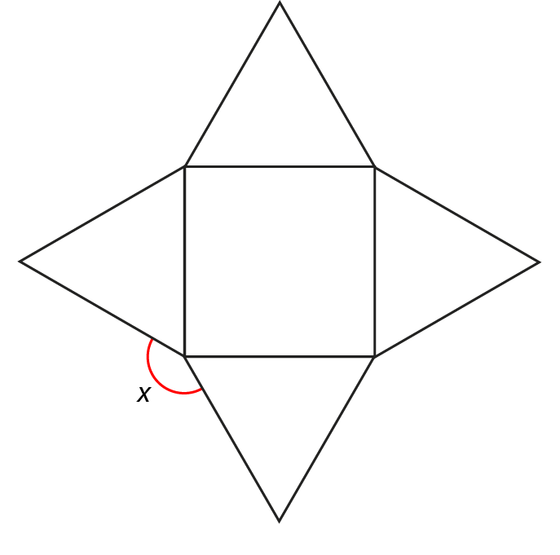




1.28 Common structures – step 4:2
0
Notes:
A square and four equilateral triangles are arranged as shown. What is the value of angle x?

Slide 43
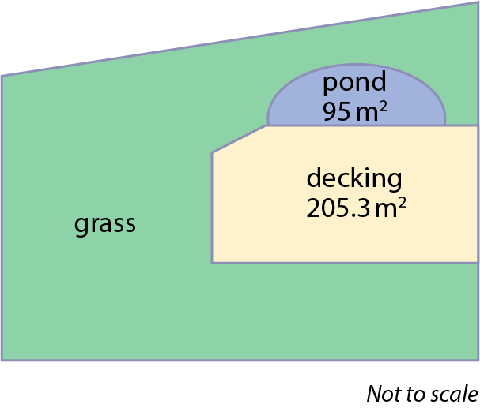
1.28 Common structures – step 4:2
Notes:
Charlie is redesigning his garden. The garden has a total area of 661.5 m². He builds a pond and a decking area as shown on the diagram. Will Charlie have enough turf to grass the rest of the garden if he buys 360 m²? Explain your answer. (No, because 661.5 – 95 – 205.3 = 361.2)

Slide 44
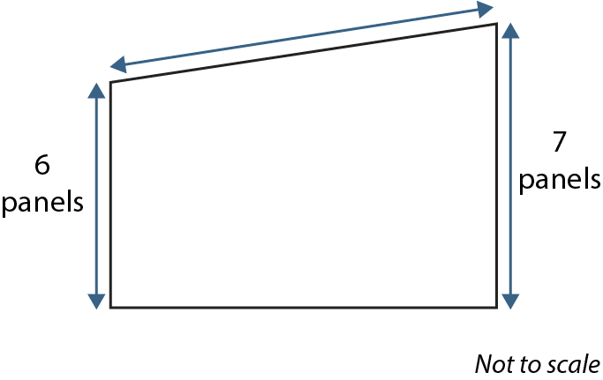
1.28 Common structures – step 4:2
8
panels
Notes:
Charlie now needs to build a new fence along three sides of the garden. Each panel costs £9 and Charlie needs to buy £189-worth of panels. How many panels are needed for the longest length of fence? (189 ÷ 9 = 21; 21 – 6 – 7 = 8)

Slide 45
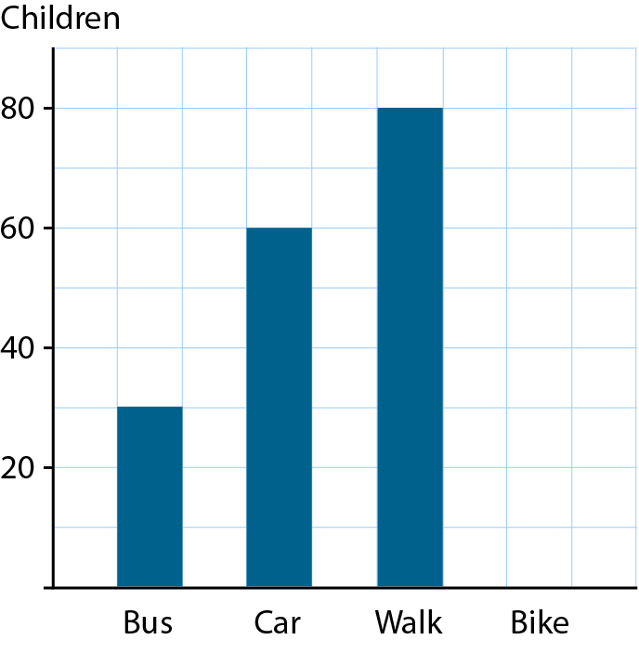

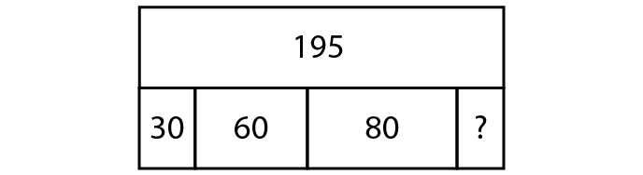

1.28 Common structures – step 4:3
Notes:
The bar chart shows the results of a survey that asked 195 children how they travel to school. Complete the chart to show how many children travelled by bike.

Slide 46


1.28 Common structures – step 4:3
Notes:
The pie chart shows the results of a school survey that asked about children’s pets. What percentage of children had a hamster?

Slide 47
1.28 Common structures – step 4:4
Sport | Boys | Girls | Total
football | 21 | 34
hockey | 27
rounders |  | 19
Total | 70 |  | 136
55
13
40
22
41
66
Notes:
Complete the table showing the favourite sports of 136 children.

Slide 48
1.28 Common structures – step 4:4
Month | Number of visitors
January – March | 138,890
April – June | 289,419
July – September | 426,810
October - December
144,881
Notes:
A theme park hopes to attract one million visitors in a year. How many visitors does it need to attract in the last three months of the year to meet its target?

Slide 49

1.28 Common structures – step 4:5
£14.53
Notes:
Daisy is spending her birthday money. She buys a new t-shirt for £12.99, a baseball cap for £5.49 and some sunglasses for £6.99. How much change does she get from two £20 notes?

Slide 50




1.28 Common structures – step 4:6
Notes:
Each row and column adds up to five. Fill in the missing numbers.

Slide 51





1.28 Common structures – step 4:6
Notes:
The number in each circle is the sum of the three closest circle below it. Fill in the missing numbers.

Slide 52
1.28 Common structures – step 4:6
 |  | 4.8 | 0.4
0.8 |  |  | 5.6
 | 4
 | 2 | 3.6 | 1.6
5.2
3.2
4.4
2.8
1.2
2.4
6
6.4
Notes:
The sum of each row, column and diagonal is 13.6. Fill in the missing numbers.

Slide 53

1.28 Common structures – Appendix

