Slide 1
1.24 Composition and calculation: hundredths and thousandths
Representations | Year 4
Number, Addition and Subtraction

Slide 2
How to use this presentation
You can find the teacher guide 1.24 Composition and calculation: hundredths and thousandths by following the link below.

Slide 3
1.24 Hundredths and thousandths – step 1:1
one hundredth

Slide 4
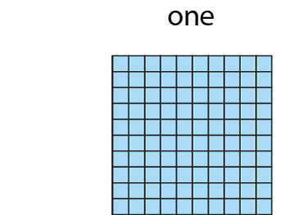

1.24 Hundredths and thousandths – step 1:1

Slide 5
1.24 Hundredths and thousandths – step 1:2
one tenth
= ten hundredths

Slide 6
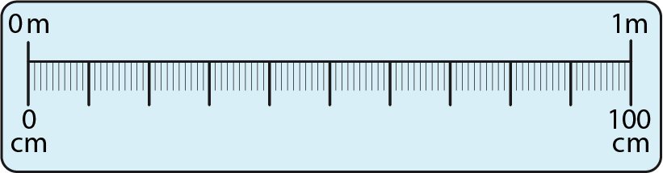
1.24 Hundredths and thousandths – step 1:3
one hundredth of a metre

Slide 7
1.24 Hundredths and thousandths – step 1:4
seven hundredths

Slide 8
1.24 Hundredths and thousandths – step 1:4
15 hundredths

Slide 9
1.24 Hundredths and thousandths – step 1:4
62 hundredths

Slide 10
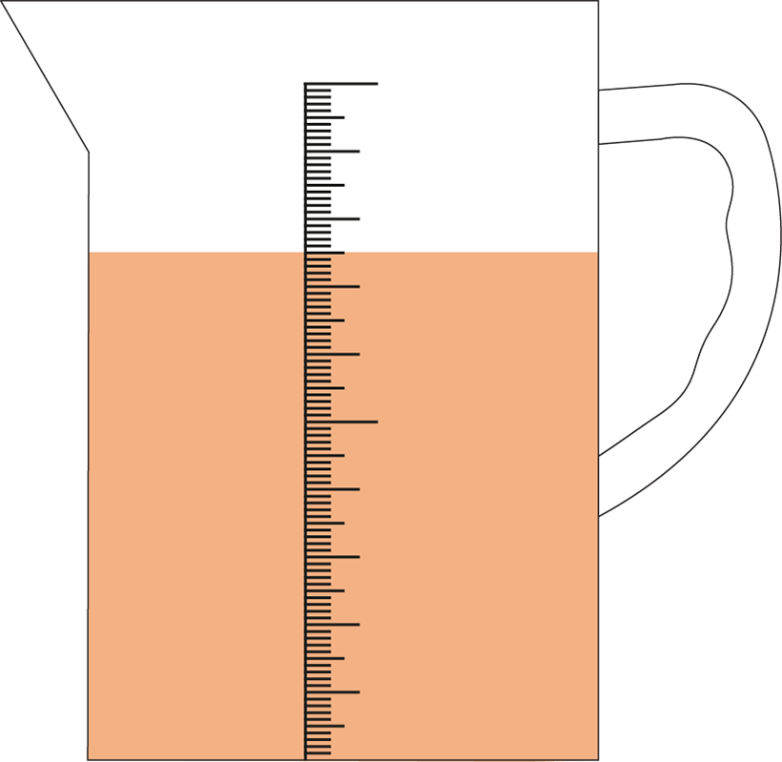
1.24 Hundredths and thousandths – step 1:4
75 hundredths

Slide 11



1.24 Hundredths and thousandths – step 2:1
1,000s | 100s | 10s | 1s | tenths | hundredths
ten times
smaller
one tenth
the size

Slide 12
1.24 Hundredths and thousandths – step 2:2
1,000s | 100s | 10s | 1s | tenths | hundredths
1
0
0
0
0
0
1
0
0
0
0
1
0
0
0
1
0
0
0
1
0
0
0
1

Slide 13
1.24 Hundredths and thousandths – step 2:3
1,000s | 100s | 10s | 1s | 0.1s | 0.01s
0
3
4

Slide 14
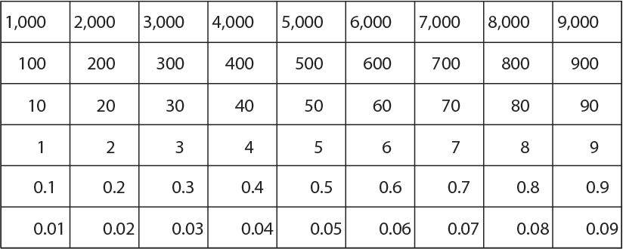
1.24 Hundredths and thousandths – step 2:4

Slide 15
1.24 Hundredths and thousandths – step 2:5
1,000s | 100s | 10s | 1s | 0.1s | 0.01s
0
.
2
3

Slide 16

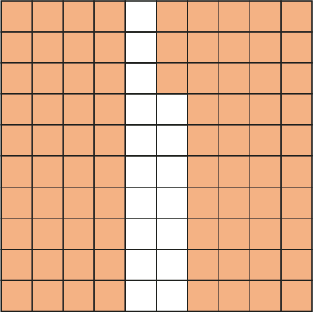
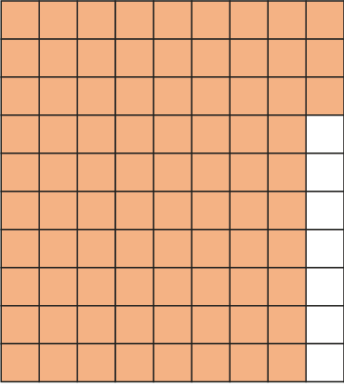
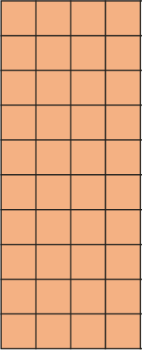
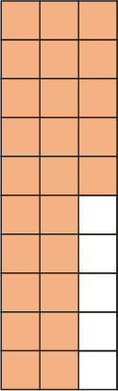
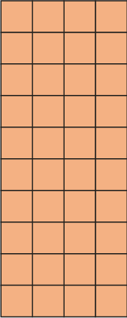
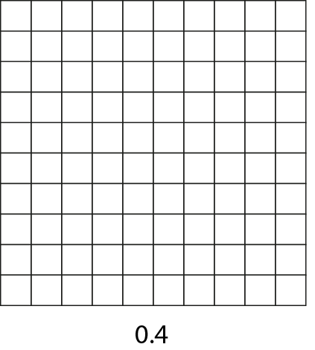




1.24 Hundredths and thousandths – step 2:5

Slide 17
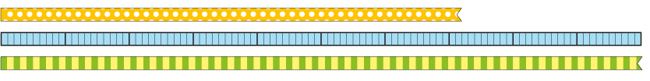
1.24 Hundredths and thousandths – step 2:5
72 hundredths

Slide 18
1.24 Hundredths and thousandths – step 3:1

Slide 19
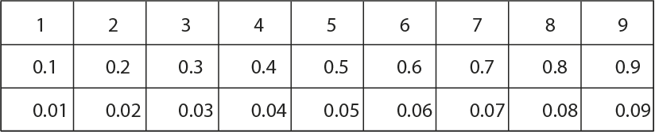


1.24 Hundredths and thousandths – step 3:2

Slide 20
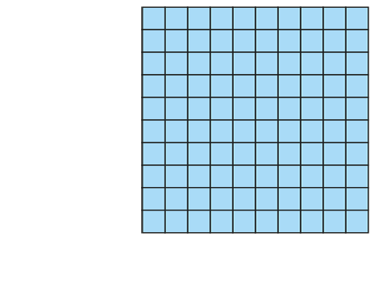





1.24 Hundredths and thousandths – step 3:3

Slide 21
1.24 Hundredths and thousandths – step 3:4
1,000s | 100s | 10s | 1s | 0.1s | 0.01s
2
3
.
1
4

Slide 22
1.24 Hundredths and thousandths – step 3:7
1,000s | 100s | 10s | 1s | 0.1s | 0.01s
1
6
9
2
0
0
1.69 < 2

Slide 23
1.24 Hundredths and thousandths – step 3:7
1,000s | 100s | 10s | 1s | 0.1s | 0.01s
1
6
9
1
7
0
1.69 < 1.7

Slide 24
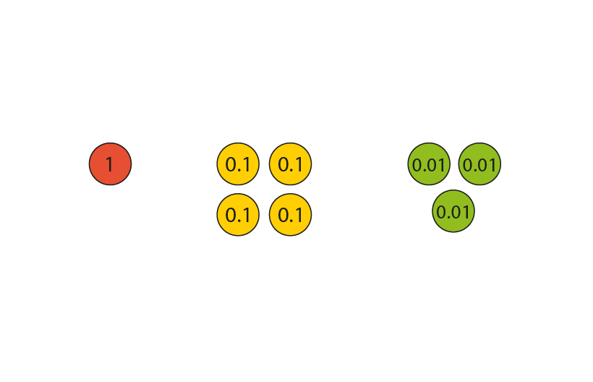
1.24 Hundredths and thousandths – step 4:1
1.43

Slide 25

1.24 Hundredths and thousandths – step 4:1
1.43

Slide 26



1.24 Hundredths and thousandths – step 4:1
1.43

Slide 27



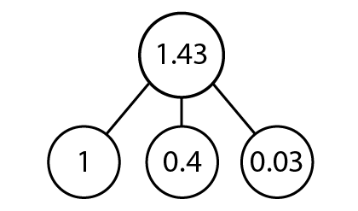
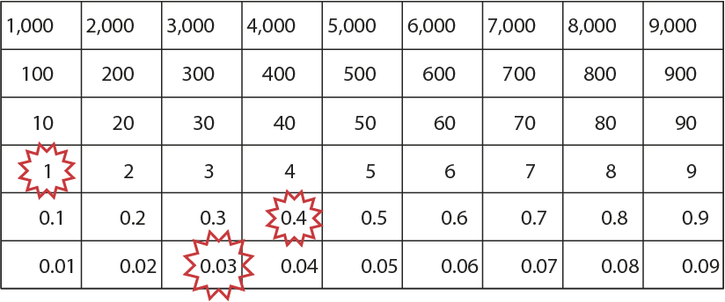
1.24 Hundredths and thousandths – step 4:1
1.43

Slide 28
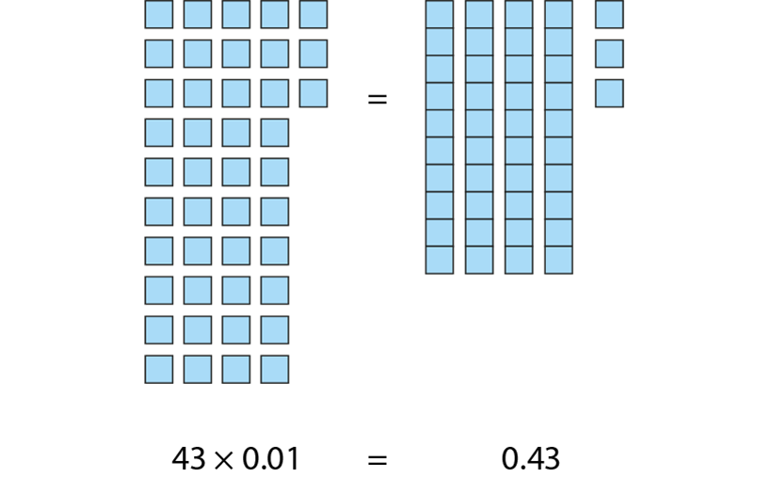
1.24 Hundredths and thousandths – step 4:2

Slide 29
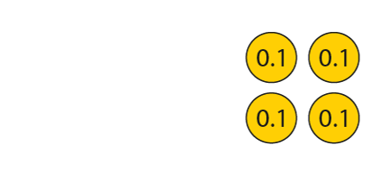
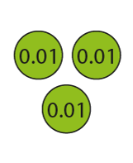





1.24 Hundredths and thousandths – step 4:2

Slide 30
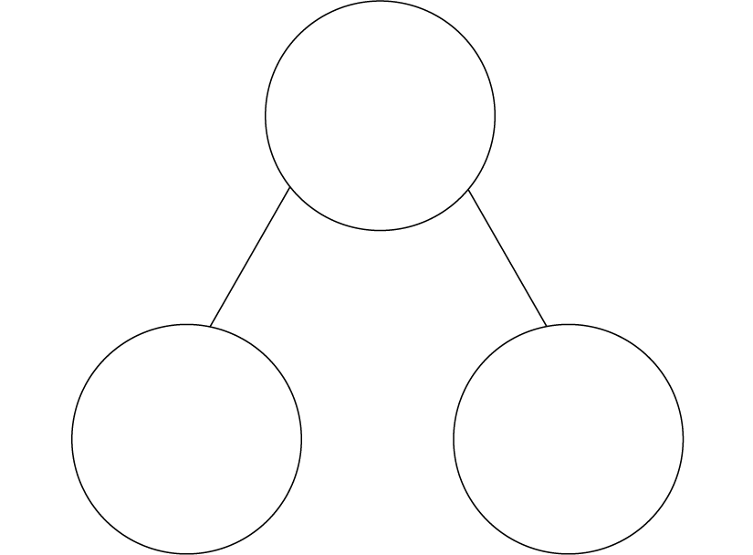
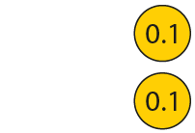

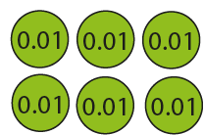

1.24 Hundredths and thousandths – step 4:3
0.46
0.46 = 0.4 + 0.06
0.3 + 0.16

Slide 31

1.24 Hundredths and thousandths – step 4:4

Slide 32
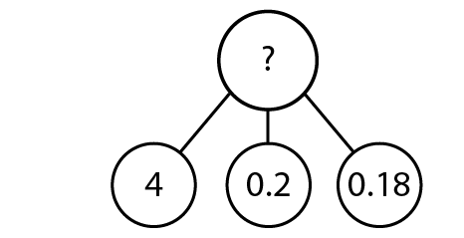
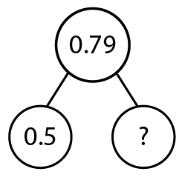
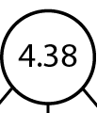

1.24 Hundredths and thousandths – step 4:4

Slide 33
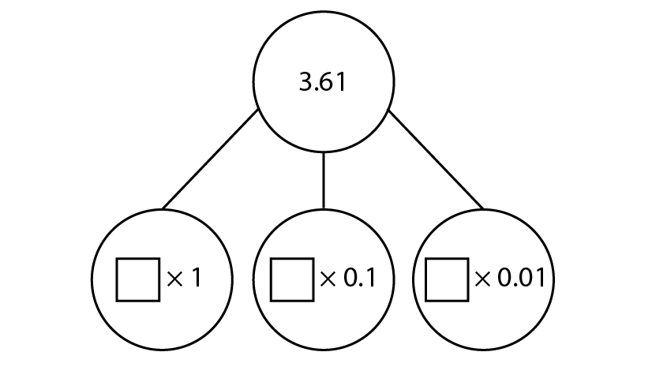
1.24 Hundredths and thousandths – step 4:4

Slide 34

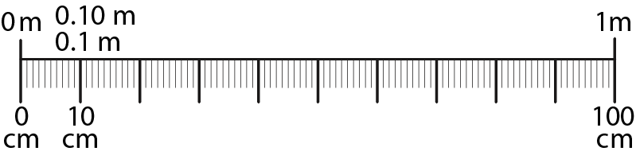



1.24 Hundredths and thousandths – step 5:1

Slide 35
1.24 Hundredths and thousandths – step 5:2
3 m 46 cm
= 3.46 m

Slide 36
1.24 Hundredths and thousandths – step 5:3
Name | Distance jumped (m)
Jamal | 3.04
Reyna | 3.40
Faisal | 2.85
Ilaria | 3.19
Charlie | 3.09
Kagendo | 2.90
Notes:
Who came third in the competition?
How much further did the winner jump compared to the child who came second?
What was difference between the longest and shortest jumps?
How much further did Ilaria jump than Faisal?

Slide 37
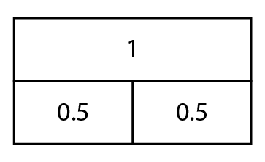
1.24 Hundredths and thousandths – step 5:5

Slide 38
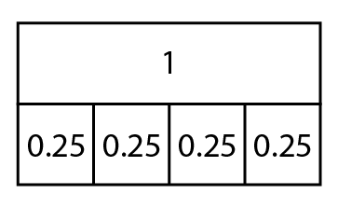
1.24 Hundredths and thousandths – step 5:5

Slide 39
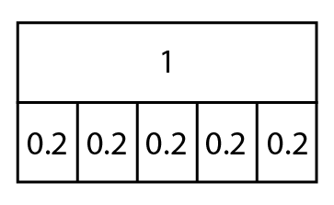
1.24 Hundredths and thousandths – step 5:5

Slide 40
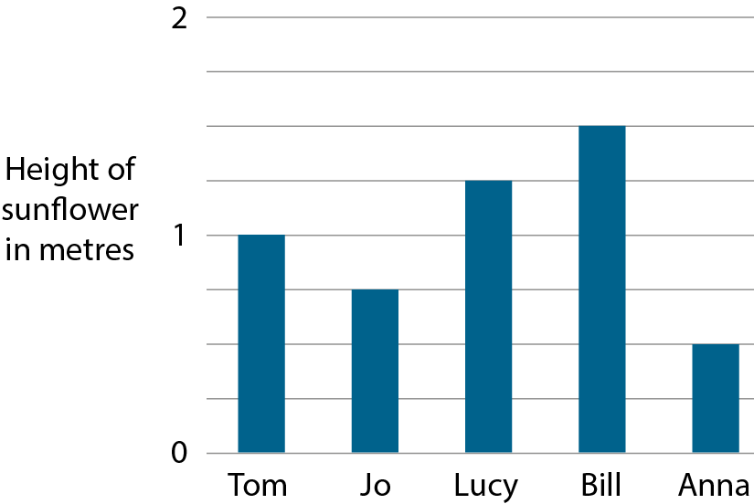
1.24 Hundredths and thousandths – step 5:8
1.5 m
1.25 m
1 m
0.75 m
0.5 m

Slide 41
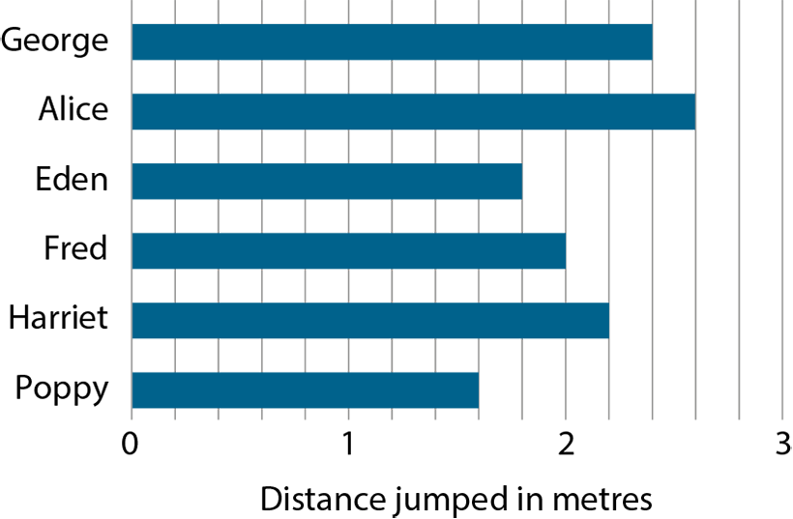
1.24 Hundredths and thousandths – step 5:8
2.4 m
2.6 m
1.8 m
2 m
2.2 m
1.6 m
Notes:
How far did the winning girl jump?
What was the difference between the two longest jumps?

Slide 42

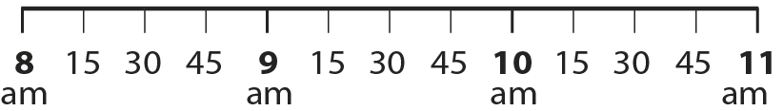







1.24 Hundredths and thousandths – step 5:9
Name | Time
Dipesh
10.15 am
Vana
8.45 am
Emily
10.45 am
Suza
8.15 am
Hector
9.45 am
Tim
9.15 am
30
minutes
30
minutes
30
minutes
30
minutes
30
minutes
Notes:
Who has their lesson first?
Who has their lesson last?
Which two children have lessons between Suza and Hector?
How long do you think a lesson lasts?

Slide 43
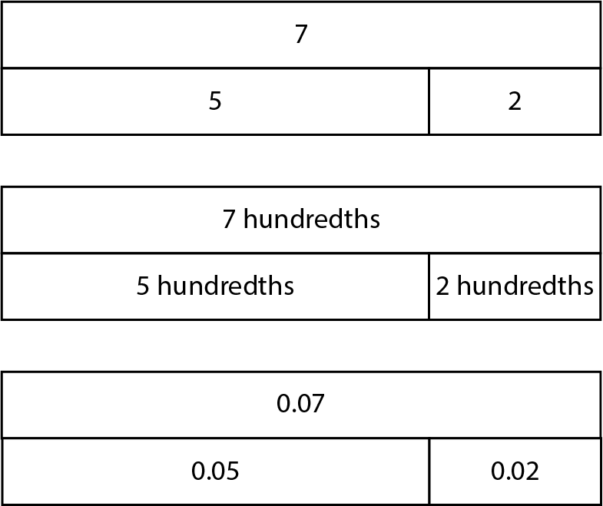
1.24 Hundredths and thousandths – step 6:1

Slide 44
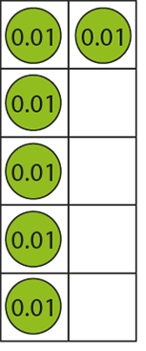
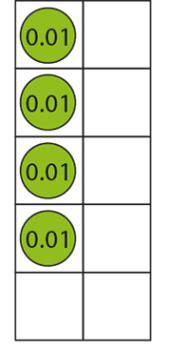




1.24 Hundredths and thousandths – step 6:1
0.06
+
0.04
=
0.1

Slide 45
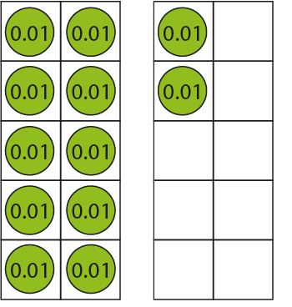












1.24 Hundredths and thousandths – step 6:1
0.12
−
0.05
=
0.07

Slide 46



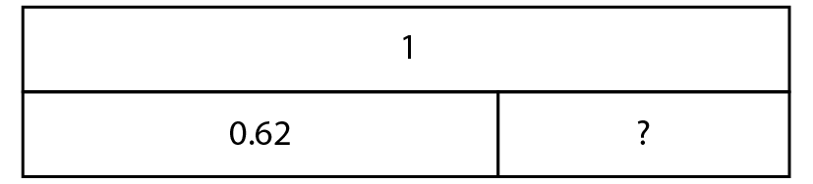





1.24 Hundredths and thousandths – step 6:3
1
=
0.62
+
?
0.38

Slide 47
1.24 Hundredths and thousandths – step 6:7
Pet | Mass (kg)
Minnie the mouse | 0.02
Molly the mouse | 0.04
Harvey the hamster | 0.07
Harold the hamster | 0.06
Chuck the chipmunk | 0.13
Ronnie the rabbit | 1.45
Roxie the rabbit | 2.32
Larry the Labrador | 32.25
Notes:
What is the total mass of the mice, Minnie and Molly?
Which two pets’ combined mass is equal to that of Chuck the chipmunk?
How much greater is Roxie the rabbit’s mass than Ronnie the rabbit’s mass?
Connie the cat’s mass is 2.03 kg more than Roxie the rabbit’s mass. What is Connie’s mass?
How much greater is Larry the Labrador’s mass than Connie the cat’s mass?

Slide 48



1.24 Hundredths and thousandths – step 7:1
previous tenth
previous tenth
next tenth
previous tenth
next tenth
next tenth

Slide 49

1.24 Hundredths and thousandths – step 7:1
previous tenth
closest tenth
next tenth

Slide 50
1.24 Hundredths and thousandths – step 7:3
Ribbon | Length (m) | Length to the nearest 10 cm | Length to the nearest metre | Length to the nearest 10 m
red | 28.45 | 28.5 | 29 | 30
blue | 15.32 | 15.3 | 15 | 20
yellow | 12.02 | 12 | 12 | 10

