Slide 1
2.19 Calculation: ×/÷ decimal fractions by whole numbers
Representations | Year 5
Multiplication and Division

Slide 2
How to use this presentation
You can find the teacher guide 2.19 Calculation: ×/÷ decimal fractions by whole numbers by following the link below.

Slide 3
2.19 Calculation: ×/÷ decimal fractions Step 1:1

Slide 4
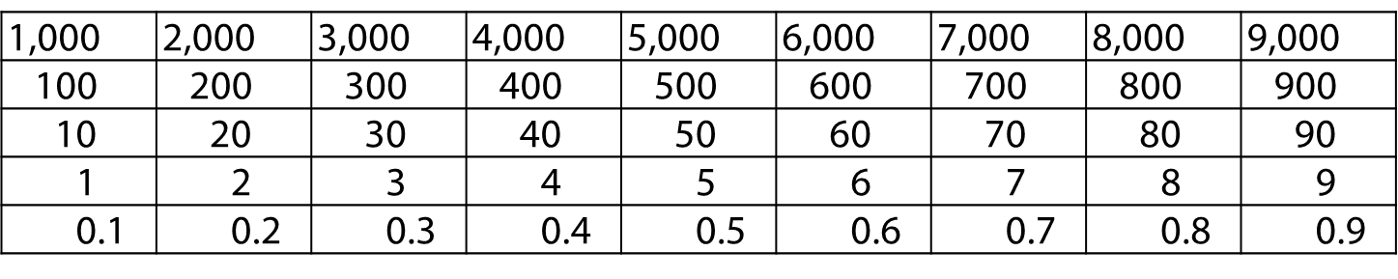
2.19 Calculation: ×/÷ decimal fractions Step 1:1

Slide 5
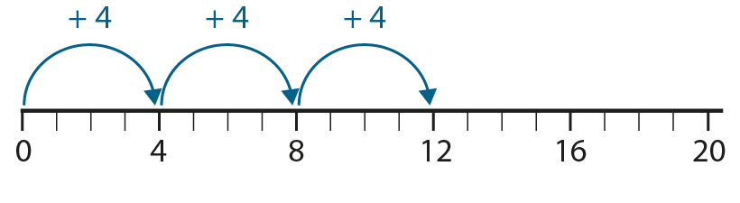
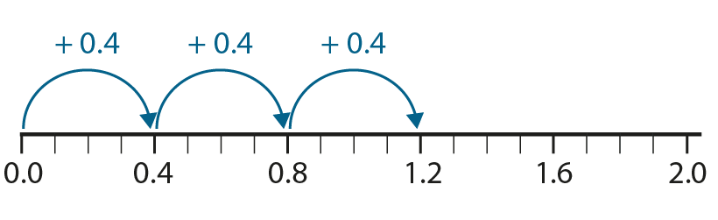
2.19 Calculation: ×/÷ decimal fractions Step 1:2

Slide 6
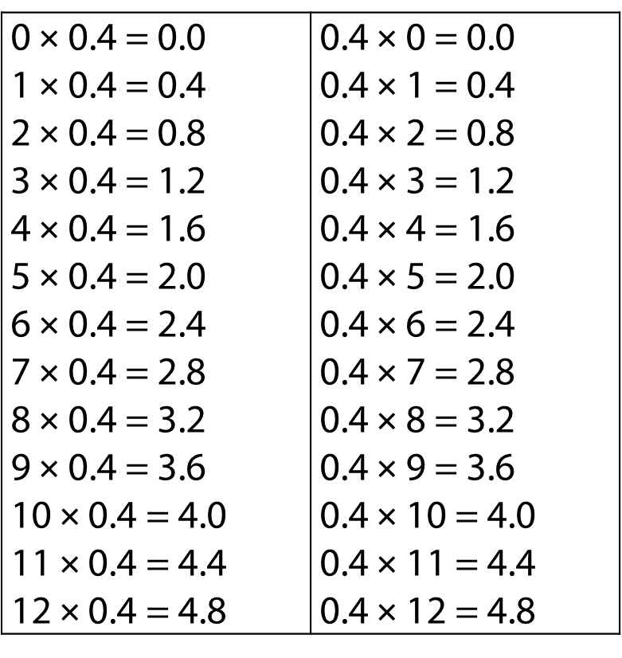
2.19 Calculation: ×/÷ decimal fractions Step 1:3

Slide 7
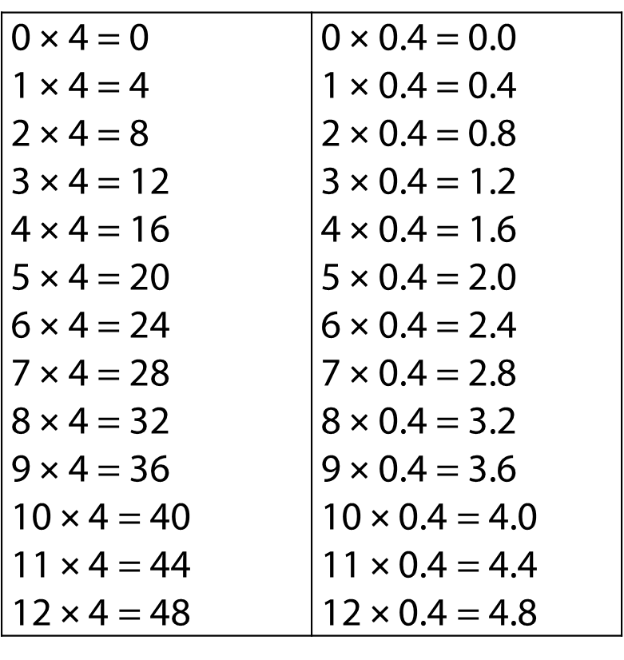
2.19 Calculation: ×/÷ decimal fractions Step 1:3

Slide 8
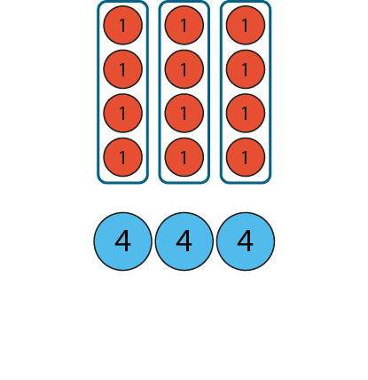
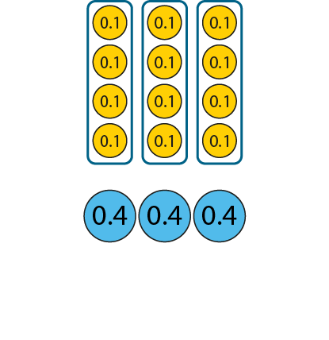
2.19 Calculation: ×/÷ decimal fractions Step 1:4
3 × 4 = 12
3 × 0.4 = 1.2
3 × 4 ones = 12 ones
3 × 4 tenths = 12 tenths
Notes:
Three times four ones is equal to twelve ones,
so three times four tenths is equal to twelve tenths.

Slide 9
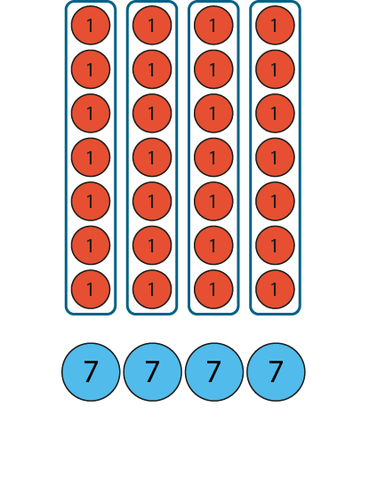
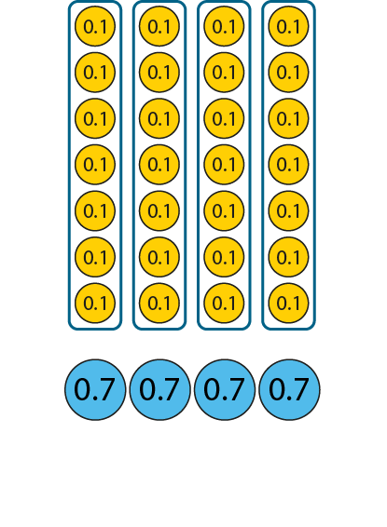
2.19 Calculation: ×/÷ decimal fractions Step 1:5
4 × 7 = 28
4 × 0.7 = 2.8
4 × 7 ones = 28 ones
4 × 7 tenths = 28 tenths
Notes:
Four times seven ones is equal to twenty-eight ones,
so four times seven tenths is equal to twenty-eight tenths.

Slide 10
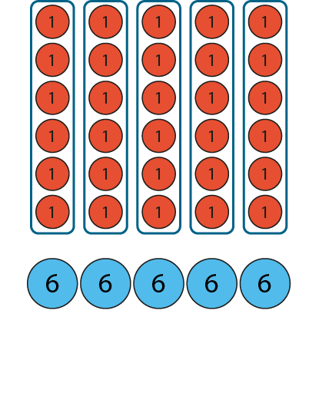
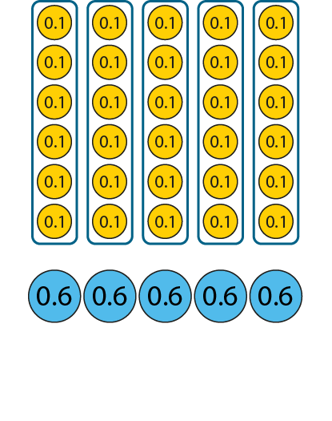
2.19 Calculation: ×/÷ decimal fractions Step 1:5
6 × 5 = 30
6 × 0.5 = 3.0
6 ones × 5 = 30 ones
6 tenths × 5 = 30 tenths
Notes:
Six ones times five is equal to thirty ones,
so six tenths times five is equal to thirty tenths.

Slide 11
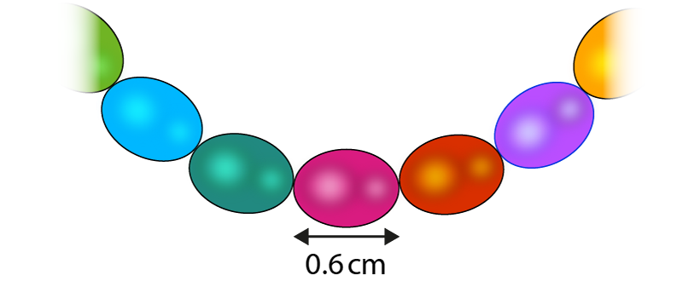
2.19 Calculation: ×/÷ decimal fractions Step 1:6
How long could the necklace be?
3.6 cm
4.6 cm
6.0 cm
3.2 cm
48 cm

Slide 12
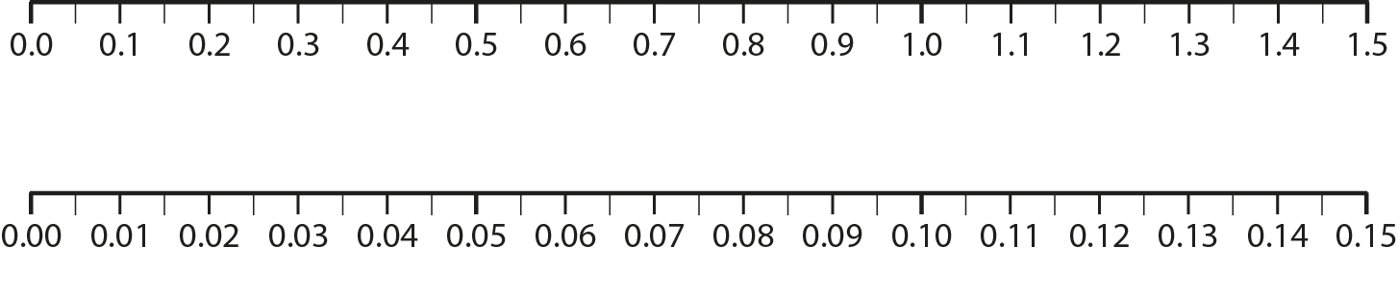
2.19 Calculation: ×/÷ decimal fractions Step 1:7

Slide 13
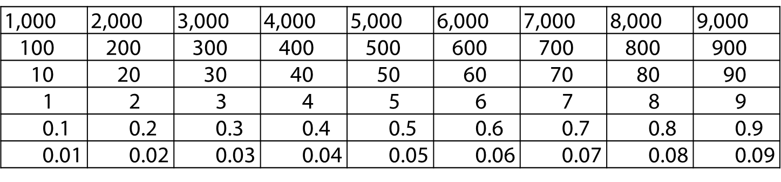
2.19 Calculation: ×/÷ decimal fractions Step 1:7

Slide 14
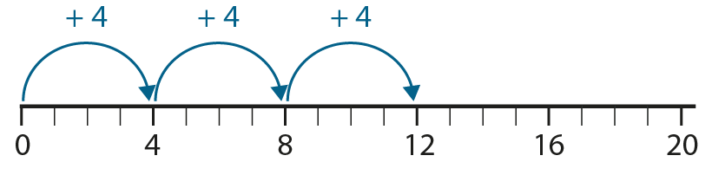
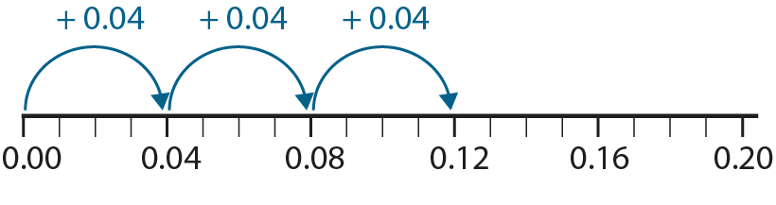
2.19 Calculation: ×/÷ decimal fractions Step 1:8

Slide 15
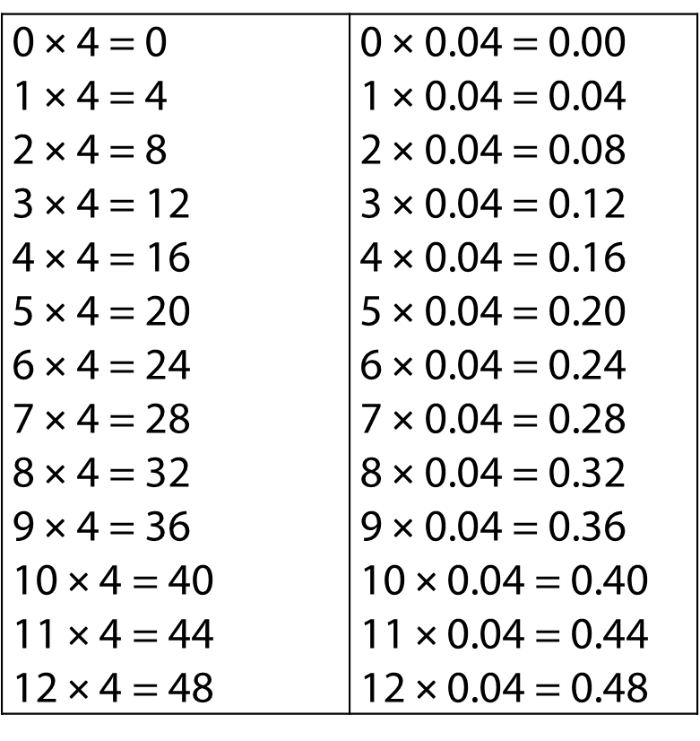
2.19 Calculation: ×/÷ decimal fractions Step 1:9

Slide 16
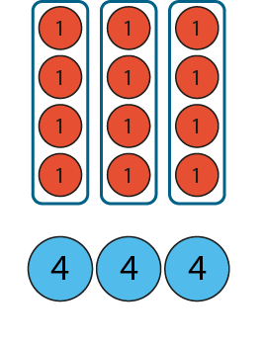
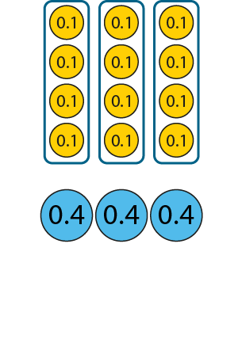
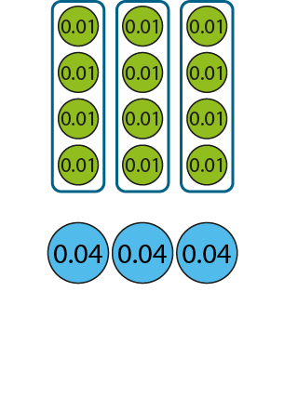
2.19 Calculation: ×/÷ decimal fractions Step 1:10
3 × 4 = 12
3 × 0.4 = 1.2
3 × 0.04 = 0.12
3 × 4 ones = 12 ones
3 × 4 tenths = 12 tenths
3 × 4 = 12
hundredths
hundredths
Notes:
Three times four ones is equal to twelve ones,
so three times four hundredths is equal to twelve hundredths.

Slide 17
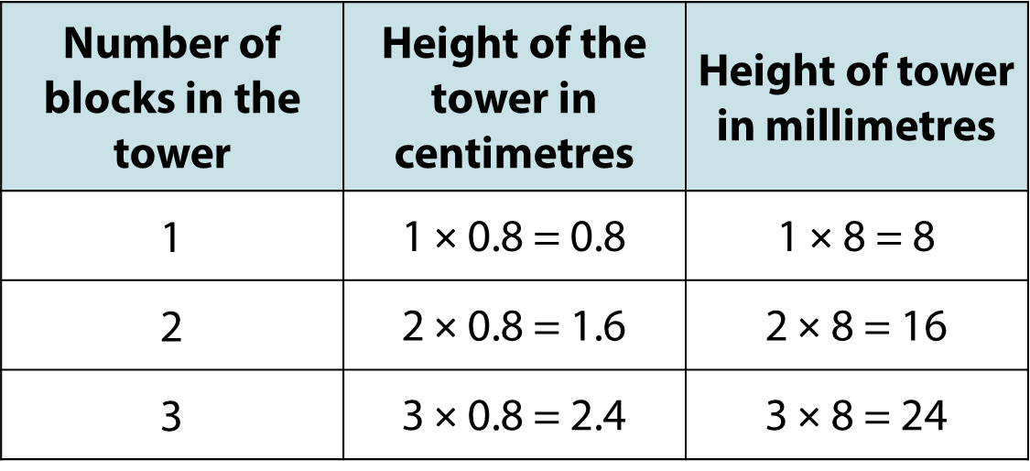
2.19 Calculation: ×/÷ decimal fractions Step 1:14
Notes:
I am building a tower out of blocks. Each block is 0.8 cm tall.
How tall could the tower be?

Slide 18
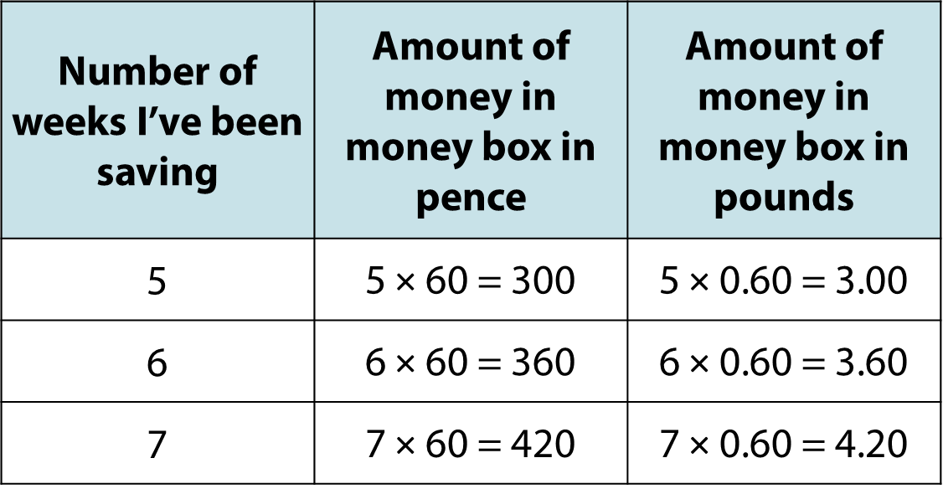
2.19 Calculation: ×/÷ decimal fractions Step 1:14
Notes:
I put 60 p in my money box each week.
How much money could there be in my money box?

Slide 19
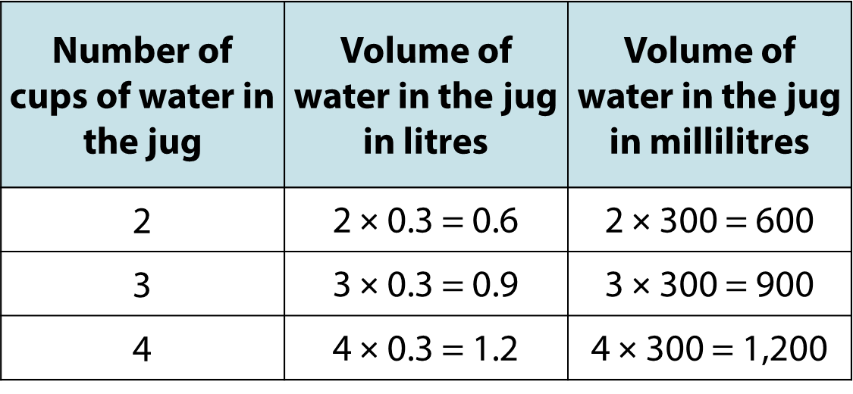
2.19 Calculation: ×/÷ decimal fractions Step 1:14
Notes:
I fill a jug with water using 0.3 litre cups.
How much water could be in the jug.

Slide 20
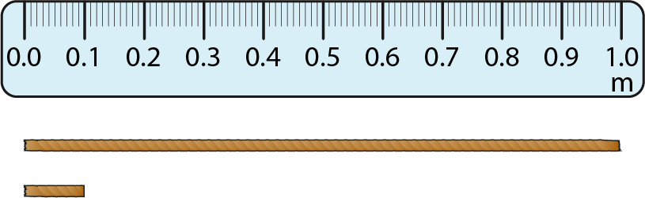
2.19 Calculation: ×/÷ decimal fractions Step 2:1
Mary’s string is one-tenth the length of William’s string.
How long is Mary’s string?
William’s string: 1 m
Mary’s string:
1 m × 0.1 = 0.1 m
?
Notes:
One tenth of one metre is zero-point-one metres.
One tenth of one metre is one-tenth of a metre.

Slide 21
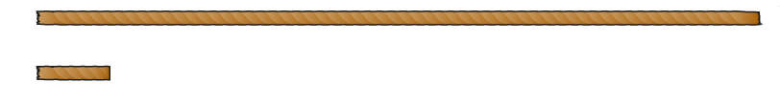
2.19 Calculation: ×/÷ decimal fractions Step 2:1
Mary’s string is one-tenth the length of William’s string.
How long is Mary’s string?
William’s string: 2 m
Mary’s string:
2 m × 0.1 = 0.2 m
?
Notes:
One tenth of two metres is zero-point-two metres.
One tenth of two metres is two-tenths of a metre.

Slide 22
2.19 Calculation: ×/÷ decimal fractions Step 2:1
Mary’s string is one-tenth the length of William’s string.
How long is Mary’s string?
William’s string: 12 m
12 m × 0.1 = 1.2 m
Mary’s string:
?
Notes:
One tenth of twelve metres is one-point-two metres.
One tenth of twelve metres is twelve-tenths of a metre.

Slide 23
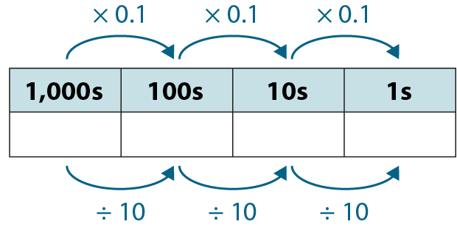
2.19 Calculation: ×/÷ decimal fractions Step 2:2
2
0
20 × 0.1
= 2
20 ÷ 10
= 2

Slide 24
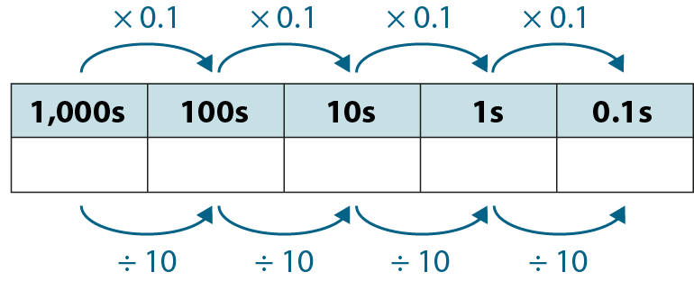
2.19 Calculation: ×/÷ decimal fractions Step 2:2
1
2
12 × 0.1
= 1.2
12 ÷ 10
= 1.2

Slide 25
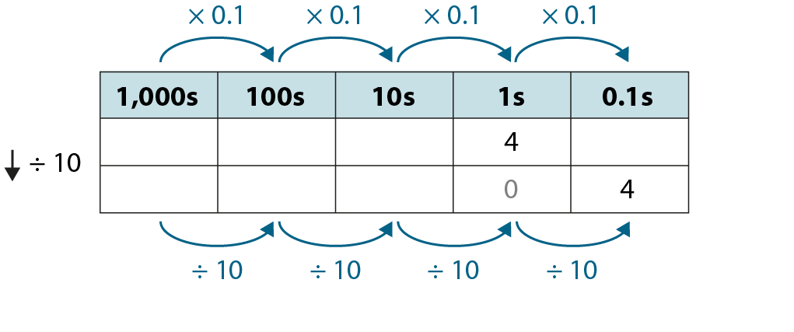
2.19 Calculation: ×/÷ decimal fractions Step 2:2
4 × 0.1 = 0.4
4 ÷ 10 = 0.4

Slide 26
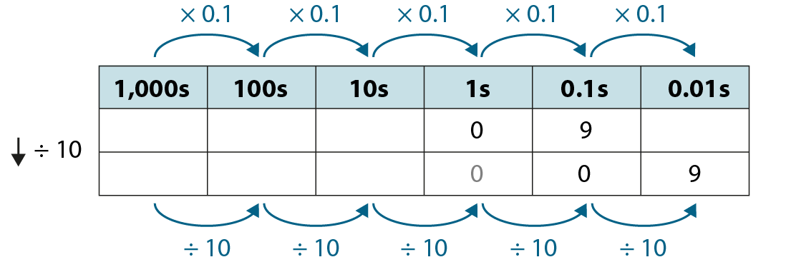
2.19 Calculation: ×/÷ decimal fractions Step 2:3
0.9 × 0.1 = 0.09
0.9 ÷ 10 = 0.09

Slide 27
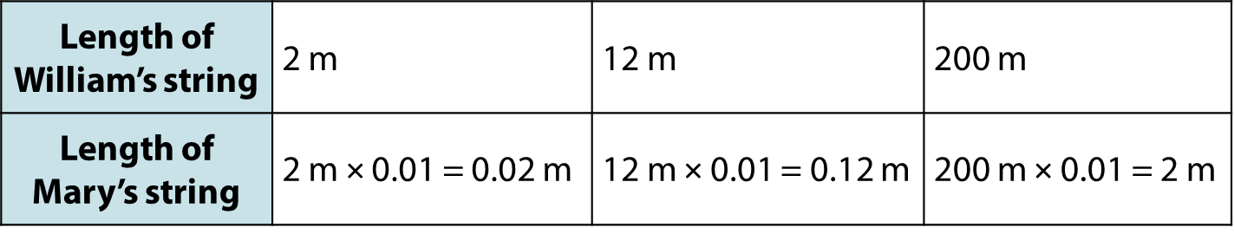
2.19 Calculation: ×/÷ decimal fractions Step 2:4
Mary’s string is one-hundredth the length of William’s string.
Notes:
Mary’s string is one-hundredth the length of William’s string.
How long is Mary’s string?

Slide 28
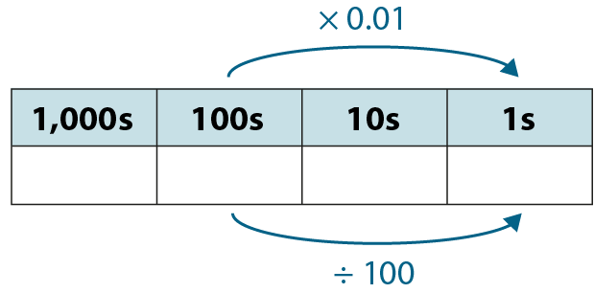
2.19 Calculation: ×/÷ decimal fractions Step 2:4
2
0
0
200 × 0.01
= 2
200 ÷ 100
= 2

Slide 29
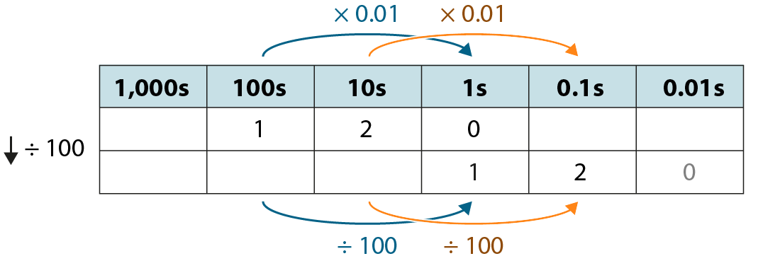
2.19 Calculation: ×/÷ decimal fractions Step 2:4
120 × 0.01 = 1.2
120 ÷ 100 = 1.2

Slide 30
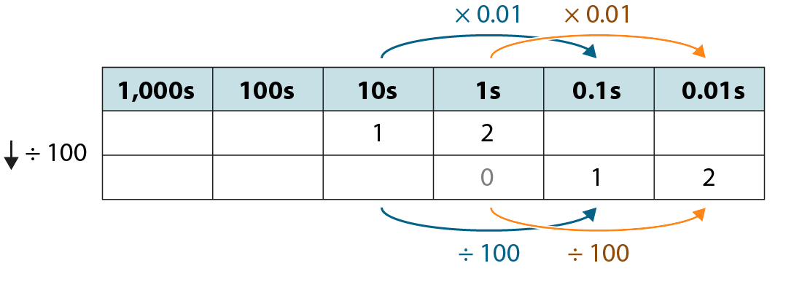
2.19 Calculation: ×/÷ decimal fractions Step 2:4
12 × 0.01 = 0.12
12 ÷ 100 = 0.12

Slide 31
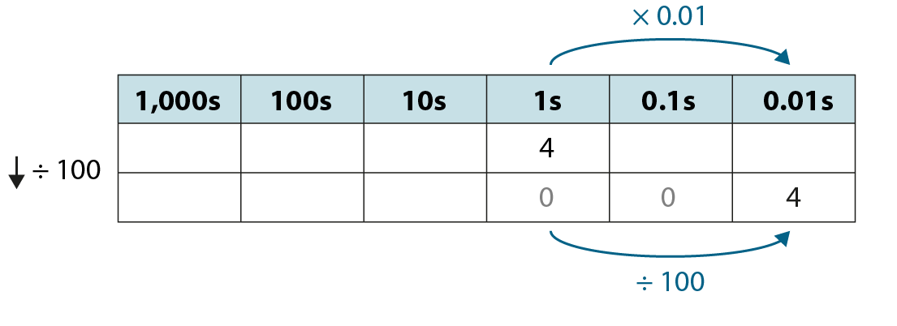
2.19 Calculation: ×/÷ decimal fractions Step 2:4
4 × 0.01 = 0.04
4 ÷ 100 = 0.04

Slide 32
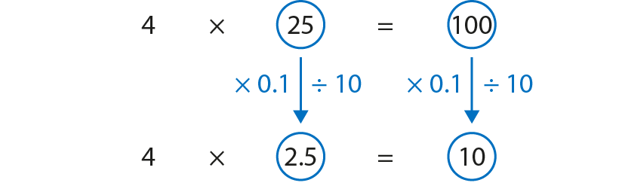
2.19 Calculation: ×/÷ decimal fractions Step 3:1
Notes:
Two-point-five is one-tenth the size of twenty-five,
so four times two-point-five is one tenth the size of four times twenty-five.

Slide 33
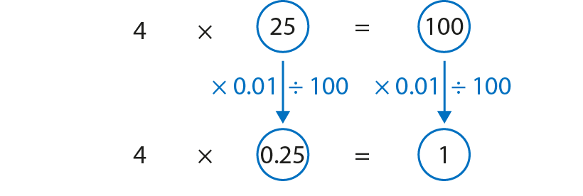
2.19 Calculation: ×/÷ decimal fractions Step 3:1
Notes:
Zero-point-two-five is one-hundredth the size of twenty-five,
so four times zero-point-five is one hundredth the size of four times twenty-five.

Slide 34
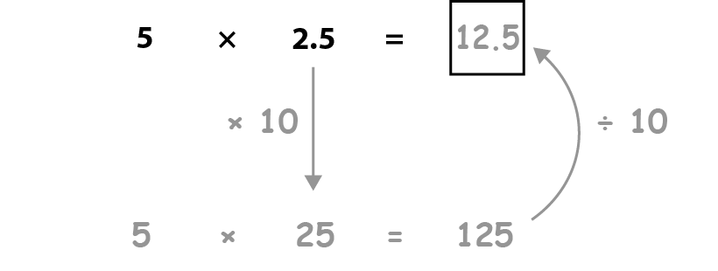
2.19 Calculation: ×/÷ decimal fractions Step 3:2
Notes:
For detailed progression and more examples to use in class,
please refer to the teacher guide for 2.19 Calculation: ×/÷ decimal fractions by whole numbers.

Slide 35
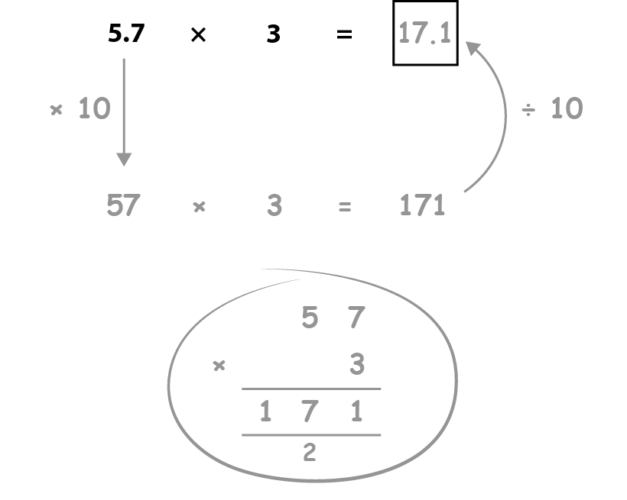
2.19 Calculation: ×/÷ decimal fractions Step 3:5
Notes:
For detailed progression and more examples to use in class,
please refer to the teacher guide for 2.19 Calculation: ×/÷ decimal fractions by whole numbers.

Slide 36
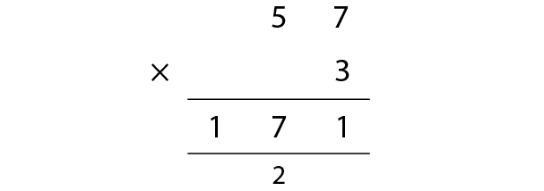
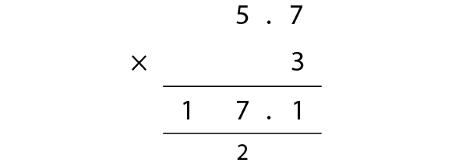
2.19 Calculation: ×/÷ decimal fractions Step 3:7
57 ones × 3 = 171 ones
so
57 tenths × 3 = 171 tenths
5.7 × 3 = 17.1

Slide 37
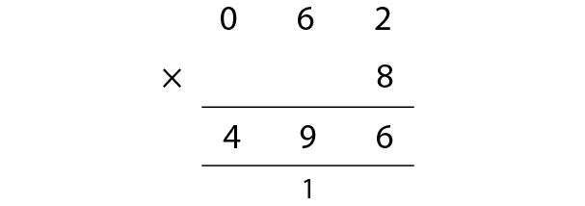
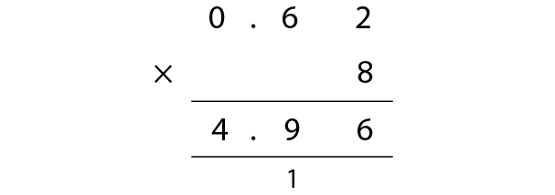
2.19 Calculation: ×/÷ decimal fractions Step 3:7
62 ones × 8 = 496 ones
so
62 hundredths × 8 = 496 hundredths
0.62 × 8 = 4.96

Slide 38
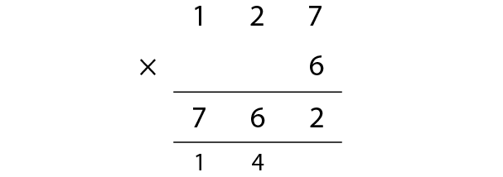
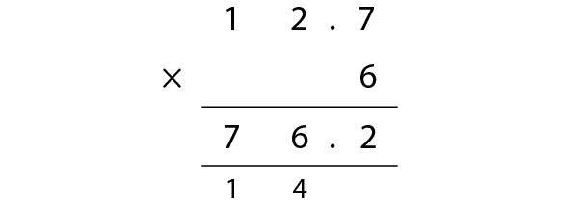
2.19 Calculation: ×/÷ decimal fractions Step 3:7
127 ones × 6 = 762 ones
so
127 tenths × 6 = 762 tenths
12.7 × 6 = 76.2

Slide 39
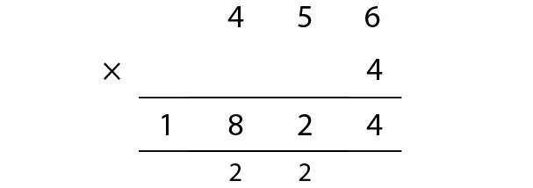
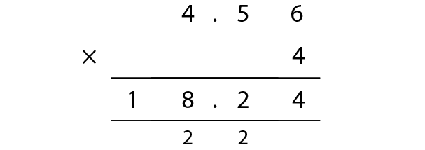
2.19 Calculation: ×/÷ decimal fractions Step 3:7
456 ones × 4 = 1,824 ones
so
456 hundredths × 4 = 1,824 hundredths
4.56 × 4 = 18.24

Slide 40
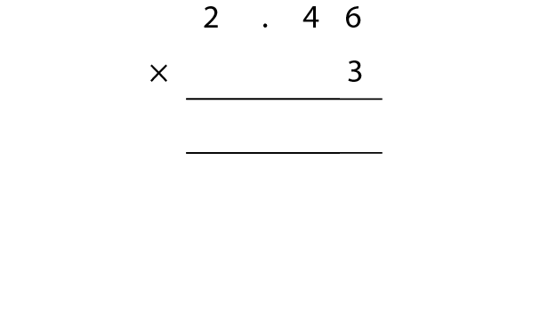
2.19 Calculation: ×/÷ decimal fractions Step 3:8
2.46 × 3
Step 1 – lay out the calculation
.

Slide 41
2.19 Calculation: ×/÷ decimal fractions Step 3:8
2.46 × 3
Step 1 – lay out the calculation
Step 2 – write the decimal point for the product
.
.

Slide 42

2.19 Calculation: ×/÷ decimal fractions Step 3:8
2.46 × 3
Step 3 – perform the calculation with unitising
Step 2 – write the decimal point for the product
6
3
8
1
Notes:
3 × 6 hundredths = 18 hundredths
18 hundredths = 1 tenth + 8 hundredths
Write ‘1’ below the tenths column and ‘8’ in the hundredths column.

Slide 43
2.19 Calculation: ×/÷ decimal fractions Step 3:8
2.46 × 3
Step 3 – perform the calculation with unitising
4
6
3
3
8
1
1
Notes:
3 × 4 tenths = 12 tenths
12 tenths + 1 tenth = 13 tenths
13 tenths = 1 one + 3 tenths
Write ‘1’ below the ones column and ‘3’ in the tenths column.

Slide 44
2.19 Calculation: ×/÷ decimal fractions Step 3:8
2.46 × 3
Step 3 – perform the calculation with unitising
2
4
6
3
7
3
8
1
1
Notes:
3 × 2 ones = 6 ones
6 ones + 1 one = 7 ones
Write ‘7’ in the ones column.

Slide 45
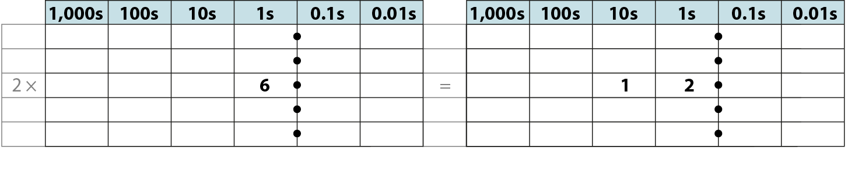
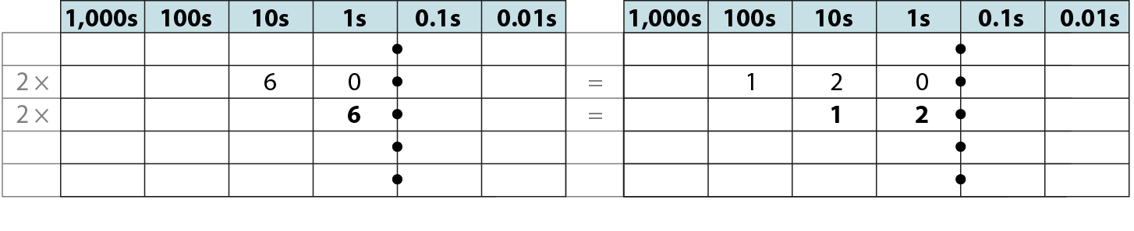
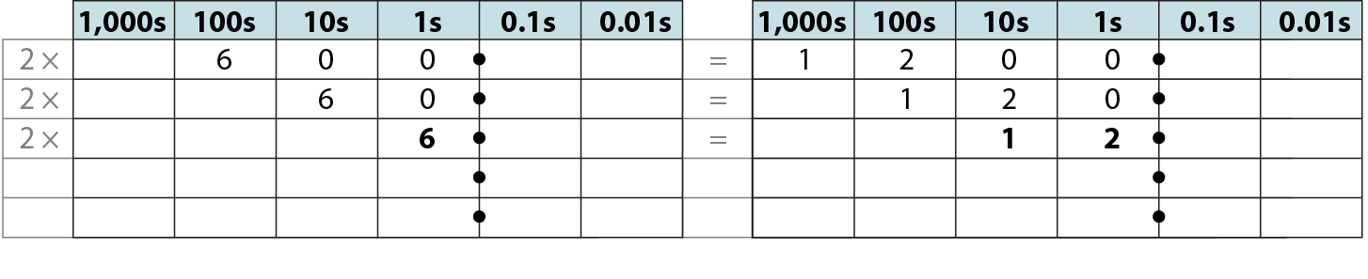


2.19 Calculation: ×/÷ decimal fractions Step 4:1

Slide 46

2.19 Calculation: ×/÷ decimal fractions Step 4:1

Slide 47



2.19 Calculation: ×/÷ decimal fractions Step 4:2

Slide 48



2.19 Calculation: ×/÷ decimal fractions Step 4:3

Slide 49

2.19 Calculation: ×/÷ decimal fractions Step 5:1
Notes:
One-point-two is one-tenth the size of twelve,
so one-point-two divided by three is one-tenth the size of twelve divided by three.

Slide 50

2.19 Calculation: ×/÷ decimal fractions Step 5:1
Notes:
Zero-point-one-two is one-hundredth the size of twelve,
so zero-point-one-two divided by three is one-hundredth the size of twelve divided by three.

Slide 51

2.19 Calculation: ×/÷ decimal fractions Step 5:2
Notes:
For detailed progression and more examples to use in class,
please refer to the teacher guide for 2.19 Calculation: ×/÷ decimal fractions by whole numbers.

Slide 52

2.19 Calculation: ×/÷ decimal fractions Step 5:5
Notes:
For detailed progression and more examples to use in class,
please refer to the teacher guide for 2.19 Calculation: ×/÷ decimal fractions by whole numbers.

Slide 53

2.19 Calculation: ×/÷ decimal fractions Step 5:7
2 1
2 . 1
3
6 3
3
6 . 3
63 ones ÷ 3 = 21 ones
so
63 tenths ÷ 3 = 21 tenths
6.3 ÷ 3 = 2.1

Slide 54

2.19 Calculation: ×/÷ decimal fractions Step 5:7
0 1 7
0 . 1 7
5
0 8 5
3
5
0 . 8 5
3
85 ones ÷ 5 = 17 ones
so
85 hundredths ÷ 5 = 17 hundredths
0.85 ÷ 5 = 0.17

Slide 55
2.19 Calculation: ×/÷ decimal fractions Step 5:7
0 5 1
0 5 . 1
5
2 5 5
2
5
2 5 . 5
2
255 ones ÷ 5 = 51 ones
so
255 tenths ÷ 5 = 51 tenths
25.5 ÷ 5 = 5.1

Slide 56
2.19 Calculation: ×/÷ decimal fractions Step 5:7
0 8 9
0 . 8 9
4
3 5 6
3
3
4
3 . 5 6
3
3
356 ones ÷ 4 = 89 ones
so
356 hundredths ÷ 4 = 89 hundredths
3.56 ÷ 4 = 0.89

Slide 57
2.19 Calculation: ×/÷ decimal fractions Step 5:8
2.46 ÷ 6
Step 1 – write the divisor, dividend and frame
6
2
.
4
6

Slide 58
2.19 Calculation: ×/÷ decimal fractions Step 5:8
2.46 ÷ 6
Step 2 – write the decimal point for the quotient
Step 1 – write the divisor, dividend and frame
.
6
2
.
4
6

Slide 59
2.19 Calculation: ×/÷ decimal fractions Step 5:8
2.46 ÷ 6
Step 2 – write the decimal point for the quotient
Step 3 – perform the calculation, with unitising
0
.
6
2
.
4
6
2
Notes:
2 ones ÷ 6 = 0 ones remainder 2 ones
Write ‘0’ in the ones column, and write ‘2’ to the left of the tenths column to make 24 tenths.

Slide 60
2.19 Calculation: ×/÷ decimal fractions Step 5:8
2.46 ÷ 6
Step 3 – perform the calculation, with unitising
0
.
4
6
2
.
4
6
2
Notes:
24 tenths ÷ 6 = 4 tenths
Write ‘4’ in the tenths column.

Slide 61
2.19 Calculation: ×/÷ decimal fractions Step 5:8
2.46 ÷ 6
Step 3 – perform the calculation, with unitising
0
.
4
1
6
2
.
4
6
2
Notes:
6 hundredths ÷ 6 = 1 hundredth
Write ‘1’ in the hundredths column.

