Slide 1
Numberblocks
Support Materials
Series 2, Episode 7
Ten Green Bottles

Slide 2
Practitioner Notes

Slide 3
Episode Description
Ten counts her ten green bottles, hanging on the wall, one falls off and is caught. One of the remaining nine bottles turns into a T-Rex, from whom Nine runs, but who turns out to be friendly. Eight hides the bottles in a box but one is stolen by a fox. Seven catches the bottles in the box, but they jet off, painting a rainbow in the sky. One hits and wakes a grizzly bear, who turns into a cuddly teddy bear. Six plays a bottle spinning game with the remaining bottles, then five of them roll down the hill. One grows a daffodil, one runs off to the fair, Three juggles three bottles and one flies off. The last two land in the sea. One water-skis, and the other (along with ten Ones and all the animals so far) is swallowed by a whale. It grows a tickly tail and everyone is shot out of the whale’s blow-hole, high into the air. They peel off and Ten lands safely next to her wall.

Slide 4
Maths in the Episode
Saying the counting numbers from 10 to 1
Throughout this episode the Numberblocks count forwards and backwards between 0 and 10.
Subtracting One
This episode provides experience of the effect of subtracting 1 from a number less than or equal to 10.

Slide 5
Using Mathematical Language
Use these stem sentences to rehearse subtraction of 1:
“10 take away 1 is 9.”
As children begin to become more familiar with subtracting one they will be able to compare numbers using:
“Eight is one less than nine”
Or
“When you subtract one from a number, the number gets one smaller.”

Slide 6
Talk and Discuss Together

Slide 7
Talk and Discuss Together
Watch the episode of Numberblocks. First ask the children what they noticed and allow them to talk to you and each other. The following slides are designed to stimulate children and adults to talk about the episode and draw out some key aspects of the mathematics.

Slide 8
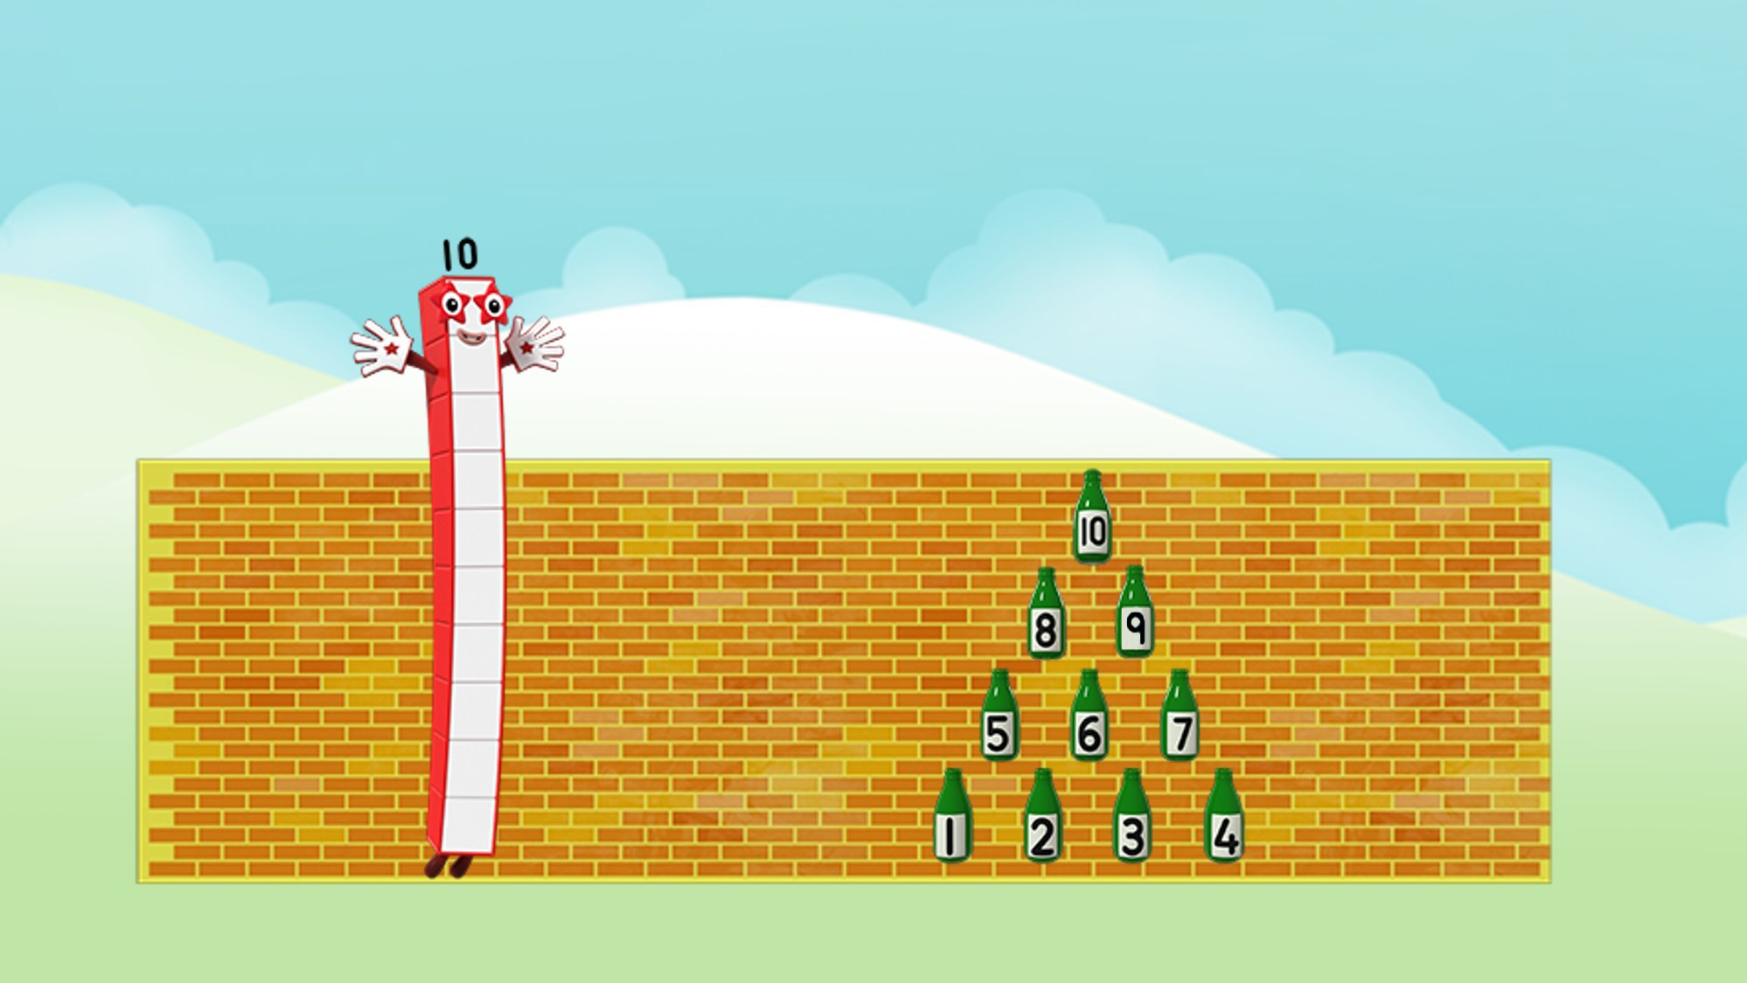
Images © 2017 Alphablocks Ltd. All Rights Reserved.
Notes:
What did you see in the episode? What was it about?
Does anyone know the real song Ten Green Bottles?

Slide 9
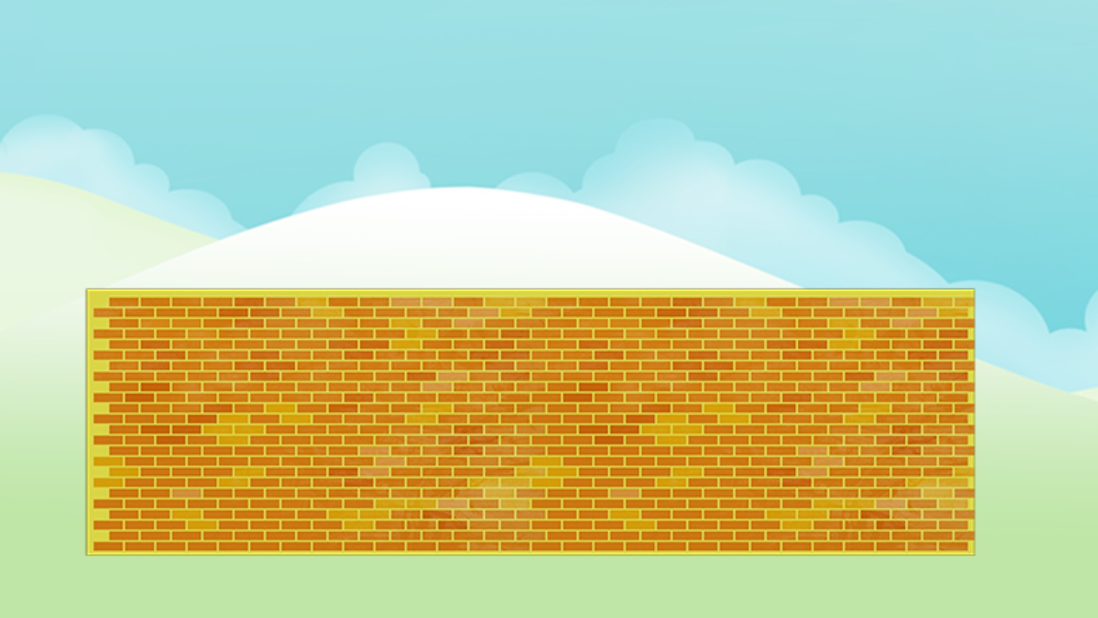
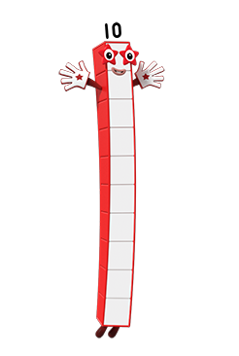

Images © 2017 Alphablocks Ltd. All Rights Reserved.
Notes:
Use slides 9-19 to accompany the familiar song.
Each slide is animated with a bottle falling off the wall each time. Provide each child with a stick of 10 linking cubes so that they can remove one each time a bottle falls off the wall. Each time count how many are left.

Slide 10
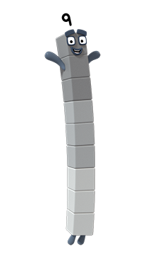
Images © 2017 Alphablocks Ltd. All Rights Reserved.

Slide 11
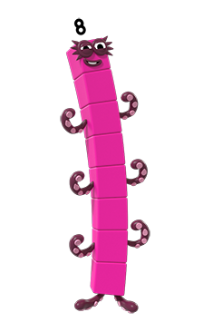
Images © 2017 Alphablocks Ltd. All Rights Reserved.

Slide 12
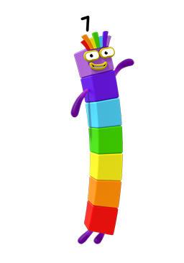
Images © 2017 Alphablocks Ltd. All Rights Reserved.

Slide 13
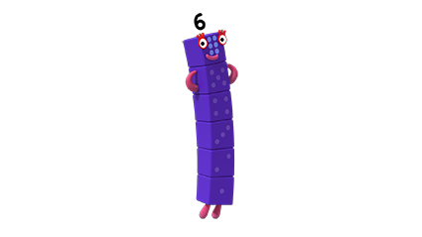
Images © 2017 Alphablocks Ltd. All Rights Reserved.

Slide 14
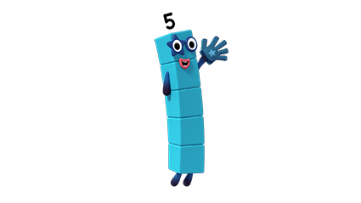
Images © 2017 Alphablocks Ltd. All Rights Reserved.

Slide 15
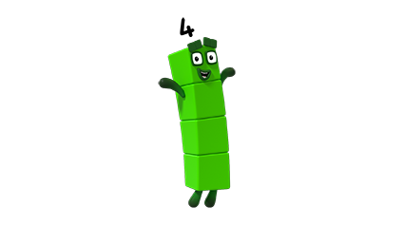
Images © 2017 Alphablocks Ltd. All Rights Reserved.

Slide 16
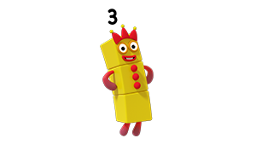
Images © 2017 Alphablocks Ltd. All Rights Reserved.

Slide 17
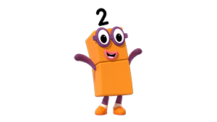
Images © 2017 Alphablocks Ltd. All Rights Reserved.

Slide 18
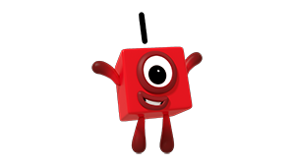
Images © 2017 Alphablocks Ltd. All Rights Reserved.

Slide 19
Images © 2017 Alphablocks Ltd. All Rights Reserved.

Slide 20
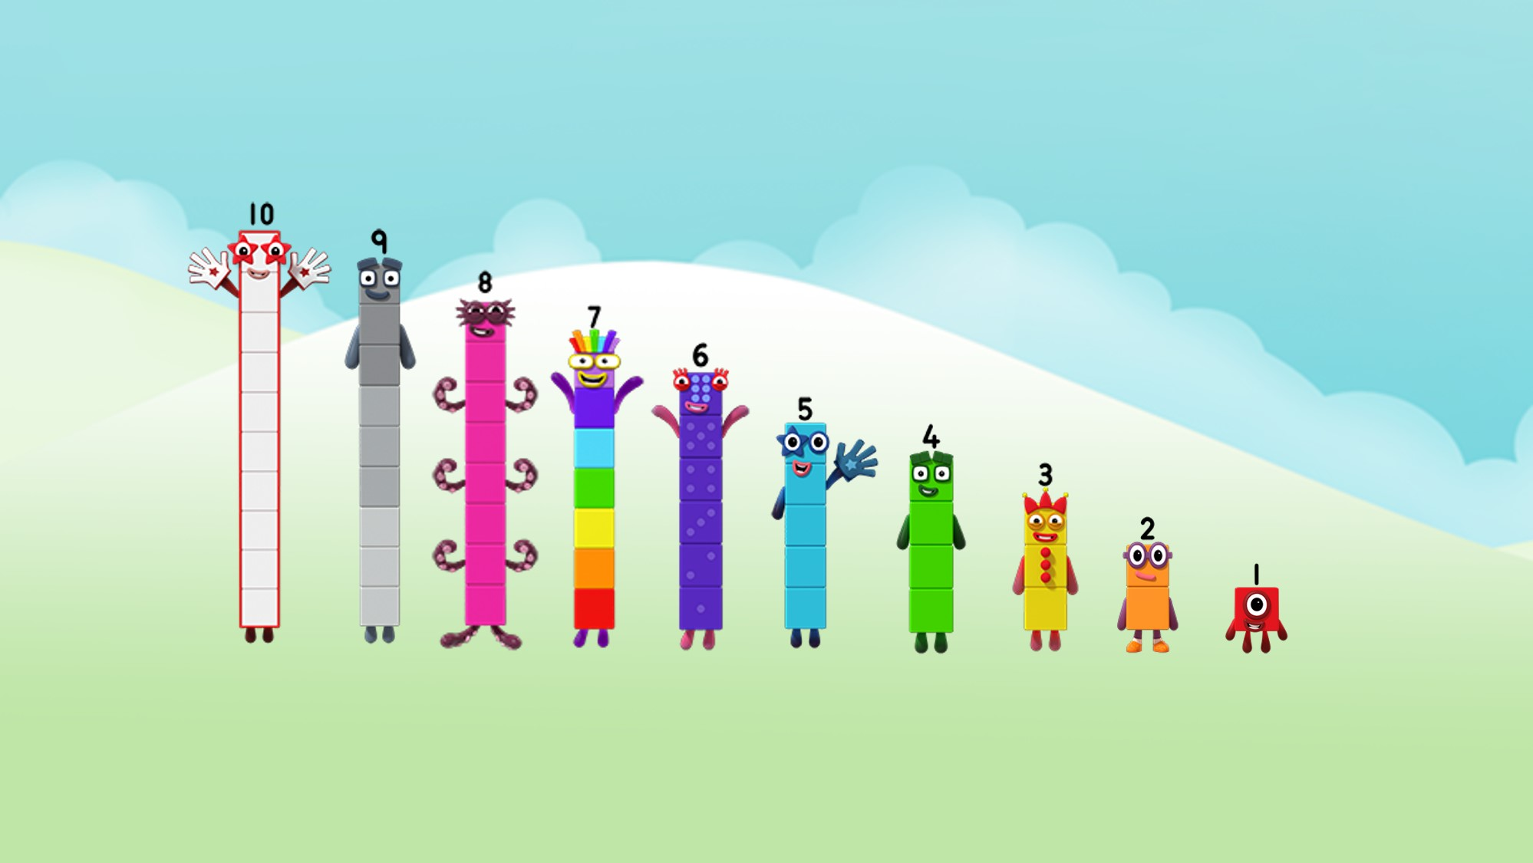
Images © 2017 Alphablocks Ltd. All Rights Reserved.
Notes:
Practise counting backwards from 10 using this image.

Slide 21
Enabling Environments

Slide 22
Enabling Environments
Playing and Exploring
Practise hitting plastic bottles or skittles off a bench one at a time by throwing a beanbag.
Active Learning
Notice how fluently the children count backwards from 10. Notice if they hesitate at any point. Notice when they use counting back one step in their play when solving problems.
Creating and Thinking Critically
Fill 10 bottles with sand or water (with lids on!). Allow the children to explore how to sing along to the song while pushing the bottles over. Make up a similar song using 10 different objects.

Slide 23
Learning Together in Y1

Slide 24
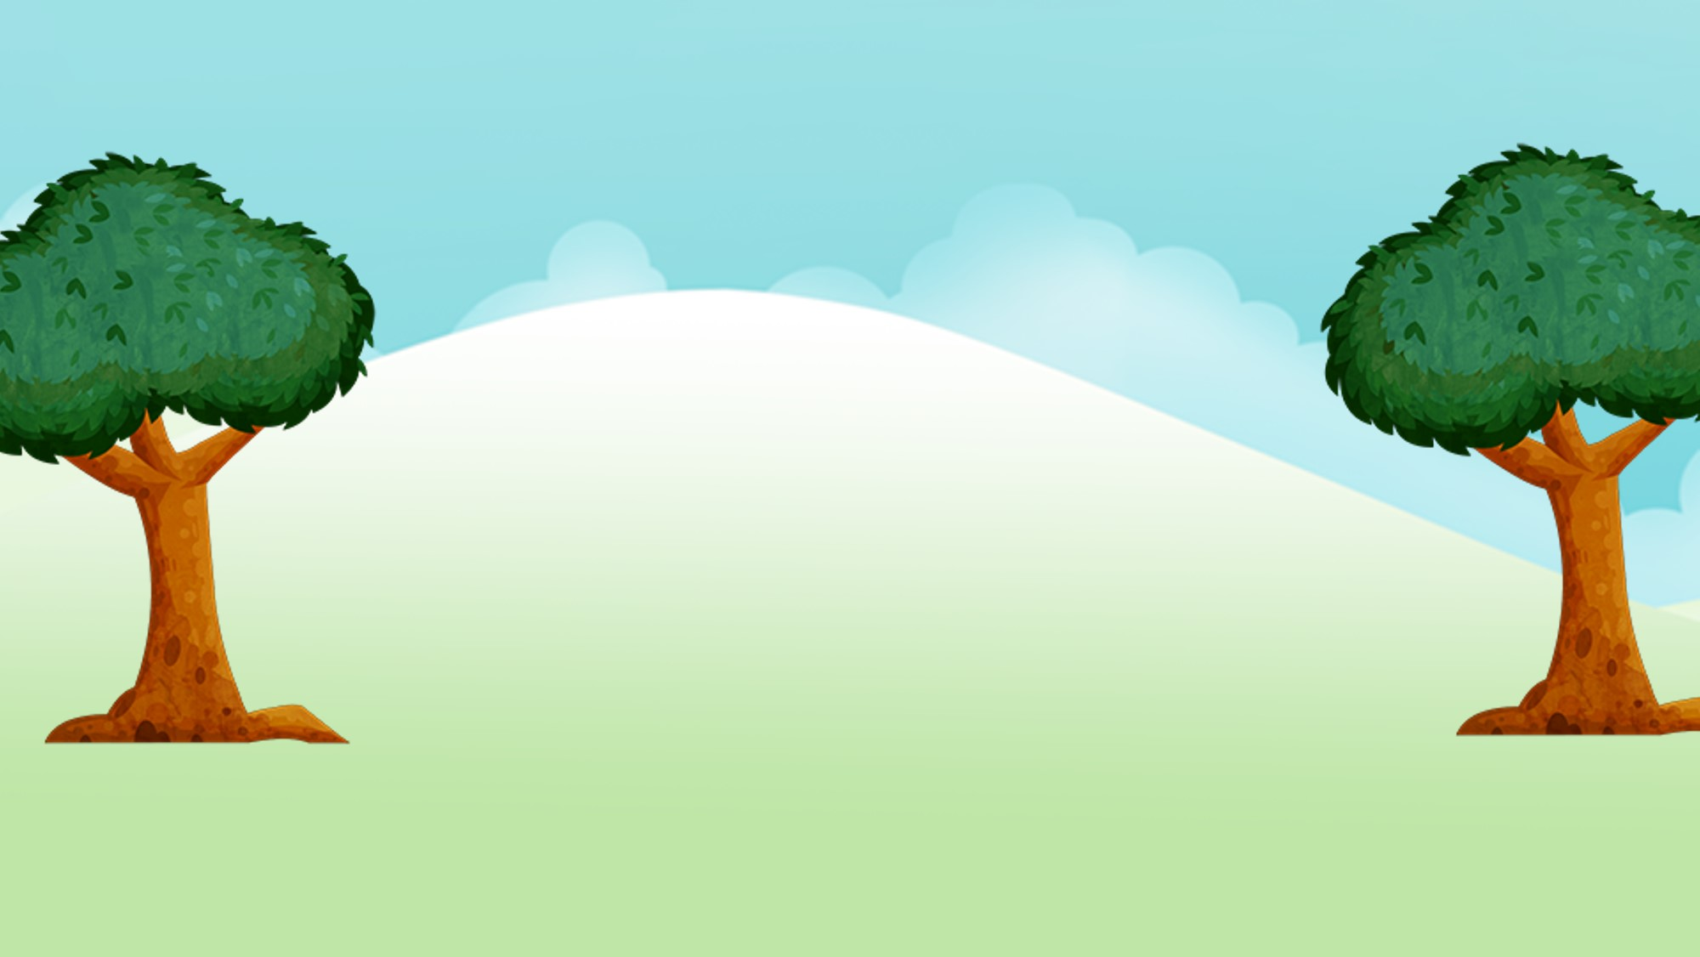





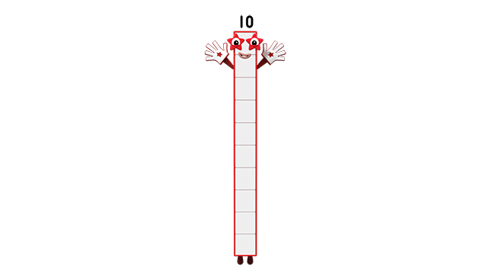
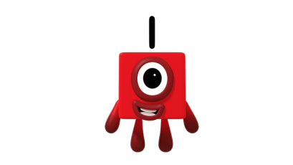
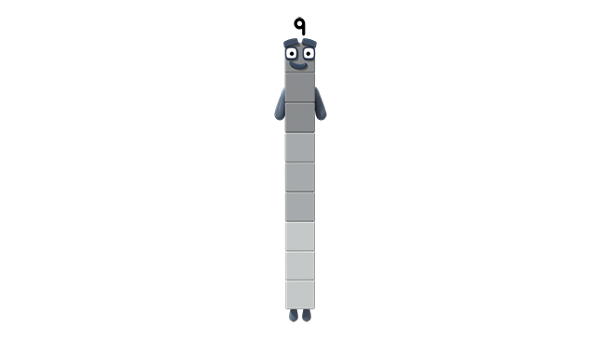
9 is 1 less
than 10
Images © 2017 Alphablocks Ltd. All Rights Reserved.
Notes:
Use slides 24-33 to experience the effect of subtracting 1 from consecutive numbers.
Provide each child with a stick of ten linking cubes, where they can remove one each time 1 is subtracted.
The slides are animated, building each Numberblock by subtracting one. The focus is placed on the subtraction of 1 and the comparison between the new number formed and the previous number. Ask children to describe this relationship. There is a sentence to read together to describe the relationship between the two Numberblocks. Ask the children to discuss or record the equation required to represent the subtraction of one. Then show the equation and ask what each number represents.

Slide 25
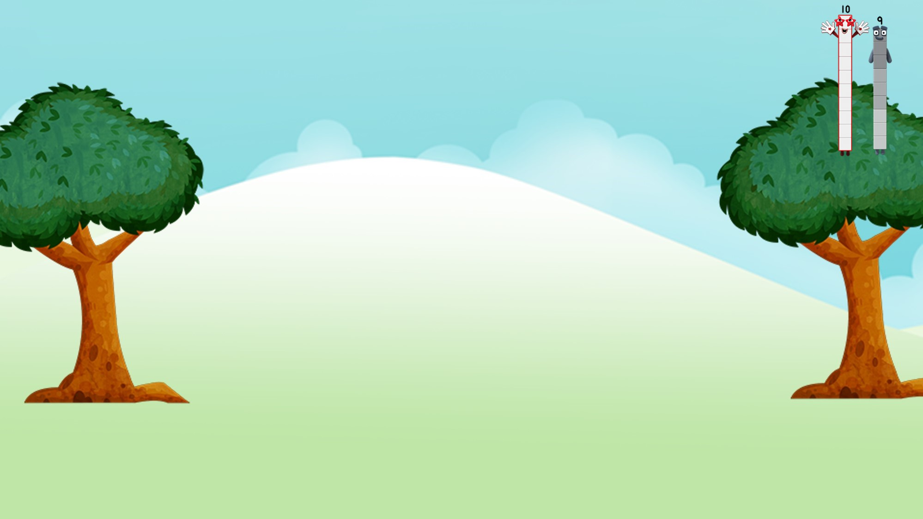

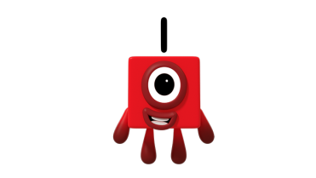
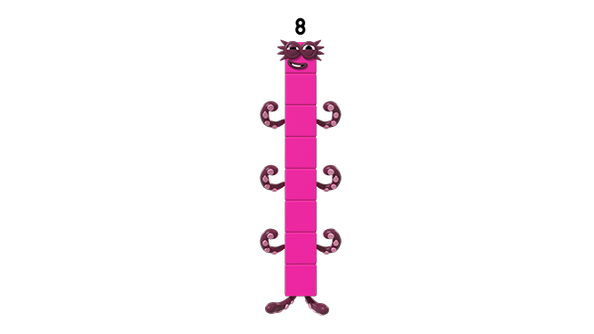
8 is 1 less than 9
Images © 2017 Alphablocks Ltd. All Rights Reserved.

Slide 26
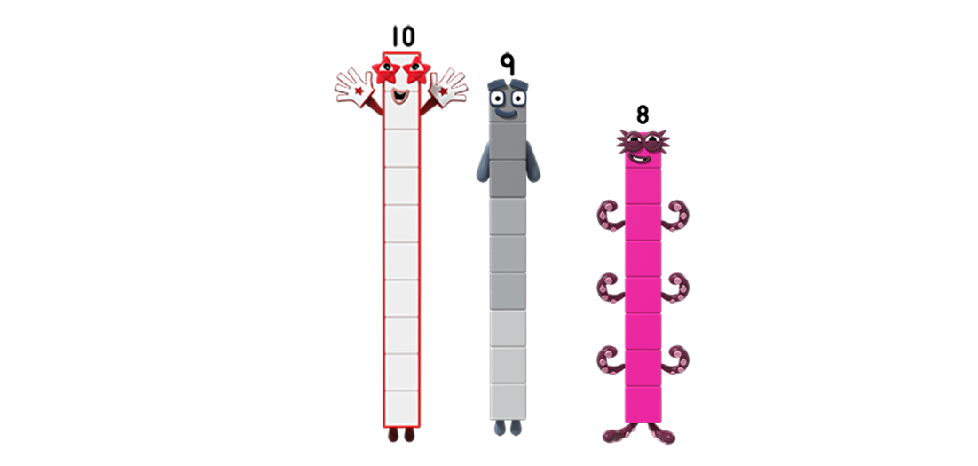


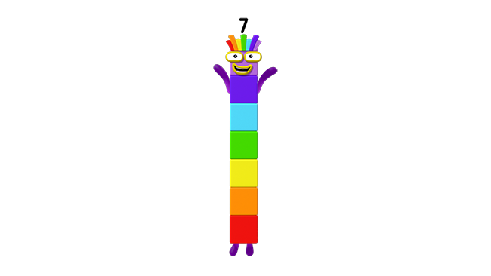
7 is 1 less than 8
Images © 2017 Alphablocks Ltd. All Rights Reserved.

Slide 27
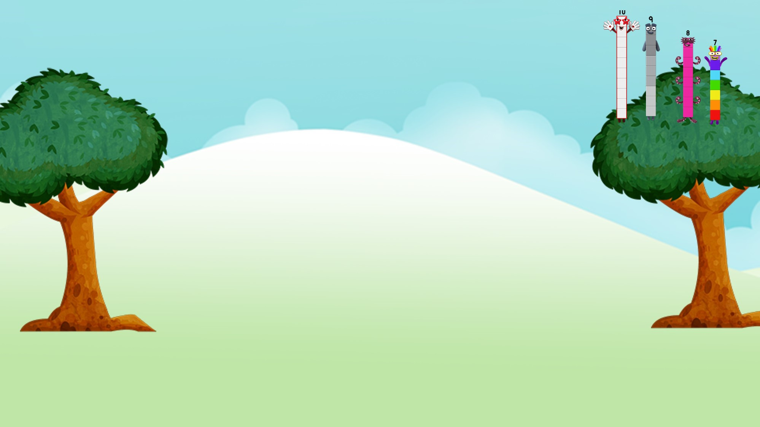

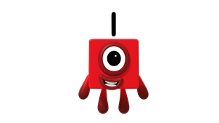
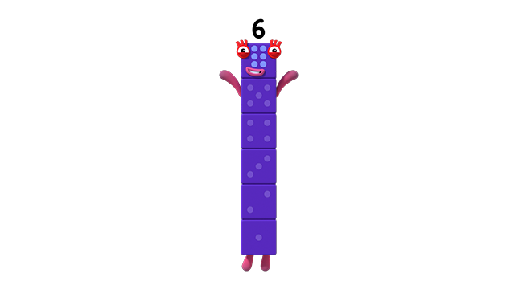
6 is 1 less than 7
Images © 2017 Alphablocks Ltd. All Rights Reserved.

Slide 28
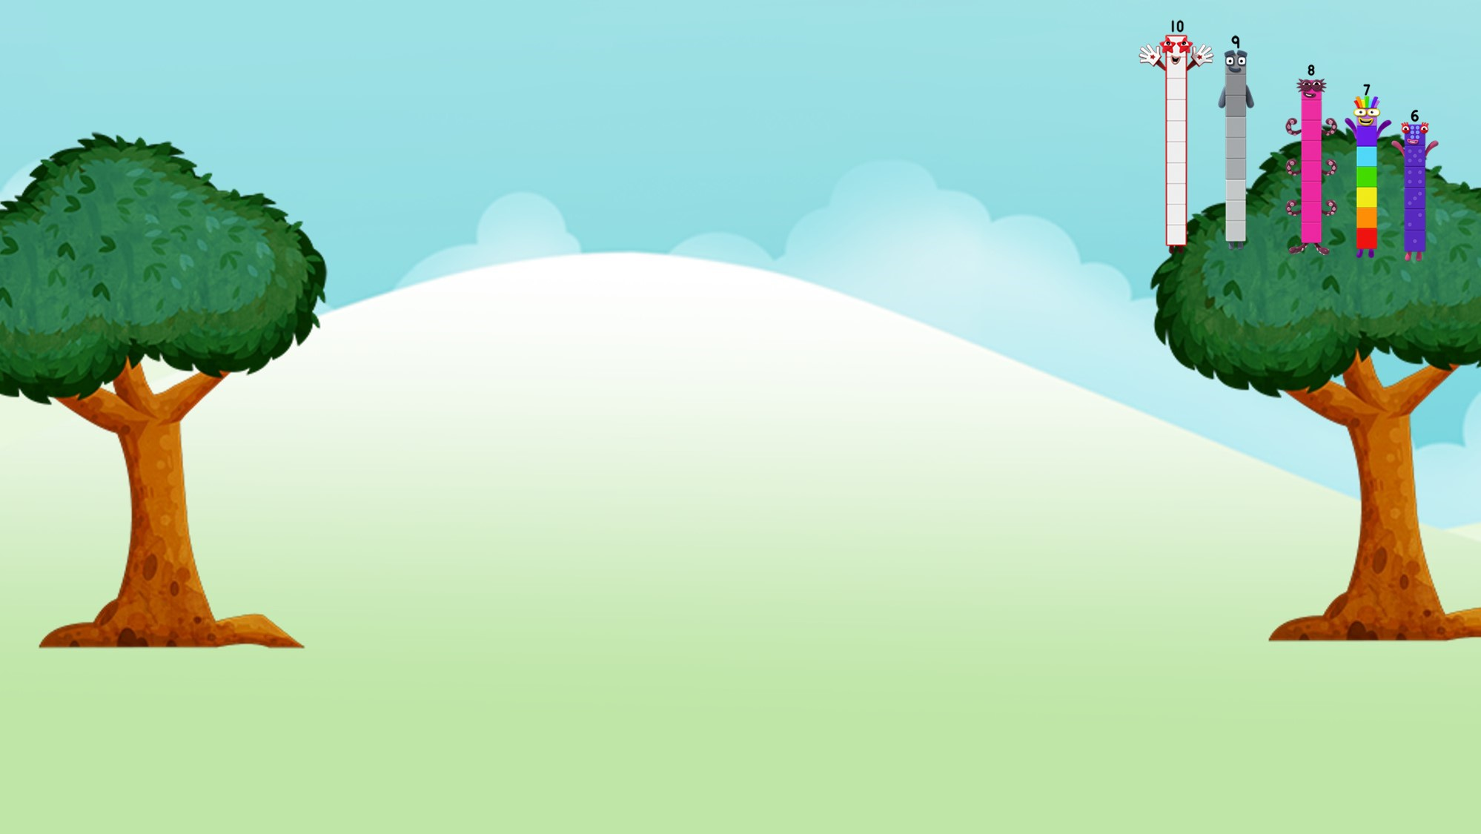

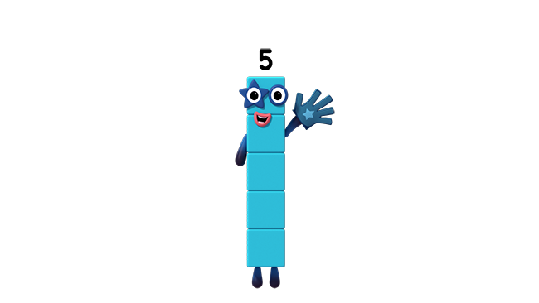
5 is 1 less than 6
Images © 2017 Alphablocks Ltd. All Rights Reserved.

Slide 29
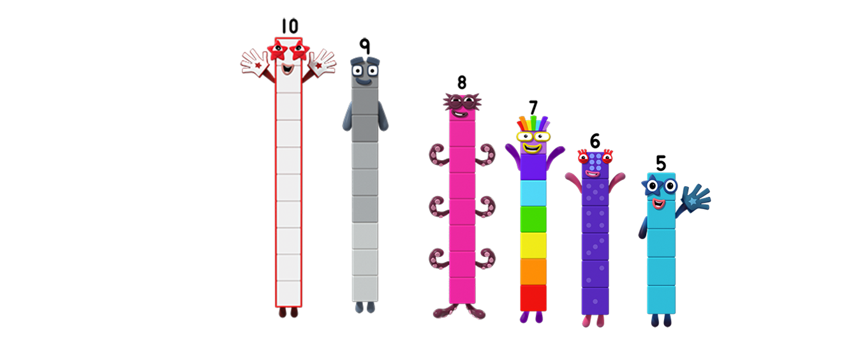

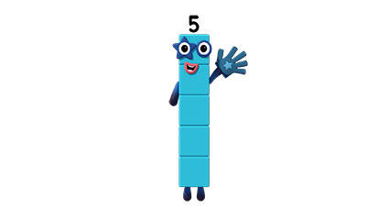
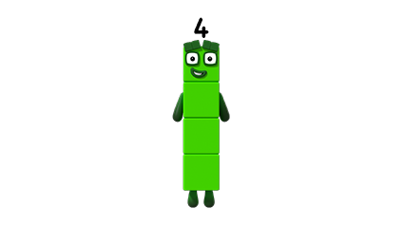
4 is 1 less than 5
Images © 2017 Alphablocks Ltd. All Rights Reserved.

Slide 30
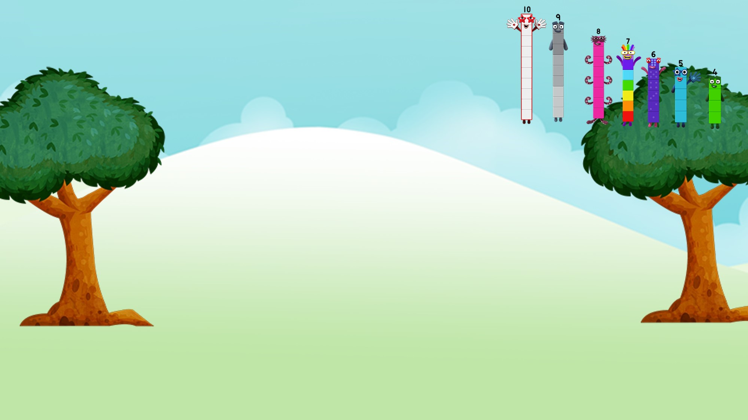

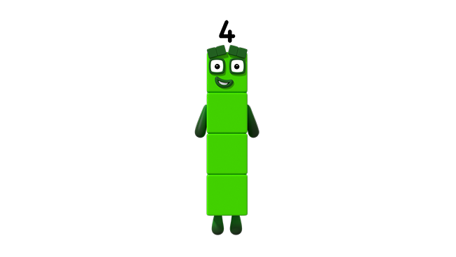
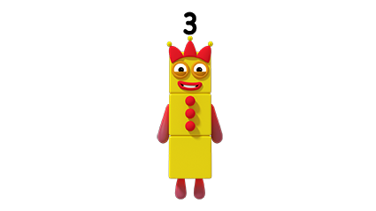
3 is 1 less than 4
Images © 2017 Alphablocks Ltd. All Rights Reserved.

Slide 31
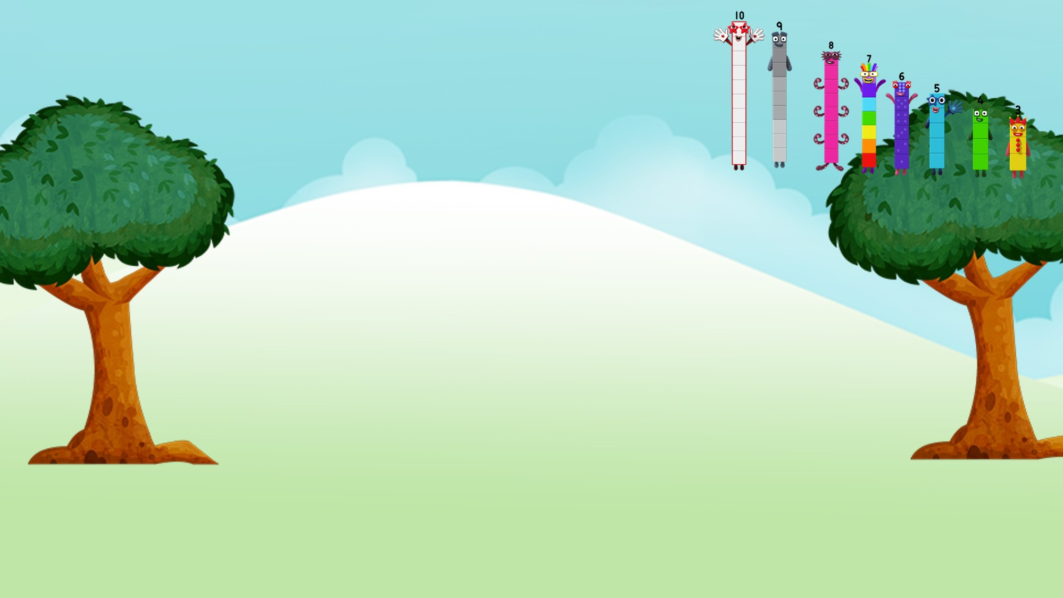

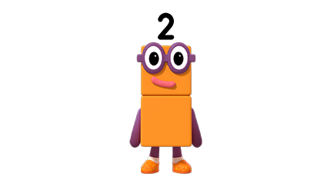
2 is 1 less than 3
Images © 2017 Alphablocks Ltd. All Rights Reserved.

Slide 32
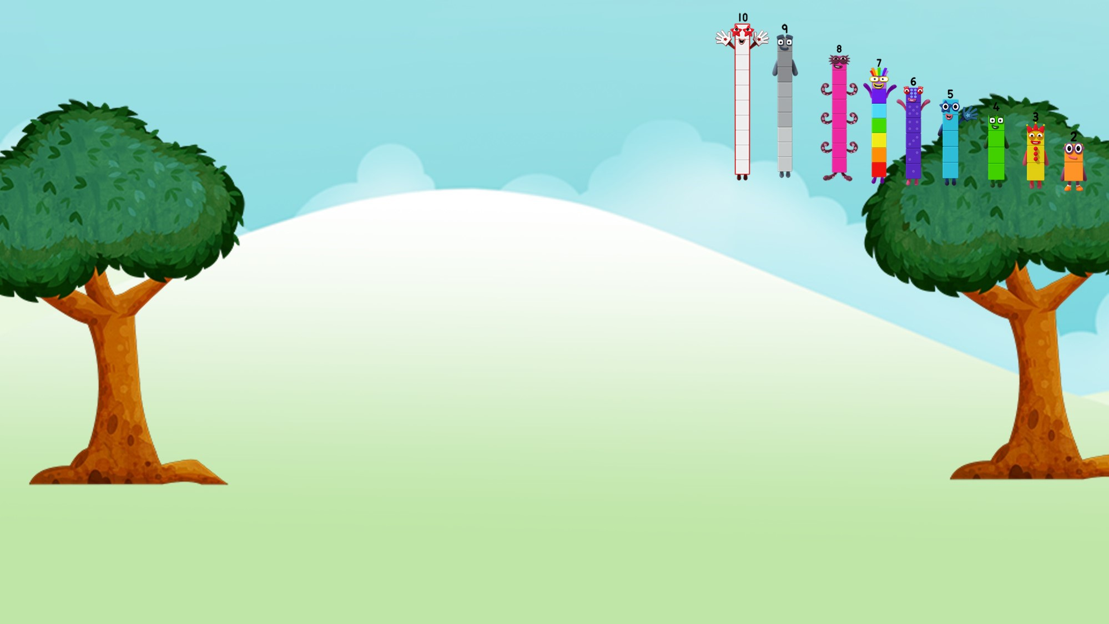

1 is 1 less than 2
Images © 2017 Alphablocks Ltd. All Rights Reserved.

Slide 33
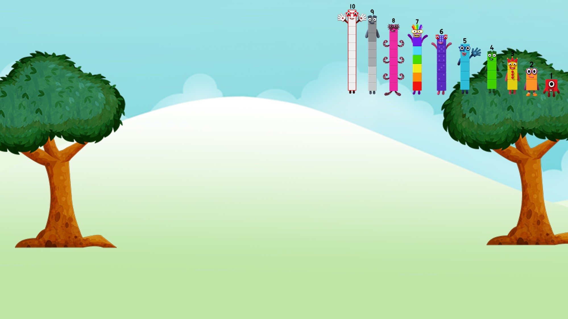

0 is 1 less
than 1
Images © 2017 Alphablocks Ltd. All Rights Reserved.

Slide 34
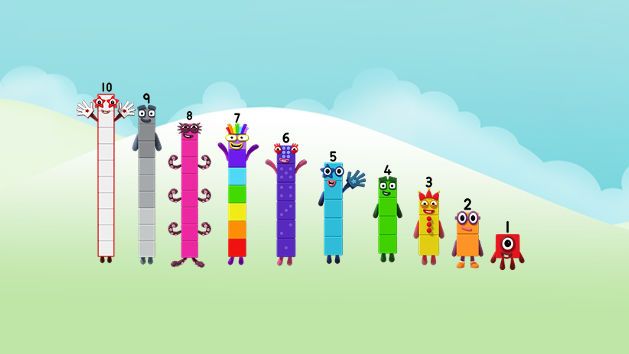
When you subtract One from a number, the number gets 1 less
Images © 2017 Alphablocks Ltd. All Rights Reserved.
Notes:
Compare the Numberblocks in the image. What do you notice?
Use the generalised statement:
“When you subtract 1 from a number, the number gets one less”.

Slide 35
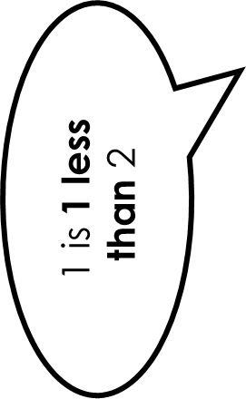
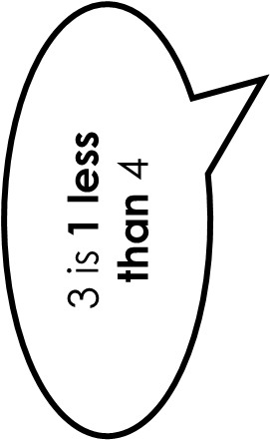


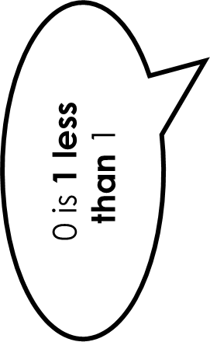




9 is 1 less than 10
Images © 2017 Alphablocks Ltd. All Rights Reserved.
Notes:
Use slides 35 and 36 to make a matching pairs game or a lotto game.

Slide 36
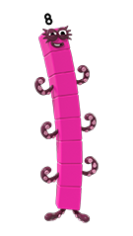
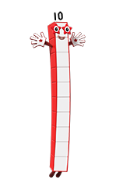
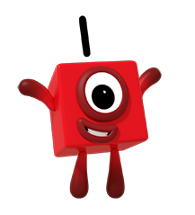
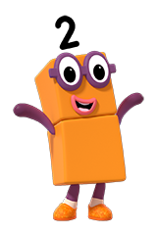


Images © 2017 Alphablocks Ltd. All Rights Reserved.

Slide 37
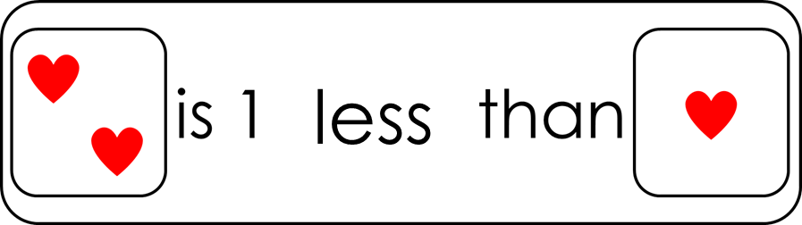
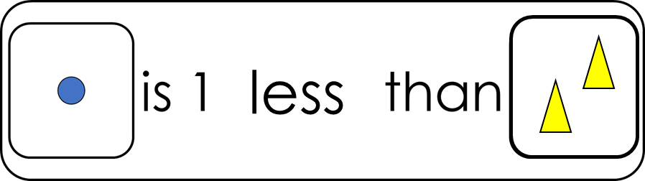




True or false?
less
Notes:
Use this slide to discuss reasoning.
Click on the statement to reveal a tick or a cross.
Remove the ticks and crosses by clicking on the title.

