Slide 1
Series 3 Episode 17
Pattern Palace

Slide 2
Practitioner Notes

Slide 3
Episode Description
Six sets a challenge for One, Two, Three, Four and Five to unlock a pattern. Each Numberblock has to follow the pattern, describe it and predict the next step in the pattern to reach the other side of the river.

Slide 4
Maths in the Episode
Describing Pattern
This episode can be used to stimulate interest in repeating patterns and growing patterns by saying aloud each step to ‘hear’ the pattern and describe it. Repeated patterns are often designed as A; A; A… or A,B; A,B... or A,B,C; A,B,C… Growing patterns are more complex and include a repeat but with an additional element such as A,B; ABB; ABBB…
Using Pattern to predict
When a pattern can be described the next step in a repeating or growing pattern can be predicted by looking back at the previous steps to notice what needs to stay the same. Asking the question “What is the rule for the pattern?” prompts children to describe the structure of the pattern.

Slide 5
Using Mathematical Language
Use these stem sentences to rehearse the mathematical ideas in the programme:
“The pattern is <red>, <yellow>, <red>, <yellow>.”
“The unit in the pattern has 2 colours.”
“The next step in the pattern is… because…”

Slide 6
Talk and Discuss Together

Slide 7
Talk and Discuss Together
Watch the episode of Numberblocks. First ask the children what they noticed and allow them to talk to you and each other.
What did the Numberblocks have to do to get to Pattern Palace?
The following slides are designed to stimulate children and adults to talk about the episode and draw out some key aspects of the mathematics.

Slide 8
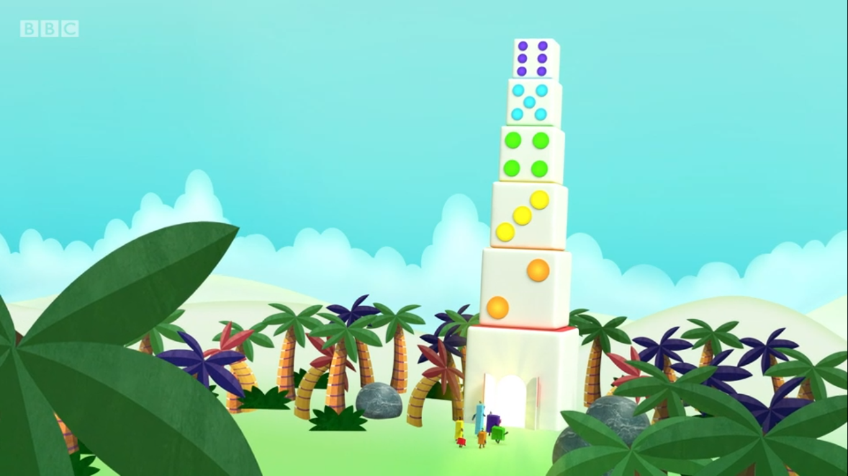
Images © 2017 Alphablocks Ltd. All Rights Reserved.

Slide 9
Enabling Environments in Reception

Slide 10
Enabling Environments
Playing and Exploring
Leave out treasure boxes with small interesting and natural materials (pebbles, pinecones etc.) for children to explore pattern with on the ground.
Active Learning
Notice when the children use pattern in their play – in their wordplay, in making sounds with different objects, or arranging shapes colour or number to make a pattern.
Creating and Thinking Critically
Decorate the edge of plates with different types of patterns – paints, stickers etc. Provide bead strings partly made with two units of a repeated pattern (A,B or ABB, or ABC) - can you continue to add beads using the same pattern? Can you use the same colours but in a different pattern?

Slide 11
Learning Together in Y1
Notes:
This set of slides introduces children to the idea of a unit of pattern, by noticing how the pattern starts and how it is repeated or develops.

Slide 12
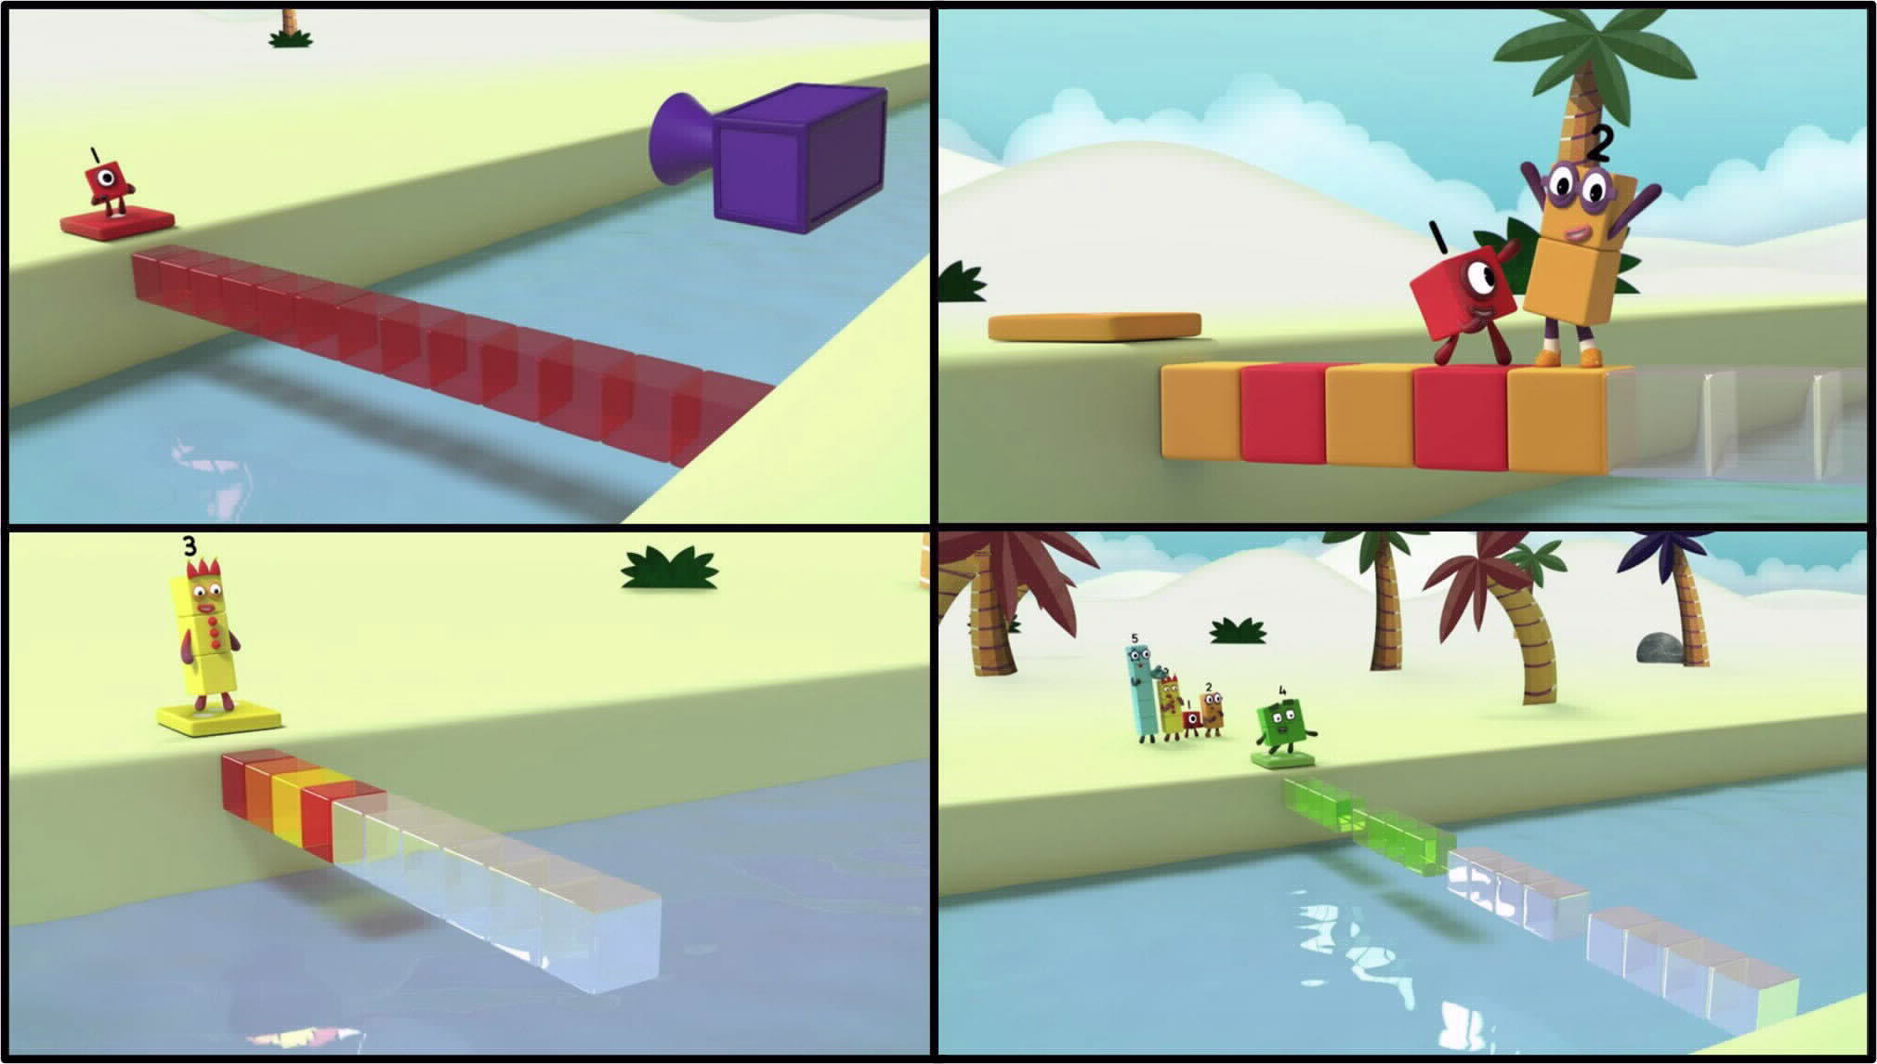
Images © 2017 Alphablocks Ltd. All Rights Reserved.
Notes:
Discuss:
What was the same about the patterns that the Numberblocks had to unlock?
Whose pattern was easiest? Whose pattern was hardest?

Slide 13
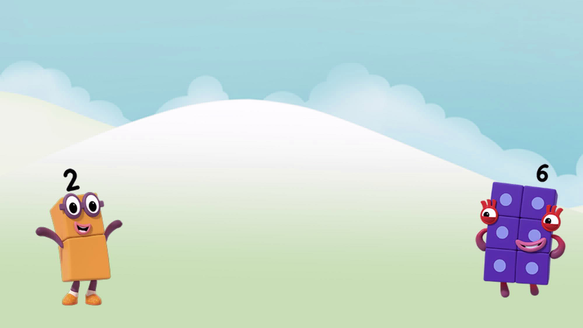
Orange, red, orange, red, orange, red.
Unlock the pattern!
Images © 2017 Alphablocks Ltd. All Rights Reserved.
Notes:
Use this slide to develop the idea of a unit of pattern.
Can you describe the pattern? (Orange, red, orange, red, orange, red.)
What colour does the pattern start on? (orange) What comes next? (red)
How many colours in the unit? (There are two colours in the unit).
How many units are there? (There are three units).
Ask the children to build the pattern and continue it using connecting cubes.

Slide 14
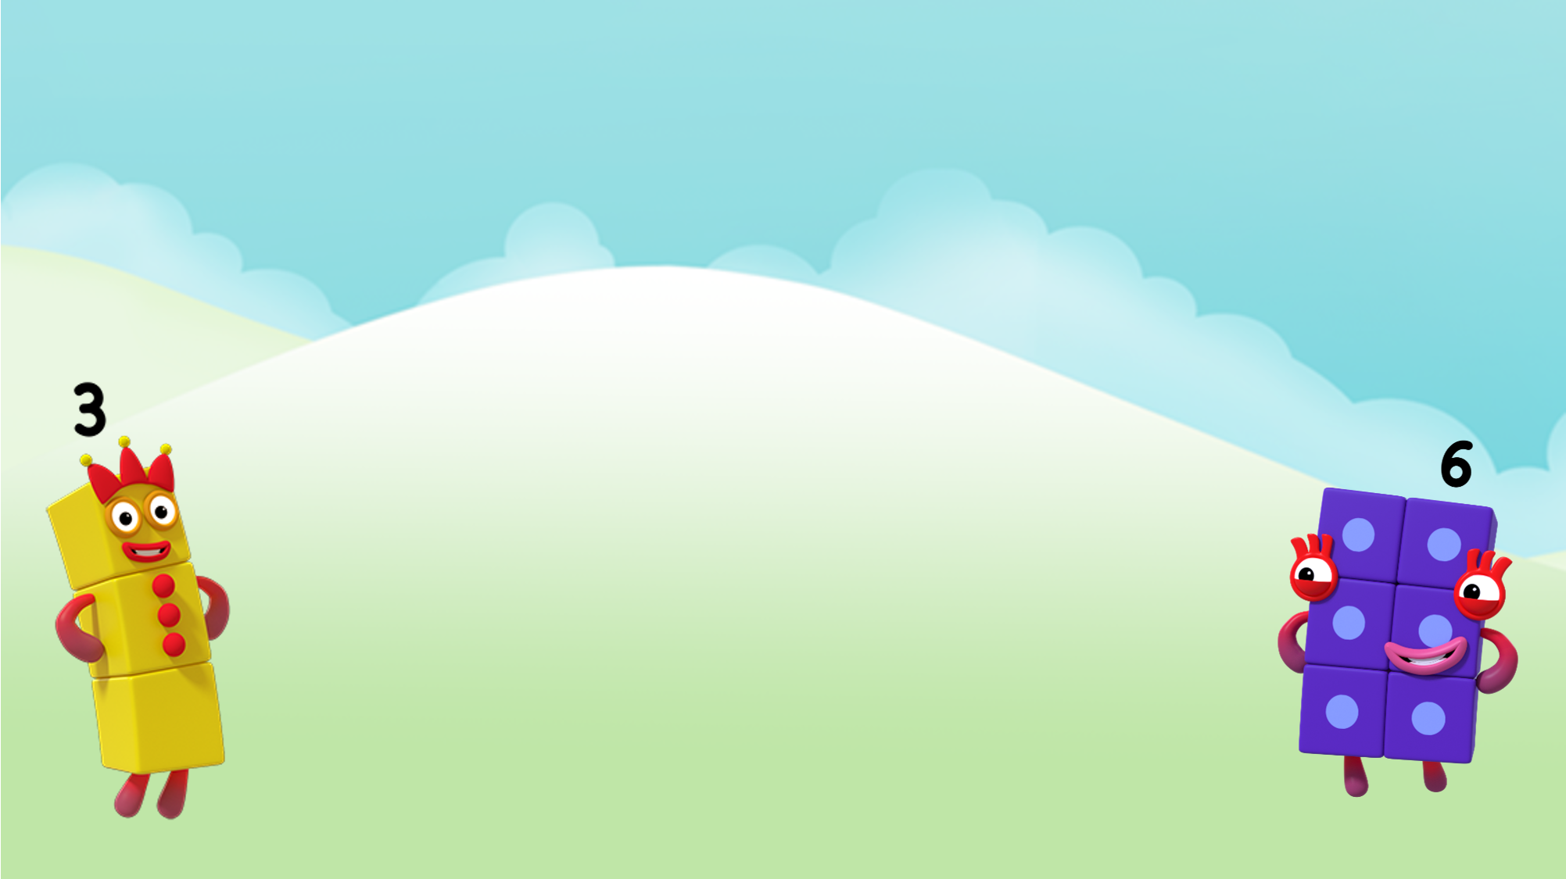
Red, orange, yellow, red, orange, yellow.
Unlock the pattern!
Images © 2017 Alphablocks Ltd. All Rights Reserved.
Notes:
Use this slide to describe the pattern and identify the unit of the pattern.
Can you describe the pattern? (red, orange, yellow, red, orange, yellow.)
What colour does the pattern start on? (red)
What comes next? (orange)
What comes next? (yellow)
How many colours in the unit? (There are three colours in the unit.)
How many units are there? (There are two units.)
Ask the children to build the pattern and continue the pattern using connecting cubes.

Slide 15
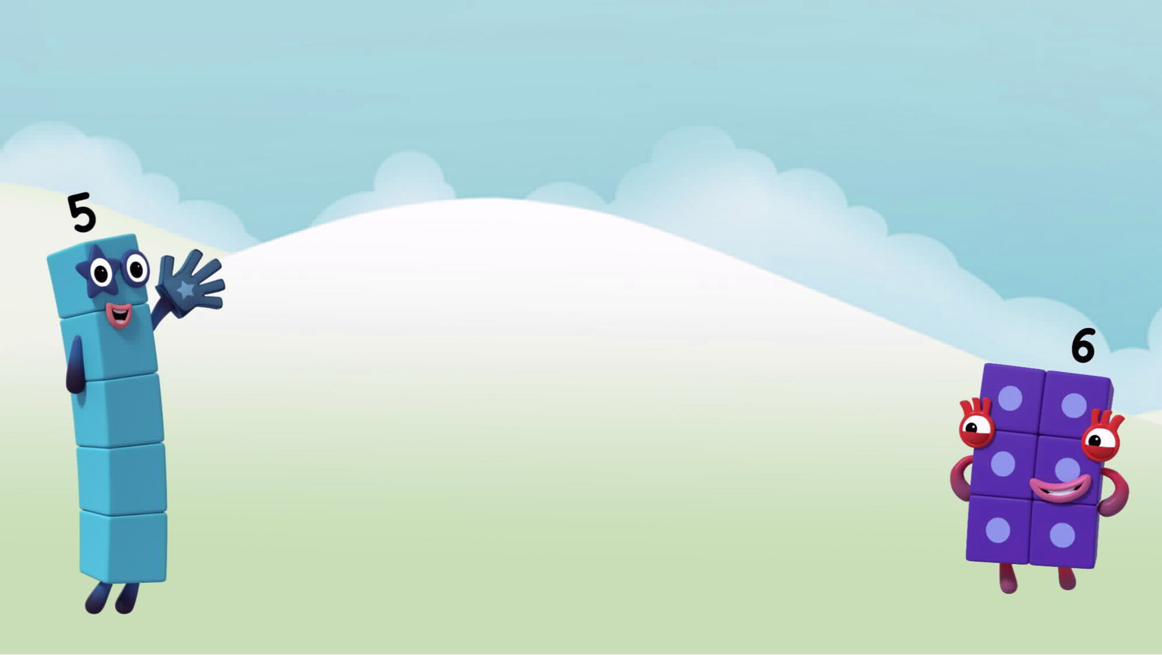
Make a pattern for Five.
Images © 2017 Alphablocks Ltd. All Rights Reserved.
Notes:
Ask the children to arrange the 3 cubes to make the first unit in a pattern.

Slide 16
is the first block.
is the next block.
is the last block.
Images © 2017 Alphablocks Ltd. All Rights Reserved.
Notes:
Use this slide to frame the different examples of units that the children found, and model by building the blocks with connecting cubes.

Slide 17
Further activities for Y1
Design units of repeating patterns for each Numberblock. For example, the unit must contain the colour of the Numberblock or the number of cubes that the Numberblock represents.
Describe repeating patterns of shapes. Circle the units of each pattern. Say the first shape in the unit and the last shape in the unit.
Describe and make repeating sound patterns using objects or body sounds. Choose three sounds to make a repeating sound pattern with. Record the pattern. Play back to the class to identify the order of the objects or body sounds.

Slide 18
Learning Together in Y2

Slide 19
I wonder what colour 7 should be?
Unlock the pattern!
7
1
4
5
6
7
2
3
Images © 2017 Alphablocks Ltd. All Rights Reserved.
Notes:
Use this slide to apply knowledge of pattern to predict hidden information.
One unit is hidden. What colour is block 7?
What do you notice about the orange blocks? (the orange blocks are odd numbers)
What do you notice about the red blocks? (the red blocks are even numbers)
Click 1: First unit is revealed.
Click 2: Second unit is revealed. What colour will 7 will be?
Click 3: Third unit is removed. Does this help to work out the colour of 7?
Click 4: 7 changes to orange.
What colour would the 20th block be? (red – even)
What colour would the 99th block? (orange – odd)

Slide 20
I wonder what colour block 2 should be?
Unlock the pattern!
1
2
3
4
5
6
Images © 2017 Alphablocks Ltd. All Rights Reserved.
Notes:
One unit is hidden. What colour is block 2? How do you know?
Click 1: remove hidden unit.
What do you notice about the yellow blocks? (in the 3 times table)
What do you notice about the red blocks? (1 more than a number in the 3 times table)
What colour would block 12 be?
Can you suggest a number that would be red?

Slide 21
I wonder what number the hidden yellow is?
Unlock the pattern!
1
2
3
4
5
6
Images © 2017 Alphablocks Ltd. All Rights Reserved.
Notes:
Use this slide to challenge thinking and reason about how units work.
There are 3 blocks in a unit.
Some of the cubes in the first unit are hidden and one cube in the second unit is hidden.
What do you think could be hidden?
Click 1: reveals the first unit. (Does this help you?)
Click 2: reveals the second unit. (Does this help you?)
Can you work out where the hidden yellow is?
Can you work out what number the hidden yellow is?
Click 3: reveal the hidden blocks. Now it is possible to confirm a prediction.
What colour would block 20 be?

Slide 22
Further activities for Y2
Make a pattern with 2 reds, 2 oranges and 2 yellows for your partner. Continue the pattern.
Make a pattern with 3 units of 4 colours. Cover 2 blocks from your partner. Work out which blocks are hiding.
Explore same tasks using different shapes (same colour).
Explore same tasks using different shapes and different colours, that is, 3 shapes in a unit and alternating colours (this is hard!).

