Slide 1
Series 3 Episode 27
Fifteen

Slide 2
Practitioner Notes

Slide 3
Episode Description
Ten and Five bump into one another and make Fifteen. Fifteen introduces herself as a Super-Special Step-Shaped Secret Agent with special powers to help make problems disappear in five simple steps.

Slide 4
Maths in the Episode
Composition and properties of 15
In this episode the Fifteen is made by combining Ten and Five. Fifteen can also be partitioned into 1 ten and 1 five. Fifteen is also the sum of the first five Numberblocks. This is known as a triangular number in mathematics (the sum of consecutive numbers starting from 1). Although this is not in the KS1 curriculum, this is a property that returns in a fun way throughout Series 3 and 4 of Numberblocks.

Slide 5
Using Mathematical Language
Use these stem sentences to rehearse the mathematical ideas in the programme:
“<15> is made from one ten and one five”
“Step 1 … Step 2… Step 3… Step 4… Step 5…”
Notes:
Text inside < > indicates what can be changed in the stem sentence.

Slide 6
Talk and Discuss Together

Slide 7
Talk and Discuss Together
Watch the episode of Numberblocks. Use the following picture as a stimulus. First ask the children what they noticed about Fifteen and allow them to talk to you and each other.
Fifteen is a Super-Special Step-Shaped Secret Agent.
The following slides are designed to stimulate children and adults to talk about the episode and draw out some key aspects of the mathematics.

Slide 8
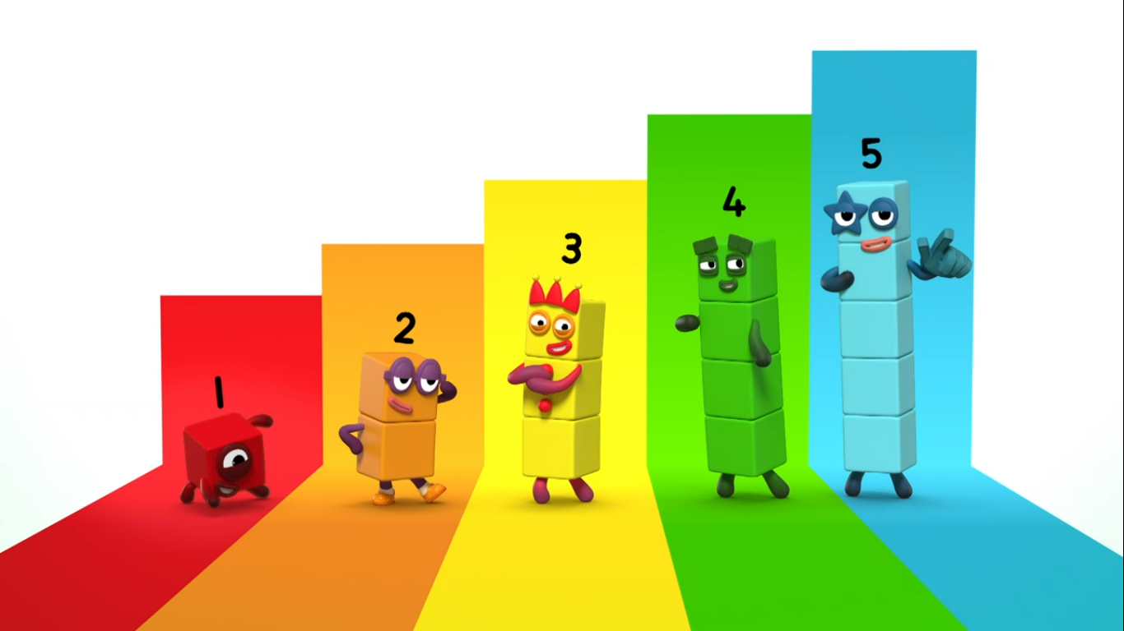
Images © 2017 Alphablocks Ltd. All Rights Reserved.
Notes:
Use this picture as the stimulus for Talk and Discussion (slide 7).

Slide 9
Enabling Environments in Reception

Slide 10
Enabling Environments
Playing and Exploring
Set a Super-Special Step-Shaped Secret Agent table with sequence cards/pictures to put in the correct order. This could include pictures of the Numberblocks 1-5. (See Slides 11-14 for two sets of sequencing cards.)
Active Learning
Take photos of the children at different moments while carrying out an activity. Print out the photos A4 size and leave them to be ordered as a set of instructions next to the Numberblocks 1-5 to show the order.
Creating and Thinking Critically
Discuss how to carry out a familiar task and describe it as “Step 1…, Step 2…”. Use the Numberblocks as characters to describe each step.
For example,
One: “Step 1, fill the jug with water”
Two: “Step 2, put the right number of cups out on the table”, etc.

Slide 11
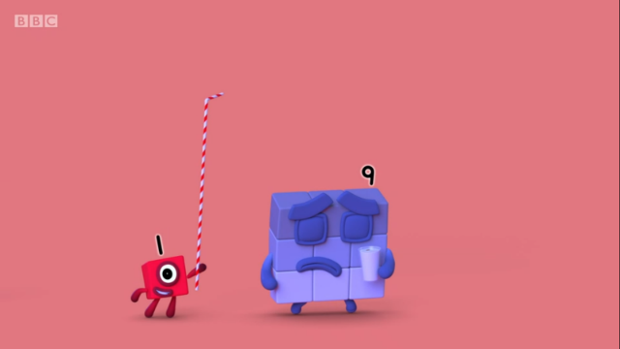
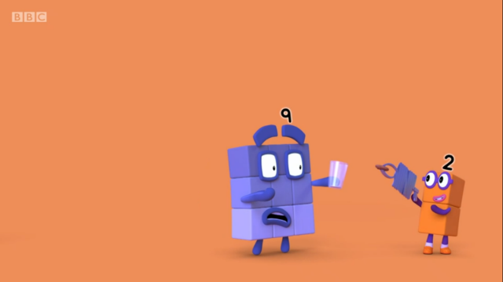
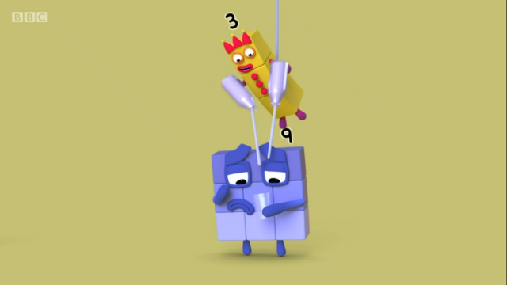
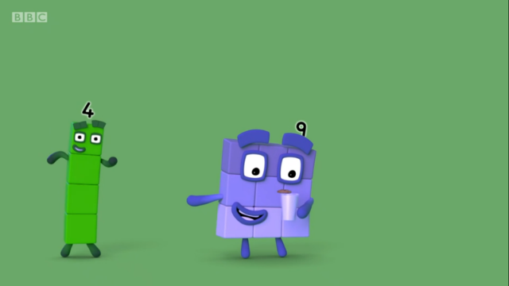
Images © 2017 Alphablocks Ltd. All Rights Reserved.
Notes:
Hidden: Set 1a: Print off and cut out into sequencing cards with set 1b

Slide 12
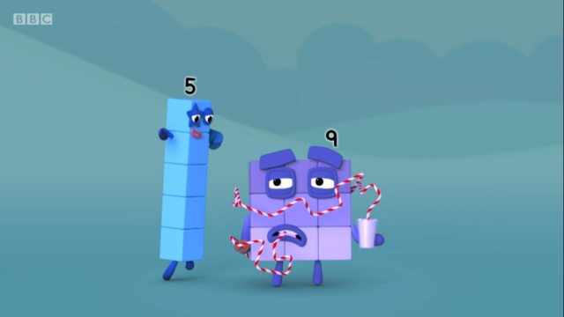
Images © 2017 Alphablocks Ltd. All Rights Reserved.
Notes:
Hidden: Set 1b: Print off and cut out into sequencing cards with set 1a

Slide 13
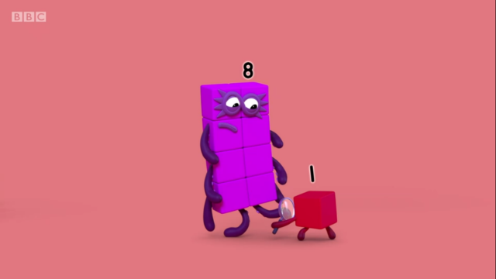
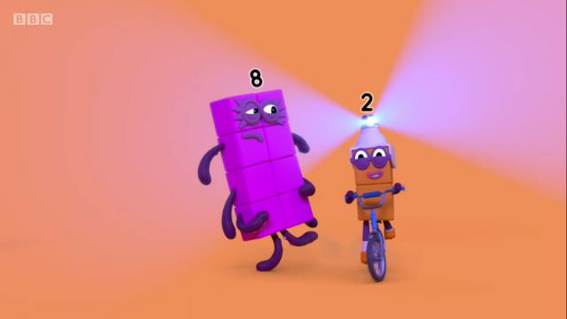
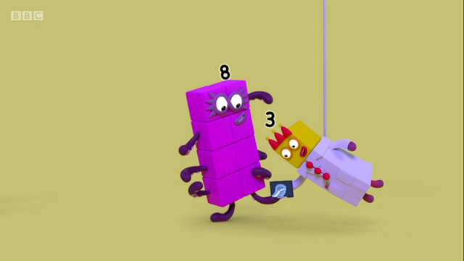
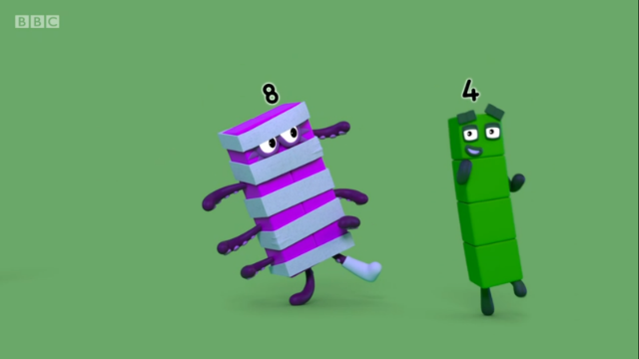
Images © 2017 Alphablocks Ltd. All Rights Reserved.
Notes:
Hidden: Set 2a: Print off and cut out into sequencing cards with set 2b

Slide 14
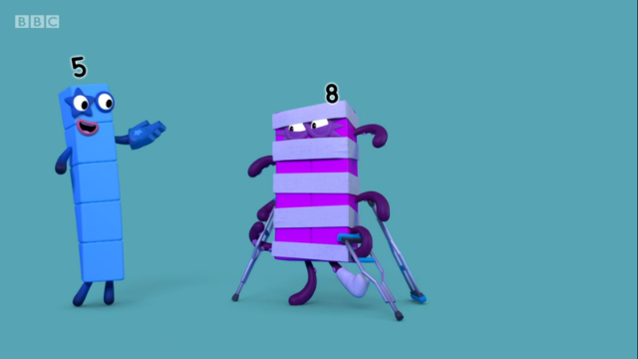
Images © 2017 Alphablocks Ltd. All Rights Reserved.
Notes:
Hidden: Set 2b: Print off and cut out into sequencing cards with set 2a

Slide 15
Learning Together in Y1

Slide 16
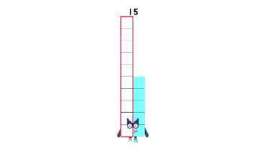
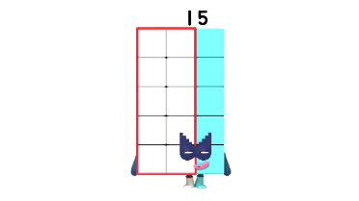
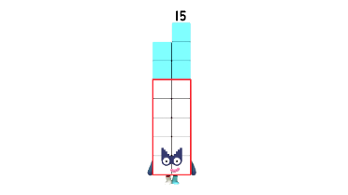
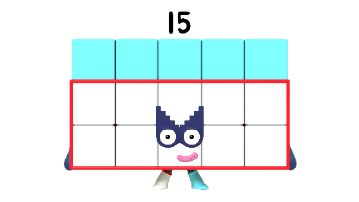
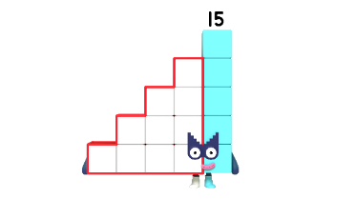
Odd one out…
Images © 2017 Alphablocks Ltd. All Rights Reserved.
Notes:
Use this slide to discuss the different representations of Fifteen.
Discuss:
What do you notice about these pictures of Fifteen?
What’s the same about all these Fifteens? (They all have a ten and a five.)
Which Fifteen do you think is the odd one out?

Slide 17
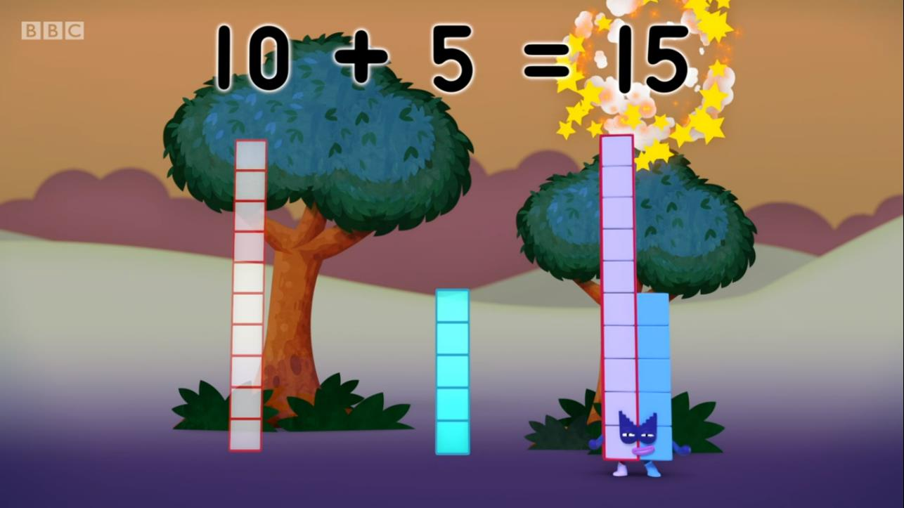
Images © 2017 Alphablocks Ltd. All Rights Reserved.
Notes:
Use this slide to show how an equation can represent the composition of Fifteen as 10 and 5.
Discuss:
When Ten and Five combine, what number do they make? (They make Fifteen.)
How does the equation represent this? (10 is a part and 5 is a part and 15 is the whole.)
If children need more support to understand this, give out cubes in rods of ten and five and ask children to find a partner to make 15 with. Combine the rods and say the stem sentence: 15 is made from one ten and one five. Children could write the equation together.

Slide 18

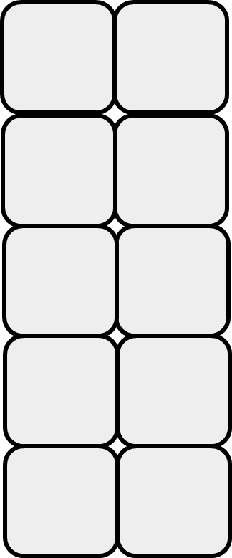
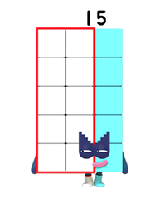
10 and 5 make 15.
Images © 2017 Alphablocks Ltd. All Rights Reserved.
Notes:
Use this slide with slide 19 to show that 10 and 5 make 15 irrespective of orientation.
The slide animates to show ten joining to five.
Ask children to describe what they saw.

Slide 19

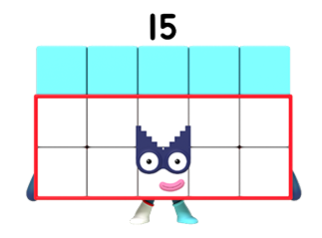
10 and 5 make 15.
Images © 2017 Alphablocks Ltd. All Rights Reserved.
Notes:
Use this slide with slide 18 to show that 10 and 5 make 15 irrespective of orientation.
The slide animates to show ten joining to five.
Ask children to describe what they see.

Slide 20








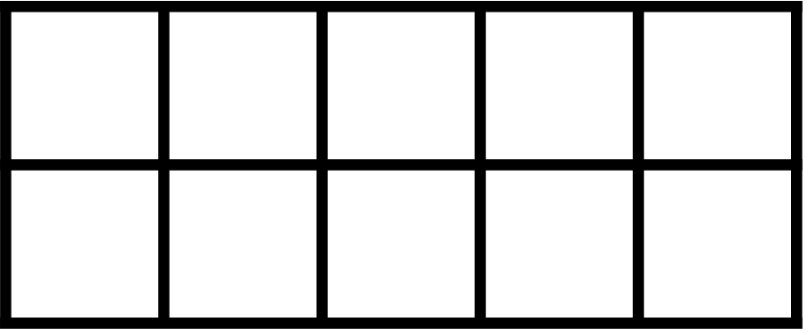
Images © 2017 Alphablocks Ltd. All Rights Reserved.
Notes:
Use this slide to animate how 10 and 5 combine to make 15 irrespective of which order the parts are displayed.
Children could work with two tens frames and double-sided counters to make what they see and talk about it with a partner.
Discuss:
How does the part-part-whole diagram represent what is on the tens frames?
How does the equation represent the tens frames/ part-part-whole diagram?
What do you notice when the position of the parts changes? (The whole stays the same.)

Slide 21
Further activities for Y1
Explore ways of representing 15 from one 10 and five 1s using Dienes equipment or Numicon or coins.
Explore ways to arrange 15 counters on 2 tens frames. (Keep 10 counters on one complete tens frame and rearrange the 5 counters in different places on an adjacent tens frame.)
Distinguish between quantities of 15 and not 15.
Ask children to count out 15 objects and encourage them to arrange them in a way that they can easily see it is 15. (They might choose to display it as ‘ten and five’ or in three rows of five, seeing that two rows of five makes ten and another row of five makes fifteen.)
Draw 15 objects in a way that they can see it is 15.
Complete missing number problems using part-part-whole diagrams and equations that involve 10, 5 and 15 using the + and = symbols.

Slide 22
Learning Together in Y2

Slide 23
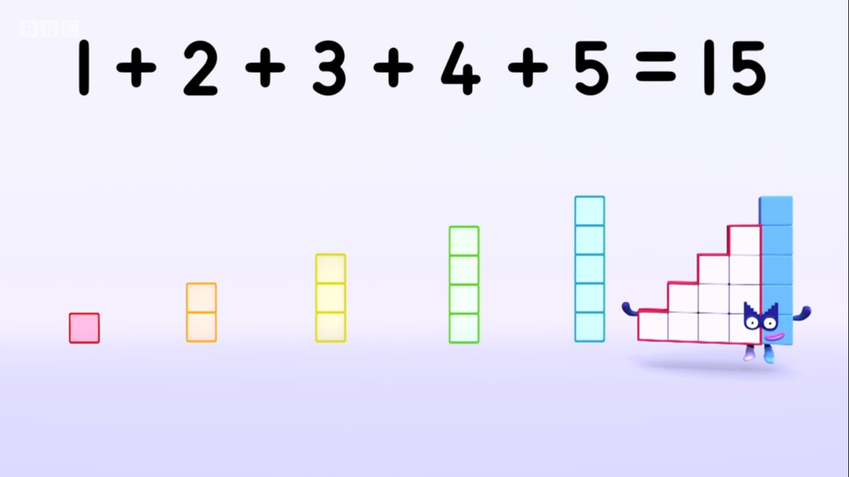
Images © 2017 Alphablocks Ltd. All Rights Reserved.
Notes:
Use this slide to discuss how Fifteen is made from the first 5 counting numbers to form a set of steps.
Discuss:
What do you notice?

Slide 24
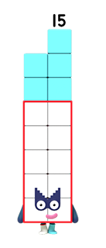
I wonder if these shapes can cover all of me?
Images © 2017 Alphablocks Ltd. All Rights Reserved.
Notes:
Use this slide to set a challenge for pairs or groups of children.
What do you notice? (There is a two-wide Fifteen, there are two-wide shapes for 1, 2, 3, 4, 5.)
Use the first two animations to model the problem and notice that Three was rotated to fit in next to one.
Give children connecting cubes or squared paper to colour to find solutions to making 15 in this shape with 1, 2, 3, 4 and 5.

Slide 25
I wonder if these shapes can cover all of me?
Images © 2017 Alphablocks Ltd. All Rights Reserved.
Notes:
Use this slide to set the next challenge for pairs or groups of children.
Discuss:
What do you notice? (There is a 3 by 5 array, there are two-wide shapes for 1,2,3,4,5.)
Share solutions and discuss:
Which pieces should you start with? Why?
Which pieces were the hardest to place last? Why?

Slide 26
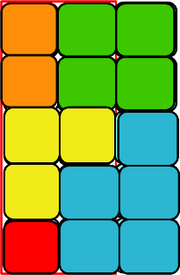
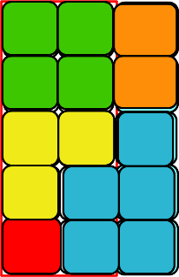
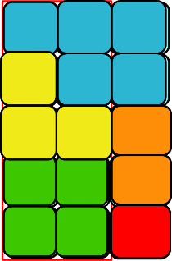
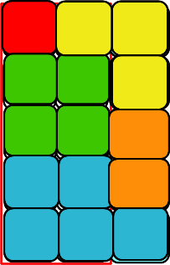
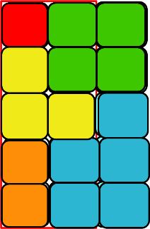
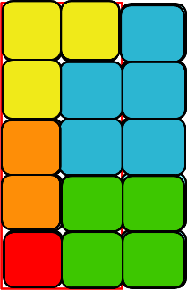
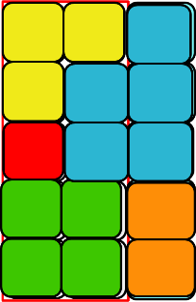
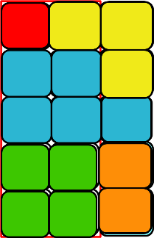
Notes:
Use this slide to reveal possible solutions.

Slide 27
Further activities for Y2
Explore different ways of covering a 3 x 5 array with towers for 1, 2, 3, 4, 5.
Explore different ways of making 15 by combining 1, 2, 3, 4, 5.
Evaluate different ways to add 1, 2, 3, 4 and 5 using smart calculations.
For example, 4 + 1 and 3 + 2 both add to 5 so count 3 5s.
Find other ways to make 15 using 3 or 4 numbers. For example, o + o + o = 15

