Slide 1
Series 3 Episode 19
Mirror, Mirror

Slide 2
Practitioner Notes

Slide 3
Episode Description
The Numberblocks head to a secret part of Numberblock Castle. One discovers a magic mirror and manages to make Two and Three. She then heads off to find the others, leaving Two and Three to look after the mirror. They begin exploring how to make the other Numberblocks by using the mirror to duplicate themselves. They can't manage to make 5 and 7 in time before One comes back with the real Numberblocks who are rather surprised to see so many of themselves already there.

Slide 4
Maths in the Episode
Multiples of 2 and 3 and prime numbers
1, 2 and 3 are prime numbers. All integers are multiples of prime factors, for example, 6 = 2 x 3 (or 3 x 2), 8 = 2 x 2 x 2 etc. In this episode the Numberblocks begin to explore how some of the numbers to 10 can be made by duplicating 2 or 3. The reason why 5 and 7 cannot be made from 2 and 3 is that 5 and 7 are prime numbers and can only be factorised into 5 x 1 and 7 x 1. Although the children are not introduced to prime numbers in Early Years and KS1, this programme begins to suggest there is something special about these numbers.
The focus of the learning for the pupils will be to understand multiplication as repeated addition, that is, numbers can be made by adding the same amount over and over again – for example, 2 + 2 + 2.

Slide 5
Using Mathematical Language
Use these stem sentences to rehearse the mathematical ideas in the programme:
“<2> lots of <3>is <6>.”
“There are <two threes> in <six>.”
“<Six> can be made from <3 2>s.”
Notes:
Text in < > indicates what can be changed in the stem sentence.

Slide 6
Talk and Discuss Together

Slide 7
Talk and Discuss Together
Watch the episode of Numberblocks. First ask the children what they noticed and allow them to talk to you and each other.
What can we use mirrors for? What happens when you look in a mirror? What do you see?
The following slides are designed to stimulate children and adults to talk about the episode and draw out some key aspects of the mathematics.

Slide 8
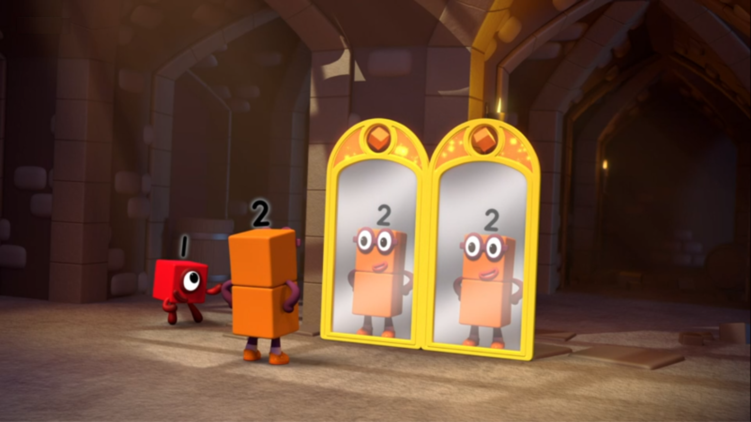
Notes:
What happened in the story when Two looked in the mirror?
What do you notice now? (I can see the ‘real’ Two and some Twos in each mirror.)
How many Twos can you see? (There are three Twos.)

Slide 9
Enabling Environments in Reception

Slide 10
Enabling Environments
Playing and Exploring
Leave hand-held plastic mirrors with a tray of Numberblock towers made from interlocking cubes for the children to explore the patterns and duplications.
Active Learning
Notice whether the children talk about ‘reflection’ and explore their expressions in the mirror. When talking with the children while they play, prompt with “I wonder how many fingers there would be if we held up 3 fingers in the mirror?”
Creating and Thinking Critically
Provide one half of a ladybird or butterfly with different numbers of spots on one wing. How many spots will there be on the other wing? How many will there be altogether. Check with a mirror.

Slide 11
Learning Together in Y1

Slide 12


Mirror, mirror, hear my plea.
I wish you could make two of me.
I see Ones.
Images © 2017 Alphablocks Ltd. All Rights Reserved.
Notes:
Use this slide to develop the language of “two lots of…”
What do you think we will see when the mirror makes another One?
How many Ones can you see now? (There are two Ones, the real One and her reflection.)

Slide 13




I see ones.
Two lots of one is .
Notes:
Use this slide to abstract the mathematics using different representations of doubling.
What do you notice? (1 spot on the ladybird, 1 spot on a dice, 1 cube).
As the slide animates, each of these is doubled.
Look at the ladybird and the dice:
What do you see now? How many lots of one can you see on the ladybird or on the dice? (Two lots of one.) How many spots are there altogether on the ladybird or dice? (Two)
Look at the blocks:
How many lots of one can you see? (Two lots of one.)
How many blocks can you see altogether? (Two)

Slide 14

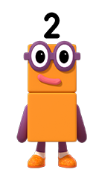
Mirror, mirror, hear my plea.
I wish you could make two of me.
I see Twos.
Images © 2017 Alphablocks Ltd. All Rights Reserved.
Notes:
What do you think we will see when the mirror makes another Two?
How many Twos can you see now? (I see two Twos.)

Slide 15

I see twos.
Two lots of two is .
Notes:
What do you notice? (2 spots on the ladybird, 2 spots on a dice, 2 cubes).
As the slide animates, each of these is doubled.
Look at the ladybird and the dice:
What do you see now? How many lots of two can you see on the ladybird or on the dice? (Two lots of two.) How many spots are there altogether on the ladybird or dice? (Four)
Look at the blocks:
How many lots of two can you see? (Two lots of two)
How many blocks can you see altogether? (Four)

Slide 16
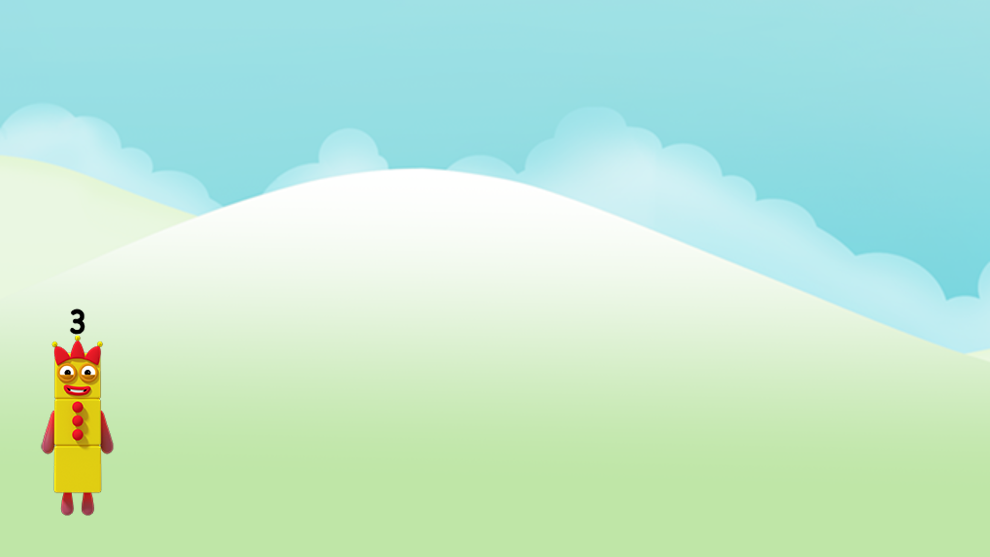
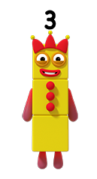
Mirror, mirror, hear my plea.
I wish you could make two of me.
I see Threes.
Images © 2017 Alphablocks Ltd. All Rights Reserved.
Notes:
What do you think we will see when the mirror makes another Three?
How many Threes can you see now? (I see two Threes.)

Slide 17


I see threes.
Two lots of three is .
Notes:
What do you notice? (3 spots on the ladybird, 3 spots on a die, 3 cubes.)
As the slide animates, each of these is doubled.
Look at the ladybird and the dice:
What do you see now? How many lots of three can you see on the ladybird/ on the dice? (Two lots of three.) How many spots are there altogether on the ladybird/ dice? (Six)
Look at the blocks:
How many lots of three can you see? (Two lots of three.)
How many blocks can you see altogether? (Six)
Discuss: what is the same or what is different about each representation. (They all represent two threes although they are different sorts of things.)

Slide 18
Further activities for Y1
Use the idea of a mirror to explore doubles of numbers to 5.
Introduce “double me” to mean the same as “make two of me” using slides 12-17.
Find examples of ‘pairs’ to represent “two of something”. For example, pairs of shoes, socks, gloves, hands, feet, pairs of friends, pairs of leaves on an ash tree, etc.
Invent board/floor games with two dice with bonus points for doubles.

Slide 19
Learning Together in Y2

Slide 20
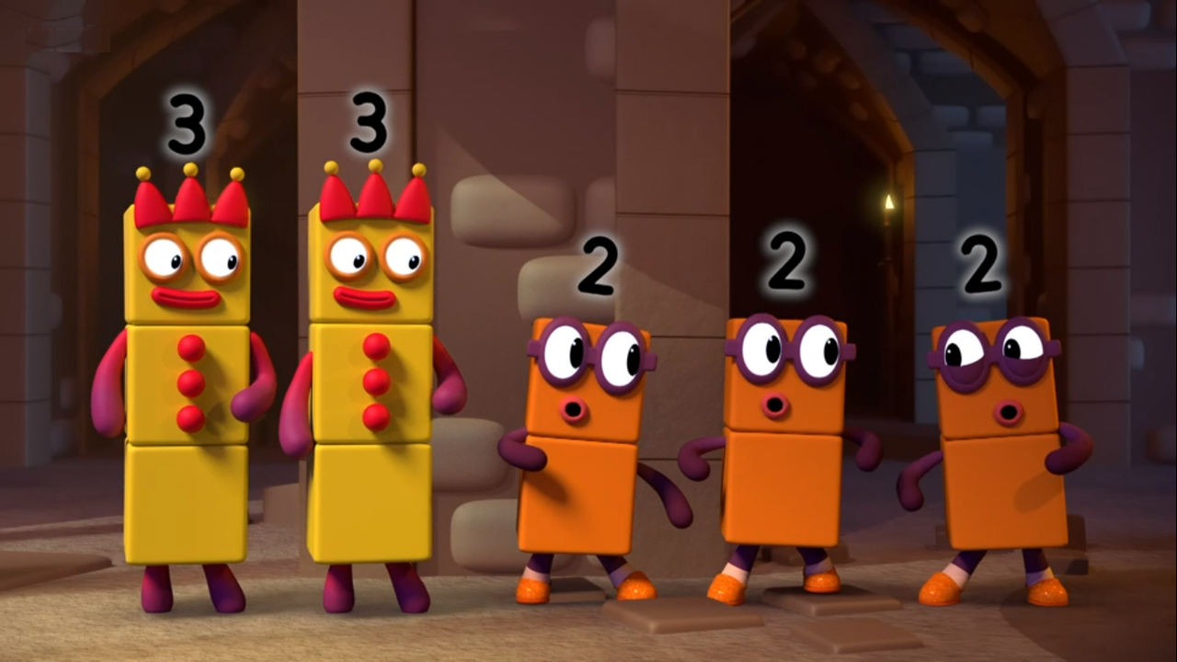
Notes:
Use this slide to discuss how there came to be two Threes and three Twos.
Which Numberblock would you get if you combined two Threes?
Which Numberblock would you get in you combined three Twos?

Slide 21
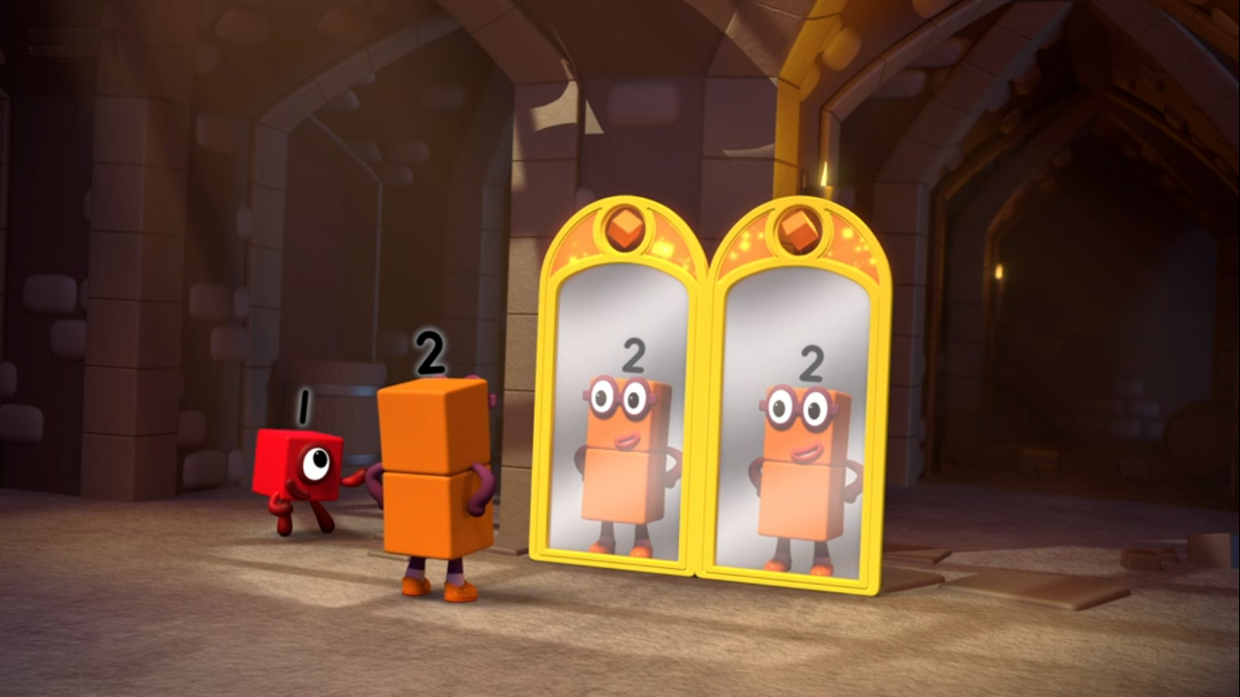
I see 2s.
Notes:
What do you notice has happened in the story? (There are two mirrors and each mirror makes another Two.)
How many Twos can you see? (I see three Twos.)

Slide 22
Three lots of 2 are 6.
6 can be made from three 2s.
Images © 2017 Alphablocks Ltd. All Rights Reserved.
Notes:
Use this slide to move from Numberblocks to more abstract representations.
Discuss as the slide animates:
What do you notice? (There are three lots of two/ three twos.)
What will three lots of two make altogether? (Three lots of two make six/ three twos make six.)
How can we write this as an equation? (2+2+2=6)
What does each number in the equation represent? (The 2s represent the blocks in groups of two and the 6 represents the number of blocks altogether.)
Rehearse stem sentences together.

Slide 23
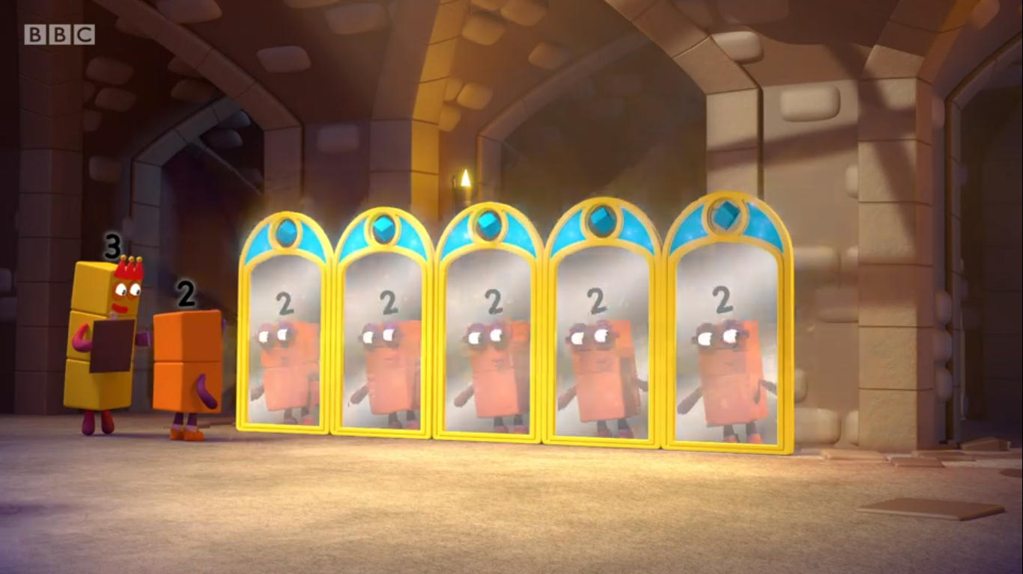
Notes:
(This slide focuses on only the number of Twos which can be seen in the five mirrors.)
How many Twos can you see in the mirrors? (There are five Twos.)

Slide 24
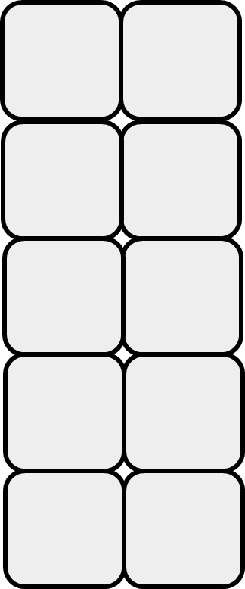

Five lots of 2 are 10.
10 can be made from five 2s.
Images © 2017 Alphablocks Ltd. All Rights Reserved.
Notes:
Use this slide to move from Numberblocks to more abstract representations.
Discuss as the slide animates:
What do you notice? (There are five lots of two/ five twos.)
What will five lots of two make altogether? (Five lots of two make ten/ five twos make ten.)
How can we write this as an equation? (2+2+2+2+2=10)
What does each number in the equation represent? (The 2s represent the blocks in groups of two and the 10 represents the number of blocks altogether.)
Rehearse stem sentences together.

Slide 25
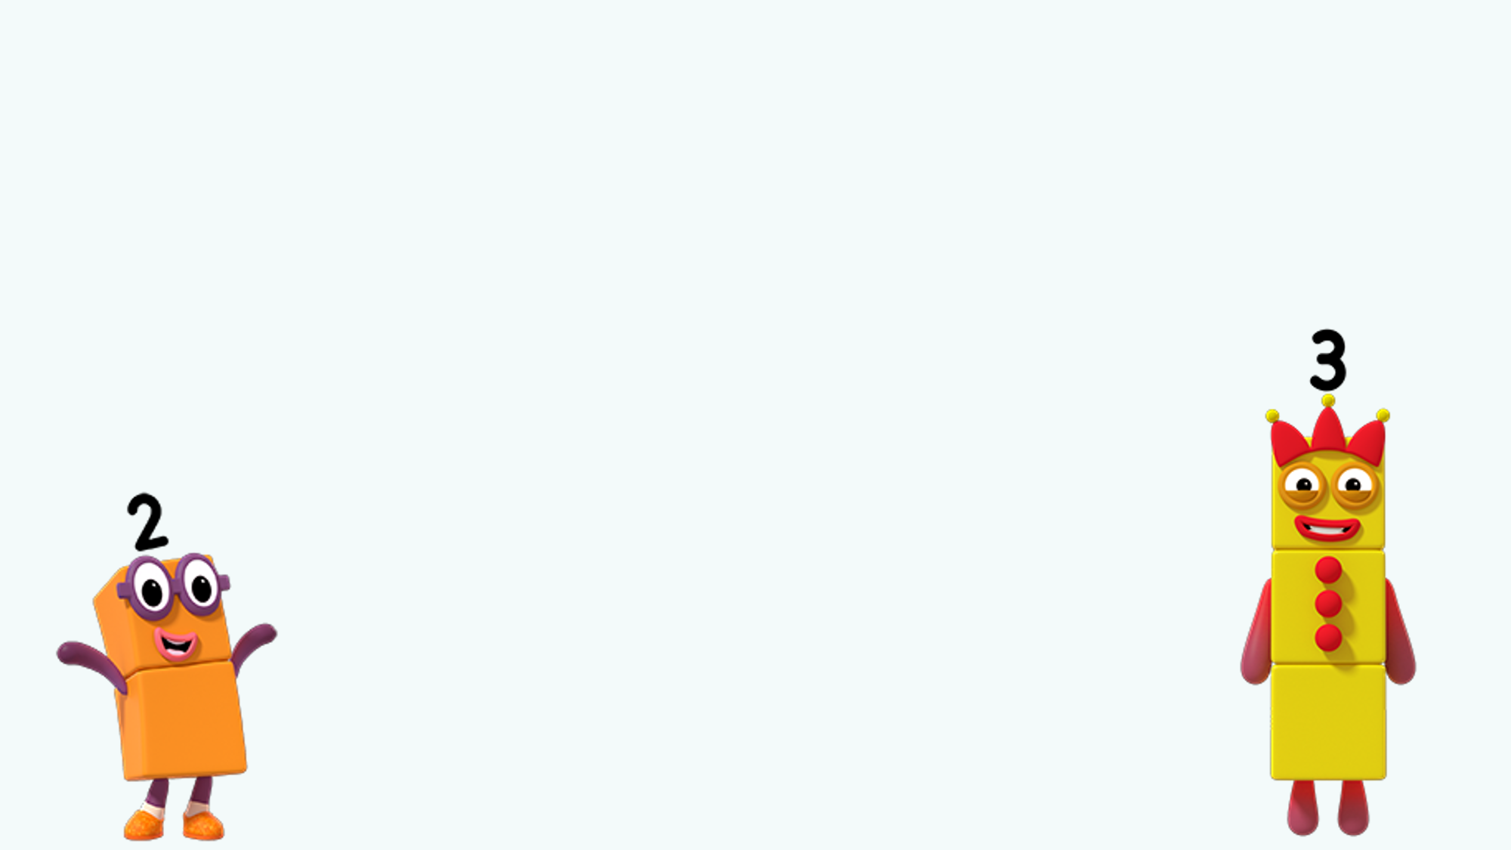
Click on the screen and then on the Blocks
Which Numberblocks can be made with just Twos?
Which Numberblocks can be made with just Threes?
Images © 2017 Alphablocks Ltd. All Rights Reserved.
Notes:
Use this slide to provide a challenge for the pupils to work on using building, drawing, and writing to solve the problem.
When solutions have been found, encourage children to explain their thinking using the stem sentences.
For example:
3 lots of 3 is 9.
There are 3 threes in nine.
Nine can be made from 3 threes.

Slide 26
4 can be made from 2 Twos.
6 can be made from 3 Twos.
8 can be made from 4 Twos.
2 can be made from 1 Two.
10 can be made from 5 Twos.
3 can be made from 1 Three.
6 can be made from 2 Threes.
9 can be made from 3 Threes.
Images © 2017 Alphablocks Ltd. All Rights Reserved.
Notes:
This slide is animated by clicking on the multiples of 2 and 3.
Click on 2, 3, 4, 6, 8, 9, 10 to reveal a speech bubble to describe how it is made from either twos or threes.
Why are 5 and 7 not circled? (It is not possible to make 5 with equal groups of 2s or 3s).
(Do not click on 1, 5, 7 as this will take you away from the slide).

Slide 27
Further activities for Y2
Write equations to represent the repeated addition to make 2, 3, 4, 6, 8, 9 and 10.
Explore other repeated-addition sentences that make numbers to 10. (4 + 4 = 8; 5 + 5 = 10).
Ask pupils to make a matching pairs game that matches images of repeated addition to “ _ lots of _” and the equations.
Explore numbers to 20. Which numbers can be made with 2s and 3s? Which can’t?
Place numbers to 20 that can be made with 2s and 3s in a Venn diagram. (There will be some numbers in the overlap and some numbers that don’t appear in the either circle).

