Slide 1
2.11 Times tables: 11 and 12
Representations | Year 4
Multiplication and Division

Slide 2
How to use this presentation
You can find the teacher guide 2.11 Times tables: 11 and 12 by following the link below.

Slide 3

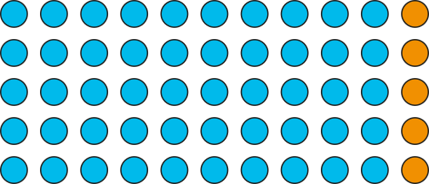
2.11 The 11 and 12 times tables Step 1:1
5 × 11 =
55
11 × 5 =
55
10
1
5
50
5
5 × 11 =
11 × 5 =
5 × 11 = 5 × 10 + 5 × 1
= 50
+
5
= 55
Notes:
Five groups of eleven is equal to fifty-five.
Eleven, five times is equal to fifty-five.

Slide 4
2.11 The 11 and 12 times tables Step 1:2
11 × 3 =
33
10
1
3
30
3
11 × 3 = 10 × 3 + 1 × 3
= 30
+ 3
= 33

Slide 5
2.11 The 11 and 12 times tables Step 1:2
7 × 11 =
77
7 × 11 = 7 × 10 + 7 × 1
= 70
+ 7
= 77

Slide 6
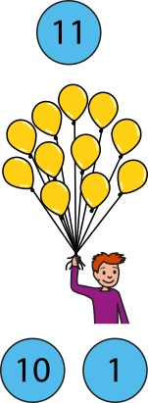
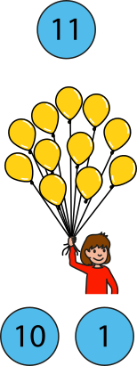
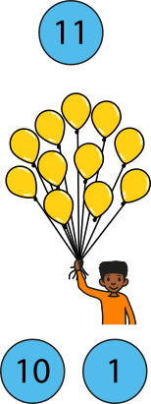
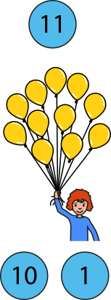
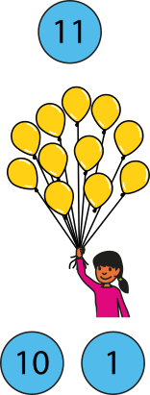
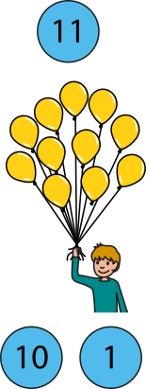
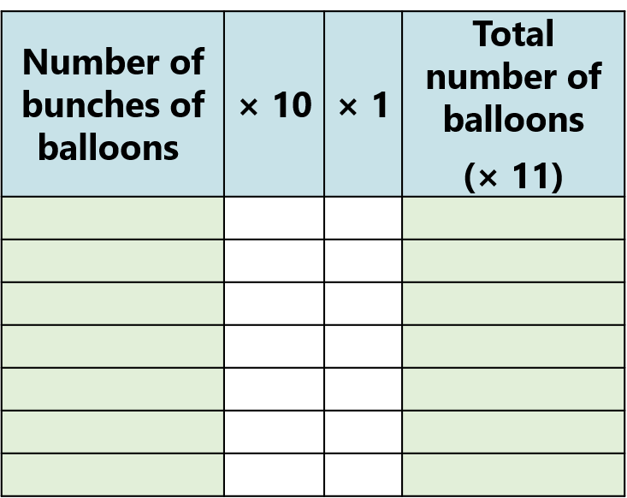

































2.11 The 11 and 12 times tables Step 1:4
Notes:
Six groups of eleven is equal to sixty-six.
Six times eleven is equal to sixty-six.
Eleven, six times is equal to sixty-six.
Eleven times six is equal to sixty-six.

Slide 7
2.11 The 11 and 12 times tables Step 1:5
Number of bunches of balloons | × 10 | × 1 | Total number of balloons (× 11)
0 | 0 | 0 | 0
1 | 10 | 1 | 11
2 | 20 | 2 | 22
3 | 30 | 3 | 33
4 | 40 | 4 | 44
5 | 50 | 5 | 55
6 | 60 | 6 | 66
7 | 70 | 7 | 77
8 | 80 | 8 | 88
9 | 90 | 9 | 99
10 | 100 | 10 | 110
11 | 110 | 11 | 121
12 | 120 | 12 | 132
0 × 11 = 0 | 11 × 0 = 0
1 × 11 = 11 | 11 × 1 = 11
2 × 11 = 22 | 11 × 2 = 22
3 × 11 = 33 | 11 × 3 = 33
4 × 11 = 44 | 11 × 4 = 44
5 × 11 = 55 | 11 × 5 = 55
6 × 11 = 66 | 11 × 6 = 66
7 × 11 = 77 | 11 × 7 = 77
8 × 11 = 88 | 11 × 8 = 88
9 × 11 = 99 | 11 × 9 = 99
10 × 11 = 110 | 11 × 10 = 110
11 × 11 = 121 | 11 × 11 = 121
12 × 11 = 132 | 11 × 12 = 132

Slide 8
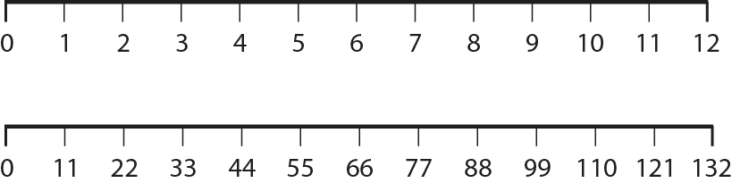
2.11 The 11 and 12 times tables Step 1:6

Slide 9
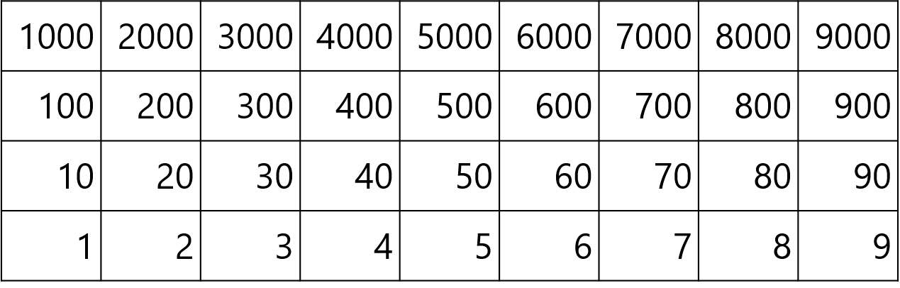
2.11 The 11 and 12 times tables Step 1:6

Slide 10


2.11 The 11 and 12 times tables Step 1:7
 | × 11
0 | 0
1 | 11
2 | 22
3
4 | 44
5 | 55
6 | 66
7
8 | 88
9 | 99
10 | 110
11 | 121
12 | 132
 | × 11
2 | 22
3
77
↑ − 11
↓ + 11
3 × 11 = 2 × 11 + 11
7 × 11 = 8 × 11 − 11
33
= 22 + 10 + 1
= 88 − 10 − 1
 | × 11
7
8 | 88
+ 11
− 11
0
11
22
33
44
55
66
77
88
99
110

Slide 11

2.11 The 11 and 12 times tables Step 1:7
4 × 11 = 55 – 11
5 × 11 = 55
= 55 – 10 – 1
= 45 – 1
= 44

Slide 12
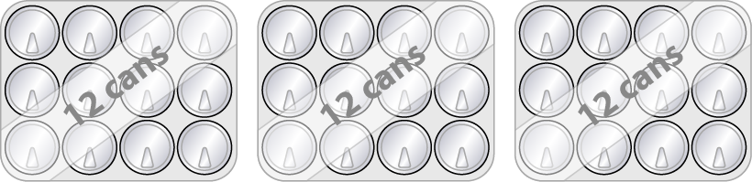

2.11 The 11 and 12 times tables Step 2:1
3 × 12 =
36
12 × 3 =
36
10
2
3
30
6
3 × 12 = 3 × 10 + 3 × 2
12 × 3 =
3 × 12 =
= 30
+
6
= 36
Notes:
Three groups of twelve is equal to thirty-six.
Twelve, three times is equal to thirty-six.

Slide 13
2.11 The 11 and 12 times tables Step 2:2
12 × 5 =
60
10
2
5
50
10
12 × 5 = 10 × 5 + 2 × 5
= 50
+ 10
= 60

Slide 14
2.11 The 11 and 12 times tables Step 2:2
8 × 12 =
96
8 × 12 = 8 × 10 + 8 × 2
= 80
+ 16
= 96

Slide 15
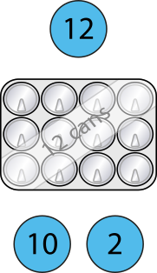
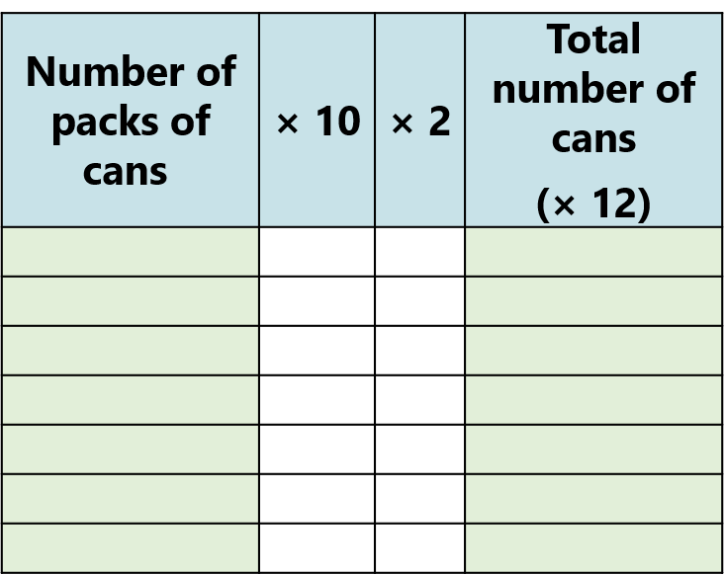























2.11 The 11 and 12 times tables Step 2:4
Notes:
Six groups of twelve is equal to seventy-two.
Six times twelve is equal to seventy-two.
Twelve, six times is equal to seventy-two.
Twelve times six is equal to seventy-two.

Slide 16
2.11 The 11 and 12 times tables Step 2:5
Number of packs of cans | × 10 | × 2 | Total number of cans (× 12)
0 | 0 | 0 | 0
1 | 10 | 2 | 12
2 | 20 | 4 | 24
3 | 30 | 6 | 36
4 | 40 | 8 | 48
5 | 50 | 10 | 60
6 | 60 | 12 | 72
7 | 70 | 14 | 84
8 | 80 | 16 | 96
9 | 90 | 18 | 108
10 | 100 | 20 | 120
11 | 110 | 22 | 132
12 | 120 | 24 | 144
0 × 12 = 0 | 12 × 0 = 0
1 × 12 = 12 | 12 × 1 = 12
2 × 12 = 24 | 12 × 2 = 24
3 × 12 = 36 | 12 × 3 = 36
4 × 12 = 48 | 12 × 4 = 48
5 × 12 = 60 | 12 × 5 = 60
6 × 12 = 72 | 12 × 6 = 72
7 × 12 = 84 | 12 × 7 = 84
8 × 12 = 96 | 12 × 8 = 96
9 × 12 = 108 | 12 × 9 = 108
10 × 12 = 120 | 12 × 10 = 120
11 × 12 = 132 | 12 × 11 = 132
12 × 12 = 144 | 12 × 12 = 144

Slide 17
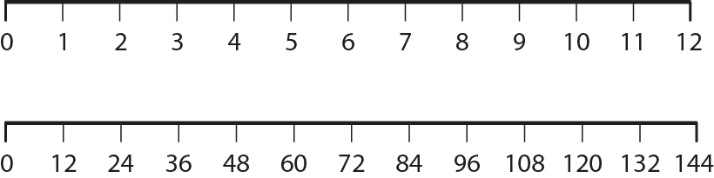
2.11 The 11 and 12 times tables Step 2:6

Slide 18
2.11 The 11 and 12 times tables Step 2:6

Slide 19
2.11 The 11 and 12 times tables Step 2:7
 | × 12
0 | 0
1 | 12
2 | 24
3
4 | 48
5 | 60
6 | 72
7
8 | 96
9 | 108
10 | 120
11 | 132
12 | 144
 | × 12
2 | 24
3
84
↑ − 12
↓ + 12
3 × 12 = 2 × 12 + 12
7 × 12 = 8 × 12 − 12
36
= 24 + 10 + 2
= 96 − 10 − 2
 | × 12
7
8 | 96
+ 12
− 12
0
12
24
36
48
60
72
84
96
108
120

Slide 20

2.11 The 11 and 12 times tables Step 2:7
4 × 12 = 60 – 12
5 × 12 = 60
= 60 – 10 – 2
= 50 – 2
= 48

Slide 21
2.11 The 11 and 12 times tables Step 3:1
0
6
12
18
24
30
36
42
48
54
60
66
72

Slide 22
2.11 The 11 and 12 times tables Step 3:1
Number | 0 | 1 | 2 | 3 | 4 | 5 | 6 | 7 | 8 | 9 | 10 | 11 | 12 | 13 | 14 | 15 | 16 | 17 | 18 | 19 | 20 | 21 | 22 | 23 | 24
Counting in 6s
Counting in 12s
✓
✓
✓
✓
✓
✓
✓
✓

Slide 23
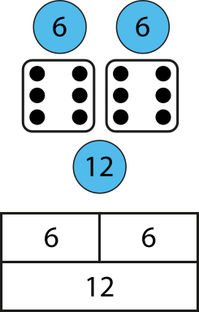
2.11 The 11 and 12 times tables Step 3:1
Notes:
Twelve is double six. Six is half of twelve.
Four times twelve is equal to forty-eight, so
double-four times six is equal to forty-eight.
Eight times six is equal to forty-eight, so
half-of-eight times twelve is equal to forty-eight.

Slide 24

2.11 The 11 and 12 times tables Step 3:1
8
×
6
=
48
half
double
4
×
12
=
48

Slide 25
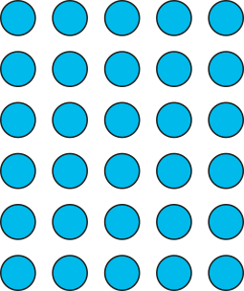
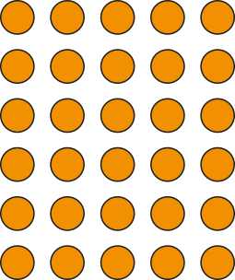
2.11 The 11 and 12 times tables Step 3:1
5
×
6
=
30
half
double
5
×
12
=
60
Notes:
Six is half of twelve, so five sixes is half of five-twelves.
Twelve is double six, so five twelves is double five-sixes.

Slide 26
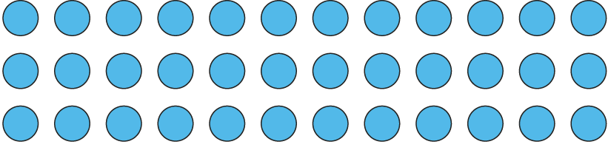
2.11 The 11 and 12 times tables Step 3:2
How many groups of six are there?
6
× 6 =
36
How many groups of twelve are there?
3
× 12 =
36

Slide 27
2.11 The 11 and 12 times tables Step 4:1
A 2-digit number is divisible by 11 if the digits are the same.
 | × 11
0 | 0
1 | 11
2 | 22
3 | 33
4 | 44
5 | 55
6 | 66
7 | 77
8 | 88
9 | 99
10 | 110
11 | 121
12 | 132

Slide 28
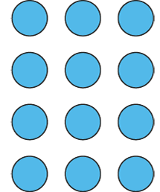
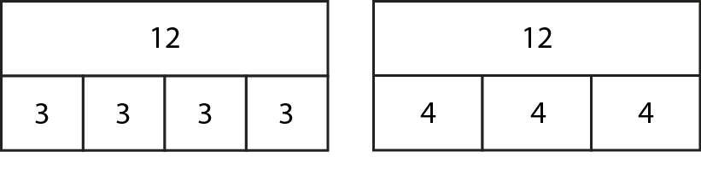
2.11 The 11 and 12 times tables Step 4:2
12 = 4 × 3
12 = 3 × 4

Slide 29
2.11 The 11 and 12 times tables Step 4:2
 | Number is divisible by…
Number to test | 3 | 4 | 12
12
15
16
18
20
21
24
30
96
109
144
240
304
1200
✓
✓
✓
✓
✓
✓
✓
✓
✓
✓
✓
✓
✓
✓
✓
✓
✓
✓
✓
✓
✓
✓
✓
✓
✓
Notes:
For a number to be divisible by twelve, the number must be
divisible by both three and four.

