Slide 1
Numberblocks
Support Materials
Series 2, Episode 13
Blast Off!

Slide 2
Practitioner Notes

Slide 3
Episode Description
One wishes she could go to the moon and Ten promises to take her. Ten turns into a rocket and gets all the Numberblocks to help her count down from 10 to 1. She takes off and the others are puzzled as to why she didn’t take them with her. Ten lands on the moon, and splits into pairs of Numberblocks in turn: Nine and One meet ten aliens who want to get home in their spaceship, Eight and Two build them a second spaceship, Seven and Three find the ‘on’ button, Six and Four roll dice, which the aliens turn into space invader sprites, which they zap with lasers. Finally, Five and Five give the saucers a push and send the aliens on their way. They recombine to make Ten, who takes off for home.

Slide 4
Maths in the Episode
Counting back from 10
The Numberblocks count backwards in ones from 10 to 1 then blast off.
Addition bonds that total 10
10 is partitioned into 9 + 1; 8 + 2; 7 + 3; 6 + 4 and 5 + 5, and then they each recombine to make 10.

Slide 5
Using Mathematical Language
During this episode children will experience counting backwards in ones from ten. Children should practise saying the number names and describing the relationship between adjacent numbers, e.g.:
“Nine is one less than ten”.
Children may begin to describe the part-part-whole structure of 10:
“10 is the whole: 9 is a part, and 1 is a part, and 10 is the whole”
(use actions – holding the 9 in one hand and the 1 in the other, bringing together and separating to show the whole and the parts).

Slide 6
Talk and Discuss Together

Slide 7
Talk and Discuss Together
Watch the episode of Numberblocks. First ask the children what they noticed and allow them to talk to you and each other. The following slides are designed to stimulate children and adults to talk about the episode and draw out some key aspects of the mathematics.

Slide 8
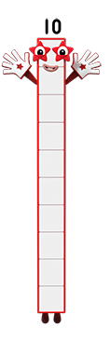

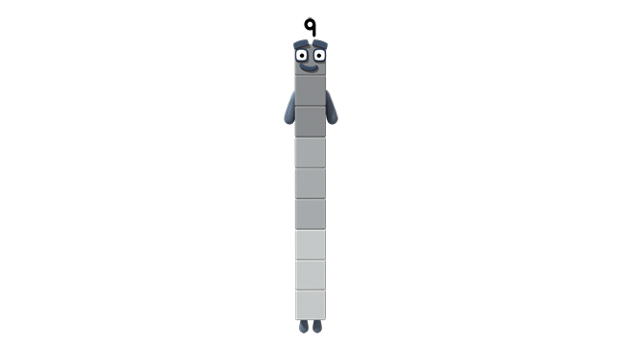
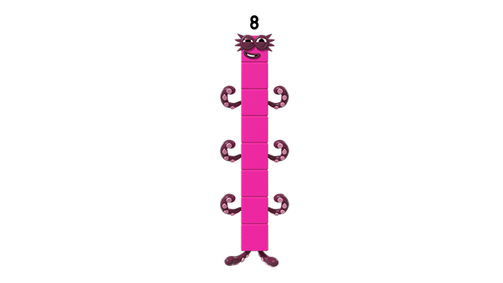
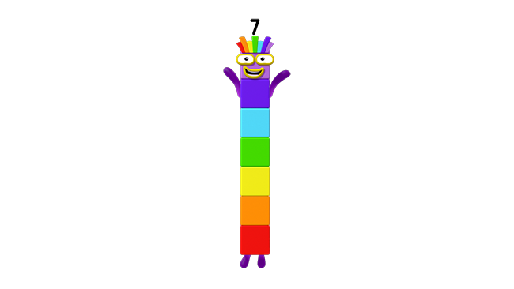
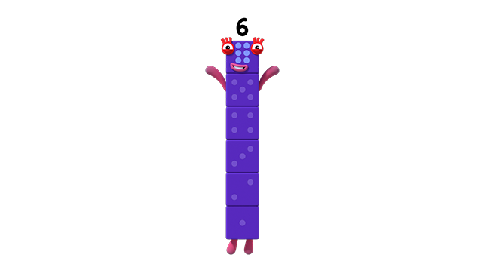
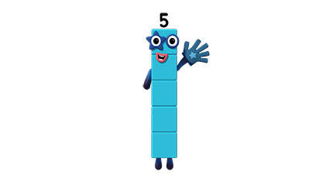
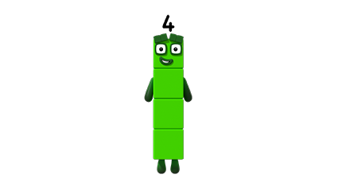
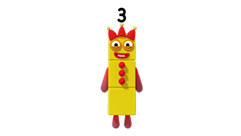
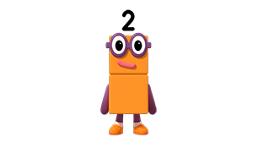
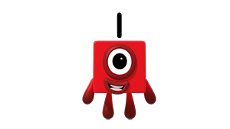
Images © 2017 Alphablocks Ltd. All Rights Reserved.
Notes:
After watching the episode, discuss what the children noticed about the programme.
What do they notice about the picture on the screen?
Give groups of ten children a Numberblock each made from linking cubes so that each child has a Numberblock from 1-10. Ask them to get into a line starting with 10. It may help to have mats or coloured paper in a row so that the children can work out who to stand adjacent to.
When all are in a line, say out loud the numbers from 10 down to 1.
Use this slide as an opportunity to experience the relationship between adjacent numbers.
In pairs, two children each have a Ten Numberblock made from connecting cubes, one child removes one from the top of his/her Ten.
Compare to the partner’s Ten.
“Nine is one less than Ten.”
Next, the partner makes his/her Ten into a Nine so both children have Nines. Repeat. One child removes one cube from his/her Nine. Compare it to the partner’s Nine.
“Eight is one less than nine.”
Continue, each time describing the relationship.

Slide 9
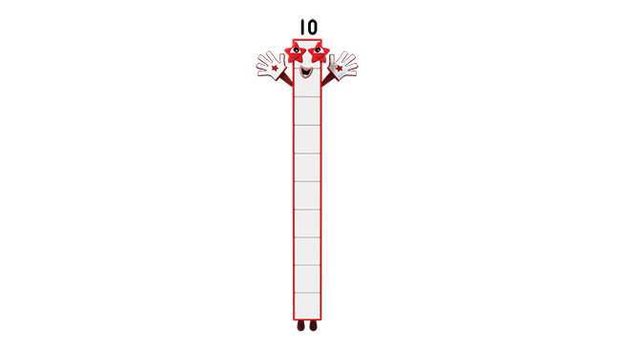

Blast off!
Images © 2017 Alphablocks Ltd. All Rights Reserved.
Notes:
This slide is animated to count down from 10 to 1.

Slide 10
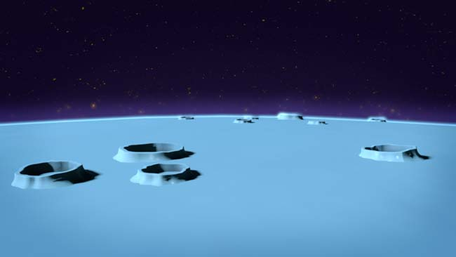
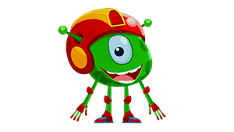
Click on the orange ear for forward counting.
Click on the background for backward counting.
Sing the song
Images © 2017 Alphablocks Ltd. All Rights Reserved.
Notes:
This slide is animated to support counting forward and back.
Click on the orange ear for forward counting.
Click on the background for backward counting.
Sing the song as the aliens jump down the craters.
Sing to the tune of Ten Green Bottles:
10 green aliens jumping in a row
10 green aliens jumping in a row
And if 1 green alien should fall into a hole,
There’ll be 9 green aliens jumping in a row.
etc.

Slide 11
Enabling Environments

Slide 12
Enabling Environments
Playing and Exploring
Leave out the 1-10 Numberblocks made from linking cubes and a sheet of A3 paper with 10 stepping stones on to lay out the Numberblocks from 10 to 1.
Active Learning
Notice how children use the role-play area as a space control centre: include pictures of rockets, microphones and a computer desk. Include small world space vehicles for children to explore taking off. Adults can model the countdown. Notice how children use counting down from 10 in this area.
Creating and Thinking Critically
Ask the children to suggest when to set the whiteboard countdown timer to 10 seconds, e.g. for coming to sit down, or lining up for dinner. Children can count down with the clock.
Notes:
https://www.online-stopwatch.com/eggtimer-countdown/full-screen/

Slide 13
Learning Together in Y1

Slide 14
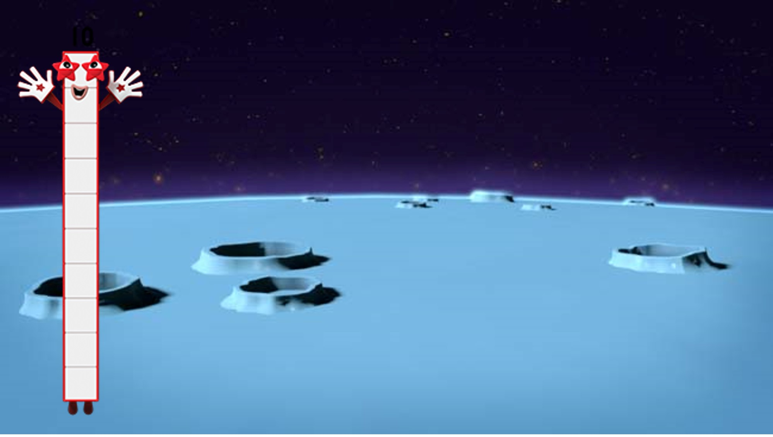








We’re on the moon,
Nine and One.
That was easy.
This is fun!
Images © 2017 Alphablocks Ltd. All Rights Reserved.
Notes:
Discuss the episode. Look at the Numberblocks. What do you notice?
Slides 14 to 18 are animated to show how Ten partitions into 2 smaller Numberblocks. First, Ten partitions into Nine and One.
This structure is then represented in a tens frame, a part-part-whole model, and then an equation. Discuss with the children and help them to make connections between the 3 representations.
Ask children to discuss or write the part-part-whole model and then the equation, before these are shown. Ask them what each number represents and help them to link to the original context of Numberblock Ten on the moon, partitioning, engaging in activity and then recombining. Say the rhyme in the speech bubble together.
Ask the children what the “fun thing” was that each pair engaged with:
Nine and One meet ten aliens who want to get home in their spaceship, Eight and Two build them a second spaceship, Seven and Three find the ‘on’ button, Six and Four roll dice, which the aliens turn into space invader sprites. Five and Five give the saucers a push and send the aliens on their way.

Slide 15




We’re on the moon,
Eight and Two.
How did we get here?
Haven’t a clue!
Images © 2017 Alphablocks Ltd. All Rights Reserved.

Slide 16




We’re on the moon,
Seven and Three.
We’re so lucky
Look at me!
Images © 2017 Alphablocks Ltd. All Rights Reserved.

Slide 17




We’re on the moon,
Six and Four.
We really couldn’t ask for more!
Images © 2017 Alphablocks Ltd. All Rights Reserved.

Slide 18



We’re on the moon,
Five and Five.
We sure feel great to be alive!
Images © 2017 Alphablocks Ltd. All Rights Reserved.

Slide 19
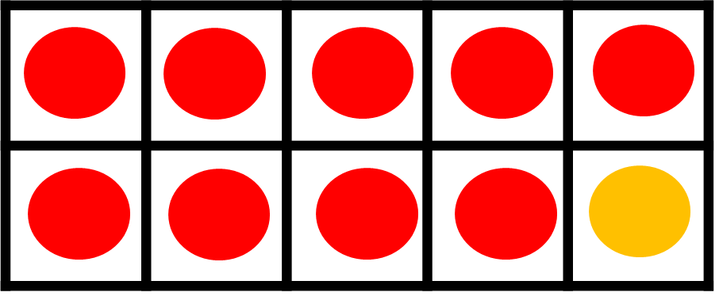
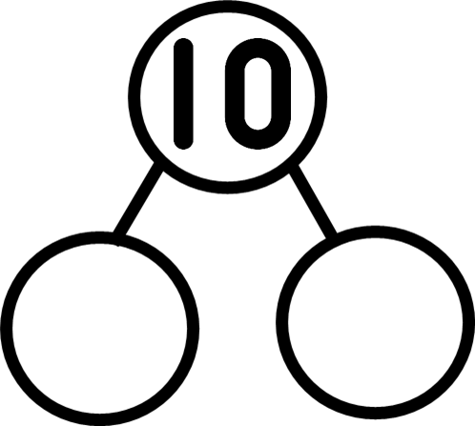
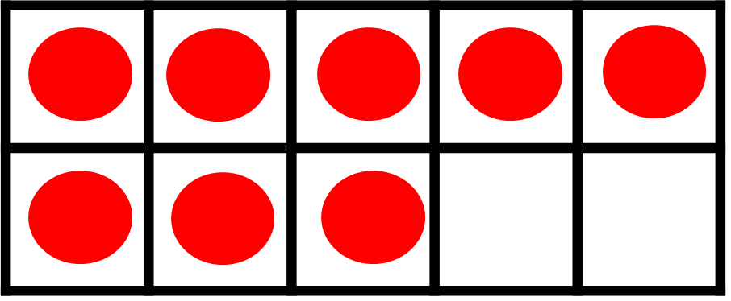



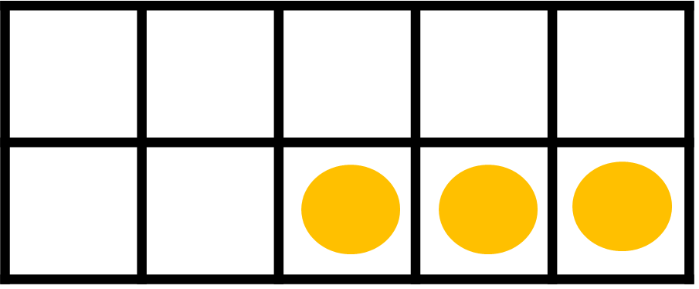
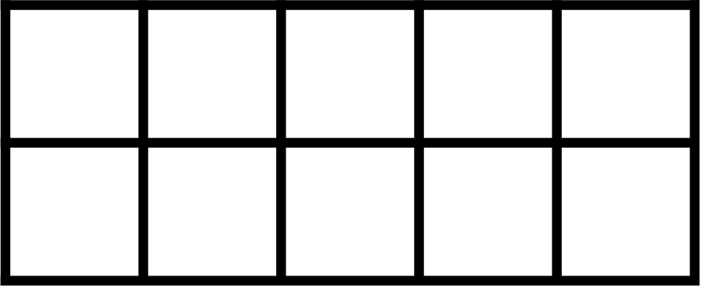
Images © 2017 Alphablocks Ltd. All Rights Reserved.
Notes:
Ask the children to work individually on this activity. Use this slide to complete together to check responses.

Slide 20
Images © 2017 Alphablocks Ltd. All Rights Reserved.
Notes:
The following slides flash up green aliens in one spaceship. Use these to discuss how many are in the other spaceship if there are 10 aliens altogether. The first 2 slides repeat the combinations used in earlier slides. The remaining slides require the children to deduce the missing information based on the fact that addition is commutative (it can be done in any order). So if ‘8 + 2 = 10’ then ‘2 + 8 = 10’.
These slides are animated:
Click the background to reveal the aliens in the second spaceship.

Slide 21
Images © 2017 Alphablocks Ltd. All Rights Reserved.

Slide 22
Images © 2017 Alphablocks Ltd. All Rights Reserved.

Slide 23
Images © 2017 Alphablocks Ltd. All Rights Reserved.

Slide 24
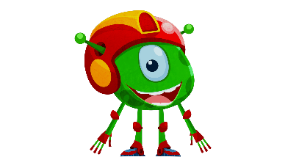
Images © 2017 Alphablocks Ltd. All Rights Reserved.

Slide 25
Images © 2017 Alphablocks Ltd. All Rights Reserved.

