Slide 1
Position-to-term rule for arithmetic sequences
KS3 Mastery PD Materials: Exemplified Key Ideas
Materials for use in the classroom or to support professional development discussions
(from 4.1 Sequences)
Summer 2021

Slide 2
About this resource
These slides are designed to complement the 4.1 Sequences Core Concept document and its associated Theme Overview document 4 Sequences and Graphs, both found in the Secondary Mastery Professional Development pages.
These slides re-present the key examples from the Core Concept document so that the examples can be used either directly in the classroom or with a group of teachers. There are prompt questions alongside the examples, and further clarification in the notes.
These slides do not fully replicate the Core Concept document, so should be used alongside it. Reference to specific page numbers, and to other useful NCETM resources, can be found in the notes for each slide.
This slide deck is not designed to be a complete PD session, rather it is a selection of resources that you can adapt and use as needed when planning a session with a group of teachers.

Slide 3


About this resource
The slides are structured as follows:
  The big picture:
    Where does this fit in?
    What do students need to understand?
    Why is this key idea important?
  Prior learning
  Misconceptions
  Exemplified key ideas
  Reflection questions
  Appendices:
    Key vocabulary
    Representations and structure
    Previous and Future learning
    Useful links
The exemplified key idea slides have the following symbols to indicate how they have been designed to be used:
Into the classroom
The examples are presented on these slides so that they could be used in PD, but also directly in the classroom. The notes feature suggested questions and things teachers might consider when using with students.
PD discussion prompts
These slides look at the examples in more detail, with question prompts to promote discussion among maths teachers. The notes feature reference to further information and guidance within the Core Concepts document.

Slide 4
Where does this fit in?
The NCETM has identified a set of six ‘mathematical themes’ within Key Stage 3 mathematics that bring together a group of ‘core concepts’.
The fourth of these themes is Sequences and graphs, which covers the following interconnected core concepts:
      4.1 Sequences
      4.1 Graphical representations
Notes:
Linked on this slide is the Theme Overview document of Sequences and graphs. This document includes why it is important, the key underpinning knowledge and links to prior and future learning. There is also guidance about how the five big ideas of Teaching for Mastery relate specifically to this theme.

Slide 5
Where does this fit in?
Within this core concept, 4.1 Sequences, there are three statements of knowledge, skills and understanding.
These, in turn, are broken down into ten key ideas. The highlighted key idea is exemplified in this slide deck.
Notes:
For key ideas marked with an asterisk, we exemplified the common difficulties and misconceptions that students might have and included elements of what teaching for mastery may look like. We have provided examples of possible student tasks and teaching approaches.
Within these slides are ‘classroom-ready’ versions of the examples for the key idea that has been highlighted. There are also slides that may be useful for discussion in a professional development session.

Slide 6
What do students need to understand?
4.1.2.2 Understand that any term in an arithmetic sequence can be expressed in terms of its position in the sequence (nth term)
Appreciate that each term in an arithmetic sequence has the same structure and that the expression of that structure in terms of its position in the sequence is the nth term.
Solve familiar and unfamiliar problems, including real-life applications.
Solve problems where there is more than one answer and where there are elements of experimentation, investigation, checking, reasoning, proof, etc.
  What prior knowledge might your students already have?
  What language might they use to describe this key idea?
  What questions might you want to ask to assess their prior learning?

Slide 7
Why is this key idea important? (1)
A fundamental feature of algebra and algebraic thinking is the recognition and expression of generality. When studying sequences, students are asked to discern what is the same about a collection of different terms, what links them together and what makes them examples of the same thing.
As such, it is a context that provides an accessible and powerful introduction to using algebraic symbolism which builds on intuitive ideas of generality, many of which have been laid down at primary school. While introduced in Year 6, algebra is developed further at Key Stage 3 and is a key element of conceptual development essential for success at Key Stage 4.
When working with sequences, a powerful and important distinction that students will make is figuring out what is needed to generate the next term in the sequence and describing any term in the sequence in relation to its position in that sequence. Such a generalisation requires seeing and expressing a common structure behind each term of a sequence and is an important precursor to proof.
Notes:
A more detailed overview of the core concept of Sequences can be found on page 2 of the 4.1 Core Concept document.
The background to each key idea is also explored in more detail on the following pages:
4.1.1 Understand the features of a sequence – page 7
4.1.2 Recognise and describe arithmetic sequences – page 7
4.1.3 Recognise and describe other types of sequences (non-arithmetic) – page 7

Slide 8
Why is this key idea important? (2)
While students will have encountered sequences in various forms throughout Key Stages 1 and 2, the extent to which students have previously explored them in depth may vary.
Therefore, students should consolidate, secure and deepen their understanding of linear sequences and how to find and use term-to-term rules to generate the next term.
Then, they can progress on to describing any term in the sequence directly in relation to its position in the sequence.
This key idea extends students’ knowledge of sequences through exploration of the mathematical structure, not just by spotting the patterns that the structure creates.
Algebraic notation is used to express the structure, and students should become familiar with finding and using the nth term of a linear sequence. It is important that students have time to develop a full understanding of the connection between the notation and the sequence, and come to see the nth term as a way of expressing the structure of every term in the sequence.
This learning has connections to other areas of algebra, particularly solving equations (when checking if a number is a term in a sequence) and straight line graphs. Work on sequences in Key Stage 3 provides the foundation for exploring quadratic sequences and simple geometric progressions in Key Stage 4.
Notes:
A more detailed overview of the core concept of Sequences can be found on page 2 of the 4.1 Core Concept document.
The background to each key idea is also explored in more detail on the following pages:
4.1.1 Understand the features of a sequence – page 7
4.1.2 Recognise and describe arithmetic sequences – page 7
4.1.3 Recognise and describe other types of sequences (non-arithmetic) – page 7

Slide 9
Prior learning
  What prior knowledge might your students already have?
  What language might they use to describe this key idea?
  What questions might you want to ask to assess their prior learning?
Upper Key Stage 2 Learning Outcome
Generate and describe linear number sequences
Use simple formulae
Describe positions on the full coordinate grid (all four quadrants)
Notes:
You may find it useful to speak to your partner schools to see how the above has been covered and the language used.
You can find further details regarding prior learning in the following segments of the NCETM primary mastery professional development materials:
Year 5: 2.21 Factors, multiples, prime numbers and composite numbers
Year 6: 1.31 Problems with two unknowns
Year 6: 2.27 Scale factors, ratio and proportional reasoning
Within the 4 Sequences and Graphs Theme Overview document, you can also find a broader description of students’ potential previous learning (page 4), alongside further information about key underpinning knowledge (page 2).

Slide 10
Prior learning
  What representations might your students already be familiar with?
  What language might they use?
  How does this fit in with your curriculum progression?
Key Stage 3 Learning Outcome
1.2.1 Understand multiples
1.2.2 Understand integer exponents and roots
1.4.1 Understand and use the conventions and vocabulary of algebra, including forming and interpreting algebraic expressions and equations
Please note: Numerical codes refer to statements of knowledge, skills and understanding in the NCETM breakdown of Key Stage 3 mathematics.

Slide 11
Checking prior learning
The following slides contain questions for checking prior learning.
  What representations might students use to support their understanding of these questions?
  What variation might you put in place for these questions to fully assess students’ understanding of the concept?
  How might changing the language of each question change the difficulty?
  Why are these such crucial pre-requisites for this key idea?

Slide 12
Checking prior learning (1)
a)
Ramesh is exploring two sequence-generating rules.
Rule A is: ‘Start at 2, and then add on 5, and another 5, and another 5, and so on.’
Rule B is: ‘Write out the numbers that are in the five times table, and then subtract 2 from each number.’
What’s the same and what’s different about the sequences generated by these two rules?
Notes:
References to the questions (links on final slide):
a) NCETM primary assessment materials: Year 6, page 27

Slide 13
Checking prior learning (2)
b)
Roshni and Darren are using sequence-generating rules.
Roshni’s rule is: ‘Start at 4, and then add on 5, and another 5, and another 5, and so on.’
Darren’s rule is: ‘Write out the numbers that are multiples of 5, starting with 5, and then subtract 1 from each number.’
Roshni and Darren notice that the first few numbers in the sequences generated by each of their rules are the same. They think that all the numbers in the sequences generated by each of their rules will be the same.
Do you agree? Explain your decision.
Notes:
References to the questions (links on final slide):
b) NCETM primary assessment materials: Year 6, page 27

Slide 14
Checking prior learning (3)
c)
On New Year’s Eve, Polly has £3.50 in her money box. On 1 January she puts 30p into her money box. On 2 January she puts another 30p into her money box. She continues putting in 30p every day.
How much money is in the box on 10 January?
How much money is in the box on 10 February?
Write a sequence-generating rule for working out the amount of money in the money box on any day in January.
Notes:
References to the questions (links on final slide):
c) NCETM primary assessment materials: Year 6, page 27

Slide 15
Common difficulties and misconceptions
What aspects of this key idea might students find challenging?
What misconceptions might students have?
When teaching this topic, you may find students encounter difficulties with…
Not understanding the constant difference is represented by the coefficient
More information, and some suggestions for overcoming these challenges, can be found on the following slides

Slide 16
Common difficulties and misconceptions (1)
When examining arithmetic sequences where each term is obtained by adding a fixed amount (constant difference) to the previous term, it is natural for students to express the rule in terms of this fixed amount. For example, students may see the sequence 4, 7, 10, 13, … as ‘Add three’ and think that, therefore, the nth term is n + 3 rather than the correct 3n + 1.
This misconception can be explored by examining the three times table (i.e. 3 (3 × 1), 6 (3 × 2), 9 (3 × 3), 12 (3 × 4), 15 (3 × 5), …, 3n) and a range of other sequences that consist of terms in the three times table with one, two, three, etc. added (or subtracted).
Students should be encouraged to notice what is the same and what is different, i.e. it is the ‘3n’ that determines the ‘increasing by three’.
It will then be helpful for students to experience substituting n = 1, 2, 3, etc. into the expression ‘n + 3’ to realise that this will give a sequence which begins at four and increases by one, rather than beginning at four and increasing by three.
Notes:
More detail can be found on page 13 of the 4.1 Core Concept document.

Slide 17
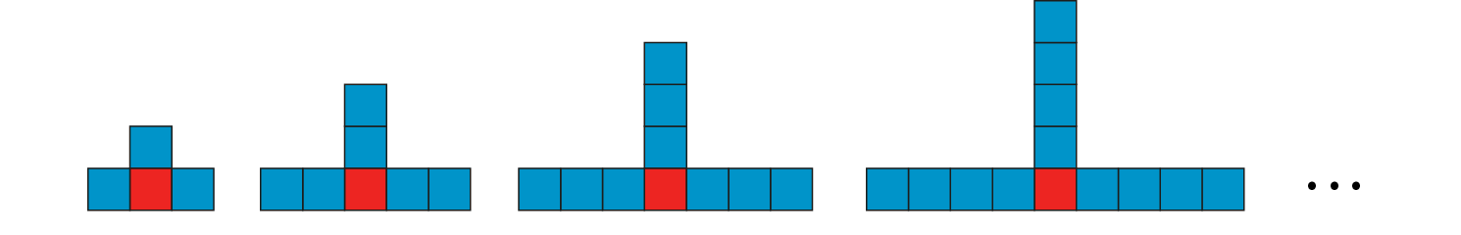
Common difficulties and misconceptions (1 cont)
The fundamental awareness here is that, in the general statement 3n + 1, the common difference is represented by the ‘3’ (the coefficient of n) because as n increases, the value of the whole expression increases by three. It will be important to explore the potential confusion between multiples of three (for example) and numbers which increase by three, and to recognise that these are not necessarily the same thing.
The use of growing shape patterns that generate such sequences of numbers can support students in seeing what is constant in each term and what varies. For example: ‘How many squares are needed to make each shape in this sequence?’
Rewriting each of the numerical terms to reveal the structure, e.g. 1 + (1 × 3), 1 + (2 × 3), 1 + (3 × 3), 1 + (4 × 3), … can also assist in developing this awareness.
Notes:
More detail can be found on page 13 of the 4.1 Core Concept document.

Slide 18
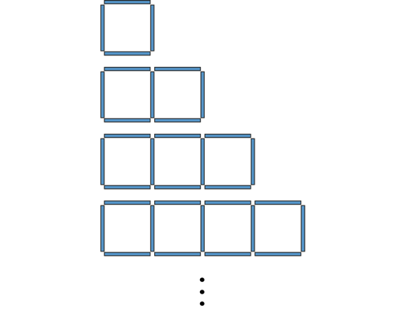
Appreciate that each term in an arithmetic sequence has the same structure and that the expression of that structure in terms of its position in the sequence is the nth term
Example 1
The following sequence of growing shapes is made up of sticks.
It generates the following sequence of numbers (the number of sticks):
4, 7, 10, 13, …
Draw the 17th diagram. Think about the structure of the diagram as you draw it.
How would you work out the number of sticks in the 17th diagram without counting them one by one? What calculation would you perform?
Notes:
Suggested questioning:
What calculation could you do for the 17th? What might the calculation be for the 25th? Or 100th? Or 999th? How about the nth?
Things for you to think about:
The purpose of the diagrams in example 1 is to support students in seeing a common structure in each of the terms of the sequence. Asking students to draw the 17th diagram (or any diagram further along in the sequence) will help them to focus on the structure of the 17th term. It will be important to discuss the various answers that students come up with in order to draw their attention to the role that the ‘17’ plays. For example, some students may draw one stick followed by 17 groups of three sticks, and this might give rise to them writing the calculation: 1 + 17 × 3 or 17 × 3 + 1. In these calculations that students devise, the ‘17’ is acting almost like an honorary variable.

Slide 19
Appreciate that each term in an arithmetic sequence has the same structure and that the expression of that structure in terms of its position in the sequence is the nth term
Example 1
The following sequence of growing shapes is made up of sticks.
  Consider the ways that students might draw the 17th diagram:
    What different calculations might arise? Would these all lead to the same algebraic expression for the nth term?
  What questions might you ask to build the students towards generalising the nth term?
It generates the following sequence of numbers (the number of sticks):
4, 7, 10, 13, …
Draw the 17th diagram. Think about the structure of the diagram as you draw it.
How would you work out the number of sticks in the 17th diagram without counting them one by one? What calculation would you perform?
Notes:
Due to space constraints, the image on this PD discussion slide is very small. PD Leads might like to use or print the ‘in the classroom’ version of this slide for teachers to access during discussions.
More detail about this example can be found on page 14 of the 4.1 Core Concept document.

Slide 20
Appreciate that each term in an arithmetic sequence has the same structure and that the expression of that structure in terms of its position in the sequence is the nth term
Example 2
The terms in each of these sequences are generated by adding 3 each time and the 17th term is circled.
  4, 7, 10, 13, 16, …, 52
  5, 8, 11, 14, 17, …, 53
  14, 17, 20, 23, 26, …, 62
  27, 30, 33, 36, 39, …, 75
For each sequence, write the 17th term as an expression involving 17.
Notes:
Suggested questioning:
What is the same about each sequence? What is different?
How many 3s will have been added to generate the 17th term? How many 3s would have been added for the 25th term? The 100th? Etc.
Things for you to think about:
By keeping the constant difference the same in all parts of example 2, it is intended that students will see that three is the multiplier in the 17th term, because three is added each time. By the 17th term, seventeen 3s will have been added. It may help to draw students’ attention to the fact that, as each term has been increased by three, it is possible to write each term in such a way to show the ‘3’s, e.g.:
4 = 1 + 3
7 = 1 + 3 + 3
10 = 1 + 3 + 3 + 3, etc.
and to ask, ‘How many 3s will have been added to generate the 17th term?’
It would be beneficial to probe students’ understanding a bit deeper by asking for the 25th (or 50th, or 100th, or 347th, etc.) term and then to generalise this to the nth term.

Slide 21
Appreciate that each term in an arithmetic sequence has the same structure and that the expression of that structure in terms of its position in the sequence is the nth term
Example 2
The terms in each of these sequences are generated by adding 3 each time and the 17th term is circled.
  4, 7, 10, 13, 16, …, 52
  5, 8, 11, 14, 17, …, 53
  14, 17, 20, 23, 26, …, 62
  27, 30, 33, 36, 39, …, 75
For each sequence, write the 17th term as an expression involving 17.
  Think about the choice of numbers here: there is a constant difference of 3 and the 17th term is referred to each time. What is students’ attention being drawn to?
  How might you use your questioning to build students towards generalising here?
Notes:
Due to space constraints, the image on this PD discussion slide is very small. PD Leads might like to use or print the ‘in the classroom’ version of this slide for teachers to access during discussions.
More detail about the sequencing of this example can be found on page 15 of the 4.1 Core Concept document.

Slide 22
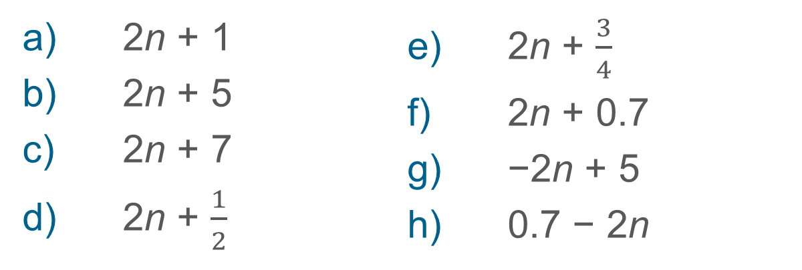
Appreciate that each term in an arithmetic sequence has the same structure and that the expression of that structure in terms of its position in the sequence is the nth term
Example 3
The following are the nth terms of different sequences.
2n + 1
2n + 5
2n + 7
2n + $\frac{1}{2}$
2n + $\frac{3}{4}$
2n + 0.7
−2n + 5
0.7 − 2n
How do these sequences increase?
Notes:
Suggested questioning:
Why isn’t the amount that is added telling us the common difference? What is this added amount actually telling us?
What is the same and different about each sequence?
What does the 2 in 2n represent each time?
Things for you to think about:
By keeping the coefficient of n constant and only varying the constant term in Example 3, students’ attention can be drawn to which aspect of the nth term is determining the difference between successive terms.
In order to address the possible misconception referred to previously, it will be useful to get students to think about the question, ‘Why isn’t the amount that is added telling us the common difference?’ and to ask, ‘What is this added amount telling us?’. In order to support students in fully generalising the idea of an arithmetic sequence, it will be important for students not to see decreasing sequences (parts g) and h)) as separate or different, but to see them as sequences formed by adding a negative number each time rather than a positive one.
An example of using a graphical representation to explore the common differences is given on page 16 of the 4.1 Core Concept document.

Slide 23
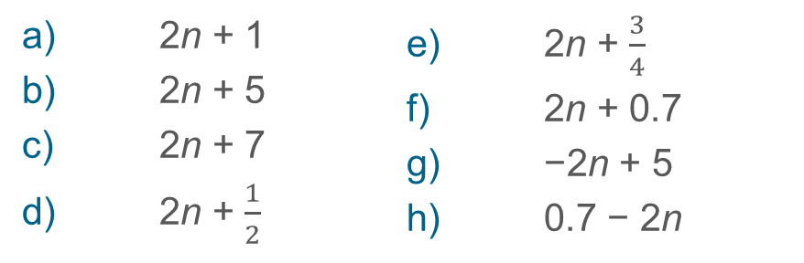
Appreciate that each term in an arithmetic sequence has the same structure and that the expression of that structure in terms of its position in the sequence is the nth term
Example 3
The following are the nth terms of different sequences.
  Here, the coefficient of n remains constant but the constant term varies. How can you use this variation to draw students’ attention to the structure of the nth term?
  Why is it important to include decreasing sequences in students’ experience of the nth term?
2n + 1
2n + 5
2n + 7
2n + $\frac{1}{2}$
2n + $\frac{3}{4}$
2n + 0.7
−2n + 5
0.7 − 2n
How do these sequences increase?
Notes:
Due to space constraints, the image on this PD discussion slide is very small. PD Leads might like to use or print the ‘in the classroom’ version of this slide for teachers to access during discussions.
More detail about this example, including how you might use graphical representations to explore common difference, can be found on pages 15 and 16 of the 4.2 Core Concept document.

Slide 24
Appreciate that each term in an arithmetic sequence has the same structure and that the expression of that structure in terms of its position in the sequence is the nth term
Example 4
How do these sequences increase (or decrease)?
5n + 3
−7n + 3
0.9n – 3
−n + 3
How can you tell just by looking at the nth term?
Notes:
Suggested questioning:
What happens to each term as n increases?
What part of the nth term determines how much your sequence increases/decreases by?*
*see notes on example 3 – you may wish to think about the language you use, for example in talking about decreasing sequences by ‘adding negatives’ each term.
Things for you to think about:
To support their developing understanding, it is important for students to articulate clearly what happens to each term as n increases and to realise that the coefficient of n determines the increase value. Sentences of the form ‘As the value of n increases by one, the value of each term increases (or decreases) by _’ should be encouraged.

Slide 25
Appreciate that each term in an arithmetic sequence has the same structure and that the expression of that structure in terms of its position in the sequence is the nth term
Example 4
  What language will you expect students to use to answer this question? How will you model this?
  Why is clarity and precision of language so important, particularly in a topic such as this?
How do these sequences increase (or decrease)?
5n + 3
−7n + 3
0.9n – 3
−n + 3
How can you tell just by looking at the nth term?
Notes:
Due to space constraints, the image on this PD discussion slide is very small. PD Leads might like to use or print the ‘in the classroom’ version of this slide for teachers to access during discussions.
More detail about this example can be found on page 16 of the 4.1 Core Concept document.

Slide 26
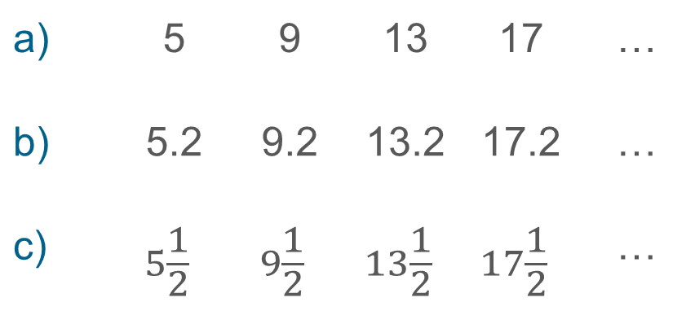
Appreciate that each term in an arithmetic sequence has the same structure and that the expression of that structure in terms of its position in the sequence is the nth term
Example 5
What’s the same and what’s different about these sequences?
a) | 5 | 9 | 13 | 17 | …
b) | 5.2 | 9.2 | 13.2 | 17.2 | …
c) | $$5\frac{1}{2}$$ | $$9\frac{1}{2}$$ | $$13\frac{1}{2}$$ | $$17\frac{1}{2}$$ | …
Notes:
Suggested questioning:
What is the same? What is different?
What will be the same and different about the nth term each time?
What will be the next term in each sequence? What will be the 10th term?
Will there be a number in all three sequences? Why or why not?
Things for you to think about:
Working with sets of clearly related sequences will help students to discern between the coefficient of n and the constant term.

Slide 27
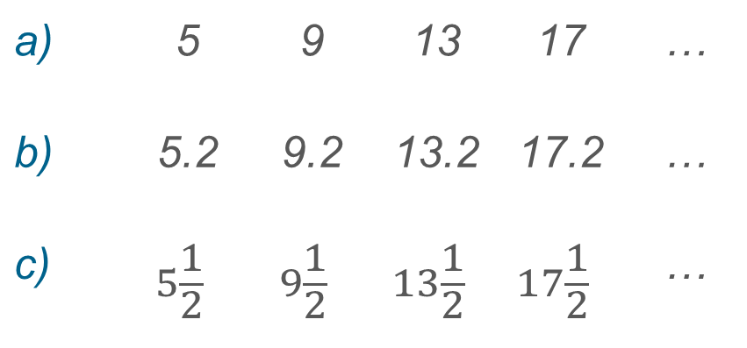
Appreciate that each term in an arithmetic sequence has the same structure and that the expression of that structure in terms of its position in the sequence is the nth term
Example 5
  Why might it be beneficial for students to work with sets of clearly related sequences?
  Design your own set of related sequences. What would you want students to notice?
What’s the same and what’s different about these sequences?
a) | 5 | 9 | 13 | 17 | …
b) | 5.2 | 9.2 | 13.2 | 17.2 | …
c) | $$5\frac{1}{2}$$ | $$9\frac{1}{2}$$ | $$13\frac{1}{2}$$ | $$17\frac{1}{2}$$ | …
Notes:
Due to space constraints, the image on this PD discussion slide is very small. PD Leads might like to use or print the ‘in the classroom’ version of this slide for teachers to access during discussions.
More detail about this example can be found on page 16 of the 4.1 Core Concept document.

Slide 28
Appreciate that each term in an arithmetic sequence has the same structure and that the expression of that structure in terms of its position in the sequence is the nth term
Example 6
What sequences of numbers are produced from the following nth terms?
  3n
  3n + 1
  3n + 2
  3n + 3
  3n + 4
Notes:
Suggested questioning:
Which sequences in this set are multiples of three?
Why are some sequences not multiples of three even though they go up in 3s?
Can you find some more nth terms that will result in generating multiples of three?
What nth term would generate a descending sequence of multiples of three?
Things for you to think about:
It will be important to draw students’ attention to what is the same and what is different in each of these sequences in order to help them become aware that, while multiples of three increase by three each time, sequences that increase by three do not necessarily contain multiples of three. Using representations such as the one pictured on page 17 of the 4.1 Core Concept document, will help students to see that every third diagram gives the set of multiples of three.
While carefully crafted explanations from the teacher may be useful for some students, other students may listen and watch passively without engaging with the thinking that is necessary. Therefore, it is vital that students are given the opportunity to use these diagrams themselves to support their own reasoning through whole-class dialogue and discussion. Avoid merely presenting these diagrams as a form of teacher demonstration.

Slide 29
Appreciate that each term in an arithmetic sequence has the same structure and that the expression of that structure in terms of its position in the sequence is the nth term
Example 6
What sequences of numbers are produced from the following nth terms?
  3n
  3n + 1
  3n + 2
  3n + 3
  3n + 4
  What do you want to draw students’ attention to here?
  What questions might you ask in order to do this?
  What representations might you use to model this?
Notes:
Due to space constraints, the image on this PD discussion slide is very small. PD Leads might like to use or print the ‘in the classroom’ version of this slide for teachers to access during discussions.
More detail about the sequencing of this example can be found on pages 17 and 18 of the 4.1 Core Concept document.

Slide 30
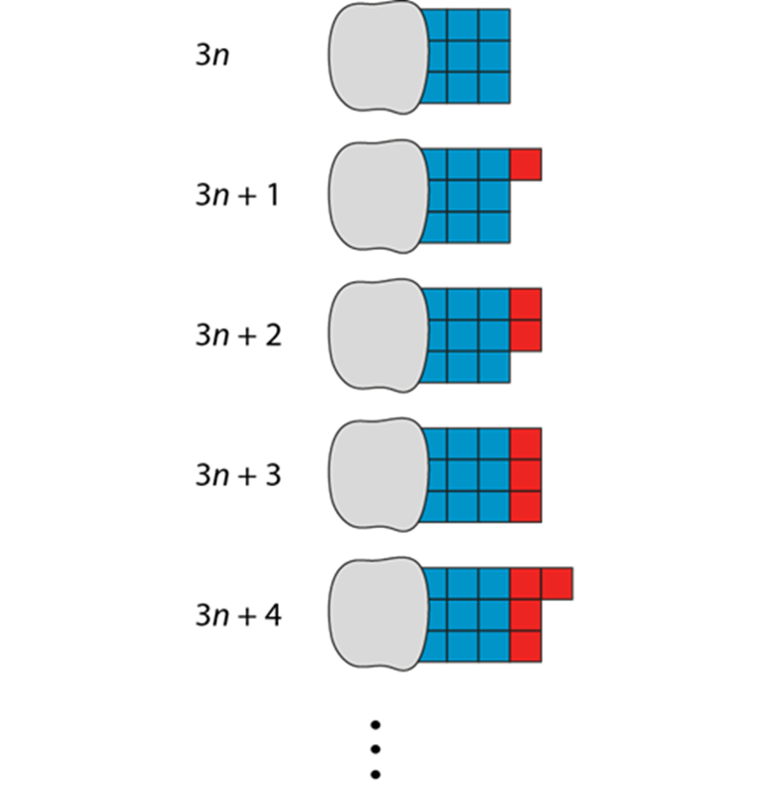
Appreciate that each term in an arithmetic sequence has the same structure and that the expression of that structure in terms of its position in the sequence is the nth term
Example 6a
What sequences of numbers are produced from the following nth terms?
  3n
  3n + 1
  3n + 2
  3n + 3
  3n + 4
  This is an example of a representation you might use.
  How would you plan to enable students to engage in the representations, rather than just being a form of teacher demonstration?
Notes:
Due to space constraints, the image on this PD discussion slide is very small. PD Leads might like to use or print the ‘in the classroom’ version of this slide for teachers to access during discussions.
More detail about the sequencing of this example can be found on pages 17 and 18 of the 4.1 Core Concept document.

Slide 31
Appreciate that each term in an arithmetic sequence has the same structure and that the expression of that structure in terms of its position in the sequence is the nth term
Example 7a and b
Mo thinks the nth term of the sequence
10, 6, 2, −2, … is 4n + 6.
Do you agree? Explain your reasoning.
Olivia thinks the nth term of the sequence
2, 7, 12, 17, … is n + 5.
Explain why Olivia is incorrect.
Notes:
Suggested questioning:
What does the 4 represent? What does the 6 represent? How could you change Mo’s nth term to be correct?
What is the coefficient of n in n + 5? What does it represent? What does the 5 represent? How could you change Olivia’s nth term to be correct?
Things for you to think about:
An aspect of variation is to vary ‘what it’s not’ (as well as what it is) to help students clarify the idea in their minds.
Example 7, part a) is designed to encourage students to notice that although the difference between the terms is four, the term-to-term rule is ‘subtract four’ rather than ‘add four’. The rule 4n + 6 will generate the 1st term correctly but will not generate subsequent terms accurately.
Part b) is designed to encourage students to pay attention to the position of each term in the sequence and not the term-to-term rule.

Slide 32
Appreciate that each term in an arithmetic sequence has the same structure and that the expression of that structure in terms of its position in the sequence is the nth term
Example 7c and d
c)
  0, 5, 10, 15, 20, …
  10, 15, 20, 25, ….
  −5, 0, 5, 10, 15, …
  −25, −20, −15, 10, −5, …
Liam thinks all the sequences can be described using the nth term ‘5n’ as they all ‘increase by 5’.
Do you agree? Explain your answer.
True or false?
The 10th term of the sequence 3, 7, 11, 15, 19, … is 38.
d)
Notes:
Suggested questioning:
What does the ‘5’ in ‘5n’ represent?
Why might someone think 38 is the 10th term of the sequence in d? What is a valid method for checking?
Things for you to think about:
An aspect of variation is to vary ‘what it’s not’ (as well as what it is) to help students clarify the idea in their minds.
Part c) is designed to encourage students to pay attention to the position of each term in the sequence and not the term-to-term rule.
Part d) is designed to highlight the misconception that the 10th term is twice the 5th term.

Slide 33
Appreciate that each term in an arithmetic sequence has the same structure and that the expression of that structure in terms of its position in the sequence is the nth term
Example 7
a)
Mo thinks the nth term of the sequence
10, 6, 2, −2, … is 4n + 6.
Do you agree? Explain your reasoning.
Olivia thinks the nth term of the sequence
2, 7, 12, 17, … is n + 5.
Explain why Olivia is incorrect.
c)
  0, 5, 10, 15, 20, …
  10, 15, 20, 25, ….
  −5, 0, 5, 10, 15, …
  −25, −20, −15, 10, −5, …
Liam thinks all the sequences can be described using the nth term ‘5n’ as they all ‘increase by 5’.
Do you agree? Explain your answer.
True or false?
The 10th term of the sequence 3, 7, 11, 15, 19, … is 38.
b)
d)
Notes:
This is a version of example 7 on one slide; it might be more suited to printing. See the previous two slides for suggested questions and prompts to think about.

Slide 34
Appreciate that each term in an arithmetic sequence has the same structure and that the expression of that structure in terms of its position in the sequence is the nth term
Example 7
a)
Mo thinks the nth term of the sequence
10, 6, 2, −2, … is 4n + 6.
Do you agree? Explain your reasoning.
Olivia thinks the nth term of the sequence
2, 7, 12, 17, … is n + 5.
Explain why Olivia is incorrect.
c)
  0, 5, 10, 15, 20, … 10, 15, 20, 25, ….
  −5, 0, 5, 10, 15, … −25, −20, −15, 10, −5, …
Liam thinks all the sequences can be described using the nth term ‘5n’ as they all ‘increase by 5’.
Do you agree? Explain your answer.
True or false? The 10th term of the sequence 3, 7, 11, 15, 19, … is 38.
b)
d)
  What features of the nth term are being highlighted here? What questions might you want to ask to make the most of these questions?
  Construct other ‘what it’s not’ examples that highlight the importance of identifying the position of a term in a sequence.
Notes:
Due to space constraints, the image on this PD discussion slide is very small. PD Leads might like to use or print the ‘in the classroom’ version of this slide for teachers to access during discussions.
More detail about the sequencing of this example can be found on page 18 of the 4.1 Core Concept document.

Slide 35
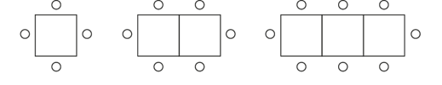
Solve familiar and unfamiliar problems, including real-life applications
Example 8
Each table seats 4 people. The diagram below shows how many people can be seated around different numbers of tables when they are put together.
How many chairs are needed for 15 tables?
What is the largest number of tables needed for 37 chairs?
Notes:
Suggested questioning:
What stays the same each time? What is different?
How many more chairs are needed for every table?
How could you describe this using a term-to-term rule? How could you describe this using a position-to-term rule?
Things for you to think about:
Problems provide opportunities for students to intelligently practise their understanding of a concept (rather than mechanical repetition), to focus on relationships – not just the procedure – and make connections. How might you draw students’ attention to the 2 being added each time?

Slide 36
Solve familiar and unfamiliar problems, including real-life applications
Example 8
  How might you support students who are struggling to connect their learning on the nth term with this example?
  What other contexts are there where there is a genuine need to calculate the nth term of a linear sequence?
  To what extent does it matter if the contexts are genuine or contrived?
Each table seats 4 people. The diagram below shows how many people can be seated around different numbers of tables when they are put together.
How many chairs are needed for 15 tables?
What is the largest number of tables needed for 37 chairs?
Notes:
Due to space constraints, the image on this PD discussion slide is very small. PD Leads might like to use or print the ‘in the classroom’ version of this slide for teachers to access during discussions.
This example can be found on page 18 of the 4.1 Core Concept document.

Slide 37
Solve problems where there is more than one answer and where there are elements of experimentation, investigation, checking, reasoning, proof, etc
Example 9
Two sequences are given by the nth terms 4n + 6 and 6n − 3. Is the following statement true or false?
‘There is at least one number that is in both sequences.’
Construct a convincing argument to support your answer.
Notes:
Suggested questioning:
What will be the first number in each sequence? What will be the second number?
How do you know whether the same number is in both sequences? Can you convince me? Can you convince me a different way?
(Once it has been established they don’t share a term) Can you change one of the nth terms so that they DO share a term?
Things for you to think about:
For students who have demonstrated a secure understanding of finding the nth term of a linear sequence, you could encourage them to go deeper by solving more complex problems, such as exploring all possibilities, creating their own examples and testing conjectures. For problems such as Example 9, students could be encouraged to find a convincing argument or proof.

Slide 38
Solve problems where there is more than one answer and where there are elements of experimentation, investigation, checking, reasoning, proof, etc
Example 9
  How might you structure this task in the classroom?
  How will you model this to students? What different approaches might they take?
Two sequences are given by the nth terms 4n + 6 and 6n − 3. Is the following statement true or false?
‘There is at least one number that is in both sequences.’
Construct a convincing argument to support your answer.
Notes:
More detail about this example can be found on page 19 of the 4.1 Core Concept document.

Slide 39
Solve problems where there is more than one answer and where there are elements of experimentation, investigation, checking, reasoning, proof, etc
Example 10
a)
One term of a linear sequence is 3 and another term is 8. The nth term of a linear sequence is an ± b.
Find possible values for a and b.
One term of a linear sequence is −2 and another term is 1.5. The nth term of a linear sequence is xn + y.
Find possible values for x and y.
b)
Notes:
Suggested questioning:
What could the first term be? Could there be a term between the two terms you’ve been given?
How many different ways can you answer this question? Can you create a decreasing sequence?
Things for you to think about:
For problems such as example 10, students could be encouraged to find non-integer values and ‘unique’ solutions (i.e. ones that no one else in the class will find!).

Slide 40
Solve problems where there is more than one answer and where there are elements of experimentation, investigation, checking, reasoning, proof, etc
Example 10
  What answers might your students give you here?
  How can you encourage them to find alternative solutions?
  What might you learn about their understanding of the nth term from this task?
a)
One term of a linear sequence is 3 and another term is 8. The nth term of a linear sequence is an ± b.
Find possible values for a and b.
One term of a linear sequence is −2 and another term is 1.5. The nth term of a linear sequence is xn + y.
Find possible values for x and y.
b)
Notes:
Due to space constraints, the image on this PD discussion slide is very small. PD Leads might like to use or print the ‘in the classroom’ version of this slide for teachers to access during discussions.
More detail about this example can be found on page 19 of the 4.1 Core Concept document.

Slide 41
Reflection questions
What other mathematical concepts will be supported by students’ stronger understanding of this key idea?
What mathematical language will you continue to use to support pupils to make connections with other areas?
Which representations might you continue to use to further develop students’ understanding?

Slide 43
Appendices
You may choose to use the following slides when planning or delivering a PD session. They cover:
  Key vocabulary
  Representations and structure
  Previous learning
  Future learning
  Library of links

Slide 44
Key vocabulary (1)
Term | Definition
arithmetic sequence | A sequence of numbers in which successive terms are generated by adding or subtracting a constant amount to/from the preceding term. Example 1: 3, 11, 19, 27, 35, …, where 8 is added. Example 2: 4, −1, −6, −11, …, where 5 is subtracted (or −5 has been added). The sequence can be generated by giving one term (usually the first term) and the constant that is added (or subtracted) to give the subsequent terms. Also called an ‘arithmetic progression’.
cube number | A number that can be expressed as the product of three equal integers. Example: 27 = 3 × 3 × 3. Consequently, 27 is a cube number. It is the cube of 3 or 3-cubed. This is written compactly as 27 = 3³, using index (or power) notation.
geometric sequence | A series of terms in which each term is a constant multiple of the previous term (known as the common ratio) is called a geometric sequence, sometimes also called a ‘geometric progression’. Example 1: 1, 5, 25, 125, 625, …, where the constant multiplier is 5. Example 2: 1, −3, 9, −27, 81, …, where the constant multiplier is −3. A geometric sequence may have a finite number of terms or it may go on forever, in which case it is an infinite geometric sequence. In an infinite geometric sequence with a common ratio strictly between zero and one, all the terms add to a finite sum.

Slide 45
Key vocabulary (2)
Term | Definition
nth term of a sequence | This is the name for the term that is in the nth position starting the count of terms from the first term. The nth term is sometimes represented by the symbol u_{n}.
prime number | A whole number greater than one that has exactly two factors: itself and one. Examples: 2 (factors 2, 1), 3 (factors 3, 1). 51 is not prime (factors 51, 17, 3, 1).
sequence | A succession of terms formed according to a rule. There is a definite relation between one term and the next and between each term and its position in the sequence. Example: 1, 4, 9, 16, 25, …
square number | A number that can be expressed as the product of two equal numbers. Example: 36 = 6 × 6 and so 36 is a square number or ‘6 squared’. A square number can be represented by dots in a square array.
term | A term is either a single number or variable, or the product of several numbers or variables. Terms are separated by a + or − sign in an overall expression. Example: In 3 + 4x + 5yzw; 3, 4x and 5yzw are three separate terms.

Slide 46
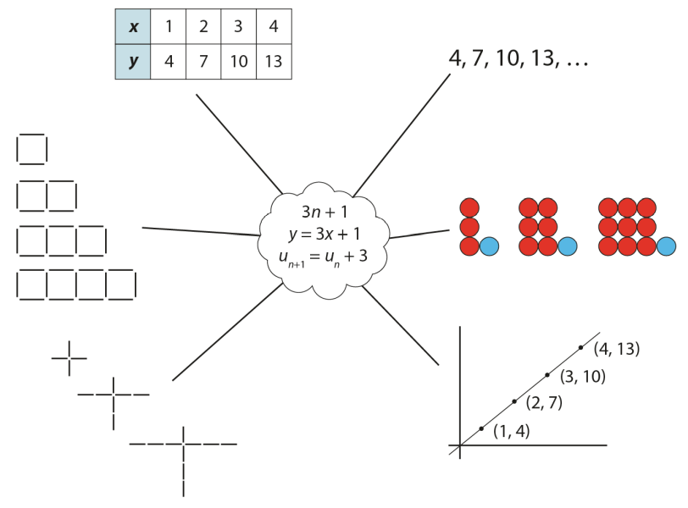
Representations and structure
There are a number of different representations that you may wish to use to support students’ understanding of this key idea. These might include:
Tables of values, graphs, sequences and structured pictorial arrangements
  It is important for students to see multiple representations of the same structure, as in the diagram, and to connect them.
  Prompts such as ‘Where is the 3 in this representation?’ and ‘Where is the 1?’ can support students in making these connections and understanding that each representation has the same underpinning structure.
Notes:
More information about the representations and structure involved in this key idea can be found:
On page 5 of the 4 Sequences and Graphs Theme Overview document.
Links can be found on the final slide.

Slide 47
Previous learning
From Upper Key Stage 2, students will bring experience of:
using simple formulae
generating and describing linear number sequences
describing positions on the full coordinate grid (all four quadrants).
Notes:
Theme 4 Sequences and graphs

Slide 48
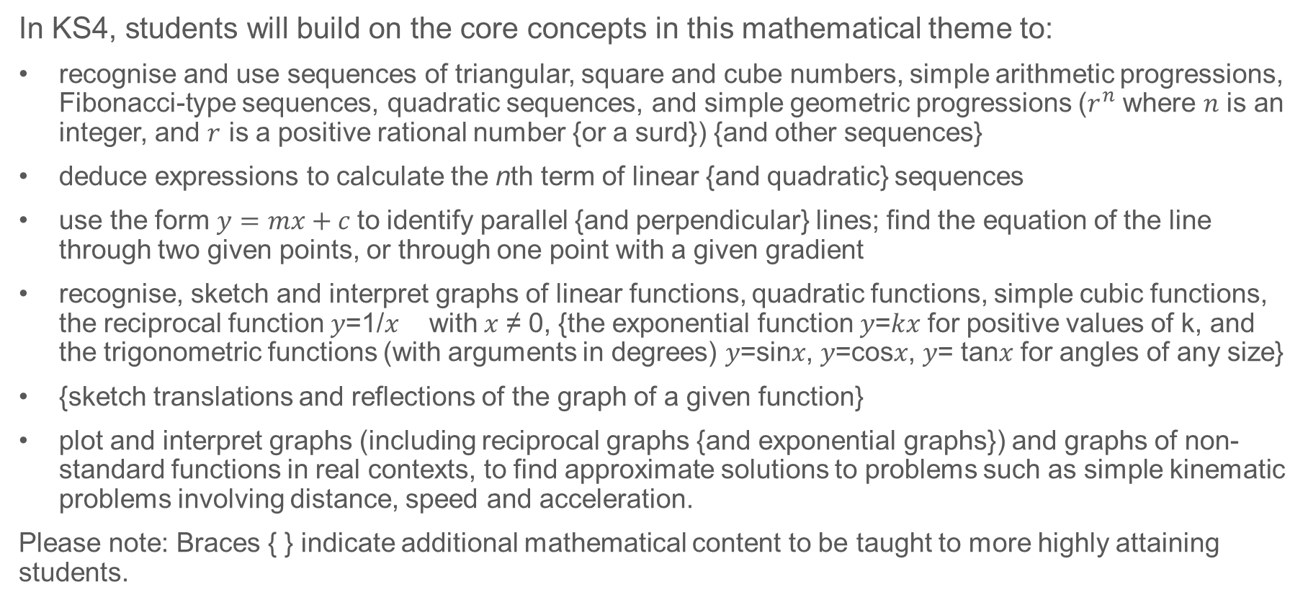
Future learning
In KS4, students will build on the core concepts in this mathematical theme to:
recognise and use sequences of triangular, square and cube numbers, simple arithmetic progressions, Fibonacci-type sequences, quadratic sequences, and simple geometric progressions ($r^{n}$ where $n$ is an integer, and $r$ is a positive rational number {or a surd}) {and other sequences}
deduce expressions to calculate the nth term of linear {and quadratic} sequences
use the form $y=mx+c$to identify parallel {and perpendicular} lines; find the equation of the line through two given points, or through one point with a given gradient
recognise, sketch and interpret graphs of linear functions, quadratic functions, simple cubic functions, the reciprocal function 𝑦=1/𝑥 with 𝑥 ≠ 0, {the exponential function 𝑦=𝑘𝑥 for positive values of k, and the trigonometric functions (with arguments in degrees) 𝑦=sin⁡𝑥, 𝑦=cos⁡𝑥, 𝑦= tan⁡𝑥 for angles of any size}
{sketch translations and reflections of the graph of a given function}
plot and interpret graphs (including reciprocal graphs {and exponential graphs}) and graphs of non-standard functions in real contexts, to find approximate solutions to problems such as simple kinematic problems involving distance, speed and acceleration.
Please note: Braces { } indicate additional mathematical content to be taught to more highly attaining students.
Notes:
Theme 4 Sequences and graphs

Slide 49
Library of links
The following resources from the NCETM website have been referred to within this slide deck:
  NCETM Secondary Mastery Professional Development
    4 Sequences and Graphs Theme Overview Document
    4.1 Sequences Core Concept Document
    1.2 Properties of number Core Concept Document
    1.4 Simplifying and manipulating expressions, equations and formulae Core Concept Document
  NCETM primary mastery professional development materials
  NCETM primary assessment materials

