Slide 1
Numberblocks
Support Materials
Series 2, Episode 10
The Three Threes

Slide 2
Practitioner Notes

Slide 3
Episode Description
Four’s kite gets stuck in a tree and Nine isn’t tall enough to get it down. He runs and falls over. He then splits into the Three Threes, moustached circus performers, who swing on high trapezes and catch each other to rescue the kite. Ten arrives, carrying balloons, and loses them to the wind. Again, Nine turns into the Three Threes, who do trampolining tricks to rescue the balloons. Finally, One can’t open a jar of honey so the Three Threes each perform an unlikely stunt - one is shot from a cannon, one does a high-dive and one does a tricycle jump. They crash in mid-air and reform to make Nine, who opens the jar with a simple twist.

Slide 4
Maths in the Episode
An inverse relationship
In this episode we see Nine partition into 3 equal parts/groups of 3 and then recombine to make Nine again. This represents an inverse relationship which can be described as ‘a doing and an undoing’ – nine is split into 3 Threes and the 3 Threes combine to put Nine back together.
Partitioning Nine into 3 Threes
A special property of Nine is that he can partition into 3 Threes and is therefore a square number.

Slide 5
Using Mathematical Language
During this episode children will experience combining 3 threes to make nine and partitioning nine to make 3 threes.
Use these sentences to describe what they see happening:
“I see 3 threes”
“3 and another 3 and another 3 are 9”
“3 threes are nine”
“Nine is made from 3 equal groups of 3.”

Slide 6
Talk and Discuss Together

Slide 7
Talk and Discuss Together
Watch the episode of Numberblocks. First ask the children what they noticed and allow them to talk to you and each other. The following slides are designed to stimulate children and adults to talk about the episode and draw out some key aspects of the mathematics.

Slide 8
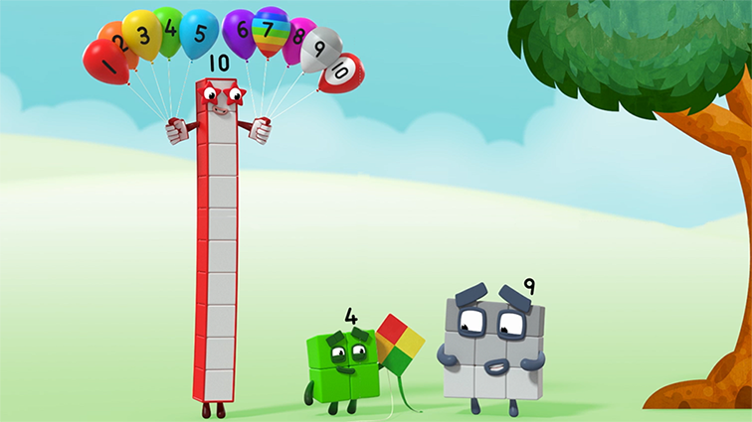
Images © 2017 Alphablocks Ltd. All Rights Reserved.
Notes:
Discuss the episode. What did you notice?
How did they get the kite down from the tree?
Has anyone been to a circus and seen trapeze artists?
Has anyone flown a kite on a windy day?

Slide 9


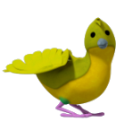


Images © 2017 Alphablocks Ltd. All Rights Reserved.
Notes:
What do you see? 9 birds. 3 birds in each tree. 3 trees. 3 groups of 3 birds. 3 groups of 3.
This slide is animated and shows the birds flying from each tree, one at a time.
What has happened to the birds?
The slide prepares the images for the next slide.

Slide 10


Images © 2017 Alphablocks Ltd. All Rights Reserved.
Notes:
What do you see?
This slide is animated.
Use this slide to experience how 3 Threes combine to make Nine.
Use children to act out this problem. Ask 9 children to pretend they are birds. Stand in groups of 3 in some PE hoops to represent the tree.
Each group takes turns to jump out of the hoop to form a row or column of the square.
Practise describing the slide and the children’s acting out, using the sentence:
“I see 3 Threes.”

Slide 11
Enabling Environments

Slide 12
Enabling Environments
Playing and Exploring
Create a den for 3 bears. Provide each bear with 3 different things, e.g. a bowl, a spoon and a pillow.
Invent a game using three PE hoops and 9 beanbags. Choose a bonus score or prize for getting 3 bean bags in each hoop.
Active Learning
Notice how children use and talk about quantities of equal groups. Can they use the language of, for example, “3 threes” to describe a collection?
Creating and Thinking Critically
Decorate 3 cookies each. Make them identical by choosing 3 of 3 kinds of decoration.

Slide 13
Learning Together in Y1

Slide 14
Images © 2017 Alphablocks Ltd. All Rights Reserved.
Notes:
Discuss the episode. What did you notice?
What was the episode about?
How did they get the kite down from the tree?
Has anyone been to a circus and seen trapeze artists?

Slide 15





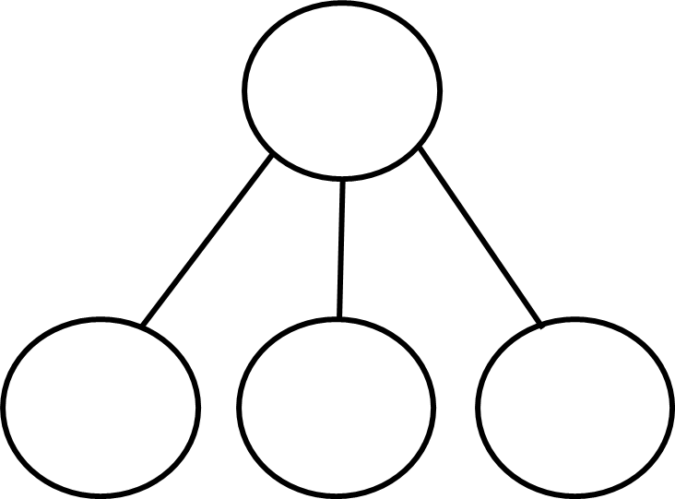
Images © 2017 Alphablocks Ltd. All Rights Reserved.
Notes:
Use this slide to discuss how 9 can be expressed as 3 threes or 3 + 3 + 3.
This slide is animated.
Click 1 animates the partitioning of Nine into 3 threes: 3 horizontal threes appear overlaid on Nine. They each jump to the right to form a new 3 x 3 array. The array rolls to the right by half a turn so the 3 threes match the colouring of Nine.
Clicks 2,3,4,5: the part-part-whole model appears with 9 as the whole and 3 parts with missing information. What will go in each part to tell the story of Nine that we have seen in the episode?
How could we write this as an equation?
Click 6: equation revealed. Read it together.
Practise using the sentences in slide 5.

Slide 16
Images © 2017 Alphablocks Ltd. All Rights Reserved.
Notes:
Use this slide to discuss how 9 can be expressed as 3 threes or 3 + 3 + 3.
This slide is animated:
Click 1 & 2 animate the partitioning of Nine into 3 threes: 3 vertical threes appear overlaid on Nine. They each jump to the right to form a new 3 x 3 array. What’s the same and what’s different about how Nine has been partitioned?
Click 3,4,5,6: the part-part-whole model appears with 9 as the whole and 3 parts with missing information. What will go in there to tell the story of Nine that we have seen in the episode?
How could we write this as an equation?
Click 7: equation revealed. Read it together.
What’s the same, what’s different about the previous slide? (There were nine blocks, there were 3 groups of 3 blocks, the three groups went along (horizontal) in the previous slide, the three groups were upright (vertical) in this slide.)
So, however Nine is arranged or partitioned into equal groups, there will always be 3 groups of 3.

Slide 17
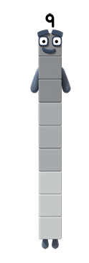
Images © 2017 Alphablocks Ltd. All Rights Reserved.
Notes:
Use this slide to discuss how 9 can be expressed as 3 threes or 3 + 3 + 3.
This slide is animated.
Click 1 animates the partitioning of Nine as a tower into 3 Threes: 3 vertical Threes appear overlaid on Nine. They each jump to the right to form a 3 x 3 array.
Click 2,3,4,5: the part-part-whole model appears with 9 as the whole and 3 parts with missing information.
What will go in there to tell the story of Nine that we have seen in the episode? How could we write this as an equation?
Click 6: equation revealed. Read it together.
What’s the same, what’s different about the previous slides?
So, however Nine is arranged or partitioned into equal groups, there will always be 3 groups of 3.

Slide 18
Images © 2017 Alphablocks Ltd. All Rights Reserved.
Notes:
Use this slide to confirm that the 3 threes don’t always have to be in lines.
What do you see? 3 threes:
3 yellow
3 pink
3 blue
Could we shade 3 threes in a different way? Discuss a few other possible ways of shading with 3 colours, 3 blocks of the same colour.

Slide 19
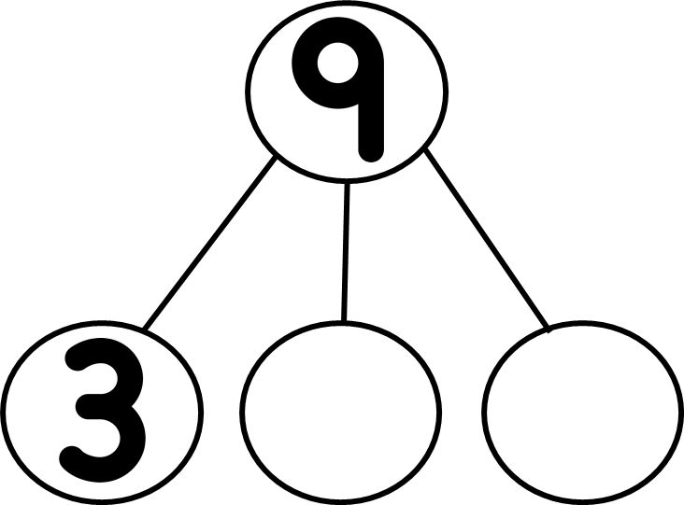
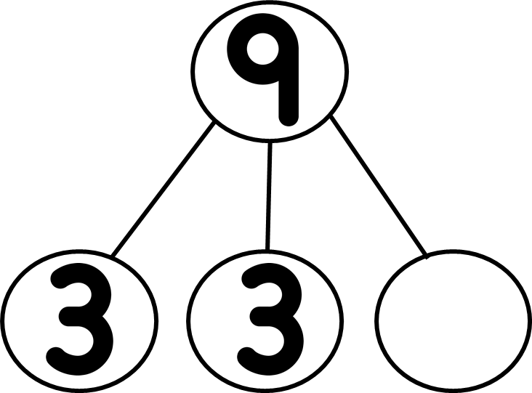


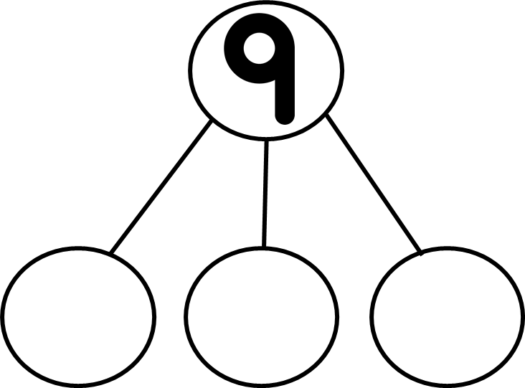


Notes:
Ask the children to work independently on this task. Can they find ways to shade 3 threes using green, red, yellow?
Ask children to share their work and confirm their answers and ideas.

