Slide 1
Visual images to support pupils to make sense of proportional problems
  Supporting pupils to represent problems and justify approaches and solutions through the use of appropriate visual images.
  In particular the use of:-
    Bar
    double number line
    ratio tables.
Notes:
Draw a diagram!
The theme is pupils making sense of problems
And drawing a diagram is a key strategy
And not just any diagrams but moving pupils towards diagrams that are particularly fruitful in modelling proportional problems
Bar, DNL, ratio tables…
There are some people who believe that as a general strategy this alone can make an immediate difference to pupils ability to solve problems, improving their resilience. June tests may or may not show this, however the main focus is the professional development of the teachers
– the careful development of these models with children so they become the basis of them making sense of problems seeing the connections between them through the use of the same underlying models and to deepen the understanding of the maths involved is the focus of the subject knowledge and pedagogy for teachers professional development
The idea is to give pupils and teachers a powerful tool and coherent framework for developing understanding in these areas –connections, problem solving and the basis for addressing the maths and issues that underpin this that pupils find difficult
Clearly this does bring together research and effective practices from high performing countries.
The lessons also outline the background research that has influenced the design the approaches in the lesson as part of the PD in SK.
In our workshops many teachers have told us:
Diagrams are often restricted to pizza diagrams and fraction walls
These are often used simply as an instructional device
Many misconceptions arise from the incorrect or over interpretation
Further possible points-
Yes recognised as best practice but not common practice. This on its own does not address the all that needs to be done though some of the key issues and difficulty are addressed it isn’t a project that attempts to systematically do that but does set the scene and need for that to be done
Exciting and participative

Slide 2
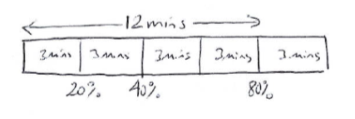
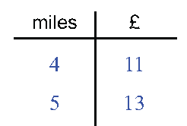
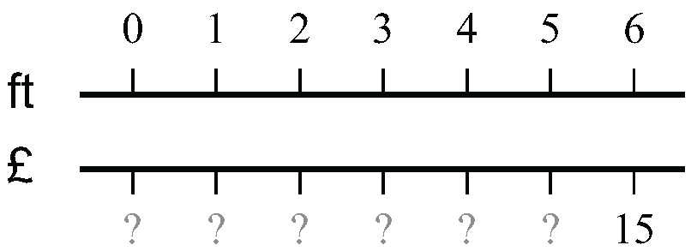
    Bar - Double number line - Ratio table.

Slide 3
