Slide 1
Choosing appropriate statistical measures
KS3 Mastery PD Materials: Exemplified Key Ideas
Materials for use in the classroom or to support professional development discussions
(from 5.2 Statistical analysis)
Summer 2021

Slide 2
About this resource
These slides are designed to complement the 5.2 Statistical analysis Core Concept document and its associated Theme Overview document 5 Statistics and probability, both found in the Secondary Mastery Professional Development pages.
These slides re-present the key examples from the Core Concept document so that the examples can be used either directly in the classroom or with a group of teachers. There are prompt questions alongside the examples, and further clarification in the notes.
These slides do not fully replicate the Core Concept document, so should be used alongside it. Reference to specific page numbers, and to other useful NCETM resources, can be found in the notes for each slide.
This slide deck is not designed to be a complete PD session, rather it is a selection of resources that you can adapt and use as needed when planning a session with a group of teachers.

Slide 3


About this resource
The slides are structured as follows:
  The big picture:
    Where does this fit in?
    What do students need to understand?
    Why is this key idea important?
  Prior learning
  Misconceptions
  Exemplified key ideas
  Reflection questions
  Appendices:
    Key vocabulary
    Representations and structure
    Previous and Future learning
    Useful links
The exemplified key idea slides have the following symbols to indicate how they have been designed to be used:
Into the classroom
The examples are presented on these slides so that they could be used in PD, but also directly in the classroom. The notes feature suggested questions and things teachers might consider when using with students.
PD discussion prompts
These slides look at the examples in more detail, with question prompts to promote discussion among maths teachers. The notes feature reference to further information and guidance within the Core Concepts document.

Slide 4
Where does this fit in?
The NCETM has identified a set of six ‘mathematical themes’ within Key Stage 3 mathematics that bring together a group of ‘core concepts’.
The fifth of these themes is Statistics and probability, which covers the following interconnected core concepts:
    5.1 Statistical representations and measures
    5.2 Statistical analysis
    5.3 Probability
Notes:
Linked on this slide is the Theme Overview document of Statistics and probability.. This document includes why it is important, the key underpinning knowledge and links to prior and future learning. There is also guidance about how the five big ideas of Teaching for Mastery relate specifically to this theme.

Slide 5
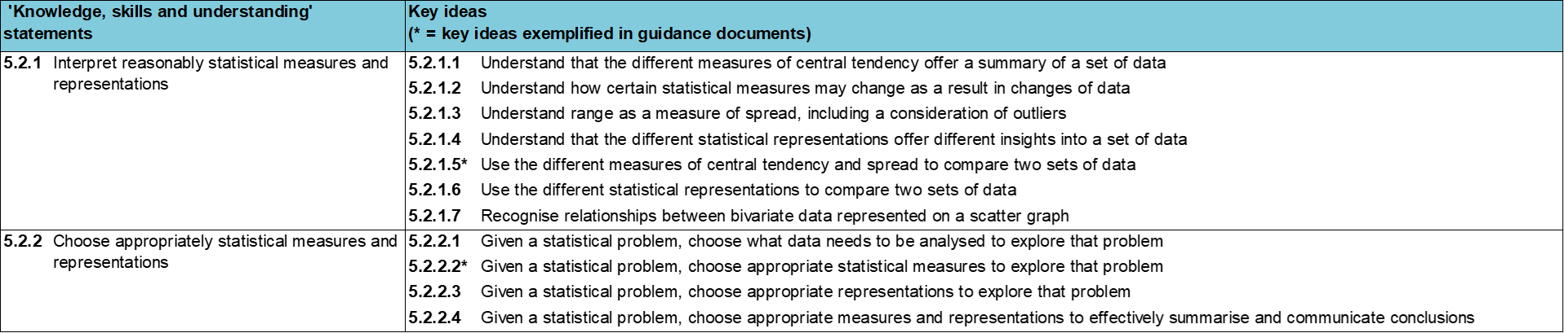
Where does this fit in?
Within this core concept, 5.2 Statistical analysis, there are two statements of knowledge, skills and understanding.
These, in turn, are broken down into eleven key ideas. The highlighted key idea is exemplified in this slide deck.
Notes:
For key ideas marked with an asterisk, we exemplified the common difficulties and misconceptions that students might have and included elements of what teaching for mastery may look like. We have provided examples of possible student tasks and teaching approaches.
Within these slides are ‘classroom-ready’ versions of the examples for the key idea that has been highlighted. There are also slides that may be useful for discussion in a professional development session.

Slide 6
What do students need to understand?
5.2.2.2 Given a statistical problem, choose appropriate statistical measures to explore that problem
Explain why a certain average is the best choice of measure of central tendency.
Explain why certain statistical measures give a better measure of dispersion.
  What prior knowledge might your students already have?
  What language might they use to describe this key idea?
  What questions might you want to ask to assess their prior learning?

Slide 7
Why is this key idea important? (1)
A key skill for students to develop at Key Stage 3 is the ability to make an informed choice of what statistical analysis and representation to use for discrete, continuous and grouped data. Being able to construct representations and calculate values that indicate a measure of central tendency or measure of spread is important in order to represent and summarise data accurately.
Just as important is the need for students to be able to make an informed choice about what statistical tools to use, and understand the effect that these choices have on the interpretation, and misinterpretation, of data, including the potential impact of outliers.
Students should be presented with summary data to interrogate, so they can appreciate the limitations of such information when the raw data is no longer available. Dealing with inaccuracies, outliers and other contextual issues will give students a greater appreciation of the realistic nature of statistical analysis.
Students should appreciate the differences between a frequency-based chart (such as a bar chart or pictogram) and a proportional chart (such as a pie chart) and how different aspects of the data can, and cannot, be inferred from each.
Notes:
A more detailed overview of the core concept of statistical analysis can be found on page 2 of the 5.3 Core Concept document.
The background to each key idea is also explored in more detail on the following pages:
5.2.1 Interpret reasonably statistical measures and representations – page 9
5.2.2 Choose appropriately statistical measures and representations– pages 9-10

Slide 8
Why is this key idea important? (2)
Situations that require statistical techniques to be employed will probably begin with an issue, a question or a problem. These situations require a number of decisions to be made:
  Which data do I need to collect?
  How will I organise this data?
  How will I analyse this data in order to address the original question/problem?
  Which representation should I choose in order to address the original question/problem and communicate clearly my findings?
Students should have the opportunity to consider all of these aspects at different stages of their work on statistics. The use of real-life contexts and issues are important to give statistics meaning.
Students should be given opportunities to solve problems that do not necessarily have a correct answer, but be required to justify decisions made and be prepared to be challenged.
Notes:
A more detailed overview of the core concept of statistical analysis can be found on page 2 of the 5.3 Core Concept document.
The background to each key idea is also explored in more detail on the following pages:
5.2.1 Interpret reasonably statistical measures and representations – page 9
5.2.2 Choose appropriately statistical measures and representations– pages 9-10

Slide 9
Prior learning
Upper Key Stage 2 Learning Outcome
Interpret and present discrete and continuous data using appropriate graphical methods, including bar charts and time graphs
Solve comparison, sum and difference problems using information presented in bar charts, pictograms, tables and other graphs
Solve comparison, sum and difference problems using information presented in a line graph
Complete, read and interpret information in tables, including timetables
Interpret and construct pie charts and line graphs and use these to solve problems
Calculate and interpret the mean as an average
  What prior knowledge might your students already have?
  What language might they use to describe this key idea?
  What questions might you want to ask to assess their prior learning?
Notes:
You may find it useful to speak to your partner schools to see how the above has been covered and the language used.
You can find further details regarding prior learning in the following segments of the NCETM primary mastery professional development materials (linked on final slide):
• Year 2: 1.12 Subtraction as difference
• Year 3: 1.17 Composition and calculation: 100 and bridging 100
• Year 5: 1.27 Negative numbers: counting, comparing and calculating
• Year 6: 2.26 Mean average and equal shares
Within the Statistics and Probability Theme Overview document, you can also find a broader description of students’ potential previous learning (page 4), alongside further information about key underpinning knowledge (page 2).

Slide 10
Prior learning
  What representations might your students already be familiar with?
  What language might they use?
  How does this fit in with your curriculum progression?
Key Stage 3 Learning Outcome
5.1.1 Understand and calculate accurately measures of central tendency and spread
5.1.2 Construct accurately statistical representations
Please note: Numerical codes refer to statements of knowledge, skills and understanding in the NCETM breakdown of Key Stage 3 mathematics.

Slide 11
Checking prior learning
The following slides contain questions for checking prior learning.
  What representations might students use to support their understanding of these questions?
  What variation might you put in place for these questions to fully assess students’ understanding of the concept?
  How might changing the language of each question change the difficulty?
  Why are these such crucial pre-requisites for this key idea?

Slide 12
Checking prior learning (1)
a) Ten pupils take part in some races on Sports Day, and the following times are recorded.
Time to run 100m (seconds):
  23, 21, 21, 20, 21, 22, 24, 23, 22, 20.
Time to run 100m holding an egg and spoon (seconds):
  45, 47, 49, 43, 44, 46, 78, 46, 44, 48.
Time to run 100m in a three-legged race (seconds):
  50, 83, 79, 48, 53, 52, 85, 81, 49, 84.
  Calculate the mean average of the times recorded in each race.
  For each race, do you think that the mean average of the times would give a useful summary of the ten individual times? Explain your decision.
Notes:
The above activity offers a useful idea for assessment, which you can use in your classes to check whether prior understanding is secure.
References to the questions (links on final slide):
a) NCETM primary assessment materials: Year 6 page 38

Slide 13
Common difficulties and misconceptions
What aspects of this key idea might students find challenging?
What misconceptions might students have?
When teaching this topic, you may find students encounter difficulties with…
Not appreciating the subtle differences between different averages
Confusing range with measures of central tendency
More information, and some suggestions for overcoming these challenges, can be found on the following slides.

Slide 14
Common difficulties and misconceptions (1)
Students may think that all statistical measures are equally valid and do not appreciate the subtle differences between them. For example, students may see the mode as too simplistic and not understand that it can be used for qualitative data, whereas mean and median cannot.
Students need to understand that the mean is a way of ‘evening out’ the data (keeping the total the same but distributing everything evenly), but does not give a good measure of central tendency when there are extreme outliers or the data set is very skewed. The median is useful if the data is evenly spaced, but may give a distorted view of the data if not.
Notes:
This can be found on page 18 of the 5.2 Core Concept document.

Slide 15
Common difficulties and misconceptions (2)
Students often confuse the range with measures of central tendency.
Representing the data as points on a number line can help students to have a visual sense of the range and so more easily distinguish it from a measure of central tendency. When considering data sets with extreme outliers, it is helpful to ask students to consider what might be a more appropriate way of measuring how dispersed the data set is by ignoring the extremes and trying to measure the spread of the middle portion. This can provide a foundation for later study involving inter-quartile range and box plots in Key Stage 4.
Notes:
This can be found on page 18 of the 5.2 Core Concept document.

Slide 16
Explain why a certain average is the best choice of measure of central tendency
Example 1
Consider the following data sets on property for a given geographical area:
    Average type of property
    Average number of bedrooms
    Average property price
For which data set would the mode be an appropriate average to use?
For which data set would the mean be an appropriate average to use?
Notes:
Suggested questioning:
Can you calculate all three averages for all three examples? Why or why not?
When might the mean NOT be an appropriate measure to use? Why?
Things for you to think about:
Example 1 is designed so that two of the examples are quantitative and one qualitative to encourage students to notice that the mode is the only average that may be possible with qualitative data and that the mean is usually the best measure of central tendency to use when the data distribution is continuous and symmetrical.

Slide 17
Explain why a certain average is the best choice of measure of central tendency
Example 1
  Students are often presented with questions about the mode, the mean and the median simultaneously. What are the advantages and disadvantages of asking students to calculate all three measures?
Consider the following data sets on property for a given geographical area:
    Average type of property
    Average number of bedrooms
    Average property price
For which data set would the mode be an appropriate average to use?
For which data set would the mean be an appropriate average to use?
Notes:
Due to space constraints, the image on this PD discussion slide is very small. PD Leads might like to use or print the ‘in the classroom’ version of this slide for teachers to access during discussions.
More detail about this example can be found on page 18 of the 5.2 Core Concept document.

Slide 18
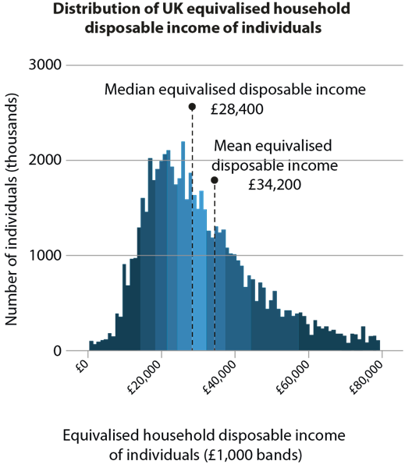
Explain why a certain average is the best choice of measure of central tendency
Example 2
This graph is produced by the Office for National Statistics. It shows the distribution of UK household disposable income for the financial year ending 2018.
When comparing household disposable incomes, why is the median often preferred over the mean to represent the ‘typical’ income?
Source: Office for National Statistics
Public sector information licensed under the Open Government Licence v3.0
Notes:
Suggested questioning:
Why might the mean be higher than the median in this data set? Which is more representative?
What is the mode of this data set?
Things for you to think about:
Example 2 is designed to encourage students to notice that the median is an appropriate measure when the data is skewed or distorted by outliers.
(Note that the mode falls in the £26 000 to £27 000 bracket.)
https://www.ons.gov.uk/

Slide 19
Explain why a certain average is the best choice of measure of central tendency
Example 2
  What language might you use to explain how this distribution affects the mean/median?
  Some real contexts are more accessible to students than others. What other data sets would be relevant to your class?
This graph is produced by the Office for National Statistics. It shows the distribution of UK household disposable income for the financial year ending 2018.
When comparing household disposable incomes, why is the median often preferred over the mean to represent the ‘typical’ income?
Source: Office for National Statistics
Public sector information licensed under the Open Government Licence v3.0
Notes:
Due to space constraints, the image on this PD discussion slide is very small. PD Leads might like to use or print the ‘in the classroom’ version of this slide for teachers to access during discussions.
More detail about the sequencing of this example can be found on page 19 of the 5.2 Core Concept document.

Slide 20
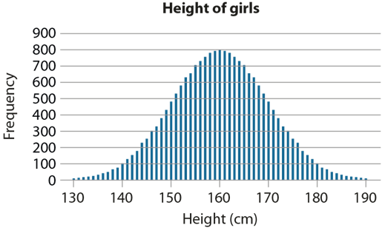
Explain why a certain average is the best choice of measure of central tendency
Example 3
What would be the best average to choose to represent the height of a ‘typical’ girl?
Notes:
Suggested questioning:
Where do you think the modal height might be on this graph? Why?
Where do you think the median is? Why?
Can you say anything about the mean in this sort of distribution? Explain your reasoning.
What do you notice about the shape of this graph? Why do you think this is?
Things for you to think about:
Example 3 encourages students to think more deeply about the meaning of the three averages (mean, median and mode). Note, in a normal distribution like this, the mode, median and mean all have the same value.

Slide 21
Explain why a certain average is the best choice of measure of central tendency
Example 3
What would be the best average to choose to represent the height of a ‘typical’ girl?
  How does using the normal distribution support students’ understanding of the structure of mean, median and mode?
  What questions might you ask to ensure students have understood this graph?
Notes:
Due to space constraints, the image on this PD discussion slide is very small. PD Leads might like to use or print the ‘in the classroom’ version of this slide for teachers to access during discussions.
More detail about this example can be found on page 19 of the 5.2 Core Concept document.

Slide 22
Explain why certain statistical measures give a better measure of dispersion
Example 4
Two friends play a darts game and record their scores.
  Debbie: 5, 1, 5, 6, 6, 5, 6, 5, 8, 5
  Eddie: 4, 8, 3, 5, 6, 8, 9, 2, 2, 5
Fatima calculates the range for each person in order to compare who is the most consistent player.
She argues that, in this case, the range alone is not sufficient in considering who is the most consistent player.
Do you think that she is right? Explain your answer.
Notes:
Suggested questioning:
What is the range for each player? What is the mean?
What has Fatima noticed?
What do you notice about Debbie’s scores? What do you notice about Eddie’s scores? Who is more likely to get a low score?
What do you think ‘outlier’ means?
Things for you to think about:
In Example 4 both data sets have a range of seven. They also have the same mean of 5.2. This data set therefore gives an opportunity to discuss outliers – how might you represent the data to support students to notice what Fatima has noticed? The slide 24 suggests one representation that might help.

Slide 23
Explain why certain statistical measures give a better measure of dispersion
Example 4
  What do you hope students will notice about these data sets?
  What questions or representations might you use to support them to recognise outliers?
Two friends play a darts game and record their scores.
  Debbie: 5, 1, 5, 6, 6, 5, 6, 5, 8, 5
  Eddie: 4, 8, 3, 5, 6, 8, 9, 2, 2, 5
Fatima calculates the range for each person in order to compare who is the most consistent player.
She argues that, in this case, the range alone is not sufficient in considering who is the most consistent player.
Do you think that she is right? Explain your answer.
Notes:
Due to space constraints, the image on this PD discussion slide is very small. PD Leads might like to use or print the ‘in the classroom’ version of this slide for teachers to access during discussions.
More detail about the sequencing of this example can be found on page 10 of the 5.2 Core Concept document.

Slide 24
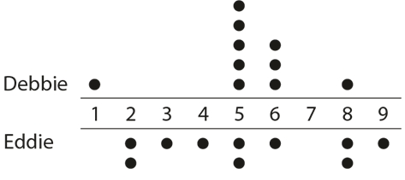
Explain why certain statistical measures give a better measure of dispersion
Example 4a
Two friends play a darts game and record their scores.
  Debbie: 5, 1, 5, 6, 6, 5, 6, 5, 8, 5
  Eddie: 4, 8, 3, 5, 6, 8, 9, 2, 2, 5
Fatima calculates the range for each person in order to compare who is the most consistent player.
She argues that, in this case, the range alone is not sufficient in considering who is the most consistent player.
Do you think that she is right? Explain your answer.
How does the dot plot diagram help to show us what Fatima has noticed?
Notes:
This slide offers a representation that you might like to use with students to support them to understand Fatima’s argument. Debbie seems more consistent because only her score of one was an extreme outlier and not representative of her set of scores.

Slide 25
Reflection questions
What other mathematical concepts will be supported by students’ stronger understanding of this key idea?
What mathematical language will you continue to use to support pupils to make connections with other areas?
Which representations might you continue to use to further develop students’ understanding?

Slide 27
Appendices
You may choose to use the following slides when planning or delivering a PD session. They cover:
  Key vocabulary
  Representations and structure
  Previous learning
  Future learning
  Library of links

Slide 28
Key vocabulary (1)
Term | Definition
(arithmetic) mean | The sum of a set of numbers, or quantities, divided by the number of terms in the set. Example: The arithmetic mean of 5, 6, 14, 15 and 45 is (5 + 6 + 14 + 15 + 45) ÷ 5 i.e. 17.
bivariate | Involving two random variables; used in statistics as a bivariate distribution.
dispersion | Dispersion (also called ‘variability’, ‘scatter’ or ‘spread’) is the extent to which the data in a distribution is spread out. A simple measure of spread is the range. Other common measures are the variance, standard deviation and interquartile range.
measure of central tendency | In statistics, a measure of how the values of a particular variable are located in terms of the values collected for a particular sample, or for the relevant population as a whole. In school mathematics up to Key Stage 4, there are three important measures of central tendency: the arithmetic mean, the median and the mode. These are all statistical averages and often one is more useful than another, depending on the spread of the values under consideration.

Slide 29
Key vocabulary (2)
Term | Definition
median | The middle number or value when all values in a set of data are arranged in ascending order. Example: The median of 5, 6, 14, 15 and 45 is 14. When there is an even number of values, the arithmetic mean of the two middle values is calculated. Example: The median of 5, 6, 7, 8, 14 and 45 is (7 + 8) ÷ 2, i.e. 7.5 The median is one example of an average.
mode | The most commonly occurring value or class with the largest frequency. Example: The mode of this set of data: 2, 3, 3, 3, 4, 4, 5, 5, 6, 7, 8 is 3. Some sets of data may have more than one mode.
outlier | In statistical samples, an outlier is an exceptional trial result that lies beyond where most of the results are clustered. Example: Six people have the following salaries: £20 000, £25 600, £2 000, £19 000, £30 000, £160 000. The salary of £160 000 is clearly out of line with the others and is an outlier. At the other end, £2 000 is also well below the central cluster of values and so may also be considered as an outlier.
range | A measure of spread in statistics. The difference between the greatest value and the least value in a set of numerical data.

Slide 30
Representations and structure (1)
There are a number of different statistical representations that students might encounter as part of their exploration of statistical analysis. It will be important that students understand how to identify measures of central tendency and spread, where possible, in each of these representations.
Pie charts
  Pie charts allow for comparisons between proportions. They are particularly relevant for students when they are working with populations of different sizes, or for making multiplicative comparisons within the same population.
Bar charts
  Bar charts can be used give students a sense of the ‘shape’ of the distribution of the data across a sample, to identify and compare frequencies. They give an opportunity for comparisons to be made using absolute values.
Pictograms
  Pictograms are a simple way of recording frequencies, tabulating images that represent a certain frequency.
Notes:
More information about the representations and structure involved in this key idea can be found on pages 6-10 of the Statistics and probability Theme Overview document (link on final slide).

Slide 31
Previous learning
From Upper Key Stage 2, students will bring experience of:
interpreting and presenting discrete and continuous data using appropriate graphical methods, including bar charts, pictograms and time graphs
solving comparison, sum and difference problems using information presented in bar charts, pictograms, tables and other graphs
interpreting and constructing pie charts and line graphs, and using these to solve problems
encountering and drawing graphs relating two variables, arising from their own enquiry and in other subjects (non-statutory guidance)
calculating and interpreting the mean as an average
knowing when it is appropriate to find the mean of a data set (non-statutory guidance).
Notes:
Theme 5 Statistics and probability

Slide 32
Future learning (1)
In KS4, students will build on the core concepts in this mathematical theme to:
infer properties of populations or distributions from a sample, whilst knowing the limitations of sampling
interpret and construct tables and line graphs for time series data
{construct and interpret diagrams for grouped discrete data and continuous data, i.e. histograms with equal and unequal class intervals and cumulative frequency graphs, and know their appropriate use}
Please note: Braces { } indicate additional mathematical content to be taught to more highly attaining students.
Notes:
Theme 5 Statistics and probability

Slide 33
Future learning (2)
In KS4, students will build on the core concepts in this mathematical theme to:
interpret, analyse and compare the distributions of data sets from univariate empirical distributions through:
  appropriate graphical representation involving discrete, continuous and grouped data, {including box plots}
  appropriate measures of central tendency (including modal class) and spread {including quartiles and inter-quartile range}
apply statistics to describe a population
use and interpret scatter graphs of bivariate data; recognise correlation and know that it does not indicate causation; draw estimated lines of best fit; make predictions; interpolate and extrapolate apparent trends whilst knowing the dangers of so doing
Please note: Braces { } indicate additional mathematical content to be taught to more highly attaining students.
Notes:
Theme 5 Statistics and probability

Slide 34
Library of links
The following resources from the NCETM website have been referred to within this slide deck:
  NCETM Secondary Mastery Professional Development
    5 Statistics and probability Theme Overview Document
    5.2 Statistical analysis Core Concept Document
    5.1 Statistical representations and measures Core Concept Document
  Using mathematical representations at KS3 | NCETM
  Insights from experienced teachers | NCETM
  NCETM primary mastery professional development materials
  NCETM primary assessment materials

