Slide 1
Year 1, Unit 1
Previous Reception experiences and counting within 100

Slide 2
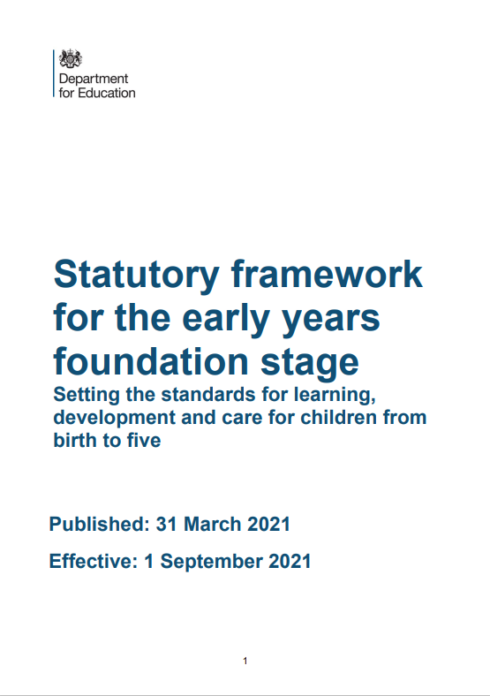

Year 1, Unit 1
This unit provides the opportunity to ensure that children have suitable previous experiences to build upon, before starting year 1 content.
This unit supports teachers to create a mathematical environment and learning opportunities that address these experiences.
The level of development children should be expected to have attained by the end of the EYFS is defined by the early learning goals (ELGs) as set out within the statutory framework for the early years foundation stage DfE publication (pages13-14 are specific to maths).
Additional guidance to help teachers meet these requirements can be found within the DfE Development Matters Guidance 2020 (pages 51-59 are specific to maths).

Slide 3
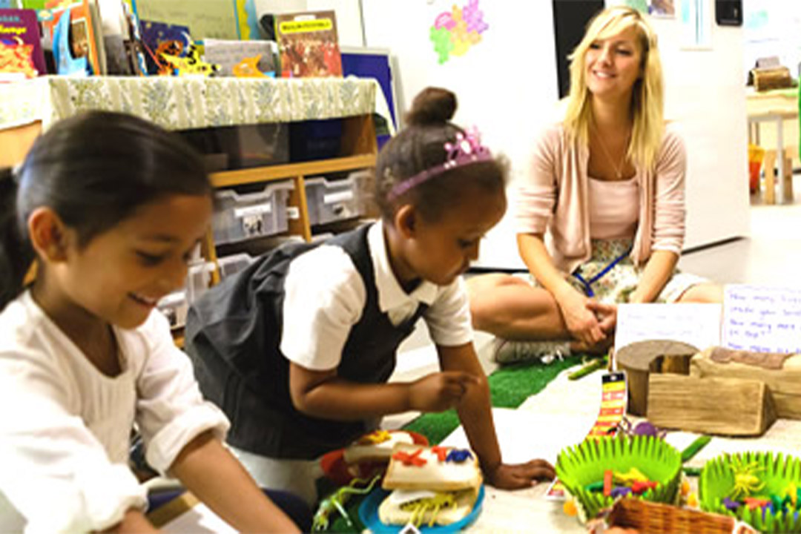
Year 1, Unit 1
For support with creating mathematical environments and learning opportunities that address the previous experience required from early years, refer to:
The Early Years section on the NCETM website including information on each of the six key areas of early mathematics learning:
  Cardinality and Counting
  Comparison
  Composition
  Pattern
  Shape and Space
  Measures
additional planning resources or high-quality textbooks used by your school.

Slide 4
Year 1, Unit 1
These materials heavily reflect the prioritisation approach of the ready-to-progress criteria in the DfE Primary Mathematics Guidance 2020 and on the PPTs that exemplify them on the NCETM website. They also include other relevant National Curriculum content. Related sections of the NCETM Primary Mastery Professional Development Materials provide small-step teaching guidance.
Ready-to-progress criteria addressed by this unit
Teaching of this unit supports the following criteria from the ‘DfE Mathematics Guidance: key stages 1 & 2’ (the 335-page document available as a download)
1NPV-1 Page 18
Previous Experience
If the children have the following previous experience, contained in the same DfE guidance document as above, they will be ready to start this unit.
Previous experience prior to 1NPV-1 Page 16
Learning Outcomes
This unit has a single Learning Outcome: Pupils count within 100 in different ways

Slide 5
Year 1, Unit 1, Learning Outcome 1
Learning Outcome 1
Pupils count within 100 in different ways
The following slides have been collated to support the teaching of this learning outcome.

Slide 6
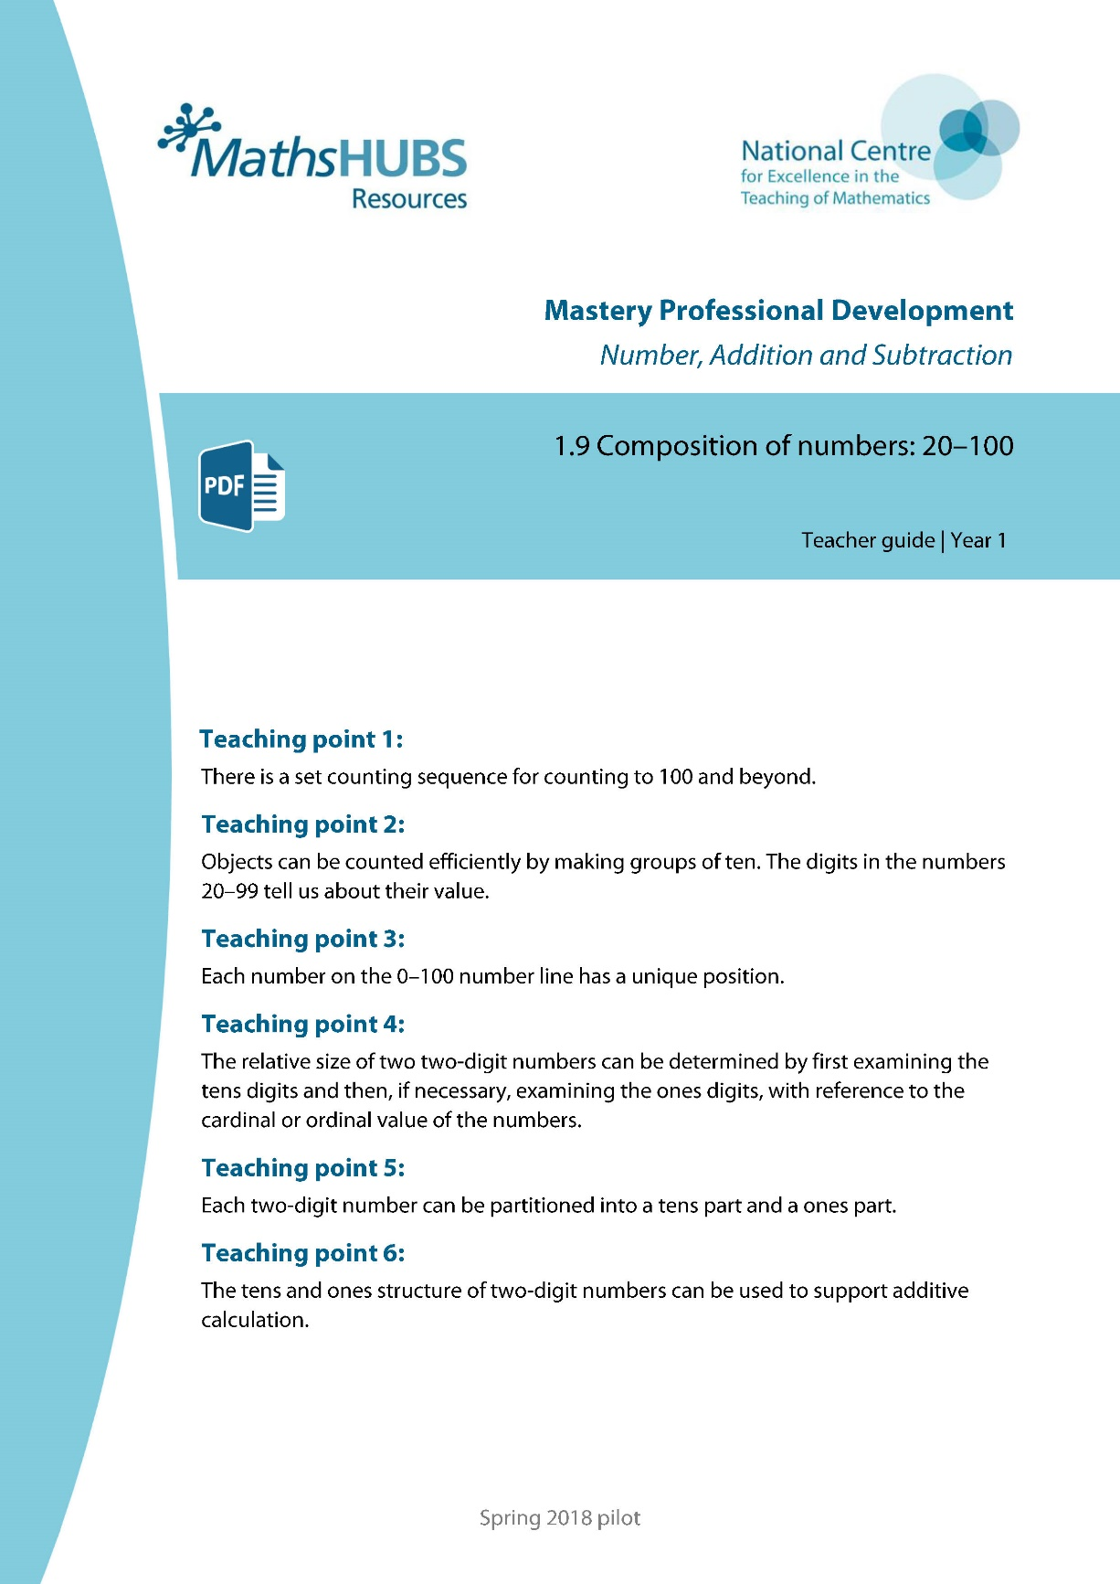
Year 1, Unit 1, Learning Outcome 1
Additional teacher guidance for this outcome should be read first and can be found in this segment of the NCETM Primary Mastery Professional Development Materials:
1.9 Composition of numbers: 20-100
The spine materials are divided into ‘teaching points’ and ‘steps in learning’.
Teaching point | Steps in learning | Pages
1 | 1:1 | 4-5

Slide 7
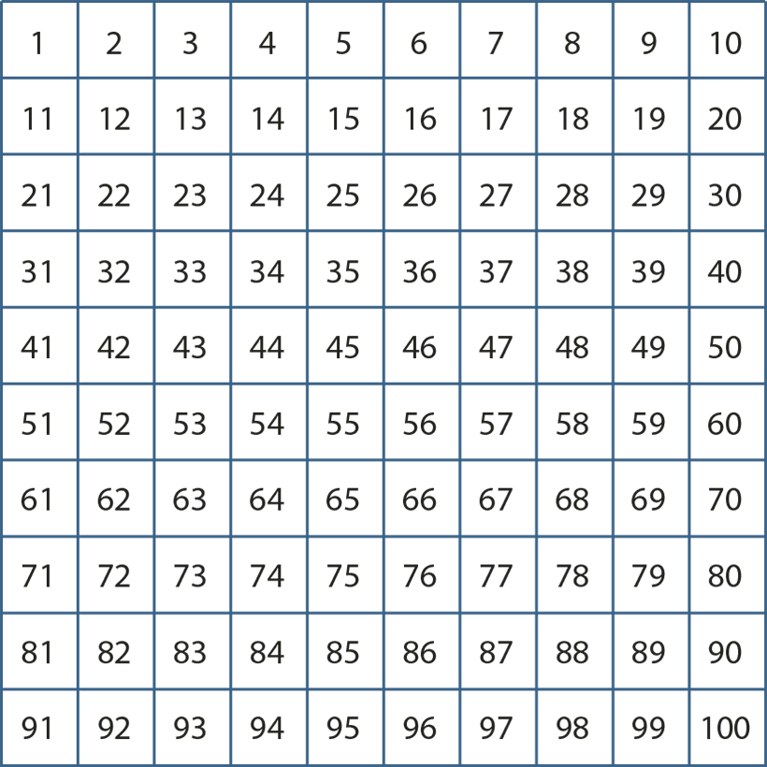
1.9 Composition: 20–100 – step 1:1

Slide 8
1.9 Composition: 20–100 – step 1:1
1000 | 2000 | 3000 | 4000 | 5000 | 6000 | 7000 | 8000 | 9000
100 | 200 | 300 | 400 | 500 | 600 | 700 | 800 | 900
10 | 20 | 30 | 40 | 50 | 60 | 70 | 80 | 90
1 | 2 | 3 | 4 | 5 | 6 | 7 | 8 | 9

Slide 9



1NPV-1 Count forwards and backwards within 100
Can you count in ones between 1 and 100, both forwards and backwards?
Can you start your count from different numbers?
Can you say the number of straws each time a bundle is tied up? Louder!
Are you saying the ‘teen numbers’ clearly?
Can you say the count in two ways?
x
Begin by using real straws to count and bundle together in groups of 10.
Seven, eight, nine, ten, eleven, twelve… twenty, twenty-one, twenty-two…
Seven, eight, nine, ten, one-ten, one-ten-one, one-ten-two… two-tens, two-tens-one, two-tens-two…

Slide 10
1NPV-1 Count forwards and backwards within 100
1
2
3
4
5
6
7
8
9
10
Can you count forwards and backwards between 1 and 100, starting in different places on the 100 square?
Can you say the ‘teen’ part of these numbers a little louder? Thirteen, fourteen, fifteen…
Can you say the numbers which come after these numbers: 19…, 29…, 39…, 99…? Say them loudly and clearly: twenty, thirty, forty…
Can you say the numbers which come before these numbers: 30, 50, 70, 100?
Where on the 100 square can you see the counting numbers which come before 21, 31, 41…?
11
12
13
14
15
16
17
18
19
20
21
22
23
24
25
26
27
28
29
30
31
32
33
34
35
36
37
38
39
40
41
42
42
44
45
46
47
48
49
50
51
52
53
54
55
56
57
58
59
60
61
62
63
64
65
66
67
68
69
70
71
72
73
74
75
76
77
78
79
80
81
82
83
84
85
86
87
88
89
90
91
92
93
94
95
96
97
98
99
100

Slide 11
1NPV-1 Count forwards and backwards within 100
Can you join in saying the numbers in the count?
Are you saying these numbers very clearly: 14/ 40, 15/50, 16/60 etc?
Watch the ‘ones digit’ as it changes - what do you notice?
Now watch the ‘tens digit’ - what do you notice?
Pause at some numbers and think about what comes next.
Can you count backwards, especially from these numbers: 20, 30, 40, 50, 60…?
100
21
31
41
51
61
71
81
91
12
22
32
42
52
62
72
82
92
13
23
33
42
53
63
73
83
93
14
24
34
44
54
64
74
84
94
15
25
35
45
55
65
75
85
95
16
26
36
46
56
66
76
86
96
17
27
37
47
57
67
77
87
97
18
28
38
48
58
68
78
88
98
19
29
39
49
59
69
79
89
99
10
20
30
40
50
60
70
80
90
11
1
2
3
4
5
6
7
8
9

Slide 12
1NPV-1 Count forwards and backwards within 100
0
10
20
30
40
50
60
70
80
90
100
Can you read the numbers shown on the number line between zero and one hundred?
What do you notice about these numbers?
Can you join in with the count as the arrow moves along the line? Say the numbers shown on the number line a little louder!
Move the arrow to different places on the number line - can you work out the number which the arrow has stopped at by counting on or back from the numbers shown on the line? Use a large class number line if possible where children can touch a point and identify the number.

Slide 13
1NPV-1 Count forwards and backwards within 100
What do you notice about the numbers written below the number line?
What do you notice about these numbers written above the number line?
Why might it be tricky to remember what comes before these numbers: 20, 30, 40, 50 etc?

Slide 14
1NPV-1 Count forwards and backwards within 100
Before we count, can you say the numbers which come before the numbers shown on the number line?
Starting from 100, can you join in with the count? Are we counting forwards or backwards?
Pause at the numbers shown. Can you remember what number we will say next?

Slide 15
1NPV-1 Count forwards and backwards within 100
1,000
2,000
3,000
4,000
5,000
6,000
7,000
8,000
9,000
100
200
300
400
500
600
700
800
900
10
20
30
40
50
60
70
80
90
1
2
3
4
5
6
7
8
9
Let’s use the chart to tap out the numbers in our count between one and one hundred! Remember to get the order right, for the teen numbers tap the ten first and then the ones.
Let’s start at 20… we can tap 20 and 1 for twenty-one, 20 and 2 for twenty-two… How can I tap twenty-three? What do we tap after twenty-nine?
How can we tap out the teen numbers? Do we say ‘tenty-one, tenty-two’? What do you notice about how we say the number fourteen when I tap the chart?

