Slide 1

Checkpoints
Year 7 diagnostic mathematics activities
Arithmetic procedures including fractions
Thirty-one Checkpoint activities
Fifteen additional activities
Published in 2021/22

Slide 2
About this resource
This resource is designed to be used in the classroom with Year 7 students, although it may be useful for other students.
The Checkpoints are grouped around the key ideas in the core concept documents 1.3 Ordering and comparing and 2.1 Arithmetic procedures, part of the NCETM Secondary Mastery Professional Development Materials.
Before each set of Checkpoints, context is explored, to help secondary teachers to understand where students may have encountered concepts in primary school.
The 10-minute Checkpoint tasks might be used as assessment activities, ahead of introducing concepts, to help teachers explore what students already know and identify gaps and misconceptions.
Each Checkpoint has an optional question marked . This will provide further thinking for those students who have completed the rest of the activities on the slide.
The notes for each Checkpoint give answers (if appropriate), some suggested questions and things to consider.
After each Checkpoint, a guidance slide explores suggested adaptations, potential misconceptions and follow-up tasks. These may include the additional activities at the end of this deck.

Slide 3
Checkpoints 1–12
Checkpoint | Underpins | Code
1: Number line trios | Representing fractions as numbers | 1.3.1
2: Where is one-quarter? | Identify and explain whether a number is or is not a multiple of a given integer
3: Fraction estimation
4: Match-up
5: Same value, different appearance
6: Crocodiles
7: Point to 0.4
8: Revenge of the fifth
9: Whole numbers
10: Dividing lines
11: Sevenths
12: 5 678
This three-digit code refers to the statement of knowledge, skills and understanding in the NCETM’s Sample Key Stage 3 Curriculum Framework (see notes below for more information).
Notes:
In the Sample Key Stage 3 Curriculum Framework, statements of knowledge, skills and understanding are arranged to give an example teaching order. The three-digit code for each statement in the framework is a clickable hyperlink to documents with more detailed information, including the key ideas contained within that statement. These key ideas are also shown on slides 6–8 in this deck.

Slide 4
Checkpoints 13–25
Checkpoint | Underpins | Code
13: Equivalent fractions | Comparing and ordering fractions | 1.3.2
14: Five different digits | Identify and explain whether a number is or is not a multiple of a given integer
15: Different number lines
16: Greater fractions
17: Three in a row
18: The inbetweeners
19: Wrong answers | Additive structures for fractions | 2.1.3
20: Snail’s pace
21: Metres of chocolate
22: Pairs of glasses
23: The sixth sense
24: Nine and three-quarters
25: Less than, more than
This three-digit code refers to the statement of knowledge, skills and understanding in the NCETM’s Sample Key Stage 3 Curriculum Framework (see notes below for more information).
Notes:
In the Sample Key Stage 3 Curriculum Framework, statements of knowledge, skills and understanding are arranged to give an example teaching order. The three-digit code for each statement in the framework is a clickable hyperlink to documents with more detailed information, including the key ideas contained within that statement. These key ideas are also shown on slides 6–8 in this deck.

Slide 5
Checkpoints 26–31
Checkpoint | Underpins | Code
26: Area | Multiplicative structures for fractions | 2.1.4
27: The greatest product | Identify and explain whether a number is or is not a multiple of a given integer
28: Half pennies
29: Buckets and barrels
30: School trip
31: Four
This three-digit code refers to the statement of knowledge, skills and understanding in the NCETM’s Sample Key Stage 3 Curriculum Framework (see notes below for more information).
Notes:
In the Sample Key Stage 3 Curriculum Framework, statements of knowledge, skills and understanding are arranged to give an example teaching order. The three-digit code for each statement in the framework is a clickable hyperlink to documents with more detailed information, including the key ideas contained within that statement. These key ideas are also shown on slides 6–8 in this deck.

Slide 6
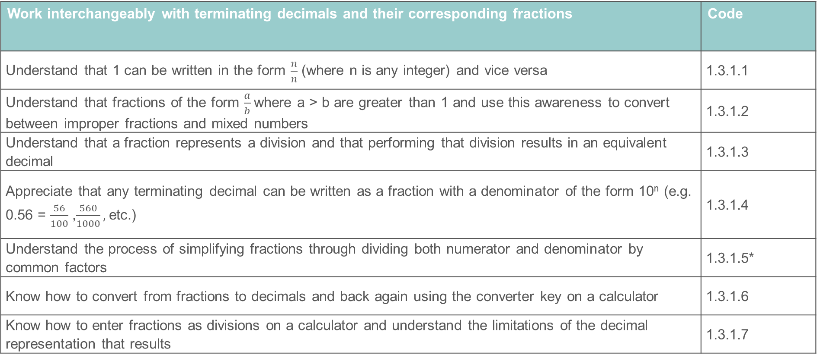
Key ideas
Work interchangeably with terminating decimals and their corresponding fractions | Code
Understand that 1 can be written in the form $\frac{n}{n}$ (where n is any integer) and vice versa | 1.3.1.1
Understand that fractions of the form $\frac{a}{b}$where a > b are greater than 1 and use this awareness to convert between improper fractions and mixed numbers | 1.3.1.2
Understand that a fraction represents a division and that performing that division results in an equivalent decimal | 1.3.1.3
Appreciate that any terminating decimal can be written as a fraction with a denominator of the form 10^{n} (e.g. 0.56 = $\frac{56}{100}$ ,$\frac{560}{1000},$etc.) | 1.3.1.4
Understand the process of simplifying fractions through dividing both numerator and denominator by common factors | 1.3.1.5*
Know how to convert from fractions to decimals and back again using the converter key on a calculator | 1.3.1.6
Know how to enter fractions as divisions on a calculator and understand the limitations of the decimal representation that results | 1.3.1.7
*‘There are additional resources exemplifying these key ideas in the Secondary Mastery Professional Development | NCETM.

Slide 7
Key ideas
Compare and order positive and negative integers, decimals and fractions | Code
Compare negative integers using < and > | 1.3.2.1
Compare decimals using < and > | 1.3.2.2
Compare and order fractions by converting to decimals | 1.3.2.3
Compare and order fractions by converting to fractions with a common denominator | 1.3.2.4
Order a variety of positive and negative fractions and decimals using appropriate methods of conversion and recognising when conversion to a common format is not required | 1.3.2.5
Appreciate that for any two numbers there is always another number in between them | 1.3.2.6
*‘There are additional resources exemplifying these key ideas in the Secondary Mastery Professional Development | NCETM.

Slide 8
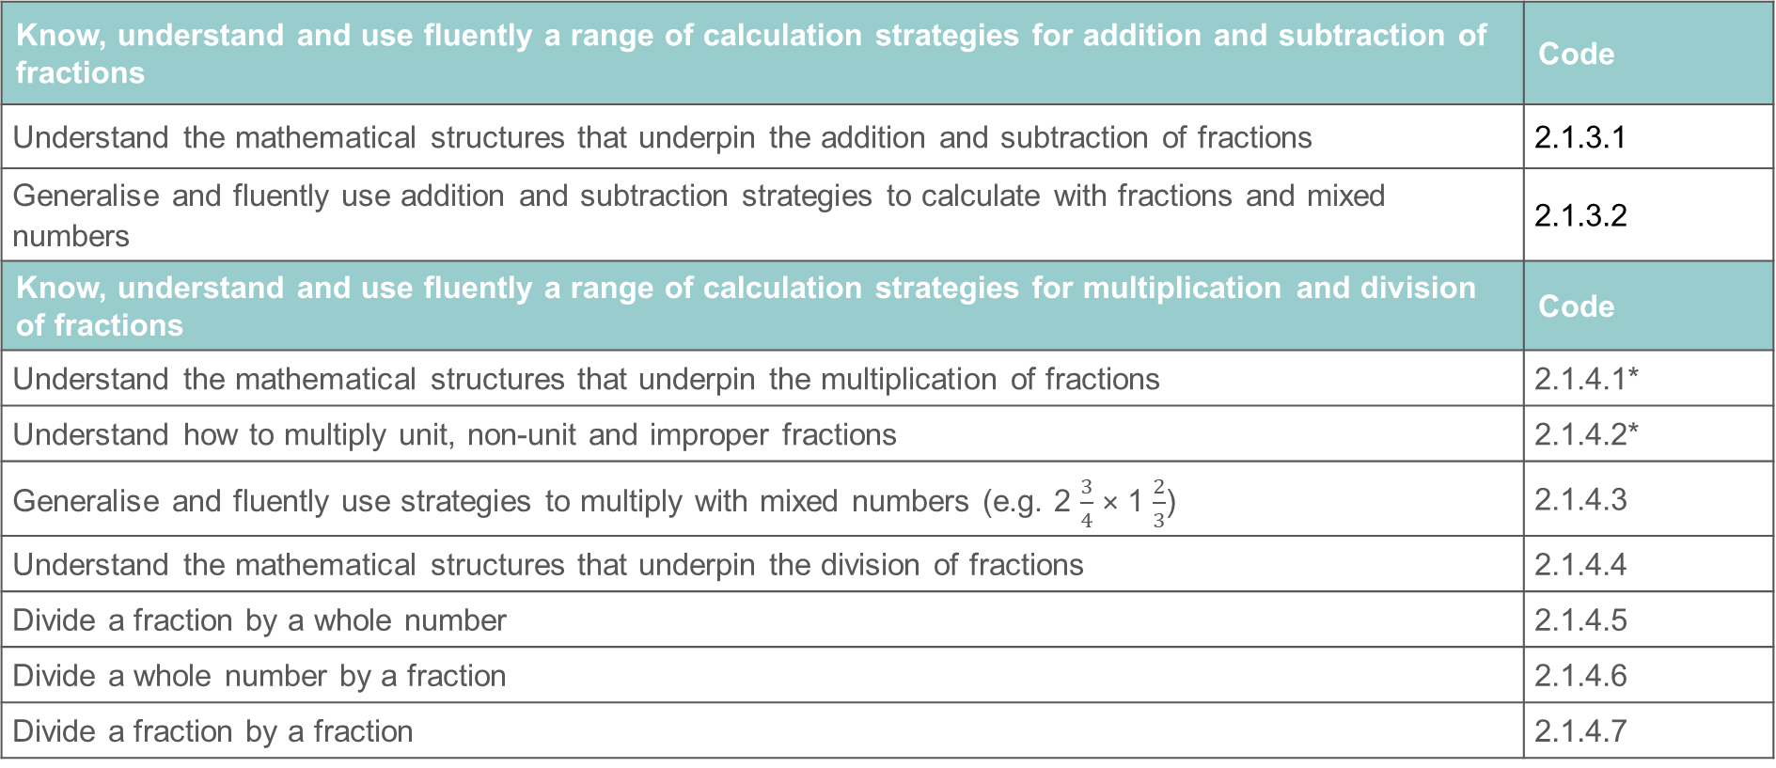
Key ideas
Know, understand and use fluently a range of calculation strategies for addition and subtraction of fractions | Code
Understand the mathematical structures that underpin the addition and subtraction of fractions | 2.1.3.1
Generalise and fluently use addition and subtraction strategies to calculate with fractions and mixed numbers | 2.1.3.2
Know, understand and use fluently a range of calculation strategies for multiplication and division of fractions | Code
Understand the mathematical structures that underpin the multiplication of fractions | 2.1.4.1*
Understand how to multiply unit, non-unit and improper fractions | 2.1.4.2*
Generalise and fluently use strategies to multiply with mixed numbers (e.g. 2 $\frac{3}{4}$ × 1 $\frac{2}{3}$) | 2.1.4.3
Understand the mathematical structures that underpin the division of fractions | 2.1.4.4
Divide a fraction by a whole number | 2.1.4.5
Divide a whole number by a fraction | 2.1.4.6
Divide a fraction by a fraction | 2.1.4.7
*‘There are additional resources exemplifying these key ideas in the Secondary Mastery Professional Development | NCETM.

Slide 9
Representing fractions as numbers
Checkpoints 1–12

Slide 10
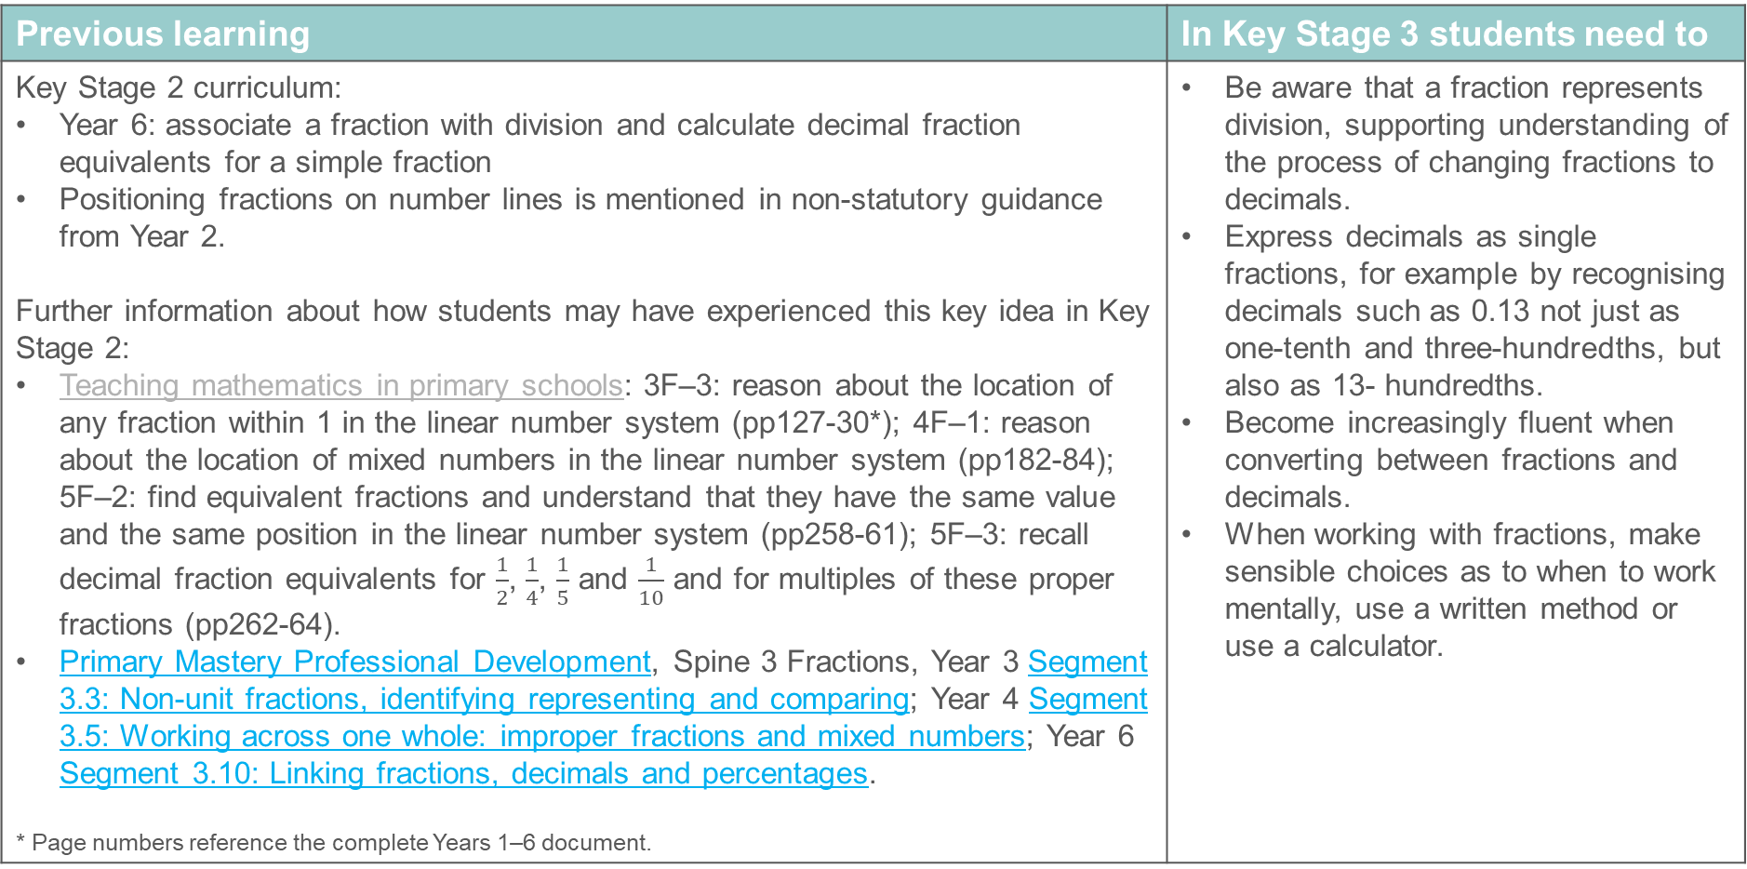
Representing fractions as numbers
Previous learning | In Key Stage 3 students need to
Key Stage 2 curriculum: Year 6: associate a fraction with division and calculate decimal fraction equivalents for a simple fraction Positioning fractions on number lines is mentioned in non-statutory guidance from Year 2. Further information about how students may have experienced this key idea in Key Stage 2: Teaching mathematics in primary schools: 3F–3: reason about the location of any fraction within 1 in the linear number system (pp127-30*); 4F–1: reason about the location of mixed numbers in the linear number system (pp182-84); 5F–2: find equivalent fractions and understand that they have the same value and the same position in the linear number system (pp258-61); 5F–3: recall decimal fraction equivalents for $\frac{1}{2}$, $\frac{1}{4}$, $\frac{1}{5}$ and $\frac{1}{10}$ and for multiples of these proper fractions (pp262-64). Primary Mastery Professional Development, Spine 3 Fractions, Year 3 Segment 3.3: Non-unit fractions, identifying representing and comparing; Year 4 Segment 3.5: Working across one whole: improper fractions and mixed numbers; Year 6 Segment 3.10: Linking fractions, decimals and percentages. * Page numbers reference the complete Years 1–6 document. | Be aware that a fraction represents division, supporting understanding of the process of changing fractions to decimals. Express decimals as single fractions, for example by recognising decimals such as 0.13 not just as one-tenth and three-hundredths, but also as 13- hundredths. Become increasingly fluent when converting between fractions and decimals. When working with fractions, make sensible choices as to when to work mentally, use a written method or use a calculator.

Slide 11
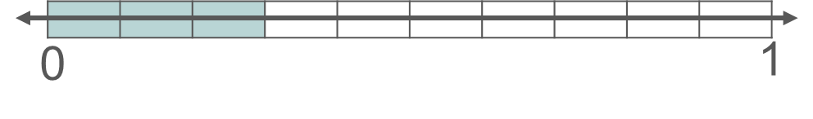
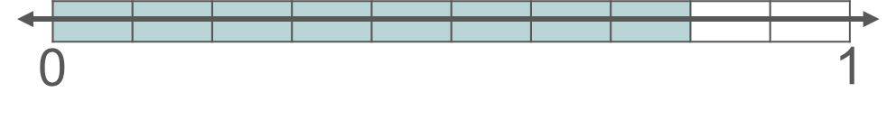
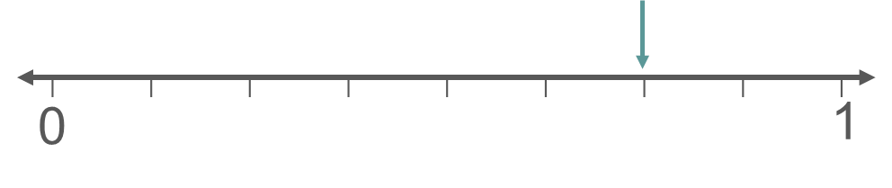
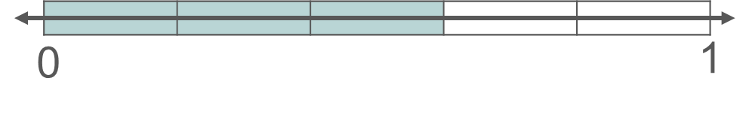
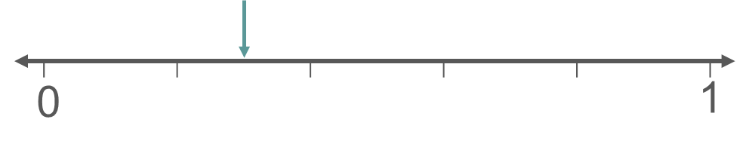
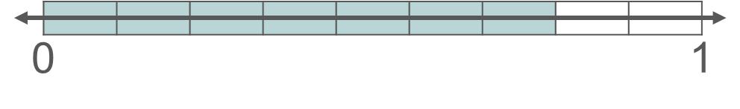
Checkpoint 1: Number line trios
For each set of number lines, state what is the same and what is different about the values being represented.
a)
b)
Add another 0-1 number line to each set, and represent a new value on each. What is the same? What is different?
Notes:
This slide is animated. Each question will appear separately so you can choose the pace at which to work with your class.
Answers
a) In the top and middle number lines, both have three ‘parts’ shaded, but as the number lines have different divisions then different values are being represented ($\frac{3}{10}$ and $\frac{3}{5}$). The top and the bottom number lines both show the value $\frac{3}{10}$. The middle and bottom number lines both divide the line into fifths. All three representations use a number line to represent fractions as values, with the first two using shading to show the value and the last one using an arrow.
b) In all three number lines, the number represented is two parts less than one whole. Each line has different divisions, so the top number line represents $\frac{8}{10}$, the middle number line represents $\frac{6}{8}$ and the bottom number line represents $\frac{7}{9}$. Again, all three representations use a number line to represent fractions as values, with the bottom and top using shading to show the value and the middle one using an arrow.
? Students’ responses will vary depending on the number lines they choose. It may be particularly interesting to notice whether they choose shading or an arrow to denote their value.
Suggested questioning
What is the same and what is different?
How many parts has the line been divided into? What does this mean for the denominator?
How is the number being represented each time? What does this mean for the numerator?
Which is the biggest value in each set? Which is the smallest?
Things to think about
This Checkpoint explores whether students are confident with the number line representation for fractions – checking their understanding of fractions as values within the number system, rather than as proportions of any given whole. The bar model representation is more commonly associated with proportion; here, it is used as a ‘bridge’ to connect students’ understanding of different representations of fractions.

Slide 12
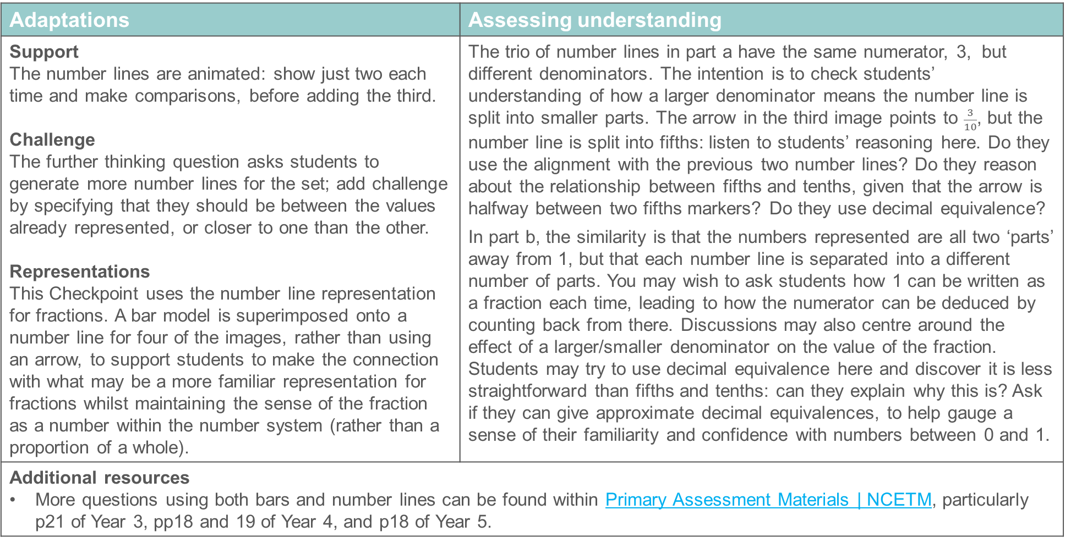
Checkpoint 1: Guidance
Adaptations | Assessing understanding
Support The number lines are animated: show just two each time and make comparisons, before adding the third. Challenge The further thinking question asks students to generate more number lines for the set; add challenge by specifying that they should be between the values already represented, or closer to one than the other. Representations This Checkpoint uses the number line representation for fractions. A bar model is superimposed onto a number line for four of the images, rather than using an arrow, to support students to make the connection with what may be a more familiar representation for fractions whilst maintaining the sense of the fraction as a number within the number system (rather than a proportion of a whole). | The trio of number lines in part a have the same numerator, 3, but different denominators. The intention is to check students’ understanding of how a larger denominator means the number line is split into smaller parts. The arrow in the third image points to $\frac{3}{10}$, but the number line is split into fifths: listen to students’ reasoning here. Do they use the alignment with the previous two number lines? Do they reason about the relationship between fifths and tenths, given that the arrow is halfway between two fifths markers? Do they use decimal equivalence? In part b, the similarity is that the numbers represented are all two ‘parts’ away from 1, but that each number line is separated into a different number of parts. You may wish to ask students how 1 can be written as a fraction each time, leading to how the numerator can be deduced by counting back from there. Discussions may also centre around the effect of a larger/smaller denominator on the value of the fraction. Students may try to use decimal equivalence here and discover it is less straightforward than fifths and tenths: can they explain why this is? Ask if they can give approximate decimal equivalences, to help gauge a sense of their familiarity and confidence with numbers between 0 and 1.
Additional resources More questions using both bars and number lines can be found within Primary Assessment Materials | NCETM, particularly p21 of Year 3, pp18 and 19 of Year 4, and p18 of Year 5.

Slide 13

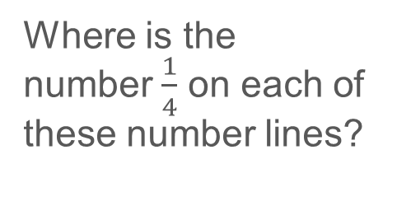


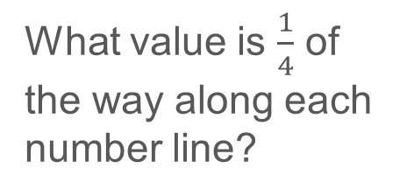
Checkpoint 2: Where is one-quarter?
Where is the number $\frac{1}{4}$ on each of these number lines?
a)
0
1
b)
0
2
c)
0
10
d)
What value is $\frac{1}{4}$ of the way along each number line?
0
$$\frac{3}{4}$$
e)
0
$$\frac{1}{3}$$
f)
0
$$\frac{1}{5}$$
Notes:
This slide is animated. Each question will appear separately so you can choose the pace at which to work with your class. A printable resource for this Checkpoint can be found on slide 100, with a version for suggested challenge on slide 101.
Answers
The answers to parts a–f are also given as animations on the next slide. Please note that there is no expectation of particularly accurate positioning, rather that students have a general sense of the relative size of $\frac{1}{4}$ compared with the given value each time.
?
a) $\frac{1}{4},$b) $\frac{1}{2},$c) 2$\frac{1}{2},$d) $\frac{3}{16},$e) $\frac{1}{12},$f) $\frac{1}{20}$
Suggested questioning
Why is $\frac{1}{4}$ not always one-quarter of the way along the line?
Where is 1 each time?
On which line will $\frac{1}{4}$ look closer to 0?
Which number line is easiest to place $\frac{1}{4}$ on? Why?
How is the ‘further thinking’ question different from the main activity?
Which number line is easiest for the ‘further thinking’ question?
Things to think about
Checkpoint 2 explores the difference between one-quarter as a value (in the main part of the task) and one-quarter as a proportion of a whole (in the further thinking question). Students who place $\frac{1}{4}$ a quarter of the way along the line each time may be more used to thinking proportionally about fractions, and have less experience of thinking about fractions as distinct numbers. What implications might this have for students’ number sense when working with fractions, for example when using the four operations?

Slide 14





Checkpoint 2: Where is one-quarter? (animated solutions)
Where is the number $\frac{1}{4}$ on each of these number lines?
a)
0
$$\frac{1}{4}$$
1
b)
0
$$\frac{1}{4}$$
2
c)
0
$$\frac{1}{4}$$
10
d)
What value is $\frac{1}{4}$ of the way along each number line?
0
$$\frac{1}{4}$$
$$\frac{3}{4}$$
e)
0
$$\frac{1}{4}$$
$$\frac{1}{3}$$
f)
0
$$\frac{1}{5}$$
$$\frac{1}{4}$$
Notes:
Clicking through this slide will reveal the position of $\frac{1}{4}$ in parts a to f. Please note that there is no expectation of particularly accurate positioning, rather that students have a general sense of the relative size of $\frac{1}{4}$ compared with the given value each time.

Slide 15
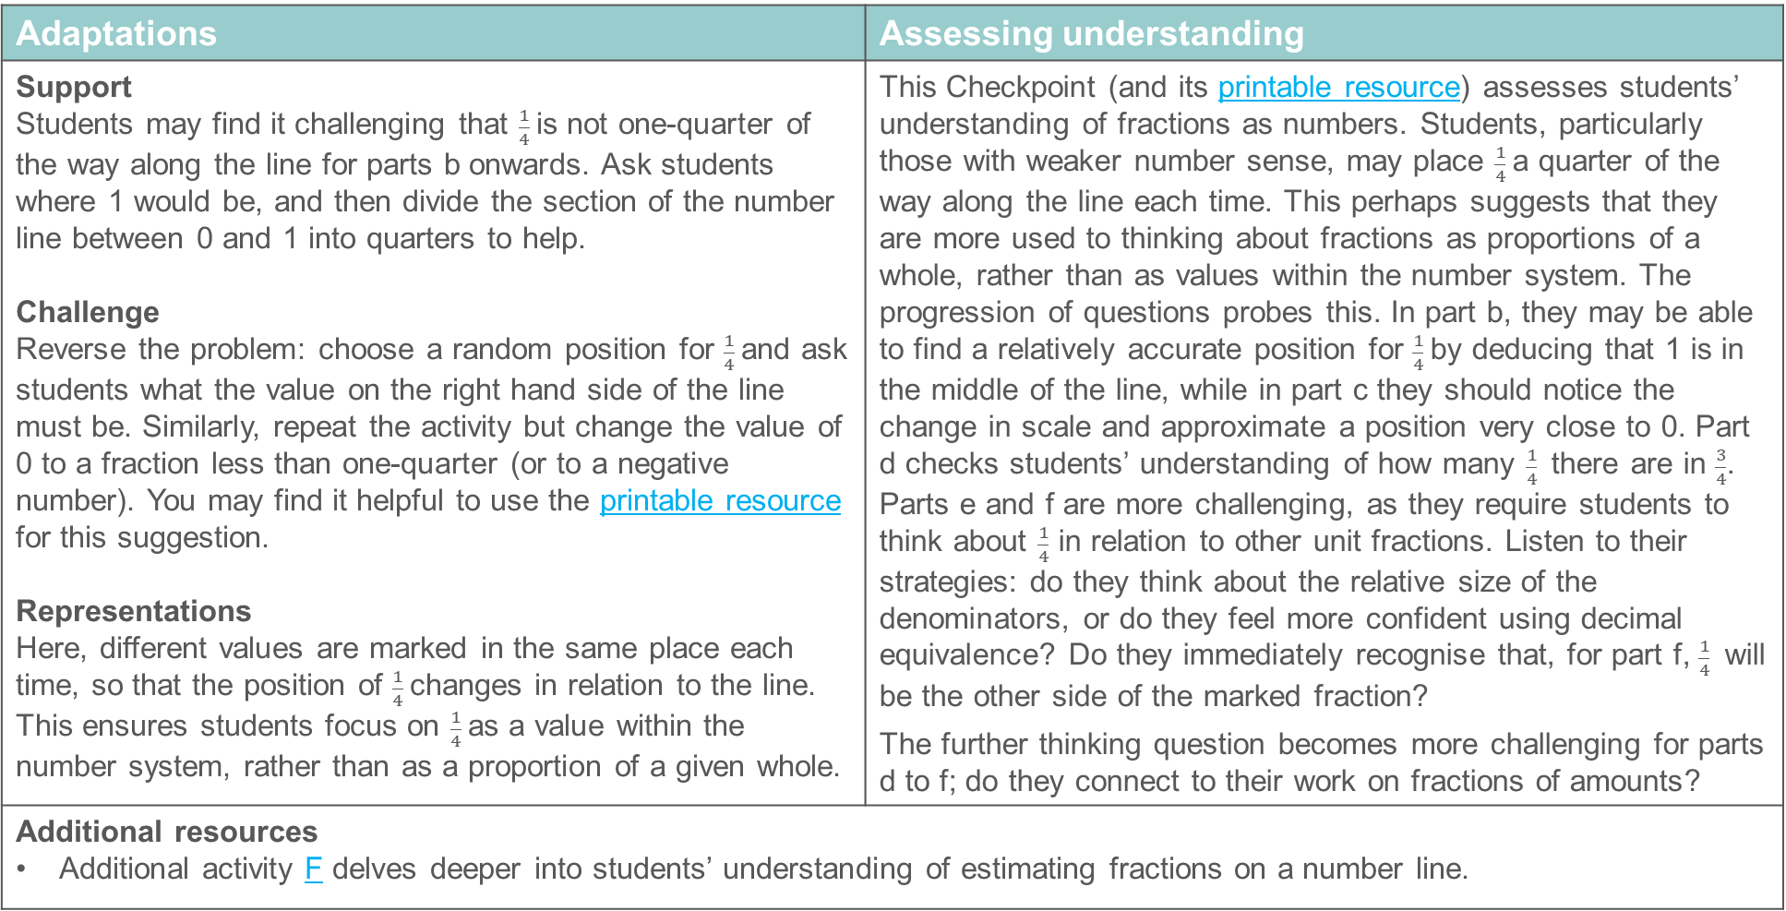
Checkpoint 2: Guidance
Adaptations | Assessing understanding
Support Students may find it challenging that $\frac{1}{4}$is not one-quarter of the way along the line for parts b onwards. Ask students where 1 would be, and then divide the section of the number line between 0 and 1 into quarters to help. Challenge Reverse the problem: choose a random position for $\frac{1}{4}$and ask students what the value on the right hand side of the line must be. Similarly, repeat the activity but change the value of 0 to a fraction less than one-quarter (or to a negative number). You may find it helpful to use the printable resource for this suggestion. Representations Here, different values are marked in the same place each time, so that the position of $\frac{1}{4}$changes in relation to the line. This ensures students focus on $\frac{1}{4}$as a value within the number system, rather than as a proportion of a given whole. | This Checkpoint (and its printable resource) assesses students’ understanding of fractions as numbers. Students, particularly those with weaker number sense, may place $\frac{1}{4}$a quarter of the way along the line each time. This perhaps suggests that they are more used to thinking about fractions as proportions of a whole, rather than as values within the number system. The progression of questions probes this. In part b, they may be able to find a relatively accurate position for $\frac{1}{4}$by deducing that 1 is in the middle of the line, while in part c they should notice the change in scale and approximate a position very close to 0. Part d checks students’ understanding of how many $\frac{1}{4}$there are in $\frac{3}{4}$. Parts e and f are more challenging, as they require students to think about $\frac{1}{4}$ in relation to other unit fractions. Listen to their strategies: do they think about the relative size of the denominators, or do they feel more confident using decimal equivalence? Do they immediately recognise that, for part f, $\frac{1}{4}$ will be the other side of the marked fraction? The further thinking question becomes more challenging for parts d to f; do they connect to their work on fractions of amounts?
Additional resources Additional activity F delves deeper into students’ understanding of estimating fractions on a number line.

Slide 16

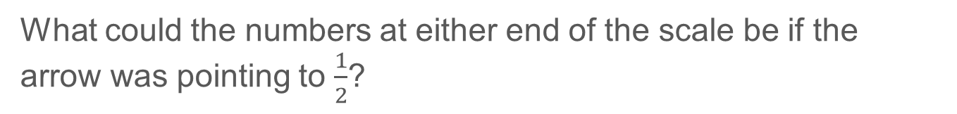
Checkpoint 3: Fraction estimation
Estimate what fraction the arrow is pointing to each time.
a)
0
1
b)
0
2
c)
0
$\frac{1}{2}$
d)
1
3
What could the numbers at either end of the scale be if the arrow was pointing to $\frac{1}{2}$?
Notes:
This slide is animated. Each question will appear separately so you can choose the pace at which to work with your class. A printable resource can be found on slide 102.
Answers
a) $\frac{3}{4}$ Students may have approximated somewhere close to this, such as $\frac{7}{10}$.
b) $1\frac{1}{2}$ Follow through from their estimation from part a: for example, if students answered $\frac{7}{10}$, then their answer for part b should be $\frac{14}{10}$ or equivalent.
c) $\frac{3}{8}$ Again, follow through from their estimation for part a: an estimation of $\frac{7}{10}$ should lead to an answer of $\frac{7}{20}$.
d) $2\frac{1}{2}$ Again, follow through from their estimation for part a: an estimation of $\frac{7}{10}$should lead to an answer of $\frac{24}{10}$.
? 0 and $\frac{4}{6}$ (or equivalent) is the most likely answer. Students could also choose other values, as long as the distance between the left-hand value and $\frac{1}{2}$ was three times the distance between $\frac{1}{2}$ and the right-hand value. For example, if the value on the left-hand end of the line was $\frac{1}{4}$, then that on the right-hand end of the line would need to be $\frac{7}{12},$since $\frac{1}{4}=\frac{3}{12}$ and $\frac{1}{2}=\frac{6}{12}$.
Suggested questioning
What do you notice about how your answer to part a is related to your answer to part b? How about part d?
What would the fraction be if the scale was 0 to 4? How about 0 to $\frac{1}{4}$?
Things to think about
Checkpoint 3 is linked to Checkpoint 2 but, instead of keeping the fraction constant and therefore varying its position, here the position on the number line is constant and therefore the fraction being marked varies. The focus is on estimation, and so it matters less whether students offer precisely the right answer, and more whether their answers are of a sensible size given the value at the end of the number line each time.

Slide 17
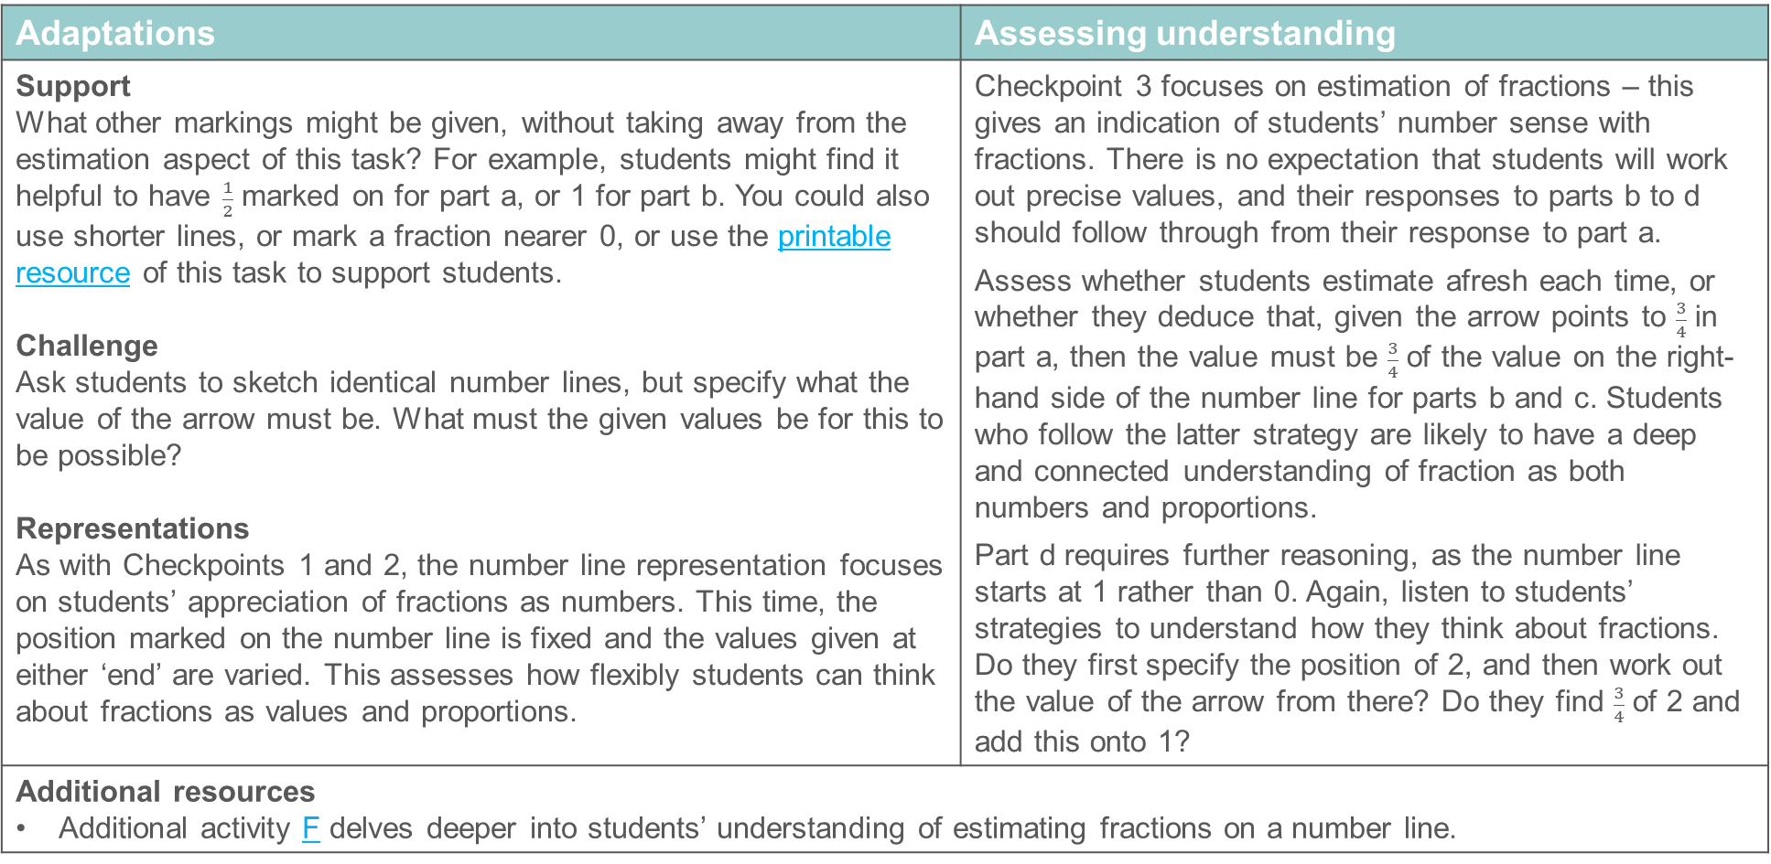
Checkpoint 3: Guidance
Adaptations | Assessing understanding
Support What other markings might be given, without taking away from the estimation aspect of this task? For example, students might find it helpful to have $\frac{1}{2}$ marked on for part a, or 1 for part b. You could also use shorter lines, or mark a fraction nearer 0, or use the printable resource of this task to support students. Challenge Ask students to sketch identical number lines, but specify what the value of the arrow must be. What must the given values be for this to be possible? Representations As with Checkpoints 1 and 2, the number line representation focuses on students’ appreciation of fractions as numbers. This time, the position marked on the number line is fixed and the values given at either ‘end’ are varied. This assesses how flexibly students can think about fractions as values and proportions. | Checkpoint 3 focuses on estimation of fractions – this gives an indication of students’ number sense with fractions. There is no expectation that students will work out precise values, and their responses to parts b to d should follow through from their response to part a. Assess whether students estimate afresh each time, or whether they deduce that, given the arrow points to $\frac{3}{4}$ in part a, then the value must be $\frac{3}{4}$ of the value on the right-hand side of the number line for parts b and c. Students who follow the latter strategy are likely to have a deep and connected understanding of fraction as both numbers and proportions. Part d requires further reasoning, as the number line starts at 1 rather than 0. Again, listen to students’ strategies to understand how they think about fractions. Do they first specify the position of 2, and then work out the value of the arrow from there? Do they find $\frac{3}{4}$ of 2 and add this onto 1?
Additional resources Additional activity F delves deeper into students’ understanding of estimating fractions on a number line.

Slide 18
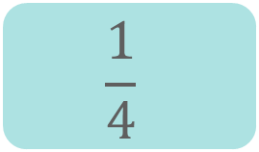
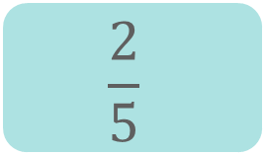
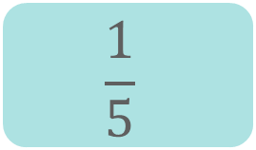
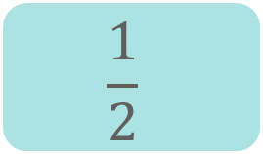
Checkpoint 4: Match up
Match the equivalent decimals and fractions.
Three values did not have a matching equivalent decimal or fraction. Write an equivalent value for each.
$$\frac{1}{4}$$
$$\frac{1}{5}$$
0.3
0.2
0.5
1.2
0.25
$$\frac{1}{2}$$
$$\frac{2}{5}$$
Create another equivalent fraction to turn each pair into a set of three. Can you think of an equivalent fraction that nobody else will choose?
Notes:
This slide is animated. The blank cards and part b will appear separately so you can choose the pace at which to reveal the slide to your class. Printable cards are available on slides 103–115.
Answers
a)
$\frac{1}{4}$ = 0.25
$\frac{1}{2}$ = 0.5
$\frac{1}{5}$ = 0.2
b)
0.3 = $\frac{3}{10}$ (or equivalent)
$\frac{2}{5}$ = 0.4 (or equivalent)
1.2 = $\frac{12}{10}$ (or equivalent)
? Any equivalent fraction or decimal for each set. Students may be likely to select more ‘common’ or easy to derive equivalences such as $\frac{3}{6}$ for $\frac{1}{2}$, so the prompt to think of a fraction that nobody else will choose may encourage them to be more creative (e.g. $\frac{303}{606}$ for $\frac{1}{2}$).
Suggested questioning
Which of these do you ‘just know’? Which do you have to work out?
How is the vinculum (fraction line) different from the decimal point?
Why is (e.g. 0.2) not equivalent to (e.g. $\frac{1}{2}$)?
Which is the biggest value on the cards? Which is the smallest?
For your missing values for part b, can you think of an equivalent fraction that nobody else will choose?
Things to think about
Checkpoint 4 assesses some common equivalences that students are likely to know from their work on decimals and fractions at primary school. Some common misconceptions may arise (see Guidance slide). Consider in advance how you will address these. Is it something that you can quickly ‘debunk’ in the moment, or will it need more in-depth exploration in future teaching?

Slide 19
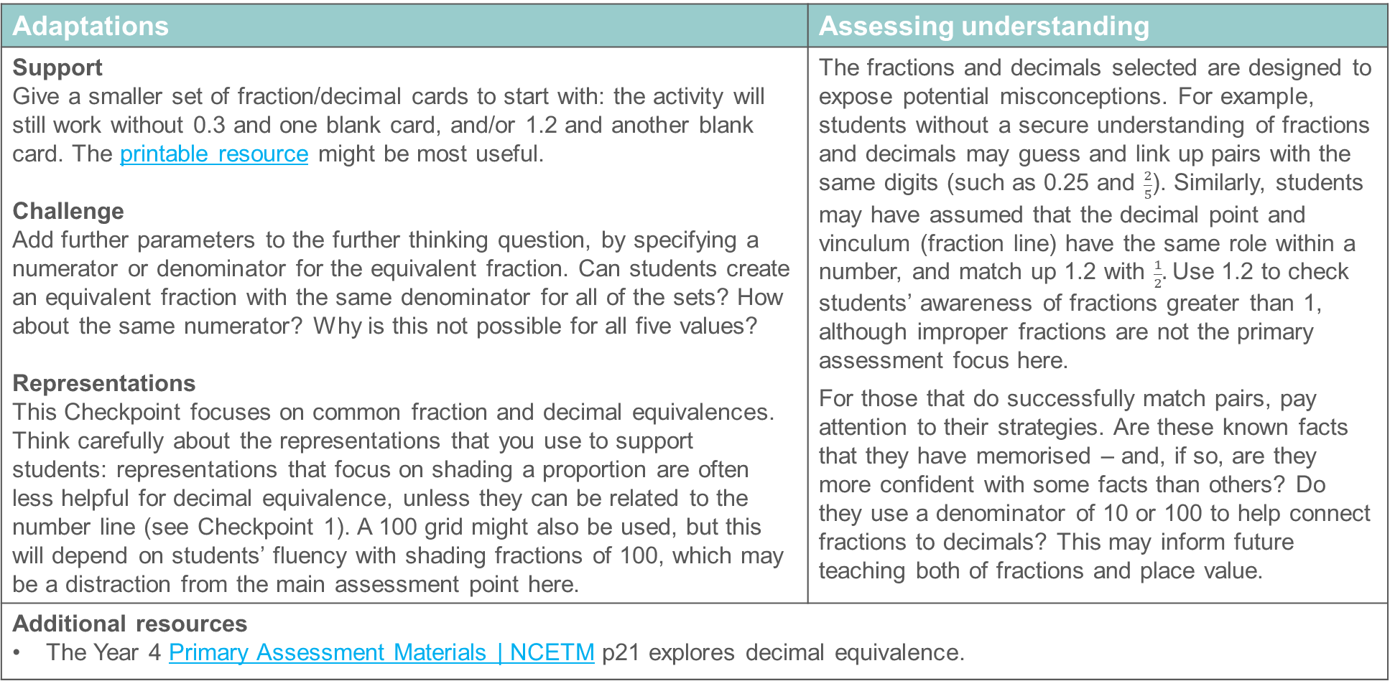
Checkpoint 4: Guidance
Adaptations | Assessing understanding
Support Give a smaller set of fraction/decimal cards to start with: the activity will still work without 0.3 and one blank card, and/or 1.2 and another blank card. The printable resource might be most useful. Challenge Add further parameters to the further thinking question, by specifying a numerator or denominator for the equivalent fraction. Can students create an equivalent fraction with the same denominator for all of the sets? How about the same numerator? Why is this not possible for all five values? Representations This Checkpoint focuses on common fraction and decimal equivalences. Think carefully about the representations that you use to support students: representations that focus on shading a proportion are often less helpful for decimal equivalence, unless they can be related to the number line (see Checkpoint 1). A 100 grid might also be used, but this will depend on students’ fluency with shading fractions of 100, which may be a distraction from the main assessment point here. | The fractions and decimals selected are designed to expose potential misconceptions. For example, students without a secure understanding of fractions and decimals may guess and link up pairs with the same digits (such as 0.25 and $\frac{2}{5}$). Similarly, students may have assumed that the decimal point and vinculum (fraction line) have the same role within a number, and match up 1.2 with $\frac{1}{2}.$Use 1.2 to check students’ awareness of fractions greater than 1, although improper fractions are not the primary assessment focus here. For those that do successfully match pairs, pay attention to their strategies. Are these known facts that they have memorised – and, if so, are they more confident with some facts than others? Do they use a denominator of 10 or 100 to help connect fractions to decimals? This may inform future teaching both of fractions and place value.
Additional resources The Year 4 Primary Assessment Materials | NCETM p21 explores decimal equivalence.

Slide 20
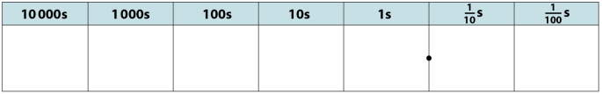
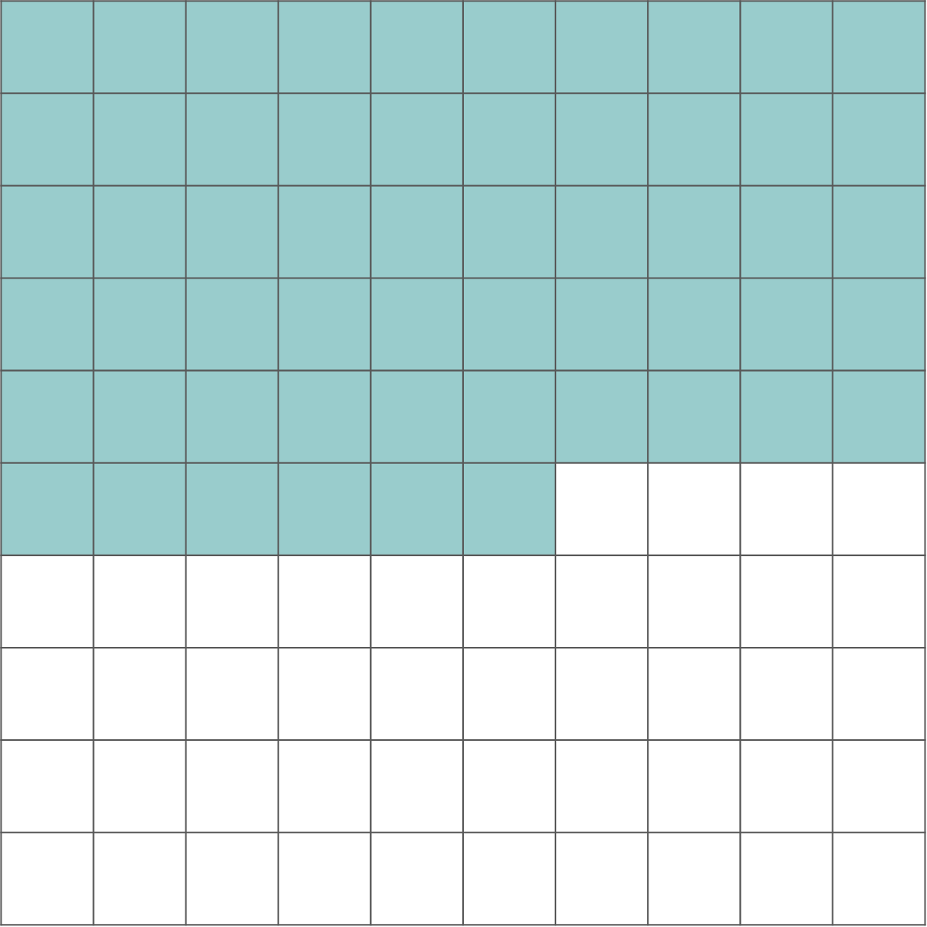
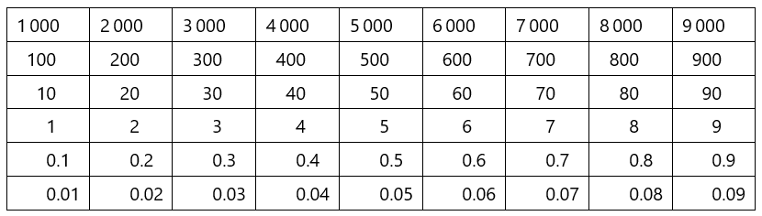
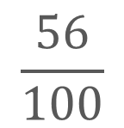
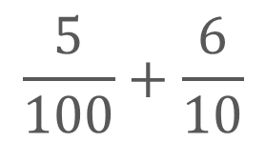
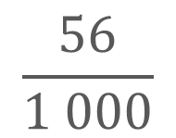
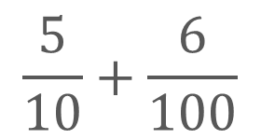
Checkpoint 5: Same value, different appearance
Which of these are equivalent?
5
6
$$\frac{56}{1 000}$$
$$\frac{5}{100}+\frac{6}{10}$$
$$\frac{56}{100}$$
$$\frac{5}{10}+\frac{6}{100}$$
fifty-six hundredths
fifty-six tenths
0.56
0.1
0.01
0.01
0.1
0.01
0.1
0.1
0.01
0.1
0.01
0.01
For those that aren’t equivalent to another, write some statements that are.
Notes:
This slide is animated. Each representation will appear separately so you can choose the pace at which to reveal the slide to your class. As there is a lot of information on this slide, you may wish to give students a copy of the printable resource on slide 116.
Answers
a) $\frac{5}{10}+\frac{6}{100}$, 0.56, $\frac{56}{100}$, fifty six hundredths, the image of five 0.1 and six 0.01 place-value counters. The hundred grid could also be included if the value of the whole square is specified as 1 (and therefore each smaller square represents 0.01).
? Any equivalent value for the remaining values. For example, $\frac{5}{100}+\frac{6}{10}$= 0.65; 56 tenths = 5.6; $\frac{56}{1000}$ = 56 thousandths; the Gattegno chart shows 56 or 5.6 tens; the place-value chart shows 5.06 or 506 hundredths. The hundred grid could be included here if the value of the whole square is specified as something other than 1 (for example, if the whole grid represented 10, then each square would represent 0.1 and the value shown would be 5.6).
Suggested questioning
What is the same? What is different?
Why is (e.g. the value in the place-value chart) not the same as (e.g. the value of the place-value counters)?
In which diagram/number does the digit 5 have the biggest value? When does it have the least value?
Things to think about
Checkpoint 5 uses different representations to make connections between fractions and decimals. While it is designed as an assessment task to check students’ understanding of equivalence, you may also gain useful information about which representations are most familiar to them. This may help you think about which representations to use in future teaching.

Slide 21
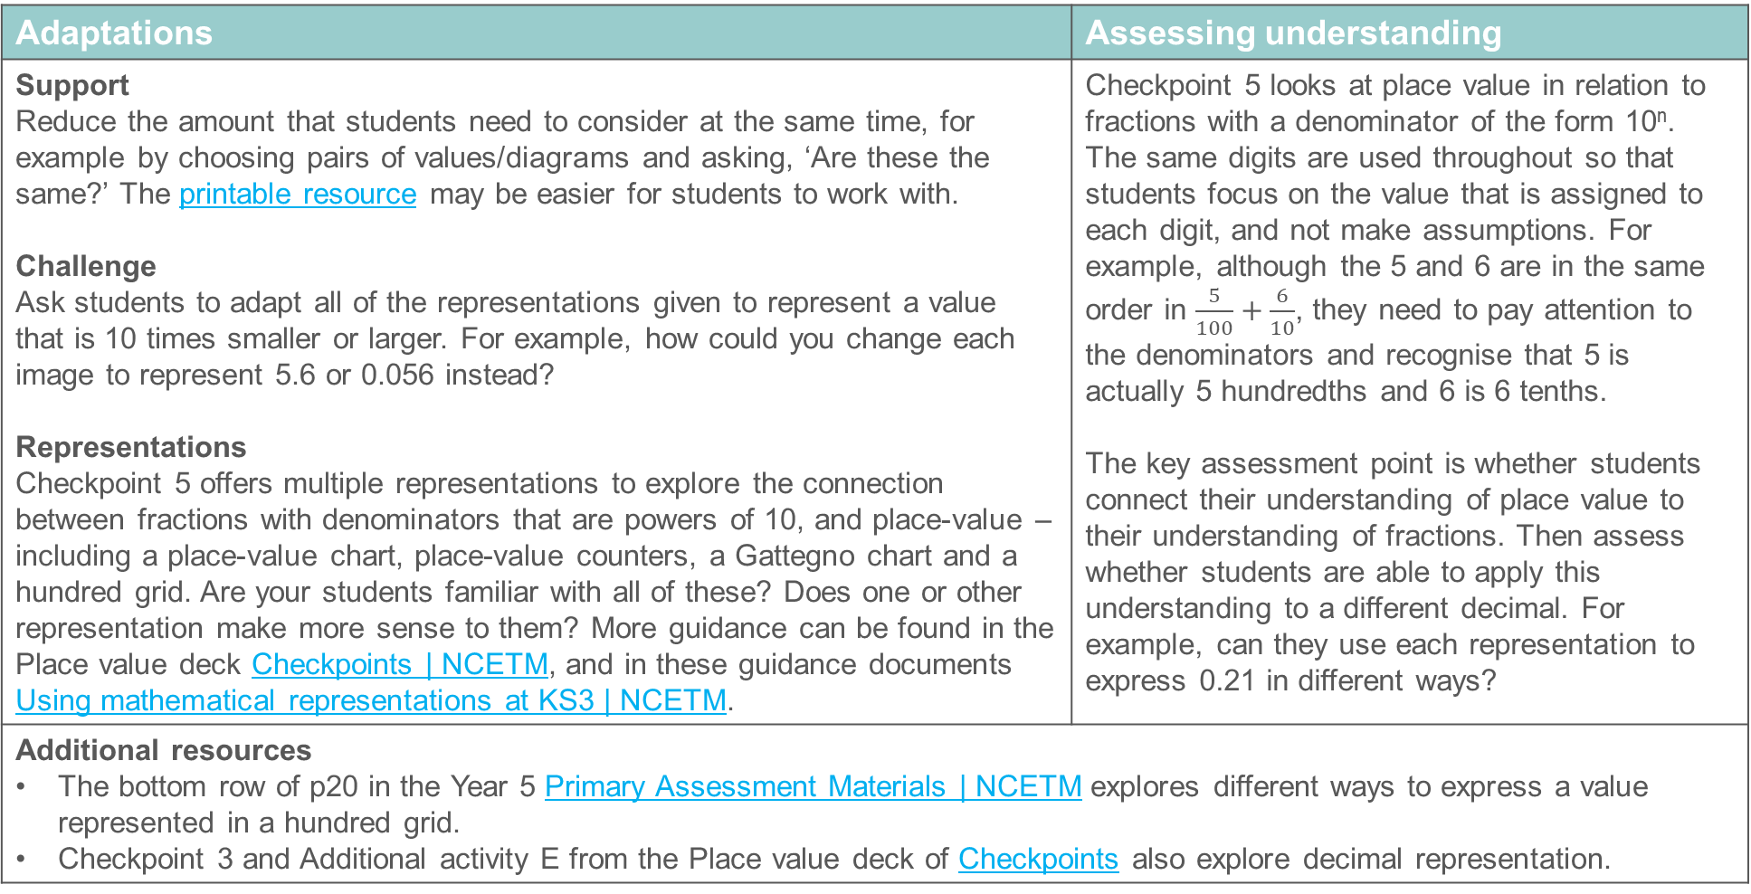
Checkpoint 5: Guidance
Adaptations | Assessing understanding
Support Reduce the amount that students need to consider at the same time, for example by choosing pairs of values/diagrams and asking, ‘Are these the same?’ The printable resource may be easier for students to work with. Challenge Ask students to adapt all of the representations given to represent a value that is 10 times smaller or larger. For example, how could you change each image to represent 5.6 or 0.056 instead? Representations Checkpoint 5 offers multiple representations to explore the connection between fractions with denominators that are powers of 10, and place-value – including a place-value chart, place-value counters, a Gattegno chart and a hundred grid. Are your students familiar with all of these? Does one or other representation make more sense to them? More guidance can be found in the Place value deck Checkpoints | NCETM, and in these guidance documents Using mathematical representations at KS3 | NCETM. | Checkpoint 5 looks at place value in relation to fractions with a denominator of the form 10^{n}. The same digits are used throughout so that students focus on the value that is assigned to each digit, and not make assumptions. For example, although the 5 and 6 are in the same order in $\frac{5}{100}+\frac{6}{10}$, they need to pay attention to the denominators and recognise that 5 is actually 5 hundredths and 6 is 6 tenths. The key assessment point is whether students connect their understanding of place value to their understanding of fractions. Then assess whether students are able to apply this understanding to a different decimal. For example, can they use each representation to express 0.21 in different ways?
Additional resources The bottom row of p20 in the Year 5 Primary Assessment Materials | NCETM explores different ways to express a value represented in a hundred grid. Checkpoint 3 and Additional activity E from the Place value deck of Checkpoints also explore decimal representation.

Slide 22
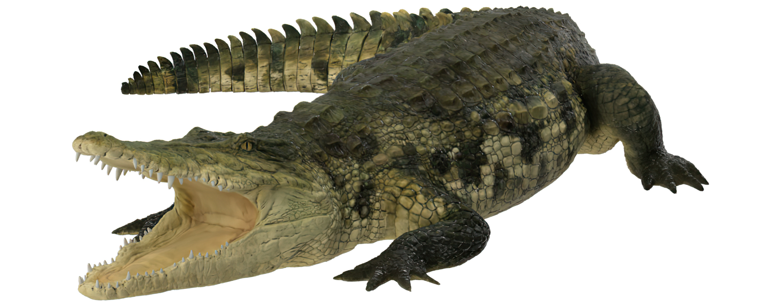
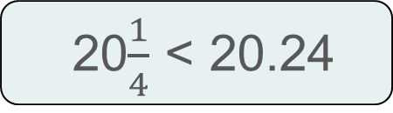
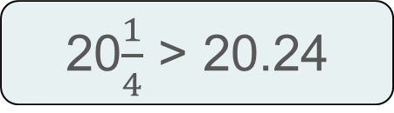
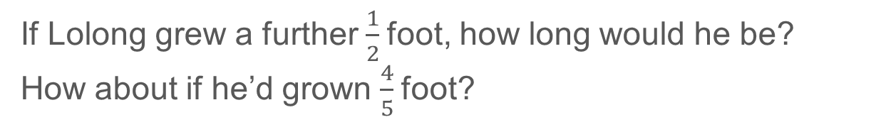
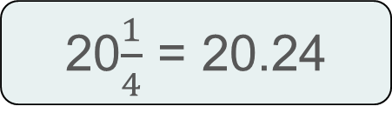
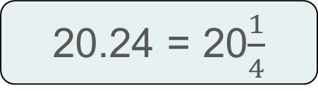


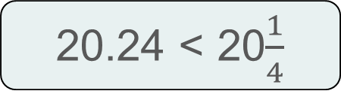
Checkpoint 6: Crocodiles
Lolong is the largest saltwater crocodile to be measured. He was first estimated to be about 20$\frac{1}{4}$ feet long. When measured, he was reported to be 20.24 feet long.
Which of the following is correct?
Was Lolong’s estimated length too long or too short?
20$\frac{1}{4}$ < 20.24
20$\frac{1}{4}$ = 20.24
20$\frac{1}{4}$ > 20.24
20.24 < 20$\frac{1}{4}$
20.24 = 20$\frac{1}{4}$
20.24 > 20$\frac{1}{4}$
If Lolong grew a further $\frac{1}{2}$foot, how long would he be? How about if he’d grown $\frac{4}{5}$foot?
Notes:
This slide is animated. Each question will appear separately so you can choose the pace at which to work with your class. Please note that this Checkpoint uses the imperial unit of feet for length, and it may be worth spending a little time establishing students are familiar with different units of measure at the outset.
Answers
a) $20\frac{1}{4 }$> 20.24 and 20.24 <$20\frac{1}{4}$
b) Lolong’s estimated length was too long (by 0.01 feet).
? If Lolong grew $\frac{1}{2}$ foot, he would be 20.74 feet long. If he grew $\frac{4}{5}$ foot, he would be 21.04 feet long.
Suggested questioning
How long is 20.24/20$\frac{1}{4}$ foot in relation to your classroom? How would this change if the units were metres?
What is the same and what is different about the statements?
How can two inequalities be true?
Can you read the statements from left to right? How about right to left?
Things to think about
Checkpoint 6 looks both at understanding of decimal/fraction equivalence and of the inequality symbol (see Guidance slide for more details). The crocodile context is a slight nod to the common metaphor used to explain inequality symbols (‘the crocodile eats the bigger number’) but unpicking this is not part of the task and you may choose not to draw attention to it. Using an imperial unit may raise some questions – model the approximate length of 1 foot/30 cm and ask students how long 20 of these would be in relation to something more familiar, such as the length of your classroom. Discuss the fact that there are 12 inches in a foot and this means that it is more straightforward to calculate halves and quarters of feet, but not fifths.

Slide 23
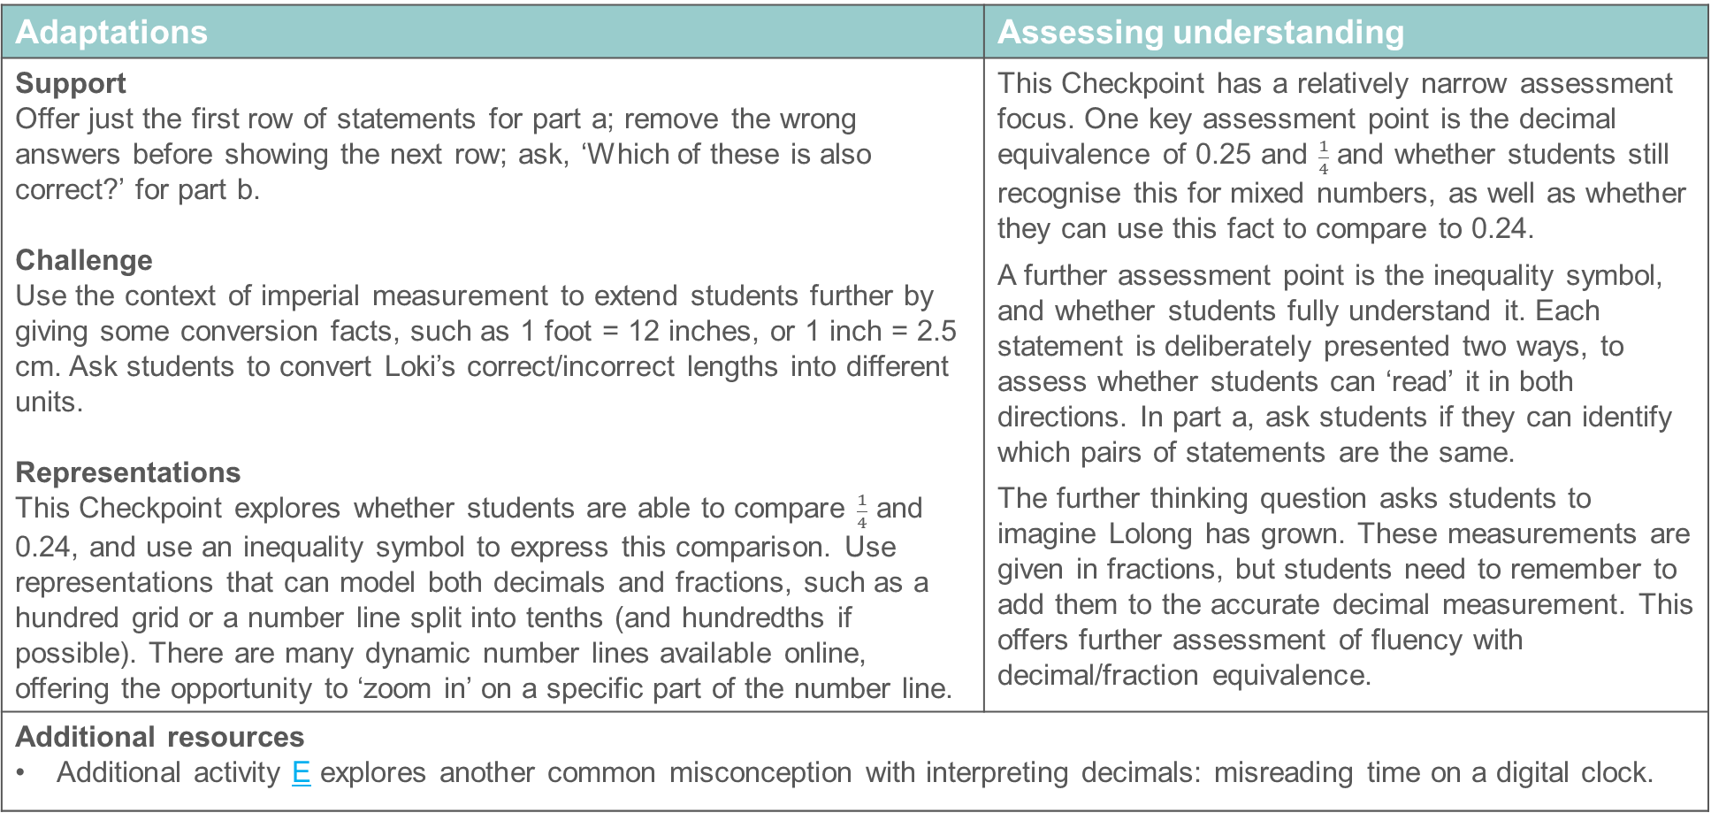
Checkpoint 6: Guidance
Adaptations | Assessing understanding
Support Offer just the first row of statements for part a; remove the wrong answers before showing the next row; ask, ‘Which of these is also correct?’ for part b. Challenge Use the context of imperial measurement to extend students further by giving some conversion facts, such as 1 foot = 12 inches, or 1 inch = 2.5 cm. Ask students to convert Loki’s correct/incorrect lengths into different units. Representations This Checkpoint explores whether students are able to compare $\frac{1}{4}$ and 0.24, and use an inequality symbol to express this comparison. Use representations that can model both decimals and fractions, such as a hundred grid or a number line split into tenths (and hundredths if possible). There are many dynamic number lines available online, offering the opportunity to ‘zoom in’ on a specific part of the number line. | This Checkpoint has a relatively narrow assessment focus. One key assessment point is the decimal equivalence of 0.25 and $\frac{1}{4}$ and whether students still recognise this for mixed numbers, as well as whether they can use this fact to compare to 0.24. A further assessment point is the inequality symbol, and whether students fully understand it. Each statement is deliberately presented two ways, to assess whether students can ‘read’ it in both directions. In part a, ask students if they can identify which pairs of statements are the same. The further thinking question asks students to imagine Lolong has grown. These measurements are given in fractions, but students need to remember to add them to the accurate decimal measurement. This offers further assessment of fluency with decimal/fraction equivalence.
Additional resources Additional activity E explores another common misconception with interpreting decimals: misreading time on a digital clock.

Slide 24
Checkpoint 7: Point to 0.4
0
1
Mungo says that the arrow is pointing to 0.4.
Explain why Mungo is wrong.
Show approximately where 0.4 would be on this scale.
What value is the arrow pointing to?
How could you change the scale so that the arrow does point to 0.4?
Notes:
This slide is animated. Each question will appear separately so you can choose the pace at which to work with your class.
Answers
Mungo is wrong because the divisions on the number line are not in tenths, so each marking does not represent 0.1. Another way of reasoning this is that 0.4 is less than 0.5 (or $\frac{1}{2}$), but the arrow is pointing to a value that is greater than halfway to 1.
b) 0.4 would be below halfway, in this case just before the third division marker.
c) The arrow is pointing to $\frac{4}{7}$.
? Instead of labelling the seventh marker as 1, it could be marked 0.7 or $\frac{7}{10}$.
Suggested questioning
Is the arrow pointing to a number that is more or less than $\frac{1}{2}$?
What does each line represent?
Why might someone think this is 0.4? What have they misunderstood?
Things to think about
Checkpoint 7 explores some common misconceptions around the number line, particularly around markings that are not given in tenths. The values are given as decimals, so notice how students handle part c. Do they attempt to estimate a decimal? If so, do they give a reasonable estimate that is greater than 0.5? Or do they recognise that fractions are a more accurate way to describe this position on the number line?

Slide 25
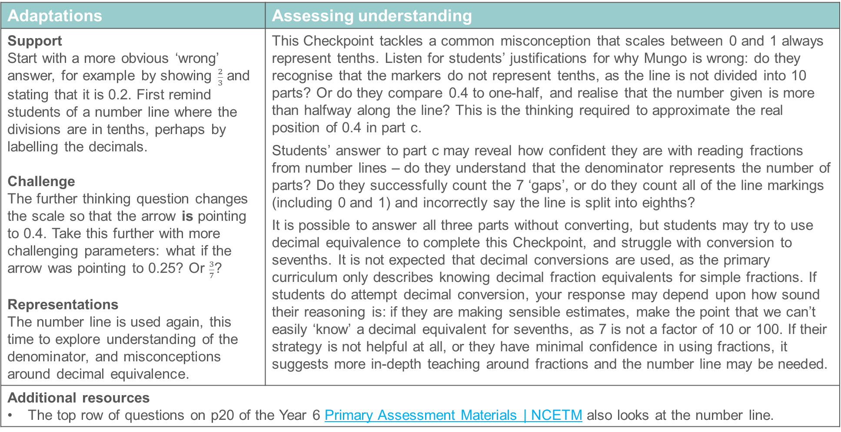
Checkpoint 7: Guidance
Adaptations | Assessing understanding
Support Start with a more obvious ‘wrong’ answer, for example by showing $\frac{2}{3}$ and stating that it is 0.2. First remind students of a number line where the divisions are in tenths, perhaps by labelling the decimals. Challenge The further thinking question changes the scale so that the arrow is pointing to 0.4. Take this further with more challenging parameters: what if the arrow was pointing to 0.25? Or $\frac{3}{7}$? Representations The number line is used again, this time to explore understanding of the denominator, and misconceptions around decimal equivalence. | This Checkpoint tackles a common misconception that scales between 0 and 1 always represent tenths. Listen for students’ justifications for why Mungo is wrong: do they recognise that the markers do not represent tenths, as the line is not divided into 10 parts? Or do they compare 0.4 to one-half, and realise that the number given is more than halfway along the line? This is the thinking required to approximate the real position of 0.4 in part c. Students’ answer to part c may reveal how confident they are with reading fractions from number lines – do they understand that the denominator represents the number of parts? Do they successfully count the 7 ‘gaps’, or do they count all of the line markings (including 0 and 1) and incorrectly say the line is split into eighths? It is possible to answer all three parts without converting, but students may try to use decimal equivalence to complete this Checkpoint, and struggle with conversion to sevenths. It is not expected that decimal conversions are used, as the primary curriculum only describes knowing decimal fraction equivalents for simple fractions. If students do attempt decimal conversion, your response may depend upon how sound their reasoning is: if they are making sensible estimates, make the point that we can’t easily ‘know’ a decimal equivalent for sevenths, as 7 is not a factor of 10 or 100. If their strategy is not helpful at all, or they have minimal confidence in using fractions, it suggests more in-depth teaching around fractions and the number line may be needed.
Additional resources The top row of questions on p20 of the Year 6 Primary Assessment Materials | NCETM also looks at the number line.

Slide 26
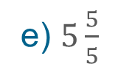
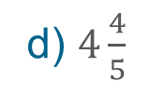
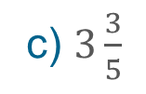
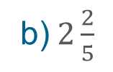
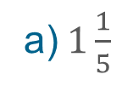

Checkpoint 8: Revenge of the fifth
One-fifth is marked on the number line
0
$$\frac{1}{5}$$
Sketch a copy of this number line and mark on the following fractions:
a)$1\frac{1}{5}$
b)$2\frac{2}{5}$
c) $3\frac{3}{5}$
d) $4\frac{4}{5}$
e) $5\frac{5}{5}$
Richard says, ‘If we continue this pattern, we will never mark a multiple of five.’ Is he correct? Explain how you know.
Notes:
This slide is animated. Each question will appear separately so you can choose the pace at which to work with your class. If you do not want students to sketch the number line, a printable resource is available on slide 117.
Answers
The answers are given as animations on the next slide.
? Richard is not correct: any common multiples of 5 and 6 will be marked. He has noticed that the next integer is 6, which is not a multiple of 5, but has not thought further ahead. The integers marked are all multiples of 6, so every fifth integer will also be a multiple of 5: 6, 12, 18, 24, 30, 36, 42, 48, 54, 60, 66, 72, 78, 84, 90 etc.
Suggested questioning
Where will 1 be? How do we know?
How far apart are one and one-fifth and two and two-fifths? Are all of the gaps the same length?
What’s your strategy for marking the points accurately?
If you know that one-fifth is 1 cm from zero, where would you mark one and one-fifth?
Things to think about
Checkpoint 8 explores fractions on a number line but also draws upon students’ familiarity with fractions greater than one. Here, they are given as mixed numbers: are students comfortable with this, or do they convert to improper fractions? Students should have experienced counting in fractions along the number line from as early as Year 3: what might be the value of asking students to count up and say the fractions out loud? Would you count beyond the values given?

Slide 27

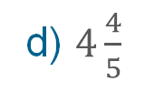

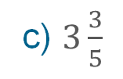

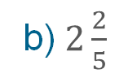

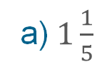

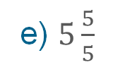
Checkpoint 8: Revenge of the fifth (animated solutions)
One-fifth is marked on the number line
0
$$\frac{1}{5}$$
$$1\frac{1}{5}$$
$$2\frac{2}{5}$$
$$3\frac{3}{5}$$
$$4\frac{4}{5}$$
$$5\frac{5}{5}$$
Sketch a copy of this number line and mark on the following fractions:
a)$1\frac{1}{5}$
b)$2\frac{2}{5}$
c) $3\frac{3}{5}$
d) $4\frac{4}{5}$
e) $5\frac{5}{5}$
Notes:
.

Slide 28
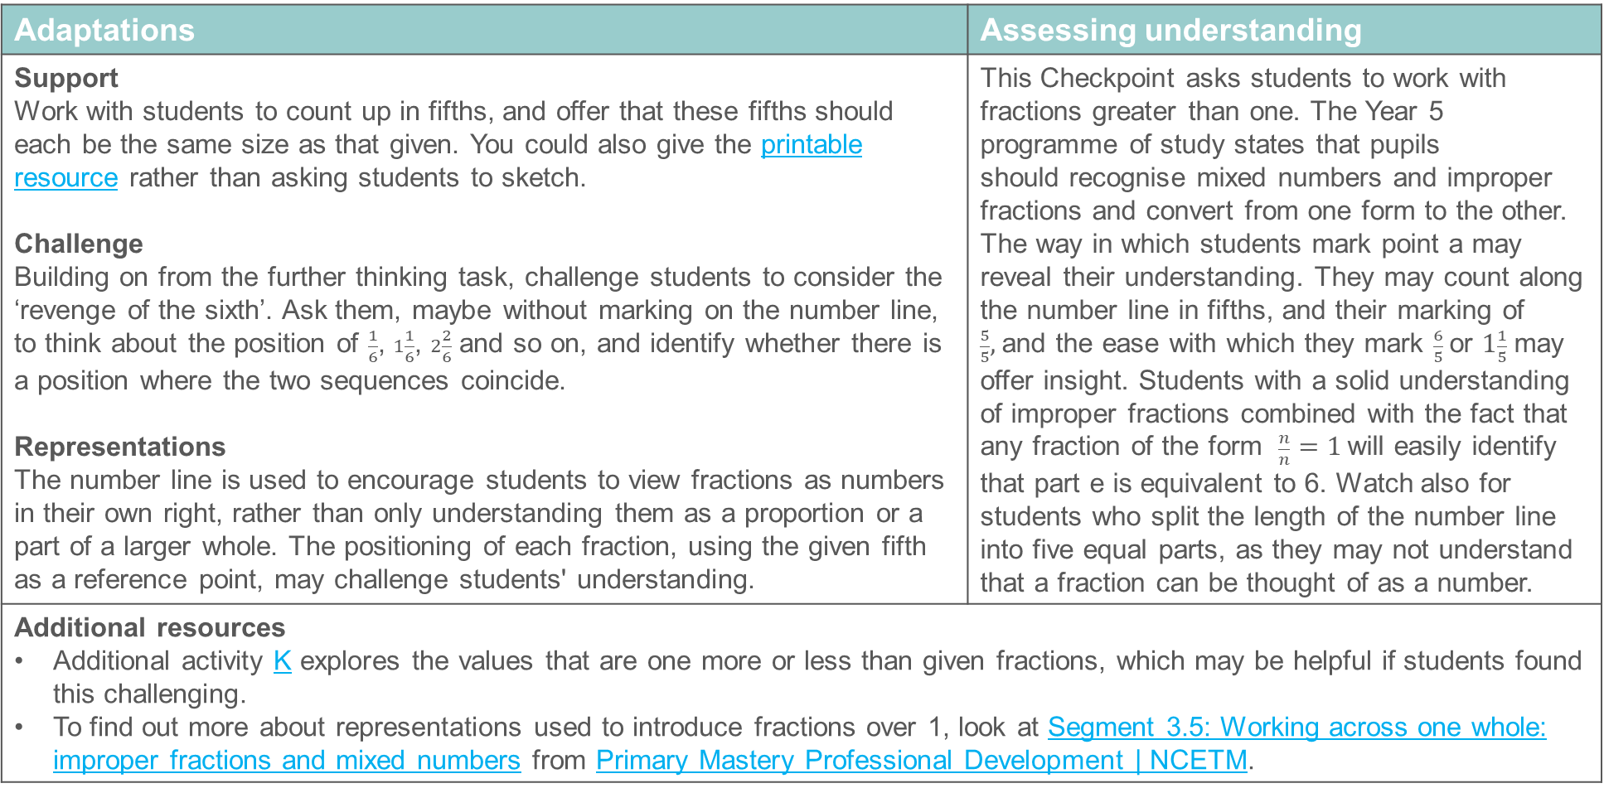
Checkpoint 8: Guidance
Adaptations | Assessing understanding
Support Work with students to count up in fifths, and offer that these fifths should each be the same size as that given. You could also give the printable resource rather than asking students to sketch. Challenge Building on from the further thinking task, challenge students to consider the ‘revenge of the sixth’. Ask them, maybe without marking on the number line, to think about the position of $\frac{1}{6}$, $1\frac{1}{6}$, $2\frac{2}{6}$ and so on, and identify whether there is a position where the two sequences coincide. Representations The number line is used to encourage students to view fractions as numbers in their own right, rather than only understanding them as a proportion or a part of a larger whole. The positioning of each fraction, using the given fifth as a reference point, may challenge students' understanding. | This Checkpoint asks students to work with fractions greater than one. The Year 5 programme of study states that pupils should recognise mixed numbers and improper fractions and convert from one form to the other. The way in which students mark point a may reveal their understanding. They may count along the number line in fifths, and their marking of $\frac{5}{5},$and the ease with which they mark $\frac{6}{5}$or $1\frac{1}{5}$ may offer insight. Students with a solid understanding of improper fractions combined with the fact that any fraction of the form $\frac{n}{n}=1$will easily identify that part e is equivalent to 6. Watch also for students who split the length of the number line into five equal parts, as they may not understand that a fraction can be thought of as a number.
Additional resources Additional activity K explores the values that are one more or less than given fractions, which may be helpful if students found this challenging. To find out more about representations used to introduce fractions over 1, look at Segment 3.5: Working across one whole: improper fractions and mixed numbers from Primary Mastery Professional Development | NCETM.

Slide 29
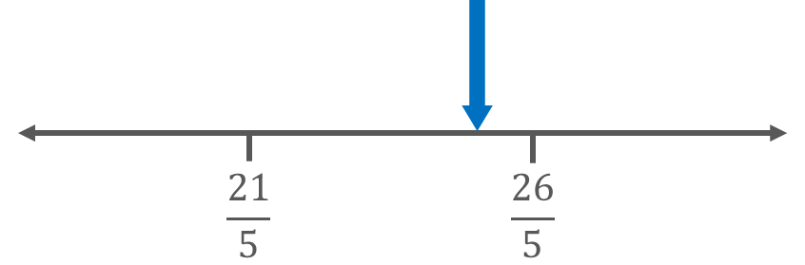
Checkpoint 9: Whole numbers
Here is a section of a number line.
The blue arrow is pointing to a whole number.
Which whole number must it be pointing to? Explain how you know.
Mark on the whole numbers that are immediately above and below it.
How would your answers change if the denominator was 6, rather than 5?
What could the denominator be if there were no whole numbers between the two fractions?
Notes:
This slide is animated. Each question will appear separately so you can choose the pace at which to work with your class.
Answers
a) The whole number must be 5, as $\frac{25}{5}$ = 5 (and the arrow is pointing to a number just below $\frac{26}{5}$ , but above $\frac{21}{5}$).
b) Four is just below $\frac{21}{5}$ (as it is $\frac{20}{5}$ ). Six is above $\frac{26}{5}$ (as it is $\frac{30}{5}$).
c) If the fractions marked were $\frac{21}{6}$ and $\frac{26}{6}$ , then the arrow must be pointing to the number 4 (as $\frac{24}{6}$ = 4 and is the only whole number between $\frac{21}{6}$ and $\frac{26}{6}$ ). The whole number below would be marked at 3 (as it is $\frac{18}{6}$ ) and 5 (as it is $\frac{30}{6}$).
? If there were no whole numbers between the fractions, the denominator could be 7 (since $\frac{21}{7}$ = 3, and $\frac{26}{7}$ < 4); 9 (since $\frac{18}{9}$ = 2 and $\frac{27}{9}$ = 3); 10 (since $\frac{20}{10}$ = 2 and $\frac{30}{10}$ = 3); 13 (as $\frac{26}{13}$ = 2); and then any integer greater than 13. It cannot be 2 (since $\frac{22}{2}$ = 11); 3 (since $\frac{24}{3}$ = 8); 4 (since $\frac{24}{4}$ = 6); 8 (since $\frac{24}{8}$ = 3); 11 (since $\frac{22}{11}$= 2); or 12 (since $\frac{24}{12}$ = 2).
Suggested questioning
What fractions are between 21 fifths and 26 fifths?
What fifths are between 21 fifths and 26 fifths?
How would you mark the next whole number along? How many fifths is it?
Things to think about
Much like Checkpoint 8, Checkpoint 9 presents fractions that are greater than one on the number line. This time, they are presented as improper fractions: are students comfortable with this, or do they convert to mixed numbers? Familiarity with multiplication facts is key to the understanding of this Checkpoint, particularly part c and the further thinking question, and you may wish to make explicit the link to students’ previous work on multiples and factors.

Slide 30

Checkpoint 9: Guidance
Adaptations | Assessing understanding
Support As in Checkpoint 8, suggest that students start from 21-fifths and count up in fifths – is there is a fraction they identify as a whole number? Some students may be more familiar with representing improper fractions as mixed numbers. Identifying the two marked values as $4\frac{1}{5}$ and $5\frac{1}{5}$ may make the missing whole number more apparent. Challenge Challenge students to identify other values that sit between the two given fractions. Rather than find the whole number, ask them to identify all the fractions with a denominator of 10, or of 6. Ask students to find the number that's exactly halfway or one-third of the way between the two given values. Representations Using the number line identifies whether students understand that a fraction is a number in its own right. Interpreting a fraction as a proportion, or a part of a whole, is correct but suggests an incomplete understanding of fractions that may prove challenging when, for example, working with equivalent decimals or using the four operations with fractions. | Checkpoint 9 explores whether students understand fractions as a representation of a division, and are able to use this to identify a division with an integer solution. Students may want to reach for mixed numbers, rather than work with improper fractions. This may be evidence of a limited understanding of the different ways that a fraction can be interpreted. Explore whether students make links with multiplication facts in recognising that, for every whole number with a denominator of five, the numerator will be a multiple of four. Part b and the further thinking question probe this understanding.
Additional resources To find out more about representations used to introduce fractions over one, use Segment 3.5: Working across one whole: improper fractions and mixed numbers | NCETM from Primary Mastery Professional Development | NCETM.

Slide 31


Checkpoint 10: Dividing lines
Carys is using a number line to think about division.
She’s already marked 12 ÷ 1, 12 ÷ 2 and 12 ÷ 3 on the line.
Where should she mark 12 ÷ 4? Why?
Which do you think is easier to mark next, 12 ÷ 5 or 12 ÷ 6? Why?
Mark 12 ÷ 5 and 12 ÷ 6 on the line.
How many division calculations can you find that occupy the same position on the line as 12 ÷ 6? How about 12 ÷ 5?
Notes:
This slide is animated. Each question will appear separately so you can choose the pace at which to work with your class. A printable resource is on slide 118.
Answers
a) 12 ÷ 4 = 3, so this should be marked at 3.
b) Students are likely to suggest 12 ÷ 6, as 6 is a factor of 12 so the division has an integer solution.
c) 12 ÷ 6 = 2, so this should be marked at 2; 12 ÷ 5 = 2.4. Please note, students are not expected to ‘know’ this, and may not work it out, but should reason that the solution will be between 2 and 3, but closer to 2.
? For 12 ÷ 6, any other divisions with a quotient of 2 (e.g. 24 ÷ 12; 48 ÷ 24; 10 ÷ 5; 11 ÷ 5.5; 6 ÷ 1). For 12 ÷ 5, any other divisions with a quotient of 2.4 (e.g. 24 ÷ 10, 48 ÷ 20, 6 ÷ 2.5).
Suggested questioning
Where do you predict 12 divided by five will be? How might you mark it accurately?
Do you expect all of the points to be the same distance apart? What’s happening to the distance between them? Can you explain why?
If we continued the sequence, dividing 12 by different whole numbers, which is the first calculation which will go below 1?
Things to think about
Checkpoint 10 does not explicitly reference fractions, but may be a useful to explore students’ understanding ahead of teaching in several key areas with fractions. Assess whether students connect division with fractions, and specifically whether they understand that fractions are divisions and that performing that division results in an equivalent decimal. There are also useful links to be made here with equivalent fractions, and understanding more deeply that this means they have the same value and position on the number line (rather than just performing a process to ‘create’ equivalent fractions). Another potential link can be made to improper fractions and mixed numbers.

Slide 32
Checkpoint 10: Guidance
Adaptations | Assessing understanding
Support Students will be familiar with division, and most of the questions offer integer solutions, but using a number line to record the results may be challenging for some. Work with students to estimate and predict the position of the numbers and give them the printable resource. Challenge Students who identify 12 ÷ 6 as a different representation of twelve-sixths are likely to be successful with the further thinking task. Challenge this further by asking them to write more equivalent divisions but with increasing constraints. For example, where the dividend starts with the digit 7, or the divisor is greater than 100. Representations The number line supports students in identifying that divisions and fractions are different ways to represent a value that occupies a position on the number line. The number line is used here to make this equivalence explicit rather than interpreting division as 'sharing' and fraction as 'a small part’. If you do use a 'sharing' interpretation of division, e.g. by considering 12 ÷ 3 as the length of 12 on the number line split into three equal parts, then plan ahead how you will explain to students that the value of the quotient is the first point marked. | Checkpoint 10 explores how students understand the connection between a division calculation and a fraction. The methods and strategies used by students offer insight into this understanding. For example, students who use an algorithm to calculate the result of the division may have a different understanding to those who use known facts. It is likely that students’ discussion around 12 ÷ 5 will offer the greatest insight into their interpretation of the calculation – take time to explore this calculation with students.
Additional resources To find out more about how division is introduced and talked about at primary school, it may be helpful to explore Topic 2.6 Segment 2.6: Structures: quotitive and partitive division from Primary Mastery Professional Development | NCETM. Additional activity A also explores the position of quotients on the number line, using the same divisions as a starting point.

Slide 33



Checkpoint 11: Sevenths
Estimate the value of 1 ÷ 7 and mark it on the number line.
Natalia uses a calculator to find out that 1 ÷ 7 is approximately 0.14.
Use this information to mark the fraction $\frac{1}{7}$ on the number line.
Tauseef uses a calculator to find out that 3 ÷ 7 is approximately 0.43.
Use this information to mark the fraction $\frac{3}{7}$ on the number line.
Mark the fraction $\frac{4}{7}$ on the number line.
Using your answers (and without using a calculator), what other sevenths can you mark on the number line?
Notes:
This slide is animated. Each question will appear separately so you can choose the pace at which to work with your class. A printable resource of the number line is provided on slide 119.
Answers
a) Approximately 0.14 (just under halfway between 0.1 and 0.2). Do not correct answers at this stage, as part b reveals the answer.
b) $\frac{1}{7}$ should be marked at 0.14 (just under halfway between 0.1 and 0.2).
c) $\frac{3}{7}$ should be marked at 0.43 (a little closer to 0.4 than 0.5).
d) $\frac{4}{7}$ = $\frac{1}{7}$ + $\frac{3}{7}$ = 0.14 + 0.43 = 0.57 (a little closer to 0.6 than 0.5).
? Students’ responses may vary, depending on which operations they choose to do with the three fractions that they have worked with in parts a to c. Two likely solutions may be doubling $\frac{3}{7}$ to mark $\frac{6}{7}$ at 0.86 or subtracting $\frac{1}{7}$ from $\frac{3}{7}$ to mark $\frac{2}{7}$ at 0.28.
Suggested questioning
What do 1 ÷ 7 and $\frac{1}{7}$ have in common? What’s different about them?
If you didn’t know that 1 ÷ 7 = 0.14, and didn’t have a calculator, what strategy would you use to mark the result?
Would you estimate 1 ÷ 7? What’s an estimate that you might be able to carry out in your head?
Things to think about
Checkpoint 11 explicitly explores fractions as divisions and checks whether students understand that $\frac{1}{7}$ is another way of writing 1 ÷ 7. The national curriculum includes association of a fraction with division, and decimal equivalence, for simple fractions such as $\frac{3}{8}$= 0.375. Students will not already know decimal equivalents for sevenths, which is why they are explored here. A sticking point may be the positioning of hundredths on a number line marked in tenths: if students cannot place these accurately, consider coming back to this after some more teaching on the decimal number line. Checkpoint 12 also explores fractions as divisions but focuses instead on the relative size of divisions with different denominators; you could consider both tasks together.

Slide 34

Checkpoint 11: Guidance
Adaptations | Assessing understanding
Support Support students in interpreting the fraction as a division, and so connecting parts a and b. Use a context to make this connection. For example, one object shared between seven people can be calculated as 1 ÷ 7 and represented as one-seventh). Use the printable resource. Challenge Explore students' understanding of the different ways of manipulating fractions. For example, having used the given information to mark $\frac{4}{7}$ on the number line, ask students to mark $\frac{4}{14}$, or determine which is greater, 0.7 or $\frac{5}{7}$. Representations A number line is used to identify whether students understand fractions as numbers in their own right. If they struggle to connect this with division, find out students’ preferred understanding of division (such as a bar model) and use a representation of fractions to complement this. Then connect this back to the number line representation in future teaching. | The focus of Checkpoint 11 is the equivalence of fractions and decimals, alongside interpreting a fraction as a division. Part a asks students to estimate – if students have a reasonable understanding here, they may use a strategy such as dividing the line into seven parts (note whether they realise they just need to divide the line between 0 and 1, rather then the whole illustrated line). Parts b and c show whether students are aware of the connection between fractions and division, as well as their understanding of marking fractions on the decimal number line. Part d goes further and asks students to work between fractions and decimals: do they fully understand the equivalence, and recognise that they can use them interchangeably? The further thinking question offers students the chance to use this understanding more creatively.
Additional resources Refer to Key idea 1.3.1.3: Understanding fractions as divisions from 1.3 Ordering and comparing, within the Secondary Mastery Professional Development | NCETM. Additional activity B is a more challenging version of this task.

Slide 35

Checkpoint 12: 5 678
Kemar has sketched the positions of three division calculations on a number line.
Use Kemar’s marking of 3 ÷ 4, 4 ÷ 4 and 5 ÷ 4 to sketch the positions of:
5 ÷ 6
6 ÷ 6
7 ÷ 6
5 677 ÷ 5 678
5 678 ÷ 5 678
5 679 ÷ 5 678
Find a similar set of three divisions that would be positioned just below 2, exactly on 2, and just above 2.
Notes:
This slide is animated. Questions a to c will appear separately to questions d to f so you can choose the pace at which to work with your class. A printable resource is provided on slide 120.
Answers
The answers are also given as animations on the next slide.
a) 5 ÷ 6 should be marked just to the right of 3 ÷ 4, closer to 3 ÷ 4 than 1.
b) 6 ÷ 6 should be marked at 1.
c) 7 ÷ 6 should be marked just to the left of 5 ÷ 4, closer to 5 ÷ 4 than 1.
NB parts a and c should be equidistant from 1.
d) 5677 ÷ 5678 should be marked just below 1, much closer to 1 than 5 ÷ 6.
e) 5678 ÷ 5678 should be marked at 1.
f) 5679 ÷ 5678 should be marked just about 1, much closer to 1 than 7 ÷ 6.
NB parts d and f should be equidistant from 1 .
Suggested questioning
What number is 3 ÷ 4 pointing to? How else could you describe that number?
How about 5 ÷ 4? How else could you describe it?
Why do the numbers get closer to 1 in d to f when compared to a to c?
Things to think about
The concepts explored in Checkpoint 12 are linked to those in Checkpoint 11. Ask students if they have other ways to write or think about 4 ÷ 4 or 3 ÷ 4. Some students may know that 3 ÷ 4 is equivalent to 0.75 and choose to work with decimals. Although offering a route into the task, this is likely to be less productive when reasoning about sixths, or about five thousand, six hundred and seventy-eighths. Showing the distance between 0 and 1 divided into two, then six parts may be a more helpful way to model this idea to students.

Slide 36
Checkpoint 12: 5 678 (animated solutions)
a) 5 ÷ 6
c) 7 ÷ 6
b) 6 ÷ 6
d) 5677 ÷ 5678
f) 5679 ÷ 5678
e) 5678 ÷ 5678
Notes:
This slide is animated. Each answer will appear separately. Students may have slightly different positions: the key point is that the answer to part d is much closer to 1 than the answer to a. Similarly, the answer to f should be much closer to 1 than the answer to c. The answers to b and e should both be 1.

Slide 37

Checkpoint 12: Guidance
Adaptations | Assessing understanding
Support Consider the order in which you present them to the class. You could summarise the answers using a sorting exercise: ask students to identify the divisions that are less than 1, exactly 1 and more than 1 and to reflect on what they notice about the numerator and denominator. The printable resource may also help. Challenge Ask students to generate their own divisions – can they find a division that is even closer to one than 5677 ÷ 5678? Challenge students to consider sets of three fractions where both the numerator and denominator are consecutive. Do they recognise the fraction closest to one for a set like $\frac{5}{6}$, $\frac{7}{8}$ and $\frac{9}{10}$? How about $\frac{8}{7}$, $\frac{9}{8}$ and $\frac{10}{9}$? Representations Use the number line to focus on the fractions equivalent to one to support students in seeing why the fractions either side are getting progressively closer to one. Marking them at a small distance from one, and considering how that distance is represented in the fraction, may help students to see the structure underpinning the task | Checkpoint 12 offers a context for students to reason with fractions and division, and to work between these two representations of number. The positioning of a division on the number line is likely to be unfamiliar. Listen for students who convert the division to a fraction to make the placement. Students may reason more comfortably about the relative sizes of fractions than divisions – do they talk about ‘bigger denominators’ and understand that these mean smaller parts? Can they connect this to divisors? The accuracy of students’ placement is less important than their relative position: look for an awareness that 5 ÷ 6 is closer to 1 than 3 ÷ 4, but that 5677 ÷ 5678 is even closer still.
Additional resources Refer to Key idea 1.3.1.3: Understanding fractions as divisions from 1.3 Ordering and comparing, within the Secondary Mastery Professional Development | NCETM.

Slide 38
Comparing and ordering fractions
Checkpoints 13–18

Slide 39

Comparing and ordering fractions
Previous learning | In Key Stage 3 students need to
Key Stage 2 curriculum: Year 3: compare and order unit fractions and fractions with the same denominators Year 5: compare and order fractions whose denominators are all multiples of the same number and read, write and compare numbers with up to three decimal places Year 6: compare and order fractions including fractions > 1 Further information about how students may have experienced this key idea in Key Stage 2: Teaching mathematics in primary schools 6F–1: recognise when fractions can be simplified and use common factors to simplify fractions (pp 312–15); 6F–2: express fractions in a common denomination and use this to compare fractions that are similar in value (pp316–19); 6F–3: compare fractions with different denominators, including fractions greater than 1, using reasoning and choose between reasoning and common denomination as a comparison strategy (pp319–21). Primary Mastery Professional Development, Spine 3 Fractions, Year 3 Segment 3.3 Non-unit fractions: identifying, representing and comparing (particularly teaching points 7 and 8) * Page numbers reference the complete Years 1–6 document. This document covers positioning decimals on a number line but not ordering them. | Understand different ways that numbers can be expressed; become more proficient in changing from one form to another. Develop methods for ordering numbers to include converting between equivalent fractions and decimals as appropriate. Have an appreciation of magnitude (e.g. if students know that 0.6 > $\frac{1}{2}$ and $\frac{3}{7}$ < $\frac{1}{2}$, they should be able to deduce that 0.6 > $\frac{3}{7}$ without resorting to converting to a common format). Recognise that for any given pair of numbers, a third that is greater than both, smaller than both or in between the two can always be found.

Slide 40





Checkpoint 13: Equivalent fractions
Complete the missing boxes to find fractions equivalent to $\frac{3}{21}$.
$$\frac{3}{21} = \frac{5}{}$$
$$\frac{3}{21} = \frac{6}{}$$
Which did you find easier to do? Why?
Find three more fractions equivalent to $\frac{3}{21}$. What is your strategy?
3 × 97 = 291. Use this fact to find these equivalent fractions:
$$\frac{3}{291} = \frac{10}{}$$
$$\frac{3}{4} = \frac{291}{}$$
Notes:
This slide is animated. Each question will appear separately so you can choose the pace at which to work with your class.
Answers
a) $\frac{3}{21}$ = $\frac{5}{35}$; $\frac{3}{21}$ = $\frac{6}{42}$
b) This will depend on students’ experience of fractions. Students are likely to find the right-hand statement more accessible as they may be more used to identifying a multiplicative relationship between two numerators, rather than the multiplicative relationship between the numerator and the denominator.
c) Any fractions where the denominator is seven times the numerator.
? $\frac{3}{291}$ = $\frac{10}{970}$; $\frac{3}{4}$ = $\frac{291}{388}$
Suggested questioning
How might you tell that $\frac{123}{246}$ is equivalent to one-half?
How might you use the fact that 3 × 7 = 21 to help you answer the questions?
Things to think about
Checkpoint 13 explores how students think about equivalent fractions, and may a reliance on using a method rather than thinking about the relationship between the numerator and the denominator. It is worth dwelling on part b and fully discussing students’ strategies before giving them the opportunity to complete part c. Consider also the language that you use to draw attention to the relationships. For example, use a sentence frame such as 'the denominator is __ times (the size of) the numerator’. What might be the benefit of having a familiar sentence structure such as this?

Slide 41

Checkpoint 13: Guidance
Adaptations | Assessing understanding
Support Use a more familiar fractional relationship. For example, using $\frac{7}{14} = \frac{8}{?}$ may offer insight into the structure of the task and draw attention to the relationship between the numerator and denominator in each case. Challenge Given a calculation such as 173 × 551= 95 323, ask students to write as many different pairs of equivalent fractions as they can. Representations If students are familiar with the use of a ratio table or double number line, they may give insight into the structure of this task. Guidance about these, and other representations, can be found in Using mathematical representations at KS3 | NCETM). | The assessment focus of this task is the different multiplicative relationships that exist in equivalent fractions. It is likely that students will be able to find equivalences using a rule such as 'whatever you multiply the top by, you multiply the bottom by the same’. However, this ignores a second relationship, that between the numerator and denominator. For example, in all fractions equivalent to two-thirds, the numerator is $\frac{2}{3}$ of the denominator and the denominator is $\frac{3}{2}$ of the numerator. This is likely to be a much rarer understanding among year 7 students, although they may be able to articulate it for simpler fractions such as $\frac{1}{2}$ or $\frac{1}{4}$. Students who have not understood this fully may fall back on using multiplication tables (for example, counting up in threes for the numerator and 21 for the denominator) for part c. A useful prompt might be to find a unit fraction equivalent to $\frac{3}{21}$ to help them see that the denominator is seven times larger than the numerator. Offering students unfamiliar multiplication facts to use, as in the further thinking question, gives a context for them to discuss and show their understanding of the different possible relationships represented by the fractions.
Additional resources Page 19 of the Year 6 Primary Assessment Materials | NCETM has equivalent fractions missing box problems. Key idea 1.3.1.5 in 1.3 Ordering and comparing, part of Secondary Mastery Professional Development | NCETM, explores equivalence and simplification of fractions.

Slide 42
Checkpoint 14: Five different digits
Arrange five different digits into this inequality to make it true.
>
>
How would your answer change if the integer was at the other end of the inequality?
>
>
Notes:
This slide is animated. The further thinking question will appear separately so you can choose the pace at which to work with your class.
Answers
There are multiple possible answers; check that students’ inequalities are valid. If you are unsure, you may find it helpful to write divisions in a calculator and compare the decimal equivalents instead. (Note that this guidance is for teachers, and we do not recommend this as a strategy for self- or peer-assessment as students are unlikely to have used calculators in this way at primary school.) Some possible examples include 1 > $\frac{3}{4}$ > $\frac{2}{5}$ or 5 > $\frac{7}{2}$ > $\frac{9}{3}$.
? Again, there are multiple possible answers. In the first example above, this would require students to change their fractions to be improper, for example $\frac{5}{2 }$> $\frac{4}{3}$ >1. It is not possible to rearrange the digits in the second example without changing the integer, as none of the digits given create an improper fraction greater than five.
Suggested questioning
Which value will you choose first? What does this mean for your other values?
Is there more than one solution?
How would this task change if I specified that…?
Things to think about
Checkpoint 14 is a classic ‘low floor, high ceiling’ question that probes understanding of the relative size of fractions. This has been left open, and you can add constraints to direct the focus of the task. Consider how these constraints impact upon the level of challenge. Does specifying the digits 1 to 5, for example, make it easier or harder for students to get started? How would specifying the position of one of these digits (for example stating that the integer has to be 1) further impact the level of challenge?

Slide 43
Checkpoint 14: Guidance
Adaptations | Assessing understanding
Support Supply one of the values (for example, the middle fraction) and support students to think about just one part of the inequality at a time to break this problem down. Challenge Add restraints such as specifying the digits (for example, only use digits 3 to 7) or the relative size of the solution (for example, that all the values must be between 2 and 5). Combine restraints to add further challenge (for example, only use digits 3 to 7 and the values must all be between 2 and 5). Representations This task uses the inequality symbol (see assessment notes) to compare two fractions, but does not suggest a specific representation to support students to compare fractions. Consider carefully the representations you might use to explain students’ solutions. In dealing with fractions as values, a number line may be most suitable. If students are more familiar with shading fractions of shapes, ensure that the shapes are identically sized for each value to avoid confusion. | This is an example of a ‘low floor, high ceiling’ task that allows you to assess students’ sense of the relative size of different fractions. It is also an opportunity to explore their approach to problem solving, and whether they can work systematically. You will need to choose carefully when to step in – either to add restraints that create more challenge, or to suggest values to support students to access the task. You may choose to assess a specific part of students’ fractional understanding, for example by specifying that one of the fractions is improper or that one of the fractions is a unit fraction. Students will be familiar with the inequality symbol, but may not always use accurately. Ask students to read the inequality aloud from left to right, and from right to left, to assess whether they can ‘read’ the symbol and understand how it describes the relationship between two values.
Additional resources Additional activity G is a more challenging version of this task, involving five values and the digits 1 to 9.

Slide 44





Checkpoint 15: Different number lines
Explain how you could use this pair of number lines to find out which is the larger of the two fractions, $\frac{27}{37}$ or $\frac{17}{24}\text{.}$
Explain how you could use this pair of number lines to find out which is the larger of the two fractions $\frac{23}{33}$ or $\frac{17}{24}$.
Show $\frac{7}{8}$ and $\frac{8}{9}$ using a pair of number lines like the ones in part a. Then show $\frac{7}{8}$ and $\frac{8}{9}$ using a pair of number lines like the ones in b. Which pair of number lines was easiest to draw? Why?
Notes:
This slide is animated. Each question will appear separately so you can choose the pace at which to work with your class. A printable resource is provided on slide 121, so that students can have a copy to examine more closely or annotate.
Answers
a) In this diagram, the larger fraction is fraction that is closest to 1, so $\frac{27}{37}$.
b) In this diagram, the larger fraction is also the fraction that is closest to its 1, so $\frac{17}{24}$. In this example, as the 1s do not align, students should be reasoning that, since the blue (bottom) 1 is closer to the numbers than the red (top) one, $\frac{17}{24}$ is a greater proportion of 1 than $\frac{23}{33}$ is.
? Number lines like part a should show the 1s in line, but $\frac{8}{9}$ closer to 1 than $\frac{7}{8}$. Number lines like part b should show $\frac{8}{9}$ in line with $\frac{7}{8}$, but the 1 for the $\frac{7}{8}$ line is further away than the 1 for the $\frac{8}{9}$ line. Students’ preferences might reveal some of their thinking about fractions.
Suggested questioning
If the top line in part a were made of elastic and the fraction marked on it in pen, would it always show $\frac{27}{37}$ no matter how far it was stretched?
If the number lines in part a were both to be stretched by the same amount, would the 1s still line up? What would happen to the gap between the red and blue lines? Would the fractions still be accurately marked?
How about if the number lines in part b were stretched?
Things to think about
Checkpoint 15 represents fractions on the number line in two different ways. The pair of number lines in part a, where the value of 1 is aligned, is likely to be much more familiar than that in part b, where the different fractions are aligned. This may prompt some interesting discussion. The fractions used are unfamiliar to encourage students to think deeply about the representation. Consider the language that you will use to explain part b in advance of using this with students. Will you model this representation using more familiar fractions to help with this explanation?

Slide 45

Checkpoint 15: Guidance
Adaptations | Assessing understanding
Support To help with access to part b, start with a pair of blank number lines and mark two familiar fractions (for example, $\frac{1}{2}$ and $\frac{1}{3}$) on them so that they are aligned vertically. Use the printable resource and ask students to mark the position of 1 on each of the lines, and explore why it is in a different place on each line. Challenge In part a, the distance between the red and the blue lines is given by the calculation $\frac{27}{37} − \frac{17}{24}$. Ask students to write a calculation that gives the distance between the red (right) and the blue (left) lines for part b. Representations Picturing the number line as elastic may provide a useful image for students in part b as they can stretch the lines so the 1s align, making the two fractions have the same 'whole’, and can consider what would happen to the marked fractions. More guidance about double number lines and how they can be used in teaching can be found in Using mathematical representations at KS3 | NCETM. | Checkpoint 15 uses double number lines as a context to explore students’ understanding of the relative size of fractions. Part a offers an accessible starting point to consider fractions as numbers, with the familiar reasoning that the number with the greater value is further to the right of the line. Part b requires students to shift their understanding and use multiplicative reasoning to notice that, although the fractions are aligned, the 'whole' is smaller for $\frac{17}{24}$ and so this is a greater proportion of the whole. Students may find this more challenging to articulate; pay particular attention to their reasoning and the language they use as it may reveal how they think about fractions both as values and as proportions of a whole.
Additional resources The top row of questions on p19 of the Year 6 Primary Assessment Materials | NCETM uses a pair of bar models to explore a similar concept.

Slide 46




Checkpoint 16: Greater fractions
How could you decide whether the first (red) or the second (blue) fraction is the greater in each pair?
a) $\frac{11}{17}$ or $\frac{13}{17}$
b) $\frac{11}{17}$ or $\frac{11}{19}$
c) $\frac{11}{44}$ or $\frac{101}{400}$
d) $\frac{11}{37238}$ or $\frac{1}{5}$
Find a fraction that has a value in between the two fractions in each pair.
Notes:
This slide is animated. Each question will appear separately so you can choose the pace at which to work with your class.
Answers
a) $\frac{13}{17}$ is larger.
b) $\frac{11}{17}$ is larger.
c) $\frac{101}{400}$ is larger.
d) $\frac{1}{5}$ is larger.
? Any number of fractions are between those given. Perhaps most likely are $\frac{12}{17}$ for part a and $\frac{11}{18}$ for part b. Students might add a smaller number still to $\frac{1}{4}$ for part c, giving solutions such as $\frac{1001}{4000}$ or $\frac{10001}{40000}.$
Part d offers many possible solutions. Any value up to $\frac{7447}{37238}$ is acceptable, as are many other fractions.
Suggested questioning
How do you know?
Could you draw a picture to help explain what you’re thinking?
How is this situation different to the other questions?
What do you know that might help you?
Things to think about
The four questions in Checkpoint 16 may look similar, but the numbers have been selected to elicit different reasoning each time. Complete this Checkpoint yourself or with your department first, and reflect on the different approaches you had to each pair. How might you explain these to your students? How might your students explain these to you? Parts c and d in particular may prompt some different reasoning, which links to the understanding of the relationship between numerator and denominator that is probed more deeply in Checkpoint 13.

Slide 47

Checkpoint 16: Guidance
Adaptations | Assessing understanding
Support Use representations (see below) to support students in accessing the task. Students' choice of representation may offer insight into their understanding of the different interpretations of fraction notation. Challenge Each pair of fractions in the task has one fraction in which the numerator is 11. Challenge students to describe how their answers would change if this number were increased to 12, and to justify how they know. Representations Bar models or number lines may prove helpful when exploring parts a and b, while a representation in which a whole is shaded may prove more fruitful for parts c and d. A number line may also be useful for all parts of this task. | Checkpoint 16 explores students' understanding of the different relationships that are represented by fraction notation, using comparison as a context. Students may have an understanding of comparing fractions using a common denominator, but apparent fluency with one strategy can mask a lack of understanding. In part b, students may reason with the notion of common numerators; in part c, they might reference a common fraction (in this case $\frac{1}{4}$); and in part d, they may reason about the relative size of the two denominators and the numerators. The intention is to give a context in which reasoning and discussion can give insight into students' understanding.
Additional resources Page 17 of the Year 5 Primary Assessment Materials | NCETM asks students to compare fractions using <, > or =, while the middle question on p18 uses an empty box problem to explore the same concept. Additional activity I looks in more detail at comparing fractions with the same denominator or numerator. To explore how students may have compared fractions with the same numerator or denominator, look at teaching points 7 and 8 of Segment 3.3: Non-unit fractions: identifying, representing and comparing from Primary Mastery Professional Development | NCETM.

Slide 48




Checkpoint 17: Three in a row
Asif
Asif
Jan
0
$$\frac{1}{5}$$
$$\frac{1}{2}$$
$$\frac{3}{4}$$
1
Asif and Jan are playing a game of ‘Three in a row’. The aim is to mark three fractions in a row on the number line, without the other person marking their fractions in between.
They each choose a fraction in turn and mark its position on the number line with their name.
Asif could win if he gets three fractions in a row on his next turn.
It’s Jan’s turn next. How could she stop Asif from winning on his next turn?
How would your answer be different if Asif’s second cross was at $\frac{2}{5}$ rather than $\frac{1}{5}$? How about $\frac{3}{5}$?
Notes:
This slide is animated. Each instruction, and the positions on the line, will appear separately so you can choose the pace at which to work with your class. Printable number lines to play the game in class are on slide 122.
Answers
Any fraction between $\frac{1}{5}$ and $\frac{1}{2}$.
? If Asif’s second cross was at $\frac{2}{5}$, then any values suggested between $\frac{1}{5}$ and $\frac{2}{5}$ (e.g. $\frac{3}{10}$or $\frac{1}{4}$) would no longer work. Similarly, if the second cross was at $\frac{3}{5}$, then any values between $\frac{1}{5}$ and $\frac{3}{5}$ would no longer work.
Suggested questioning
What is the closest fraction to $\frac{1}{2}$ Jan could choose? How about $\frac{1}{5}$?
Would $\frac{1}{3}$ be closer to $\frac{1}{5}$ or $\frac{1}{2}$?
Would the distance between $\frac{1}{3}$ and $\frac{1}{2}$ be greater or smaller than the distance between $\frac{1}{3}$ and $\frac{1}{4}$?
Things to think about
Checkpoint 17 explores understanding of the relative size of fractions, and whether students can approximate their position on the number line. The animations should aid understanding of how the game unfolds, and playing the game yourself with students (or colleagues!) may further support them to understand the context. This is intended as a task that promotes discussion, and the different strategies that students choose should reveal a lot about how they choose to think about numbers under one. Do they rely on decimal conversion? Do they use common fractions that they are familiar with? Do they think about splitting the line into parts? It may also promote interesting discussion between teachers.

Slide 49
Checkpoint 17: Guidance
Adaptations | Assessing understanding
Support Give students the chance to play three in a row first, to familiarise them with the concept. This could be with values 0 to 10 first so that they develop some strategies with more familiar numbers, before introducing fractions. Printable resources for both the 0-1 and 0-10 versions are provided. Challenge Playing teacher vs students gives you an opportunity to dictate the level of challenge within the game, and push students to think more deeply about the relative size of two fractions, as well as what values are in between. Representations This checkpoint uses the number line representation in the context of a game. Estimation is a key skill here and you may wish to consider how you will judge if a student’s placement is accurate enough. Use a piece of string or ribbon to support explanations, as it can be placed along the number line and folded or marked into the requisite number of parts. | First establish that students understand how the game works before exploring the strategies that will result in Jan stopping Asif from winning (the slide is animated to support this explanation). This checkpoint assesses students’ understanding of the relative size of fractions under one, and whether they are able to place them on a number line. A key principle here is that, for any two numbers, there is always a number in between them. The fractions that the students suggest might reveal their level of confidence with reasoning about fractions. Useful questions here will be, ‘Is there another answer?’; or ‘Can you think of an answer no one else has?’. Model the game with different numbers to further probe students’ understanding – the closer together Asif’s two numbers are, the more deeply students will have to think about what number might be between them, and encourage them to think beyond common fractions that they may have worked with a lot.
Additional resources Additional activity H is a playable version of the game, featuring values 0 to 10 to simplify the concept. Similar examples are found on p18 of Year 4, p18 of Year 5 and p20 of Year 6 in Primary Assessment Materials | NCETM.

Slide 50

Checkpoint 18: The inbetweeners
Choose a fraction or decimal that is between:
0.5 and 1
0.5 and 0.6
0.55 and 0.6
0.61 and 0.6
0 and $\frac{1}{2}$
$\frac{1}{6}$ and $\frac{1}{2}$
$\frac{1}{6}$ and $\frac{2}{6}$
$\frac{5}{10}$ and $\frac{6}{10}$
What is the largest possible answer for question a?
What is the largest answer that:
doesn’t include the digit 9?
doesn’t include the digit 9, but does include the digit 7?
Notes:
This slide is animated. Each question will appear separately so you can choose the pace at which to work with your class.
Answers
NB the answers given assume that students will give their answers in the format of the question, but equivalent fractions/decimals are also valid.
a) 0.6, 0.7, 0.8 and 0.9 are the most likely answers.
b) 0.51, 0.52, 0.53 and so on up to and including 0.59.
c) Any decimals starting 0.55, 0.56, 0.57, 0.58, 0.59 will work.
d) Any decimal where the first three decimal places are 0.60_ where the space is a single digit >0.
e) Any unit fraction where the denominator is greater than 2 will work, as will many other fractions.
f) Unit fractions such as $\frac{1}{5}$ , $\frac{1}{4}$ and $\frac{1}{3}$ are the most likely solutions but there are others.
g) The most likely answers may be $\frac{1}{5}$ and $\frac{1}{4}$if students notice that $\frac{2}{6}$ is equivalent to $\frac{1}{3}$, or $\frac{3}{12}$ if students have tried to find halfway between them.
h) The most likely answer may be $\frac{11}{20}$ if students have tried to find halfway between them.
? The largest possible answer is $0.\dot{9}$. The largest possible answer that doesn’t include the digit 9 is $0.\dot{8}$. The largest possible answer that doesn’t include the digit 9, but does include the digit 7 is $0.87\dot{8}$.
Suggested questioning
Did you think of fractions or decimals? Why?
If you’d have thought in fractions/decimals, would your answer have a different value?
Can you apply the further thinking question to part b? What is the same and what is different about your answers?
Things to think about
Checkpoint 18, like Checkpoint 17, explores the understanding that, between any two given numbers, there will always be a third. The values chosen are designed so that the strategy students chose for a previous part may not necessarily work for the next part, helping you to assess the depth of their understanding of both decimals and fractions. Both are included to support students to recognise the connections between decimals and fractions, and to understand that any value can be represented in both forms. Do students notice, for example, that parts b and h are identical? If you wanted to isolate just decimals or fractions, show just one column or give one of Additional activities C or D.

Slide 51
Checkpoint 18: Guidance
Adaptations | Assessing understanding
Support Use a number line, and prompts to mark values of the same unit (such as 0.5, 0.6, 0.7 etc for parts a to d and sixths for parts f and g) along that line to offer a scaffold. Challenge Challenge students to find the fraction or decimal which is exactly halfway between the two given values, and to describe their strategies. Do they use the same strategy when working with fractions as when working with decimals? Adapt the further thinking question to parts b, c and d and ask students to compare their answers; do they notice which digits they work with each time? Can they generalise about this? Representations A number line may support reasoning around the different values. | Checkpoint 18 uses the context of intervals to offer a task in which students can discuss and show the different ways in which they understand fractions, decimals and perhaps the connection between them. Parts a to d might be perceived to be a place-value exercise, but students’ strategies and the format in which they give their answers may be illuminating. For example, a student who offers an answer to part e as a decimal may not have a secure understanding of fractions. Students’ strategies for parts f and g may similarly reveal how confidently they can reason about the relative size of fractions: do they attempt to use equivalent fractions, even though sixths are not a fraction they are likely to know equivalence for? Do they consider splitting sixths in half to think in twelfths for part g? Exploring their reasoning behind this choice may offer insight into their understanding. Knowing how students prefer to think about these values will also be a useful assessment point to plan further teaching on fractions and decimals.
Additional resources Additional activities C and D use the same structure to explore decimals and fractions respectively. The last question on p7 of the Secondary Assessment Materials | NCETM uses a number line to model values between two decimals.

Slide 52
Additive structures for fractions
Checkpoints 19–25

Slide 53
Additive structures for fractions
Previous learning | In Key Stage 3 students need to
Key Stage 2 curriculum: Year 3: add and subtract fractions with the same denominator within one whole Year 4: add and subtract fractions with the same denominator Year 5: add and subtract fractions with the same denominator and denominators that are multiples of the same number Year 6: add and subtract fractions with different denominators and mixed numbers using the concept of equivalent fractions Further information about how students may have experienced this key idea in Key Stage 2: Teaching mathematics in primary schools: 3F–4: add and subtract fractions with the same denominator within 1 (pp131–33); 4F–3: add and subtract improper and mixed fractions with the same denominator including bridging whole numbers (pp188–91). Primary Mastery Professional Development, Spine 3 Fractions Year 3 Segment 3.4: adding and subtracting within one whole; Year 4 Segment 3.5: working across one whole: improper fractions and mixed numbers; Year 5 Segment 3.8: common denomination: more adding and subtracting * Page numbers reference the complete Years 1–6 document. | Continue to develop fluency with strategies for adding and subtracting a wide range of types of fractions (including improper fractions/mixed numbers). Further develop their understanding of the additive structure underpinning the operation. Understand the key idea of unitising and its relevance to adding and subtracting fractions. For example, adding halves and thirds is not using the same ‘unit’; however, converting both to sixths means that both have the same unit and addition is relatively straightforward.

Slide 54


Checkpoint 19: Wrong answers
Mary thinks that she has a good strategy for adding fractions:
$$\frac{1}{4}+\frac{1}{4} = \frac{2}{8}$$
Show why $\frac{2}{8}$ cannot be the answer to this addition.
Mary uses her strategy again:
What does she do wrong?
Show how you would add her fractions.
$$\frac{1}{4}+\frac{2}{3} = \frac{3}{7}$$
Write fraction additions or subtractions that have the answers $\frac{2}{8}$ or $\frac{3}{7}$.
Notes:
This slide is animated. Each question will appear separately so you can choose the pace at which to work with your class.
Answers
a) $\frac{2}{8}$ cannot be the answer because $\frac{2}{8}$ is equivalent to $\frac{1}{4}$, and the question has two $\frac{1}{4}$ added together. Students may also recall that two-quarters are equivalent to one-half, but that two-eighths are not.
b) Mary has added her denominators and numerators, without first writing her two fractions as equivalent fractions.
c) Students may have different strategies or reasoning for writing their fractions as equivalent fractions with a common denominator. Most are likely to identify 12 as a common multiple of 4 and 3, and rewrite the calculation as $\frac{3}{12}+\frac{8}{12}=\frac{11}{12}$.
? Any valid addition or subtraction. For example $\frac{1}{8}+\frac{1}{8}=\frac{2}{8}$ or $\frac{1}{2}−\frac{1}{4}=\frac{2}{8}$ and $\frac{1}{3}+\frac{2}{21}=\frac{3}{7}$ or $\frac{5}{7}−\frac{2}{7}=\frac{3}{7}$.
Suggested questioning
Why can’t _ be the solution when you add _ and _?
Show me a representation for (e.g. $\frac{2}{8}$). Show me a representation for (e.g. $\frac{1}{4}$). What do you notice?
How will you decide how to rewrite your calculation?
Things to think about
Checkpoint 19 offers prompts for tackling some common misconception with adding fractions. The focus can start with reasoning about the answer, rather than just the steps for the process. Students may relate their rewritten calculation to the concept of unitising, for example by justifying that quarters and thirds are not the same ‘unit’ and so we rewrite the calculation as twelfths, adding three lots of $\frac{1}{12}$ to eight lots of $\frac{1}{12}$.

Slide 55

Checkpoint 19: Guidance
Adaptations | Assessing understanding
Support Provide some blank representations, such as number lines or bar models, to help students reason about the relative sizes of the fractions they are adding and Mary’s totals. Challenge Add parameters to the further thinking question, for example by asking students to include specific fractions in their calculations. Representations No representations have been included, to give students the opportunity to reach for the representations that make most sense to them in their explanations. Be mindful that representations that focus on proportion but not number sense (such as circles or shapes unconnected to the number line) may make it more challenging to reason about whether answers make numerical sense. | Part a offers an opportunity to reason about the value of the sum, rather than about the steps that have taken place in the calculation. Look for students to identify that $\frac{2}{8}$ cannot be the answer, either because they recognise its equivalence to $\frac{1}{4}$ or because they know that two-quarters is equivalent to one-half. This should help to identify students who have memorised adding fractions as a sequence of steps without understanding, and those who are able to think more deeply about the fractions as values and reason about the likelihood of their answers. Parts b and c show another calculation with the same mistake, but this time allow students to talk about the mistakes in the process rather than the values. See what approaches students take to adding fractions and how secure their understanding is. You may still encourage students to reason about why $\frac{3}{7}$ is not a sensible answer (for example, since it is less than one-half but $\frac{2}{3}$ is more than one-half).
Additional resources Useful questions from within the Primary Assessment Materials | NCETM include the last question on p20 of the Year 4 document, and the middle question on p19 of the Year 5 document.

Slide 56


Checkpoint 20: Snail’s pace
A snail can crawl $\frac{2}{5}$ m in 30 seconds. Barney places a snail on different points on the measuring tape. Where will the snail be after 30 seconds each time?
a)
b)
c)
The snail finishes on 1$\frac{3}{10}$. Where did it start? How would your answer be different if the snail finished on 1$\frac{1}{2}$?
Notes:
This slide is animated. Each question will appear separately so you can choose the pace at which to work with your class. A printable resource can be found on slide 123.
Answers
a) $\frac{3}{5}$ m
b) $\frac{7}{10}$ m
c) $\frac{9}{10}$ m
? If the snail finished on $1\frac{3}{10}$ m, it started on $\frac{9}{10}$ m. If the snail finished on $1\frac{1}{2}$ m, it would have started $\frac{1}{5}$ m further along, on $1\frac{1}{10}$ m.
Suggested questioning
What is the same and what is different about each question?
How can you work out a movement of $\frac{2}{5}$ m on a scale that is not in fifths?
How might the number lines from parts a and b help you with part c?
Things to think about
Checkpoint 20 offers both a context and a representation to explore the addition of fractions. The progression of the questions is helps to explore students’ awareness of equivalent fractions and how they can be used to help solve problems. Some students may make further connections with the method they may have learnt for adding fractions, and recognise that the number line in part b is helpful because it shows the common denominator. Consider whether or not you want to prompt for this, perhaps by writing out each part as an addition calculation. Decisions about whether to this might depend on the timing of this Checkpoint: if you are immediately moving on to teach fraction addition, it might be more helpful to make this link explicit. If you are using this to gauge understanding to support your later planning, it might be a distraction at this stage. Where in your sequence of learning are you planning to use this assessment task?

Slide 57

Checkpoint 20: Guidance
Adaptations | Assessing understanding
Support Build students’ confidence by exploring part a further, starting with different points on the number line. Repeat with part b, so that students grow used to counting on in fifths when the line is marked in tenths. The printable resource might also be helpful. Challenge Give students a specified distance and ask them how long it would have taken the snail to travel that far. Representations Three number lines, with related markings, provide a visual representation for adding fractions with both the same and different denominators.. Students are likely to have experienced the number line for counting in steps of fractions in lower Key Stage 2, but their more recent experience of adding fractions may have been more abstract. | Checkpoint 20 uses a context to explore students’ understanding of addition of fractions, without explicitly showing the addition as a calculation. The fractions have been chosen so that students can see the connections between the number lines. Listen to students’ reasoning for part b – do they convert $\frac{2}{5}$ to $\frac{4}{10}$ first, or do they simply shift their answer to part a? The number lines are aligned so that, if students need to, they can use the number line from part b to help answer part c. Do students make the connection between this and the process of finding common denominators without prompting? If not, make this link explicit and consider how future teaching of fractions can make sense of the process of finding common denominators. From this, explore whether students connect this Checkpoint with the process of adding fraction.
Additional resources Additional activities J and M offer more practice of addition of fractions. Within the Primary mastery professional development materials, Topic 3.4 explores Adding and subtracting within one whole | NCETM and Topic 3.8 explores Common denomination: more adding and subtracting | NCETM

Slide 58










Checkpoint 21: Metres of chocolate
Salma has three enormous bars of chocolate. Each one is a metre long.
$\frac{1}{4}$ m
$\frac{1}{4}$ m
$\frac{1}{2}$ m
$\frac{3}{8}$ m
1 m
1 m
1 m
Every day, she records how much chocolate she eats as a fraction of a metre.
How might you group these fractions to help you add up the total length of chocolate she has eaten?
$\frac{1}{4}$ m
$\frac{1}{4}$ m
$\frac{1}{4}$ m
$\frac{1}{4}$ m
How much chocolate will Salma have left after 10 days?
$\frac{1}{8}$ m
$\frac{1}{3}$ m
If Salma ate the same amount every day, what fraction of a chocolate bar would she eat?
How would your answer change if her chocolate was meant to last for two weeks?
Notes:
This slide is animated. Each question will appear separately so you can choose the pace at which to work with your class.
Answers
a) Students may come up with different strategies. A likely solution is to group the six $\frac{1}{4}$ s, then the two fractions with a denominator of eight ($\frac{3}{8} + \frac{1}{8} =\frac{4}{ 8}$). Students might identify that the group of quarters totals $1\frac{1}{2}$ and that the group of eights totals $\frac{1}{2}$ and then group both of these with the $\frac{1}{2}$ to total $2\frac{1}{2}$. The remaining fraction is $\frac{1}{3}$, and $2\frac{1}{2} +\frac{1}{3} =2\frac{5}{6}$. Students may also give their numbers as improper fractions, f$or example \frac{5}{2} + \frac{1}{3} = \frac{15}{6} + \frac{2}{6} =\frac{17}{6}$ .
b) Salma will have $3− \frac{5}{6} = \frac{1}{6}$ of a bar of chocolate.
? Salma should have eaten $\frac{3}{10}$ of a bar if she was meant to eat the same amount every day for ten days. If it was meant to last for two weeks, she should have eaten $\frac{3}{14}$.
Suggested questioning
What groupings did you choose? Is there another way to do this?
Why does grouping make it easier to find the total?
How else could Salma have recorded how much chocolate she ate?
Things to think about
Checkpoint 21 explores addition of fractions, but explicitly asks students to think about grouping fractions rather than immediately adding the values given. What might this reveal about students’ understanding of fractions, equivalence and relationships to one whole? Is this an idea you explicitly explore with students within your Key Stage 3 teaching? The context of three long bars of chocolate has been chosen so that bars of chocolate could be used as bar models to visualise the fractions that group to one, but other less visual contexts (such as 3 kg bags of flour, with fractions of a kilogram used for baking each day) might also be used.

Slide 59

Checkpoint 21: Guidance
Adaptations | Assessing understanding
Support Show just the top four fraction boxes or one of the columns to reduce the amount of fractions students have to work with, while maintaining the idea of grouping to make sense of the addition. Challenge Ask students to create a different set of ten fractions with the same total. What is their strategy? Would their strategy have changed if you’d asked for 12 fractions? Representations The chocolate bars modelled here could be used as bar models to represent the groupings of fractions that students use, and to demonstrate how they combine to make wholes. | This Checkpoint offers a context for the addition of fractions, but specifically asks students to group the fractions rather than choose a formal method to add them. The groupings that students choose could provide some interesting discussion points – do they only look to group those with the same denominator, or do they use known facts to, for example, group the quarters and halves together? Talk about strategies for adding fractions, and whether students understand how finding a common unit/denominator helps them to add fractions. Quarters, halves and eighths were selected to be easily combined using either known facts or a common denominator strategy, so there may be some discussion about whether the same strategy can be applied so easily for $\frac{2}{3}$. This Checkpoint also touches on fractions greater than one. These have been included throughout the additive structures Checkpoints, rather than as a separate topic, to explore whether students treat them in the same way as proper fractions, or view them differently. Do they feel more comfortable working with improper fractions, or do they prefer to convert to mixed numbers? How does this affect their accuracy with calculations?
Additional resources Additional activity O could be used to explore grouping to add fractions in the context of money. Within the Primary Mastery Professional Development Materials, Topic 3.4 explores Adding and subtracting within one whole | NCETM and Topic 3.8 explores Common denomination: more adding and subtracting | NCETM.

Slide 60









Checkpoint 22: Pairs of glasses
Stewart has some different glasses, which can hold fractions of a pint. He arranges them into pairs.
a) Which is the bigger glass in each pair?
In each pair, the bigger glass is full and the smaller glass is empty. Stewart pours the liquid from the bigger glasses into the smaller glasses.
b) How much will be left in the bigger glass each time?
$$\frac{1}{2}$$
$$\frac{1}{4}$$
$$\frac{1}{3}$$
$$\frac{1}{2}$$
$$\frac{1}{6}$$
$$\frac{1}{3}$$
The liquid from one pair fits exactly into a bigger glass. What might its volume be?
$$?$$
Notes:
This slide is animated. Each question will appear separately so you can choose the pace at which to work with your class. Please note that this Checkpoint uses the imperial unit of pints for volume, and it may be worth spending a little time establishing students are familiar with different units of measure at the outset.
Answers
a) For the first and last pairs, $\frac{1}{2}$ is the bigger glass. In the middle pair, $\frac{1}{3}$ is the bigger glass.
b) From left to right: $\frac{1}{4}$, $\frac{1}{6}$, $\frac{1}{6}$ .
? It could be $\frac{3}{4}$ pint, $\frac{1}{2}$ pint or $\frac{5}{6}$ pint, using the pairs from left to right.
Suggested questioning
What is the bigger fraction each time?
How could you change the bigger fraction to make it smaller than the other fraction?
What operation do you need to do here?
Are there any that you ‘just know’, or do you always need to calculate?
Things to think about
Checkpoint 22 offers a context for subtraction of fractions. Do students immediately recognise this? Consider modelling this, by pouring a full glass into a smaller, empty glass. How might this help students to understand the context and identify the operation needed? Subtraction may be an operation that students have practised less than addition; is this evident in their level of confidence?

Slide 61

Checkpoint 22: Guidance
Adaptations | Assessing understanding
Support Show one pair of glasses at a time, and ensure students fully understand the context, to separate the assessment points. Use more pairs of fractions where one is half of the other (as in the first two pairs) before exploring subtraction. Challenge Extend students’ understanding by specifying a fraction of a pint that has been left in a glass, and asking them to suggest pairs of glasses that would fit that situation. Representations The relative sizes of the glasses are ambiguous, so students cannot rely on the images to compare fractions. If students use a common denominator method for finding the difference, it may be tempting to mark on the divisions on the image of the glass (for example, by splitting the $\frac{1}{2}$ pint into sixths). However, this is likely to confuse students as the glasses have different dimensions, so $\frac{1}{6}$ will be marked at different heights on each glass. | Checkpoint 22 explores subtraction of unit fractions. Part a initially assesses whether students are able to identify the larger fraction: notice whether students also offer a relationship between the two fractions (for example, whether they recognise that $\frac{1}{2}$ is twice the size of $\frac{1}{4}$ and $\frac{1}{3}$ is twice the size of $\frac{1}{6}$). Part b asks students to imagine pouring a full glass into an empty glass, providing a context for calculating the difference between the two values. The values for the first two pairs of glasses feature relationships that students might know without calculating, and might help identify where students reach for a method rather than reasoning about the values given. The third pair, $\frac{1}{2}$ and $\frac{1}{3}$, are less likely to be compared using known facts and so students will need to recognise that subtraction is the operation being modelled. Assess students’ accuracy with their method for subtracting fractions and if they recognise that this is the same method as for adding fractions.
Additional resources Within the Primary Mastery Professional Development Materials, Topic 3.4 explores Adding and subtracting within one whole | NCETM and Topic 3.8 explores Common denomination: more adding and subtracting | NCETM.

Slide 62







Checkpoint 23: The sixth sense
Find the missing value each time.
a)
b)
c)
d)
e)
f)
How many different ways can you complete this?
Notes:
This slide is animated. Each question will appear separately so you can choose the pace at which to work with your class.
Answers
a) $\frac{1}{6}$
b) $\frac{9}{6}$ = $1\frac{3}{6}$ (or equivalent)
c) $0$
d) $\frac{10}{6}=1\frac{4}{6}$ (or equivalent)
e) $\frac{2}{6}$ (or equivalent)
f) $\frac{8}{6}=1\frac{2}{6}$ (or equivalent)
? Any pairs of values with a difference of $\frac{5}{6}$; there are an infinite number of solutions. Students may initially choose the most obvious solutions of 0 and $\frac{5}{6}$, 1 and $1\frac{5}{6}$ or $\frac{1}{6}$ and 1. Encourage them to explore fractions with different denominators as well.
Suggested questioning
What operation is being represented each time?
What equivalent fractions might help you here?
What do you notice about your answer to part c? What other fractions would have the same answer?
What do you notice about the difference between your answers to e and f? Why is this?
What is the relationship between your other pairs of answers?
Things to think about
Checkpoint 23 uses a blank number line to explore students’ confidence with addition and subtraction, using the same fraction as a starting point each time. This means that the calculation is implicit rather than explicit. See whether students use the number line in their strategy, or whether they interpret the calculation from it and then complete it using their chosen method. The number line here represents one model of subtraction: a number (the subtrahend) being taken away from another number (the minuend). Students may also be used to seeing another model for subtraction, where the two values are marked and the arrow represents the difference between them. Being aware of these two models may help you consider the language you use and the consistency with which you use it.

Slide 63

Checkpoint 23: Guidance
Adaptations | Assessing understanding
Support Use markings on the line to support students to visualise the calculation and make sense of the process. For example, for part a, once $\frac{2}{3}$ is rewritten as $\frac{4}{6}$, the gap between the missing number and $\frac{5}{6}$could be divided into four equal parts. Challenge Add additional constraints to the further thinking question, such as specifying a denominator, or that both values need to be less than 1. Representations A number line representation is used to model the difference or sum in each pair of fractions, but this is not drawn to any consistent scale so it represents the additive structure rather than the specific values. There are also no markings that might support students to use the representation to complete the calculation. Students or teachers may choose to mark helpful values, such as 1, to support their explanations. See the notes for further guidance about the subtraction questions in this example. | Checkpoint 23 explores pairs of additions and subtractions, with the same fraction being both subtracted from and added to the same starting value. Do students use this connection to be more efficient in their second calculation for each pair? In all the pairs given, one denominator is a fraction of the other and so students should see that it is only necessary to find an equivalent for one of the fractions if using a common denominator method. There are some specific assessment points created by the number selection: Parts b, d and f explore students’ confidence with fractions greater than 1. Part c explores understanding of the equivalence of fractions, as the difference is 0. Parts b, d, e and f could all be simplified; check whether students do this automatically or can do so when prompted.
Additional resources Additional activities L and M use the same structure, but separate into addition and subtraction to explore students’ understanding in more detail.

Slide 64









Checkpoint 24: Nine and three-quarters
Which of these have an answer of 9$\frac{3}{4}?$
$$10\frac{1}{2}−1\frac{1}{4}$$
$$2\frac{1}{4}+7\frac{3}{4}$$
$$11\frac{1}{4}−2\frac{2}{4}$$
$$6\frac{1}{2}+3\frac{1}{4}$$
$$3\frac{1}{4}+3\frac{1}{4}+3\frac{1}{4}$$
$$2\frac{1}{4}+3\frac{2}{4}+4\frac{3}{4}$$
$$\frac{40}{4}−\frac{1}{4}$$
For those that don’t have an answer 9$\frac{3}{4}$, what do you need to add or subtract so that they do?
Create your own calculations with an answer of 9$\frac{3}{4}$.
Create some that don’t use a denominator of 4.
Notes:
This slide is animated. Although part a is intended to be explored as a set of seven questions, each question will appear separately so you can choose the pace at which to work with your class.
Answers
a) The fractions with an answer of $9\frac{3}{4}$ are: $6\frac{1}{2}+3\frac{1}{4}; 3\frac{1}{4}+3\frac{1}{4}+3\frac{1}{4}; \frac{40}{4}−\frac{1}{4}$.
Those that do not have an answer of $9\frac{3}{4}\text{are}: 10\frac{1}{2}−1\frac{1}{4} \left(=9\frac{1}{4}\right); 2\frac{1}{4}+7\frac{3}{4} \left(=10\right);11\frac{1}{4}−2\frac{2}{4} \left(=8\frac{3}{4}\right);$ $2\frac{1}{4}+3\frac{2}{4}+4\frac{3}{4} (=10\frac{1}{2})$.
b) $10\frac{1}{2}−1\frac{1}{4}$: add a further $\frac{1}{2}$ ; $2\frac{1}{4}+7\frac{3}{4}$: subtract $\frac{1}{4}$; $11\frac{1}{4}−2\frac{2}{4}$: add 1; $2\frac{1}{4}+3\frac{2}{4}+4\frac{3}{4}$: subtract $\frac{3}{4}$
? Students’ responses will vary. For those that successfully use denominators other then four, probe whether they are using decimals or fractions to work out their answers.
Suggested questioning
Are there any that are definitely not $9\frac{3}{4}$? How do you know?
Can you tell any more of these without calculating?
What is your strategy? Is it the same for all of the calculations?
Are there any that surprised you? Why?
Things to think about
Checkpoints 24 could be approached by completing all the calculations and then identifying which totals are equal to $9\frac{3}{4}$. What are the advantages and disadvantages of letting students approach the task in this way? How might you encourage students to reason about the calculations given, and identify obviously right or wrong answers without calculating?

Slide 65

Checkpoint 24: Guidance
Adaptations | Assessing understanding
Support Offer students just one statement and ask, ‘Is this $9\frac{3}{4}$?’. Alternatively, take two statements, one that does and one that doesn’t sum to $9\frac{3}{4}$ (such as $10\frac{1}{2}−1\frac{1}{4}$ and $6\frac{1}{2}+3\frac{1}{4}$) and ask, ‘Which one is $9\frac{3}{4}$?’. Challenge Can students work with additional parameters for the further thinking question, such as one of the fractions must have a denominator of 5, or choose three fractions that are an equal distance apart. Representations No representations are provided, but it may be helpful for students to visualise the additions, particularly how the fractions group to larger fractions or integers. Some of the calculations are subtractions, which are harder to model clearly using shading, so steps on a number line might be a more flexible representation for this task. Show $9\frac{3}{4}$using the representation first, to picture the value students are aiming for. | This Checkpoint asks if several addition and statements have the specified total, to encourage students to reason rather than go straight to calculation. Ask if there are any that are definitely not $9\frac{3}{4}$, to see if students are able to reason about combinations of fractions that will not result in $\frac{3}{4}$. It is likely that students will need to complete some of the calculations. Assess their confidence and accuracy with adding and subtracting fractions. Do they group integers and then fractions? If so, do they use a formal process to convert to equivalent fractions with the same denominator, or do they use known equivalence facts? Alternatively, do they convert to improper fractions? Do students’ strategies hold for subtraction and, if not, are they aware of this?
Additional resources Additional activity J removes the improper fraction element of this task by looking at calculations with an answer of $\frac{3}{4}$ instead. Within the Primary Assessment Materials | NCETM, p20 of Year 6 has some more addition/subtraction calculations with fractions over 1 and p23 of Year 4 explores complements to 2 with fractions and decimals.

Slide 66







Checkpoint 25: Less than, more than
What digit could you use to fill in the missing denominators? Is there more than one possible answer?
$$\frac{1}{7}+\frac{1}{7}<\frac{1}{}$$
$$\frac{1}{5}+\frac{1}{5}<\frac{1}{}$$
$$\frac{1}{3}+\frac{1}{3}<\frac{1}{}$$
What digit could you use to fill in the missing denominators now? Is there more than one possible answer?
$$\frac{1}{7}+\frac{1}{7}>\frac{1}{}$$
$$\frac{1}{5}+\frac{1}{5}>\frac{1}{}$$
$$\frac{1}{3}+\frac{1}{3}>\frac{1}{}$$
$$\frac{1}{}>\frac{1}{}+\frac{1}{}$$
What digits could you use to fill in the missing denominators? What digits can you not use?
Notes:
This slide is animated. Each question will appear separately so you can choose the pace at which to work with your class.
Answers
a) For $\frac{1}{7}+\frac{1}{7}$, the denominator could be 3, 2 or 1. For $\frac{1}{5}+\frac{1}{5}$, the denominator could be 2 or 1. For $\frac{1}{3}+\frac{1}{3}$, the denominator could only be 1.
b) For $\frac{1}{7}+\frac{1}{7}$, the denominator should be 4 or greater. For $\frac{1}{5}+\frac{1}{5}$, the denominator should be 3 or greater. For $\frac{1}{3}+\frac{1}{3}$, the denominator should be 2 or greater.
? There are numerous correct answers; use a calculator to check students’ statements are correct. Students might continue the pattern of adding two equivalent unit fractions, and ascertain that the denominators of 1 or 2 are not possible. Equivalent fractions are not specified, and so students may create statements using different denominators, such as $\frac{1}{2}>\frac{1}{5}+\frac{1}{6}$. In such an example, students might identify that, for pairs of fractions that sum to greater than $\frac{1}{2}$ (e.g. $\frac{1}{3}+\frac{1}{4}$), then only a denominator of 1 will work for the remaining fraction (i.e. $\frac{1}{1}>\frac{1}{3}+\frac{1}{4}$).
Suggested questioning
Is your total more or less than $\frac{1}{2}$? If you kept the denominator given, what numerator would give a fraction equivalent to $\frac{1}{2}$?
For part a: what is the smallest fraction that would work? Is there more than one possible answer?
For part b: what is the largest fraction that would work? Is there more than one possible answer?
Which had more possible answers, $\frac{1}{7}+\frac{1}{7}<\frac{1}{}$ or $\frac{1}{7}+\frac{1}{7}>\frac{1}{}$? Why?
Things to think about
Checkpoint 25 may look straightforward at first: adding two unit fractions is part of the Year 3 curriculum. However, students are then asked to reason about which unit fractions will be greater than this total, which should stretch their understanding of the relative size of fractions under 1, and particularly of fractions under $\frac{1}{2}$. Listen out for their strategies, as this may reveal a lot about how they are most comfortable in thinking about numbers less than 1. Consider how you might deal with the different strategies in the classroom: will you encourage students to share and compare their approaches? What are the advantages and disadvantages of exposing students to lots of different ways of thinking about a problem?

Slide 67

Checkpoint 25: Guidance
Adaptations | Assessing understanding
Support Start with a more familiar statement such as $\frac{1 }{4}+ \frac{1}{4} = ?$ Change the = sign for a < sign to lead to discussion about what the denominator must be. The denominator could then be changed to 5, rather than 4, and the process repeated. Challenge The further thinking question asks students to generalise about a statement similar to part a. Note the order of the inequality has been reversed here, and check whether students’ understanding of the symbol means they recognise the connection to part a. Challenge further by asking students to do the same for a general statement linked to part b. Representations No particular representations are specified here, although number lines or bar models could be used to compare the totals with other unit fractions. Ensure that the size of 1 whole is consistent throughout. | The first assessment point in this Checkpoint is whether students can successfully add fractions: a common misconception would be to add the denominators. However, the primary focus is to problem students’ understanding of the relative size of unit fractions. The first two for part a sum to less than $\frac{1}{2}$: do students use decimal equivalence for this, or reason about the numerator being less than half of the denominator? Can students take this further and deduce that $\frac{2}{7}$ is also less than $\frac{1}{3}$? The third total is more than $\frac{1}{2}$ so a key understanding is that 1 can be written as a fraction with a denominator of 1: $\frac{1}{1}$. Another key point is the difference between parts a and b, which checks students’ understanding of inequalities. Push students to generalise here: do they understand that there are only limited solutions to part a, but infinite solutions (with different boundary cases) to part b?
Additional resources Pages 17 and 18 of the Year 5 Primary Assessment Materials | NCETM compare fractions using inequalities. In the Primary Mastery Professional Development Materials, Topic 3.2 Unit fractions: identifying, representing and comparing | NCETM may offer insight into representations and thinking around unit fractions.

Slide 68
Multiplicative structures for fractions
Checkpoints 26–31

Slide 69

Multiplicative structures for fractions
Previous learning | In Key Stage 3 students need to
Key Stage 2 curriculum: Year 5: multiply proper fractions and mixed numbers by whole numbers, supported by materials and diagrams Year 6: multiply simple pairs of proper fractions, writing the answer in its simplest form (for example, $\frac{1}{4}×\frac{1}{2}=\frac{1}{8})$ Year 6: divide proper fractions by whole numbers (for example, $\frac{1}{3}÷2=\frac{1}{6})$ Further information about how students may have experienced this key idea in Key Stage 2: Teaching mathematics in primary schools: multiplication of fractions is not included in this guidance document. Primary Mastery Professional Development, Spine 3 Fractions, Year 4 Segment 3.6: multiplying whole numbers and fractions; Year 6 Segment 3.9: multiplying and dividing fractions by a whole number. | Extend work on fractions to include multiplication of any two fractions and the division of any fraction by another. See fractions or rational numbers as a part of a unified number system, and understand that the operations on such numbers are connected to previously taught and learnt concepts for integers (for example, the area model for multiplication).

Slide 70

Checkpoint 26: Area
Each of these large squares has an area of 1 m². Find the area of each shaded section.
a)
b)
c)
d)
e)
f)
g)
h)
Draw a diagram like these that shows a shaded area of $\frac{1}{24}$ m². How many different ones can you draw?
Notes:
This slide is animated. The large squares are not animated, but each shaded section and question number will appear separately so you can choose the pace at which to work with your class.
Answers
NB answers are given in m². Students may attempt to convert to cm; in this case, we suggest that you specify m² (as this activity is designed to asses understanding of fractions).
a) $\frac{1}{2}$ m² ($\frac{1}{2}×1$)
b) $\frac{1}{4}$ m² ($\frac{1}{2}×\frac{1}{2}$)
c) $\frac{1 }{6}$ m² ($\frac{1}{3}×\frac{1}{2}$)
d) $\frac{1}{8}$ m² ($\frac{1}{2}×\frac{1}{4}$)
e) $\frac{2}{6} = \frac{1}{3}$ m² ($\frac{2}{3}×\frac{1}{2}$)
f) $\frac{6}{12} = \frac{1}{2}$ m² ($\frac{2}{3}×\frac{3}{4}$)
g) $\frac{8}{15}$ m² ($\frac{2}{3}×\frac{4}{5}$)
h) $\frac{12}{20}=\frac{3}{5}$m² ($\frac{4}{4}×\frac{3}{5}=1×\frac{3}{5}$)
? Any square with 24 parts and one shaded. This might include: $\frac{1}{6}×\frac{1}{4}$, $\frac{1}{8}×\frac{1}{3}$, $\frac{1}{12}×\frac{1}{2}$ or $\frac{1}{24}×1$. Students may also create examples that simplify to $\frac{1}{24}$ such as $\frac{1}{8}×\frac{2}{6}$.
Suggested questioning
What is the total length? What is the total width? How could I write this as a fraction?
What is the shaded length? What is the shaded width?
How would you write the calculation for finding the shaded area?
Things to think about
Students may encounter the area model for multiplication at various points in their mathematics education: from grid methods for multiplication (although it is the column method that is explicitly assessed at Key Stage 2), to algebra tiles for expanding and factorising. As you work through Checkpoint 26, reflect on how confidently students are using this representation to understand multiplication. Do they understand the fractions in each product as dimensions of a unit square? Do they make the link between the product and area? Their level of understanding may have implications for future teaching based on this representation.

Slide 71

Checkpoint 26: Guidance
Adaptations | Assessing understanding
Support Students may need to spend some time understanding the representation: label the sides of the whole square with values of 1 m and then add further labels (perhaps in a different colour) for the lengths of the shaded rectangles. Challenge Challenge students to find other areas, including fractions that are in their simplest form (such as $\frac{3}{5}$), or improper fractions (such as $\frac{5}{3}$). Representations A key feature of this set of area models is that the larger shape is a unit square: do students recognise that the longest lengths are both 1, and can they then identify the lengths of each smaller part? You may need to remind students of the dimensions and units involved: for example, the lengths of the shaded area in part b are $\frac{1}{3}$ m and $\frac{1}{2}$ m, and so the area is $\frac{1 }{6}$m². | This Checkpoint uses the context of area to explore multiplication with fractions. The area model is a common representation at secondary school: assess students’ familiarity with it before planning future teaching using it. Some students may only see this as an ‘identifying fractions of a whole’ task, and simply count the total and shaded parts. This is a useful skill to assess in itself. Some students may follow the instruction to calculate the area by multiplying fractions, providing an opportunity to explore the methods that they use. Others may make connections between both: identifying the lengths involved, but choosing to find the area by observation rather than calculation. All approaches are valid, although the latter two perhaps suggest a deeper understanding of operating with fractions in context. You may wish to use Checkpoint 27 or Additional activity N to further assess their approach to multiplying fractions if they do not explicitly make that connection here.
Additional resources On pp28-30 of the 2.1 Arithmetic procedures document, found in Theme 2 of Secondary Mastery Professional Development | NCETM, there more examples using the area model to explore multiplication of fractions.

Slide 72






Checkpoint 27: The greatest product
Without calculating, decide which is the greater product in each pair.
$$\frac{1}{5}×\frac{1}{6}$$
$$\frac{1}{6}×\frac{1}{7}$$
$$\frac{3}{4}×\frac{8}{27}$$
$$\frac{3}{27}×\frac{8}{4}$$
$$\frac{2}{3}×\frac{2}{5}$$
$$\frac{2}{3}×\frac{5}{2}$$
Place all six products in order from least to greatest.
Notes:
This slide is animated. Each question will appear separately so you can choose the pace at which to work with your class.
Answers
$\frac{1}{5}×\frac{1}{6}$ is greater than $\frac{1}{6}×\frac{1}{7}$
$\frac{3}{4}×\frac{8}{27}$ is the same as $\frac{3}{27}×\frac{8}{4}$
$\frac{2}{3}×\frac{5}{2}$ is greater than $\frac{2}{3}×\frac{2}{5}$
? $\frac{1}{6}×\frac{1}{7};$ $\frac{1}{5}×\frac{1}{6};$ $\frac{3}{4}×\frac{8}{27}$ = $\frac{3}{27}×\frac{8}{4};$ $\frac{2}{3}×\frac{2}{5};$ $\frac{2}{3}×\frac{5}{2}$.
Suggested questioning
What is the same and what is different about each pair?
If the numerator is the same, what does the denominator tell us about the size of the fraction?
What do you notice about the product of the numerator/denominator?
How could you change one thing to make the two products the same?
Things to think about
Students will have a method for multiplying fractions: this Checkpoint asks students to put this method aside and reason about the products instead. This may reveal where students have become unthinkingly reliant on the method. The Guidance slide details some key assessment points: use these to plan what you will draw students’ attention to each time.

Slide 73

Checkpoint 27: Guidance
Adaptations | Assessing understanding
Support Show just one pair of products at a time. You could also show a pair with a more exaggerated difference, as is suggested in Additional activity N. Challenge Ask students to create their own products that would fit in between each of the products in their ascending order. Representations This Checkpoint presents fraction multiplications without any representations. As students are asked to reason rather than calculate, they may suggest their own models or representations as part of their explanations. An area model (such as in Checkpoint 26) may be suited to the first pair of products, but would become cumbersome for the second pair as the denominator is so large. Bar models showing $\frac{2}{5}$ and $\frac{5}{2}$ may be compared for the third pair of products. | This Checkpoint requires students to think about multiplication, rather than to calculate. This may reveal where students have memorised a procedure without thinking deeply about the actual values they are calculating with. A key assessment point is whether students recognise that, when fractions have the same numerator (as in the first pair of products), the fraction with the largest denominator will be the smallest. The second two pairs assess whether students understand commutativity in the context of fraction multiplication: each time, the same four digits are used to create the two fractions. In the middle pair, the denominators are swapped so the products are equivalent. In the right-hand pair, one of the numerators and denominators are swapped so the products are not equivalent. Students may still think that they are equal; encourage them to estimate the relative size of the two products by asking, for example, if they will be more or less than one.
Additional resources Additional activity N might be a helpful alternative. Page 22 of the Year 6 Primary Assessment Materials | NCETM has a missing box problem that explores multiplication and division of fractions.

Slide 74





Checkpoint 28: Half pennies
This coin has a value of $\frac{1}{2}$ p. It could be used in the UK until 1982.
If I had 30 of these coins, how much money did I have?
If I had 30 p in these coins, how many coins did I have?
Imagine if the coins on the right existed. For each one, work out:
If you have 30 of the coins, how much money would you have?
If you have 30 p in the coins, how many coins would you have?
$\frac{1}{3}$ p
$\frac{1}{4}$ p
$\frac{3}{4}$ p
I have 30 identical coins, with a value of 12 p. What is each coin worth?
How about if their value was 6 p? Or 9 p?
Notes:
This slide is animated. Each question will appear separately so you can choose the pace at which to work with your class.
Answers
a) 15 p
b) 60 coins
c) 30 × $\frac{1}{4}$ p =$7\frac{1}{2}$ p; 30 ×$\frac{1}{3}$ p = 10 p; 30 × $\frac{3}{4}$ p = 22$\frac{1}{2}$ p
d) $\frac{1}{4}$ p: 120 coins; $\frac{1}{3}$ p: 90 coins; $\frac{3}{4}$ p: 40 coins
? If the value of 30 identical coins is 12 p, then each is worth $\frac{2}{5}$ p. If their value was 6 p, then each is worth $\frac{1}{5}$ p. If their value was 9 p, then each is worth $\frac{3}{10}$ p.
Suggested questioning
What is the same and what is different about parts a and b, or c and d?
For every __ coins, I have __ p. Build up the values to help emphasise the multiplicative relationship.
What was your strategy for 30 coins? How was it different for 30 p?
Things to think about
Checkpoints 28 and 29 both explore multiplicative relationships with fractions, and some of the strategies students employ may be similar in both. In Checkpoint 28, the same values are used to ask two different, but related, questions. This should help you to explore the depth of students’ understanding of the situation. Questions that ask students to generalise or predict may be revealing. For example, ‘Will the amount of money be more or less than 30?’ and ‘Will the amount of coins be more or less than 30?’

Slide 75

Checkpoint 28: Guidance
Adaptations | Assessing understanding
Support Ask students to think about fewer coins initially, such as 12: a multiple of three and four will make the reasoning in parts c and d more straightforward. Challenge Ask students to invent their own coins within parameters – and extend to situations where there are two different coins. For example, ‘I have 15 coins in my purse, but only two different types. If the total value is 10 p, what could my coins be?’ Representations Replicate the coins described using counters, or circles drawn on the board. A double number line, showing number of coins against value of coins, might also be used. Consider the way in which the representation might encourage students to think: counters/circles might encourage more additive thinking, while a double number line might help students to think multiplicatively about the situation. | This Checkpoint explores students’ multiplicative reasoning around fractions. Parts a and c ask students to work out what value they would have with 30 fractional coins. Look out for whether students set this up formally, perhaps by writing 30 as a fraction over 1, or are confident enough to calculate mentally. Division of an integer by a fraction is not in the Key Stage 2 curriculum, so parts b and d do not necessarily need to involve a formal method – although some students may be able to use their method for dividing a fraction by an integer. Students may instead work out how many coins are needed to create an integer (such as 3 × $\frac{1}{3 }$ p = 1 p) and then use this to deduce how many 1 ps could be created with 30 coins.
Additional resources In the Primary Mastery Professional Development Materials, Topic 3.6 explores Multiplying whole numbers and fractions | NCETM and Topic 3.9 explores Multiplying fractions and dividing fractions by a whole number | NCETM.

Slide 76








Checkpoint 29: Buckets and barrels
Sam needs to fill a 10 litre barrel by carrying a bucket to and from the tap.
He needs to decide which bucket to use to fill the barrel. The capacity of each bucket in litres is written on the side.
$$\frac{1}{3} l$$
$$\frac{2}{5} l$$
$$\frac{2}{3} l$$
$$\frac{1}{2} l$$
$$\frac{1}{4} l$$
$$\frac{3}{10} l$$
Which bucket would need the most trips? How do you know?
Which buckets would involve more than 20 trips? How do you know?
Which bucket would take exactly 30 trips?
Which bucket or buckets could not be used in an exact number of trips?
Notes:
This slide is animated. Each question will appear separately so you can choose the pace at which to work with your class.
Answers
a) The $\frac{1}{4}$ litre bucket will need the most trips, as it is the smallest so carries the least amount of water at a time.
b) $\frac{2}{5}$, $\frac{1}{3}$ $\frac{1}{4}$ and $\frac{3}{10}$. Any buckets with a capacity of less than $\frac{1}{2}$ would require more than 20 trips, as $\frac{1}{2}$ × 20 = 10, so a smaller bucket would take more than 20 trips to fill the barrel.
c) The $\frac{1}{3}$ litre bucket would take exactly 30 trips, as $\frac{1}{3}$ × 30 = 10.
? The $\frac{2}{3}$ litre and$\frac{3}{10}$ litre buckets could not be used in an exact number of trips.
Suggested questioning
Which are the biggest/smallest buckets?
Which buckets are more than half full?
How can you tell if a bucket can fill the barrel in an exact number of trips?
How many trips would it take to fill a 1 litre barrel? How about 2? How might this help you work out the 10 litre barrel?
Things to think about
Checkpoint 29, much like Checkpoint 28, uses a context to explore multiplicative relationships between fractions and integers. (See the Guidance slide for some information about why the link to division is not made explicit here.) Consider the questions you might ask, and the representations you might use. How will you support students to identify the number of trips needed each time? You may wish to refer back to earlier Checkpoints that explored the relative size of different fractions, such as Checkpoints 1, 17 or 22.

Slide 77

Checkpoint 29: Guidance
Adaptations | Assessing understanding
Support Explore parts a and b using just two or three fractions: $\frac{2}{3}$, $\frac{1}{2}$ and $\frac{1}{4}$ would still provide discussion about the relative size of fractions and how they relate to the total of 10. Or start by asking students how many trips would be required for a 1 litre bucket, and relate this fact to the buckets described above. Challenge Ask students to consider how to vary the total volume of the barrel to change their answer for each statement. For example, what total volume is required for exactly 30 trips for each bucket? Representations The structure that this Checkpoint relies upon is the quotitive model for division – here, we are not sharing 10 litre of water, but grouping known quantities of water to ‘make’ ten. Students may be able to visualise volumes of water being poured into a larger vessel – you could model using actual containers and water. Bar models can be also effective representations for the quotitive structure for division. | Division of an integer by a fraction is not included in the Key Stage 2 curriculum and, although this Checkpoint does provide a context for division, we do not expect students to use a formal method to solve the problems posed. Instead, it explores whether students understand the context and are able both to reason multiplicatively about fractions, and about their relative size. Can they reason, for part a, that the smallest fraction will require the most trips? Do they understand that a bucket with a capacity of $\frac{1}{2}$ litre will fill a 10 litre barrel in 20 trips, so those with a capacity of less than $\frac{1}{2}$ will require more trips? For part c, are they led astray by $\frac{3}{10}$ and assume this takes 30 trips rather than $\frac{1}{3}$? All of these assessment points will support planning for future teaching on division of fractions, particularly thinking about the models and representations that are likely to be most successful. If students approach this additively rather than multiplicatively then a useful link might be made back to Mary’s mistake in Checkpoint 19.
Additional resources Additional activity O looks at the equivalence between fifths and 20 ps, and could be used to explore multiplicative structures for fractions in the context of money.

Slide 78


Checkpoint 30: School trip
A bottle contains $\frac{3}{4}$ litre of water. On a school trip, three teachers have a different number of water bottles to give to the students in their groups. Each student gets an equal share.
Mr Smith
Ms Khan
How much water does each teacher have to share?
How much water do the students in each group get if:
  There are three students in Mr Smith’s group?
  There are six students in Ms Khan’s group?
  There are five students in Ms O’Neill’s group?
  There are four students in Mrs Okereke’s group?
Ms O’Neill
Mrs Okereke
How would you rearrange the bottles or the students so the water is shared more fairly between all of the students?
Notes:
This slide is animated. Each question will appear separately so you can choose the pace at which to work with your class.
Answers
a) Mr Smith and Mrs Okereke have $1\frac{1}{2}$ litre; Ms Khan and Ms O’Neill have 3 litres.
b) Mr Smith’s students get $\frac{1}{2}$ litre each; Ms Khan’s students also get $\frac{1}{2}$ litre each; Ms O’Neill’s students get $\frac{3}{5}$ litre each; Mrs Okereke students get $\frac{3}{8}$ litre each.
? Moving one student from Mrs Okereke’s group to Ms O’Neill’s group would enable every student to get $\frac{1}{2}$ litre of water each. It would not be possible to rearrange the bottles instead, as you would need for $\frac{1}{2}$ litre of water to be given from Ms O’Neill’s group to Mrs Okereke’s group, which is $\frac{2}{3}$ of a bottle.
Suggested questioning
Can you count in steps of $\frac{3}{4}$? How might this be helpful?
Will a larger group of students always get less water?
Can you use one of your answers to work out another?
Which group would you rather join?
Things to think about
Checkpoint 30, much like Checkpoint 31, explores division of a fraction by an integer. In this Checkpoint, the context of water being shared between students is used and the link to division is perhaps less explicit. This has been included before a more explicit exploration of the calculation so that you may elicit more reasoning and conversations about different strategies, before students reach toward a method. However, there is no set order for the Checkpoints and you might wish to consider which task your students are exposed to first.

Slide 79



Checkpoint 30: Guidance
Adaptations | Assessing understanding
Support Write the solutions from part a onto each image, so students do not confuse the value being divided with the number of bottles. Challenge Ask students if they would approach the problem differently with different values: is it easier or harder if the bottles contain $\frac{1}{2}$ litre of water? How about $\frac{5}{8}$? Representations Bar models might be used: consider the use of ‘one whole’ in the representation. While it might be tempting for one ‘part’ to represent one bottle, this will be more confusing when it comes to representing the division of the water. These images suggest two potential ways to represent the problem – when modelling the division itself, we suggest removing the ‘bottle’ bars so it is clear what is the total quantity to be divided. | Checkpoint 31 offers a context for calculating with fractions. In part a, students first need to calculate the amount of water in each set of bottles. Consider whether students think multiplicatively or additively for this step. Do they give their answers as mixed numbers or improper fractions? Is this led by their choice of method, or their understanding of how they might go onto use the values later in the task? Part b asks students to divide the total amount of water (not bottles) by the number of students in the group. Do students recognise this as a division problem? If so, do they reach for a procedure or reason about the values given? It is possible to think about each solution in relation to the previous one. Even if students cannot give exact answers, being able to reason successfully about which group gets more/less water indicates an understanding of the mathematical structure of the problem. For example, Ms Khan has both twice as much water and twice as many students as Mr Smith, so the students get the same amount. Mrs O’Neill has the same amount of water as Mr Smith but one fewer student, so there is $\frac{3}{4}$ litre more to share round the five students. Similarly, Mrs Okereke has the same amount of water as Ms Khan but one more student.
Additional resources Fair Shares (Unit 1Ai – available as a download from A model for professional development | NCETM) is a similar task.

Slide 80





Checkpoint 31: Four
a)
A team of four runs a relay race of $\frac{4}{10}$ km. How far will each person run if the total distance is shared equally between them?
c)
$\frac{8}{10}÷4=$ ?
d)
b)
There is $\frac{6}{10}$ of a pint left in the milk bottle. How much milk will each person get if it is shared equally between four people?
$\frac{7}{10}÷4=$ ?
A fifth question is written for this set. It has an answer of $\frac{3}{40}$. What could the question have been?
Notes:
This slide is animated. Each question will appear separately so you can choose the pace at which to work with your class.
Answers
a) $\frac{1}{10}$ km
b) $\frac{3}{20}$ pint (or equivalent)
c) $\frac{2}{10}$ (or equivalent)
d) $\frac{7}{40}$
? Any valid division question. For example, if students have maintained the pattern of tenths divided by four, $\frac{3}{10}÷4$. Worded contexts might also be offered, such as $\frac{3}{10}$ of a tin of paint is to be painted over four canvases. What fraction of a tin is painted on each canvas? Or a rectangle has an area of $\frac{3}{40}$. If one length is four, what is the other length?
Suggested questioning
What operation is needed for the worded question? What words help you to identify this?
What is the connection between each question? Can you use the answer to one question to work out another?
Do you need to use a method each time?
Things to think about
Division of a fraction by an integer is taught within the Year 6 curriculum. This Checkpoint explores students’ experience of division and their level of reliance upon a method. Consider the representations you might use to model these questions – how might you support students to see the relationships between them, and to reason about the relationships between the answers?

Slide 81

Checkpoint 31: Guidance
Adaptations | Assessing understanding
Support Use counters (see below) or bar models to support students to visualise the problems. Make explicit the links between parts a and c to support students to see the connection between their answers. Challenge Build on the further thinking question by asking students to consider divisors other than four. Representations When choosing representations for division, think about which structure for division you are modelling. In the context of a fraction divided by an integer, it is likely to be the partitive (sharing) structure. For example, you could model part c using eight counters (labelled as units of $\frac{1}{10}$) that are ‘shared’ between four people. Counters are a less helpful representation for continuous contexts such as a and b. | This Checkpoint explores students’ understanding of division, and reveals how flexibly they think about division with fractions – not only whether they recall a taught process, but whether they can reason about a problem without reaching for the process. In the Year 6 curriculum, division of a fraction by an integer is covered but division by a fraction is not. Parts a and b assess how readily students are able to recognise a contextual problem as a division. The values in part a are very straightforward, and no formal method should be required; part b is slightly less straightforward but could be deduced using their answer to part a. In parts c and d, the division is presented as a calculation but, in part c, the values are straightforward so that a formal method is not necessary. This might help to identify where students follow steps without thinking about the values involved first. Part d is likely to be the calculation where students are most reliant on a procedure, although it should be noted that not all students will have been taught, or will recall, a method for division by a fraction. It offers an opportunity to understand the approaches that they have been taught to use and how reliably they use them. However, some students may recognise the connection between parts b, c and d and offer a value that is halfway between their answers to b and c.
Additional resources The first question on p11 of the Secondary Assessment Materials | NCETM explores methods for dividing fractions.

Slide 82
Additional activities
Activities A–O

Slide 83
Additional activity A: Dividing lines 2
Vicky looks at a number line with some divisions marked on.
She says, ‘I’ve found loads of other divisions that I can write in the same place as 12 ÷ 1. I could write 36 ÷ 3, 60 ÷ 5 or even 720 ÷ 60.’
Is Vicky correct?
How many division calculations can you find that occupy the same position as 12 ÷ 1 on the number line?
How many division calculations can you find that occupy the same position as 12 ÷ 2? How about 12 ÷ 3?
How many division calculations can you find that would be between 12 ÷ 2 and 12 ÷ 3?
Notes:
This slide is animated. Each question will appear separately so you can choose the pace at which to work with your class. A printable resource can be found on slide 118.
Answers
a) Yes, Vicky is correct as all of these divisions have a quotient of 12.
b) Any division with a quotient of 12.
c) For 12 ÷ 2, any division with a quotient of 6. For 12 ÷ 3, any division with a quotient of 4.
? Any division with a quotient of between 4 and 6. Students may initially look for quotients of 5 (such as 60 ÷ 12). Can they reason that their quotient may be a fraction too (such as 60 ÷ 14)? Students may also initially wish to use 12 as their dividend, and choose a divisor between 2 and 3 (such as 12 ÷ 2.5).
Suggested questioning
How many divisions can you think of? Can you think of a division that no one else has thought of?
How could you change the values in 12 ÷ 1, but keep the quotient the same?
Could you write these divisions as fractions?
Things to think about
Additional activity A does not make explicit the link to fractions, but may be a useful assessment task before teaching on equivalent fractions. The Year 6 curriculum associates fractions with division, but students may not yet fully appreciate the connection. Here, students are asked to think about equivalent divisions by talking about divisions with the same ‘position’ on the number line. You may choose to write these divisions as fractions, or you may prefer for this step to come later in your teaching sequence. The division symbol is used as this is what students will be familiar with from primary school. The further thinking question may need some prompting – both to unpick that the value halfway between 12 ÷ 3 and 12 ÷ 2 is not 12 ÷ 2.5, and to nudge students to consider quotients that are non integers (for example, the actual answer to 12 ÷ 2.5 is 4.8).

Slide 84



Additional activity B: Fifty-eighths
Natalia uses a calculator to find out that 18 ÷ 58 is approximately 0.31.
Use this information to mark the fraction $\frac{18}{58}$ on the number line.
Tauseef uses a calculator to find out that 10 ÷ 58 is approximately 0.17
Use this information to mark the fraction $\frac{10}{58}$ on the number line.
Mark the fraction $\frac{28}{58}$ on the number line.
Using your answers (and without using a calculator), what other fifty-eighths can you mark on the number line?
Notes:
This slide is animated. Each question will appear separately so you can choose the pace at which to work with your class. A printable resource of the number line is provided on slide 119.
Answers
a) $\frac{18}{58}$ should be marked at 0.31 (just above 0.3).
b) $\frac{10}{58}$ should be marked at 0.17 (closer to 0.2 than 0.1).
c) $\frac{28}{58}$ = $\frac{18}{58}$ + $\frac{10}{58}$ = 0.31 + 0.17 = 0.48 (closer to 0.5 than 0.4).
? Students’ responses may vary, depending on which operations they choose to do with the three fractions that they have worked with in parts a to c. Some likely solutions include doubling $\frac{18}{58}$ to mark $\frac{36}{58}$ at 0.62; doubling $\frac{10}{58}$ to mark $\frac{20}{58}$ at 0.34; subtracting $\frac{10}{58}$ from $\frac{18}{58}$ to mark $\frac{8}{58}$ at 0.14; adding $\frac{10}{58}$ onto $\frac{28}{58}$ to mark $\frac{38}{58}$ at 0.65.
Suggested questioning
What do 18 ÷ 58 and $\frac{18}{58}$ have in common? What’s different about them?
If you didn’t know that 18 ÷ 58 = 0.31, and didn’t have a calculator, strategy would you use to mark the result?
Would you estimate 18 ÷ 58? What’s an estimate that you might be able to carry out in your head?
Things to think about
Additional activity B is a more challenging version of Checkpoint 11. It uses fractions with a denominator that is likely to feel unfamiliar but that will stretch students’ understanding of the relationship between fractions and decimals. See the notes and guidance for Checkpoint 11 for more information about assessment points and potential adaptations.

Slide 85
Additional activity C: Decimal inbetweeners
Choose a decimal that is between:
0 and 1
0 and 0.5
0 and 0.25
0.5 and 1
0.3 and 0.2
0.2 and 0.24
0.05 and 0.2
0.1 and 0.05
0.05 and 0.06
0.405 and 0.415
Choose a decimal that could be an answer for as many of the questions as possible. How many questions is it possible to answer with the same decimal?
Notes:
This slide is animated. Each question will appear separately so you can choose the pace at which to work with your class.
Answers
There are an infinite number of possible solutions.
? The range in part e is covered by parts a to d as well, so any solution that satisfies part e is an answer to a total of five questions. Students might also notice that all solutions are also solutions for part a and either parts b or f so every answer is a solution for at least three questions.
Suggested questioning
What is your strategy? Is it the same for every pair of numbers?
Choose a decimal for part __ that has a __ as one of its digits.
Choose a decimal for part __ that is as close to __ as possible.
Choose a decimal for part __ that is as close to __ as possible and that has a __ as one of its digits.
Things to think about
Additional activity C is a more focused version of Checkpoint 18, specifically exploring understanding of the infinite values in between two decimals. Use it to dig deeper into students’ understanding, either because students have struggled (where a to c might be a helpful progression to explore), or because they have found it more straightforward (where f – j) in particular may provide opportunities for further discussion). When students offer an answer, what does their choice of answer reveal about their understanding? It might be, for example, that students only offer values that are halfway between or know that adding another column to the first number is likely to work – what do they do when this strategy falls down, as in part e? Using prompts such as the increasing constraints suggested above, or even just asking for another decimal or two that fit the given interval may reveal more about students' understanding. Additional activity D is similar to this, but with fractions. It may be illuminating to use both with the same class to see where their preference is, and where there are challenges.

Slide 86

Additional activity D: Fraction Inbetweeners
Choose a fraction that is between:
0 and 1
0 and $\frac{1}{2}$
$\frac{2}{5}$ and $\frac{4}{5}$
$\frac{2}{5}$ and $\frac{3}{5}$
0 and $\frac{1}{5}$
$\frac{1}{4}$ and $\frac{3}{4}$
$\frac{1}{2}$ and $\frac{1}{4}$
$\frac{1}{3}$ and $\frac{2}{3}$
$\frac{1}{2}$ and $\frac{1}{3}$
$\frac{3}{10}$ and $\frac{3}{5}$
1 and 2
1$\frac{1}{2}$ and 2
10 and 22
Choose a different fraction for each of the questions.
Notes:
This slide is animated. Each question will appear separately so you can choose the pace at which to work with your class.
Answers
There are an infinite number of possible solutions.
? Again, there are an infinite number of possible solutions. Students’ choice of an alternative fraction may reveal a lot about how flexibly they think about fractions as numbers.
Suggested questioning
What is your strategy? Is it the same for every pair of numbers?
Choose a fraction for part __ that has a __ as its denominator/numerator.
Choose a fraction for part __ that is as close to __ as possible.
Choose a fraction for part __ that is as close to __ as possible and that has a __ as its denominator/numerator.
Things to think about
Additional activity D is a more focused version of Checkpoint 18, specifically exploring understanding of the infinite values in between two fractions. Use it to dig deeper into students’ understanding, either because students have struggled (where b and c or f and g might be a helpful pairs to explore); or because they have found it more straightforward (where i to m in particular may provide opportunities for further discussion. When students offer an answer, what does it reveal about their understanding? The choice of fraction may lead students to different strategies – for example, they are more likely to use decimal equivalence to help with parts a to g than parts h onwards. Using prompts such as the increasing constraints suggested above, or even just asking for another fraction or two that fit the given interval may reveal more about students' understanding. Additional activity C is similar to this, but with decimals.

Slide 87




Additional activity E: Top of the clocks
A stopwatch measures time in minutes and seconds:
Is this more or less than 20.5 minutes? By how much?
Is this more or less than 20.3 minutes? By how much?
Which time is closer to 20$\frac{5}{10}$ minutes?
Which time is closer to 20$\frac{1}{3}$ minutes?
Which do you think are further apart: 20.4 minutes and 20$\frac{1}{4}$ minutes, or 20.5 minutes and 20$\frac{1}{5}$ minutes?
Write them all as if they are times on the stopwatch.
Were you correct?
Notes:
This slide is animated. Each question will appear separately so you can choose the pace at which to work with your class.
Answers
a) It is 20 seconds more than 20.5 minutes
b) It is 12 seconds more than 20.3 minutes
c) 20:30 is exactly equal to 20$\frac{5}{10}$ minutes.
d) 20:30 is closer to 20$\frac{1}{3}$ minutes (as this would be 20:20).
? 20.5 minutes and 20$\frac{1}{5}$ minutes are furthest apart. For 20.4 minutes, 20:24 would be showing and, for 20$\frac{1}{4}$ minutes, 20:15 would be showing. These are nine seconds apart. For 20.5 minutes, 20:30 would be showing and, for 20$\frac{1}{5}$ minutes, 20:12 would be showing. These are 18 seconds apart.
Suggested questioning
How would you read each time out loud? What other ways are there to say that?
How many other ways could you write 20.5?
Can you sketch the times on a clock face?
Things to think about
Additional activity E offers a similar theme to Checkpoint 6 – looking at assumptions students might make around decimal equivalence. It offers a context to discuss what decimal numbers represent, in this case exploring a common misconception around time and the fact that a digital clock does not use base 10, unlike our decimal number system. Students are likely to find part a easier than part b, as they will be more familiar with half and quarter measurements of an hour. Notice if any students recognise that part a and part c are the same question, as this is likely to indicate a greater security with working with fractions and decimals interchangeably. Similarly, those that mistakenly think that parts b and d are the same are likely to be less secure. Consider in advance how you might work with a student who responds that 20:50 is the same as 20.5, and what images might offer a supportive narrative. Would it be helpful, for example, to mark 50 minutes on a clockface and compare with a circle that has half shaded?

Slide 88









Additional activity F: Estimating fractions
Estimate where each fraction will sit on the number line.
$$\frac{1}{2}$$
$$\frac{3}{4}$$
$$\frac{1}{12}$$
$$\frac{1}{4}$$
Now mark each fraction accurately on the second number line.
$$\frac{5}{6}$$
$$\frac{1}{3}$$
$$\frac{1}{6}$$
Mark some fractions that have denominators that are not a factor of 12.
Notes:
This slide is animated. Each fraction, and part b, will appear separately so you can choose the pace at which to work with your class. The intention is that parts a and b are done separately, so students practise estimation as a separate skill to using a marked number line; printable resources are available on slides 124 and 125.
Answers
The answers are given as animations on the next slide.
? Students’ responses to this will vary depending on which fractions they choose. A likely solution is $\frac{1}{5}$ (as it is between $\frac{1}{6}$ and $\frac{1}{4}$). If students do choose this fraction, be sure to clarify that it should be marked closer to $\frac{1}{6}$ than $\frac{1}{4}$, not exactly halfway between.
Suggested questioning
What is the easiest fraction to place? Why?
Which fraction is closest to 0/$\frac{1}{2}$/1?
Which fractions are closest together?
Which were you most accurate with?
Why are fractions with a denominator of 12 harder to place on this number line?
Things to think about
Additional activity F explicitly explores students’ number sense with common fractions. Parts a and b assess different skills, so it is important not to move ahead with the animations (or give the part b printed copy) until you have fully explored part a with students. Part a checks whether students are able to estimate the position of some common fractions on the number line. Explore the order in which students choose to place their fractions. It is likely that $\frac{1}{2}$, $\frac{1}{4}$ and $\frac{3}{4}$ will be the fractions they place first, as they will have had the most experience of working with them. (Students first explore these formally in Key Stage 1). Students may then compare their remaining fractions with these fixed points on the line. A useful discussion point would be the links between the given fractions, for example between $\frac{1}{3}$, $\frac{1}{6}$ and $\frac{1}{12}$. Do students recognise that each one is half of the former, without prompting? Part b gives a number line divided into twelfths and asks students to place these fractions accurately. This time, $\frac{1}{12}$ may be included in the group that students find more straightforward. Listen for their strategies here – are they converting the given fractions into twelfths? Do they work out that fraction of 12, and count the markings? Or do they use relationships between given fractions? The strategies students choose might give insight into their confidence with fractions, and how they prefer to work with them. A student who finds fractions of 12, for example, may well have more experience with working with fractions as proportions of a whole than as distinct numbers within the number system.

Slide 89







Additional activity F: Estimating fractions (animated solutions)
Estimate where each fraction will sit on the number line.
$$\frac{5}{6}$$
$$\frac{3}{4}$$
Now mark each fraction accurately on the second number line.
$$\frac{1}{2}$$
$$\frac{1}{3}$$
$$\frac{1}{4}$$
Mark some fractions that have denominators that are not a factor of 12.
$$\frac{1}{6}$$
$$\frac{1}{12}$$
Notes:
The accessibility on this is really bad with the very narrow questions on the left. Have a look at the fix I made on the previous slide. If it's OK, we should replicate here - haven't just gone ahead and done it because I'm worried about losing the integrity of the individually placed arrows and fractions...

Slide 90
Additional activity G: 1 to 9
Arrange the digits 1 to 9 to make this inequality true.
>
>
>
>
How would your answer change if the integer was at the other end of the inequality?
>
>
>
>
Notes:
This slide is animated. The further thinking question will appear separately so you can choose the pace at which to work with your class.
Answers
There are multiple possible solutions. One likely solution is: $1>\frac{8}{9}>\frac{6}{7}>\frac{4}{5}>\frac{2}{3}$.
? The solution to the further thinking question will depend upon the integer chosen. In the example given above, all the fractions would need to become improper. Students may be tempted to just switch the numerators and denominators. Discuss why the order must also reverse if you do this: $\frac{3}{2}>\frac{5}{4}>\frac{7}{6}>\frac{9}{8}>1$
Suggested questioning
Which value will you choose first? What does this mean for your other values?
Is there more than one solution?
How would this task change if I specified that …?
Things to think about
Additional activity G is an extended version of Checkpoint 14, and could be used to add further depth and challenge. While Checkpoints are designed to be ten-minute assessment tasks, this open-ended activity could form a longer part of a lesson, with various teaching points that could be emphasised. For example, in the solution given above, discuss the distance that each fraction is from 1, and how this could be used as a strategy for ordering fractions. See the guidance slide for Checkpoint 14 for further prompts.

Slide 91
Additional activity H: Three in a row
0
10
Play ‘Three in a row.’ The aim of the game is to get three crosses in a row.
Player 1 says a number and then marks it on the number line.
Player 2 says a different number and marks it on the number line.
Continue to take turns until one player has three crosses in a row.
Remember, you can block the other player by placing a cross in between two of their numbers.
Play the game again but swap the number 10 on the line for the number 1.
Notes:
This slide is animated. Each instruction will appear separately so you can choose the pace at which to work with your class. Printable number lines are provided on slide 126 in the printable resources section so that students can play in pairs or small groups.
Answers
Suggested answers cannot be provided as there are an infinite number of possible games to play. Monitor the accuracy of students’ placement of their crosses.
Suggested questioning
What value would be bigger/smaller?
What value would be in between their two values?
Is it possible to win in this move?
What value is halfway?
Things to think about
Additional activity H is a playable version of Checkpoint 17, to familiarise students with the concept of the ‘three in a row’ game. Play it as a class on the board, or ask students to play it in pairs. This version uses the range 0–10, so that students can play using integers at first, although it is likely that they will need to use some fractions in order to outwit each other. Replacing the 10 for 1 mirrors Checkpoint 17, and gives you the opportunity to assess students’ confidence with the relative size of fractions less than 1.

Slide 92


Additional activity I: Larger, smaller, in between
Place the words ‘larger’ and ‘smaller’ in the sentence:
$\frac{3}{11}$ is ___________ than $\frac{4}{11}$ but ___________ than $\frac{2}{11}.$
Sam says,$′\frac{3}{11}$ is exactly halfway between $\frac{4}{11}$ and $\frac{2}{11}.′$ Is he correct?
Place the words ‘larger’ and ‘smaller’ in the sentence:
$\frac{3}{11}$ is ___________ than $\frac{3}{12}$ but ___________ than $\frac{3}{10}$.
Sam says, $′\frac{3}{11}$ is exactly halfway between $\frac{3}{10}$ and $\frac{3}{12}.′$ Is he correct?
Find another fraction in between $\frac{3}{10}$ and $\frac{3}{12}$ . Can you find one that is closer to $\frac{3}{10}$ ? How about $\frac{3}{12}$? How about exactly halfway?
Notes:
This slide is animated. Each question will appear separately so you can choose the pace at which to work with your class.
Answers
a) $\frac{3}{11}$ is smaller than $\frac{4}{11}$ but larger than $\frac{2}{11}$.
b) Sam is correct as there is $\frac{1}{11}$ between $\frac{3}{11}$ and $\frac{4}{11}$, as well as between $\frac{3}{11}$ and $\frac{2}{11}$.
c) $\frac{3}{11}$ is larger than $\frac{3}{12}$ but smaller than $\frac{3}{10}$.
d) Sam is not correct: $\frac{3}{11}$ is closer to $\frac{3}{12}$.
Students’ reasoning here may give insight into their understanding. They may convert the values to decimals, knowing decimal equivalences for $\frac{3}{10}$ and $\frac{1}{4}$ (which is equivalent to $\frac{3}{12}$). Or reason that as the denominator gets larger, the size of each 'part' gets smaller, so $\frac{3}{11}$ must be closer to $\frac{3}{12}$. The approach they take – or if they have no helpful strategy – may help to inform the priorities for future teaching.
? There are an infinite number of possibilities for a fraction closer to either $\frac{3}{10}$ or $\frac{3}{12}$. The fraction that is halfway between is $\frac{11}{40}$ (the decimal equivalent is 0.275). Use a calculator and type students’ fractions as divisions to check their answers are between 0.3 and 0.275 (to be closer to $\frac{3}{10}$) or between 0.275 and 0.25 (to be closer to $\frac{3}{12}$).
Suggested questioning
What is the same and what is different about the values in each sentence?
Will the words be in the same order? Why or why not?
Why are your answers to b and d different?
Things to think about
Additional activity I goes into more detail about how we can compare fractions with the same denominator, and how this is different to comparing fractions with the same numerator. Students are likely to find parts a and b more straightforward than parts c and d. For part c, a numerator greater than one is used so that students are working with less familiar fractions and focusing on the role of the denominator. Part d explores how, as the value of the denominator increases by one, the distance between each new denominator will get incrementally smaller. Parts b and d can be modelled on a number line. If students find part d challenging, use a number line to model all unit fractions from $\frac{1}{2}$ to $\frac{1}{12}$, and demonstrate how they will be marked closer together each time.

Slide 93








Additional activity J: Three-quarters
Which of these have the answer $\frac{3}{4}$?
$$\frac{1}{2}−\frac{1}{4}$$
$$\frac{3}{8}+\frac{3}{8}$$
$$\frac{1}{5}+\frac{1}{4}+\frac{3}{10}$$
$$1\frac{1}{4}−\frac{1}{2}$$
$$\frac{1}{4}+\frac{1}{4}+\frac{1}{4}$$
$$\frac{1}{2}+\frac{2}{2}$$
$$1−\frac{1}{4}$$
For those that don’t have the answer $\frac{3}{4}$, what do you need to add or subtract so that they do?
Create your own calculations with an answer of $\frac{3}{4}$. Can you create some that don’t use a denominator of 4?
Notes:
This slide is animated. Each question will appear separately so you can choose the pace at which to work with your class.
Answers
a) The following have an answer of $\frac{3}{4}$: $\frac{3}{ 8}+\frac{3}{8};$ $\frac{1}{5}+\frac{1}{4}+\frac{3}{10};$ $1\frac{1}{4}−\frac{1}{2};$ $\frac{1}{4}+\frac{1}{4}+\frac{1}{4};$ $1−\frac{1}{4}$.
The following do not have an answer of $\frac{3}{4}$: $\frac{1}{2}−\frac{1}{4}$ (= $\frac{1}{4}$); $\frac{1}{2}+\frac{2}{2}$ (= $\frac{3}{2}$).
b) For $\frac{1}{2}−\frac{1}{4}$ add $\frac{1}{2}$ back on. For this example, students might also suggest changing the subtraction to an addition); for $\frac{1}{2}+\frac{2}{2}$ subtract $\frac{3}{4}$.
? Students’ responses will vary; for those that successfully use denominators other than four, probe whether they are using decimals or fractions to work out their answers.
Suggested questioning
Are there any that you know are definitely not $\frac{3}{4}$ without calculating? How do you know?
What is your strategy? Is it the same for all of the calculations?
Are there any that surprised you? Why?
Things to think about
This activity is a simplified version of Checkpoint 24, offering a target total that is a fraction under one rather than a mixed number. Two of the calculations have been chosen as potential misconceptions: $\frac{1}{2}+\frac{2}{2}$, where students might be tempted to incorrectly add the denominators as well as the numerators; and $\frac{1}{2}−\frac{1}{4}$, where students might recognise the pair of values as totalling $\frac{3}{4}$ and disregard the operation symbol. Some of the correct answers might not be immediately recognised, in which case dwell on some examples to explore understanding of a concept. For example, identifying $\frac{3}{8}+\frac{3}{8}$ as correct relies on both an understanding of how to deal with the denominators when adding, and of the equivalence of $\frac{6}{8}$ and $\frac{3}{4}$. The different denominators of $\frac{1}{5}+\frac{1}{4}+\frac{3}{10}$ may be off putting – but, if students are confident with converting to decimals and remember the equivalence of 0.75 and $\frac{3}{4}$, this becomes more obvious. For $1−\frac{1}{4}$ , students need an understanding of how many quarters make one whole; compare with $1\frac{1}{4}−\frac{1}{2}$ to explore their understanding. The guidance slide for Checkpoint 24 offers some suggestions for assessment points or adaptations.

Slide 94

Additional activity K: One more, one less
Write the numbers that are:
One more than 7
One more than $\frac{1}{5}$
One more than 7 $\frac{1}{5}$
One less than $\frac{7}{5}$
One more than $\frac{17}{5}$
One less than $\frac{17}{5}$
Repeat the activity, swapping the words more and less each time. What do you notice about your answers?
Notes:
This slide is animated. Each question will appear separately so you can choose the pace at which to work with your class.
Answers
a) 8; b) $1\frac{1}{5}$ (= $\frac{6}{5}$); c) $8\frac{1}{5}$ (= $\frac{41}{5}$); d) $\frac{2}{5};$e) $\frac{22}{5}$ (= $4\frac{2}{5}$); f) $\frac{8}{7}$ (=$1\frac{1}{7}$)
? a) 9; b) $\frac{4}{5}$; c) $6\frac{1}{5}$ (= $\frac{31}{5}$); d) $\frac{12}{5}$ (= $2\frac{2}{5}$); e) $\frac{12}{5}$ (= $2\frac{2}{5}$); f) $\frac{22}{7}$ (= $3\frac{1}{7}$).
Students' responses for what they notice may vary. For example, some may recognise that the corresponding answers all have a difference of two. They may take this further and be able to explain that their answers for parts d and e are the same because $\frac{7}{5}$ and $\frac{17}{5}$ are $\frac{10}{5}$, or 2, apart.
Suggested questioning
What is your strategy? Is it the same for all values?
Do you think in improper fractions or mixed numbers? Is it the same for all the questions?
What is the same and what is different about parts e and f?
Things to think about
Use Additional activity K as part of any teaching exploring fractions greater than one, for example as a follow up if students struggled with Checkpoint 8. The first three form a group, and students may find that their connections, as well as the fact that part c is expressed as a mixed number, make them very straightforward to complete. Note particularly their answer to b: do they instinctively use a mixed number or convert 1 to $\frac{5}{5}$ and give their answer as an improper fraction? Parts d to f explore improper fractions: do students find these as straightforward? Consider their approach – do they convert the value to a mixed number, or do they think of 1 as $\frac{5}{5}$? Part f changes the denominator – are students comfortable with this change, and able to adapt their strategy accordingly? Listen to their strategies here: do they operate with $\frac{7}{7}$, or do they recognise that $\frac{15}{7}$ is one more than a whole number, and reason accordingly?

Slide 95





Additional activity L: Differences
Find the missing value each time.
a)
b)
c)
d)
e)
f)
For each example, write a fraction addition with the same solution.
Notes:
This slide is animated. Each question will appear separately so you can choose the pace at which to work with your class.
Answers
a) $\frac{4}{6};$b) $\frac{2}{6}=\frac{1}{2};$c) $\frac{3}{6}=\frac{1}{2};$d) $\frac{1}{6};$e) $\frac{2}{6}=\frac{1}{3};$f) $\frac{7}{12}$
? Any fraction additions with the answers given above.
Suggested questioning
What operation is being represented each time?
Put your answers for a to d in ascending order. Can you do this without calculating?
When might you want to use an equivalent fraction to help you?
What do you notice about your answers to b and e? What other fractions would have the same answer?
What is your strategy for f?
Things to think about
Additional activity L is an extended version of Checkpoint 23, focusing on subtraction in the main part of the task. Use this if students struggled with the checkpoint or if you wish to delve more deeply into their understanding of the structure of subtraction with fractions. The questions are structured so that specific skills are isolated each time, to support with your assessment of students’ needs for future teaching. The first two, for example, both use a denominator of 6 and build from subtracting a unit fraction to a non-unit fraction within 1. The next three deal with different denominators, using denominators that are a factor of 6 (or might be known equivalences). The final part requires students to use a common multiple of 4 and 6 to find a common denominator. Throughout, the minuend (number being subtracted from) remains constant; this may help students to reason about the accuracy of their answers, for example by comparing to previous answers and whether they should be smaller or larger.
The number line here represents one model of subtraction: a number (the subtrahend) being taken away from another number (the minuend). Students may also be used to seeing another model for subtraction, where the two values are marked and the arrow represents the difference between them. Being aware of these two models may help you consider the language you use and the consistency with which you use it.

Slide 96






Additional activity M: Sums
Find the missing value each time.
a)
b)
c)
d)
e)
f)
For each example, write a fraction subtraction with the same solution.
Notes:
This slide is animated. Each question will appear separately so you can choose the pace at which to work with your class.
Answers
a) $\frac{8}{10}=\frac{4}{5};$b) $\frac{10}{10}=1;$c) $\frac{16}{10}=1\frac{3}{5};$d) $\frac{9}{10};$e) $\frac{12}{10}=1\frac{1}{5};$f) $\frac{41}{30}=1\frac{11}{30}$
? Any fraction subtractions with the answers given above.
Suggested questioning
What operation is being represented each time?
Put your answers for a to e in ascending order. Can you do this without calculating?
When might you want to use an equivalent fraction to help you?
What do you notice about your answers to a, b and d? Why is this?
What is your strategy for f?
Things to think about
Additional activity M is an extended version of Checkpoint 23, focusing on addition in the main part of the task. Use this if students struggled with the checkpoint or if you wish to delve more deeply into their understanding of the structure of addition with fractions. The questions are structured so that specific skills are isolated each time, to support with your assessment of students’ needs for future teaching. The top row, for example, all use a denominator of 10 and build from adding to a unit fraction, to a non-unit fraction within 1, to a total that is over 1. The second row deals with different denominators, building up from denominators that are a factor of 10 (or might be known equivalences) to a denominator of 3, which does not share a factor with 10. Throughout, the augend varies but the addend remains constant; this may help students to reason about the accuracy of their answers, for example by comparing to previous totals and whether they should be smaller or larger.

Slide 97


Additional activity N: The greatest product
Without calculating, decide which is the greater product.
$$\frac{1}{2} × \frac{1}{3}$$
$$\frac{1}{99} × \frac{1}{100}$$
Write a product that is in between the value of these two products.
Notes:
This slide is animated. The further thinking question will appear separately so you can choose the pace at which to work with your class.
Answers
$\frac{1}{2} × \frac{1}{3}$ is greater than $\frac{1}{99} × \frac{1}{100}$
? Any product that is between $\frac{1}{6}$ and $\frac{1}{990}$. Students may follow the ‘pattern’ that is suggested here, and suggest two unit fractions with consecutive denominators between 3 and 99.
Suggested questioning
What is the same and what is different about each pair?
If the numerator is the same, what does the denominator tell us about the size of the fraction?
Things to think about
Additional activity N is a much simplified version of Checkpoint 27, offering just one pair of products. The difference between the values of the denominators is exaggerated, so that discussion can focus on how the size of the denominator relates to the size of the fraction. See the Guidance side for Checkpoint 27 for more information.

Slide 98

Additional activity O: Twenty twenties
The prices in Mr Fraction’s shop are all written in fifths!
Sarah has twenty 20 p coins in her purse.
What can she afford to buy?
20
How many 20 p coins would she need to buy everything in the shop? How do you know?
Notes:
This slide is animated. The instructions and further thinking question will appear separately so you can choose the pace at which to work with your class.
Answers
Sarah could afford to buy anything that costs less than £4. Students may recognise (or be encouraged to consider) that Sarah could buy some combinations, such as:
Exactly 10 drums; 1 plane + 3 hats; 1 plane + 2 hats + 1 drum; 1 plane + 1 hat + 2 drums; 1 ball + 2 hats + 1 drum; 1 ball + 1 plane + 1 drum.
? Sarah would need 19 + 7 + 6 + 11 + 2 + 21 = 66 20 p coins. This is because the cost of the items comes to a total of 66 fifths (or 13$\frac{1}{5}$).
Suggested questioning
If Sarah bought (e.g. a teddy bear), could she afford anything else?
What can Sarah not afford? How much more would she need?
Things to think about
Additional activity O explores the equivalence of 0.2 and $\frac{1}{5}$ in the context of money. The first assessment point is whether students understand that 20 p is $\frac{1}{5}$ of a pound; clarify this in order to access the rest of the task. The key understanding that underpins this task is that of unitising – in this case working with ‘units’ of 20 p/£$\frac{1}{5}$. Assessing students’ familiarity of unitising may be helpful for future teaching on addition and subtraction of fractions, as well as algebraic concepts such as collecting like terms.

Slide 99
Printable resources

Slide 100



a)
0
1
b)
0
2
c)
0
10
d)
0
$\frac{3}{4}$
e)
0
$\frac{1}{3}$
f)
0
$\frac{1}{5}$
Notes:
This is a printable resource for Checkpoint 2.

Slide 101
0
0
0
Notes:
This is a printable/editable resource for the suggestion for ‘Challenge’ in the guidance for Checkpoint 2.

Slide 102


Estimate what fraction the arrow is pointing to each time
a)
0
1
b)
0
2
c)
0
$\frac{1}{2}$
d)
1
3
What could the numbers at either end of the scale be if the arrow was actually pointing to $\frac{1}{2}$?
Notes:
This is a printable resource for Checkpoint 3.

Slide 103
Printable cards for Checkpoint 4
Print slides 102–13 to create sets of cards for students to work with.
Stack and clip the set of 10 pages and cut along the lines to produce 20 sets.

Slide 104

$$\frac{1}{4}$$ | $$\frac{1}{4}$$ | $$\frac{1}{4}$$ | $$\frac{1}{4}$$ | $$\frac{1}{4}$$
$$\frac{1}{4}$$ | $$\frac{1}{4}$$ | $$\frac{1}{4}$$ | $$\frac{1}{4}$$ | $$\frac{1}{4}$$
$$\frac{1}{4}$$ | $$\frac{1}{4}$$ | $$\frac{1}{4}$$ | $$\frac{1}{4}$$ | $$\frac{1}{4}$$
$$\frac{1}{4}$$ | $$\frac{1}{4}$$ | $$\frac{1}{4}$$ | $$\frac{1}{4}$$ | $$\frac{1}{4}$$
Notes:
Printable card sort for Checkpoint 4: card 1

Slide 105

$$\frac{1}{2}$$ | $$\frac{1}{2}$$ | $$\frac{1}{2}$$ | $$\frac{1}{2}$$ | $$\frac{1}{2}$$
$$\frac{1}{2}$$ | $$\frac{1}{2}$$ | $$\frac{1}{2}$$ | $$\frac{1}{2}$$ | $$\frac{1}{2}$$
$$\frac{1}{2}$$ | $$\frac{1}{2}$$ | $$\frac{1}{2}$$ | $$\frac{1}{2}$$ | $$\frac{1}{2}$$
$$\frac{1}{2}$$ | $$\frac{1}{2}$$ | $$\frac{1}{2}$$ | $$\frac{1}{2}$$ | $$\frac{1}{2}$$
Notes:
Printable card sort for Checkpoint 4: card 2

Slide 106

$$\frac{1}{5}$$ | $$\frac{1}{5}$$ | $$\frac{1}{5}$$ | $$\frac{1}{5}$$ | $$\frac{1}{5}$$
$$\frac{1}{5}$$ | $$\frac{1}{5}$$ | $$\frac{1}{5}$$ | $$\frac{1}{5}$$ | $$\frac{1}{5}$$
$$\frac{1}{5}$$ | $$\frac{1}{5}$$ | $$\frac{1}{5}$$ | $$\frac{1}{5}$$ | $$\frac{1}{5}$$
$$\frac{1}{5}$$ | $$\frac{1}{5}$$ | $$\frac{1}{5}$$ | $$\frac{1}{5}$$ | $$\frac{1}{5}$$
Notes:
Printable card sort for Checkpoint 4: card 3

Slide 107

$$\frac{2}{5}$$ | $$\frac{2}{5}$$ | $$\frac{2}{5}$$ | $$\frac{2}{5}$$ | $$\frac{2}{5}$$
$$\frac{2}{5}$$ | $$\frac{2}{5}$$ | $$\frac{2}{5}$$ | $$\frac{2}{5}$$ | $$\frac{2}{5}$$
$$\frac{2}{5}$$ | $$\frac{2}{5}$$ | $$\frac{2}{5}$$ | $$\frac{2}{5}$$ | $$\frac{2}{5}$$
$$\frac{2}{5}$$ | $$\frac{2}{5}$$ | $$\frac{2}{5}$$ | $$\frac{2}{5}$$ | $$\frac{2}{5}$$
Notes:
Printable card sort for Checkpoint 4: card 4

Slide 108
0.2 | 0.2 | 0.2 | 0.2 | 0.2
0.2 | 0.2 | 0.2 | 0.2 | 0.2
0.2 | 0.2 | 0.2 | 0.2 | 0.2
0.2 | 0.2 | 0.2 | 0.2 | 0.2
Notes:
Printable card sort for Checkpoint 4: card 5

Slide 109
0.25 | 0.25 | 0.25 | 0.25 | 0.25
0.25 | 0.25 | 0.25 | 0.25 | 0.25
0.25 | 0.25 | 0.25 | 0.25 | 0.25
0.25 | 0.25 | 0.25 | 0.25 | 0.25
Notes:
Printable card sort for Checkpoint 4: card 6

Slide 110
0.3 | 0.3 | 0.3 | 0.3 | 0.3
0.3 | 0.3 | 0.3 | 0.3 | 0.3
0.3 | 0.3 | 0.3 | 0.3 | 0.3
0.3 | 0.3 | 0.3 | 0.3 | 0.3
Notes:
Printable card sort for Checkpoint 4: card 7

Slide 111
0.5 | 0.5 | 0.5 | 0.5 | 0.5
0.5 | 0.5 | 0.5 | 0.5 | 0.5
0.5 | 0.5 | 0.5 | 0.5 | 0.5
0.5 | 0.5 | 0.5 | 0.5 | 0.5
Notes:
Printable card sort for Checkpoint 4: card 8

Slide 112
1.2 | 1.2 | 1.2 | 1.2 | 1.2
1.2 | 1.2 | 1.2 | 1.2 | 1.2
1.2 | 1.2 | 1.2 | 1.2 | 1.2
1.2 | 1.2 | 1.2 | 1.2 | 1.2
Notes:
Printable card sort for Checkpoint 4: card 9

Slide 113
Notes:
Printable card sort for Checkpoint 4: card 10

Slide 114
Notes:
Printable card sort for Checkpoint 4: card 11

Slide 115
Notes:
Printable card sort for Checkpoint 4: card 12

Slide 116




Which of these are equivalent?
5
6
$$\frac{5}{100}+\frac{6}{10}$$
$$\frac{56}{100}$$
$$\frac{56}{1000}$$
$$\frac{5}{10}+\frac{6}{100}$$
0.56
Fifty-six hundredths
Fifty-six tenths
0.1
0.01
0.01
0.1
0.01
0.1
0.1
0.01
0.1
0.01
0.01
Notes:
This is a printable resource for Checkpoint 5.

Slide 117











a)$1\frac{1}{5}$
b)$2\frac{2}{5}$
c) $3\frac{3}{5}$
d) $4\frac{4}{5}$
e) $5\frac{5}{5}$
Mark on the fractions:
a)$1\frac{1}{5}$
b)$2\frac{2}{5}$
c) $3\frac{3}{5}$
d) $4\frac{4}{5}$
e) $5\frac{5}{5}$
Mark on the fractions:
a)$1\frac{1}{5}$
b)$2\frac{2}{5}$
c) $3\frac{3}{5}$
d) $4\frac{4}{5}$
e) $5\frac{5}{5}$
Mark on the fractions:
Notes:
You may wish to print this (three per page) rather than asking students to sketch the number line for Checkpoint 8.

Slide 118
Notes:
You may wish to print this (nine per page) for students to mark their divisions when working with Checkpoint 10/Additional activity A .

Slide 119
Notes:
You may wish to print this (four per page) for students to mark their fractions when working with Checkpoint 11.

Slide 120

Notes:
You may wish to print this (eight per page) for students to mark their fractions when working with Checkpoint 12.

Slide 121

Notes:
You may wish to print this (four per page) for students to explore and annotate the number lines when working with Checkpoint 15.

Slide 122
0
1
0
1
0
1
0
1
0
1
Notes:
You may wish to print this (five per page or a single page for five games) for students to be able to explore the idea of the three in a row game when working with Checkpoint 17.

Slide 123

Notes:
You may wish to print this (three per page) for students to be able to explore and annotate the number lines when working with Checkpoint 20.

Slide 124





















$$\frac{1}{2}$$
$$\frac{1}{2}$$
$$\frac{1}{2}$$
$$\frac{1}{6}$$
$$\frac{1}{6}$$
$$\frac{1}{6}$$
$$\frac{1}{12}$$
$$\frac{1}{12}$$
$$\frac{1}{12}$$
$$\frac{1}{3}$$
$$\frac{1}{3}$$
$$\frac{1}{3}$$
$$\frac{1}{4}$$
$$\frac{1}{4}$$
$$\frac{1}{4}$$
$$\frac{3}{4}$$
$$\frac{3}{4}$$
$$\frac{3}{4}$$
$$\frac{5}{6}$$
$$\frac{5}{6}$$
$$\frac{5}{6}$$
Notes:
You may wish to print this (three per page) and the following slide (which is printed to the same scale), so that students can line up their solutions to parts a and b when working with Additional activity F.

Slide 125





















$$\frac{1}{2}$$
$$\frac{1}{2}$$
$$\frac{1}{2}$$
$$\frac{1}{6}$$
$$\frac{1}{6}$$
$$\frac{1}{6}$$
$$\frac{1}{12}$$
$$\frac{1}{12}$$
$$\frac{1}{12}$$
$$\frac{1}{3}$$
$$\frac{1}{3}$$
$$\frac{1}{3}$$
$$\frac{1}{4}$$
$$\frac{1}{4}$$
$$\frac{1}{4}$$
$$\frac{3}{4}$$
$$\frac{3}{4}$$
$$\frac{3}{4}$$
$$\frac{5}{6}$$
$$\frac{5}{6}$$
$$\frac{5}{6}$$
Notes:
You may wish to print this (three per page) and the previous slide (which is printed to the same scale), so that students can line up their solutions to part a and b when working with Additional activity F.

Slide 126
0
10
0
10
0
10
0
10
0
10
Notes:
You may wish to print this (five per page or a single page for five games) for students to be able to explore the idea of the three in a row game when working with Additional activity H.

