Slide 1
Numberblocks
Support Materials
Episode 11
Stampolines

Slide 2
Practitioner Notes

Slide 3
Episode Description
In this episode Three has opened a Stampoline park where the Numberblocks can bounce on some paint and leave an image of themselves on a large canvas. One is quite disheartened to find that she can only leave one image, Two can show two arrangements but Three points out they are the same (one tall and one long), Three can make 2 different shapes, Four several and Five many. It is identified that the more blocks (ones) the Numberblocks are made from, the more arrangements that they can make. The Numberblocks also point out that One is in each of them so One feels happier by the end of the episode.

Slide 4
Maths in the Episode
Subitising numbers 1 to 5
Subitising is where we recognise a small quantity without counting. Often the shape of an arrangement will help children’s number recognition, e.g. dice patterns. Subitising is an important skill that supports the development of children’s number sense.
Different ways of arranging blocks to 5
Children need to develop a flexibility with number and recognise five items arranged in different ways. Over time they will learn to work systematically and justify that they have found all the ways to arrange a small number of items.
Conservation of number
Children need to recognise that the number of objects remains the same however they are rearranged.

Slide 5
Using Mathematical Language
Encourage children to use full sentences to explain their thinking.
“I know it is Four because there are four blocks.”
“I can see four blocks without counting.”
“Four is more than three because it has more blocks.”
“Three is less than four because it has fewer blocks.”
“Three is more than two because it has one more block”

Slide 6
Talk and Discuss Together

Slide 7
Talk and Discuss Together
Watch the episode of Numberblocks. First ask the children what they noticed and allow them to talk to you and each other. The following slides are designed to stimulate children and adults to talk about the episode and draw out some key aspects of the mathematics.

Slide 8

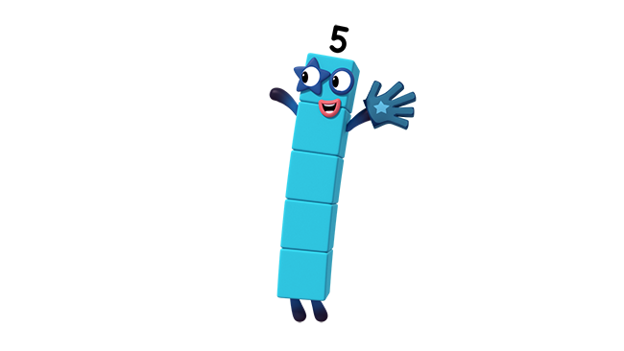
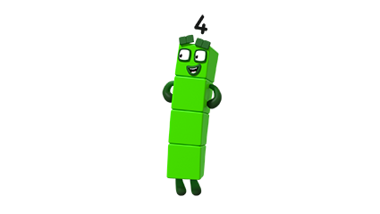
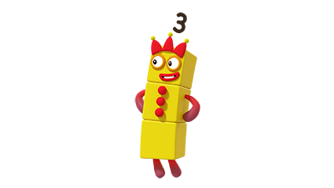
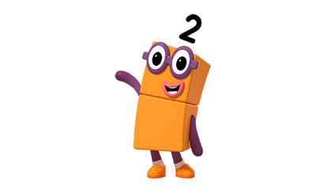
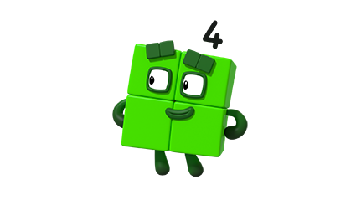
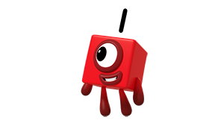
Images © 2017 Alphablocks Ltd. All Rights Reserved.
Notes:
Spend a few minutes exploring the Numberblocks characters made from connecting cubes.
Put arrangements of connecting cubes to represent Numberblocks 1,2,3,4,5 into a feely bag. Ask a child to put their hands in but keep their hands in the bag. Can they feel which Numberblock they have? Say who it might be and then take it out and check.
This slide is animated:
Each click reveals a Numberblocks character. Ask the children to call out who it is.
Did anyone need to count? How did they know?

Slide 9
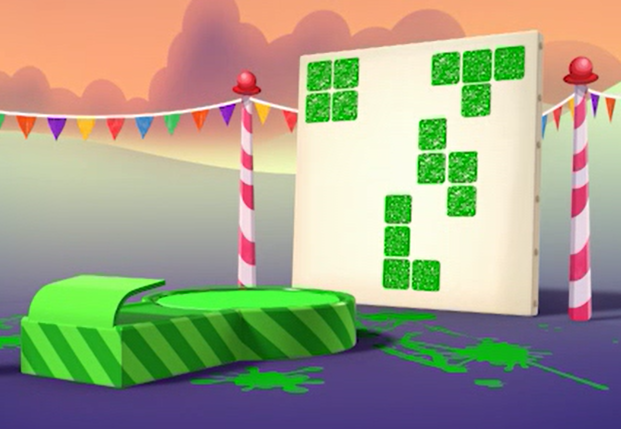
Notes:
Ask the children which Numberblock has made these shapes.
How do you know?
Children should identify that it was Four as there are 4 blocks in each shape.
Using sets of 4 connecting cubes, ask children if they can show another shape that Four can make? (4 cubes in a straight line).

Slide 10
Notes:
For each shape ask the children who has made this shape?
How do you know?
Compare 2 shapes and ask: What is the same and what is different about these two shapes? (draw out the language of more and less, e.g. “this shape has one more block than that shape”).

Slide 11
Odd one out
Images © 2017 Alphablocks Ltd. All Rights Reserved.
Notes:
Look at the three images. Which is the odd one out? Why? Is there more than one way to answer?

Slide 12
Odd one out
Images © 2017 Alphablocks Ltd. All Rights Reserved.
Notes:
Look at the three images. Which is the odd one out? Why? Is there more than one way to answer?

Slide 13
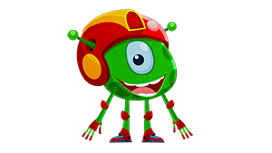
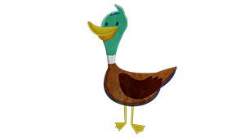
Notes:
This slide is animated. Ask children to say the number in the set without counting as soon as it appears on the screen.

Slide 14
Notes:
This slide is animated.
How quickly can children say the number of dots on a dice without counting?

Slide 15
Notes:
This slide is animated and will provide practice in recognising dice patterns to five.

Slide 16
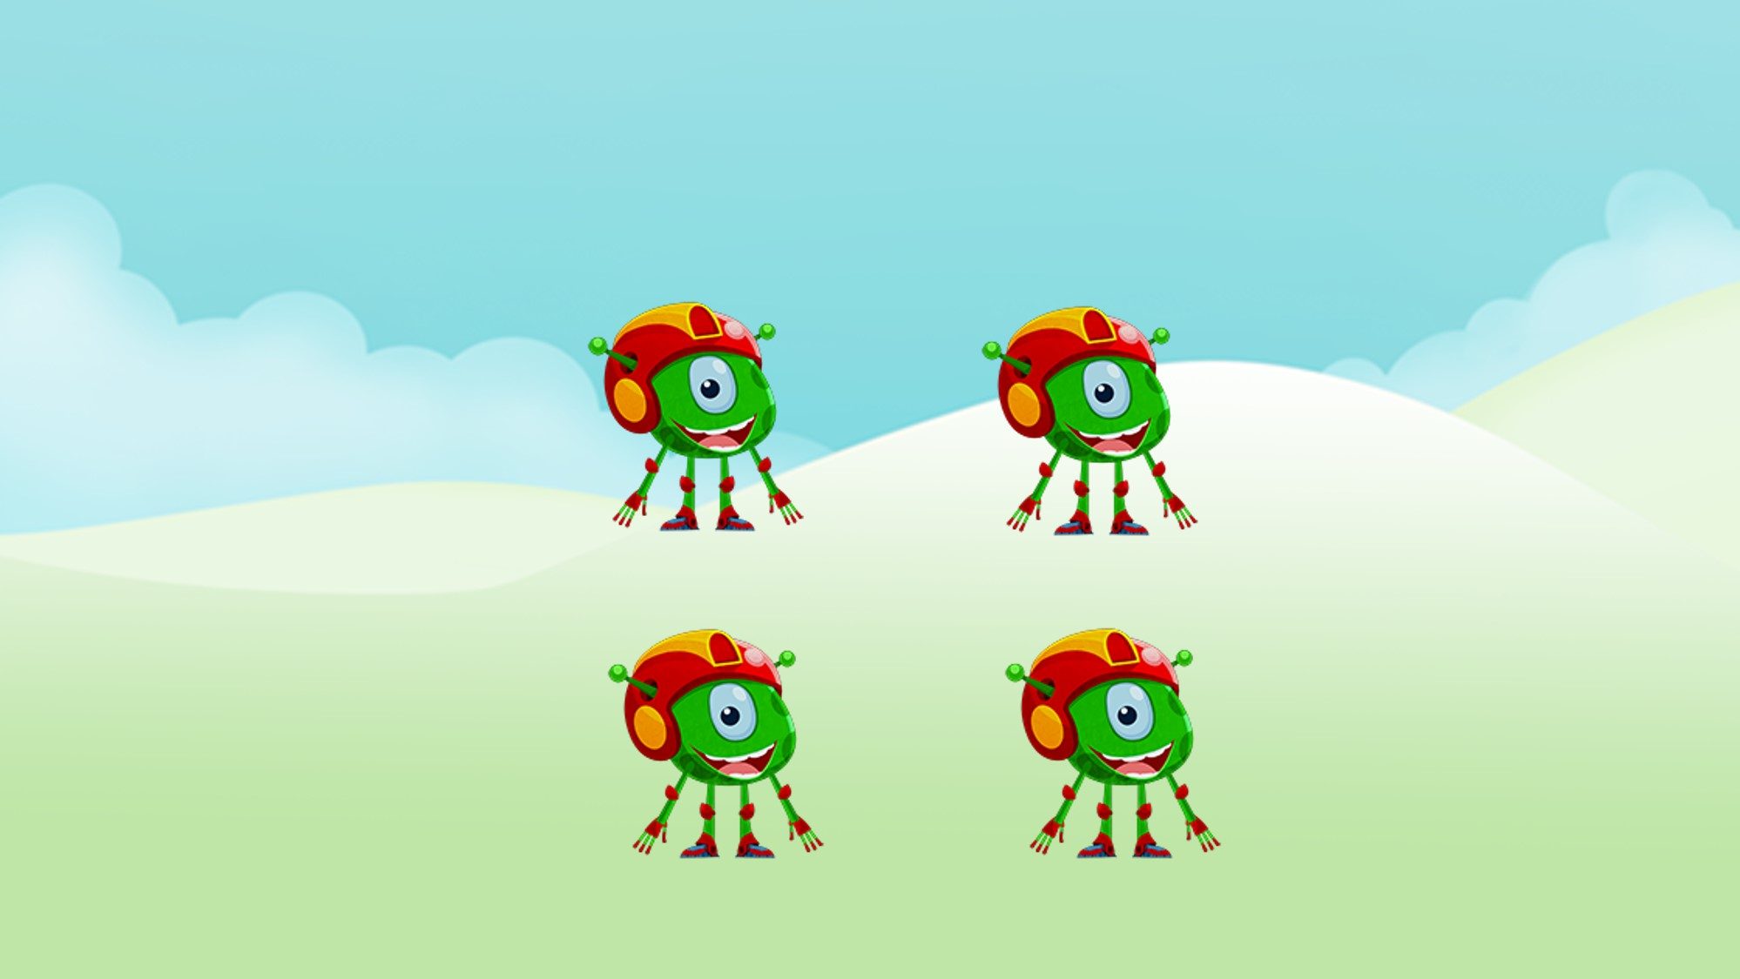
Notes:
Ask the children:
How many are there?

Slide 17
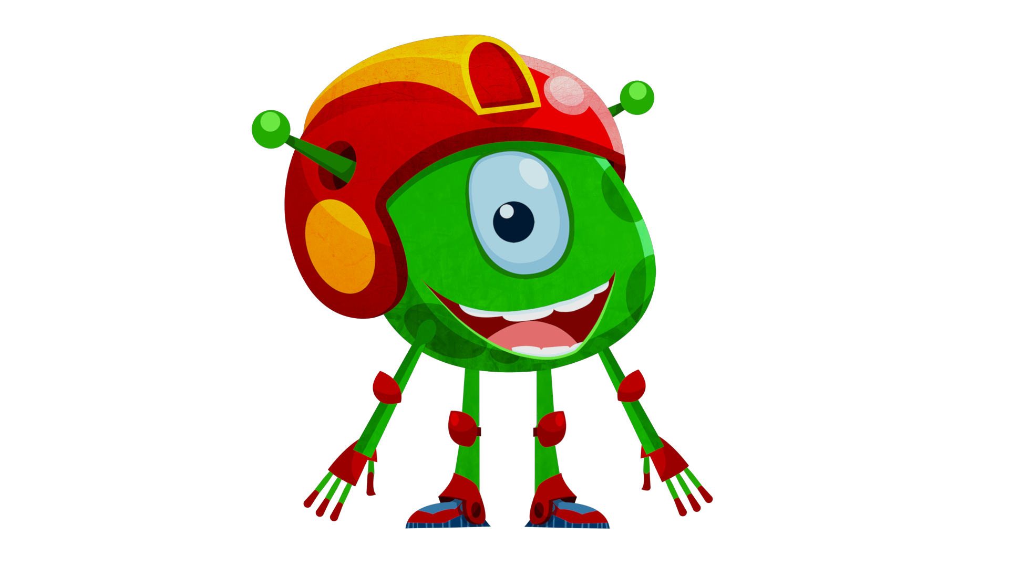
Notes:
After the characters have moved, ask:
Are there still 4?
Children should not need to count, demonstrating conservation of number.

Slide 18
Enabling Environments

Slide 19
Enabling Environments
Playing and Exploring
Place a card on a washing line with a Numberblocks image (2,3,4 or 5). Hide an assortment of (subitising) cards around the setting with 2,3,4 items on in different arrangements and variation in images used. When children discover a card, they can add it to the washing line if it is the right amount.
Active Learning
Notice whether children recount known quantities of objects when they are rearranged. Notice whether children are subitising small quantities when asked to collect an amount of something.
Creating and Thinking Critically
Children create their own arrangement for each Numberblock, either as joined up images, separate blocks or a combination.
e.g. “This is Five. I can see a 3 and a 2 in it.”

Slide 20
Learning Together in Y1

Slide 21
Notes:
After watching the episode, ask the children to express what they think the episode was about.
Show the children the images of some ‘stampoline prints’ and immediately ask them to work in pairs to use connecting cubes to make the images they can see. When they have made all the shapes ask them to discuss what they noticed.
Which prints were not made by Four?
What if the prints had been made by two Numberblocks together, who could have made them?

Slide 22
Notes:
Which stampoline print has not been made by Four? How do you know?
Look for how children use their reasoning by comparing parts in the Five stamp that appear as Four in the other stamps.

Slide 23
Notes:
Use this slide to set the children a challenge to build all the stamps that Four could make by thinking about the shapes that three can make and rearranging the 4th cube.
Click 1,2,3 reveal further examples to share with the children after they have explored.

Slide 24
Notes:
Discuss which of these shapes would produce the same stampoline print if we were to dip them in paint.

Slide 25
Notes:
Discuss which Numberblocks could have made these stampoline shapes.

