Slide 1
Year 5, Unit 2
Money

Slide 2
Year 5, Unit 2
These materials heavily reflect the prioritisation approach of the ready-to-progress criteria in the DfE Primary Mathematics Guidance 2020 and on the PPTs that exemplify them on the NCETM website. They also include other relevant national curriculum content. Related sections of the NCETM Primary Mastery Professional Development Materials provide small-step teaching guidance.
There are no specific ready-to-progress criteria supported by this unit.

Slide 3
Contents
The links below take you to the starting slide of each learning outcome.
1 | Pupils explain and represent whole pounds as a quantity of money
2 | Pupils explain and represent whole pounds and pence as a quantity of money
3 | Pupils explain how to compare amounts of money
4 | Pupils convert quantities of money between pounds and pence
5 | Pupils use their knowledge of addition to efficiently add commonly used prices
6 | Pupils use their knowledge of subtraction to calculate the change due when paying whole pounds or notes
7 | Pupils use and explain the most efficient strategies when adding quantities of money
Click the arrow button to return to this Contents slide.

Slide 4
Contents
The links below take you to the starting slide of each learning outcome.
8 | Pupils use and explain the most efficient strategies when subtracting quantities of money
9 | Pupils find the change when purchasing several items
10 | Pupils use the most efficient and reliable strategy to find the change when purchasing several items
Click the arrow button to return to this Contents slide.

Slide 5
Year 5, Unit 2, Learning Outcome 1
Learning Outcome 1
Pupils explain and represent whole pounds as a quantity of money
The following slides have been collated to support the teaching of this learning outcome.

Slide 6
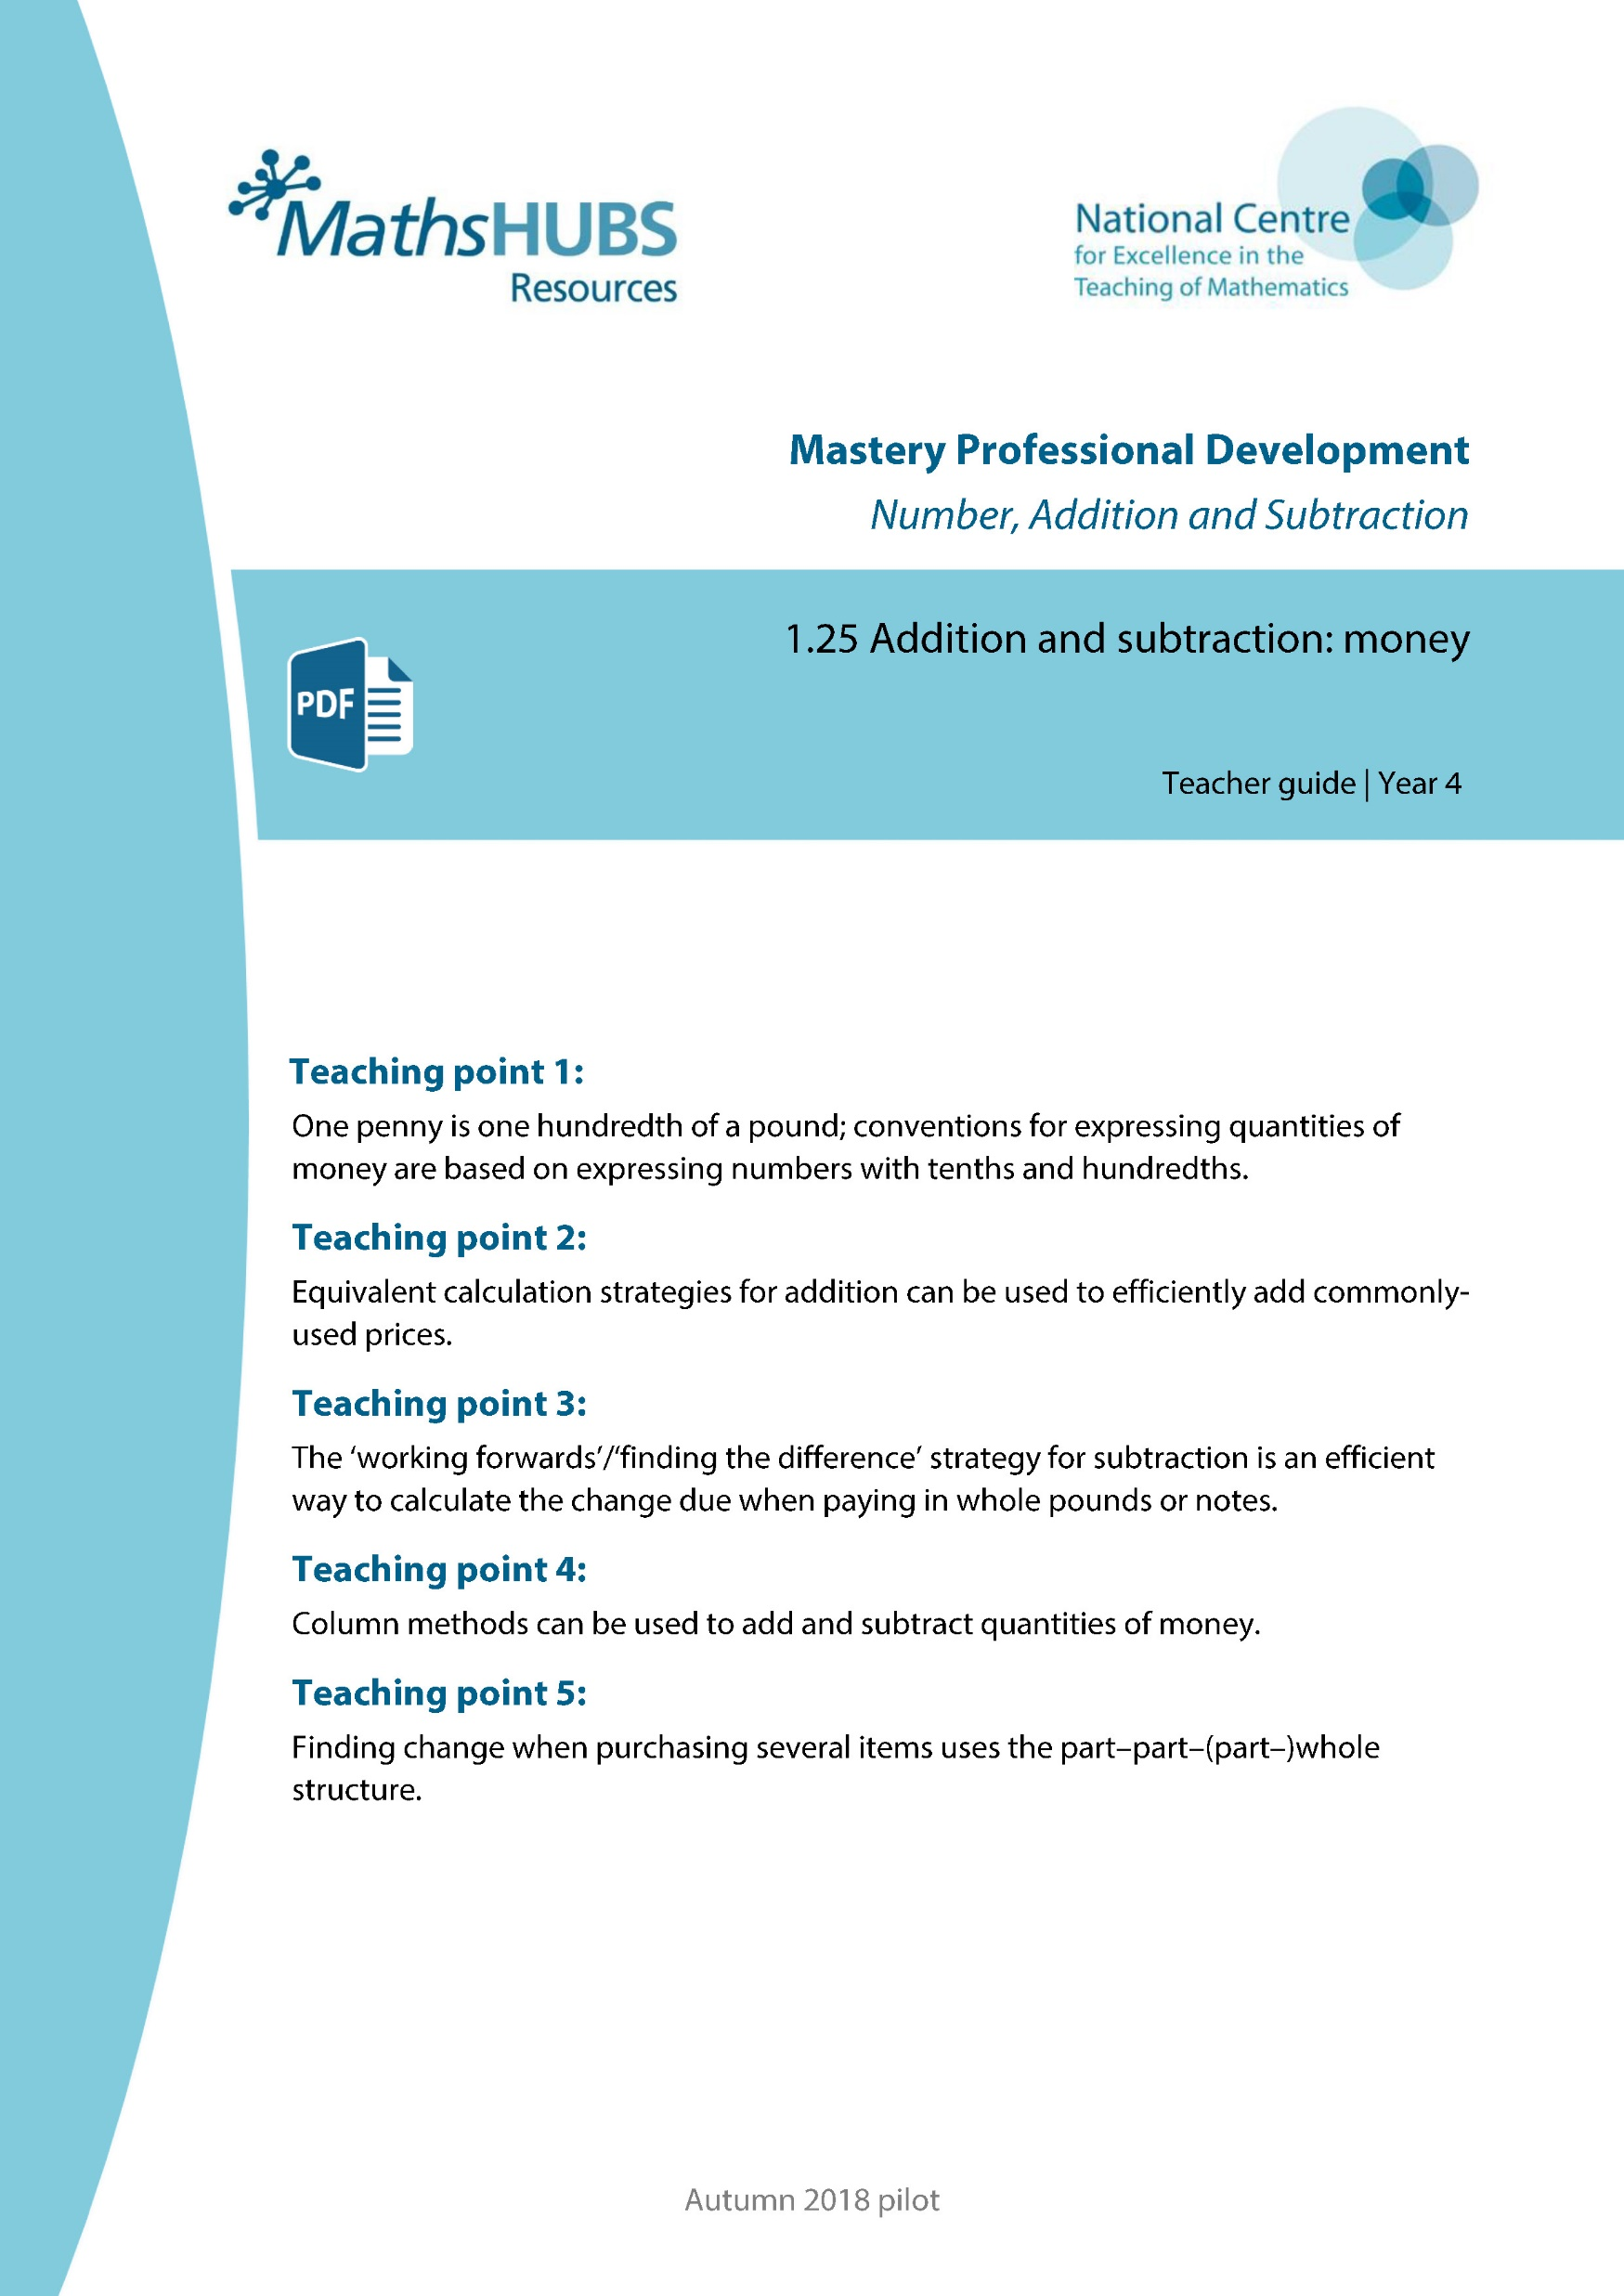
Year 5, Unit 2, Learning Outcome 1
Additional teacher guidance for this outcome should be read first and can be found in this segment of the NCETM Primary Mastery Professional Development Materials:
1.25 Addition and subtraction: money
The spine materials are divided into ‘teaching points’ and ‘steps in learning’.
Teaching point | Steps in learning | Pages
1 | 1:1-1:2 and 1:8 | 4 and 9-10

Slide 7

1.25 Calculation: money – step 1:2
£3
or £3.00
three pounds

Slide 8



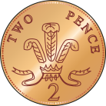
1.25 Calculation: money – step 1:8
£
4
.
2
5
Notes:
How much money is here? Write your answer in decimal notation.

Slide 9
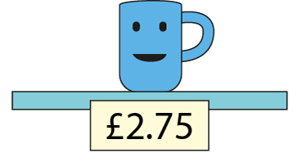
1.25 Calculation: money – step 1:8
Notes:
Felicity wants to buy this mug.
What is the smallest number of coins she can use?

Slide 10
Year 5, Unit 2, Learning Outcome 2
Learning Outcome 2
Pupils explain and represent whole pounds and pence as a quantity of money
The following slides have been collated to support the teaching of this learning outcome.

Slide 11
Year 5, Unit 2, Learning Outcome 2
Additional teacher guidance for this outcome should be read first and can be found in this segment of the NCETM Primary Mastery Professional Development Materials:
1.25 Addition and subtraction: money
The spine materials are divided into ‘teaching points’ and ‘steps in learning’.
Teaching point | Steps in learning | Pages
1 | 1:3-1:6 and 1:8 | 5-8 and 9-10

Slide 12
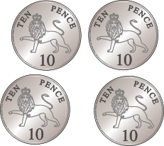
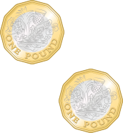
1.25 Calculation: money – step 1:3
£1 (or 100 p) | 10 p | 1 p
2
4
0
£
2
•
4
0
£2.40
two pounds forty
two pounds and forty pence

Slide 13
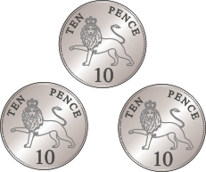


1.25 Calculation: money – step 1:4
£1 (or 100 p) | 10 p | 1 p
1
3
2
£
1
•
3
2
£1.32
one pound thirty-two
one pound and thirty-two pence

Slide 14
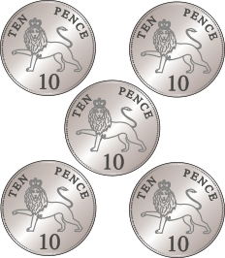
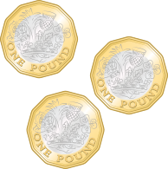
1.25 Calculation: money – step 1:5
£1 (or 100 p) | 10 p | 1 p
3
5
0
£
3
•
5
0
£3.50
three pounds fifty
three pounds and fifty pence

Slide 15

1.25 Calculation: money – step 1:5
£1 (or 100 p) | 10 p | 1 p
3
0
5
£
3
•
0
5
£3.05
three pounds and five pence

Slide 16
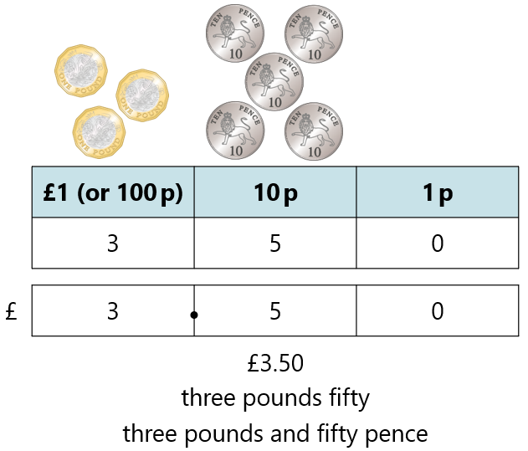
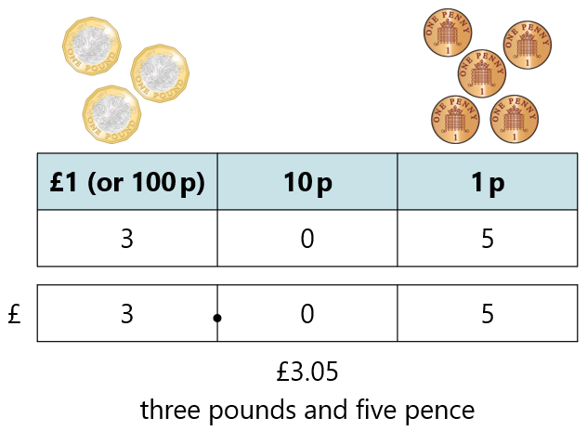
1.25 Calculation: money – step 1:5

Slide 17
1.25 Calculation: money – step 1:8
£
4
.
2
5
Notes:
How much money is here? Write your answer in decimal notation.

Slide 18
1.25 Calculation: money – step 1:8
Notes:
Felicity wants to buy this mug.
What is the smallest number of coins she can use?

Slide 19
Year 5, Unit 2, Learning Outcome 3
Learning Outcome 3
Pupils explain how to compare amounts of money
The following slide will support the teaching of this learning outcome.

Slide 20

Year 5, Unit 2, Learning Outcome 3
For support with lesson and task design, refer to:
the NCETM National Curriculum Resource Tool
additional planning resources or high-quality textbooks used by your school.

Slide 21
Year 5, Unit 2, Learning Outcome 4
Learning Outcome 4
Pupils convert quantities of money between pounds and pence
The following slides have been collated to support the teaching of this learning outcome.

Slide 22
Year 5, Unit 2, Learning Outcome 4
Additional teacher guidance for this outcome should be read first and can be found in this segment of the NCETM Primary Mastery Professional Development Materials:
1.25 Addition and subtraction: money
The spine materials are divided into ‘teaching points’ and ‘steps in learning’.
Teaching point | Steps in learning | Pages
1 | 1:7-1:8 | 8-10

Slide 23
1.25 Calculation: money – step 1:8
£
4
.
2
5
Notes:
How much money is here? Write your answer in decimal notation.

Slide 24
1.25 Calculation: money – step 1:8
Notes:
Felicity wants to buy this mug.
What is the smallest number of coins she can use?

Slide 25
Year 5, Unit 2, Learning Outcome 5
Learning Outcome 5
Pupils use their knowledge of addition to efficiently add commonly used prices
The following slides have been collated to support the teaching of this learning outcome.

Slide 26
Year 5, Unit 2, Learning Outcome 5
Additional teacher guidance for this outcome should be read first and can be found in this segment of the NCETM Primary Mastery Professional Development Materials:
1.25 Addition and subtraction: money
The spine materials are divided into ‘teaching points’ and ‘steps in learning’.
Teaching point | Steps in learning | Pages
2 | 2:1-2:5 | 11-14

Slide 27

1.25 Calculation: money – step 2:1

Slide 28
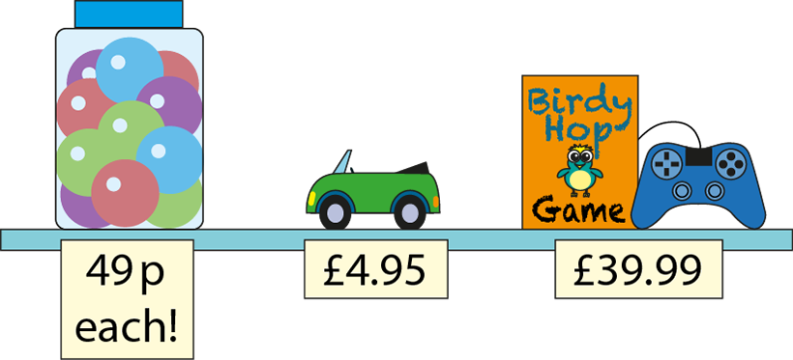
1.25 Calculation: money – step 2:1

Slide 29

1.25 Calculation: money – step 2:2
£3.45 + 99 p
= £4.44
+ £1.00
− 1 p
£3.45
£4.44
£4.45

Slide 30
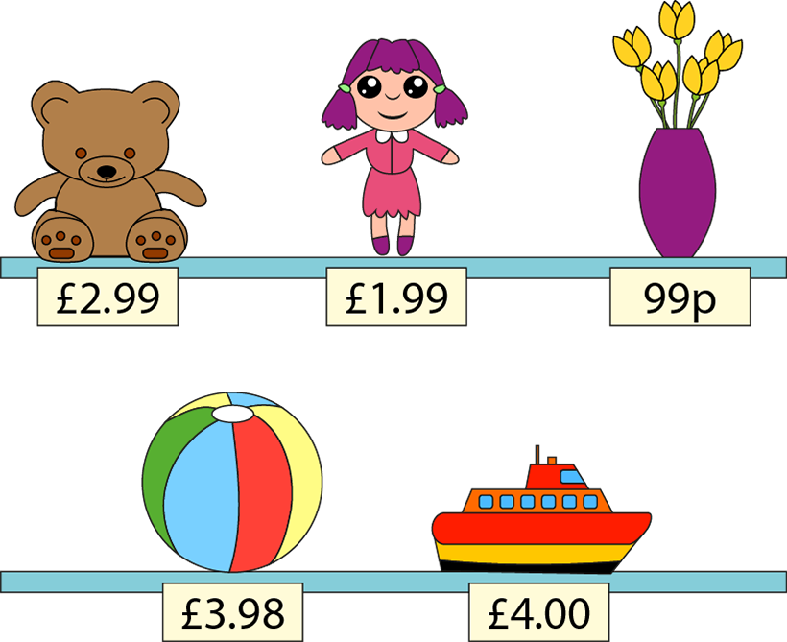
1.25 Calculation: money – step 2:5
Notes:
Choose two items and find the total cost.
Choose another two items and find the total cost.
And another…
Choose three items and find the total cost.
What costs about £1?
Which two items, together, cost about £4?

Slide 31
Year 5, Unit 2, Learning Outcome 6
Learning Outcome 6
Pupils use their knowledge of subtraction to calculate the change due when paying whole pounds or notes
The following slides have been collated to support the teaching of this learning outcome.

Slide 32
Year 5, Unit 2, Learning Outcome 6
Additional teacher guidance for this outcome should be read first and can be found in this segment of the NCETM Primary Mastery Professional Development Materials:
1.25 Addition and subtraction: money
The spine materials are divided into ‘teaching points’ and ‘steps in learning’.
Teaching point | Steps in learning | Pages
3 | 3:1-3:3 | 15-17

Slide 33
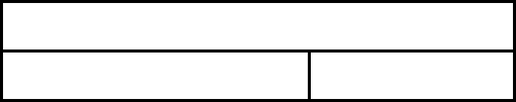
1.25 Calculation: money – step 3:1
Amount paid: £5
Cost of item: £3
?
Change: £2
?
£5
£3
£2
£3
+
£2
=
£5
£5
−
£3
=
£2
Notes:
I buy something that costs three pounds. How much change will I get from a five-pound note?

Slide 34



1.25 Calculation: money – step 3:1
£5.00 − £3.40
= £1.60
£5.00
£3.40
£1.60
?
£1.60
+ 60 p
+ £1
£3.40
£4.00
£5.00
Notes:
What if I spend three pounds and forty pence? How much change will I get from five pounds now?

Slide 35
1.25 Calculation: money – step 3:1
✓
✗
 | or
£5.00 − £2.30 = £3.70
£10.00 − £1.70 = £8.30
£3.90 + £1.10 = £5.00
£7.60 + £3.40 = £10.00
✗
✓
✓
✗

Slide 36


1.25 Calculation: money – step 3:2
£5 − £2.98
= £2.02
£2.02
+ 2 p
+ £2.00
£2.98
£3.00
£5.00
Notes:
I had £5.00 and I spent £2.98 on football cards. How much money did I have left?

Slide 37



1.25 Calculation: money – step 3:2
£10 − £8.48
= £1.52
£1.52
+ 2 p
+ 50 p
+ £1
£8.48
£8.50
£9.00
£10.00
Notes:
I had £10 and I spent £8.48 on books. How much money did I have left?

Slide 38
1.25 Calculation: money – step 3:3
Cost of item | Amount paid | Change
£8 | £10
£7.99 | £10
£7.49 | £10
£7 | £10
£6.49 | £10
£2
£2.01
£2.51
£3
£3.51
Notes:
Find the change I would get from ten pounds if I spent the following amounts.

Slide 39
Year 5, Unit 2, Learning Outcome 7
Learning Outcome 7
Pupils use and explain the most efficient strategies when adding quantities of money
The following slides have been collated to support the teaching of this learning outcome.

Slide 40
Year 5, Unit 2, Learning Outcome 7
Additional teacher guidance for this outcome should be read first and can be found in this segment of the NCETM Primary Mastery Professional Development Materials:
1.25 Addition and subtraction: money
The spine materials are divided into ‘teaching points’ and ‘steps in learning’.
Teaching point | Steps in learning | Pages
4 | 4:1-4:3 and 4:6 | 18-20 and 22

Slide 41

1.25 Calculation: money – step 4:1
£1.37 + £2.45
= £3.82
£3.82
?
£1.37
£2.45
 | £ | 1 | . | 3 | 7
 | £ | 2 | . | 4 | 5
+
£
3
.
8
2
1
Notes:
I buy two magazines. One costs £1.37 and the other costs £2.45. How much do I spend altogether?

Slide 42
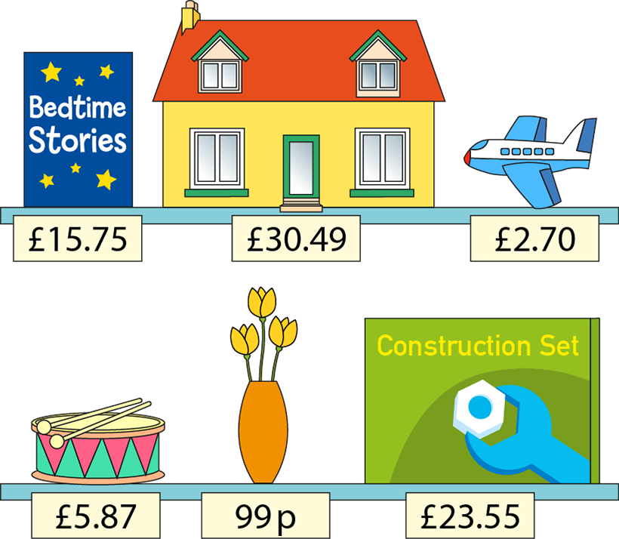
1.25 Calculation: money – step 4:3
Notes:
Choose two items and find the total cost.
Choose another two items and find the total cost.
And another…
Choose three items and find the total cost.

Slide 43
Year 5, Unit 2, Learning Outcome 8
Learning Outcome 8
Pupils use and explain the most efficient strategies when subtracting quantities of money
The following slides have been collated to support the teaching of this learning outcome.

Slide 44
Year 5, Unit 2, Learning Outcome 8
Additional teacher guidance for this outcome should be read first and can be found in this segment of the NCETM Primary Mastery Professional Development Materials:
1.25 Addition and subtraction: money
The spine materials are divided into ‘teaching points’ and ‘steps in learning’.
Teaching point | Steps in learning | Pages
4 | 4:4-4:6 | 20-22

Slide 45

1.25 Calculation: money – step 4:4
£6.53 − £4.38
= £2.15
£6.53
£4.38
£2.15
?
4
1
 | £ | 6 | . | 5 | 3
 | £ | 4 | . | 3 | 8
−
£
2
.
1
5
Notes:
I have saved £6.53 and my brother has saved £4.38. How much more money have I saved than my brother?

Slide 46
1.25 Calculation: money – step 4:4
£29.50 − £18.94
= £10.56
8
1
4
1
 | £ | 2 | 9 | . | 5 | 0
 | £ | 1 | 8 | . | 9 | 4
−
£
1
0
.
5
6
Notes:
The game I want to buy costs £29.50. I have saved £18.94. How much more do I need to save before I can buy the game?

Slide 47
1.25 Calculation: money – step 4:4
£12.50 − £7.08
= £5.42
0
4
1
1
 | £ | 1 | 2 | . | 5 | 0
 | £ |  | 7 | . | 0 | 8
−
£
0
5
.
4
2
Notes:
I need £12.50 to enter a swimming competition, but I only have £7.08. How much more money do I need?

Slide 48
Year 5, Unit 2, Learning Outcome 9
Learning Outcome 9
Pupils find the change when purchasing several items
The following slides have been collated to support the teaching of this learning outcome.

Slide 49
Year 5, Unit 2, Learning Outcome 9
Additional teacher guidance for this outcome should be read first and can be found in this segment of the NCETM Primary Mastery Professional Development Materials:
1.25: Addition and subtraction: money
The spine materials are divided into ‘teaching points’ and ‘steps in learning’.
Teaching point | Steps in learning | Pages
5 | 5:1-5:2 | 23-25

Slide 50
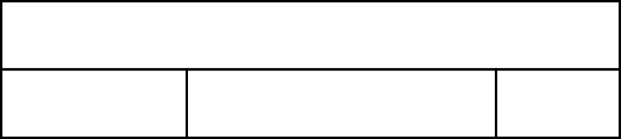




1.25 Calculation: money – step 5:1
£1
30 p
?
50 p
20 p
80 p
Notes:
Tim had £1.00. He bought a pencil for 20 p and a pen for 50 p. How much money does he have left?
(Repeated subtraction)

Slide 51

1.25 Calculation: money – step 5:1
£1
30 p
?
50 p
70 p
+
20 p
Notes:
Tim had £1.00. He bought a pencil for 20 p and a pen for 50 p. How much money does he have left?
(Adding first)

Slide 52


1.25 Calculation: money – step 5:2
£2
55 p
72 p
73 p
?
£1.27
73 p
+ 3 p
+ 70 p
£1.27
£1.30
£2.00
Notes:
An apple costs 55 p and a drink costs 72 p. How much change will I get from £2.00 if I buy both?

Slide 53






1.25 Calculation: money – step 5:2
£100
£25.49
£58.09
£13.85
£18.75
?
£41.91
 | £ | 2 | 5 | . | 4 | 9
 | £ | 1 | 3 | . | 8 | 5
+ | £ | 1 | 8 | . | 7 | 5
 | £ | 5 | 8 | . | 0 | 9
 |  | 1 | 2 |  | 1
£41.91
+ 1 p
+ 90 p
+ £1
+ £40
£58.09
£58.10
£59.00
£60.00
£100.00
Notes:
The class has raised £100 to spend on a party. They spend £25.49 on pizzas, £13.85 on drinks and £18.75 on decorations. How much do they have left to spend on the entertainment?

Slide 54
Year 5, Unit 2, Learning Outcome 10
Learning Outcome 10
Pupils use the most efficient and reliable strategy to find the change when purchasing several items
The following slides have been collated to support the teaching of this learning outcome.

Slide 55
Year 5, Unit 2, Learning Outcome 10
Additional teacher guidance for this outcome should be read first and can be found in this segment of the NCETM Primary Mastery Professional Development Materials:
1.25 Addition and subtraction: money
The spine materials are divided into ‘teaching points’ and ‘steps in learning’.
Teaching point | Steps in learning | Pages
5 | 5:3 | 25-26

Slide 56
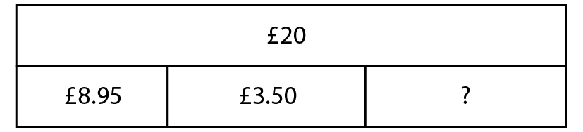
1.25 Calculation: money – step 5:3

Slide 57



1.25 Calculation: money – step 5:3
£20.00 − £8.95
= £11.05
£11.05
+ 5 p
+ £1
+ £10
£8.95
£9.00
£10.00
£20.00
Step 1
Notes:
Joe gets £20 for his birthday on Monday and spends £8.95 on a game. At the weekend, he spends £3.50 on an ice-cream sundae. How much money does Joe have left?
(Repeated subtraction)

Slide 58
1.25 Calculation: money – step 5:3
£11.05 − £3.50
= £7.55
0
1
0
1
 | £ | 1 | 1 | . | 0 | 5
 | £ |  | 3 | . | 5 | 0
−
£
0
7
.
5
5
Step 2
Notes:
Joe gets £20 for his birthday on Monday and spends £8.95 on a game. At the weekend, he spends £3.50 on an ice-cream sundae. How much money does Joe have left?
(Repeated subtraction)

Slide 59
1.25 Calculation: money – step 5:3
£8.95 + £3.50
= £12.45
 | £ |  | 8 | . | 9 | 5
 | £ |  | 3 | . | 5 | 0
+
£
1
2
.
4
5
1
1
Step 1
Notes:
Joe buys a game for £8.95 and some football cards for £3.50. He pays with a £20 note. How much money does Joe have left?
(Adding first)

Slide 60


1.25 Calculation: money – step 5:3
£20.00 − £12.45
= £7.55
£7.55
+ 55 p
+ £7
£12.45
£13.00
£20.00
Step 2
Notes:
Joe buys a game for £8.95 and some football cards for £3.50. He pays with a £20 note. How much money does Joe have left?
(Adding first)

