Slide 1
Series 3 Episode 7
Numberblobs

Slide 2
Practitioner Notes

Slide 3
Episode Description
The Numberblocks’ favourite friends, the Numberblobs, are here to find out ‘how many’. These new characters sing a happy counting song. Learn to say the counting numbers in the correct order.

Slide 4
Maths in the Episode
Counting
This episode offers an opportunity for discussion about the skills involved in counting. Gelman and Gallistel’s (1978) principles of counting are addressed in this episode.
One-to-one principle: each object counted is tagged with one number name only. (The Numberblobs tag each object being counted.)
Stable order principle: the sequence of numbers is always said in the same order. (The Numberblobs count up to each number each time.)
Order irrelevance principle: it doesn’t matter where you start or finish so long as the first two principles are applied.
Cardinal principle: the last number in the count (assuming the one-to-one and stable order principle has been applied) reveals the quantity. (Numberblobs announce the quantity.)
Abstraction principle: counting principles can be applied to a variety of contexts including sounds. (Listen for the Numberblob pings at the end of each verse.)

Slide 5
Using Mathematical Language
Use these stem sentences to rehearse the mathematical ideas in the programme:
“One, two, three” there are three trees.
“One, two, three” there are three bees.
Notes:
< > indicates what can be changed in the stem sentence.

Slide 6
Talk and Discuss Together

Slide 7
Talk and Discuss Together
Watch the episode of Numberblocks. Use the following picture as a stimulus. First ask the children about what the Numberblobs do.
Numberblobs help to keep track of counting.
The following slides are designed to stimulate children and adults to talk about the episode and draw out some key aspects of the mathematics.

Slide 8
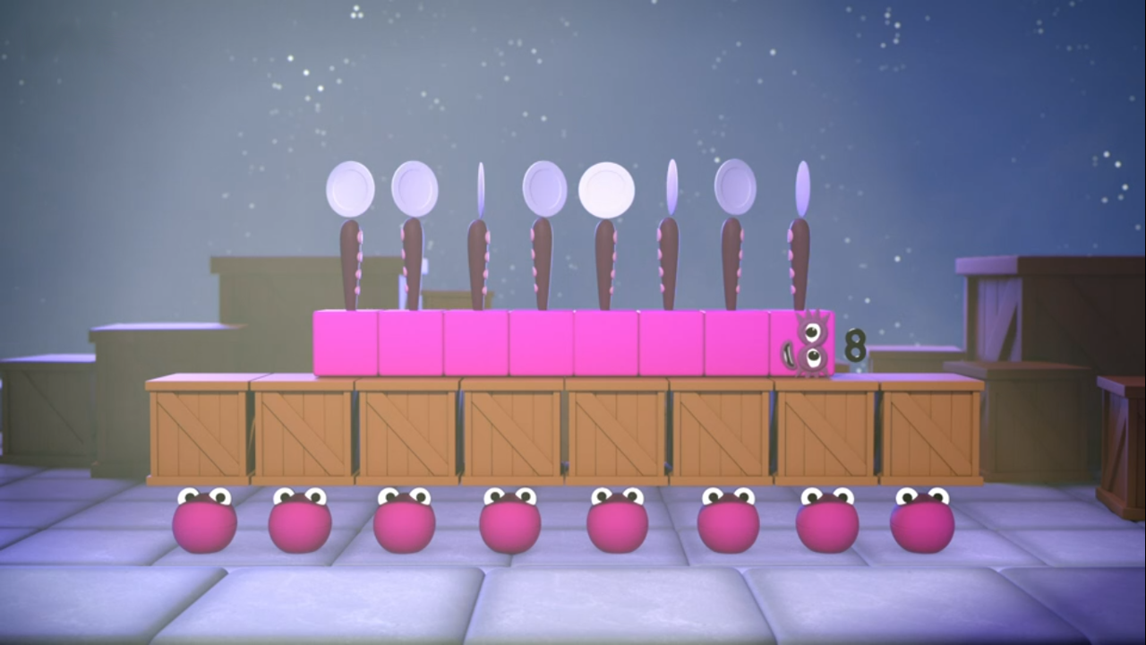
Images © 2017 Alphablocks Ltd. All Rights Reserved.
Notes:
Use this picture as the stimulus for Talk and Discussion (slide 7).

Slide 9
Enabling Environments in Reception

Slide 10
Enabling Environments
Playing and Exploring
Set up a musical instruments area in the setting. Encourage the children to compose their own rhythms and record their rhythm using mark making to show how many notes there are in their rhythm. Encourage them to write a rhythm piece for others to play.
Active Learning Look for opportunities to use the counting principles in everyday play. Encourage finger pointing and object moving when something has been counted.
Creating and Thinking Critically Play call response with instruments. Count the sound beats and say how many. Use fingers to represent the number of sound beats heard.

Slide 11
Learning Together in Y1

Slide 12
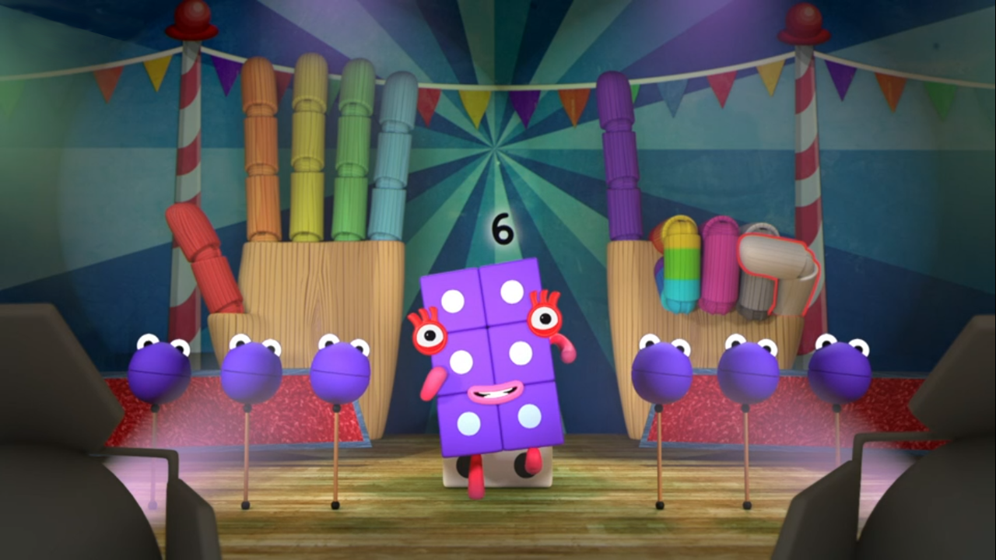
Images © 2017 Alphablocks Ltd. All Rights Reserved.
Notes:
Can you find six of something?
There are: six blocks, six Numberblobs, six fingers.

Slide 13
Good counting?
Bad counting?
Images © 2017 Alphablocks Ltd. All Rights Reserved.
Notes:
Use this slide to show yourself or a puppet not doing ‘good counting’.
(If children can subitise this arrangement of six, accept that there are six and tell them, “let’s use this six to see if our puppet can count to six correctly.”)
(Click on each Numberblob to make it grow/shrink.)
Watch carefully, tell me if I/ the puppet do anything wrong.
The puppet can make common errors for children to spot and discuss. For example, counting a flower more than once, counting randomly and missing a flower, or tagging but not matching words and tagging.

Slide 14
Images © 2017 Alphablocks Ltd. All Rights Reserved.
Notes:
Use this slide to explore the ‘order irrelevance’ principle, starting and finishing counting from different stars.
Explain that while we can see there are five stars, our puppet wants to make sure. She/he wants to try counting the stars in a different order each time: will it make a difference?
Choose a large yellow star and click on it to reveal a smaller blue star that indicates the last star to count. Let the puppet have several goes of counting, trying to remember which stars she/he has counted.
Confirm that ‘it doesn’t matter which order you count in, as long as you count all the stars.’

Slide 15
Further activities for Y1
Provide opportunities for daily counting in Y1 without numerals.
Practise counting:
objects that can’t be moved
objects that can’t be touched
pictures of objects presented in a line
pictures of objects presented in irregular arrangements
coins/counters being dropped in a tin can
claps or beats of a drum
the number of jumps someone does
representing counting 0-10 using fingers.

Slide 16
Learning Together in Y2

Slide 17
Count and record.
Colour | Number
 | 3
 | 6
 | 3
 | 5
 | 8
Object | Number
Flower | 7
Car | 7
Buttons | 5
Apple | 6
Images © 2017 Alphablocks Ltd. All Rights Reserved.
Notes:
Use this slide to record the result of a count in a two-way table and one-way table.
What do you notice about the table? It has rows and columns and the colours and pictures help us know where to put the number of each object according to colour/ object.
Print out slide 18 for children to complete then compete the other table by adding/ counting the number of each colour/ object.

Slide 18
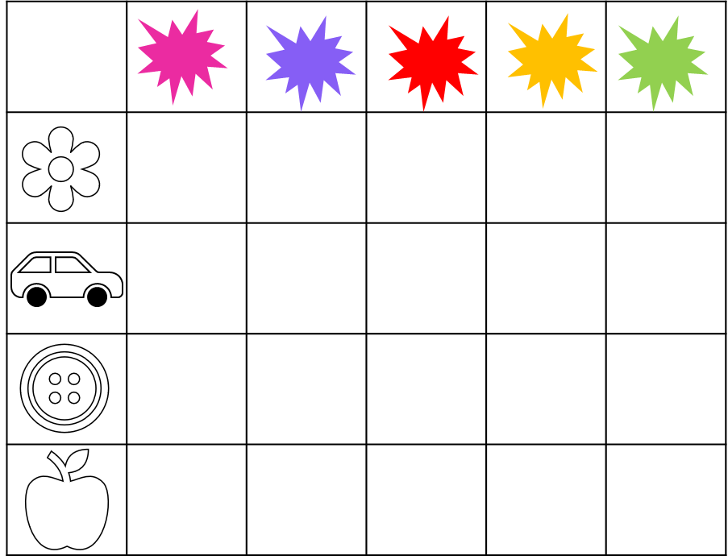
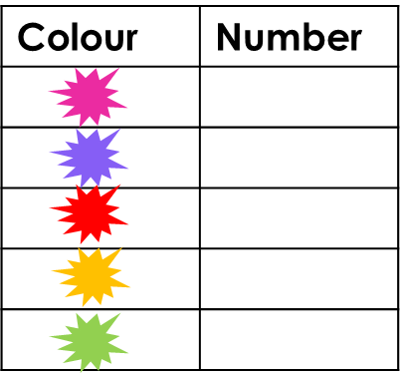
Object | Number
Notes:
Hidden slide: Use this slide to print off and use with the children in groups or pairs to accompany slide 17.

Slide 19
Further activities for Y2
Build a construction with different coloured 2D shapes. Create a 2-way table using colour and number to record the different numbers of shapes and colour that were used.
Draw information from a 2-way table, for example, shape and colour. Read the table and draw the shape and colour.
Complete a 2-way table with some missing information and pictures of shapes.
Record information from a 2-way table on a frequency table.
Record information on 2 frequency tables onto a 2-way table.

