Slide 1
Understanding the mean
KS3 Mastery PD Materials: Exemplified Key Ideas
Materials for use in the classroom or to support professional development discussions
(From 5.1 Statistical representations and measures)
Summer 2021

Slide 2
About this resource
These slides are designed to complement the 5.1 Statistical representations and measures core concept document and its associated Statistics and probability theme overview document, both found in the Secondary Mastery Professional Development pages.
These slides re-present the key examples from the Core Concept document so that the examples can be used either directly in the classroom or with a group of teachers. There are prompt questions alongside the examples, and further clarification in the notes.
These slides do not fully replicate the Core Concept document, so should be used alongside it. Reference to specific page numbers, and to other useful NCETM resources, can be found in the notes for each slide.
This slide deck is not designed to be a complete PD session, rather it is a selection of resources that you can adapt and use as needed when planning a session with a group of teachers.

Slide 3


About this resource
The slides are structured as follows:
  The big picture:
    Where does this fit in?
    What do students need to understand?
    Why is this key idea important?
  Prior learning
  Misconceptions
  Exemplified key ideas
  Reflection questions
  Appendices:
    Key vocabulary
    Representations and structure
    Previous and Future learning
    Useful links
The exemplified key idea slides have the following symbols to indicate how they have been designed to be used:
Into the classroom
The examples are presented on these slides so that they could be used in PD, but also directly in the classroom. The notes feature suggested questions and things teachers might consider when using with students.
PD discussion prompts
These slides look at the examples in more detail, with question prompts to promote discussion among maths teachers. The notes feature reference to further information and guidance within the Core Concepts document.

Slide 4
Where does this fit in?
The NCETM has identified a set of six ‘mathematical themes’ within Key Stage 3 mathematics that bring together a group of ‘core concepts’.
The fifth of these themes is Statistics and probability, which covers the following interconnected core concepts:
    5.1 Statistical representations and measures
    5.2 Statistical analysis
    5.3 Probability
Notes:
Linked on this slide is the Theme Overview document of Statistics and probability. This document includes why it is important, the key underpinning knowledge and links to prior and future learning. There is also guidance about how the five big ideas of Teaching for Mastery relate specifically to this theme.

Slide 5
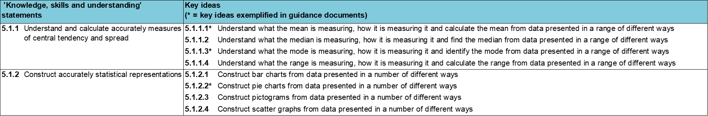
Where does this fit in?
Within this core concept, 5.1 Statistical representations and measures, there are two statements of knowledge, skills and understanding.
These, in turn, are broken down into eight key ideas. The highlighted key idea is exemplified in this slide deck.
Notes:
For key ideas marked with an asterisk, we exemplified the common difficulties and misconceptions that students might have and included elements of what teaching for mastery may look like. We have provided examples of possible student tasks and teaching approaches.
Within these slides are ‘classroom-ready’ versions of the examples for the key idea that has been highlighted. There are also slides that may be useful for discussion in a professional development session.

Slide 6
What do students need to understand?
5.1.1.1 Understand what the mean is measuring, how it is measuring it and calculate the mean from data presented in a range of different ways
Calculate the mean from a list of data values.
Apply knowledge of the mean to arithmetic problems.
Correctly calculate the mean from a frequency table.
Calculate the mean of data represented in a bar chart.
  What prior knowledge might your students already have?
  What language might they use to describe this key idea?
  What questions might you want to ask to assess their prior learning?

Slide 7
Why is this key idea important?
We live in an information and data-rich age. The ability to interpret, analyse and critically evaluate all that we are presented with is vitally important if our students are to be engaged, thoughtful and aware citizens.
At Key Stage 2, students encountered the concept of central tendency and learnt how to calculate the (arithmetic) mean.
At Key Stage 3, they will develop their knowledge of calculating measures of central tendency to include the mode and median, will work with grouped data and be introduced to a measure of spread in statistics: range. This will enable students to engage in more sophisticated data analysis.
While calculating measures of central tendency accurately and efficiently is important, this should not be the dominant aspect of the learning and teaching. It is vital that students have a sense of what the measures of central tendency are actually measuring, and engage in activities which prompt questions, such as:
  How can we use measures of central tendency to compare sets of data?
  What do these measures tell us? For example, ‘On average, who has the most pocket money: class A or class B?’
  How do these measures change when particular data points change? For example, ‘When considering the average wage in a company, what difference does it make to the various measures when the company director’s salary is added in, or removed?’
Students should also appreciate how these values, which summarise a set of data in some way, are affected by extra data being added to the whole data set and how such values can be found by comparing averages before and after the inclusion of additional data.
Notes:
A more detailed overview of the core concept of Statistical representations and measures can be found on page 2 of the 5.1 Core Concept document.
The background to each key idea is also explored in more detail on the following pages:
5.1.1 Understand and calculate accurately measures of central tendency and spread – page 5
5.1.2 Construct accurately statistical representations – pages 5-6

Slide 8
Prior learning
  What prior knowledge might your students already have?
  What language might they use to describe this key idea?
  What questions might you want to ask to assess their prior learning?
Upper Key Stage 2 Learning Outcome
Calculate and interpret the mean as an average.
Notes:
You may find it useful to speak to your partner schools to see how the above has been covered and the language used.
You can find further details regarding prior learning in the following segments of the NCETM primary mastery professional development materials (linked on final slide):
• Year 6: 2.26 Mean average and equal shares
Within the 5 Statistics and probability Theme Overview document, you can also find a broader description of students’ potential previous learning (page 3), alongside further information about key underpinning knowledge (page 2).

Slide 9
Checking prior learning
The following slides contain questions for checking prior learning.
  What representations might students use to support their understanding of these questions?
  What variation might you put in place for these questions to fully assess students’ understanding of the concept?
  How might changing the language of each question change the difficulty?
  Why are these such crucial pre-requisites for this key idea?

Slide 10
Checking prior learning (1)
a) Ten pupils take part in some races on Sports Day, and the following times are recorded.
Time to run 100m (seconds):
  23, 21, 21, 20, 21, 22, 24, 23, 22, 20.
Time to run 100m holding an egg and spoon (seconds):
  45, 47, 49, 43, 44, 46, 78, 46, 44, 48.
Time to run 100m in a three-legged race (seconds):
  50, 83, 79, 48, 53, 52, 85, 81, 49, 84.
Calculate the mean average of the times recorded in each race.
For each race, do you think that the mean average of the times would give a useful summary of the ten individual times? Explain your decision.
Notes:
References to the questions:
a) NCETM primary assessment materials: Year 6 page 38

Slide 11
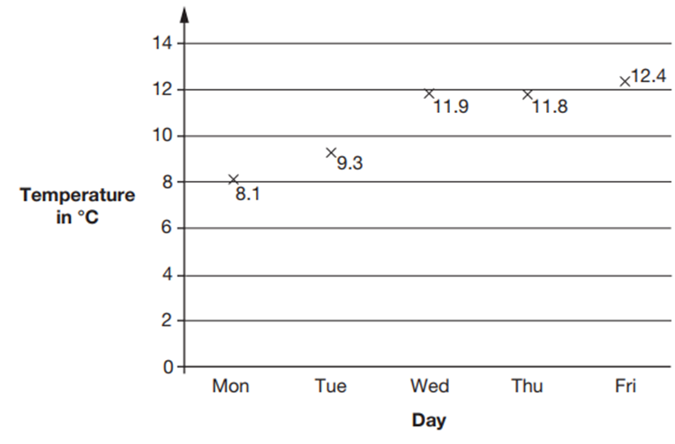
Checking prior learning (2)
b) This graph shows the maximum temperature for five days.
For what fraction of the five days was the maximum temperature below 10°C?
What was the mean maximum temperature, to one decimal place?
Notes:
References to the questions:
b) 2019 Key Stage 2 Mathematics Paper 2: reasoning, question 22

Slide 12
Common difficulties and misconceptions
What aspects of this key idea might students find challenging?
What misconceptions might students have?
When teaching this topic, you may find students encounter difficulties with…
Being able to calculate the mean, but not really understanding what the calculation measures
Calculating the mean from frequency tables/charts
More information, and some suggestions for overcoming these challenges, can be found on the following slides.

Slide 13
Common difficulties and misconceptions (1)
Students may know the mean only as a calculation to perform without understanding what the calculation is measuring.
Various representations could be used to support students to develop a conceptual understanding of the method for finding the mean. This is described in more detail on the ‘Representations and Structures (2)’ slide.
Notes:
This can be found on page 6 of the 5.1 Core Concept document.

Slide 14
Common difficulties and misconceptions (2)
When working with grouped data, errors often arise from students not fully understanding that the same values are represented many times in a frequency table.
In many cases, asking students to write out the full data set will help them to appreciate what is represented and how they might calculate with the data.
Notes:
This can be found on page 6 of the 5.1 Core Concept document.

Slide 15
Calculate the mean from a list of data values
Example 1
James wants to improve his diet. For a fortnight he records the number of portions of vegetables he eats each day.
What is the mean daily number of portions of vegetables he eats?
M | T | W | Th | F | Sa | Su
5 | 3 | 6 | 2 | 2 | 1 | 2
5 | 4 | 4 | 2 | 3 | 1 | 3
Notes:
Suggested questioning:
What does each column represent? What does each row represent?
How many data values are in this data set?
What is the sum? What is the count?
Things for you to think about:
Calculation of the mean requires three operations: the sum of the data values, the count of the number of data and then the division of the sum by the count. Students could be encouraged to verbalise what different rows or columns represent, to help them correctly identify the values needed for each step of the calculation. Furthermore, you could encourage students to use the words ‘sum’ and ‘count’ to distinguish between the two concepts and calculations.

Slide 16
Calculate the mean from a list of data values
Example 2
James also records how many portions of protein he eats each day for ten days.
2, 3, 1, 1, 2, 0, 2, 1, 1, 2
What is the mean number of protein portions he eats in that time period?
Notes:
Suggested questioning:
What happens when there is a zero in your data count?
What is different about this set of data compared with James’s previous data set?
What is the sum? What is the count?
Things for you to think about:
The use of data values of zero, such as in Example 2, will draw students’ attention to what values must be included in the count of the number of data.

Slide 17
Calculate the mean from a list of data values
Example 1
James wants to improve his diet. For a fortnight he records the number of portions of vegetables he eats each day.
What is the mean daily number of portions of vegetables he eats?
  What questions might you ask to ensure students have understood these data sets?
  What mistakes might they make in trying to calculate the mean?
  What language will you use to describe each stage of the process?
M | T | W | Th | F | Sa | Su
5 | 3 | 6 | 2 | 2 | 1 | 2
5 | 4 | 4 | 2 | 3 | 1 | 3
Example 2
James also records how many portions of protein he eats each day for ten days.
2, 3, 1, 1, 2, 0, 2, 1, 1, 2
What is the mean number of protein portions he eats in that time period?
Notes:
Due to space constraints, the image on this PD discussion slide is very small. PD Leads might like to use or print the ‘in the classroom’ version of this slide for teachers to access during discussions.
More detail about these examples can be found on page 7 of the 5.1 Core Concept document.

Slide 18
Calculate the mean from a list of data values
Example 3
Find the mean:
6, 6, 6, 6
6, 7, 5, 6
12, 0, 0, 12
4, 5, 7, 8
Notes:
Suggested questioning:
Is a calculation necessary for part a)?
What has changed and what has stayed the same between parts a and b?
Why do the zeroes need to be included in the calculation for part c? What would happen if they were not?
How do the numbers in part d related to the numbers in part a?
If you start with all values equivalent to the mean (as in part a)) and then add a value to one number and subtract the same value from another number, will the mean remain the same? Why? What would happen if you added a value but didn’t subtract the equivalent from another number?
Things for you to think about:
The values in Example 3 have been chosen to draw students’ attention to the features of the mean calculation and what it is measuring. There are some suggested questions to draw attention to these features; what else might you ask?

Slide 19
Calculate the mean from a list of data values
Example 3
  What features of the mean calculation are these questions designed to draw students’ attention to?
  What questions could you ask to deepen students’ understanding?
  Could you create your own set of minimally different questions to draw attention to what the mean measures?
Find the mean:
6, 6, 6, 6
6, 7, 5, 6
12, 0, 0, 12
4, 5, 7, 8
Notes:
More detail about the sequencing of this example can be found on page 7 of the 5.1 Core Concept document.

Slide 20
Apply knowledge of the mean to arithmetic problems
Example 4
Reena times her walk from the bus stop each day for six days.
The timings for the first five days are 16, 14, 20, 11 and 17 minutes.
On the sixth day Reena calculates that her mean walking time for the six days is 15 minutes.
How long did it take for her to walk from the bus stop on the sixth day?
Notes:
Suggested questioning:
If her mean walking time for 6 days is 15 minutes, what is her total walking time over the six days?
What is the sum? What is the count?
What do we know? What do we need to find out?
Things for you to think about:
Offering problems such as Example 4, where the answer (the mean) is given and students have to figure out one of the missing values, forces students to work with inverse operations, think more deeply and reason about the mean as a concept. What prompts might you need to give students to support them to unpick this problem? An example of how bar modelling might be used can be found on slide 40 in this slide deck.

Slide 21
Apply knowledge of the mean to arithmetic problems
Example 5
The mean of eight data values is six.
Another piece of data is included and the mean is now seven.
What is the value of the ninth piece of data?
Notes:
Suggested questioning:
What is the count? So what is the sum?
What is the new count? What is the new sum?
How can you use this to work out the missing value?
Would a bar model help to represent this problem?
Things for you to think about:
This is another example, similar to Example 4, where inverse operations need to be used. Such exercises are less about a student proving they can calculate the mean and more about thinking deeply about what is meant by the mean.

Slide 22
Apply knowledge of the mean to arithmetic problems
Example 4
Reena times her walk from the bus stop each day for six days.
The timings for the first five days are 16, 14, 20, 11 and 17 minutes.
On the sixth day Reena calculates that her mean walking time for the six days is 15 minutes.
How long did it take for her to walk from the bus stop on the sixth day?
  How do these questions support students to think more deeply about what is meant by the mean?
  What representations might you use to support students to visualise these problems?
  What questions or prompts might they need?
Example 5
The mean of eight data values is six.
Another piece of data is included and the mean is now seven.
What is the value of the ninth piece of data?
Notes:
Due to space constraints, the image on this PD discussion slide is very small. PD Leads might like to use or print the ‘in the classroom’ version of this slide for teachers to access during discussions.
More detail about these examples can be found on page 8 of the 5.1 Core Concept document. An example of using a bar model to support students with example 4 can be found on slide 40 in this slide dec

Slide 23
Correctly calculate the mean from a frequency table
Example 6
Students were asked to calculate the mean number of goals scored in a set of matches, as recorded in this table.
One student described their thinking, ‘I calculated 50 divided by five because the total number of goals is 50 and there are five items.’
What has this student misunderstood?
Another student stated, ‘There are 19 goals and 15 matches, so I worked out the goals divided by matches, 19 divided by 15’.
Do you agree with this student’s method?
What advice would you give the students to ensure they calculate the mean from a frequency table correctly in future?
Goals | Matches
1 | 3
2 | 5
4 | 2
5 | 3
7 | 2
Notes:
Suggested questioning:
What is the sum of the goals?
What is the count of the matches?
What mistakes are easy to make when calculating the mean from the table?
How would this data look if you wrote a list of the number of goals in each match?
Things for you to think about:
Problems involving frequency tables draw students’ attention to what values must be included in the sum and count of data values. In a table such as the one in Example 6, students should realise that, in order to calculate the total number of goals scored, they must first multiply the number of goals by the number of matches. How else might students make sense of this data and how to find the mean?

Slide 24
Correctly calculate the mean from a frequency table
Example 6
Students were asked to calculate the mean number of goals scored in a set of matches, as recorded in this table.
One student described their thinking, ‘I calculated 50 divided by five because the total number of goals is 50 and there are five items.’
What has this student misunderstood?
Another student stated, ‘There are 19 goals and 15 matches, so I worked out the goals divided by matches, 19 divided by 15’.
Do you agree with this student’s method?
What advice would you give the students to ensure they calculate the mean from a frequency table correctly in future?
Goals | Matches
1 | 3
2 | 5
4 | 2
5 | 3
7 | 2
  What misconceptions are being highlighted here?
  How will your modelling support students to understand how to calculate the mean here?
  What strategies might you and your students use?
Notes:
Due to space constraints, the image on this PD discussion slide is very small. PD Leads might like to use or print the ‘in the classroom’ version of this slide for teachers to access during discussions.
More detail about this example can be found on page 8 of the 5.1 Core Concept document.

Slide 25
Correctly calculate the mean from a frequency table
Example 7
Students were asked to calculate the mean number of goals scored in another set of matches, as recorded in this table.
Goals | Matches
0 | 2
2 | 5
3 | 3
5 | 3
6 | 1
Some students used this calculation: 40 ÷ 12.
What have they misunderstood?
Notes:
Suggested questioning:
What is the sum of goals? What is the count of matches?
Why might someone use the calculation 40/12? What have they not understood?
Things for you to think about:
Asking students to think about common misconceptions can support them to reason about why they are wrong, and help them to avoid the same mistakes in future.

Slide 26
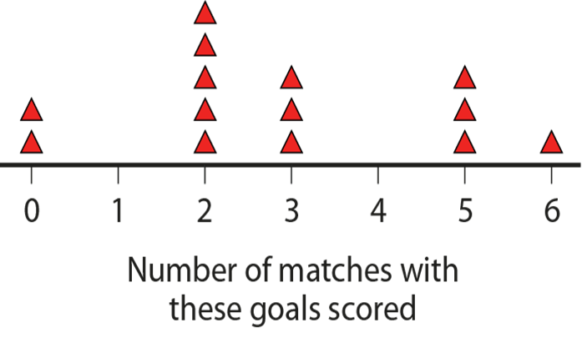
Correctly calculate the mean from a frequency table
Example 7a
What is the same and what is different about these representations?
Goals | Matches
0 | 2
2 | 5
3 | 3
5 | 3
6 | 1
Which helps more when trying to think about how to calculate the mean?
Notes:
Suggested questioning:
What is the sum of goals? What is the count of matches?
What is the same? What is different?
What does each triangle represent?
Things for you to think about:
A number line representation of the data is a powerful visualisation that could help students move from a list of data values to a frequency table.

Slide 27
Correctly calculate the mean from a frequency table
Example 7
  What misconception is this example trying to expose?
  How might this number line representation support your explanation?
Students were asked to calculate the mean number of goals scored in another set of matches, as recorded in this table.
Goals | Matches
0 | 2
2 | 5
3 | 3
5 | 3
6 | 1
Some students used this calculation: 40 ÷ 12.
What have they misunderstood?
Notes:
Due to space constraints, the image on this PD discussion slide is very small. PD Leads might like to use or print the ‘in the classroom’ version of this slide for teachers to access during discussions.
More detail about this example can be found on page 9 of the 5.1 Core Concept document.

Slide 28
Correctly calculate the mean from a frequency table
Example 7
  Watch video 2 of Insights from experienced teachers | NCETM.
  How do the teachers’ reflections on teaching algorithmically in the past compare to your own experience of this topic?
  Why is it important to ‘do the maths’ first when preparing to give a task like this to your students?
Students were asked to calculate the mean number of goals scored in another set of matches, as recorded in this table.
Goals | Matches
0 | 2
2 | 5
3 | 3
5 | 3
6 | 1
Some students used this calculation: 40 ÷ 12.
What have they misunderstood?
Notes:
Due to space constraints, the image on this PD discussion slide is very small. PD Leads might like to use or print the ‘in the classroom’ version of this slide for teachers to access during discussions.
More detail about this example can be found on page 9 of the 5.1 Core Concept document.

Slide 29
Correctly calculate the mean from a frequency table
Example 8
Bhanu records how long she can hold the ‘plank’ position for.
What is her mean hold time?
25 s | 30 s | 45 s | 1 min
4 | 6 | 5 | 2
Notes:
Suggested questioning:
What is the sum of hold times? What units should you use?
What is the count of holds?
How can you ensure the units are consistent in your data? Is there more than one way to do this?
Things for you to think about:
This shows a frequency table arranged in columns not rows; it will be important to ensure students are familiar with both arrangements. This example also involves mixed units, drawing students’ attention to the need to use a single unit.

Slide 30
Correctly calculate the mean from a frequency table
Example 8
  What errors might students make in calculating the mean here?
  What other mixed unit examples might you show to students?
Bhanu records how long she can hold the ‘plank’ position for.
What is her mean hold time?
25 s | 30 s | 45 s | 1 min
4 | 6 | 5 | 2
Notes:
Due to space constraints, the image on this PD discussion slide is very small. PD Leads might like to use or print the ‘in the classroom’ version of this slide for teachers to access during discussions.
More detail about this example can be found on page 9 of the 5.1 Core Concept document.

Slide 31
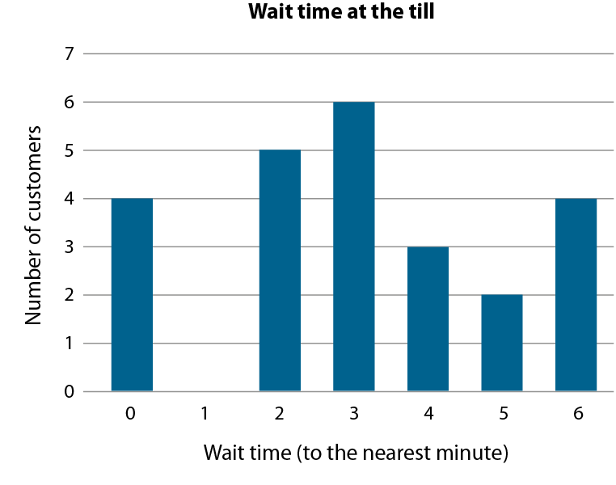
Calculate the mean of data represented in a bar chart
Example 9
This bar chart shows the length of time people spent waiting at a self-service till (to the nearest minute).
What is the mean wait time?
Notes:
Suggested questioning:
What is the sum of waiting times? What is the count of people?
What would this data look like if presented in a list? Or a table?
Things for you to think about:
Students should be encouraged to work with a variety of different representations of data from which to calculate the mean. When working with bar charts, students should be encouraged to think about what the list of data points would look like and to reason that the vertical axis is indicating the frequency of different wait times.

Slide 32
Calculate the mean of data represented in a bar chart
Example 9
  What questions/prompts might you use to support students to find the sum and count in the bar chart?
  What other representations might you want to ask students to calculate the mean from?
This bar chart shows the length of time people spent waiting at a self-service till (to the nearest minute).
What is the mean wait time?
Notes:
Due to space constraints, the image on this PD discussion slide is very small. PD Leads might like to use or print the ‘in the classroom’ version of this slide for teachers to access during discussions.
More detail about this example can be found on page 9 of the 5.1 Core Concept document.

Slide 33
Reflection questions
What other mathematical concepts will be supported by students’ stronger understanding of this key idea?
What mathematical language will you continue to use to support pupils to make connections with other areas?
Which representations might you continue to use to further develop students’ understanding?

Slide 35
Appendices
You may choose to use the following slides when planning or delivering a PD session. They cover:
  Key vocabulary
  Representations and structure
  Previous learning
  Future learning
  Library of links

Slide 36
Key vocabulary
Term | Definition
(arithmetic) mean | The sum of a set of numbers, or quantities, divided by the number of terms in the set. Example: The arithmetic mean of 5, 6, 14, 15 and 45 is (5 + 6 + 14 + 15 + 45) ÷ 5 i.e. 17.
bivariate data | Data that compares the values of two variables by pairing each value of one of the variables with a value of the other.
measure of central tendency | In statistics, a measure of how the values of a particular variable are located in terms of the values collected for a particular sample, or for the relevant population as a whole. In school mathematics up to Key Stage 4, there are three important measures of central tendency: the arithmetic mean, the median and the mode. These are all statistical averages and often one is more useful than another, depending on the spread of the values under consideration.
measures of dispersion | Measures of dispersion describe how much a set of data is spread out or dispersed. They include the range (where you subtract the lowest score from the highest score) and the standard deviation, which calculates the spread of values around the mean.
median | The middle number or value when all values in a set of data are arranged in ascending order. Example: The median of 5, 6, 14, 15 and 45 is 14. When there is an even number of values, the arithmetic mean of the two middle values is calculated. Example: The median of 5, 6, 7, 8, 14 and 45 is (7 + 8) ÷ 2 i.e. 7.5 The median is one example of an average.
mode | The most commonly occurring value or class with the largest frequency. Example: The mode of this set of data: 2, 3, 3, 3, 4, 4, 5, 5, 6, 7, 8 is 3. Some sets of data may have more than one mode.
range | A measure of spread in statistics. The difference between the greatest value and the least value in a set of numerical data.

Slide 37
Representations and structure (1)
There are a number of different statistical representations that students might encounter as part of their exploration of the mean. It will be important that students understand how to calculate the mean, where possible, in each of these representations.
Pie charts
  Pie charts allow for comparisons between proportions. They are particularly relevant for students when they are working with populations of different sizes, or for making multiplicative comparisons within the same population.
Bar charts
  Bar charts can be used give students a sense of the ‘shape’ of the distribution of the data across a sample, to identify and compare frequencies. They give an opportunity for comparisons to be made using absolute values.
Pictograms
  Pictograms are a simple way of recording frequencies, tabulating images that represent a certain frequency.
Notes:
More information about the representations and structure involved in this key idea can be found on pages 5-7 of the Statistics and probability Theme Overview document.

Slide 38
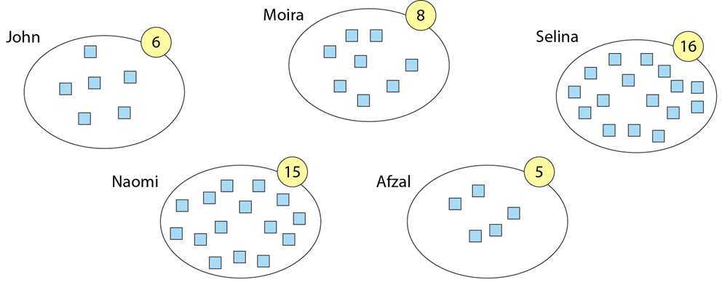
Representations and structure (2)
You may also wish to use counters, place-value counters, Dienes or multi-link cubes to support students’ conceptual understanding of the mean.
For example, you could ask the question, ‘If five students have a different amount each, how much would they have if, without adding or removing any, they all had the same amount?’
Students may begin by taking counters from one student and giving them to another until all students have the same amount. Careful questioning on how this might be achieved more efficiently, coupled with a change of example where the numbers involved are much larger, can result in students becoming aware of the fact that the total (6 + 8 + 16 + 15 + 5) needs to be distributed among five people.
Notes:
This example is taken from page 6 of the 5.1 Core Concept document.

Slide 39
Representations and structure (3)
Bar models can be a powerful way to represent (literally re-present) problems. In the context of the mean, they can be used to model re-distributing the total in reverse mean problems.
Consider example 4 from slide 22, and how the bar models represent what we know at each stage:
Reena times her walk from the bus stop each day for six days.
The timings for the first five days are 16, 14, 20, 11 and 17 minutes.
On the sixth day Reena calculates that her mean walking time for the six days is 15 minutes.
How long did it take for her to walk from the bus stop on the sixth day?
16
14
20
11
17
?
?
15
15
15
15
15
15
60
16
14
20
11
17
?
60
Notes:
More information about bar models can be found in the Using mathematical representations at KS3 documents on the NCETM website.

Slide 40
Previous learning
From Upper Key Stage 2, students will bring experience of:
interpreting and presenting discrete and continuous data using appropriate graphical methods, including bar charts, pictograms and time graphs
solving comparison, sum and difference problems using information presented in bar charts, pictograms, tables and other graphs
interpreting and constructing pie charts and line graphs, and using these to solve problems
encountering and drawing graphs relating two variables, arising from their own enquiry and in other subjects (non-statutory guidance)
calculating and interpreting the mean as an average
knowing when it is appropriate to find the mean of a data set (non-statutory guidance).
Notes:
Theme 5 Statistics and probability

Slide 41
Future learning (1)
In KS4, students will build on the core concepts in this mathematical theme to:
infer properties of populations or distributions from a sample, whilst knowing the limitations of sampling
interpret and construct tables and line graphs for time series data
{construct and interpret diagrams for grouped discrete data and continuous data, i.e. histograms with equal and unequal class intervals and cumulative frequency graphs, and know their appropriate use}
Please note: Braces { } indicate additional mathematical content to be taught to more highly attaining students.
Notes:
Theme 5 Statistics and probability

Slide 42
Future learning (2)
In KS4, students will build on the core concepts in this mathematical theme to:
interpret, analyse and compare the distributions of data sets from univariate empirical distributions through:
  appropriate graphical representation involving discrete, continuous and grouped data, {including box plots}
  appropriate measures of central tendency (including modal class) and spread {including quartiles and inter-quartile range}
apply statistics to describe a population
use and interpret scatter graphs of bivariate data; recognise correlation and know that it does not indicate causation; draw estimated lines of best fit; make predictions; interpolate and extrapolate apparent trends whilst knowing the dangers of so doing
Please note: Braces { } indicate additional mathematical content to be taught to more highly attaining students.
Notes:
Theme 5 Statistics and probability

Slide 43
Library of links
The following resources from the NCETM website have been referred to within this slide deck:
  NCETM Secondary Mastery Professional Development
    Statistics and probability theme overview document
    5.1 Statistical representations and measures core concept guidance document
  Using mathematical representations at KS3 | NCETM
  Insights from experienced teachers | NCETM
  NCETM primary mastery professional development materials
  NCETM primary assessment materials
There are also references to:
  Standards & Testing Agency’s past mathematics papers

